Slide 1
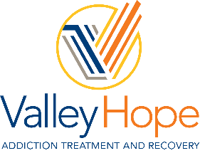
Substance Abuse Treatment

Slide 2
Treating addiction with
experience
Treating patients with
compassion
Since 1967, we’ve helped thousands of people struggling with addiction to alcohol and other drugs find a path to long-term recovery. As a non-profit organization, we’re dedicated to providing evidence based, high-quality treatment at an affordable price.
We treat the whole person – mind, body and spirit. Our multidisciplinary team of counselors, chaplains, physicians, and nurses work together to meet the physical, mental, social and spiritual needs of each patient.
Our admissions staff are available day and night to help you. Whether you’re seeking treatment for yourself or a loved one, we can provide answers to your questions and make the admissions process quick and easy. We are a preferred provider with most major insurance companies and offer a variety of payment options to help with the cost.
Notes:
To change the image behind the Mock up.
Select the layer - > Right Click -> Send to Back -> Delete the image -> Drag & Drop your Own Picture -> Send to Back (again)

Slide 3
Array of SUD services available at Valley Hope
Same Day Access To Comprehensive Detox, Residential and Outpatient Services
Specialty Staff in Psychiatry, Internal Medicine, Counseling and Peer Support
Comprehensive Care Model
Intensive Outpatient Services
Medication Assisted Treatment with FDA Approved Addiction Medications
Peer and Mobile App Support
Case Management and Care Coordination with Community Providers
Transportation

Slide 5
How to reach out for help
24/7 Admissions
valleyhope.org
800 / 544 / 5101
Aaron Kreager
Director of Business Development – O’Neill & Omaha
aaronkreager@valleyhope.org
402 / 340 / 0239

Slide 6
ADDICTION WILL NEVER GO AWAY,
BUT THERE WILL
ALWAYS BE HOPE.

