Slide 1
Promoting Interoperability
Autumn Waldman, BSN, RN
Clinical Informatics at Saunders Medical Center

Slide 2
Objectives
Defining the Quality Payment Program
Objectives and Measures of the PI Program
Who is required to participate in PI?
Attestation Process

Slide 3
Quality Payment Program (QPP)
The Merit-based Incentive Payment System (MIPS) is one way to participate in the QPP.
The program rewards MIPS eligible clinicians for providing high quality care to their patients.

Slide 4
Quality Payment Program (QPP)
The MIPS performance categories have different “weights” and the scores from each are added together to give you a MIPS final score.
Notes:
There are different pathways:
Traditional MIPs
Advance Payment Model (APM)
APM Performance Pathway (APP)

Slide 5
Who is required to participate?
The program is open to eligible hospitals and critical access hospitals (CAHs) that receive federal funds from Medicare.
Those who are eligible but do not participate are subject to a downward payment adjustment.
Check eligibility status on the QPP website

Slide 6
Getting Started (key dates):

Slide 7
Program Requirements
To be considered a Meaningful User in the program, eligible hospitals and CAHs must:
Use the appropriate edition of Certified Electronic Health Record Technology (CEHRT)
Attest to the required objectives and their measures for the required EHR reporting period
Satisfy the minimum score requirement
Report on the required number of Electronic Clinical Quality Measures (eCQM)
Notes:
What is CEHRT and why do I have to use CEHRT?
To efficiently capture and share patient data, health care providers need certified electronic health record (EHR) technology (CEHRT) that stores data in a structured format. Structured data allows health care providers to easily retrieve and transfer patient information and use the EHR in ways that can aid patient care.
To meet the CEHRT requirements for 2023 Promoting Interoperability performance category objective and measure reporting, you’ll need to:
•Have 2015 Edition Cures Update CEHRT functionality in place by the first day of your MIPS Promoting Interoperability performance period;
•Have your EHR certified by ONC to the 2015 Edition Cures Update CEHRT criteria by the last day of your performance period; and
•Provide your EHR’s CMS identification code from the Certified Health IT Product List (CHPL), available onHealthIT.gov, when you submit your data.
If you’re not sure what edition your EHR is, work with your practice technology support team or contact your EHR vendor to verify that your system is on track to meet CEHRT requirements by the last day of your performance period.

Slide 8
Program Requirements continued
Attest to the following:
The Security Risk Analysis measure
The annual self-assessment of the SAFER Guides measure, with a “yes/no” attestation;
Office of the National Coordinator (ONC) Direct Review Attestation; and
The Actions to limit or restrict the compatibility or interoperability of CEHRT attestation.
Notes:
You must conduct or review a security risk analysis on your 2015 Edition Cures Update CEHRT functionality on an annual basis, within the calendar year of the performance period.
You must conduct an annual self-assessment using the High Priority Practices Guide (a part of the SAFER Guides), within the calendar year of the performance period.
To complete the self-assessment, you must complete a review and mark the associated checkboxes (fully, partially, or not implemented) of recommended practices included in the beginning of the Guide.
- Detailed worksheets with the rationale for, and examples of how to implement each recommended practices follows the checklist section of the Guide.
- These worksheets include likely sources of information that your practice may reference to complete your assessment of a recommended practice, as well as fillable note fields to record follow-up actions.
- A “yes” or "no" response will satisfy this measure.

Slide 9
Objectives and Measures
Electronic Prescribing
Health Information Exchange
Provider to Patient Exchange
Public Health and Clinical Data Exchange

Slide 10
Objectives and Measures: Points
Notes:
The 2023 Promoting Interoperability performance category focuses on the following objectives:
•e-Prescribing
•Health Information Exchange (HIE)
•Provider to Patient Exchange
•Public Health and Clinical Data Exchange
Within these objectives, there are 6 to 7 required measures(dependent upon which measure(s) you choose to report for the HIE objective) in addition to required attestations.
Some of these measures have exclusions; if you qualify, you can claim (submit) the exclusion instead of reporting the measure. See the Appendixfor a list of these measures and exclusions.
•You must collect data for all required measures (unless you can claim an exclusion(s)) for the same minimum continuous 90-day period in calendar year (CY) 2023.
•The last 90-day performance period begins on October 3, 2023.
Update: For the HIE objective, you have the option to report data for the 2 existing HIE measures and associated exclusions OR the HIE Bi-Directional Exchange measure OR the Enabling Exchange under TEFCA measure.

Slide 11
e-Prescribing
Notes:
Within these objectives, there are 6 to 7 required measures (dependent upon which measure(s) you choose to report for the HIE objective) in addition to required attestations and optional measures.

Slide 12
Provider to Patient Exchange

Slide 13
Health Information Exchange (HIE)

Slide 14
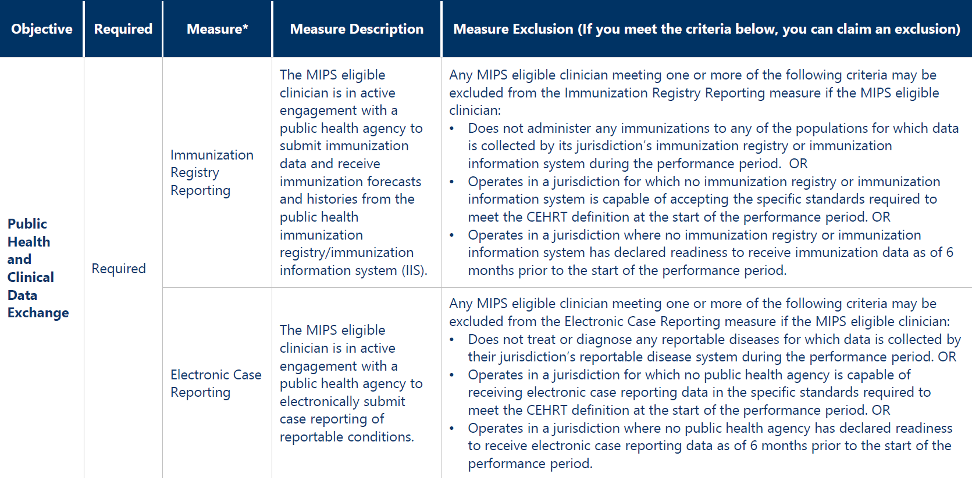
Public and Health Clinical Data Exchange

Slide 15
Public and Health Clinical Data Exchange - continued

Slide 16
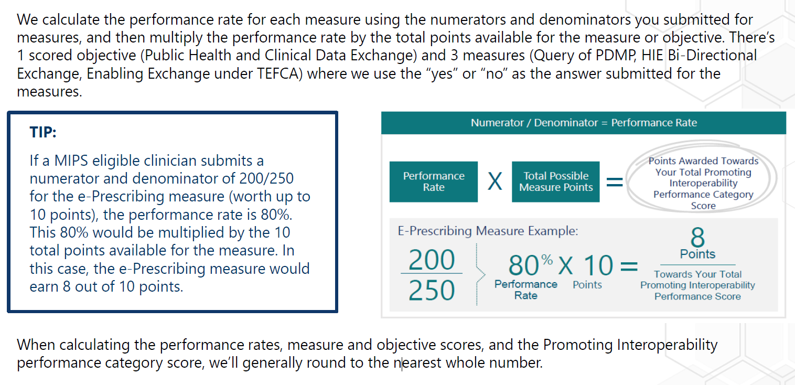
How are Measures Scored?
Notes:
For 2023, you can earn a total of 5 bonus points by submitting a “yes” for 1, 2 or 3 of the optional Public Health and Clinical Data Exchange measures listed below:
Public Health Registry Reporting
Clinical Data Registry Reporting
Syndromic Surveillance Reporting
NOTE: Your Promoting Interoperability performance category score can’t exceed 100 achievement points.

Slide 17
Quality Payment Program (QPP)
The MIPS performance categories have different “weights” and the scores from each are added together to give you a MIPS final score.
Notes:
How Is the Total Promoting Interoperability Category Calculated?
The Promoting Interoperability performance category is weighted at 25% of the MIPS final score.
There are 105 total points available, but any score above 100 points will be capped at 100 points.
Your Promoting Interoperability performance category score is the sum of points earned for the measures you submitted, multiplied by the 25% Promoting Interoperability performance category weight. This product is the number of points this performance category contributes to the MIPS final score.

Slide 18
Submit Your Data
You will need to report the required Promoting Interoperability performance category data during the 2023 submission period (1/2/2024 –4/1/2024).

Slide 19
Submit Your Data (continued):
Notes:
You don’t need to include supporting documentation when you attest to your Promoting Interoperability performance category data, but you must keep documentation for 6 years subsequent to submission.

Slide 20
Hardship
You qualify for a Promoting Interoperability Performance Category Hardship Exception when you:
Have decertified EHR technology
Have insufficient internet connectivity
Face extreme and uncontrollable circumstances such as disaster, practice closure, severe financial distress, or vendor issues
Lack control over availability of CEHRT
Submit a 2023 Promoting Interoperability Performance Category Hardship Exception application by January 2, 2024.

Slide 21
Reference Websites:
Quality Payment Program Website: http://qpp.cms.gov/
2023 Promoting interoperability Program Specs: https://www.cms.gov/files/zip/2023-medicare-pi-program-specs.zip
2023 MIPS Quick Start Guide: https://qpp-cm-prod-content.s3.amazonaws.com/uploads/2219/2023%20MIPS%20Quick%20Start%20Guide.pdf
Check your current participation status: https://qpp.cms.gov/participation-lookup
SAFER Guides: https://www.healthit.gov/topic/safety/safer-guides

