Slide 1
Behavioral Health Challenges for Healthcare Workers
Jerry V. Walker, III, Ph.D., ABPP, MSCP, CMPE
Board-Certified Counseling Psychologist
Certified Medical Practice Executive, MGMA
Psychology Services Manager, Nebraska Medicine
Adj. Asst. Professor, Dept of Neurological Sciences, UNMC

Slide 2
Disclaimers
Presenter does not have any relevant financial or non-financial relationships to disclose relating to the content of this presentation
The views expressed in this presentation are those of the author and do not necessarily reflect those of Nebraska Medicine or UNMC
Ph.D., not an M.D./D.O. (not the kind of “doctor” my mother can be proud of)

Slide 3
Objectives
Define the most common present-day behavioral health challenges for healthcare workers.
01
Describe the primary systemic drivers of anxiety/depression, burnout, moral injury, SUD, and suicide for this population.
02
Explain organizational approaches to mitigating risk for behavioral health decompensation.
03

Slide 4
Why we talk about this
Occupational Stress – “This is challenging, but I can manage”
Occupational Fatigue – “I don’t know how much longer I can do this”
Occupational Burnout – “I’m done; I don’t care; get me out of here”
Emotional Fatigue – “That was really taxing”
Emotional Exhaustion – “I’m having difficulty controlling my emotions”
Psychological Distress – “I can’t do this anymore; I feel like I’m falling apart”
43%
49%
38%
Prasad, et al., 2021

Slide 5
HCW Stress/Burnout During Covid-19
20,947 HCWs from 42 organizations were surveyed between May 28 and October 1, 2020:
38% reported anxiety/depression
43% suffered work overload
49% had burnout
Stress scores highest among:
Nursing assistants
Medical assistants
Medical social workers
Inpatient (vs outpatient) workers
Women (vs men)
Black and Latinx workers (vs Whites)
Prasad, et al. Lancet, May 2021

Slide 6
Behavioral Health Impacts
2022 survey of 5,000 HCWs—regardless of job title or involvement with COVID-19 patients:
91% reported regularly experiencing stress
83% reported struggling with anxiety
77% reported feeling “overwhelmed”
81% reported feelings of exhaustion or burnout
Insomnia reported at 2x rate of the general population
Worse if disrupted sleep schedule (12-24 hour shifts)
36% report increased alcohol use to manage stress
Clinicians with direct patient care and supervisors at greatest risk for alcohol misuse
1 in 6 surgeons report engaging in alcohol abuse
MHA International, 2022

Slide 7
Social & Occupational Impacts
63% reported feeling too tired to attend to household chores or self-care needs after work
27% endorsed inordinately taking out work stress on family members
Divorce rate ranges from 23-33%
Job hunting & remote work
Leaving the profession altogether: 90% of nurses report having considered quitting nursing
71% for nurses with 15+ years of experience

Slide 8
What are the individual and systemic drivers of HCW stress & burnout?

Slide 9
HCW job profile
Highly variable based on setting
Ambulatory vs. Inpatient, ED vs. specialty, clinical vs. teaching/research vs. administrative
Highly variable based on community needs
Recurrent trauma exposure
Long work hours
Competitive environment
High risk vs. Moderate Reward
Saving lives to soccer practice (“combat to cul-de-sac”)

Slide 10
Workload and Demand
70% of HCW report workload being their primary occupational stressor
Increasing hospital occupancy associated with increased workload, patient length of stay, and health system cost
Avg. occupancy at 88-93% across Nebraska in 2020
Staffing issues affect frontline staff
Increased workload/patient care ratios, level of responsibility
Increased reliance on temp staff (travelers)
Payout of OT and requiring mandatory OT
Challenges in work-life balance: 55% felt unable to take time off to attend to physical or emotional needs

Slide 11
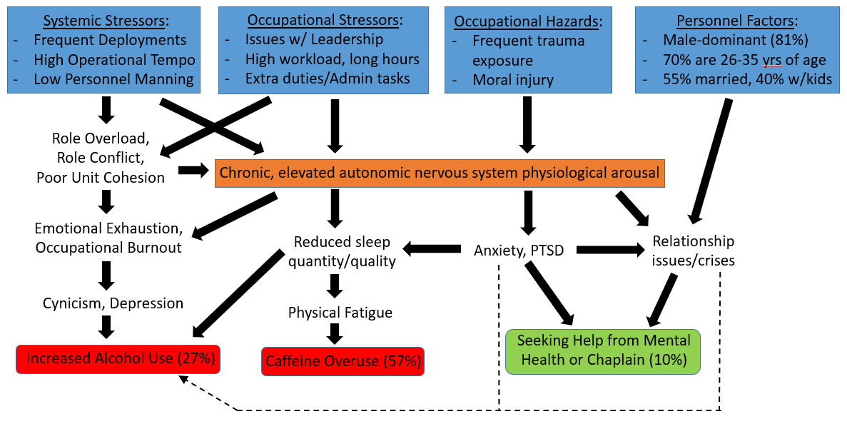
USAF Personnel in High-Stress / High Risk Career Fields

Slide 12
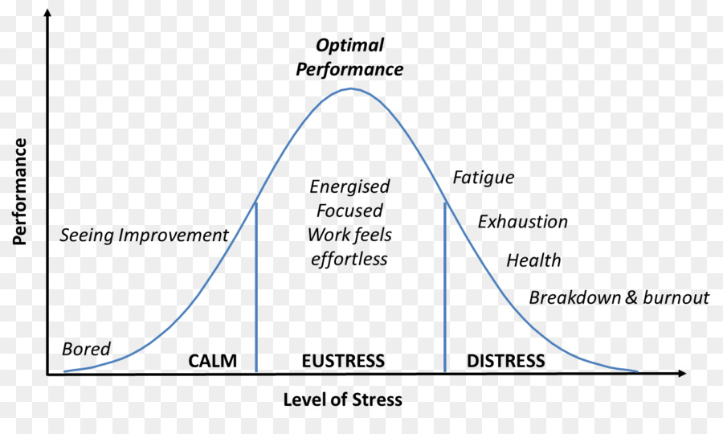
Stress and Optimal Functioning
Ideal Steady State
Ideal Operational State
Maladaptive Chronic State
Rothschild, 2017

Slide 13
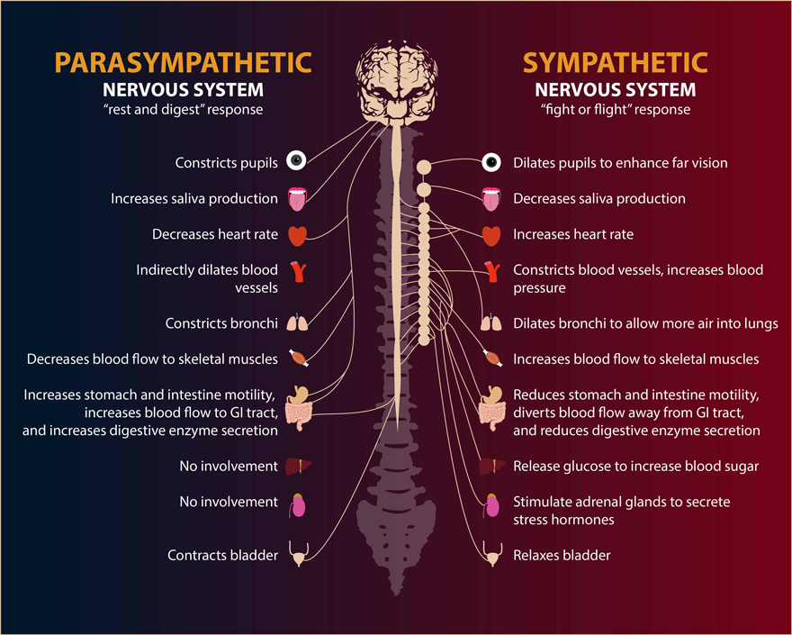
It’s An Ongoing Balance
From http://brain-bodyhealth.com/rheumatoid-arthritis-autonomic-nervous-system-imbalance/

Slide 14
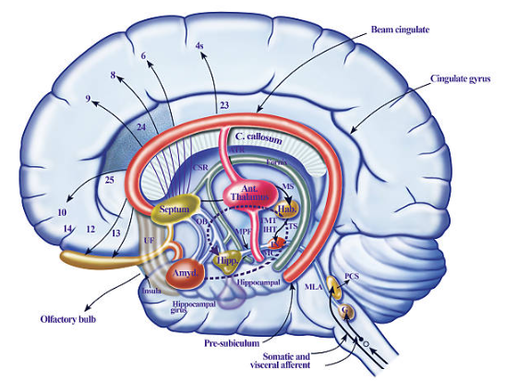
Our brain changes in response to significant stress or trauma
Decreased medical PFC function
Decreased anterior cingulate function
Increased amygdala function
Increased cortisol and NE response to future stressors
Reduced hippocampal volume

Slide 15
Moral Injury
“Moral injury describes the challenge of simultaneously knowing what care patients need but being unable to provide it due to constraints that are beyond our control.”
Notes:
Amber about staff shortages (6 patients by myself and 7 with a paramedic) on the trauma floor – not seeing patients for 5 hours; behind on meds – very frustrating, you just do what you can – thinking about work outside of work a lot more often (started to dream about week) – didn’t want to go in, patients are upset

Slide 16
Effects of Moral Injury
Feelings of guilt, shame and disgust
Negative thoughts about self and/or others
Can contribute to mental health difficulties
45% of HCWs said they didn’t have the time or space to process adverse events at work
British Medical Journal, 2020

Slide 17
Primary and Secondary Trauma
Clinicians report feelings of shame, anger, failure, depression (3-fold increase), inadequacy, loss of confidence, PTSD, and decreased QOL
Feelings can be long-lasting and appear to occur at all stages
Medical errors → Increased stress → Reduced confidence and second guessing → Medical errors
AHRQ Patient Safety Primer, Updated September 2019; West CP, JAMA, 2018.
Notes:
In a survey of more than 3000 physicians in the United States and Canada, 92% reported previous involvement in events ranging from near misses to serious errors, and 81% reported some degree of job-related stress linked to the event
When a medical error or patient harm occurs, the first priority is to attend to the patient and family members.

Slide 18
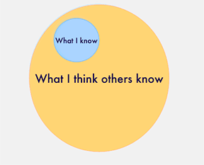
Imposter Syndrome
Feeling inadequate and incompetent despite contradictory evidence
Most common among high achievers
Presents most strongly during transitions
Affects both genders

Slide 19
Burnout
First described in 1976 by Dr. Christina Maslach
Emotional exhaustion
Depersonalization
Low sense of personal accomplishment
In 2019, the World Health Organization (WHO) updated Maslach’s definition of burnout and made it an official diagnosis

Slide 20
Consequences of Burnout
Lower patient care quality, safety, and experience
Higher error rate and risk for patient harm
Increased malpractice claims
Increased risk of clinician/learner substance use disorder, depression & suicide
Lower clinician/staff morale and productivity
Turnover/staff shortages affecting workload & patient access to care
“Quiet Quitting”
“The Great Resignation”

Slide 21
20,665 respondents at 124 institutions
Burnout, anxiety/depression, and workload were independently related to intent to reduce work hours (all P<.01).
1 in 5 physicians and 2 in 5 nurses intend to leave their practice altogether
“Reducing burnout and improving a sense of feeling valued may allow health care organizations to better maintain their workforces postpandemic.”
Mayo Clinic Proceedings, Jan 2022

Slide 22
Questions?
jerwalker@nebraskamed.com
402-559-5031

Slide 23
Ways to Address the Behavioral Health Challenges Faced by Healthcare Workers
Jerry V. Walker, III, Ph.D., ABPP, MSCP, CMPE
Board-Certified Counseling Psychologist
Certified Medical Practice Executive, MGMA
Psychology Services Manager, Nebraska Medicine
Adj. Asst. Professor, Dept of Neurological Sciences, UNMC

Slide 24
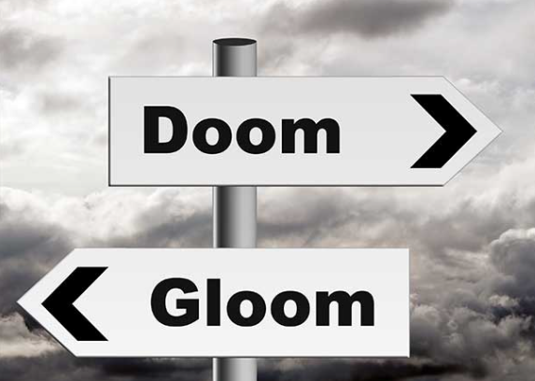
So, what can we do about it?

Slide 25
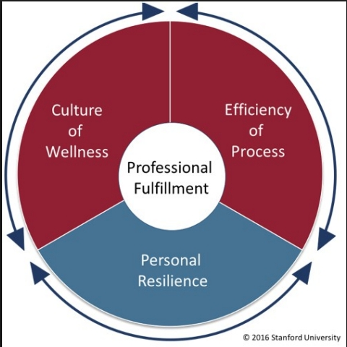
Notes:
Sarah - Operating framework for our work
Burnout vs. Occupational fulfillment
One if the person’s responsibility
The other two can be influenced by the organization

Slide 26
Mayo Clin Proc. 2017

Slide 27
Organizational Drivers of Resilience
Fostering a sense of community
Promoting peer engagement and support
Creating a culture of gratitude
Meaning-making
Recognizing and addressing moral injury
Modeling and encouraging self-care and help-seeking
Schwartz, et al. (2020). Addressing Postpandemic Clinician Mental Health

Slide 28
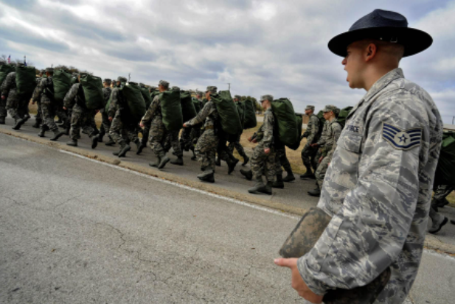
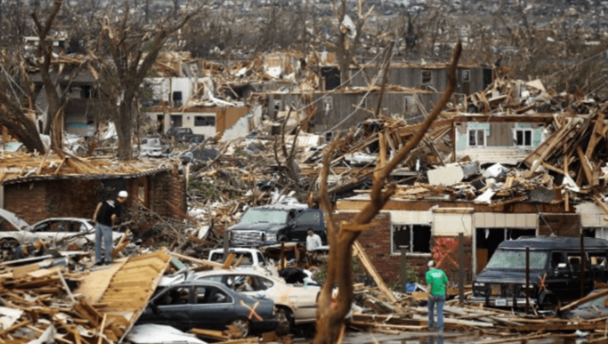
Communities bond--and thrive--through shared struggles

Slide 29
What makes a community?
Shared
Goals
Values
Vision
Experiences
Purpose
Trials

Slide 30
Communities provide the opportunity for individuals to:
Unite under their shared experiences
Gain validation of their emotions
Give and express empathy, compassion
Make sense of their experiences
Find meaning and purpose
Become a catalyst for constructive change

Slide 31
Community drives culture
Culture drives performance and retention

Slide 32
Peer Support: Tools for Building Resilience
The ability to adapt to, or bounce back from, challenging life situations. “BEND, NOT BREAK”
Key components of resilience:
1. Knowing when you’re stressed and how to manage it
2. Maintaining healthful sleep, eating, and exercise habits
3. Obtaining strong social support
4. Engaging in healthy thinking, including recognizing and correcting distorted thoughts
5. Having a perspective of adaptability
6. Focusing on positive emotions and experiences

Slide 33
Social Support
Essential element of resilience
Buffers the effects of stress
Social disconnection is at least as harmful as physical inactivity, obesity, and smoking up to 15 cigarettes a day
Identify who can provide you with support? Who can you provide support?
Identify 3 people
Cheerleader (unconditional support)
Battle Buddy (someone in the trenches with you)
Mentor (provides advice or guidance)

Slide 34
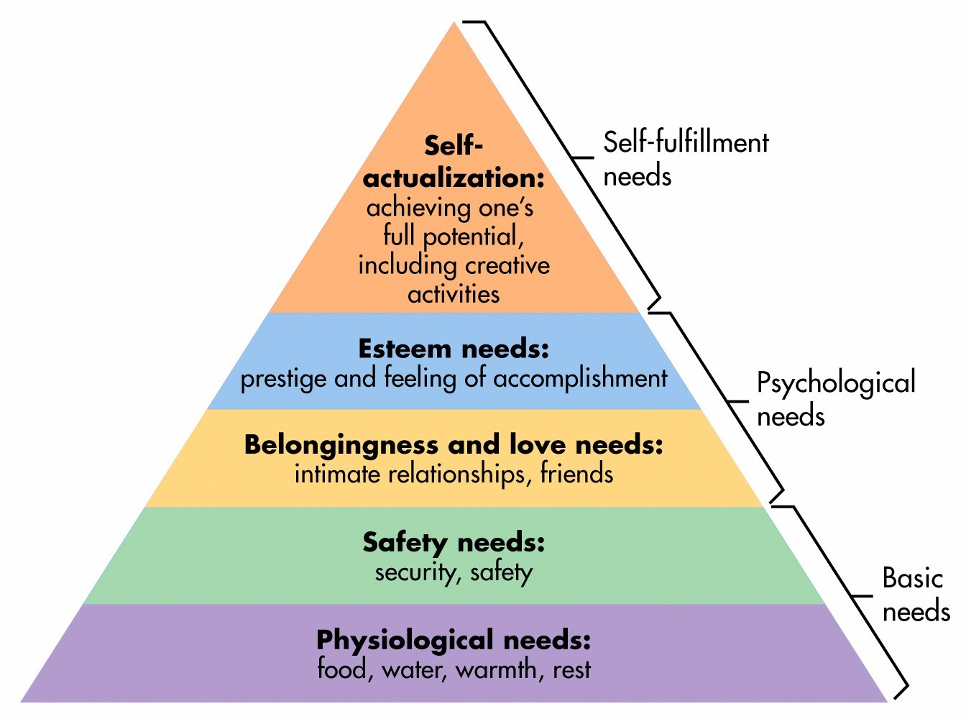
Psychotherapy
Peer Support
PFA

Slide 35
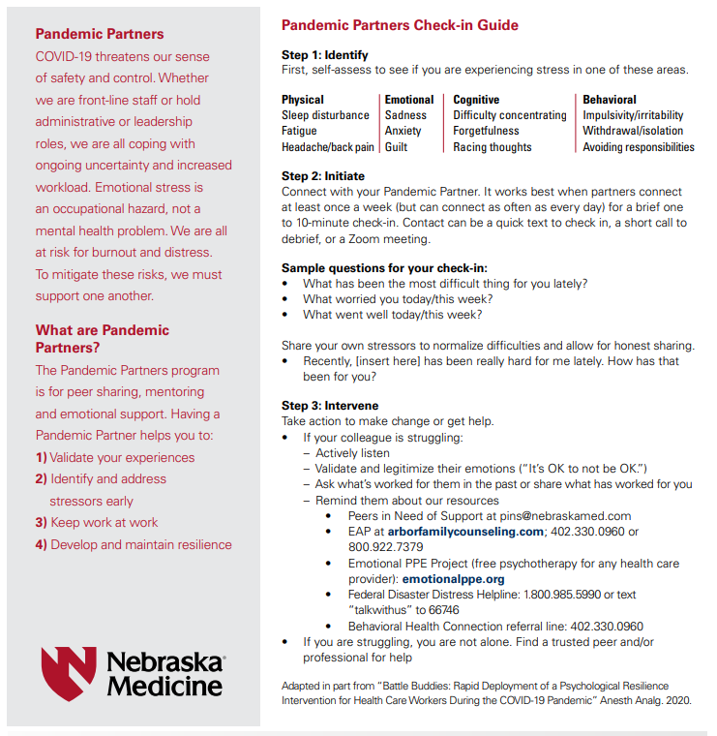
Peer Support: Pandemic Partners
How are you doing?
“Fine”
“Outstanding”
“Living the dream”
“Better than I deserve”

Slide 36
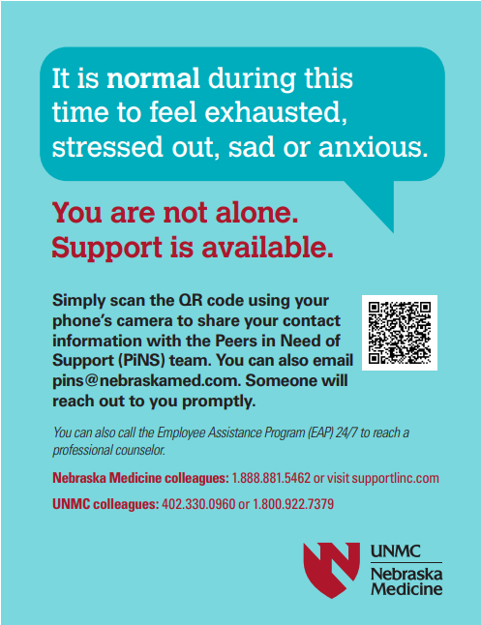
Peer Support Programs

Slide 37
Fostering a Culture of Gratitude & Appreciation
Gratitude
Recognize the good things in one’s life
Recognize when they are due to someone/something outside of yourself
Being thankful

Slide 38
2
2
1
1
2
2
2
1
1

Slide 39
Where can I find help?
Your support system!
You colleagues or supervisor
Institutional Peer Support Program(s)
Employee Assistance Program
Suicide Prevention Crisis Line: 988
Other Crisis Lines (Federal Disaster, DV)
Behavioral Health Connection: 402-836-9292 (Call M-F, 8-5)
Special program to help Eastern Nebraska & Western Iowa adults with psychological or substance use disorders, and their families and friends, get connected to local mental health treatment services and other resources
Resource info should be:
Messaged on a recurrent basis
Easy to find
Known to, and encouraged by, leaders at all levels in the organization

Slide 40
Address the barriers to getting help
Stigma
“Only weak or crazy people go to counseling”
Remember: These are normal reactions to abnormal situations. Many others are experiencing the same things.
Pride
“I shouldn’t be having this reaction”
Remember: You are a human being, and all humans have these reactions.
Embarrassment
“Everyone will think something is wrong with me”
Remember: It takes courage to ask for help. You can be a role model.
Fear
“I can lose my license if I admit something’s wrong or go to treatment”
Remember: You stand to lose much more if you don’t.

Slide 41
Challenge Maladaptive Cultural Expectations
Encourage focus on physical and emotional self-care, especially during work hours
Modeling and vulnerability are key
Promote creation and maintenance of appropriate work/life boundaries
Address perceived constraints to taking PTO
Promote innovation that increases simplicity and efficiency (not simply to overcome staffing challenges)

Slide 42
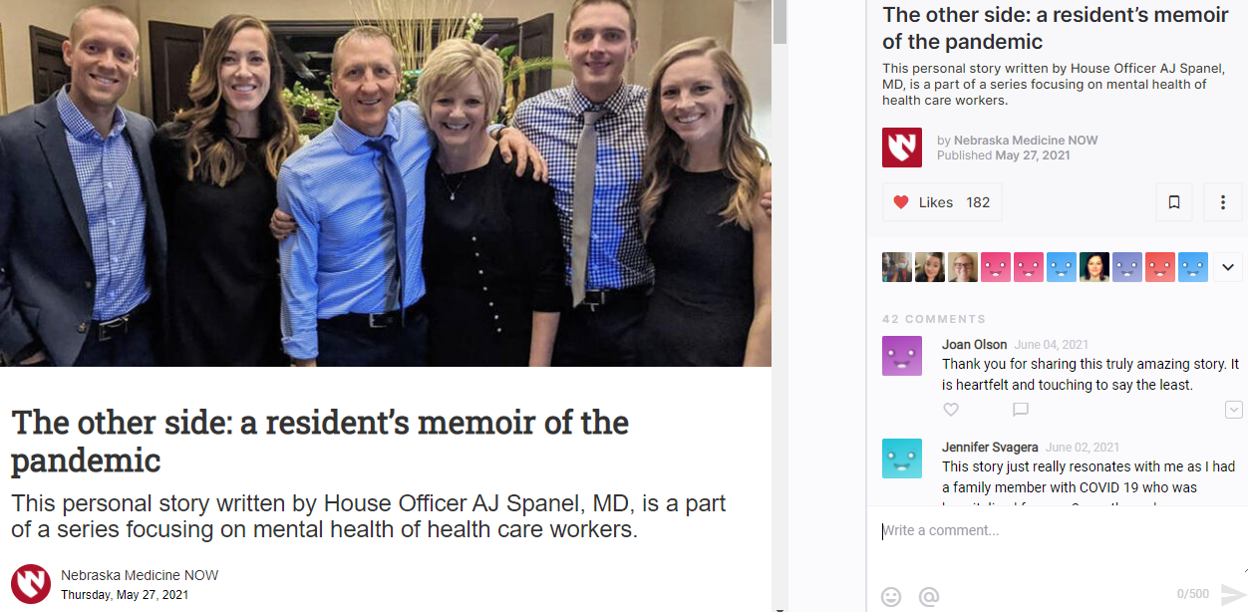
Champion Help-Seeking & Recovery

Slide 43
Questions?
jerwalker@nebraskamed.com
402-559-5031

