Slide 1
Northpoint Recovery - Omaha
Stephanie Lewis
Manager of Outreach
402-332-9431

Slide 2
Northpoint Recovery – Adult Inpatient Detox & Residential
Opening September 9, 2021 - 44 Bed Drug & Alcohol Rehabilitation
24-hour Medically Supervised Detox
Prescription medications to ease withdrawals, including Vivitrol
Integrated Care Approach to Treating Addiction
Substance Addiction, Mental Health Conditions & Medical Care Needs
Community Integration Activities
Length of Stay = 28 days
Discharge planning for ongoing care

Slide 3
Program Includes:
Co-occurring mental health conditions
Community integration activities
Family Therapy
Medication Management
Medical Staff on site
Psychiatric Evaluation & Diagnosis with follow-up appointments
Alumni Program

Slide 4
Coming Soon…
October 2021:Outpatient Facility - Located 87 and Fredrick in Omaha
-IOP and PHP
Early 2022: Imagine by Northpoint
Location TBD
Outpatient Adolescent Program

Slide 5
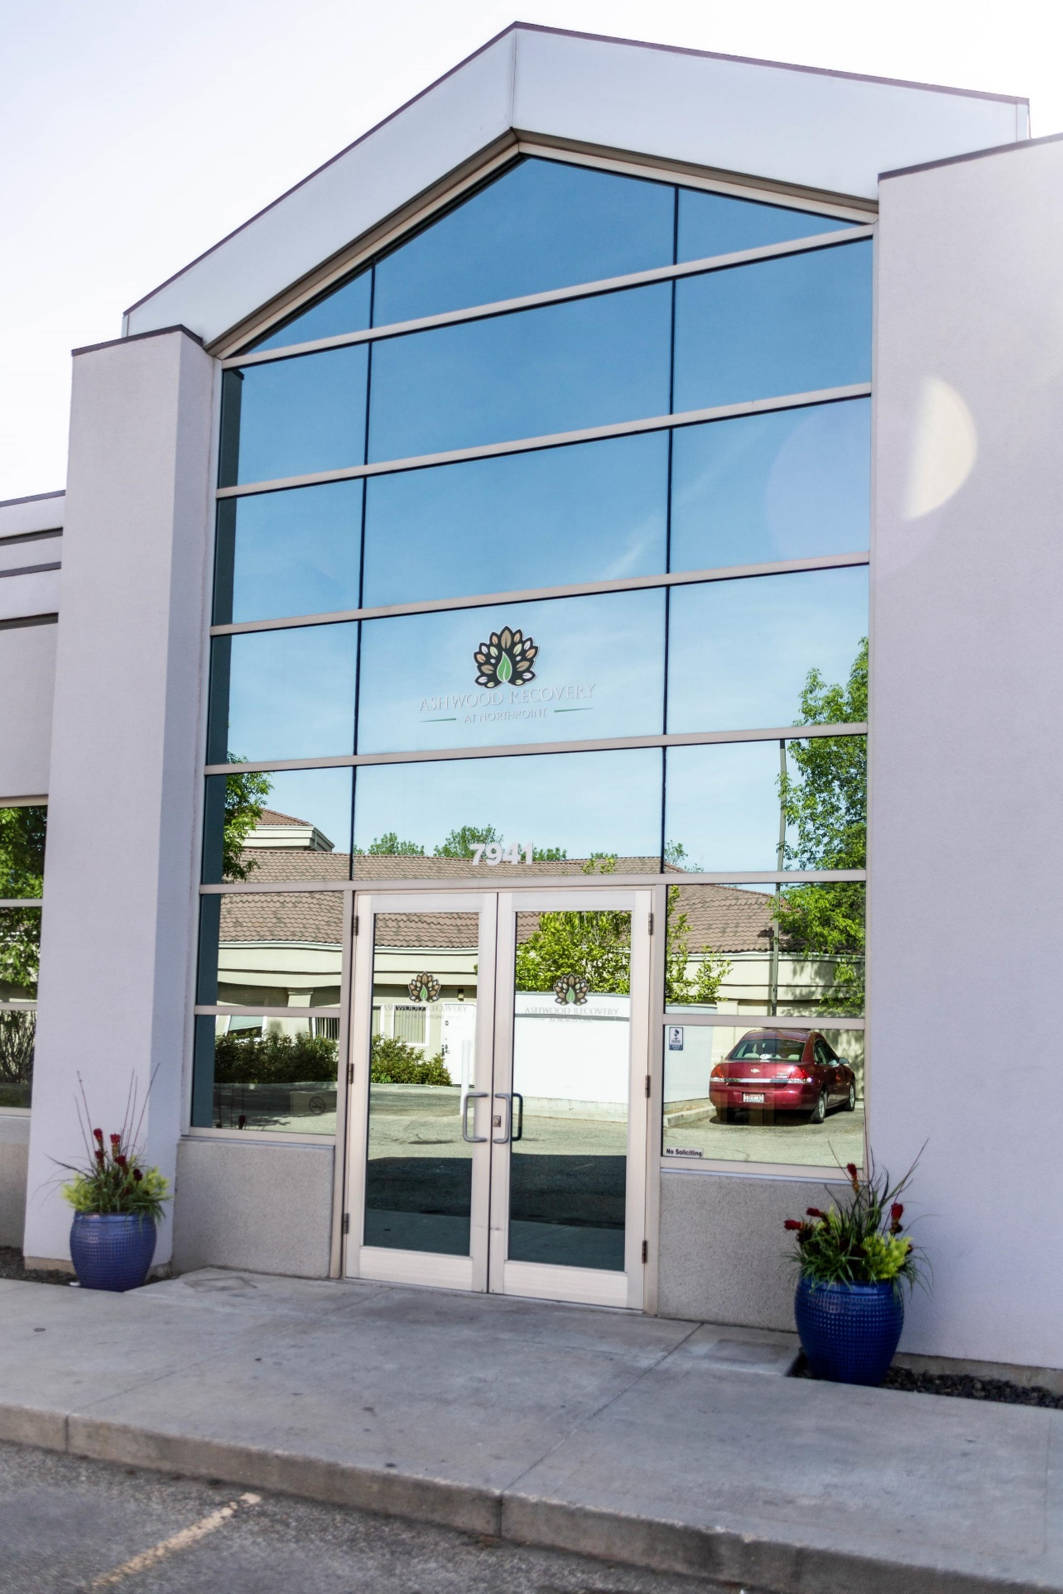
Admissions & Intake Process
We will work through the financial & logistical issues to ensure patients understand the cost of treatment.
No Cost Assessments, scheduled within 48-72 hours – Starting September 1.
Flexible Assessment Schedule
Call Center open 24/7
Admissions line: 402-242-3770
Stephanie Lewis, Outreach Manager
slewis@northpointrecovery.com

