Slide 1
Working with Conflict
NHA Leadership Institute 2019
Jonathan P. Titus, MBA, CPLP
Director of Continuing Education
jtitus@bellevue.edu

Slide 2
Warm Up

Slide 3
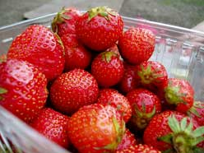
Where We’ve Been/We’re Going

Slide 4
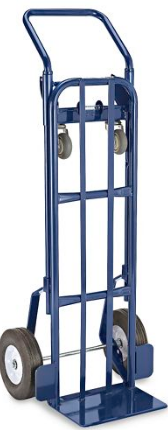

Slide 5
Objectives
At the end of today’s session, you will be able to:
Define conflict in the workplace.
Anticipate potential outcomes resulting from conflict.
Identify contributing factors and types of conflict in the workplace.
Recognize personal style/approach to situations involving conflict.
Compare and contrast various strategies for conflict.
Examine strategies for conflict resolution.
Practice “How to fight fair.”

Slide 6
Case Study
Switch to case study from last session (the one that we didn’t get to)

Slide 7
CONFLICT Defined
What’s the definition of CONFLICT?

Slide 8
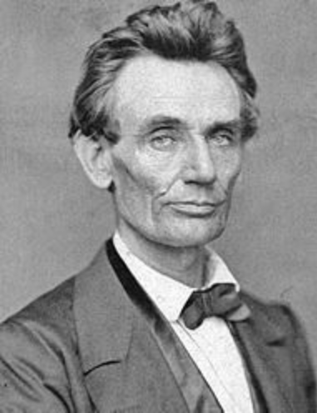
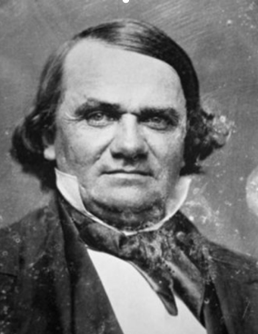

Slide 9
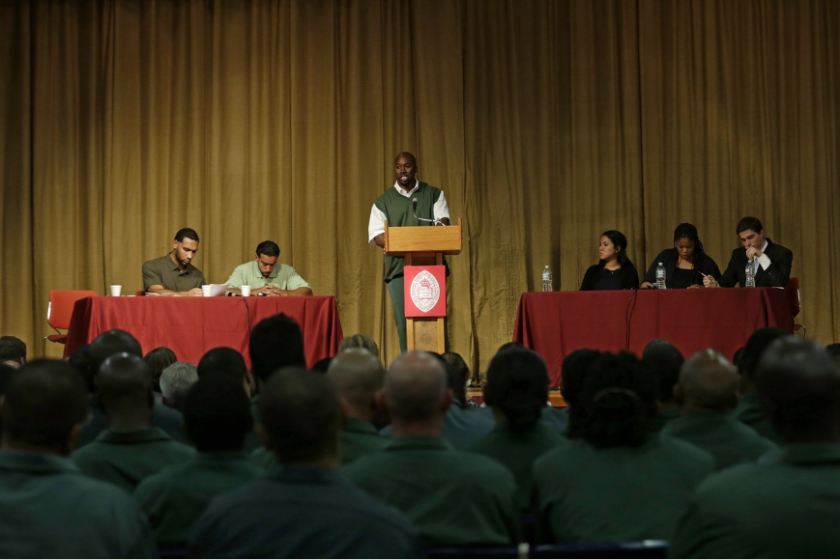

Slide 10
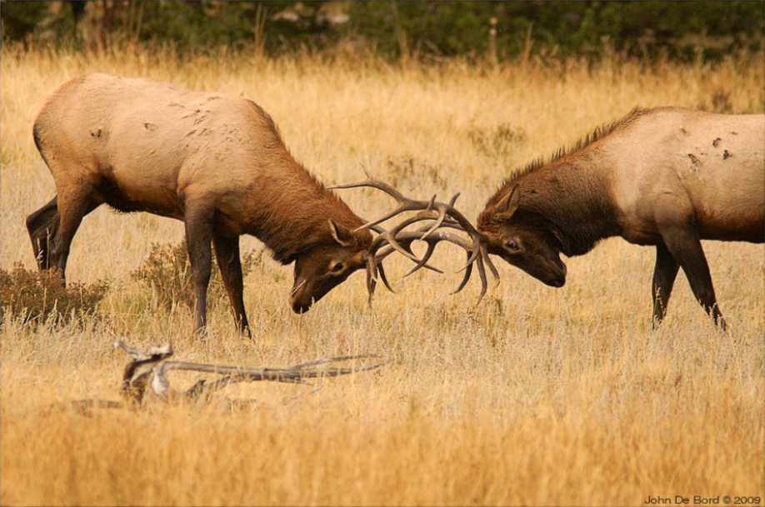

Slide 11
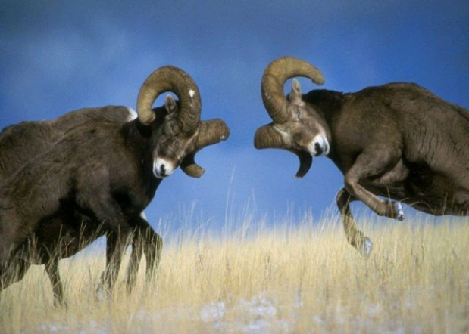

Slide 12
CONFLICT Defined
What’s the definition of CONFLICT?
Is all CONFLICT bad?
Why is CONFLICT resolution so important?

Slide 13
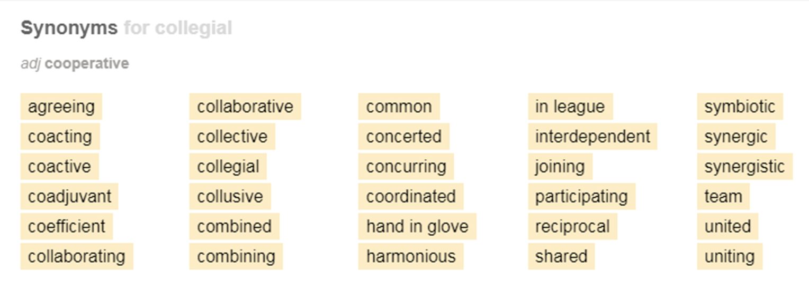

Slide 14
The PRODUCT of CONFLICT!
28% lost time AVOIDING the instigator.
53% lost work time WORRYING about the incident.
37% believed their COMMITMENT to the organization declined.
22% decreased their EFFORT at work.
10% decreased the amount of TIME they spent at work.
46% contemplated CHANGING JOBS.
12% actually CHANGED JOBS to avoid the instigator.
Only 25% were satisfied with the way their organization handled the situation.
University of North Carolina Chapel Hill’s Kenan-Flagler Business School.

Slide 15
Organizational Costs
Between 30-42% of a manager’s time is spent dealing with conflict. Unresolved conflict can have major organizational impact:
Employee attitudes/interactions
Increasing complaints and legal actions
Retention and recruiting
Productivity

Slide 16
What Keeps YOU From Fixing CONFLICT?
What’s your biggest concern about how why conflict isn’t resolved?

Slide 17
What are the DRIVING factors of CONFLICT?
The ROOT of all CONFLICT?
What are the common SOURCES of CONFLICT?

Slide 18
The ROOT of all CONFLICT?
Organizational Factors
Organizational change
Diverse employee groups
Strategic and operational disagreement
Interpersonal Factors
Lack of common understanding
Goal conflict
Poor communication skills
Unclear or unfamiliar expectations
Power plays and manipulation

Slide 19
The TYPES of CONFLICT?
Substantive Conflict
Affective Conflict

Slide 20
The TYPES of CONFLICT?
Task Conflict
Relationship Conflict

Slide 21
CONFLICT Handling STYLES
Complete the CONFLICT HANDLING STYLES self assessment and transfer your scores to the scoring sheet. Rank your top 2 CONFLICT STYLES.

Slide 22
CONFLICT Styles
Cautious
Seeking
Strong
Peaceful
Calm
Feeling
Compromising
Solution-Focused

Slide 23
CONFLICT Handling STYLES
Avoiding
Accommodating
Competing
Compromising
Collaborating
PEOPLE
TASKS

Slide 24
What Would YOU Do?
Compete
Collaborate
Compromise
ASSERTIVENESS
Avoid
Accommodate
COOPERATIVENESS
(Thomas & Kilmann, 1974)

Slide 25
Scenario
Dr. Rose and Dr. Buckley work on solutions for curing diseases and ending world hunger, respectively. The key to solving both problems is PIRO, produced by NASA and grown only once a year during scheduled space missions. In order for both doctors to solve their problems, an agreement has to be reached between them and NASA, and they must determine a win-win solution for themselves!

Slide 26
Dr. ROSE and Dr. BUCKLEY
Review the role-play provided to you. Summarize all you want, but DO NOT read your scenario line-by-line aloud to your partner, and don’t read the other person’s scenario.
Only WIN-WIN solutions will be acceptable!!! It’s ALL or NOTHING!

Slide 27
Dr. ROSE and Dr. BUCKLEY
How did you eventually solve the conflict, or was it even resolved?
In what ways does this exercise parallel your current work environment?
What insights can you take back to your day-to-day job environment?

Slide 28
CONFLICT Resolution
Be proactive
Plan an approach, practice effective things to say
Recognize conflict early and intervene as early as possible
Identify the problem and acknowledge the costs
Look at the relationships
Be cognizant of the biases and blind spots

Slide 29
CONFLICT Resolution
Describe the behavior
Remain calm
State what you want
Consider what they want
Think about those outside of the group who might be affected by the decision
Consider downstream effects
Seek commitment and take action

Slide 30
When EMOTIONS Run High
Determine your goal and focus on it
Speak to who is present
Avoid name-calling and blaming
Beware of self-righteousness

Slide 31
How to FIGHT FAIR!
Attack the problem, not the person.
Work towards solving the problem, not changing the person.
Work on one problem at a time – no problem piling.
Agree ahead of time to remain professional no matter what.

Slide 32
TOOLS for dealing with CONFLICT!
Unified vision
Systems thinking
Presence
Inquiry
Conscious conversations
Dialogue
Bridging
Innovation

Slide 33
Case Study
The Poor Attitude Dilemma

Slide 34
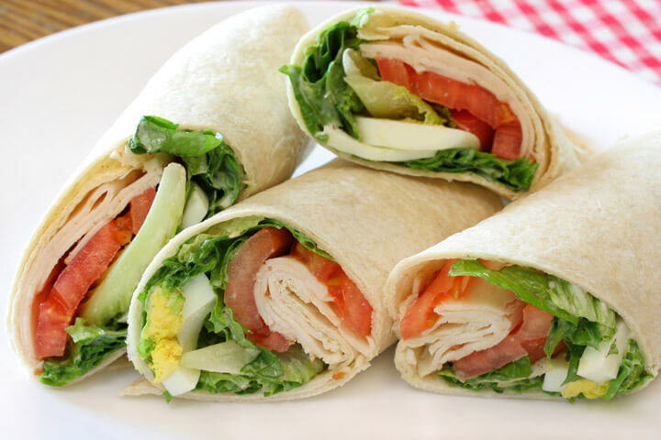
Wrap Up

Slide 35
A private, non-profit institution founded in 1966, Bellevue University is accredited by the Higher Learning Commission through the U.S. Department of Education. For general information, please call 800.756.7920. Email: Jonathan.Titus@bellevue.edu bellevue.edu

