Slide 1
Age: Is it Really Just a Number?
Presented by:
Kevin Fields
RAS Loss Control
May 2019

Slide 2
Objectives
Review the demographics of the aging worker.
Understand the physical changes in this population.
Review the most common injuries in the aging worker.
Review prevention strategies for these injuries.

Slide 3
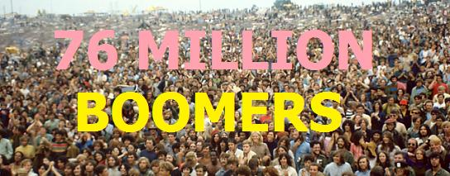
Who Are They?
Baby Boomers:
Born between 1946 and 1963.
In 2019, those born in 1946 started to turn 73.
Females outnumber males with increasing age.

Slide 4
How Old Is “Old?”
NCCI
Looked systematically at age groups from 16 to 64, and 65+.
Work Comp costs increased gradually beginning around age 35.
Most authors consider anyone over 50 or 55 “old.”
Source: 2011 NCCI Research Brief: Workers’ Compensation and the Aging Workforce

Slide 5
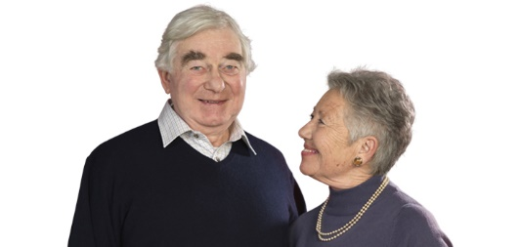
The Youngest Baby
THE YOUNGEST BABY boomers turned 50 in 2013. The oldest baby boomers started turning 65 back in 2011, and many of them have already retired. The aging of this massive generation born between 1946 and 1963 will have significant implications for the entire country.

Slide 6
Aging Population
Aging population.
By 2030, more than 20 percent of U.S. residents are projected to be age 65 or older, compared with 13 percent in 2010 (before any of the baby boomers turned 65) and 9.8 percent in 1970.
In 2050, there will be 83.7 million people age 65 and older, almost double the 43.1 million seniors in 2012.

Slide 7
Why Are We Working Longer?
Living longer.
Increasing retirement age for social security.
More active generation in general.
Insufficient retirement savings, volatile markets, increasing costs of goods, drop in real estate prices, etc.
Tighter labor markets lead companies to recruit older workers.
Bureau of Labor Statistics (BLS) - traditional retirement will be an exception.

Slide 8
Expected Retirement Age
A Survey asked individuals turning 65 when they expected to retire.
Source AARP

Slide 9
Extra Money Story
After being on Social Security disability for five years, Janene Evans, 55, of Bozeman, Montana, decided to get a part-time job as a Walmart cashier in 2018 to earn some extra money. Although her disability paycheck rose 2.9 percent last year, she also faced a higher health insurance premium.
However - After putting in four weeks last spring, she quit the $11.50-an-hour job because it was too physically taxing, she says.
Source - USA TODAY Published Jan. 9, 2019

Slide 10
Are Employers Struggling to Find Workers?
With unemployment at 3.9 percent, it has gotten harder for employers to find qualified workers. In October 2018, there was a near-record 7.1 million job openings, but just 6 million unemployed workers. As a result, more employers are willing to hire and accommodate older Americans by letting them work from home, for example.
That has drawn in more older workers. The share of 55-to-64 year-olds in the workforce increased to 65.5 percent in December from 64.5 percent a year earlier, Koropeckyj notes. And the portion of 65-and-older Americans in the labor force averaged 19.6 percent last year, the highest in decades, according to AARP and Labor.
Source - Paul Davidson USA TODAY Published Jan. 9, 2019

Slide 11
The Reality in Health Care
It’s not uncommon for us to see 70+ year old female CNAs in a long term care facility taking care of 80-year-old residents.

Slide 12
Physical Changes
Decreased
Muscle strength
Flexibility
Balance
Vision
Reaction time
Hearing
All except vision and hearing improve with
EXERCISE

Slide 13
Aging Worker Injury Facts
Injury Severity
Injury Frequency
is greater
is lower than their younger counterparts

Slide 14
The Injuries
Rotator Cuff Tears
Carpal Tunnel Syndrome
Knee Injuries
Also osteoarthritis, spinal stenosis, etc.

Slide 15
Rotator Cuff Tears

Slide 16
Rotator Cuff Tears
A normal shoulder

Slide 17
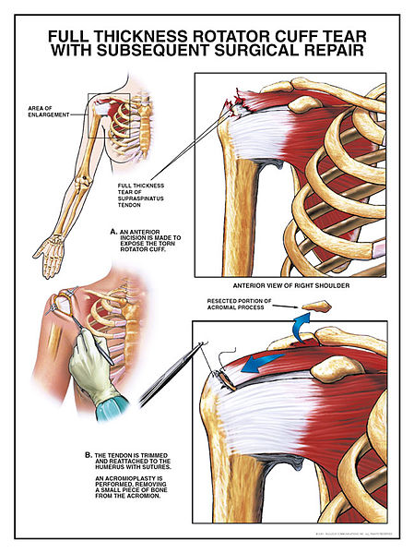
Location
Rotator Cuff Tears
Typically occur on the supraspinatous tendon.
Tears may start on the bursal side or the articular side of the supraspinatous tendon.
Image from Wikipedia.com

Slide 18
Commonly Seen In:
Rotator Cuff Tears
Overhead Athletes
Racquet Sports
Weight Lifters (bench pressing)
Fall on an Outstretched Arm
Extreme Force Lifting
Aging Folks

Slide 19
Important Fact
Rotator Cuff Tears
Blood flow to the supraspinatous tendon decreases significantly at age 40 unless you’re an exerciser.
Much of the deterioration seen in the cuff is thought to start with this universal change.

Slide 20
Asymptomatic Cuff Tears
Between 6 and 40% of people at age 50 have rotator cuff tears with no symptoms.
All patients reported no functional deficits, although strength was significantly lower in the patient group with complete supraspinatus tendon tear.
Tear incidence increases with age:
50 to 59 years – 13%
60 to 69 years – 20%
70 to 79 years – 31%
> 80 years – 51%

Slide 21
Tear Progression and Symptom Development
The presence of rotator cuff disease was highly correlated with age. The average age was:
48.7 years for patients with no rotator cuff tear.
58.7 years for those with a unilateral tear.
67.8 years for those with a bilateral tear.
There was a 50% likelihood of a bilateral tear after the age of 66 years.

Slide 22
More ...
In patients with a bilateral rotator cuff tear where one tear was symptomatic and the other tear was asymptomatic, the symptomatic tear was significantly larger.
The average size of a symptomatic tear was 30% greater than that of an asymptomatic tear.
Overall, patients who presented with a full-thickness symptomatic tear had a 35.5% prevalence of a full-thickness tear on the contralateral (opposite) side.

Slide 23
Protecting the Shoulder
Avoid overhead work.
Keep elbows below 60 degrees (grocery checkout).
Avoid tools that kick back or torque – electric vs. impact vs. pulse (hydraulic).
Adjust work heights to avoid shoulder shrugging.
Strengthen the cuff.

Slide 24
Examples 53-year-old Hospital Housekeeper
Left shoulder pain with “totaling” O.R.’s up to 6 hrs/day for MRSA prevention.
Non-work factors
Age
No MRI or X-Ray, joint changes unknown
Work stressors
Left arm overhead posture
Long duration
Force

Slide 25
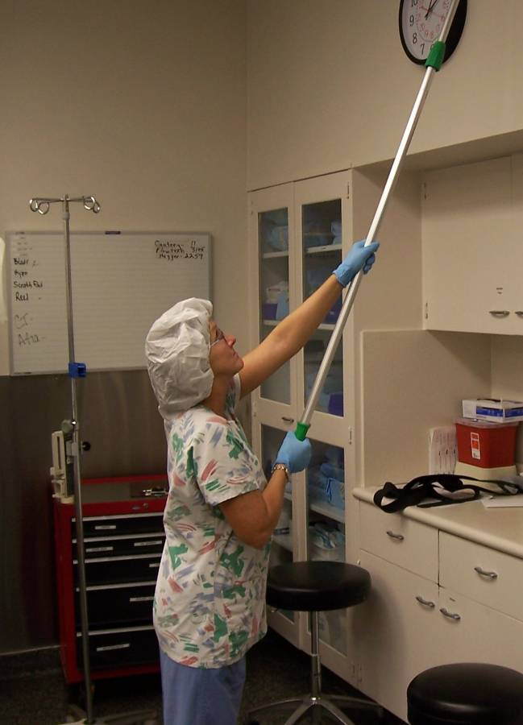
Postures While Totaling O.R.

Slide 26
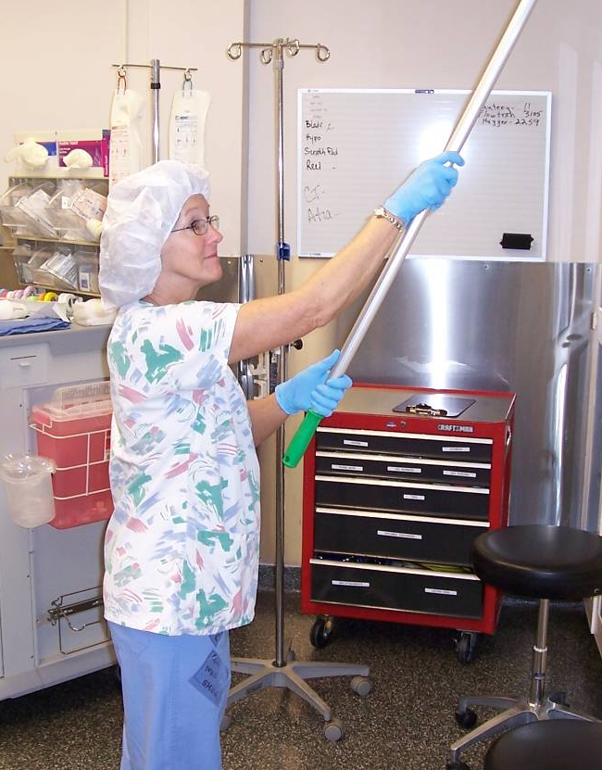
Solutions
Postures While Totaling O.R.

Slide 27
Right Shoulder Pain in Dish Room
Pushing across midline vs. straight ahead in dish room.

Slide 28
Carpal Tunnel Syndrome (CTS)

Slide 29
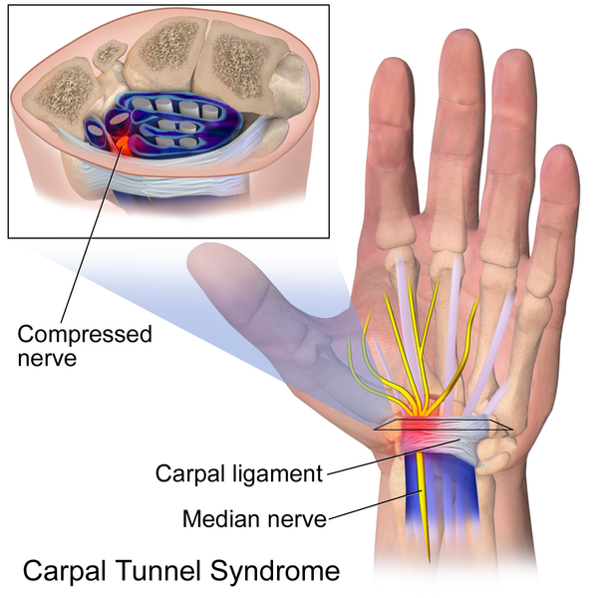
CTS
2-3 times more common in women.
Most cited risk factor combo – being an aging female.
Image from Bruce Blaus at Wikipedia.com

Slide 30
Causes
Non-occupational
Age: very strong evidence with increasing age
BMI: very strong evidence with BMI over 30
Sex: strong evidence: female
Diabetes: strong evidence

Slide 31
Causes
Occupational
Combination of risk factors e.g. force and posture, force and repetition: strong evidence
Vibration: some evidence
Highly repetitive work alone or in combination with other factors: some evidence
Forceful work: some evidence
Wrist size: some evidence
Keyboard work: insufficient evidence

Slide 32
Protecting the Wrist
Use wrist splints at night if symptomatic.
Change pinching tasks to gripping.
Maintain neutral wrist by keeping the wrist straight – move the tool in your hand not with your wrist.
Reduce vibration or rotate.

Slide 33
Awkward Wrist Posture

Slide 34
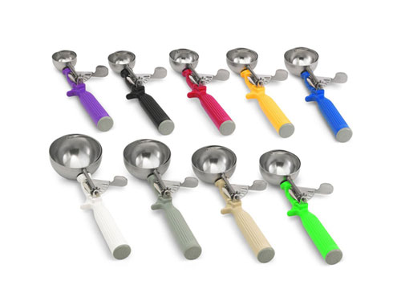
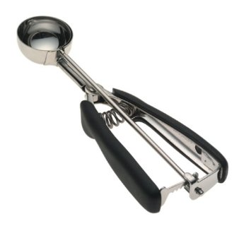
Basal Thumb Joint Arthritis Tool Options

Slide 35
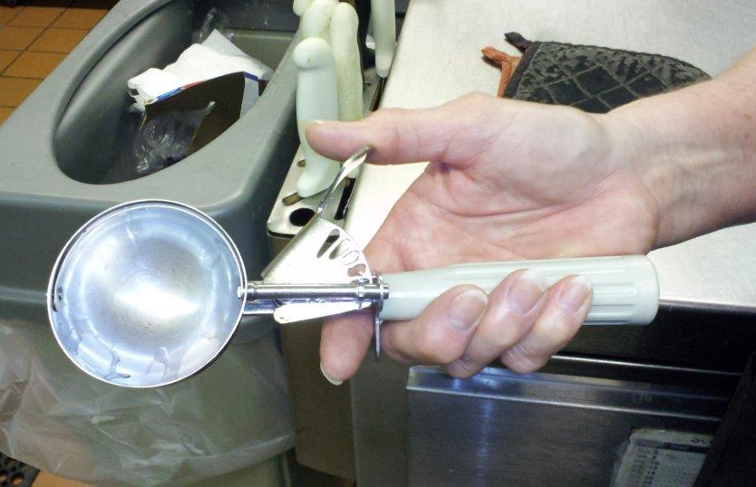
Basal Thumb Joint Osteoarthritis

Slide 36
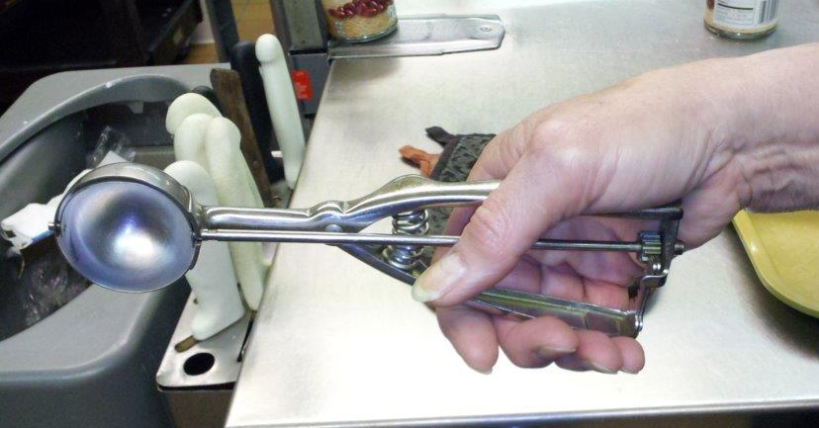
Alternate Tool but Still Awkward

Slide 37
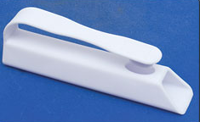
Pill Presses Change Grip to Pinch

Slide 38
Protecting the Neck
Must avoid awkward postures – especially “bifocal posture.”
http://www.ergonut.com

Slide 39
Protecting the Neck

Slide 40
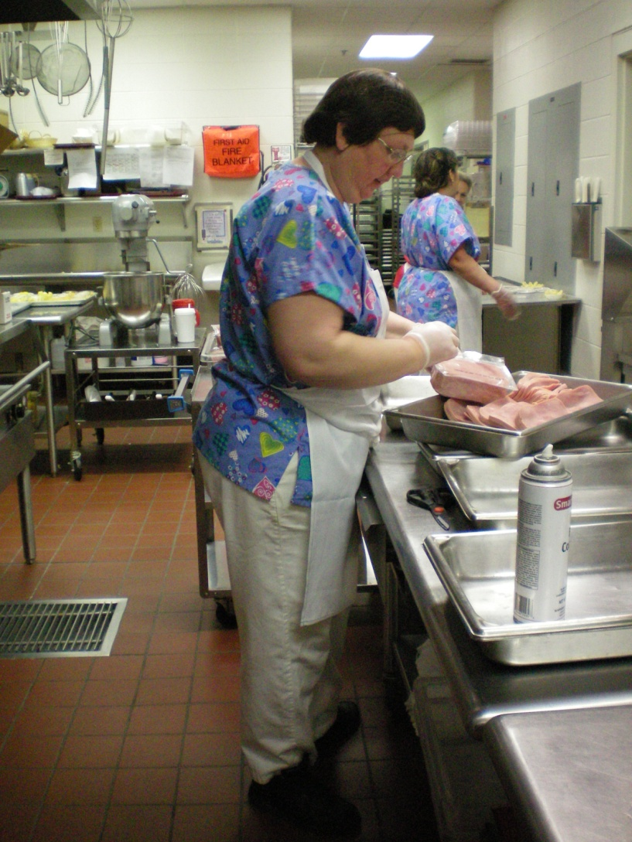
Protecting the Neck
Protecting the Neck

Slide 41
Knee Injuries

Slide 42
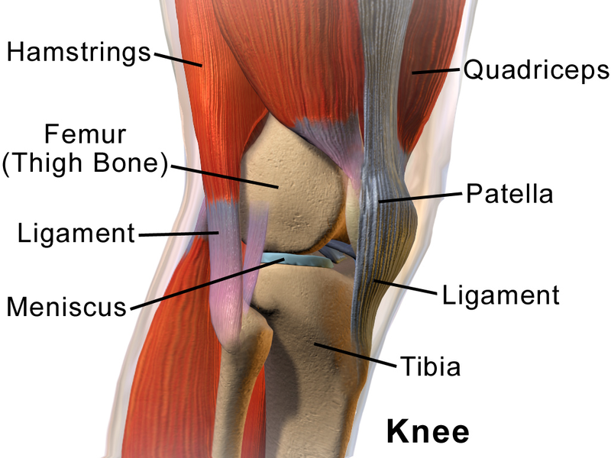
Knee Injuries
Meniscus tear
Ligament tear
Collateral ligament
Cartilage wear and arthritis
Image from Bruce Blaus at Wikipedia.com

Slide 43
Causes
Meniscus, ligament, and cartilage tears are typically from trauma and common in sports.
Osteoarthritis happens when cartilage wears out and bone rests on bone.
Cartilage does well with impact type of forces but wears quickly with shear or sliding type of forces.
The above injuries can contribute to osteoarthritis.

Slide 44
Difficulties Seen In ...
Lifting
Squatting
Getting up from the floor
Walking on uneven ground
Jumping down (truck trailer to ground, etc.)
Climbing onto work platforms without steps

Slide 45
AMA Guidelines to the Evaluation of Disease and Injury Causation Meniscal Tears
Non-occupational FACTORS
Overweight or obese – strong evidence
Sporting Activities – strong evidence
Occupational FACTORS
Insufficient evidence for:
Climbing
Driving
Kneeling
Lifting
Sitting
Squatting
Standing
Walking

Slide 46
Management Ideas
Provide lift equipment.
Ceiling and floor based lifts, pallet levelers, etc.
Keep supplies and equipment off the floor.
Avoid uneven ground.
Install steps, do not jump off equipment, docks, etc.

Slide 47
Rule of Thumb
Treat everyone in your work force as if they already have:
A knee injury
CTS
A rotator cuff tear
... and probably a previous disc herniation, too!

Slide 48
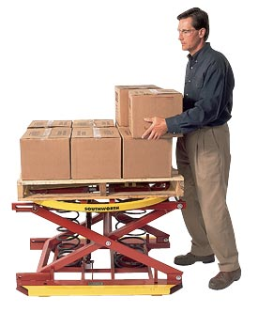
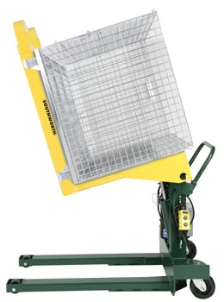
Lift Equipment and Push/Pull
Photos from Southworthproducts.com

Slide 49
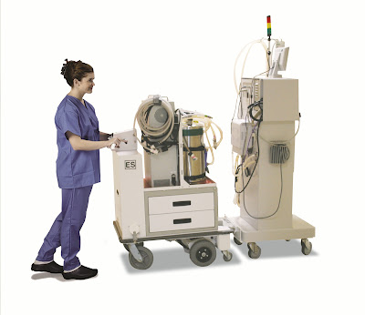
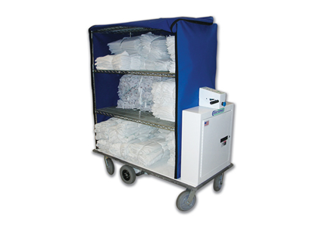
Powered Carts

Slide 50
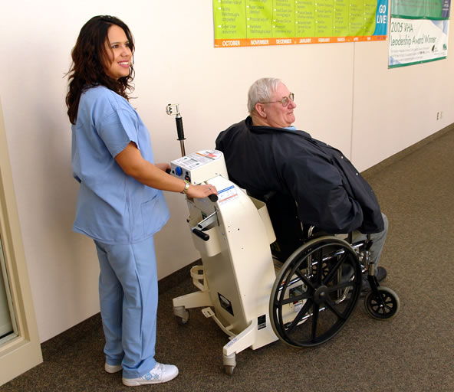
Wheelchair Assist

Slide 51
Lift Equipment
Photo from www.guldmann.com

Slide 52
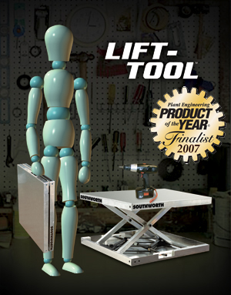
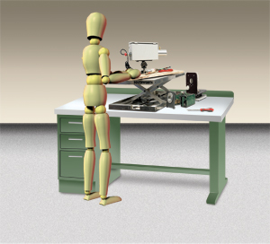
Positioning Equipment
Illustration from Southworthproducts.com

Slide 53
Why Invest in these Changes?
Reducing or eliminating extra force, awkward postures, and repetition decreases the workload for everyone, decreases the chance for injury, and improves productivity.
Our workforce will continue to age and we’ll need to adjust the work to match what the worker can do. There isn’t anyone else to do it!

Slide 54
Impact on Claims Management
Return to work (RTW) may be more challenging.
Longer heal time = longer modified duty time.
Complicating comorbidities = longer modified duty time.
More training time may be required for new positions.
RTW becomes more critically important.
Increased risk of perm total claims.
Medicare set-asides.

Slide 55
Impact on Hiring and Retention
Avoid legal implications of perceiving aging workers as “disabled.”
Treat all applicants to a specific position alike.
Use Post-offer Pre-placement Tests and Fitness for Duty Tests consistently.
Objectively document essential function performance issues in employee files - consistently with all workers.
Accurately and objectively define the essential functions through job analysis.

Slide 56
Claim Prevention for Older Workers
Best to aim prevention efforts at all employees equally.
Treat everyone in your work force as if they already have:
Knee injuries
CTS
Rotator cuff tears
Disc herniation
Vision limitations
Etc.

Slide 57
Claim Prevention for Older Workers
Address age-related performance issues proactively.
Don’t wait for the perm total claim!
Document any and all accommodations made.
Document performance problems and request Fit for Duty tests (preferably through FJA process).
If no longer “fit for duty” - officially transition them into positions within their physical capacities.
Part-time/Job-share
Different position entirely
Phased retirement
Dismissal

Slide 58
Summary
In the coming decades we’ll see more aging workers in our workforce.
Aging workers don’t have higher frequency of injury.
Aging workers do have greater injury severity (longer recovery times).
Rotator cuff tears, knee injuries, and CTS are three of the more common conditions.
Survey employees to discover which ones need help, then make individual changes.
Work with insurer to determine which injuries are occupational in nature.

Slide 59
Questions
Kevin Fields
Loss Control Specialist
RAS
300 Cherapa Place, Suite 401
Sioux Falls, SD 57103
P. 605.361.5704 or
800.732.1486 ext. 5704
E. kevin.fields@rascompanies.com

