Slide 1
CATCH RURAL Falls: A Fall Risk Management Program for Rural Health Clinics
Victoria Kennel, PhD
Assistant Professor, Department of Allied Health Professions Education, Research, and Practice, College of Allied Health Professions, University of Nebraska Medical Center
Dawn Venema, PT, PhD
Associate Professor, Department of Health and Rehabilitation Sciences, College of Allied Health Professions, University of Nebraska Medical Center

Slide 2
Introductions and Contact Information
Dawn Venema, PT, PhD
20+ years of experience in geriatric physical therapy
Clinical expertise in fall risk management and mobility dvenema@unmc.edu
Victoria (Vicki) Kennel, PhD
10+ years of experience in industrial organizational psychology
Quality improvement and behavioral, team, and organizational science expertise victoria.kennel@unmc.edu

Slide 3
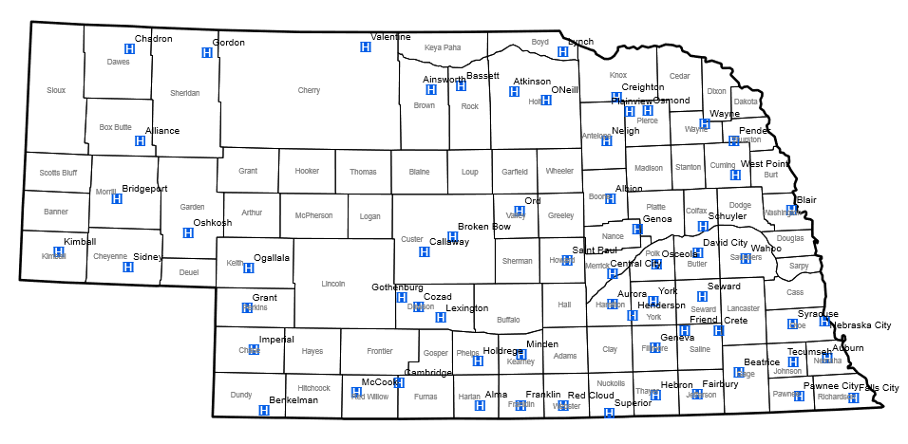
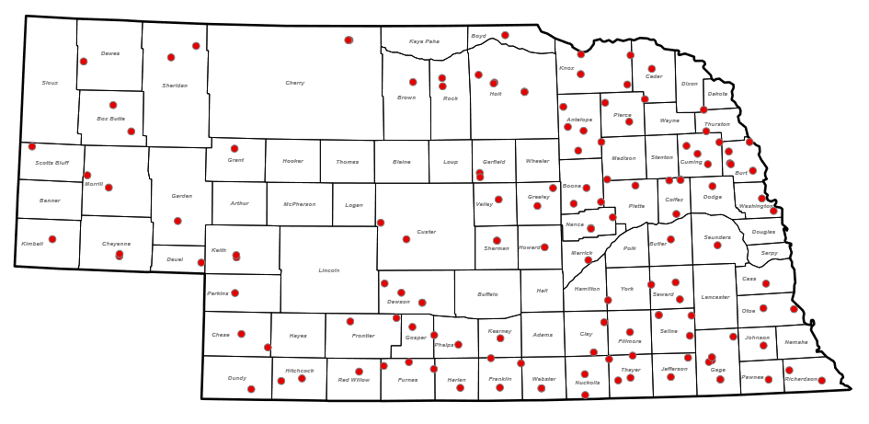
Acknowledgements: Funding
This work is supported by the
Nebraska Department of Health and Human Services Office of Rural Health Medicare Rural Hospital Flexibility Program.
Image Credit: https://dhhs.ne.gov
The content is solely the responsibility of the presenters
and does not necessarily represent the views of any funding source.

Slide 4
CAPTURE Falls vs CATCH RURAL Falls
Collaboration And Proactive Teamwork Used to REduce (CAPTURE) Falls
10+ years of support to over 30 Nebraska Critical Access Hospitals for quality improvement of inpatient fall risk reduction
“Capture” a patient’s risk during a hospital stay
https://www.unmc.edu/patient-safety/capturefalls/index.html
Coordinated Action Toward Community Health: RedUce Risk And Limit (CATCH RURAL) Falls
Logical extension of our work with hospitals to Rural Health Clinics
“Catch” a patient’s risk when they have an appointment
Both efforts are funded by the NE DHHS via the Medicare Rural Hospital Flexibility Program

Slide 5
Impact of Falls in Community Settings
25%
< 50%
20%
Of people ≥ 65 years old fall annually
Of falls cause a serious injury such as head trauma or fracture
Of Medicare beneficiaries who fell in the past year talked to their healthcare provider about it
> 3 million
Older adults treated in the emergency department for nonfatal fall injuries each year
CDC STEADI Fact Sheet (2017) https://www.cdc.gov/steadi/pdf/STEADI-FactSheet-MajorThreat-508.pdf

Slide 6
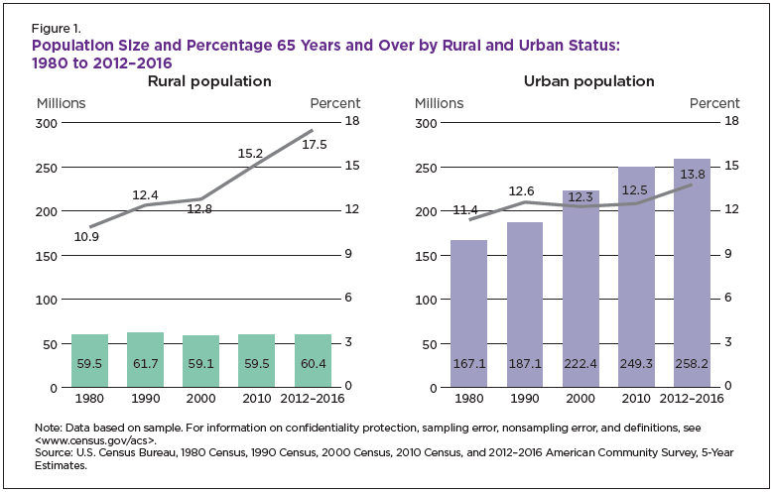
Aging Demographics in Rural Areas
Bars = overall population in millions; lines = percentage of that population ≥ 65 y/o
Symens Smith & Trevelyan (2019)

Slide 7
Learning Objectives
Explain the fall risk screening, assessment, and intervention practices as indicated in the CDC STEADI Toolkit.
Discuss barriers and facilitators to fall risk management in Rural Health Clinics.

Slide 8
Objective 1 Explain the fall risk screening, assessment, and intervention practices as indicated in the CDC STEADI Toolkit

Slide 9
Centers for Disease Control (CDC) STEADI Toolkit
Created for healthcare providers to support implementation of a coordinated approach to manage falls
Algorithm for Decision-Making
Patient Education Materials
Provider Education Materials
Implementation Strategies
Screening and Assessment Tools
CDC STEADI: Stopping Elderly Accidents, Deaths & Injuries (2023) https://www.cdc.gov/steadi/index.html

Slide 10
Three Key Actions: Screening, Assessment, and Intervention
CDC STEADI: Stopping Elderly Accidents, Deaths & Injuries (2023) https://www.cdc.gov/steadi/index.html

Slide 11
Fall Risk Screening
Identification of patients at increased risk of falling to determine if additional in-depth assessment of risk factors is needed
Fall Risk Assessment
Identification of specific risk factors to guide intervention
Intended to be quick
More thorough and therefore more time-consuming
Fall Risk Intervention
Reduction of identified risk factors using effective strategies
Individualized to the patient
May include direct medical management or referral to other health care professionals or resources
CDC STEADI: Stopping Elderly Accidents, Deaths & Injuries (2023) https://www.cdc.gov/steadi/index.html

Slide 12
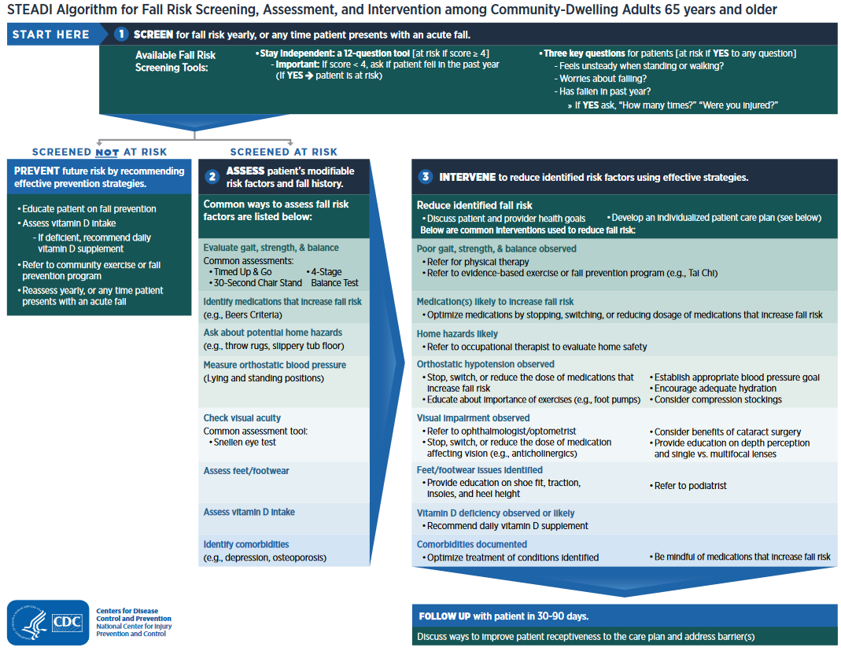
CDC STEADI Algorithm (2019) https://www.cdc.gov/steadi/pdf/STEADI-Algorithm-508.pdf

Slide 13
CDC STEADI Algorithm (2019) https://www.cdc.gov/steadi/pdf/STEADI-Algorithm-508.pdf

Slide 14
(1) Fall Risk Screening
CDC STEADI Algorithm (2019) https://www.cdc.gov/steadi/pdf/STEADI-Algorithm-508.pdf

Slide 15
Screening Results Guide Next Steps
CDC STEADI Algorithm (2019) https://www.cdc.gov/steadi/pdf/STEADI-Algorithm-508.pdf

Slide 16
Fall Risk (2) Assessment and (3) Intervention
CDC STEADI Algorithm (2019) https://www.cdc.gov/steadi/pdf/STEADI-Algorithm-508.pdf

Slide 17
Research Supporting the STEADI Toolkit
STEADI was successfully incorporated into primary care at Oregon Health Science University via team training, EHR tools, and tailored clinic workflow
75% (18/24) of providers used STEADI tools
64% (773/1207) of patients were screened over 6 months
(Did not consider patients with history of frequent falls, dementia, non-ambulatory, or on hospice)
Eckstrom et al. (2017)

Slide 18
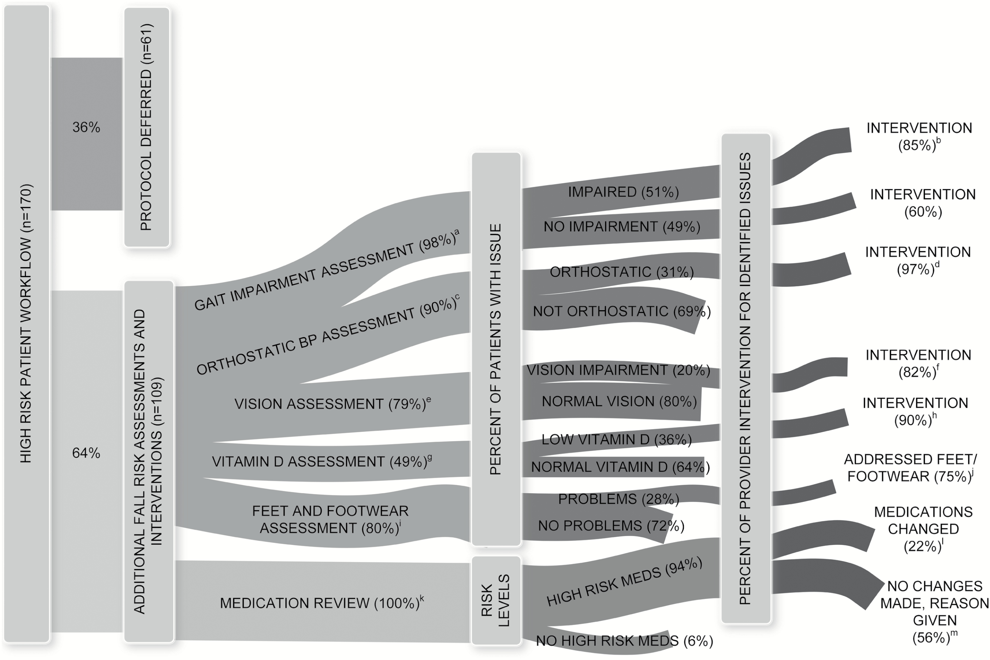
Research Supporting the STEADI Toolkit
Eckstrom et al. (2017)

Slide 19
Research Supporting the STEADI Toolkit
Older Adults with Primary Care Visit
n = 12,346
Screened
n = 11,080 (90%)
Not screened
n = 1,266 (10%)
At Risk
n = 2,032 (18%)
Not At Risk
n = 8,447 (76%)
Fall Plan of Care
n = 1,237 (61%)
Incomplete Screen
n = 601 (5%)
No Fall Plan of Care
n = 795 (39%)
STEADI implemented in 19 primary care clinics across Broome County, NY from 2012-2014
Assessed fall-related ED visits and hospitalizations in Broome County hospitals from 2012-2015 for 12,346 patients who had a primary care visit
40% less likely to go to ED and 50% less likely to be hospitalized than those at risk with no plan of care
40% less likely to be hospitalized than those at risk with no plan of care; No difference in risk of ED visits
Comparison Group
Johnston et al. (2019)

Slide 20
Objective 2 Discuss barriers and facilitators to fall risk management in Rural Health Clinics

Slide 21
Factors that Influence Implementation of Fall Risk Management in Primary Care
Provider Beliefs and Practice
Lack of awareness of importance of falls
Fragmented services and lack of coordination
Lack of Knowledge
Providers feel uninformed about how to manage fall risk
Time Constraints
High volume of patients
Patient Engagement
Financial Factors
Inadequate reimburse-ment given the time required
Direct and indirect costs of interven-tions
Unaware of clinical guidelines
Much to address within a single appointment
Stigma of falls
Lack of awareness falls are a medical issue
McConville & Hooven (2020)

Slide 22
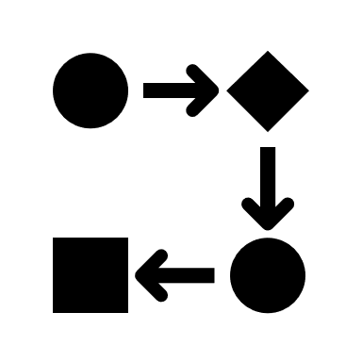
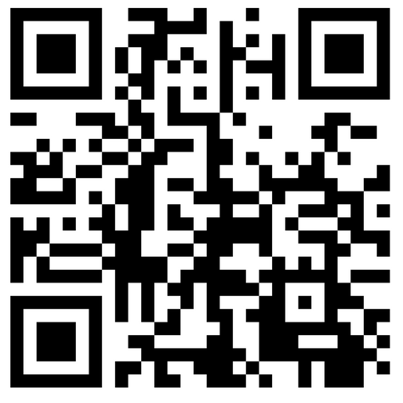
Your Experience of Facilitators and Barriers to Fall Risk Management
Scan QR Code:
OR
Visit the link below:
https://padlet.com/dvenema/your-experience-of-facilitators-and-barriers-to-fall-risk-ma-lvsn2qwegnprm5zf

Slide 23
CATCH RURAL Falls Program
Coordinated Action Toward Community Health:
RedUce Risk And Limit Falls
Purpose of the CATCH RURAL Falls Program
Provide education, resources, and improvement support for Rural Health Clinics
to adopt and implement an evidence-based fall risk reduction program
to improve care for older adults in your community

Slide 24
CATCH RURAL Falls Pilot Program
On-demand education on fall risk screening, assessment, and intervention practices; improvement strategies; implementation considerations
Virtual discussions to discuss education topics and support practice change
Pre-program assessment to establish a baseline of the current state of fall risk management
Post-program evaluation to evaluate program design and delivery, what was learned, and changes planned or implemented
Bergen & Shakya (2019); Eckstrom et al. (2021)

Slide 25
Fall Risk Management Practices in Rural Health Clinics Survey
What do you do?
Fall risk screening, assessment, and intervention practices used in your clinic
What helps or hinders?
Facilitators and barriers to fall risk screening, assessment, and intervention practices in your clinic
What do/can you track?
Feasibility of measures/metrics for monitoring practices in fall risk management programs

Slide 26
Vision for Next Iteration of the CATCH RURAL Falls Program
On-demand education regarding fall risk management activities including fall risk screening, assessment, and intervention practices; improvement strategies; implementation considerations
Virtual collaborative discussions and 1:1 consultations to discuss education topics and support practice change
Pre-program assessment to establish a baseline of the current state of fall risk management
Post-program evaluation to evaluate outputs and short-term outcomes
Design of improvement cycles to establish goals, identify measures and run tests of change and support implementation of strategies into practice
Bergen & Shakya (2019); Eckstrom et al. (2021)

Slide 27
CATCH RURAL Falls Program Activities, Outputs, and Outcomes for Consideration
Outputs
Form fall risk management team
Select screening and assessment tools/strategies
Short-Term Outcomes
% of older adult patients screened for fall risk
% of older adult patients at risk for falls with appropriate assessments completed
Intermediate Outcomes
Patients and family aware of fall risk status
Patients participate in recommended interventions
% of older adult patients with fall risk and appropriate interventions documented in care plan
% of older adult patients with appropriate intervention referrals
Develop/enhance referral and community resource lists
Develop/enhance patient and family education materials
Train providers and staff
Integrate tools into workflow/EHR
Identify billing codes
Create and update improvement and program monitoring plans
Long-Term Outcomes
Patients gait, strength, balance improves
Fewer patients fall in their community dwelling setting
Fewer patients fall with injury in their community dwelling setting
Fewer patient fall-related visits to ED
Fewer patient fall-related hospitalizations
Bergen & Shakya (2019)

Slide 28
Resources and References
Bergen G, Shakya I. CDC STEADI: Evaluation Guide for Older Adult Clinical Fall Prevention Programs. Atlanta, GA: National Center for Injury Prevention and Control, Centers for Disease Control and Prevention, 2019.
CDC STEADI. Resource: Algorithm for Fall Risk Screening, Assessment, and Intervention, 2019. https://www.cdc.gov/steadi/pdf/STEADI-Algorithm-508.pdf
CDC STEADI. Fact Sheet: Falls are a Major Threat for Your Patients, 2017. https://www.cdc.gov/steadi/pdf/STEADI-FactSheet-MajorThreat-508.pdf
CDC STEADI Toolkit: Stopping Elderly Accidents, Deaths & Injuries, 2023. https://www.cdc.gov/steadi/index.html
Eckstrom E, Parker EM, Lambert GH, Winkler G, Dowler D, Casey CM. Implementing STEADI in Academic Primary Care to Address Older Adult Fall Risk. Innov Aging. 2017;1(2):igx028. doi:10.1093/geroni/igx028
Eckstrom E, Parker EM, Shakya I, Lee R. Coordinated Care Plan to Prevent Older Adult Falls. Edition 1.1. Atlanta, GA: National Center for Injury Prevention and Control, Centers for Disease Control and Prevention, 2021.
Johnston YA, Bergen G, Bauer M, et al. Implementation of the Stopping Elderly Accidents, Deaths, and Injuries Initiative in Primary Care: An Outcome Evaluation. Gerontologist. 2019;59(6):1182-1191. doi:10.1093/geront/gny101
McConville A, Hooven K. Factors influencing the implementation of falls prevention practice in primary care. J Am Assoc Nurse Pract. 2020;33(2):108-116.
Smith Symens A, Trevelyan E. “The Older Population in Rural America: 2012–2016,” ACS-41, American Community Survey Reports, U.S. Census Bureau, Washington, DC, 2019.

