Slide 1
MBQIP: Critical Access Hospitals Reporting and Improving Quality
Sarah Brinkman, MBA, MA, CPHQ
Robyn Carlson, RHIA, CPHQ
Stratis Health
May 5, 2022
Rural QI Residency Program

Slide 2


Sarah Brinkman
Robyn Carlson

Slide 3
Stratis Health
Independent, nonprofit, Minnesota-based organization founded in 1971
  Lead collaboration and innovation in health care quality and safety, and serve as a trusted expert in facilitating improvement for people and communities
Work at intersection of research, policy, and practice
  Long history of working with rural providers, CAHs, and the Flex Program
  Rural Quality Improvement Technical Assistance (RQITA) is a FORHP funded program of Stratis Health

Slide 4
Rural Quality Improvement
Technical Assistance Center (RQITA)
Cooperative agreement awarded to Stratis Health starting September 2015 from the Health Resources and Services Administration Federal Office of Rural Health Policy (HRSA FORHP).
Improve quality and health outcomes in rural communities through TA for FORHP quality initiatives
  Flex/MBQIP
  Small Health Care Provider Quality Improvement Grantees (SCHPQI)
Focus on quality reporting and improvement

Slide 5
Objectives
Articulate the purpose of the Medicare Beneficiary Quality Improvement Program (MBQIP) program and its position in the national quality reporting landscape
Understand requirements of MBQIP and how data is reported
Identify ways to utilize MBQIP data and suggested strategies to drive improvement

Slide 6

Medicare Beneficiary Quality Improvement Project (MBQIP) Overview

Slide 7
MBQIP Overview
Quality improvement (QI) activity under the Medicare Rural Hospital Flexibility (Flex) grant program through the Federal office of Rural
Health Policy (FORHP)
Improve the quality of care in CAHs by increasing quality data reporting and driving improvement activities based on the data
Common set of rural-relevant hospital metrics, technical assistance, encouragement, and support
Ability for FORHP to demonstrate impact of hospital and state-based efforts on a national scale

Slide 8
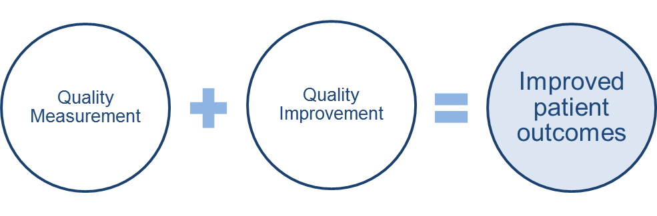
Goals of MBQIP
CAHs report common set of rural-relevant measures
Measure and demonstrate improvement
Prepare CAHs for participation in value-based payment programs

Slide 9
Benefits of MBQIP Participation
Improved patient care and quality outcomes
Increased capacity for participation in Federal reporting programs
Access to full scope of Flex resources

Slide 10
Move to Value: Rural Context
Value-Based Purchasing (VBP) programs have typically launched with ‘reporting’ efforts:
  Progression to CMS Hospital VBP
Continued roll-out across health care sectors:
  Hospitals, ESRD, Home Health, Long Term Care, Physicians…
  Most programs include metrics related to cost/efficiency, including hospital readmissions or admissions
Increasing engagement by rural providers in alternative models
Broad movement across payers
Continued theme spanning across numerous administrations

Slide 11
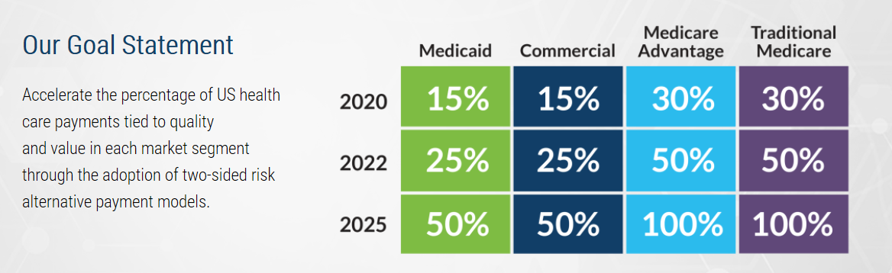
Health Care Payment
Learning & Action Network
https://hcp-lan.org/

Slide 12
MBQIP Current State Assessment
Significant increases in CAH quality reporting (consistency still a challenge)
To date, improvement on individual metrics is mixed
Seeing a shift in conversations - from a focus on reporting to more focus on improvement
Growing set of resources to support reporting and improvement

Slide 13
MBQIP Measures

Slide 14
MBQIP Core Measures
Patient Safety/ Inpatient | Patient Engagement | Care Transitions | Outpatient
HCP/IMM-3 – Healthcare personnel influenza vaccination Antibiotic Stewardship – Implementation of core elements | Hospital Consumer Assessment of Healthcare Providers & Systems (HCAHPS) | Emergency Department Transfer Communication (EDTC)§ | AMI: OP-2 – Fibrinolytic therapy w/in 30 OP-3 – Time to transfer ED Throughput: OP-18 – Time from arrival to departure OP-22 – Left w/o being seen
§ EDTC – Only measure not collected through CMS or NHSN

Slide 15
Reporting Channels for Core MBQIP Measures
Hospital Quality Reporting (HQR)
CMS Outpatient Measures
(Submitted via CART or vendor tool)
OP-2, OP-3, OP-18
CMS Outpatient Measures
(Submitted via HARP)
OP-22
HCAHPS Survey
(Vendor or self-administered)
HCP/IMM-3
Antibiotic Stewardship (submitted via Annual Facility
Survey)
NHSN*
State Flex Office
EDTC†
*National Healthcare Safety Network †Emergency Department Transfer Communication

Slide 16
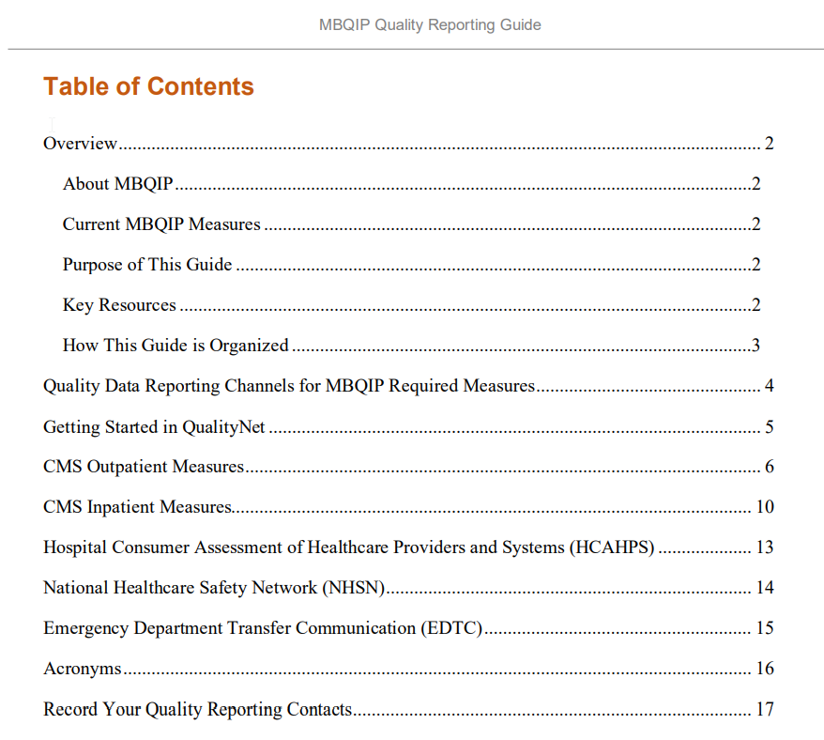
MBQIP Quality Reporting Guide
https://www.ruralcenter.org/resource-library/mbqip-quality-reporting-guide
Focus on MBQIP Measures
Reporting channel resources including
  How to register
  Which measures to report
  How to submit measures
Links embedded throughout
Hospital quality reporting contact form

Slide 17
Abstraction Resources for CAHs
Online MBQIP Data Abstraction Training Series
  https://www.ruralcenter.org/resource-library/online-mbqip-data-abstraction-training-series
Ask Robyn – Quarterly Open Office Hours Calls (July 26)
  https://www.ruralcenter.org/resource-library/ask-robyn-quarterly-open-office-hour-calls-for-mbqip-data-abstractors
MBQIP Monthly – Robyn’s Quips
  https://www.ruralcenter.org/tasc/mbqip/mbqip-monthly
MBQIP Measures Fact Sheets
  www.ruralcenter.org/resource-library/mbqip-measures-fact-sheets

Slide 18
Abstracting for Accuracy
An opportunity for CAHs to participate in an abstraction review process
Help to increase validity of data collection
Identify opportunities for additional training and clarification related to
chart abstraction
www.ruralcenter.org/resource-library/abstracting-for-accuracy-project

Slide 19

EDTC
Streamlined measure – 8 data elements
Training videos and FAQ available
Started using for Q1 2020 encounters
https://www.ruralcenter.org/resource-library/data-specifications-manual-edtc-measure

Slide 20
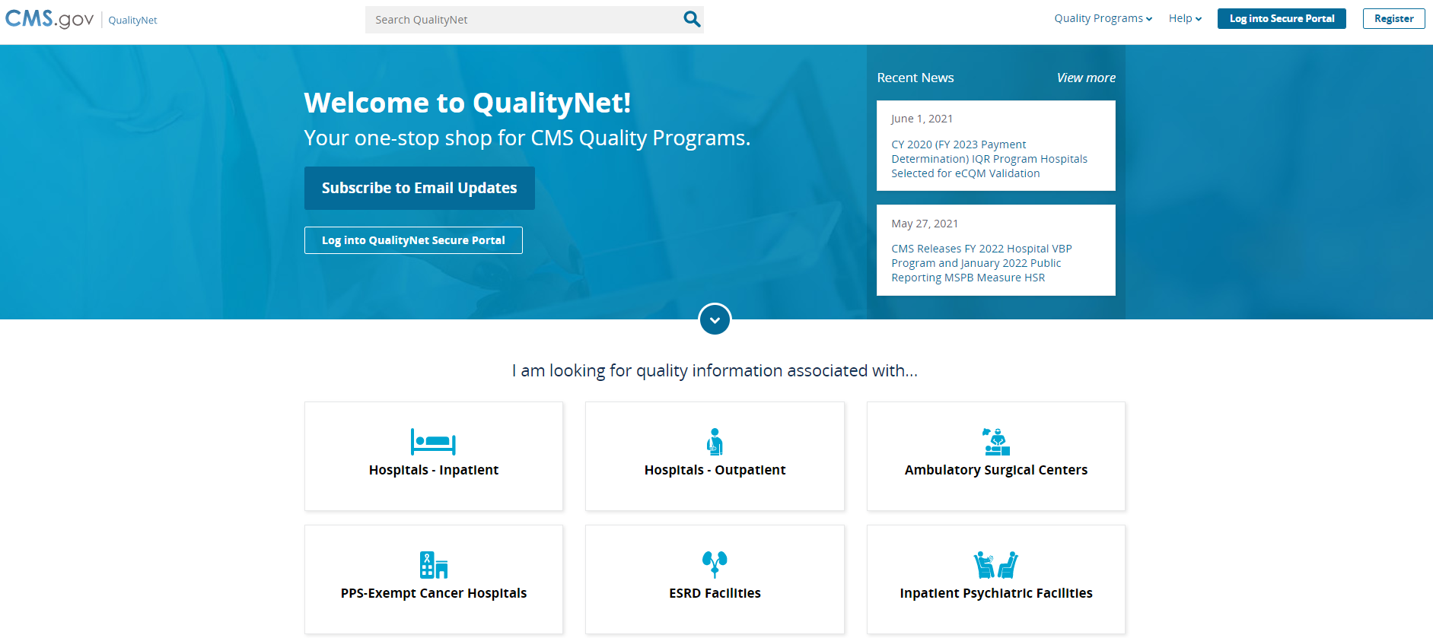
Quality Net
Specifications Manuals
CMS Abstraction & Reporting Tool (CART)
Subscribe for updates
https://qualitynet.cms.gov/

Slide 21
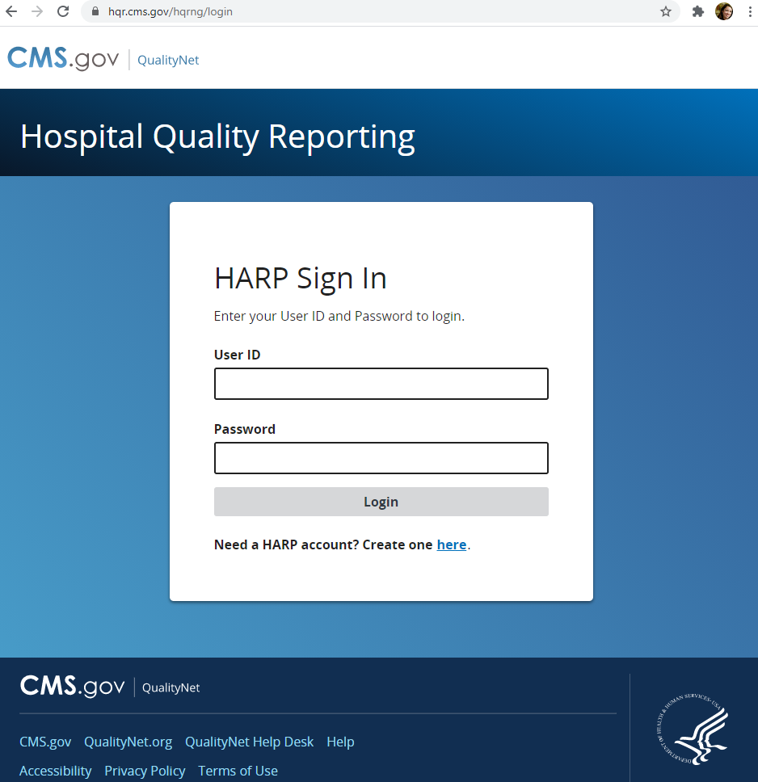
HARP
Login here to submit data:
https://hqr.cms.gov/hqrng/login

Slide 22
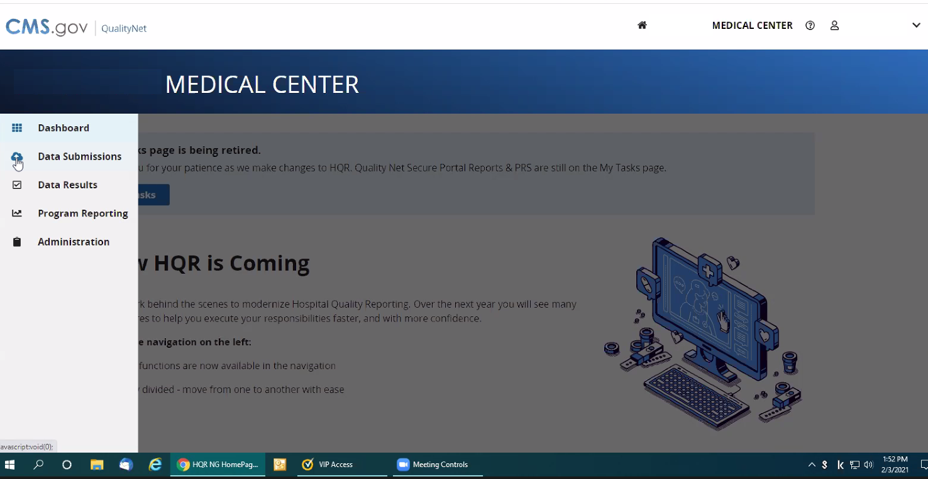
sdfasfasd

Slide 23
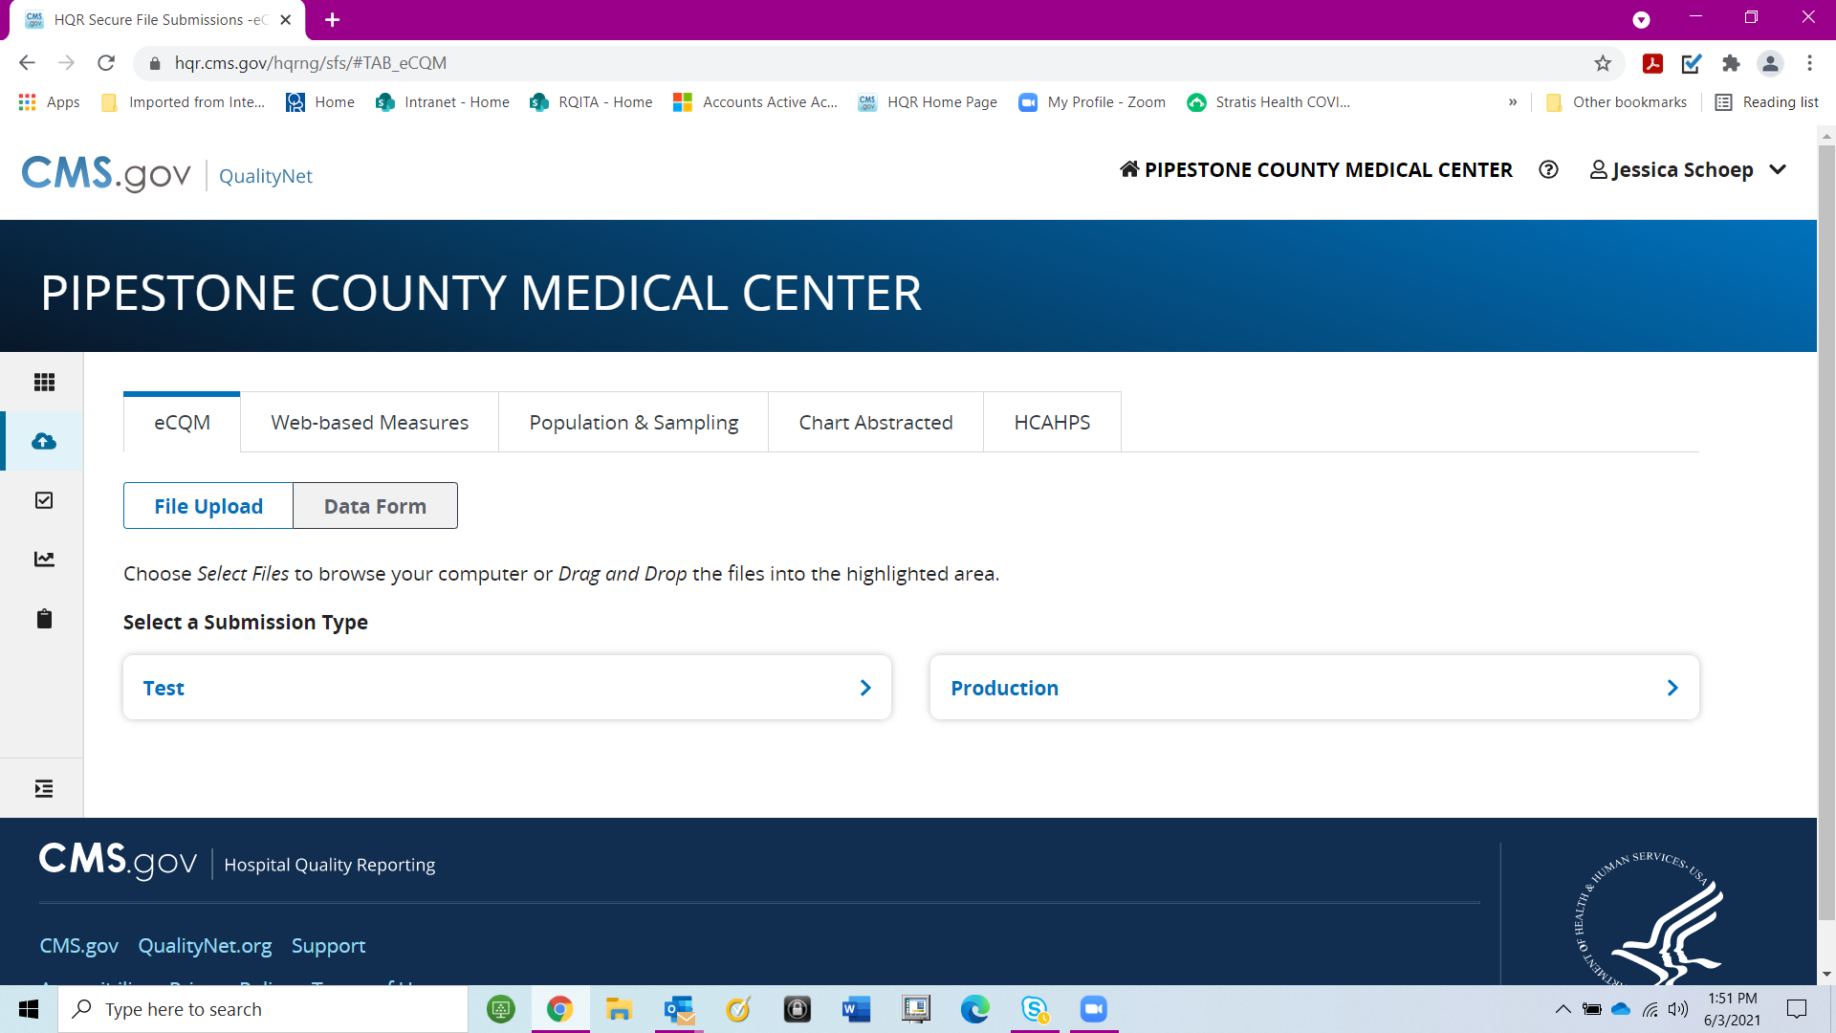

Slide 24
Nebraska MBQIP Performance Data

Slide 25
HCP/IMM-3 (OP-27): Immunization among Health Care Personnel
Flu Season | # (%) CAHs Reporting |  | Average |  | 90th Percentile
 | NE CAHs (63) | National CAHs (1,338) | NE CAHs | National CAHs | NE CAHs | National CAHs
2017-2018 | 48 (76%) | 1,030 (77%) | 93% | 89% | 99% | 99%
2018-2019 | 41 (65%) | 985 (74%) | 94% | 90% | 99% | 99%
2019-2020 | 31 (49%) | 718 (54%) | 91% | 92% | 99% | 99%
2020-2021 | 37 (59%) | 903 (67%) | 89% | 87% | 99% | 99%

Slide 26
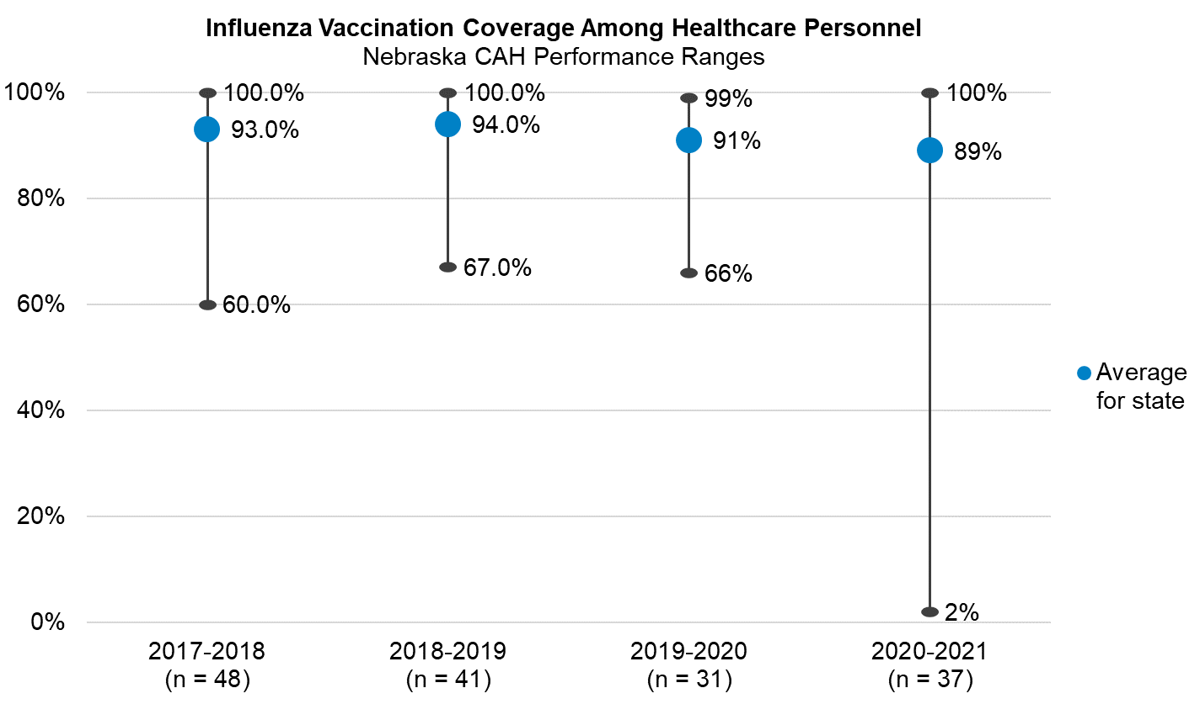
National CAH average for 2020-2021: 87%
National CAH 90th Percentile for 2020-2021: 99%

Slide 27
OP-18: Median time from ED Arrival to Departure (in minutes)
Timeframe | # (%) CAHs Reporting |  | Median |  | 90th Percentile
 | NE CAHs (63) | National CAHs (1,338) | NE CAHs | National CAHs | NE CAHs | National CAH benchmark
3Q 2020 | 48 (76%) | 924 (69%) | 98 | 110 | 80 | 80
4Q 2020 | 51 (81%) | 953 (71%) | 113 | 117 | 91 | 84
1Q 2021 | 54 (86%) | 1,045 (78%) | 105 | 116 | 90 | 86
2Q 2021 | 51 (81%) | 1,017 (76%) | 102 | 111 | 83 | 79
3Q 2021 | 54 (86%) | 1,042 | 105 | 115 | 82 | 79

Slide 28
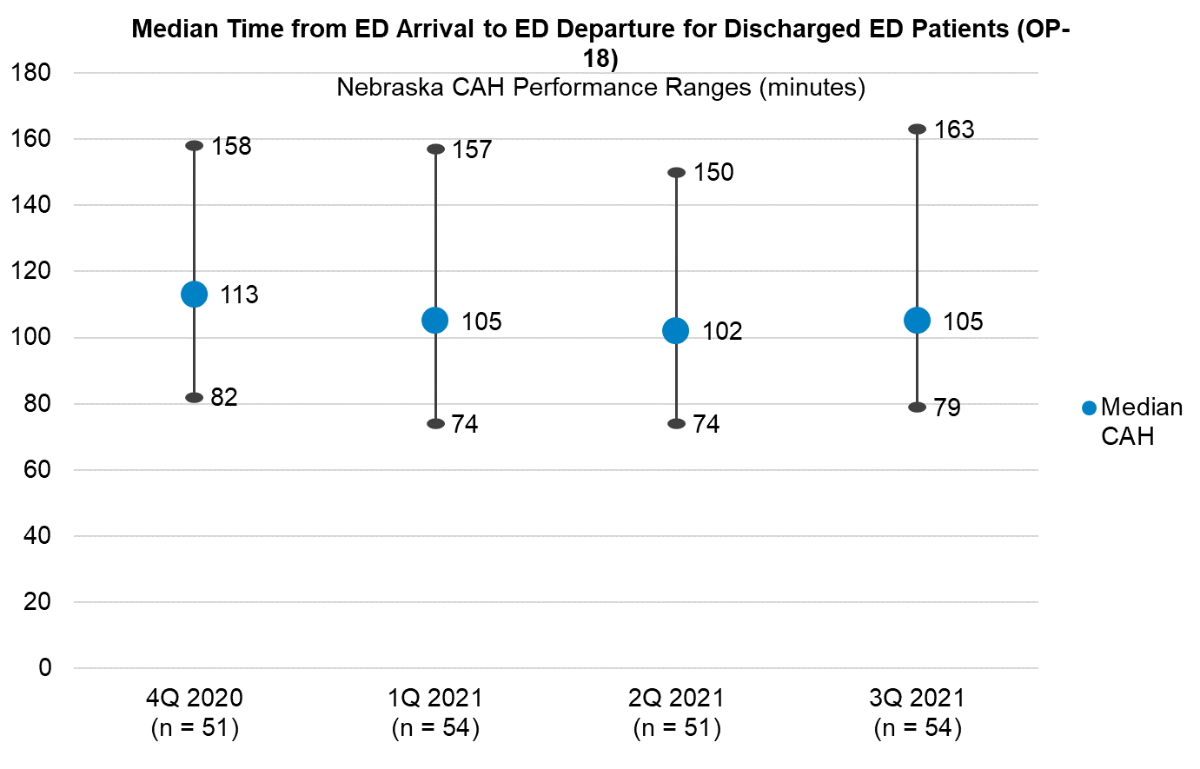
National median CAH in 3Q 2021: 115
National CAH 90th Percentile Benchmark for Q3 2021: 79

Slide 29
EDTC-All: Emergency Department Transfer Communication Composite
Timeframe | # (%) CAHs Reporting |  | Average |  | 90th Percentile
 | NE CAHs (63) | National CAHs (1,338) | NE CAHs | National CAHs | NE CAHs | National CAHs
1Q 2021 | 58 (92%) | 1,157 (86%) | 87% | 90% | 100% | 100%
2Q 2021 | 56 (89%) | 1,185 (89%) | 87% | 91% | 100% | 100%
3Q 2021 | 61 (97%) | 1,200 (90%) | 88% | 90% | 100% | 100%
4Q 2021 | 59 (64%) | 1,153 (86%) | 86% | 90% | 100% | 100%

Slide 30
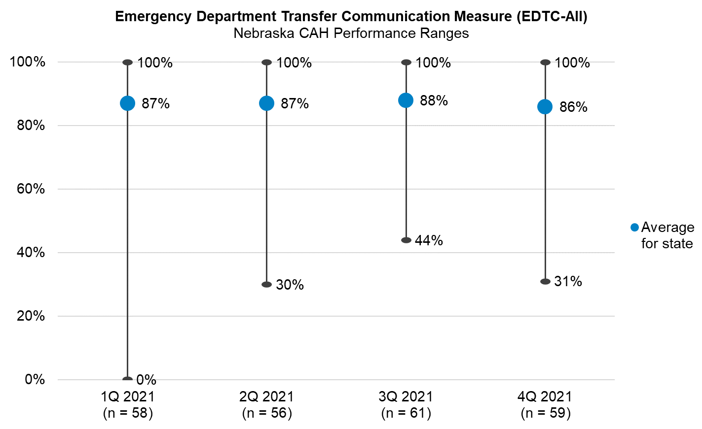
National CAH average for 4Q 2021: 90%
National CAH 90th Percentile in Q4 2021: 100%

Slide 31
HCAHPS
The most recent available HCAHPS data is for the time period of Q3 2020 – Q1 2021 encounters (released in October 2020).
  “HCAHPS scores are based on three quarters of data rather than the customary four quarters. Use caution when interpreting these HCAHPS results as they are based on fewer months of data and fewer discharged patients than normal.” (HCAHPS Online)
Public Health Emergency
  HCAHPS reporting for Q1 2020 and Q2 2020 encounters was optional due to the Public Health Emergency
  CMS has announced that Q2 2021 HCAHPS data will not be released. Q3 2021 HCAHPS data are expected to be released in summer 2022

Slide 32
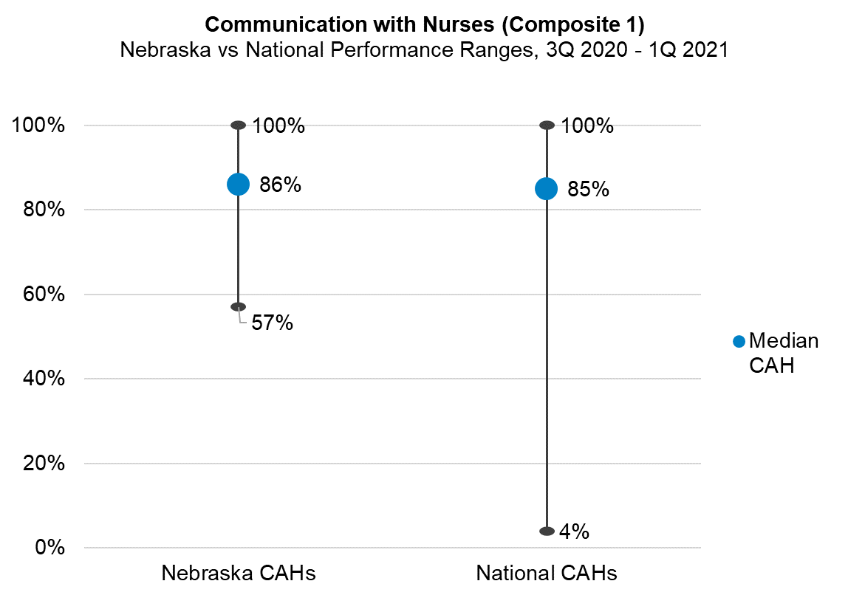

Slide 33
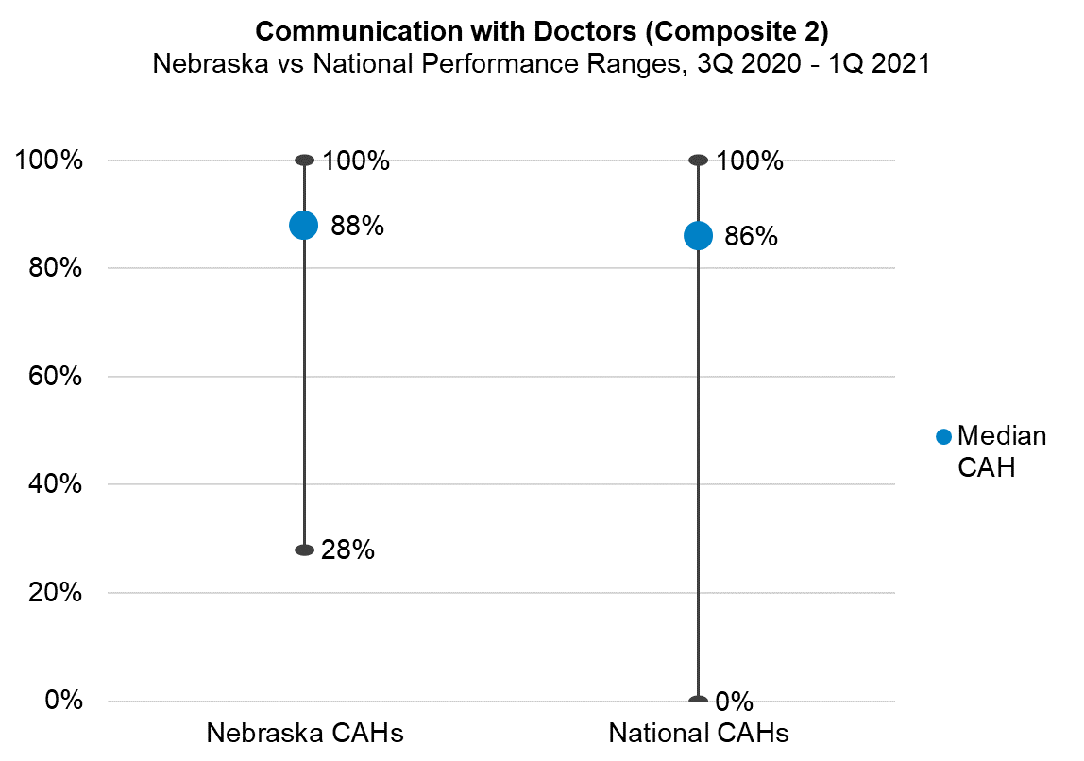

Slide 34
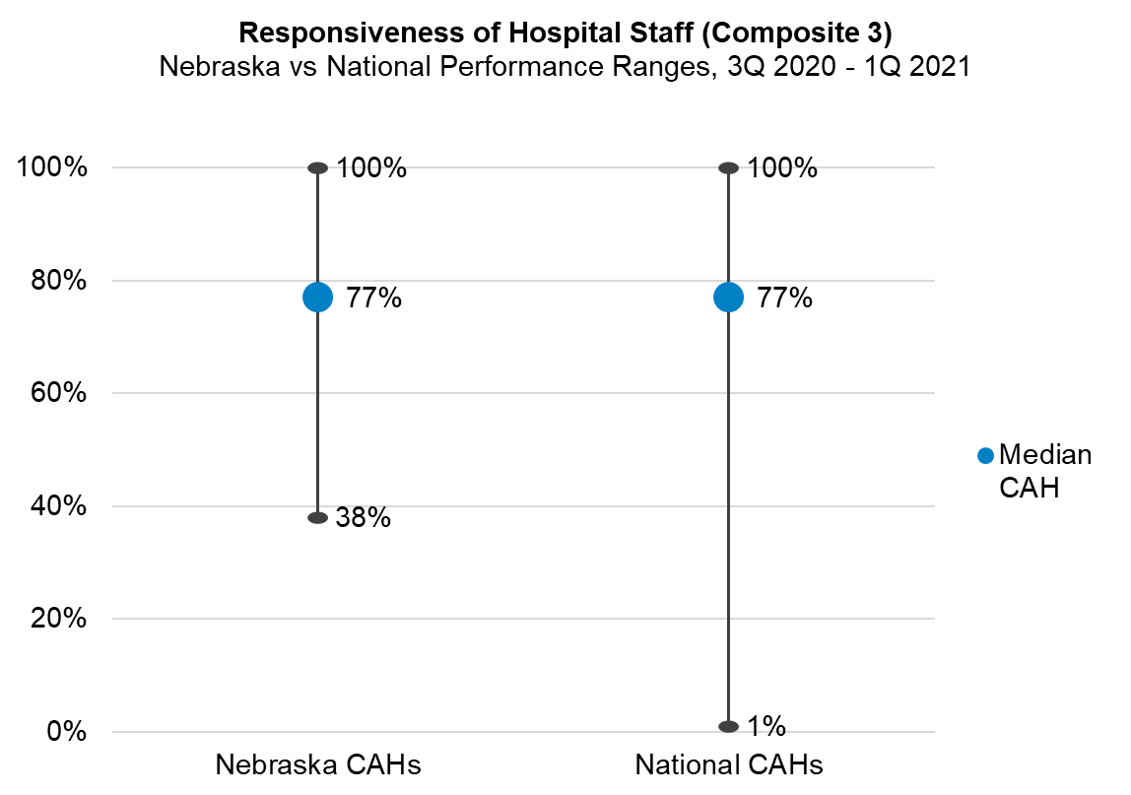

Slide 35
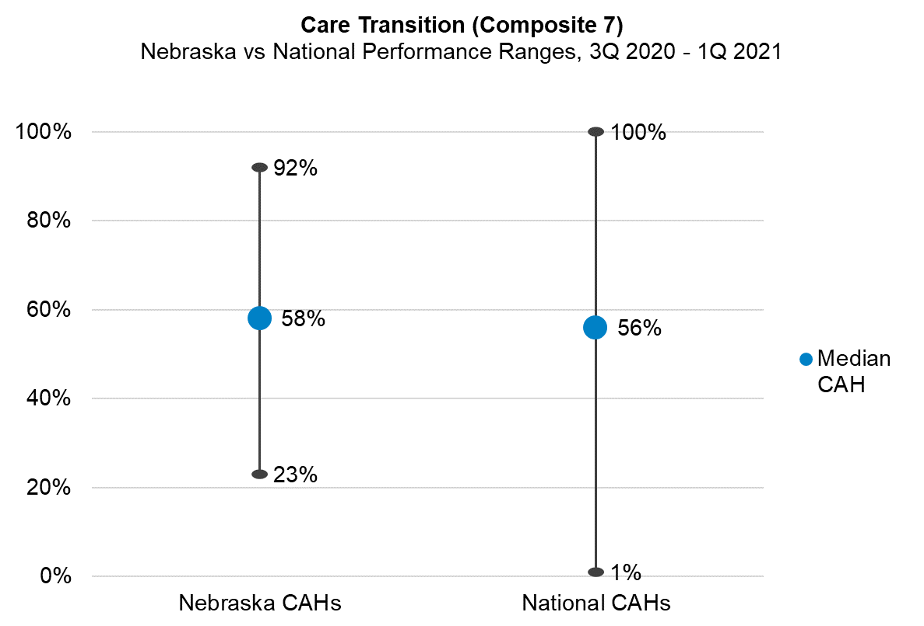

Slide 36
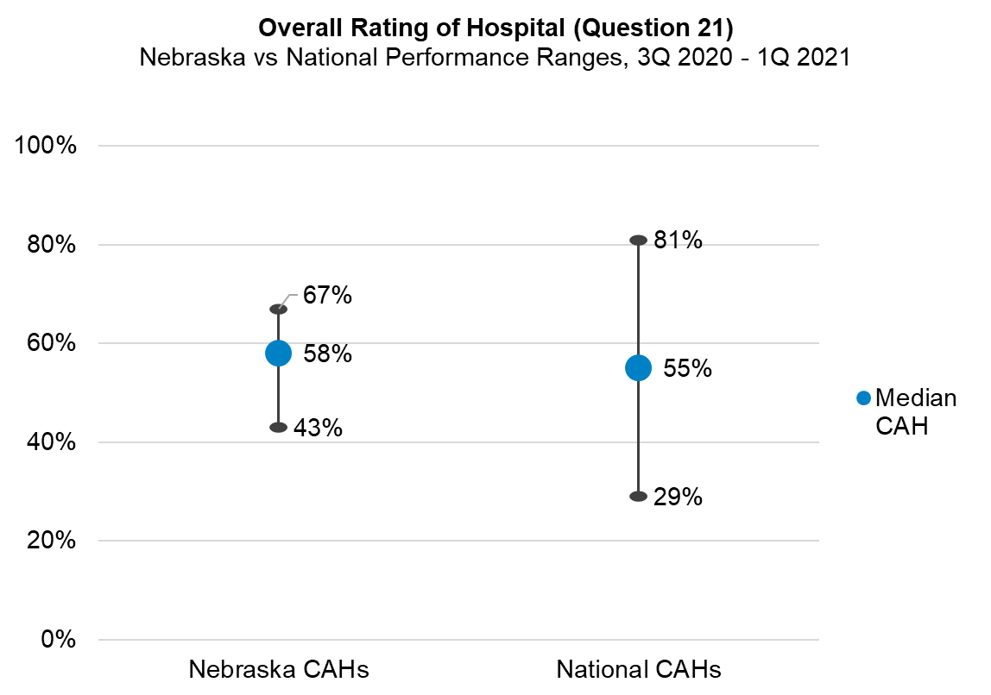

Slide 37

Core Elements of Hospital Antibiotic Stewardship
Leadership Commitment
Accountability
Drug Expertise
Action
Tracking
Reporting
Education

Slide 38
Core Elements – 2020
Nationally: 1,203 of 1,338 CAHs (90%) have completed the 2020 survey
Nebraska: 49 of 63 CAHs (78%) have completed the 2020 survey
# of Core Elements Met | % CAHs Nationally | NE CAHs | % NE CAHs
0 | <0% | 0 | 0%
1 | <0% | 0 | 0%
2 | <0% | 0 | 0%
3 | <0% | 0 | 0%
4 | 2% | 0 | 0%
5 | 4% | 3 | 5%
6 | 8% | 3 | 5%
7 | 74% | 43 | 68%
Survey not completed | 10% | 14 | 22%

Slide 39
Leadership
Our facility has a formal statement of support for antibiotic stewardship (e.g., a written policy or statement approved by the board).
Facility leadership has demonstrated a commitment to antibiotic stewardship efforts by:
 | Communicating to staff about stewardship activities, via email, newsletters, events, or other avenues
 | Providing opportunities for staff training and development on antibiotic stewardship
 | Allocating information technology resources to support antibiotic stewardship efforts
Our facility has a committee responsible for antibiotic stewardship.
If a physician and/or pharmacist are leading antibiotic stewardship activities, are antibiotic stewardship responsibilities in their contract or job description?
48 NE CAHs
40 NE CAHs
43 NE CAHs
37 NE CAHs
48 NE CAHs
18 NE CAHs

Slide 40
Accountability
Our facility has a leader (or co-leaders) responsible for antibiotic stewardship outcomes.
49 NE CAHs
Drug Expertise
Our facility has pharmacist lead or co-lead responsible for antibiotic stewardship
Our facility has a physician or other lead responsible for antibiotic stewardship and at least one pharmacist is responsible for improving antibiotic use at the facility.
39 NE CAHs
10 NE CAHs

Slide 41
Leadership, Accountability, & Drug Expertise
Core Element | State Level (NE) | Nationally
Leadership | 49 out of 63 CAHs (78%) | 1,188 out of 1,338 CAHs (89%)
Accountability | 49 out of 63 CAHs (78%) | 1,161 out of 1,338 CAHs (87%)
Drug Expertise | 49 out of 63 CAHs (78%) | 1,136 out of 1,338 CAHs (85%)
Who is meeting the Leadership Core Element?
State Level: X out of X CAHs (XX%) are meeting the
Nationally: XXX out of 1345 CAHs (XX%)

Slide 42
Action
Our facility has a policy or formal procedure for:
 | Required documentation of indication for antibiotic orders
 | Required documentation of duration for antibiotic orders
 | The treating team to review antibiotics 48-72 hours after initial order (i.e., antibiotic time-out)
 | The stewardship team to review courses of therapy for specific antibiotic agents and provide real-time feedback and recommendations to the treatment team (i.e., prospective audit and feedback)
 | Required authorization by the stewardship team before restricted antibiotics on the formulary can be dispensed (i.e., prior authorization)
39 NE CAHs
22 NE CAHs
31 NE CAHs
23 NECAHs
3 NE CAHs

Slide 43
Action Cont’d
Providers have access to facility- or region-specific treatment guidelines or recommendations for commonly encountered infections.
Our facility targets select diagnoses for active interventions to optimize antibiotic use (e.g., intervening on duration of therapy for patients with community-acquired pneumonia according to clinical response)
47 NE CAHs
35 NE CAHs
Core Element | State Level (NE) | Nationally
Action | 49 out of 63 CAHs (78%) | 1,180 out of 1,338 CAHs (88%)

Slide 44
Tracking
Our facility has a policy or formal procedure for required documentation of indication for antibiotic orders and our stewardship team monitors adherence to that policy or formal procedure.
Providers have access to facility- or region-specific treatment guidelines or recommendations for commonly encountered infections and our stewardship team monitors adherence to those guidelines or recommendations.
Our stewardship team monitors:
 | Antibiotic resistance patterns
 | Antibiotic use in days of therapy (DOT) per 1000 patient days or days present, at least quarterly
 | Antibiotic use in defined daily doses (DDD) per 1000 patient days, at least quarterly
 | Antibiotic expenditures (i.e., purchasing costs), at least quarterly
33 NE CAHs
32 NE CAHs
39 NE CAHs
23 NE CAHs
7 NE CAHs
8 NE CAHs

Slide 45
Reporting
Our facility has a policy or formal procedure for the stewardship team to review courses of therapy for specific antibiotic agents and provide real-time feedback and recommendations to the treatment team (i.e., prospective audit and feedback)
If antibiotic use in DOT, DDD, or some other means of monitoring are selected, our stewardship team provides individual-, unit-, or service-specific reports on antibiotic use to prescribers, at least annually.
Our stewardship team provides the following updates or reports, at least annually:
 | Updates to facility leadership on antibiotic use and stewardship efforts
 | Outcomes for antibiotic stewardship interventions to staff
23 NE CAHs
19 NE CAHs
42 NE CAHs
23 NE CAHs

Slide 46
Tracking & Reporting
Core Elements | State Level (NE) | Nationally
Tracking | 47 out of 63 CAHs (75%) | 1,159 out of 1,338 CAHs (87%)
Reporting | 43 out of 63 CAHs (68%) | 1,099 out of 1,338 CAHs (82%)
Who is meeting the Leadership Core Element?
State Level: X out of X CAHs (XX%) are meeting the
Nationally: XXX out of 1345 CAHs (XX%)

Slide 47
Education
Which of the following groups receive education on appropriate antibiotic use at least annually? (Check all that apply)
 | Prescribers
 | Nursing staff
 | Pharmacists
42 NE CAHs
27 NE CAHs
41 NE CAHs
Core Element | State Level (NE) | Nationally
Education | 48 out of 63 CAHs (76%) | 1,090 out of 1,338 CAHs (81%)

Slide 48
Using Data and Driving Quality Improvement

Slide 49
MBQIP Data Analysis Resources
Interpreting MBQIP Hospital Data Reports for Quality Improvement
  https://www.ruralcenter.org/tasc/resources/interpreting-mbqip-hospital-data-reports-quality-improvement
How Small is Too Small?
  https://www.ruralcenter.org/resource-library/how-small-is-too-small
Eliminate the Denominator
  https://www.ruralcenter.org/resource-library/eliminate-the-denominator

Slide 50

MBQIP Monthly
https://www.ruralcenter.org/tasc/mbqip/mbqip-monthly
CAHs Can!
Data: CAHs Measure Up
Tip: Robyn Quips
Tools and Resources

Slide 51

Quality Time: Sharing PIE
(performance improvement experience)
https://stratishealth.org/quality-time-sharing-pie/
CAH QI Mentors share lessons learned, strategies, tips, and ideas from their in-the-field performance improvement experience.
Listen online or wherever you get your podcasts.

Slide 52
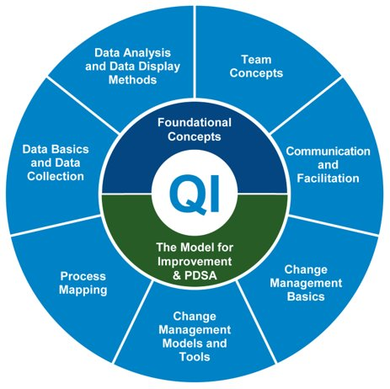
Quality Improvement Basics Course
https://stratishealth.org/quality-improvement-basics/
11 didactic modules including videos, slides, and transcripts
  Can be completed in sequence or stand-alone
Templates and tools
Facilitator Guide and Sample Syllabus also available

Slide 53
Quality Improvement Implementation Guide & Toolkit for CAHs
https://www.ruralcenter.org/resource-library/quality-improvement-implementation-guide-and-toolkit-for-cahs
QI Implementation Guide
QI Measure Summaries
Brainstorming Tool
Internal Quality Monitoring Tool
Project Action Plan Template
Meeting Agenda Template
Rapid Tests of Change Tool
Prioritization Tool
Internal Quality Monitoring Tool
10-Step QI Project Documentation Template

Slide 54

Suggested Strategies for Improving MBQIP Measures
Part of the Quality Improvement Implementation Guide and Toolkit for CAHs
Suggested promising strategies for QI for each of the MBQIP Core Measures
  https://www.ruralcenter.org/resource-library/quality-improvement-implementation-guide-and-toolkit-for-cahs

Slide 55

HCAHPS Best Practices
Best practices for improving HCAHPS as collected from high performing CAHs
Includes strategies for increasing response rates and performance in each of the HCAHPS domain
  https://www.ruralcenter.org/resource-library/study-of-hcahps-best-practices-in-high-performing-cahs

Slide 56
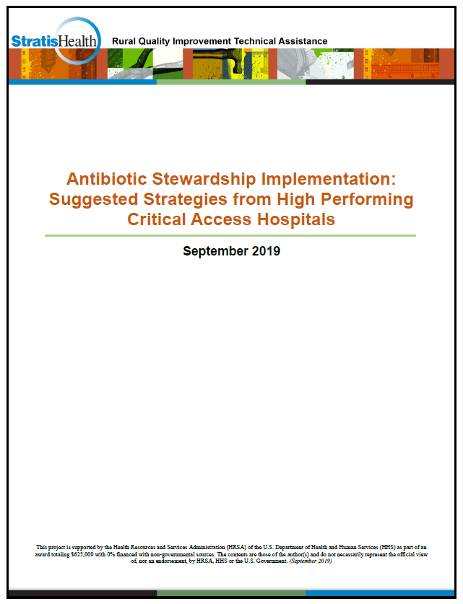
Antibiotic Stewardship Strategies
Best practices for improving implementing AS collected from high performing CAHs
Aligned with the Centers for Disease Control & Prevention 7 core elements of antibiotic stewardship
  https://www.ruralcenter.org/resource-library/antibiotic-stewardship-implementation-suggested-strategies-from-high-performing

Slide 57
Questions & Discussion
What will you take from this presentation?

Slide 58
Questions?
Sarah Brinkman
Program Manager
952-853-8552 sbrinkman@stratishealth.org
www.stratishealth.org
Robyn Carlson
Quality Reporting Specialist
952-853-8587 rcarlson@stratishealth.org

Slide 59
Stratis Health is a nonprofit organization that leads collaboration and innovation in health care quality and safety, and serves as a trusted expert in facilitating improvement for people and communities.
This project is supported by the Health Resources and Services Administration (HRSA) of the U.S. Department of Health and Human Services (HHS) as part of an award totaling $625,000 with 0% financed with non-governmental sources. The contents are those of the author(s) and do not necessarily represent the official view of, nor an endorsement, by HRSA, HHS or the U.S. Government. (07/2021)

Slide 60
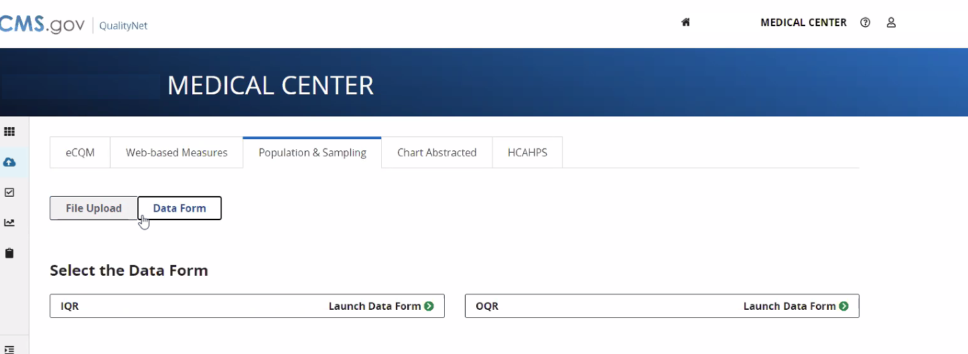
sdfasfasd

Slide 61
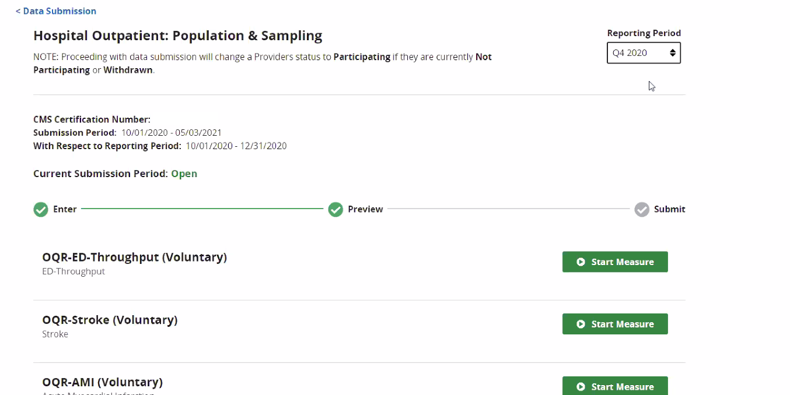
a

Slide 62
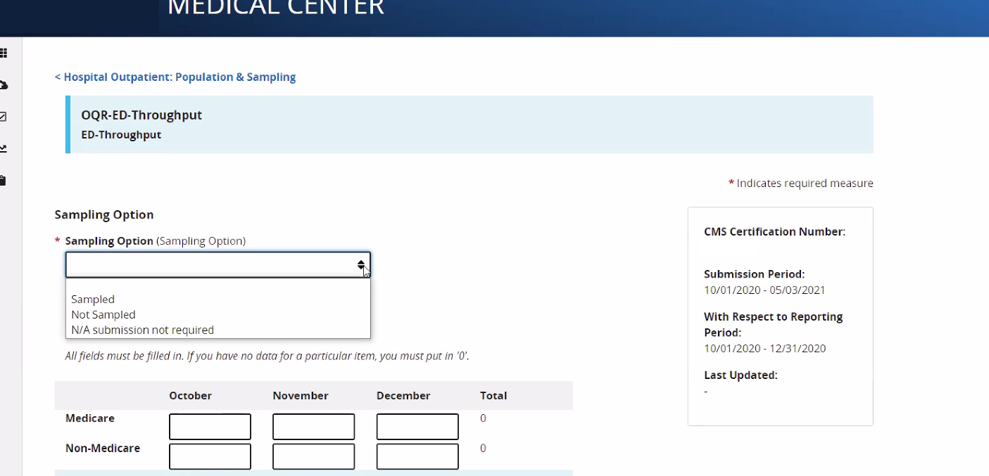
a

Slide 63
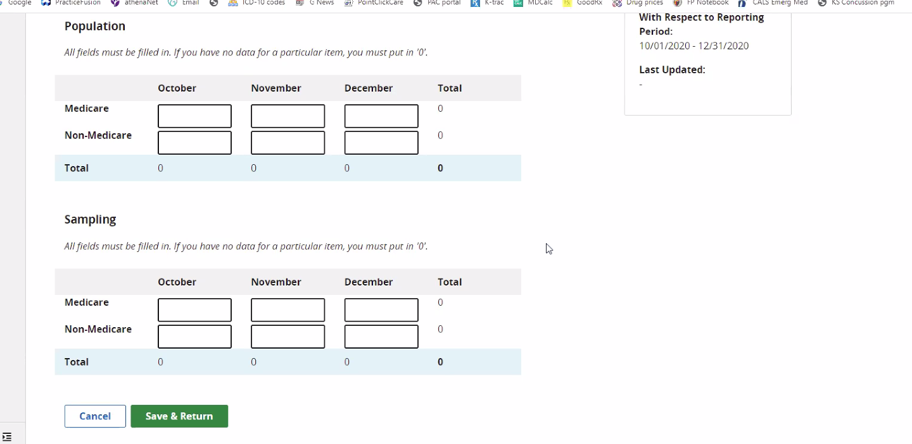
a

Slide 64
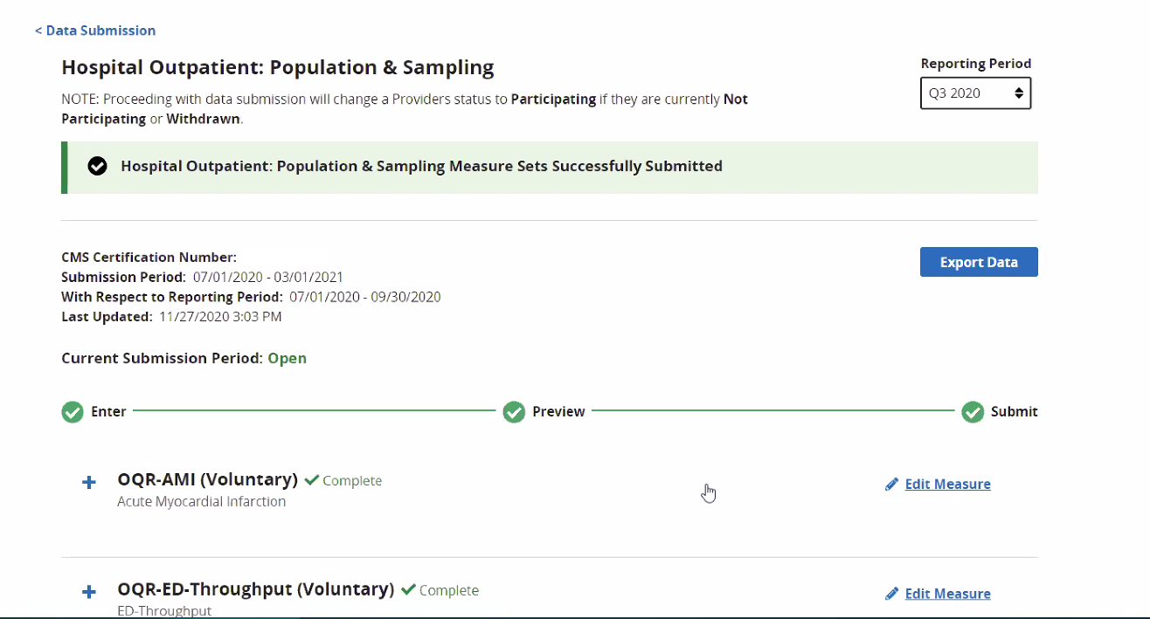
a

Slide 65
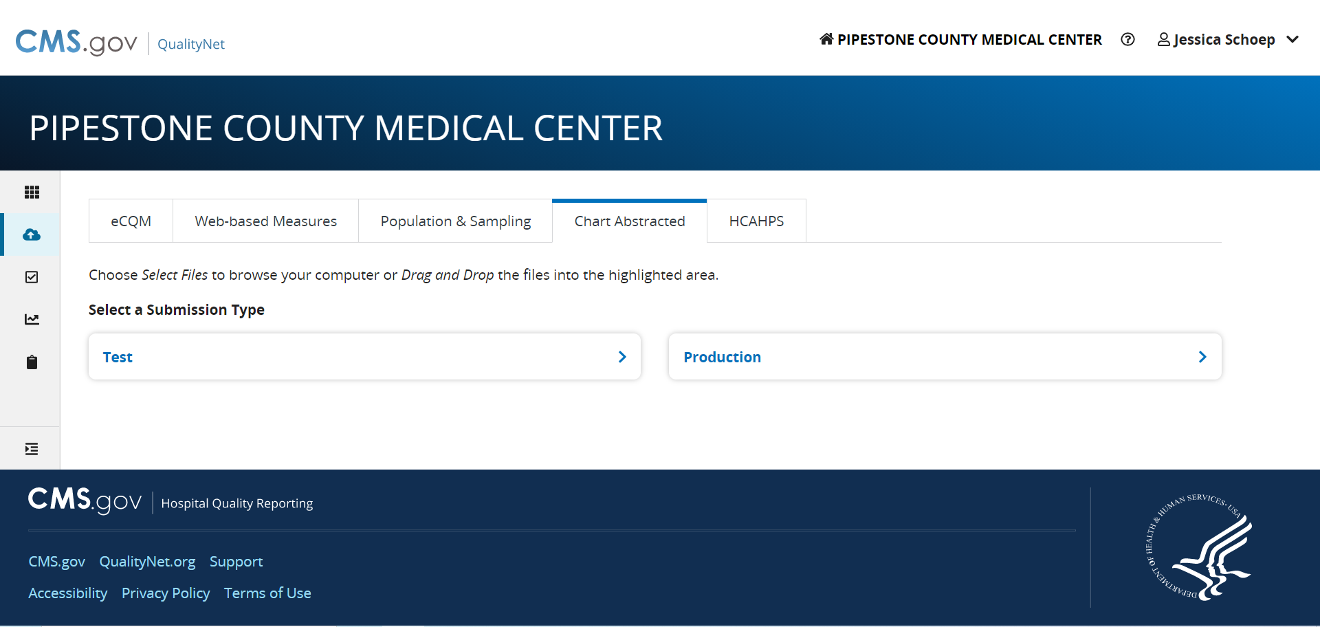

Slide 66
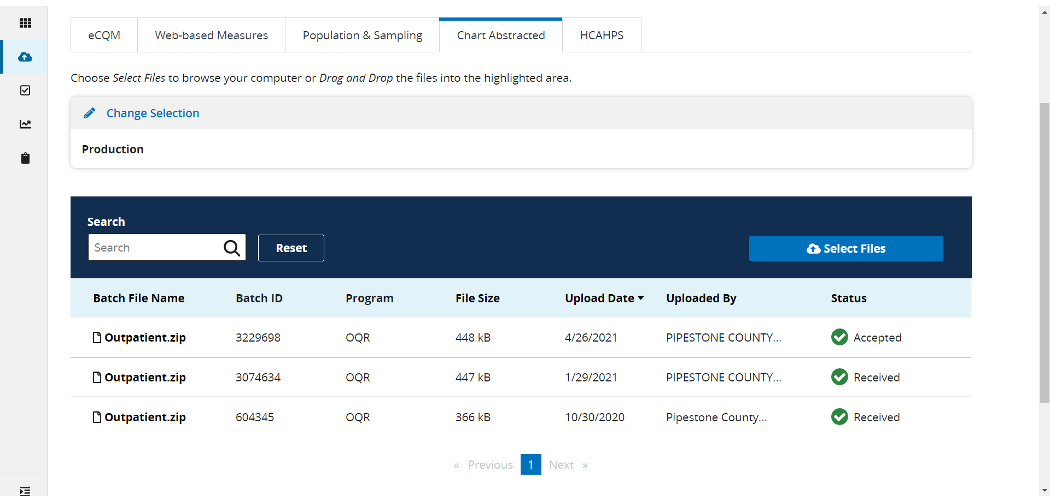

Slide 67
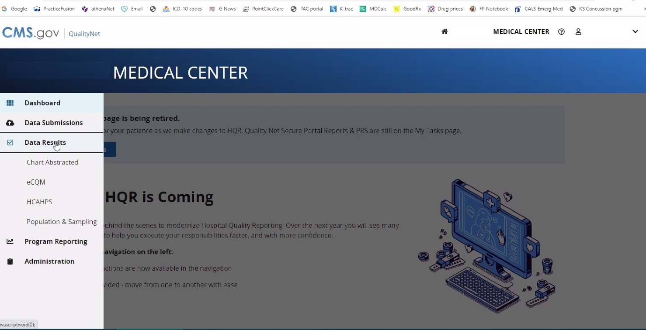
a

Slide 68
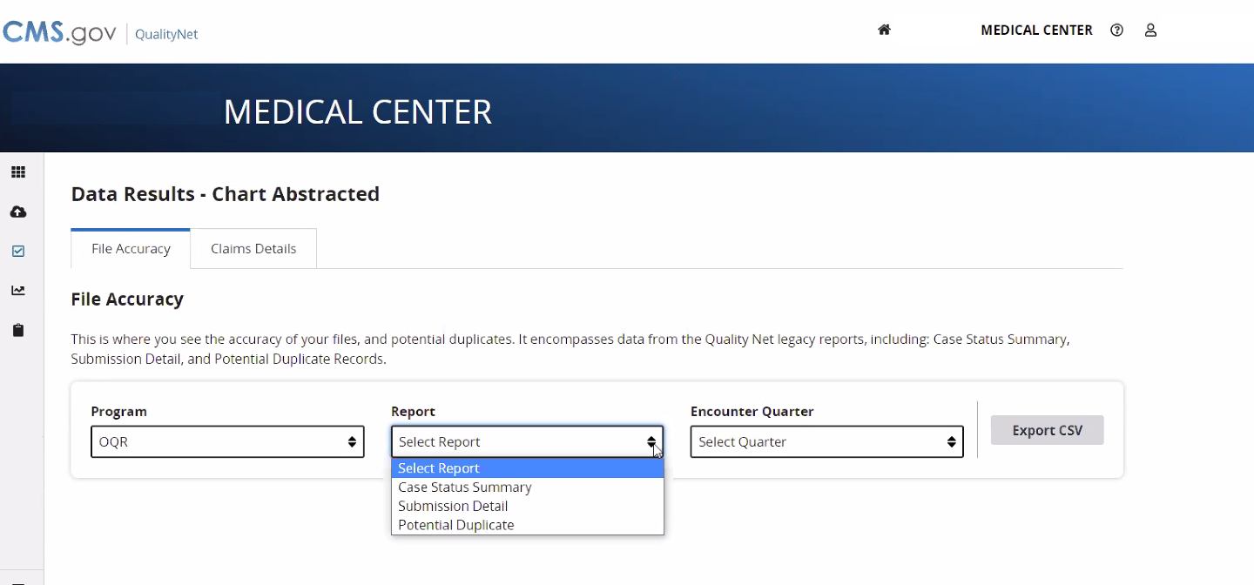
a

