Slide 1
Six Meetings for Success
Stephanie Sobczak, MS, MBA
UW HEALTH – PROJECT MANAGER
Notes:
Hello, I’m SS and welcome to the presentation on “How to Improve Anything in Six Meetings or Less”

Slide 2
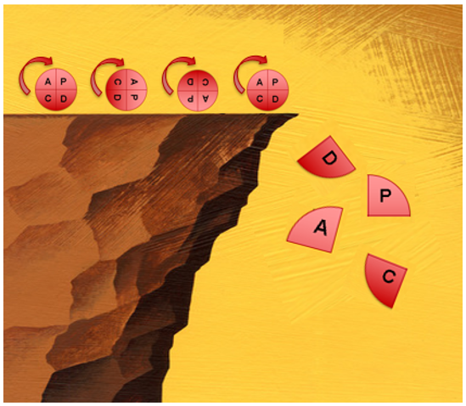
Some Background
Notes:
In my current role with UW Health, I lead projects large and small, but I started
my career in a rural hospital leading QI teams.
Over the years, I’ve facilitated a lot of teams – not always successful ones.
Teams would get started, come up with great ideas, establish baseline measures and great plans…
However, once those ideas were attempted where the patients were….things could easily fall off a cliff.
So, after dozens of struggling teams, I started to notice some patterns in what went wrong.
What I am sharing with you today isn’t some great innovation,
But a new way of combining some tried and true methods that might be a different way of looking at how improvement works.

Slide 3
Common Missteps Slow Improvement
Loose adherence to a defined Improvement Process
Just-in-time scheduling of meetings; frequent rescheduling
Meeting time spent discussing personalities vs. processes
Being OK with improvements taking 9, 12, 18+ months to implementation
Willingness to accept dropping the ball on tasks; people are “too busy”
Failure to connect the improvement to the front-line; early and often!
Notes:
First let’s explore how improvements can go awry.
I will say I’m very familiar with these missteps because I have lived them.
In fact, I’ve been the cause of them more than a few times over the years.

Slide 4
Six Meetings!?! How?
Grounded in the standardized approach to improvement in your organization
Willingness to use pre-defined agendas for each meeting
Stakeholders committed to doing work between meetings
Discipline to document and manage “Action Items”
Plan, in detail, small tests of change to apply in operational areas
Structured follow-up to emphasize sustainability
Notes:
When I present this approach to an improvement, it’s not uncommon to hear an incredulous “Six Meetings or Less…. How will that work”?
It does work
I’m not going to bury the lede here but share right up from what this takes.
These are not new and revolutionary ideas – it is about putting these ideas into an executable framework.

Slide 5
Improvement doesn’t happen here…
Notes:
The primary shift is to recognize this truth – Improvement doesn’t happen in meeting rooms around a conference table

Slide 6
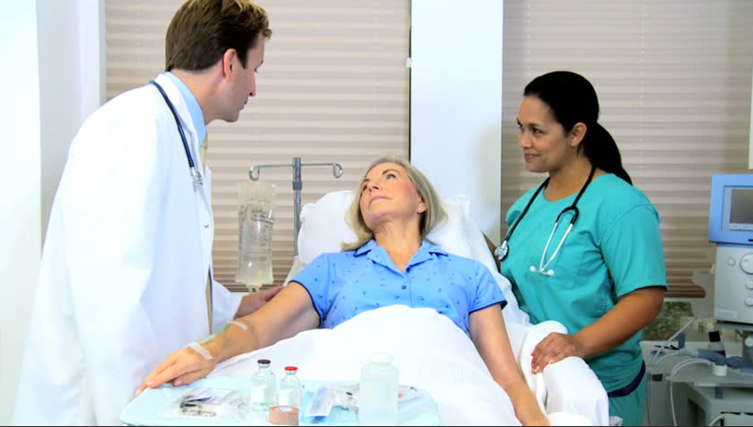
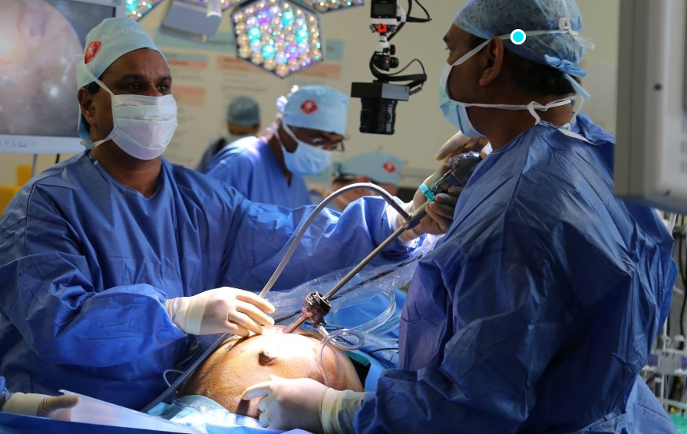
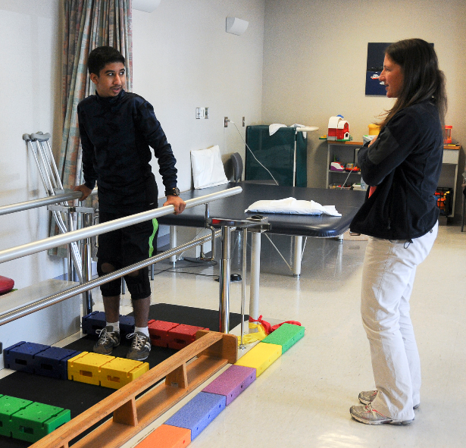
Improvement happens here!
Notes:
Improvement has little chance of sustaining results if it’s not be developed and testing in the place where the work happens

Slide 7
The Method
Base framework is 6 one-hour meetings with defined deliverables from each
The goal is to work through problem definition, root cause identification and solution selection quickly
Participants must commit to completing Action Items on-time
The heart & soul of this method is engaging those who do the work, in the place where they work (a.k.a. our experts!)
Notes:
Here is the method.

Slide 8
The Application
A few examples how this approach has been used in a variety of care settings:
Implementing clinical bundle elements: CAUTI, SSI, CLABSI etc.
Cross-functional coordination: Discharge checklist, Med Reconciliation
Process challenges: Ordering wound vacs, Gaps in supply stocking
Closing hand-off issues: ED to Inpatient admissions, Cardiology clinic triage
→Any need for improvement that has a defined scope
Notes:
How has this approached been used? It has a number of applications.
Any need for improvement that has a defined scope.

Slide 9
The 6 Meeting Structure
Schedule all 6 meetings in advance – avoid rescheduling
-1-
Stakeholder Meeting
-2-
Action Planning Meeting
-3-
Small Test Design Meeting
-4-
Progress Check Meeting
-5- Implementation Planning Meeting
-6- Implementation Follow-up Meeting
October 1
October 5
October 10
October 17
October 31
November 27
4d
5d
7d
14d
26d
56 calendar days, 40 business days
Vary the time needed between meetings to allow for task completion
Notes:
Here is the 6 meeting structure. Each has a specific purpose.
We don’t schedule meetings on a weekly cadence. This is another paradigm to blow up.
We know that doing tests of change will take the longest, so we provided for that in the cadence of meetings
The key is how much time do we really need to complete the tasks between meetings.

Slide 10
Use the 6 meetings wisely
1) Stakeholder Meeting
Brief Intros Overview of Purpose: Share data, safety reports, etc. Identify specific Gaps/Root Causes Determine “Just do its” Set Action Items
Confirm gaps w/others Gather input on OFI’s Assess readiness to change
AGENDA
TASKS
Bite sized tasks
Notes:
Each meeting has a defined agenda, and results in a set of specific tasks.
One caveat is to be sure the tasks are small; just big enough to be accomplished in a few days.

Slide 11
Integrate Improvement Methods
1) Stakeholder Meeting | 2) Action Planning Meeting
Brief Intros Overview of Purpose: Share data, safety reports, etc. Identify specific Gaps/Root Causes Determine “Just do its” Set Action Items | Introduce anyone new Round robin report out Two lists: Low Hanging Fruit, Tests of Change Identify invitees to change planning Set Action Items
Confirm gaps w/others Gather input on OFI’s Assess readiness to change | Draft A3 or PDSA Discuss planning ideas with others Identify testing volunteers
AGENDA
Outside of meeting
TASKS
Notes:
The next meeting is our Action Planning meeting – notice we bring forward our QI approach at this point.
We don’t use meeting time to document the work, however.

Slide 12
Engage Staff in Tests of Change
1) Stakeholder Meeting | 2) Action Planning Meeting | 3) Small Test of Change Design
Brief Intros Overview of Purpose: Share data, safety reports, etc. Identify specific Gaps/Root Causes Determine “Just do its” Set Action Items | Introduce anyone new Round robin report out Two lists: Low Hanging Fruit, Tests of Change Identify invitees to change planning Set Action Items | Introduce anyone new Confirm what change(s) will be tested Design testing phases Confirm Action Items & assignments
Confirm gaps w/others Gather input on OFI’s Assess readiness to change | Draft A3 or PDSA Discuss planning ideas with others Identify testing volunteers | Engage staff testing changes Use frequent informal feedback Grow the testing pool
AGENDA
TASKS
Keep in the loop
Notes:
Once we’ve scoped the problem, identified gaps, discovered root causes and identified some changes to test
We design the Small Tests of Change.
The intention is to hit the ground running after this meeting.

Slide 13
Disciplined Progress Expectation
1) Stakeholder Meeting | 2) Action Planning Meeting | 3) Small Test of Change Design | 4) Progress Check Meeting
Brief Intros Overview of Purpose: Share data, safety reports, etc. Identify specific Gaps/Root Causes Determine “Just do its” Set Action Items | Introduce anyone new Round robin report out Two lists: Low Hanging Fruit, Tests of Change Identify invitees to change planning Set Action Items | Introduce anyone new Confirm what change(s) will be tested Design testing phases Confirm Action Items & assignments | Overview of planned tests Report from testers Consensus decision: continue testing, move to implementation, convene leaders? Confirm assignments
Confirm gaps w/others Gather input on OFI’s Assess readiness to change | Draft A3 or PDSA Discuss planning ideas with others Identify testing volunteers | Engage those testing changes Use frequent informal feedback Grow the testing pool | Continue testing or discuss incorporating the change into existing infrastructure Discuss barriers
AGENDA
Critical step
TASKS
Notes:
The 4th meeting is to check on the initial results of the process tests.
This is a key transition point. If an effort is going to fail this is the point when we see it.
We haven’t engaged the stakeholders well enough to deserve their effort and participation during the clinical work day.
Ideally, the tests continue. We’ll address what to do when we look at the meeting agendas

Slide 14
Plan the Implementation
1) Stakeholder Meeting | 2) Action Planning Meeting | 3) Small Test of Change Design | 4) Progress Check Meeting | 5) Implementation Planning
Brief Intros Overview of Purpose: Share data, safety reports, etc. Identify specific Gaps/Root Causes Determine “Just do its” Set Action Items | Introduce anyone new Round robin report out Two lists: Low Hanging Fruit, Tests of Change Identify invitees to change planning Set Action Items | Introduce anyone new Confirm what change(s) will be tested Design testing phases Confirm Action Items & assignments | Overview of planned tests Report from testers Consensus decision: continue testing, move to implementation, convene leaders? Confirm assignments | Introduce anyone new Discuss implementation steps: measurement, audit, oversight Assign accountabilities Confirm assignments
Confirm gaps w/others Gather input on OFI’s Assess readiness to change | Draft A3 or PDSA Discuss planning ideas with others Identify testing volunteers | Engage those testing changes Use frequent informal feedback Grow the testing pool | Continue testing or discuss incorporating the change into existing infrastructure Discuss barriers | Carry out implementation tasks according to plan Share the work with others
AGENDA
Plan to sustain
TASKS
Notes:
For the 5th meeting, we should have a process that has been tested and vetted by the front line.
Now we shift into implementation mode. And have an eye on sustainability.

Slide 15
Accountability & Sustained Results
1) Stakeholder Meeting | 2) Action Planning Meeting | 3) Small Test of Change Design | 4) Progress Check Meeting | 5) Implementation Planning | 6) Implementation Follow-up
Brief Intros Overview of Purpose: Share data, safety reports, etc. Identify specific Gaps/Root Causes Determine “Just do its” Set Action Items | Introduce anyone new Round robin report out Two lists: Low Hanging Fruit, Tests of Change Identify invitees to change planning Set Action Items | Introduce anyone new Confirm what change(s) will be tested Design testing phases Confirm Action Items & assignments | Overview of planned tests Report from testers Consensus decision: continue testing, move to implementation, convene leaders? Confirm assignments | Introduce anyone new Discuss implementation steps: measurement, audit, oversight Assign accountabilities Confirm assignments | Introduce anyone new Report out on Implementation tasks Develop plan to close gaps Confirm ownership and assign tasks
Confirm gaps w/others Gather input on OFI’s Assess readiness to change | Draft A3 or PDSA Discuss planning ideas with others Identify testing volunteers | Engage those testing changes Use frequent informal feedback Grow the testing pool | Continue testing or discuss incorporating the change into existing infrastructure Discuss barriers | Carry out implementation tasks according to plan Share the work with others | Accountable owners monitor outcomes Identify timeframe to revisit – annually?
AGENDA
TASKS
Notes:
The 6th meeting sets up the process for ownership and sustaining results.

Slide 16
Key Tools
Six Meetings or Less Implementation Guide w/ Checklists – shared with you
Use an Outcome-based Agenda Format – shared with you
Use an A3, or other standard format, to document the work
Root Cause Analysis Tool: Cause & Effect, 5 Whys, etc.
Small Test of Change Design/Planning Tool – shared with you
Manage change tolerance: “Engage the engaged”
Notes:
There are a few key tools we’ll utilize in this approach.
We don’t go over all the tools since several are what I’ll call “classics”
A few you might not be as familiar with, so that is how we will spend our time.

Slide 17
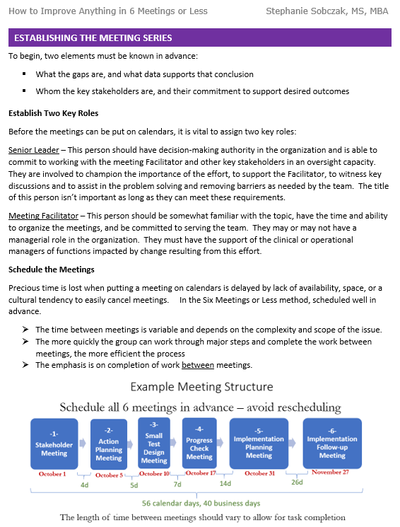
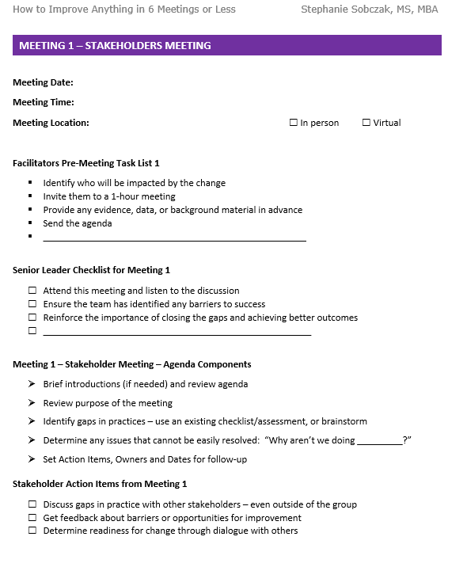
Six Meetings Implementation Guide
Notes:
First tool is the implementation guide.
In addition to the rational and general framework, there is a checklist for each of the 6 meetings. This will help you work through the steps and engage the stakeholders.

Slide 18
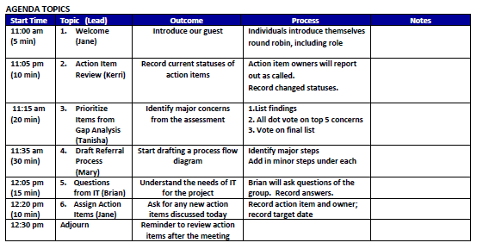
Use Outcome Based Agendas
Check for a variety of participants as leads
OUTCOME: Why the topic is on the agenda AND What is needed as a result
Note start time and how much time will be used.
PROCESS: Describe How the topic will be approached to achieve the outcome AND let people know what they will be asked to do in the meeting.
TOPIC: Ensure detail is included - enough so all understand
Ensure there is a clear owner for each Action Item assignment
Notes:
The second tool is the Outcome Based Agenda format. This was developed by a well-known group facilitation expert, Sam Kaner.
This is a powerful agenda design as it puts a focus on achieving outcomes and fully engaging those in the room.
Meetings conducted in this way are efficient and very productive.

Slide 19
Documenting Progress – The A3
Logo here
This can be any similar tool; any format
Notes:
Another tools is the classic A3 framework.
A3’s can be used with PDSA or PDCA projects, DMAIC, or in this case FOCUS-PDCA; where on the left we define the root causes and select an improvement
And on the right is our cycles of testing and results.

Slide 20
Case Study
Care coordination issue with an external facility
There were problems with hand-offs between a residential care facility for persons with intellectual disability, EMS and hospital ED.
These patients were typically non-communicative
Caregiver presence and their knowledge about the patient varied
Near miss safety events were documented x 2 in one month
A “Blue Folder” one-page intake form, brought with the patient, is used with area skilled nursing facilities
A “Red Folder” might be a solution, but the team discovers the “Blue folder” compliance has declined after implementation
→ The team is exploring options for closing these gaps.
Notes:
This slide should be after your content.
The key takeaways are a nice way to summarize the most important ideas, and completes the circle of your session.

Slide 21
Key Stakeholders
ED Physicians and Residents
ED RNs x 36
Director Acute Services
ED Manager and 4 Supervisors
PATIENT
Care Coordination RNs & SW
12 ED Techs
Quality & Compliance
Care Facility Staff
EMS
Nursing Education
A visual depiction of all stakeholders can be helpful
Notes:
Improvement projects often a a complex set of stakeholders. In this specific case, this is the universe of people who will be impacted by the work of this team.
One of the early decisions is who really should be invited to the meetings.
In my experience the more you can engage the people working with patients versus those occupying offices, the easier the implementation.
The front-line will make or break any change effort.

Slide 22
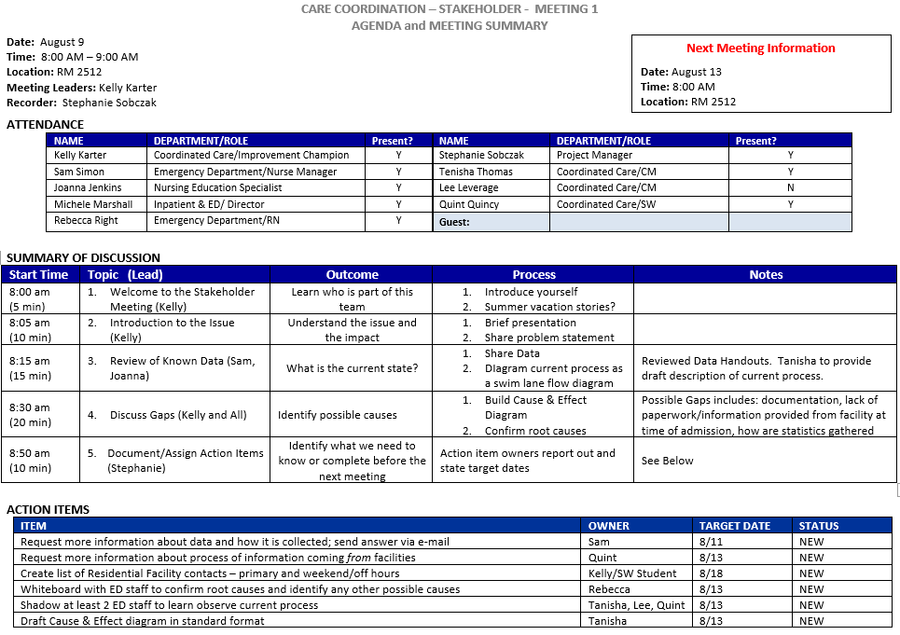
Meeting #1
SUPER IMPORTANT!

Slide 23
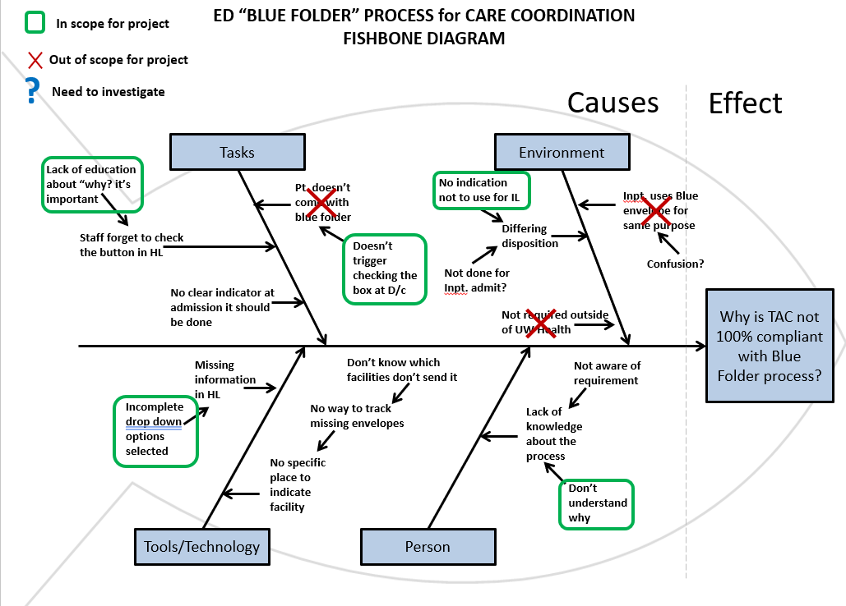
Work Product from Meeting #1
Notes:
This slide should be after your content.
The key takeaways are a nice way to summarize the most important ideas, and completes the circle of your session.

Slide 24
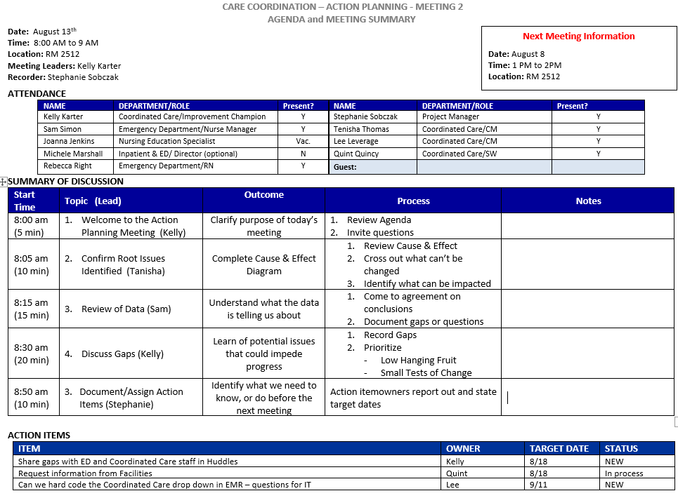
Meeting #2
4 days later
Completed action items come off the list
Notes:
This slide should be after your content.
The key takeaways are a nice way to summarize the most important ideas, and completes the circle of your session.

Slide 25
Information Flow between Meetings
Team Meeting
Action Items
Dialogue with Others
Dept Huddles
Front Line Individuals
Feedback Loop to Leaders
Bring Info Forward
Team Meeting
Work Product from Meeting #2
Notes:
Another paradigm shift is to talk about the findings outside of the meeting.
Share the work documents
Speak about the findings in huddles
Loop the dialogue between staff and leaders
You want any wisdom gathered outside the meeting to come back into the meeting

Slide 26
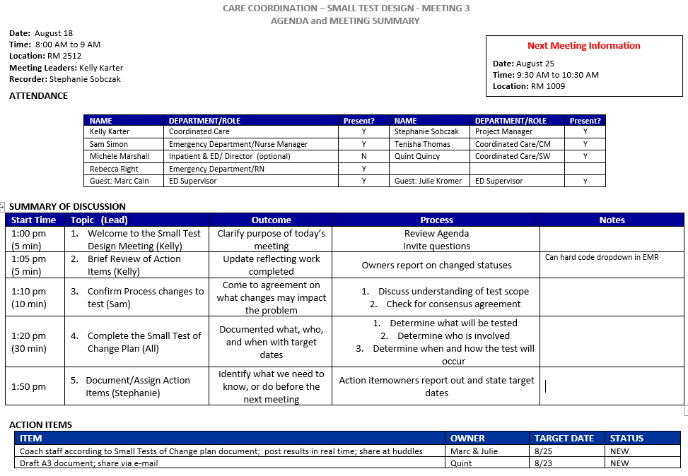
Meeting #3
5 days later

Slide 27
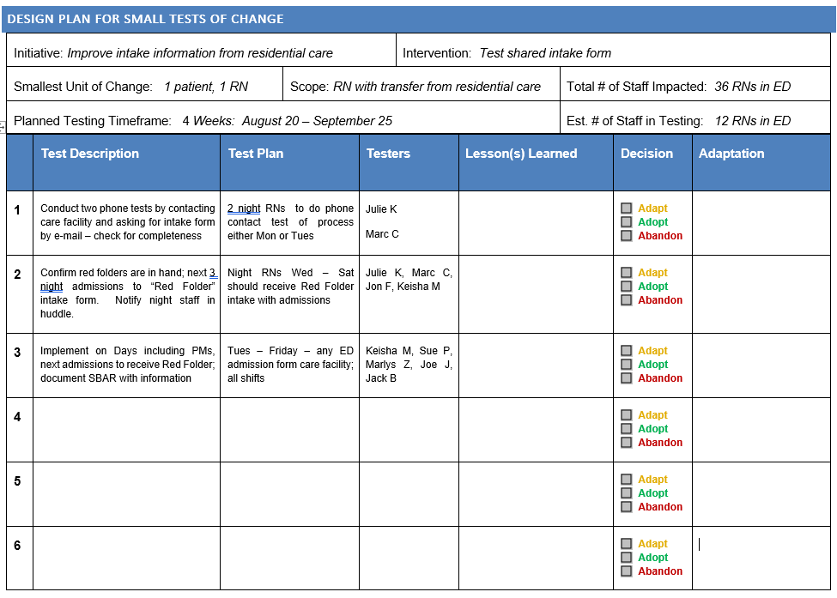
Work Product from Meeting #3

Slide 28
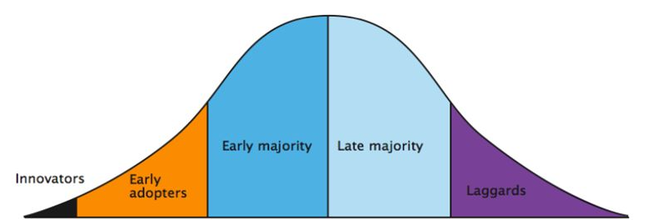
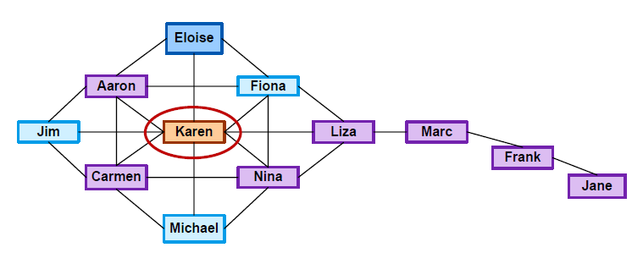
Engage the Engaged!
Identify the early adopters
Leverage the social network
Understanding this is important for successful change adoption
Notes:
They is a key point in the effort.
If we’ve not understood who our early adopters are, or who our key network influencers are, we can set ourselfs up to fail.

Slide 29
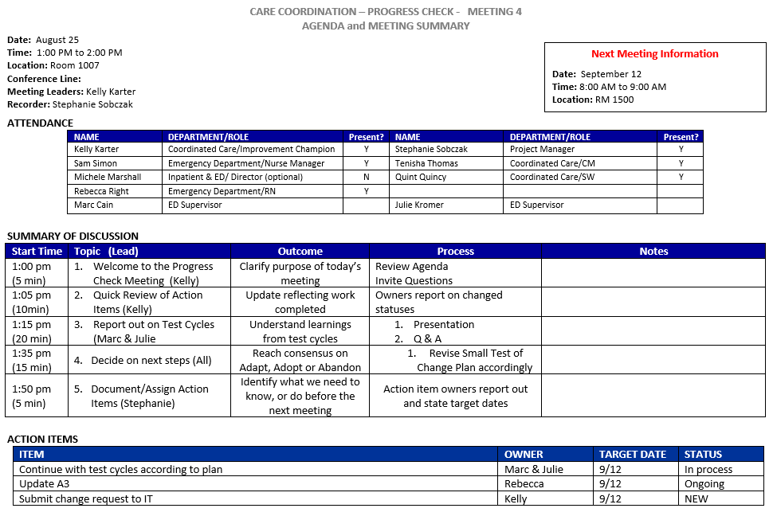
Meeting #4
7 days later
Notes:
This slide should be after your content.
The key takeaways are a nice way to summarize the most important ideas, and completes the circle of your session.

Slide 30
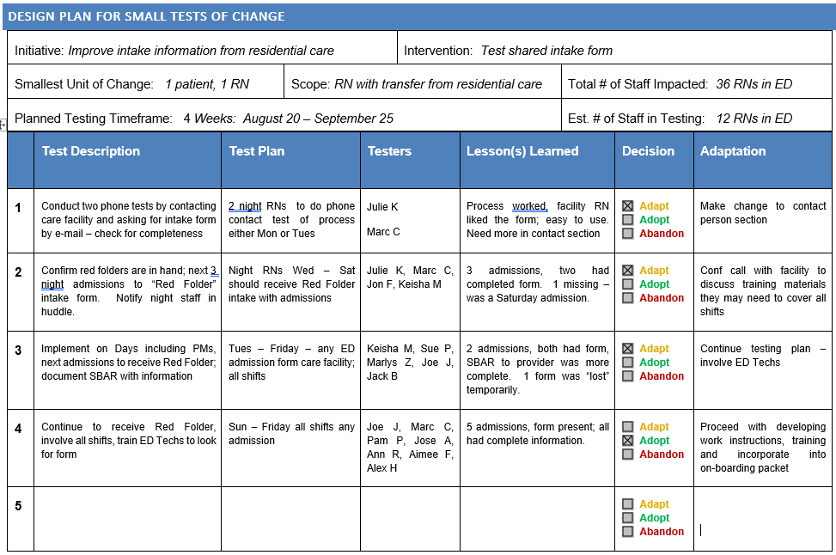
Work Product from Meeting #4

Slide 31
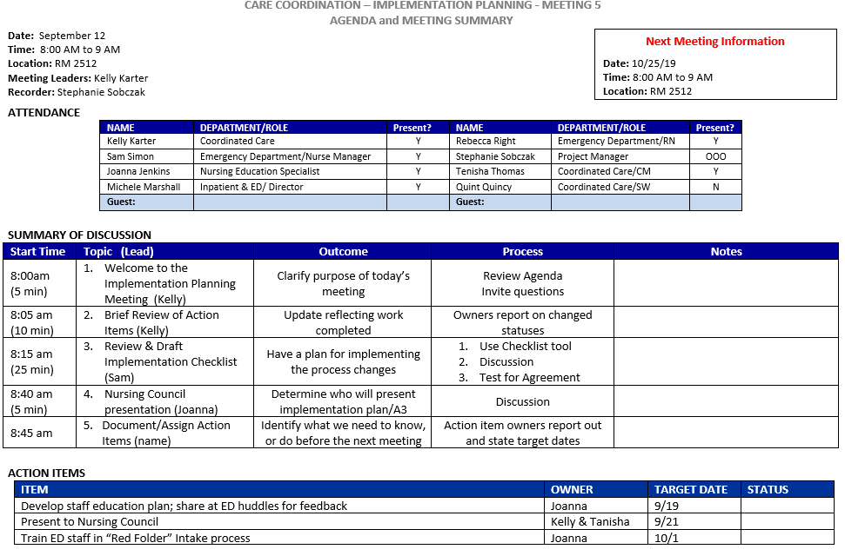
Meeting #5
15 days later
Notes:
This slide should be after your content.
The key takeaways are a nice way to summarize the most important ideas, and completes the circle of your session.

Slide 32
Ready to Implement?
Work Product from Meeting #5
Implementation Checklist:
The tested process is stable and can be documented
Process is immune to census/staffing
Ready to train others; plan for how
Ensure policy, procedure, work instructions, etc. are accounted for
Leadership supports formal adoption
Defined accountability for sustaining results

Slide 33
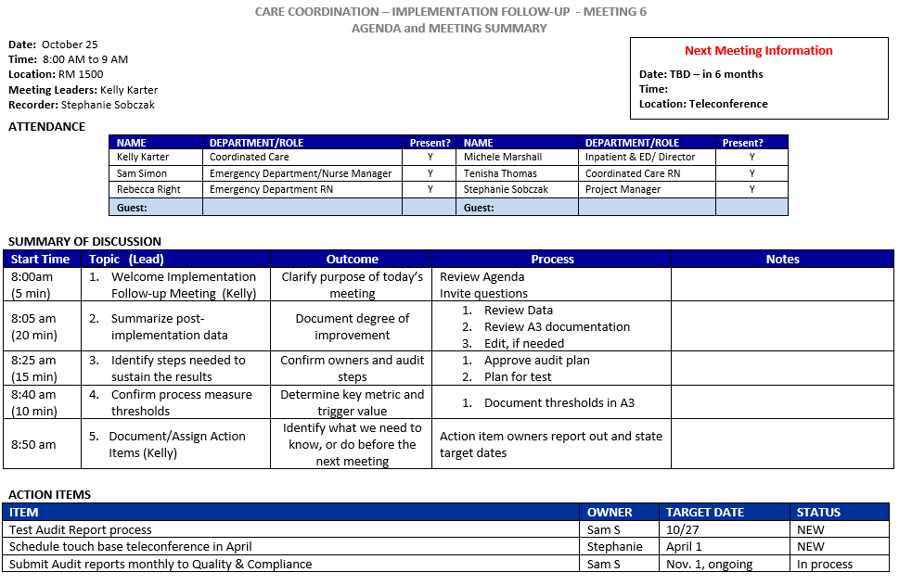
Meeting #6
43 days later
Notes:
This slide should be after your content.
The key takeaways are a nice way to summarize the most important ideas, and completes the circle of your session.

Slide 34
Transition Plan
Work Product from Meeting #6
This is included on the back of the Small Test of Change Design document

Slide 35
Documented outcome
Process map
Education plan
Work instructions
Audit plan
Clear accountability

Slide 36
Why does this approach work?
Shifting Paradigms!
Group membership is flexible based on need in the meeting. (This isn’t a “club”)
It is easier to recruit participants from operations for a defined length of time
Actively discuss with others the work of the improvement team in real time
Less focus on filling out the “right” document: A3 or PDSA or DMAIC – and taking meeting time to do it. Pro tip: this can be done on the side
Progress is steady so people do not lose interest
The front-line is “in the loop” from the beginning – results in less resistance later!
Crystal clear expectations for accountability and consistent leader involvement as an antidote to cultural “sludge”
Notes:
This slide should be after your content.
The key takeaways are a nice way to summarize the most important ideas, and completes the circle of your session.

Slide 37
Recommendations
Start with something lower risk and smaller in scope, conduct 2-3 projects
Make the defined deliverables an expectation
Works well with a ‘train the trainer’ model of spread
Front-line staff have led projects with this method
Engage the leader
Keep them apprised of the progress of the improvement
Also - Highlight the “Meta” improvements that result from the method: Consistency, Accountability, Rapid Adoption, Engaging the front line

Slide 38
#1 Takeaway
Notes:
This slide should be after your content.
The key takeaways are a nice way to summarize the most important ideas, and completes the circle of your session.

Slide 39
Questions

Slide 40
Contact Information
Stephanie Sobczak MS, MBA Project Manager
Certified Just Culture™ Champion
UW^{Health} at The American Center
SSobczak2@uwhealth.org

