Slide 1
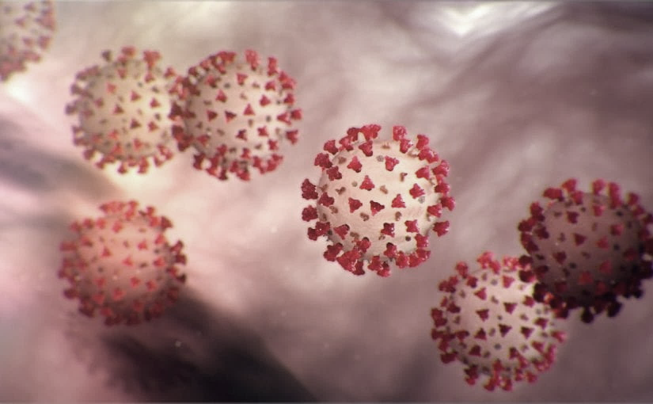
Covid-19 Webex Update 6-10-20
Tom Safranek, MD, State Epidemiologist
Louis Safranek, MD, PhD
Board Certified Specialist Infectious Disease

Slide 2
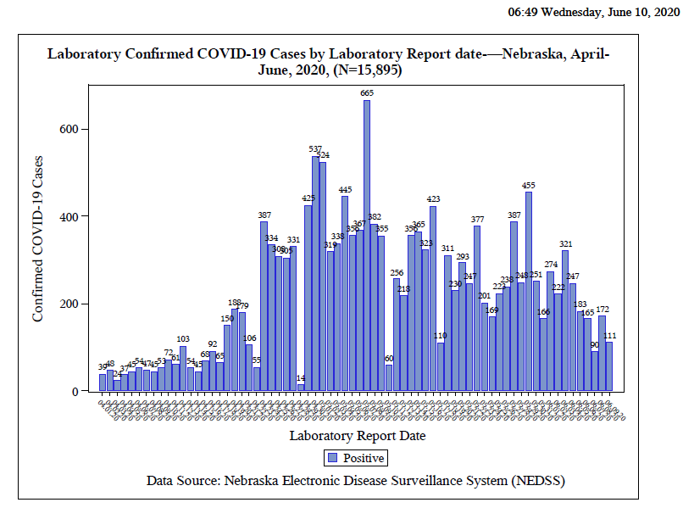

Slide 3
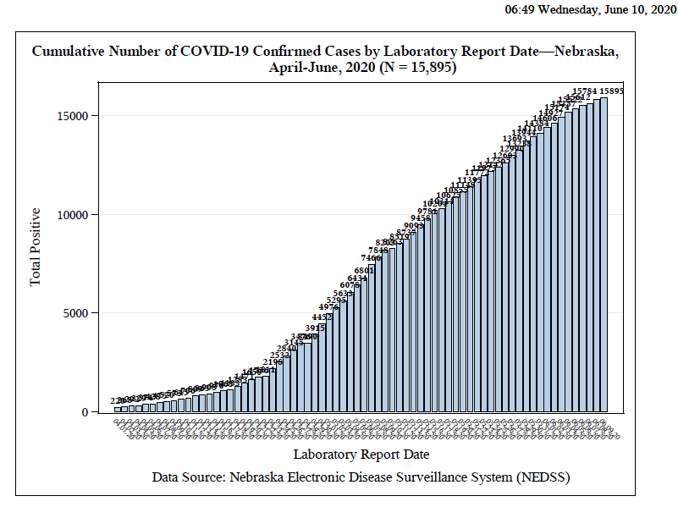

Slide 4
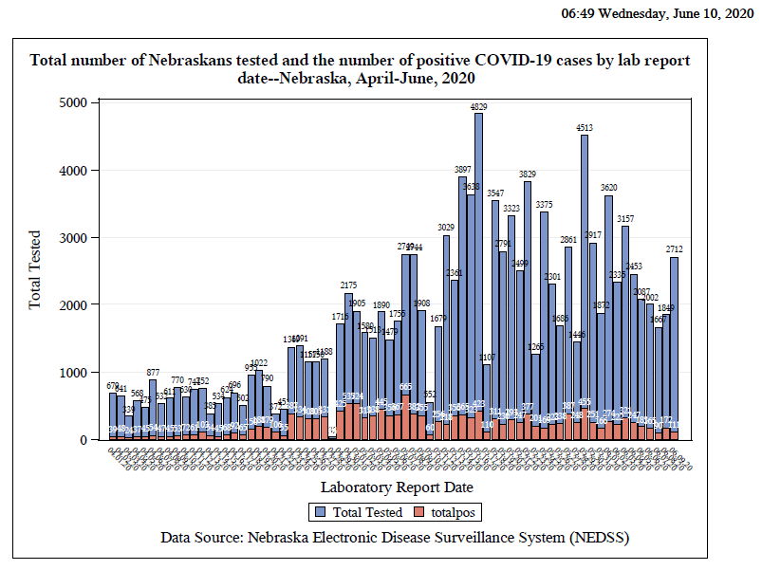

Slide 5
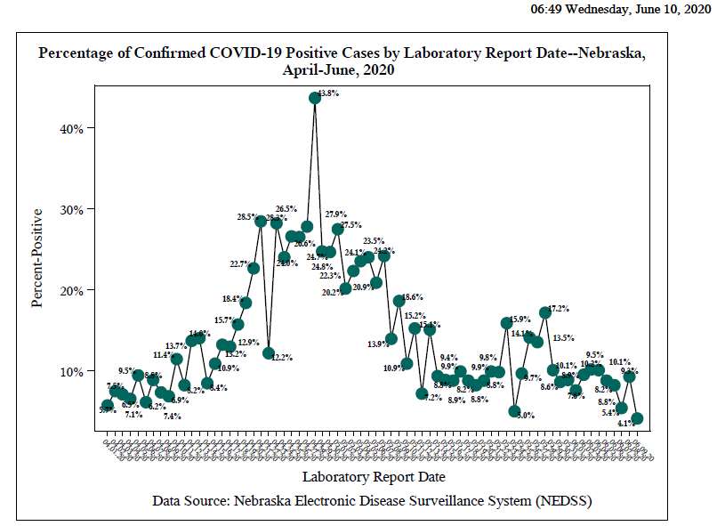

Slide 6
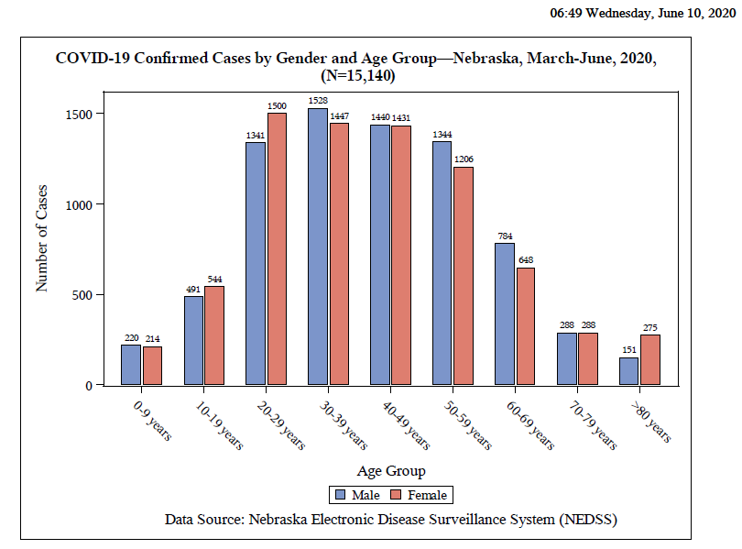

Slide 7
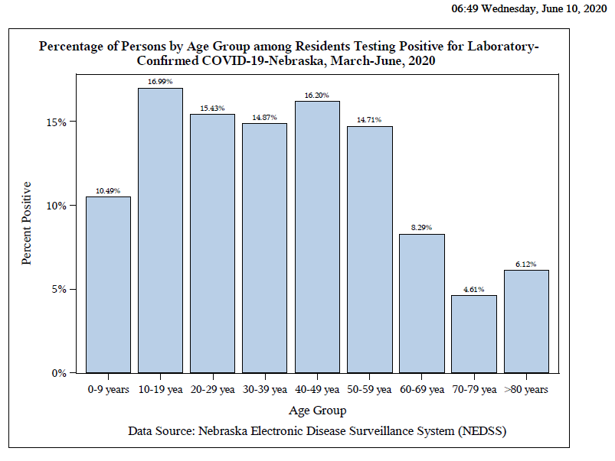

Slide 8
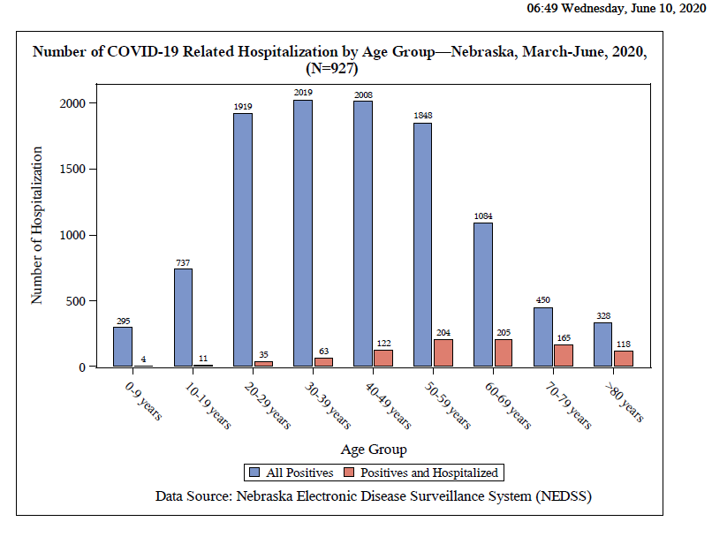

Slide 9
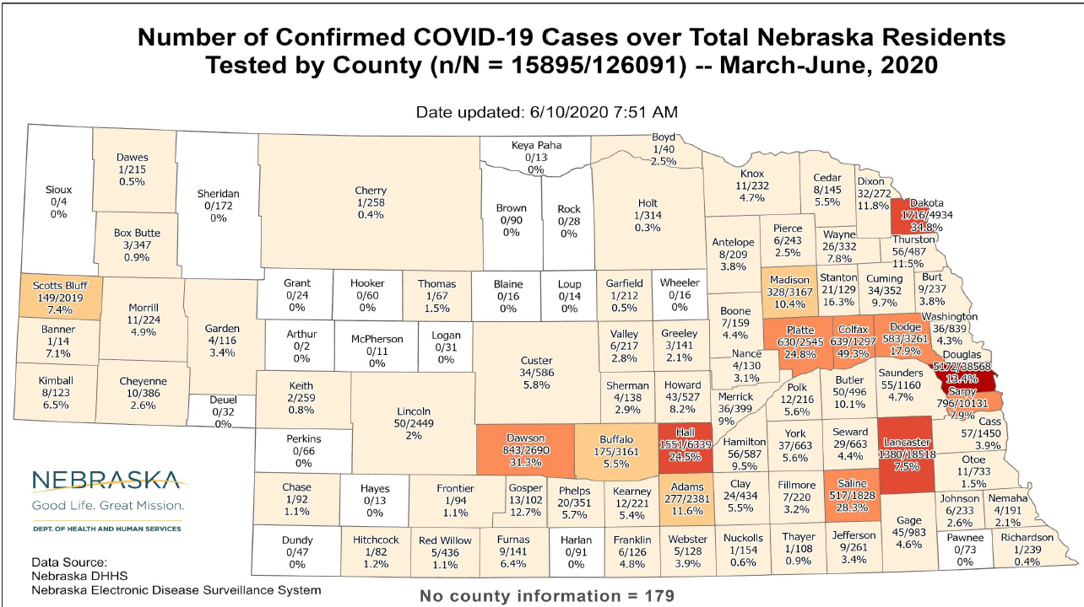

Slide 10
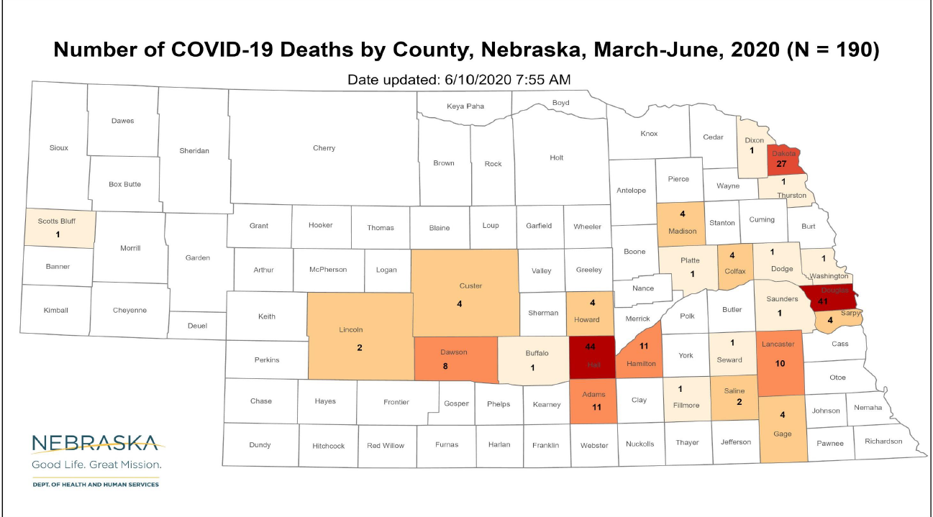

Slide 11
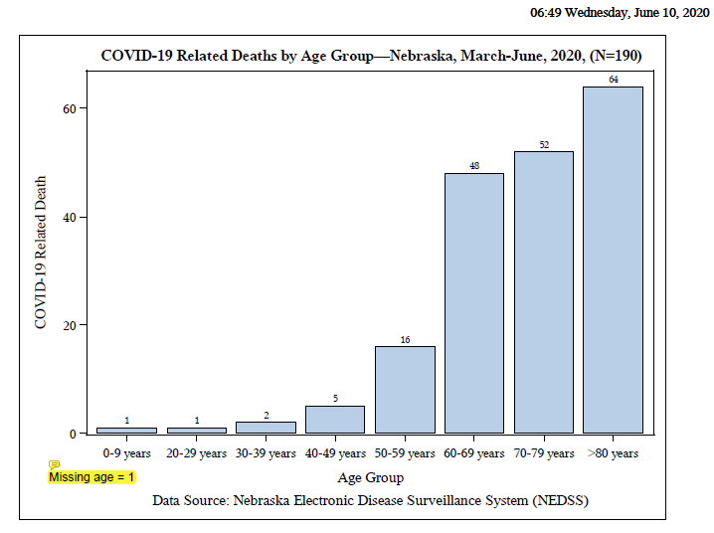

Slide 12
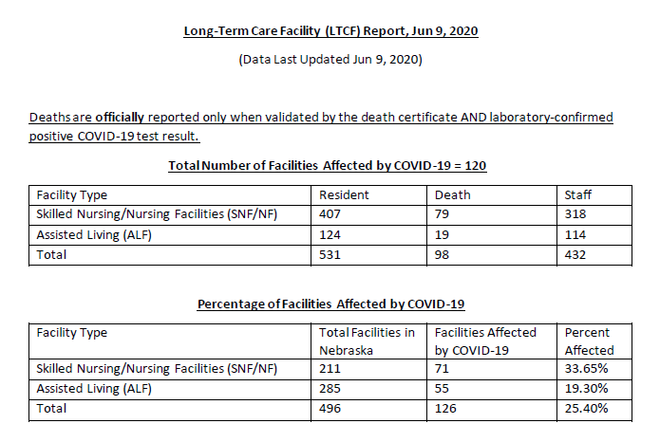
Long-Term Care Facility Report

Slide 13
Pre-Surgical and Pre-Op COVID testing
NPHL CANNOT accept pre-surgical or Pre-op specimens for COVID testing
These tests should be sent to commercial labs:
Nebraska Medicine
CHI
Physicians laboratory
Bryan Medical Center
Regional West

Slide 14
Hydroxychloroquine Update
New England Journal and Lancet retracted prior studies published
Data analysis company- methods and ability to gather data has been questioned
New England Journal published a recent study out of Minnesota (Dr. Boulware) concluding no significant difference in patients who received placebo, no evidence of benefit.
https://www.nejm.org/doin/full.10.1056/NEJMoa2016638

Slide 15
Face Masks
Continue to recommend face masks in the community.
Any type of mask is better than none.
Masks may provide the wearer with protection, but in addition…
Masks may protect others in the vicinity by reducing their level of viral exposure.
Low intensity exposures may lead to milder disease.

Slide 16
Lessons from individuals who have had repeated SARS-CoV-2 testing
Paper from NYC in Journal of Clinical Microbiology
https://jcm.asm.org/content/jcm/early/2020/06/08/JCM.00995-20.full.pdf
3432 patients who underwent repeated testing
2413 initially negative, 802 initially positive.
Of those undergoing repeat testing, about 40% were positive at some point (compared to 50% for those tested only once).

Slide 17
Initial negatives
Of initially negative patients who were retested, 20% eventually tested positive. Thus, a negative test predicted a subsequent negative test 80% of the time.
About 5% retested the same day as the initial negative test were positive; after that 0.5-1.0 of those retested were positive, totaling eventually 20% of all initially negative patients (up to 23 days).
Most conversions (N-P) occurred 10 days or less after onset of symptoms, with the mean interval between an initial negative test result and the first positive result was 9.4 days.

Slide 18
Initial test sensitivity
Only 60% of those who would test positive at any point were detected on the first test.
Of those who tested positive on the first day, 95% were positive on the initial test.

Slide 19
Initial test positive
Less than 10% of the patients who converted to negative converted before 15 days after onset of symptoms or 10 days after initial testing.
50% convert to negative only at 28 days after initial positive test.

Slide 20
Flippers
60 patients were flippers (11 NPN, 49 PNP).

Slide 21
What is the sensitivity of an initial test?
Sensitivity could be as low as 60% and is unlikely to be better than 95%.

Slide 22
Conclusions
Patients with a high clinical suspicion or exposure setting should undergo laboratory testing; it is appropriate to repeat the test the same day or on subsequent days if the results are initially negative and there is high suspicion or prevalence of COVID-19.

Slide 23
Conclusions
For patients with a positive SARS-CoV-2 molecular assay result, repeating the test before at least 15 days after the first test is unlikely to yield a negative result.
Whether patients who continue to be positive remain infectious is unknown, but seemingly not.

Slide 24
Are retest-positive cases infectious?
No.
https://www.cdc.go.kr/board/board.es?mid=a30402000000&bid=0030

Slide 25
Questions Awaiting Answers
How does a particular viral load at any point relate to infectivity?
Does demonstration of IgG antibody signal lack of infectivity?

Slide 26
Return to Work Strategies
Time based strategy: Return to work 10 days after the first positive test for asymptomatic patients; for symptomatic patients,
Symptom based strategy: Return to work 10 days after onset of symptoms.
Test based strategy: resolution of fever and improving symptoms and 2 negative COVID assays.

