Slide 2
Coping With Stress and Burnout
STRATEGIES FOR DEALING WITH BURNOUT AND STRESS IN THE WORKPLACE

Slide 3
employee burnout
A syndrome conceptualized as resulting from chronic workplace stress that has not been successfully managed.
The three dimensions of employee burnout are feelings of energy depletion or exhaustion; increased mental distance from one’s job or feelings of negativism or cynicism related to one’s job; and reduced professional efficacy.
Sources:
World Health Organization. (2019). Burn-out an "occupational phenomenon": International classification of diseases. Retrieved from https://www.who.int/mental_health/evidence/burn-out/en/
ICD-11: International classification of diseases 11th revision. (2018). World Health Organization. Retrieved from https://icd.who.int/en/

Slide 4
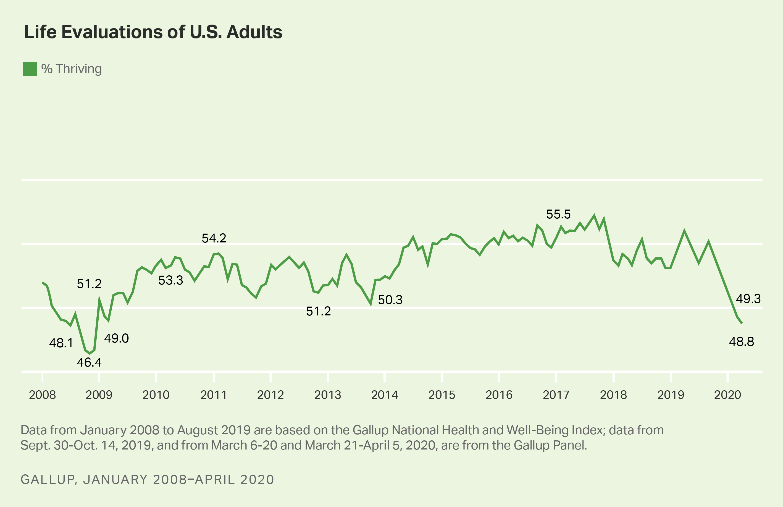
Wellbeing is plummeting as worry and stress have spiked to unprecedented levels
Many leaders are rightfully concerned about the declining wellbeing and the threat it poses to clinical productivity and clinical care performance.
+
Percentage who are "thriving" has dropped to Great Recession (2009) levels
+
Daily significant stress and worry have spiked with unprecedented magnitude
+
There is significant anxiety about personal finances as financial situations only worsen
+
People indicate their mental health will suffer before their physical or financial health does
=
76%
say they have experienced a great deal or fair amount of life disruption
Notes:
Wellbeing is cratering and stress and worry is spiking at unprecedent speed and magnitude
Jim harter march 18 2022-more recent data on wb

Slide 5
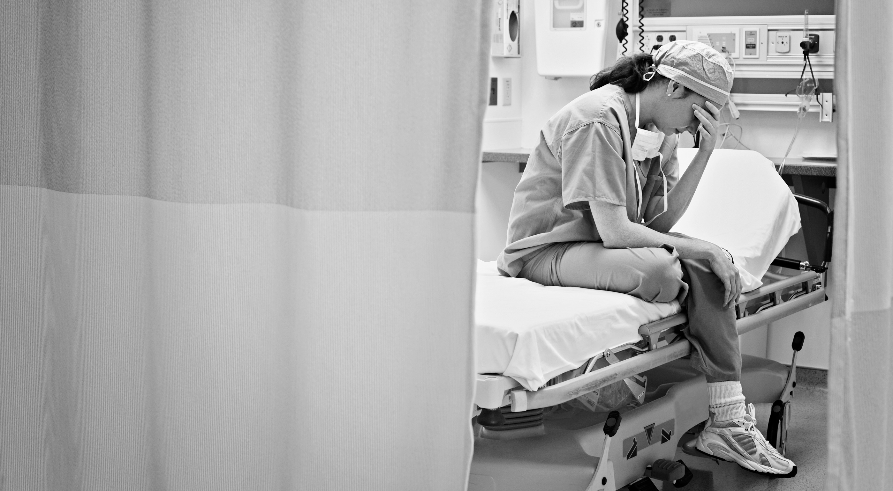
EMPLOYEE BURNOUT IS A WIDESPREAD PROBLEM
76%
OF FULL-TIME EMPLOYEES
experience feeling burned out on the job at least sometimes.
28% report feeling burned out at work “very often” or “always,” while an additional 48% report feeling burned out “sometimes.”
Source:
2019 Gallup study
Notes:
Burnout is a work-related stress syndrome resulting from chronic exposure to job stress. symptoms characterized by "feelings of energy depletion or exhaustion; increased mental distance from one’s job, or feelings of negativism or cynicism related to one's job; and reduced professional efficacy".

Slide 6
Signs/Symptoms: Characteristics of Burnout at Different Stages
CHRONIC STRESS
BURNOUT
HABITUAL BURNOUT
Persistent tiredness
Procrastination
Resentfulness
Social withdraw
Chronic exhaustion
Feeling pressured
Obsession with problems
Pessimistic outlook
Self-doubt
Social isolation
Behavioral changes
Chronic sadness
Chronic mental fatigue
Chronic mental fatigue
Depression
Depleted or exhausted
Mentally distant from their job or negative feelings or cynicism about their job
Reduced professional efficacy
THEMES
Source:
De Hert S. Burnout in Healthcare Workers: Prevalence, Impact and Preventative Strategies. Local Reg Anesth. 2020;13:171-183 https://doi.org/10.2147/LRA.S240564

Slide 7
The First Five: Root Causes of Burnout
Five factors correlate most highly with employee burnout. We call these “root causes” because they have the greatest effect on burnout. Here’s what you can do about it:
1
UNFAIR TREATMENT AT WORK
Deal with bias, favoritism and mistreatment.
YOUR TOP PRIORITY: Address the Root Causes of Burnout
Create a culture where employees can do their best work.
2
UNMANAGEABLE WORKLOAD
Help employees focus on what they do best.
3
UNCLEAR COMMUNICATION FROM MANAGERS
Regularly discuss responsibilities, priorities.
4
LACK OF MANAGER SUPPORT
Managers support provide a psychological buffer. Ask “I want to be the best boss you’ve ever had. What can I do to get there?”
5
UNREASONABLE TIME PRESSURE
Recognize willingness to go the extra mile.
Notes:
Unfair treatment from managers, teammates and/or executive leadership. From Gallup: “Unfair treatment can include all kinds of workplace issues, from bias, favoritism and mistreatment by a coworker to inconsistently applied compensation or corporate policies. When employees do not trust their manager, teammates or executive leadership, the psychological bond that makes work meaningful breaks. Conversely, when employees are treated fairly and feel respected, strong relationships form quickly, and employees are more resilient.”

Slide 8
The Next Five: Preventing Burnout
Beyond personally addressing and helping leadership solve the five root causes, managers should focus on action items that reflect the five next-highest correlates of burnout.
6
LISTEN TO WORK-RELATED PROBLEMS
Invest in awareness, time and attention. Check in frequently. Ask “how are you doing today?”
MANAGERS: Turn Your Team From Burned Out to Built Up
Ensure that employees feel supported.
7
ENCOURAGE TEAMWORK
Create an environment where teamwork thrives. Recognize teamwork and call it out when you see it.
8
MAKE EVERYONE’S OPINION COUNT
Listen until someone feels heard and leverage shared governance forums.
9
MAKE WORK PURPOSEFUL
Personalize your purpose. Remember the bigger picture—changing lives one patient at a time.
10
FOCUS ON STRENGTHS-BASED FEEDBACK AND DEVELOPMENT
Help employees do their best work—call out their strengths and reinforce the good work they are doing.
Notes:
conversations into meetings and gatherings where managers can reflect on common scenarios and share best practices with peers.

Slide 9
ONE OF GALLUP’S BIGGEST DISCOVERIES:
It’s the manager.
The primary determinants of burnout are largely a reflection of how effectively someone is managed.
Leaders can prevent and reverse burnout while increasing productivity by understanding what causes burnout and fostering a work environment that combats it.

Slide 10
Managers play a significant role in reducing stress and loneliness during COVID-19, primarily by providing regular meaningful feedback.
% EMPLOYEES STRESSED DURING COVID-19
Meaningful feedback also reduces feelings of loneliness by up to 11 pts. during COVID-19.
Strongly Agree
77% | 57%
74% | 61%
Feel well prepared to do my job
Use all opportunities like safety huddles, shift report, rounding to provide feedback.
Not Strongly Agree
Not Strongly Agree
Strongly Agree
Received meaningful feedback in the last week
Notes:
The manager is one of the greatest causers or mitigators of stress
They can reduce stress by 25% during COVID-19

Slide 11
Invest in Your Wellbeing
What should wellbeing look like to employees? Gallup’s research has found five essential elements that differentiate thriving lives from those that are struggling or suffering.
GALLUP WELLBEING MODEL
CAREER
ELEMENTS OF WELLBEING
Elements of Wellbeing
Career: Do you like what you do each day and are you motivated to achieve your goals?
Social: Do you have supportive relationships and love in your life?
Financial: Are you managing your economic life to reduce stress and increase security?
Community: Do you like where you live, feel safe and have pride in your community?
Physical: Do you feel you have good health and have enough energy to get things done daily?
PHYSICAL
SOCIAL
COMMUNITY
FINANCIAL

Slide 12
Coping With Stress and Burnout at the Individual Level
You can't help others with their wellbeing if you don’t help focus on your own wellbeing.
FOCUS ON YOURSELF: Self Care
1
INVEST IN YOUR OWN WELLBEING
Choose an activity—but be consistent.
Invest in your own wellbeing and resilience.
2
DISCONNECT
From information, news—often and consistently.
3
DON’T LET MULTI-TASKING EXHAUST YOU
Focus your energy on mono-tasking.
4
GET HELP. GIVE HELP
Ask for (and give) support and care.
5
THINK OF WORK AS SPRINTS, NOT AS ONE LONG MARATHON
Take meaningful breaks that fuel your energy.

Slide 13
Coping With Stress and Burnout at the Team Level
Managers are your best solution for burnout when they take time to learn the causes of burnout and are open to changing how they manage their teams.
MANAGERS: Turn Your Team From Burned Out to Built Up
1
DETERMINE TEAM’S BURNOUT FACTORS
Discuss them with team members on an ongoing basis.
Commit to addressing burnout
2
EXAMINE MANAGEMENT STYLE
Help managers examine how their habits, communications and management style could be causing or mitigating burnout.
3
MAKE BURNOUT A FOCUS
Incorporate burnout-related conversations into meetings and gatherings where managers can reflect on common scenarios and share best practices with peers.
Notes:
conversations into meetings and gatherings where managers can reflect on common scenarios and share best practices with peers.

Slide 14
What Followers Need
Trust: Be predictable in an unpredictable time
Stability: Provide psychological safety
Compassion: Show care. Back it up with policy
Hope: Inspire others to what is possible

Slide 15
Copyright Standards
This document contains proprietary research, copyrighted materials and literary property of Gallup, Inc. It is for the guidance of your organization only and is not to be copied, quoted, published or divulged to others outside your organization. All of Gallup, Inc.’s content is protected by copyright. Neither the client nor the participants shall copy, modify, resell, reuse or distribute the program materials beyond the scope of what is agreed upon in writing by Gallup, Inc. Any violation of this Agreement shall be considered a breach of contract and misuse of Gallup, Inc.’s intellectual property.
This document is of great value to Gallup, Inc. Accordingly, international and domestic laws and penalties guaranteeing patent, copyright, trademark and trade secret protection safeguard the ideas, concepts and recommendations related within this document.
No changes may be made to this document without the express written permission of Gallup, Inc.
Gallup® and Gallup PanelTM are trademarks of Gallup, Inc. All rights reserved. All other trademarks and copyrights are property of their respective owners.

