Slide 1
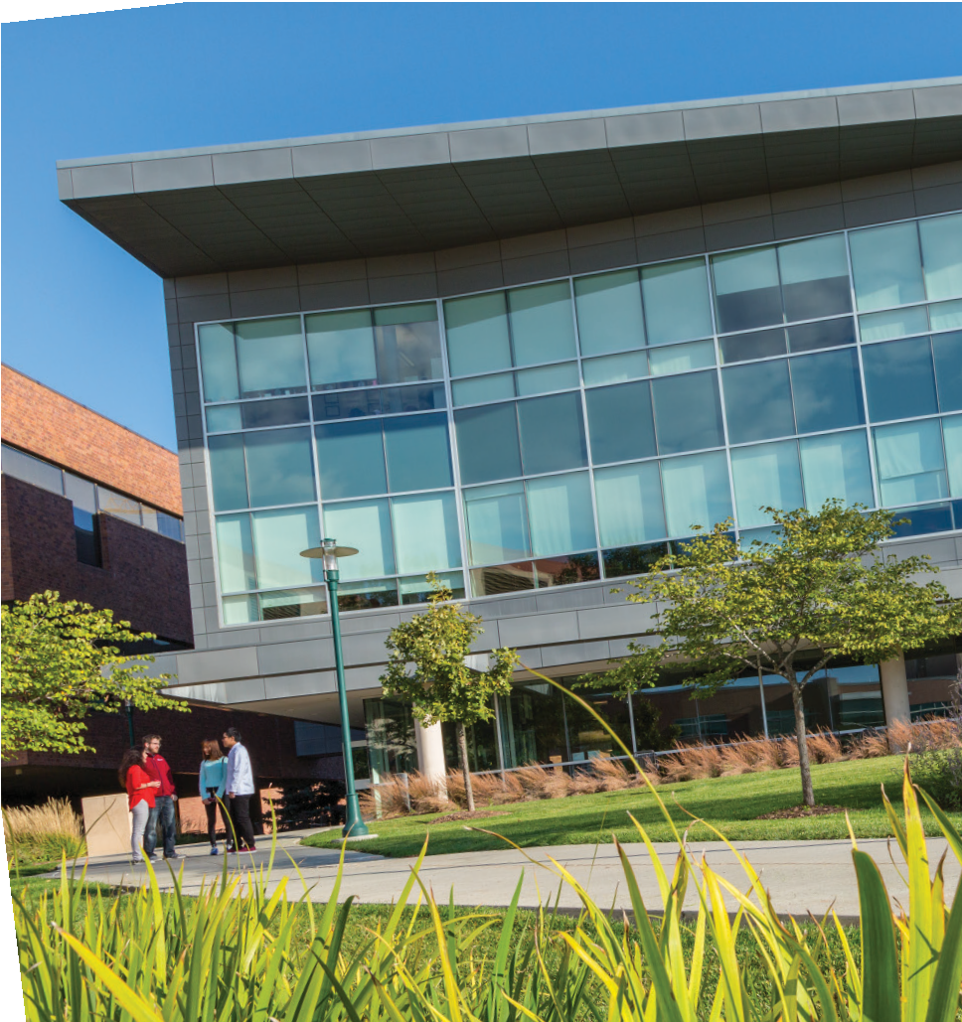
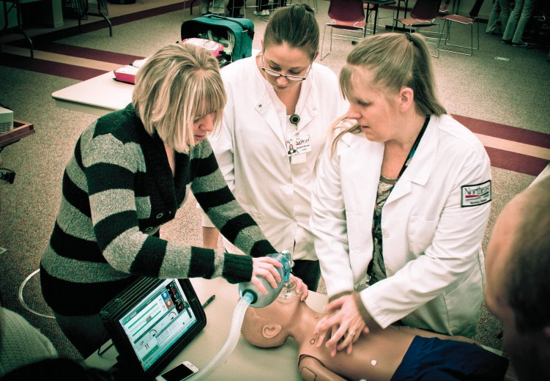
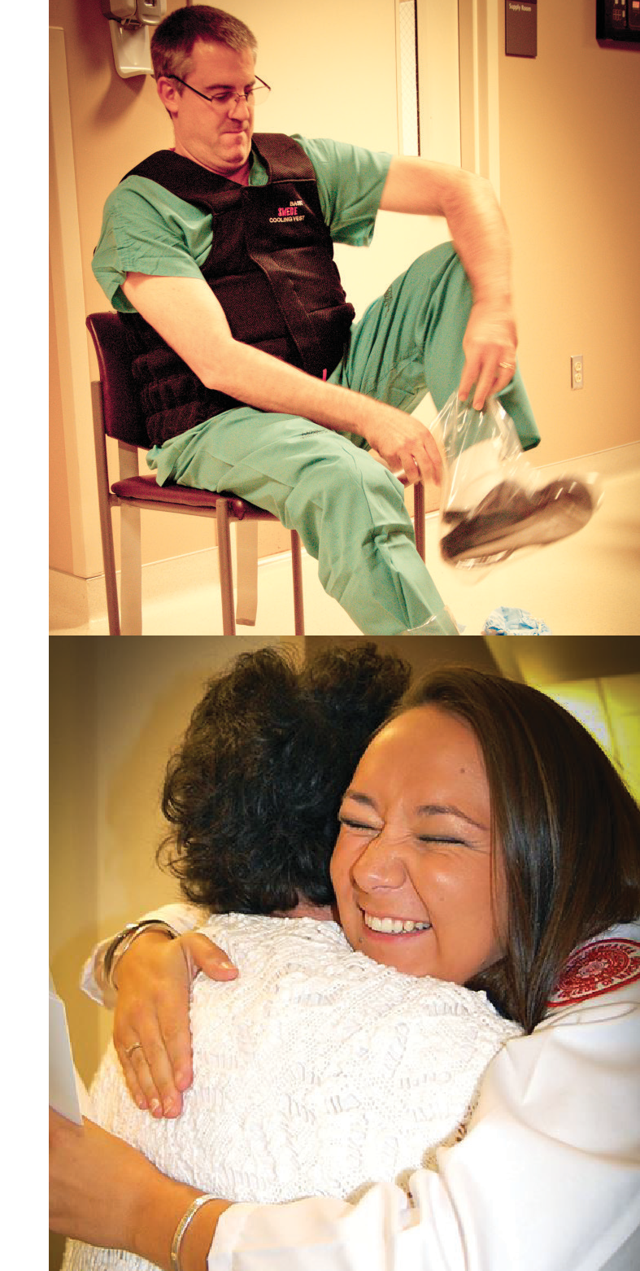
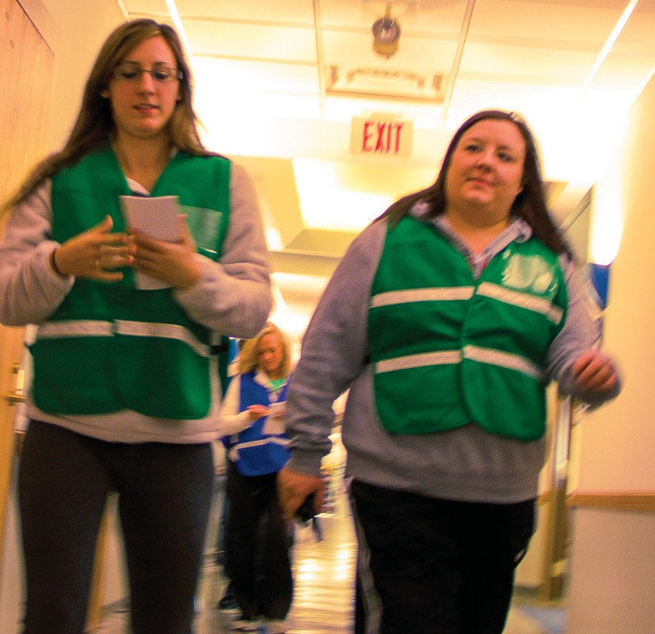
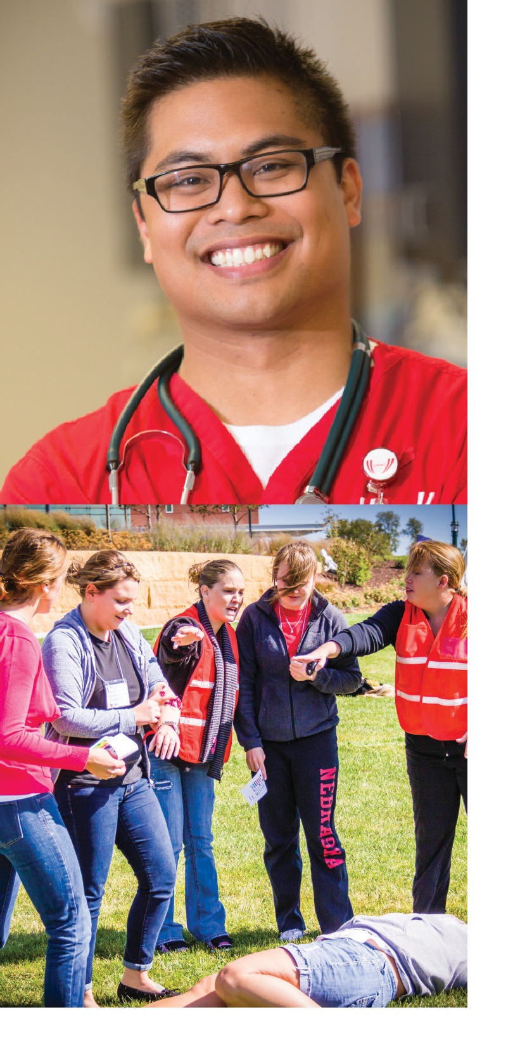
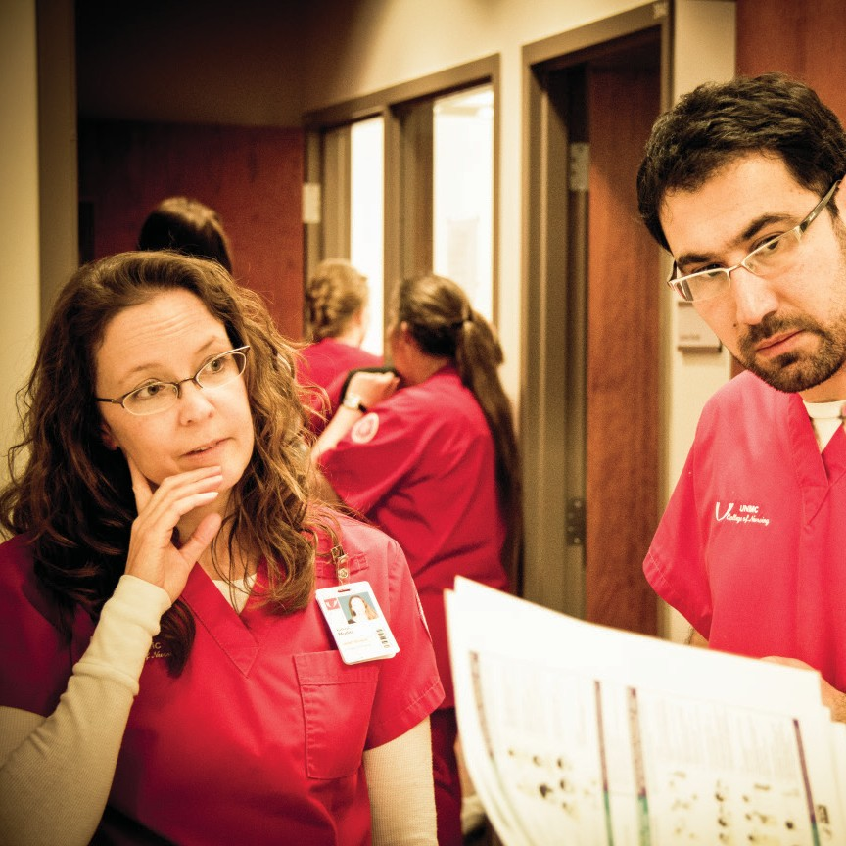
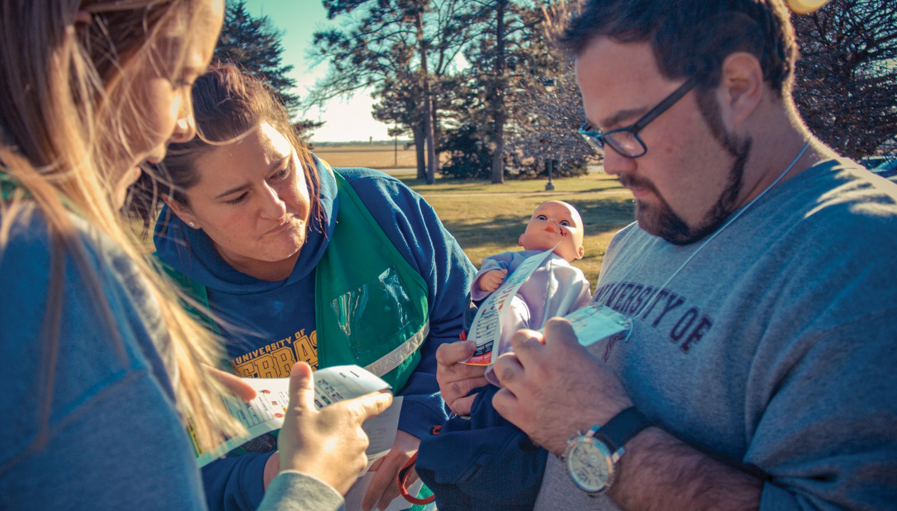
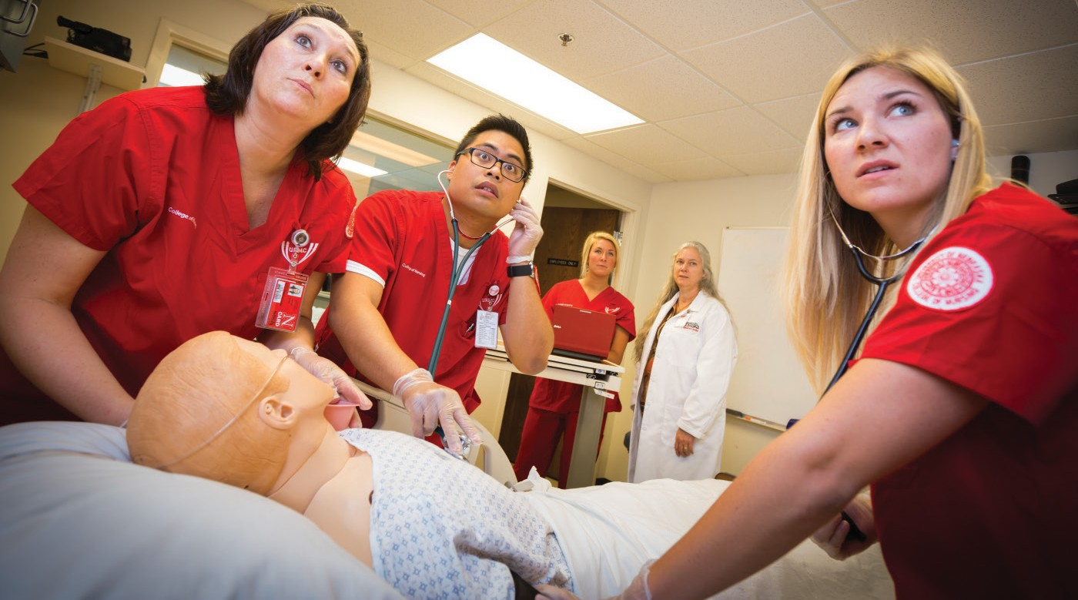
YOU BELONG HERE
U N I V E R S I T Y O F N E BR AS K A ME D IC A L C E NT E R
COLLEGE OF NURSING
Discover career and educational pathways.
RN-BSN | MSN | DNP | PhD
Online and hybrid programs with live-streamed classes.
Stay close to home with no or minimal required campus time.
See why you belong here — unmc.edu/nursing

Slide 2
Nebraska Forecast
SHORTAGE – NE Action Coalition
Year | RNs | APRNs
2019 | 2,849 | 418
2020 | 2,482 | 423
2021 | 2,547 | 457
2022 | 2,660 | 479
2023 | 2,821 | 534
2024 | 3,000 | 555
2025 | 3,238 | 592

Slide 3
Master’s or Doctorate
MSN
Builds on BSN foundation
Focus: Practitioner, Administration, Bedside
DNP or PhD
Builds on prior education
41 to 49 credit hours
72 to 80 credit hours
Terminal degree
Focus: Leadership/System Change, or Research
DNP Project or PhD Dissertation

Slide 4
Specialties
Adult-Gero Primary or Acute Care NP
Family Primary Care NP
Peds Primary or Primary/Acute Care NP
Psychiatric Mental Health NP
Women’s Health NP
Nurse Leader/Executive
Nurse Leader/Exec & MBA Dual

Slide 5
Admissions Process August Start
APPLY: Sept 1 - Feb 1
INTERVIEW: Sept - Feb
ADMIT: March

Slide 6
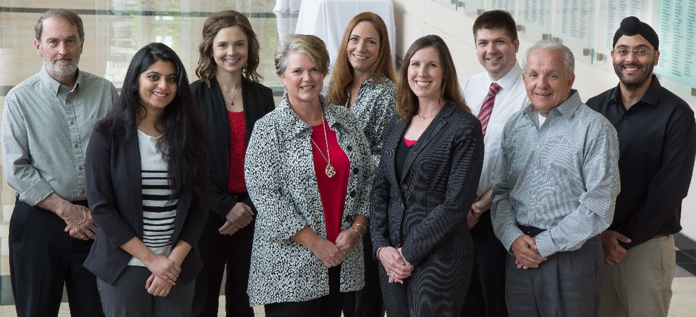
CON Continuing Education

