Slide 1
Leadership in Action
December 8, 2021
Mike Freel, PhD
Mike.Freel@bellevue.edu

Slide 2
Congratulations!
You have successfully committed to your own leadership development by completing the NHA Leadership Institute!
You have embraced 360 degree feedback, coursework, coaching, and the benefits and challenges that come with them!
You are ready to spend some time considering how you can continue to develop as a leader!

Slide 3
QUESTION
If you were to complete the sentences below, what would you say?
“What healthcare needs is……….”
“What I still need to know about leadership is…..”

Slide 4
Healthcare Priorities 2022
What does it mean to be a HIGH RELIABILITY ORGANIZATION?
Collaborative Medicine – who’s in charge?
Leadership
Staffing – turnover, talent acquisition, talent management, knowledge sharing, technology, revenue generation, etc…, etc…, etc…,
Yet, you are still here!

Slide 5
Now that you’re ALMOST DONE,
Let’s Discuss…
What behaviors make a successful leader?
What behaviors make a good follower?
Who are you, as a LEADER?
Who are you as a FOLLOWER?

Slide 6
Leaders and Storytelling
Storytelling is one of the best communication techniques leaders can develop
Stories bring the listener to you on a personal and professional level
Take some time and put your leadership story on a timeline (draw it out)
Remember to include the Leadership Institute
What made you the leader you are today? Tell us your story…
Now, where do you want to go?

Slide 7
Reflections from Leadership Institute
January – December
Becoming more self-aware
Revisit your leadership goals
360 degree feedback
Hidden strengths and black holes
Coaching

Slide 8
Month by Month – What Did You Gain?
What were your learning highlights?
Orientation
Using 360s for Improved Leadership
Conflict and Coaching for Improved Performance
Analyzing Performance Issues
Recruitment and Performance Management/Workplace Diversity
What’s My Type? Temperament at Work
Leading Teams
Today?

Slide 9
How have you become more self-aware?
Self perception – how do you think about yourself differently now?
What did you learn about your hidden strengths and/or black holes?

Slide 10
DISCUSSION Questions
Leadership and followers…… are they the same? You can be given a subordinate, but you can’t be given a follower.
What is your definition of the “ideal” leader?
What is your definition of the “ideal” follower?

Slide 11
What’s the Difference?
Not everyone is a leader – that’s ok
Not everyone wants to be a leader – that’s ok
Management differs from leadership
You can be a leader/follower in multiple settings throughout your day
Leadership/followership is a relationship, and you have many relationships
Friend, employee, student, son/daughter, spouse, roommate, volunteer, etc…

Slide 12
Expectations of Followers
Drive successes of leaders
Followers’ needs, aspirations, values, hopes fears – all allow leadership to arise
Followers ask, “How can this leader help me get what I want/need?”
Leaders meet those needs and then encourage our “best” selves to emerge

Slide 13
The ACTIVE Concept of Followers
Active followers – active in leadership process
Situational followership – you function as a leader/follower based upon the situation
Some prefer not to exert power required to be leader
Some followers are leaders – actively passive or passive aggressive (actively disengaged)
Followers “do” leadership

Slide 14
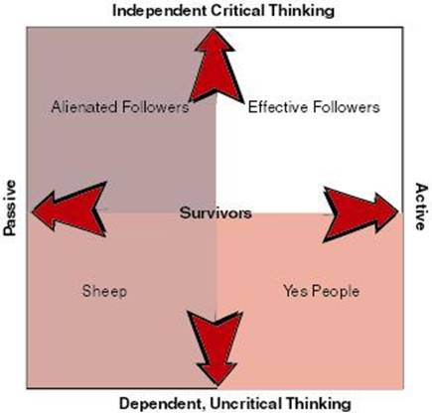
DIMENSIONS of Effective/Ineffective Followers
Critical Thinking
vs.
Engagement

Slide 15
How to ENCOURAGE Excellent Followership
Improve independent/critical thinking
Encourage self-management
Disagreeing agreeably
Building credibility
Align personal and organizational goals
Acting responsibly toward the organization
Understand similarities and differences between leader and follower roles
Move between roles easily

Slide 16
What’s your definition of leadership?
WRITE IT OUT NOW.
How does it compare to what you wrote in the first session back in January?

Slide 17
NEXT Steps
Now… what are your next steps?
What specific steps could you take to build your leadership skills?
Where and how do you want to lead?
How can you achieve those goals?
What can you read?
Who can you keep in touch with?

Slide 18
A private, non-profit institution founded in 1966, Bellevue University is accredited by the Higher Learning Commission through the U.S. Department of Education. For general information, please call 800.756.7920. Faculty Phone: 402.557.7121 Faculty Email: mike.freel@bellevue.edu bellevue.edu

