Slide 1
Where are we now?
Current State of Practice for New Nurses in Nebraska
Tina Pate MSN, RN CEN

Slide 2
Objectives
The current state of nursing workforce in Nebraska
Understanding the importance of a good preceptor experience
Opportunities for improving preceptor and orientation programs

Slide 3
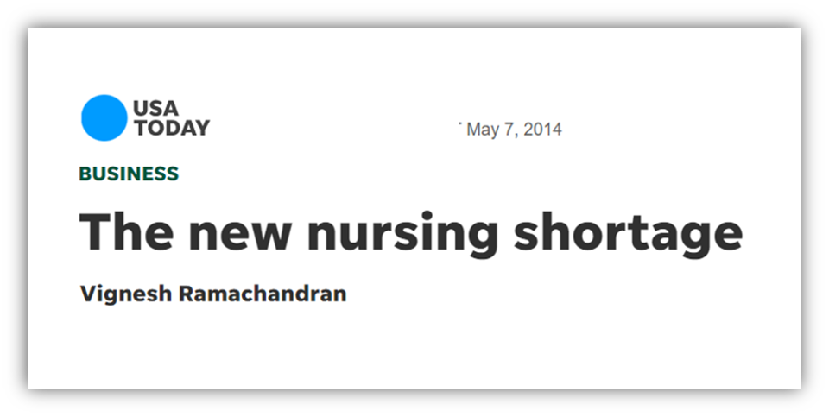
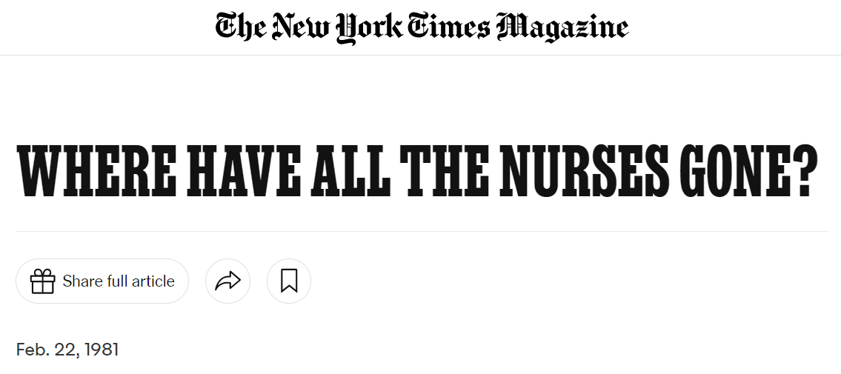
1981
2014

Slide 4



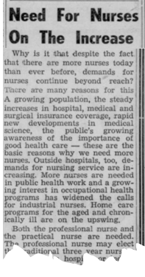
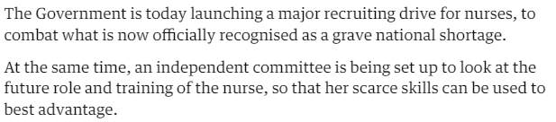
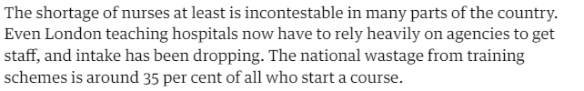
1970
1960

Slide 5

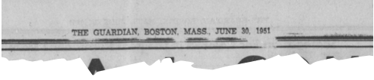
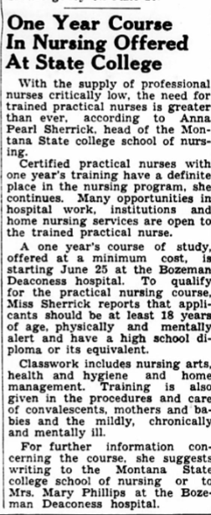
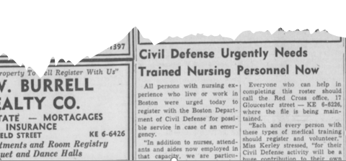
1951

Slide 6
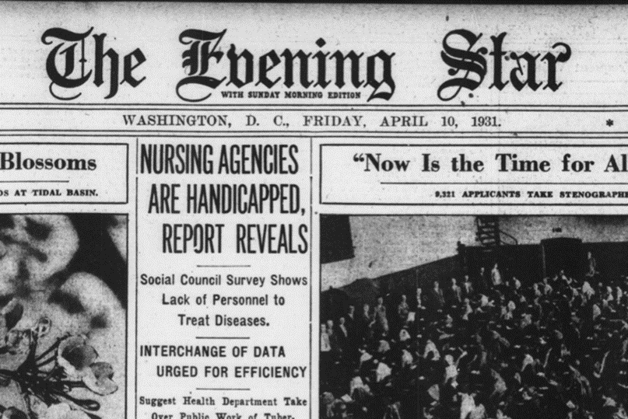
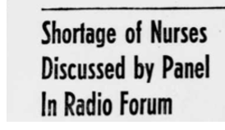
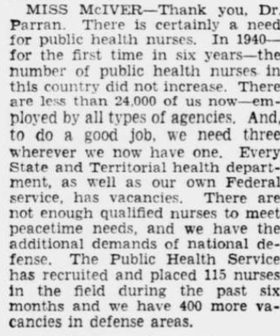
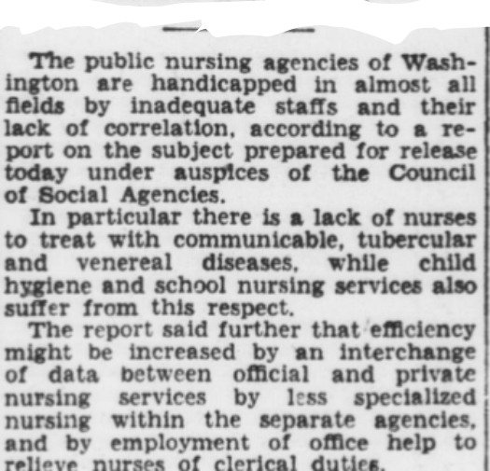
1941
1931

Slide 7
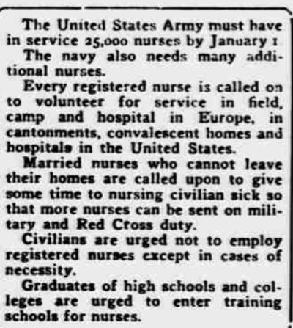
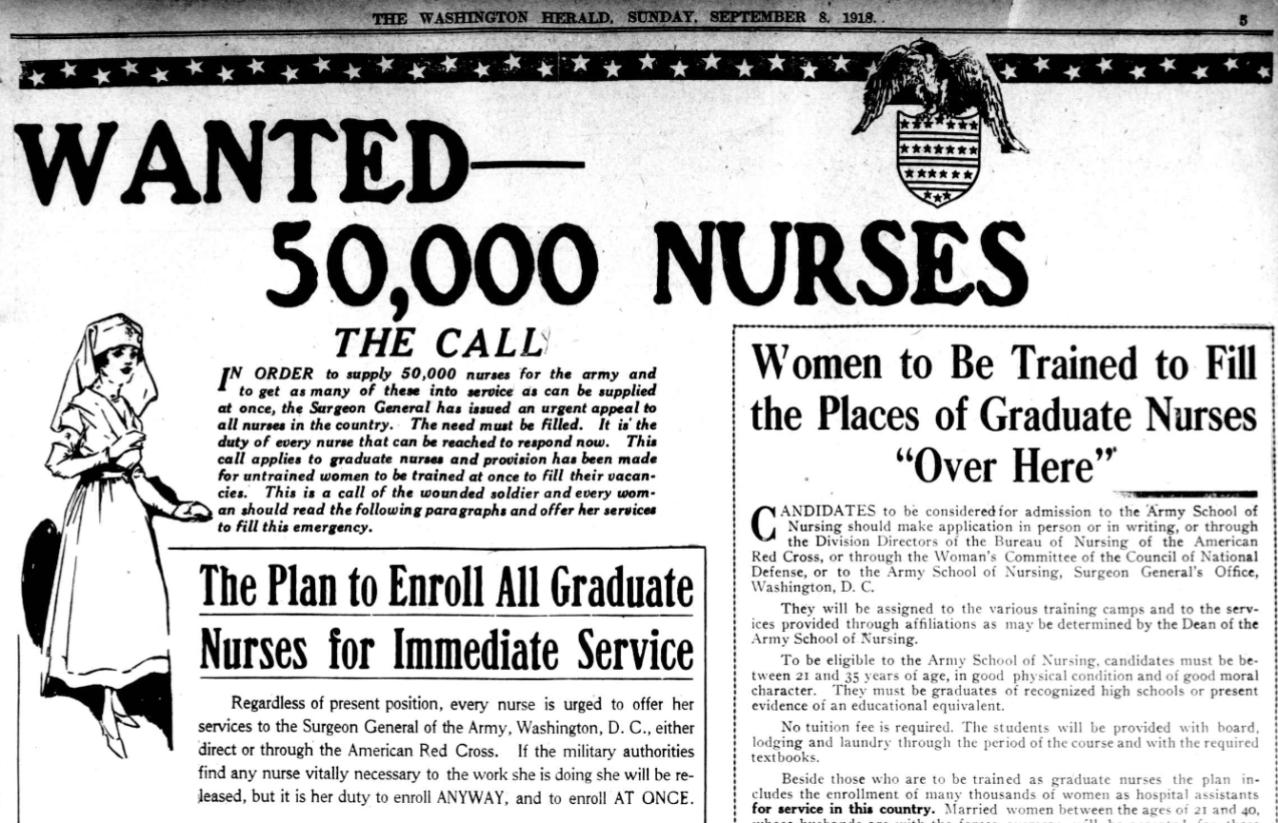
1918

Slide 8
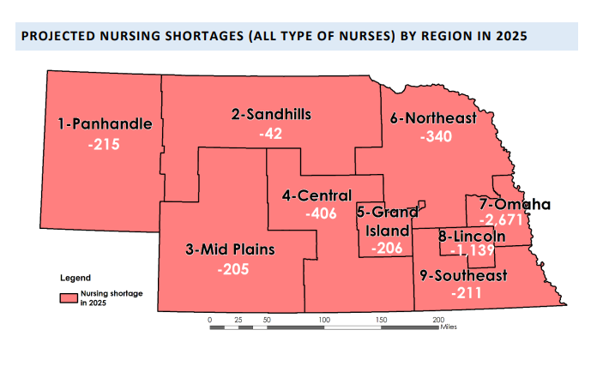
Current State of Nursing
National:
6% growth over next decade
  Increase of 177,440
  Need 193,100
Nebraska
2600 fewer nurses working in 2022 (compared to 2018)
5436 FTE nurses short by 2025

Slide 9
Causes and Consequences
Nursing Shortage
Difficulty
Recruiting
Nurse Turnover
Accidents/errors
Aging population
Nurse fatigue
Adverse outcomes
Nurse dissatisfaction
Lack of faculty
High ratios
Mandatory overtime
Nurse burnout
Retirement
Decreased interest in profession

Slide 10
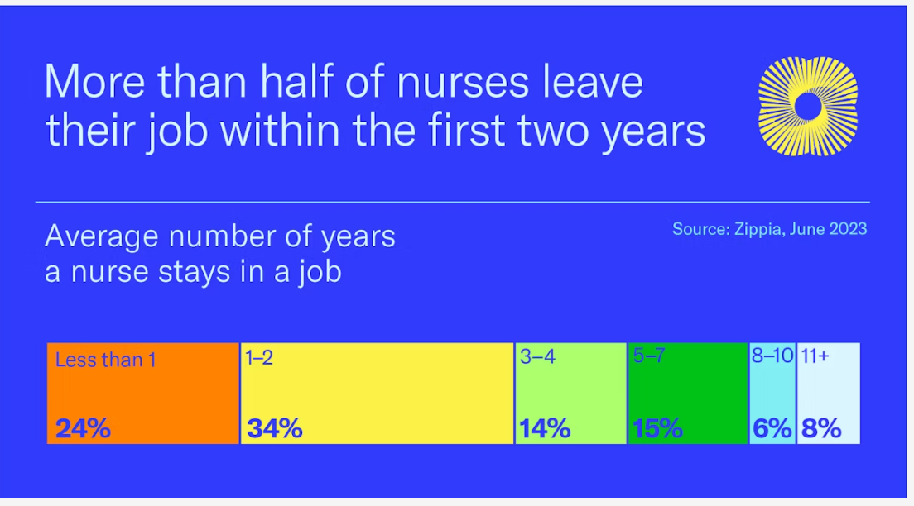

Slide 11
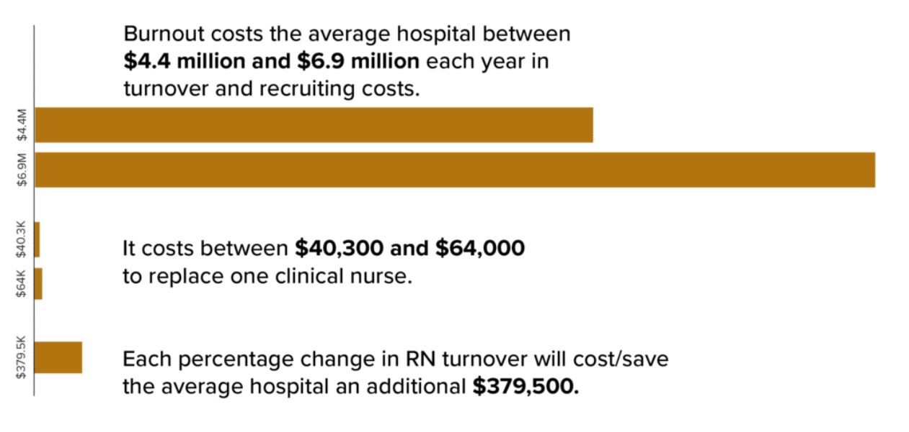
https://www.bestuponrequest.com/wp-content/uploads/2021/03/May_Blog_Graphics-01-1024x484.png

Slide 12
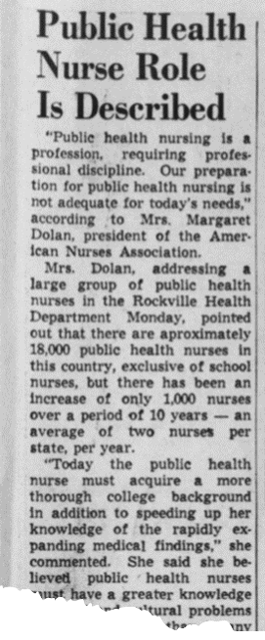
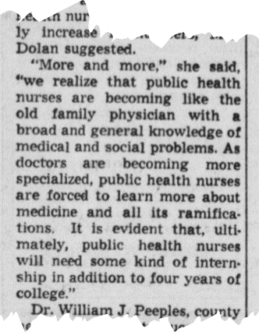
Orientation or Residency
New graduate nurses are the future
There is always going to be somewhere “better”
Important component of culture
Montgomery County Sentinel
May 23, 1963

Slide 13
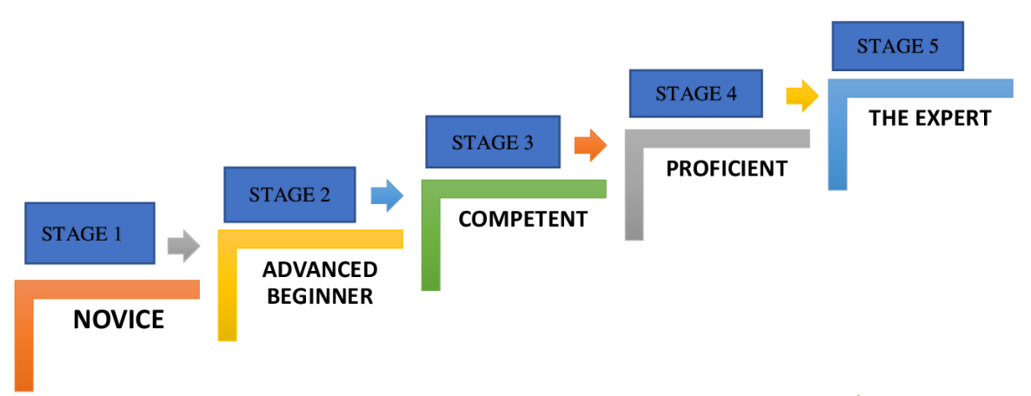
Novice to Expert

Slide 14
Get out there and get to work…
Hospital Orientation
Department Orientation
General hospital orientation
Regulatory bodies
Policy/procedures
Patient experience
Intro to preceptor & schedule
Unit tour
Equipment/EMR
Rooms/supplies

Slide 15
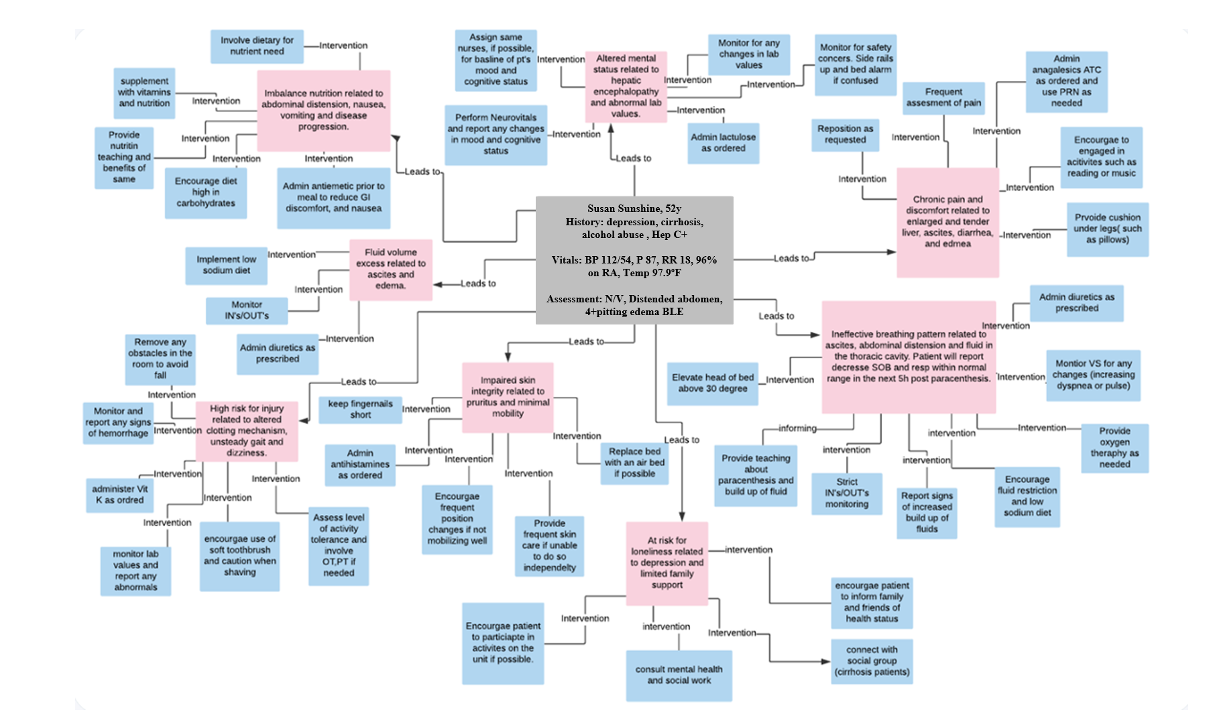

Slide 16
Anatomy of a Nurse Residency Program
Person Centered
Safety & Quality
Tech & Informatics
Leadership
Evidence Based Practice

Slide 17
Anatomy of a Nurse Residency Program
Person Centered
More assessments
Communication

Slide 18
The Anatomy of a Nurse Residency Program
Person Centered
More assessments
Communication
Safety & Quality
Time management
Interprofessional teams

Slide 19
The Anatomy of a Nurse Residency Program
Person Centered
More assessments
Communication
Safety & Quality
Time Management
Interprofessional Teams
Tech & Informatics
All the gadgets
Electronic Medical Record

Slide 20
The Anatomy of a Nurse Residency Program
Person Centered
More assessments
Communication
Safety & Quality
Time management
Interprofessional teams
Tech & Informatics
Evidence Based Practice
All the gadgets
Electronic Medical Record
Interdisciplinary teams
Continuing education

Slide 21
The Anatomy of a Nurse Residency Program
Person Centered
More assessments
Communication
Safety & Quality
Time management
Interprofessional teams
Tech & Informatics
Evidence Based Practice
Leadership
Delegation
All the gadgets
Electronic Medical Record
Interdisciplinary teams
Continuing education
Peer to peer accountability

Slide 22
Preceptors
Role | Definition | Examples
Role Model | Demonstrates safe nursing practice and encourages like behavior through influence and accountability | Integrates hospital policies and evidence-based guidelines in nursing care
Socializer | Assists with integration to the unit and organization | Welcomes and introduces novice nurse to care team members Explains formal and informal role expectations Supports conversations with medical team.
Coach (educator) | Acknowledges learning needs and identifies experiences to support learning progression | Identifies learning preferences Identifies experiences to increase critical thinking skills Documents progress and provides feedback
Protector | Creates a safe learning environment while protecting the patient | Creates a safe space for questions or expression of doubt Protects from incivility and escalates concerns Ensures safe delivery of care

Slide 23

Future Trends in Precepting
Formal preceptor selection processes
Standardized preceptor programs
Opportunities for continuing education
Preceptor specific mentoring programs

Slide 24
Beneficiaries
Nurses
Employers
Patients
Increase confidence
Increase job satisfaction
Reduce burnout
Skill development
Stronger teams
Lower turnover
Improved patient safety and outcomes
Better moral
Improved quality of care
Better patient experience
Higher level of caregiver commitment

Slide 25
Call to Action
Advocate for consistency
Generate a culture of learning
Continue your own education
Engage in the process

Slide 26
Questions?
Thank you.

Slide 27
References
2022 Biennial Report (2022) Center for Nursing https://center4nursing.ne.gov/wp-content/uploads/2024/01/2022-CFN-BIENNIAL-REPORT.pdf
Angelilli, Sara (2024) The Four Primary Roles of the Preceptor AORN 1/5/24 https://www.aorn.org/article/the-four-primary-roles-of-the-preceptor
Benner, Patricia E. From Novice to Expert Excellence and Power in Clinical Nursing Practice Patricia Benner. Addison-Wesley Publ, 1984.
Fact Sheet: Nursing Shortage (2022) AACN https://www.aacnnursing.org/news-data/fact-sheets/nursing-shortage

Slide 28
References
Gamble, M. (2024) Becker’s 07Apr24 The cost of nurse turnover in 24 numbers. https://www.beckershospitalreview.com/finance/the-cost-of-nurse-turnover-in-24-numbers-2024.html#:~:text=Given%20varying%20bed%20size%2C%20RN,in%202022%2C%20which%20was%20%2452%2C350.
Mohamed Z, Al-Hmaimat N. The effectiveness of nurse residency programs on new graduate nurses' retention: Systematic review. Heliyon. 2024 Feb 17;10(5):e26272. doi: 10.1016/j.heliyon.2024.e26272. PMID: 38434316; PMCID: PMC10907523
Robinson, Kathryn, PhD, MHA, Cavanaugh, Robert, et al. An Analysis of Orientation and Preceptorship Influence on Nurse Job Satisfaction Across Two States. J. nurses prof. dev.. 2024;40(3):149-155. doi:10.1097/NND.0000000000001052
Robinson, Sharmaine (2024) Pros and Cons of Becoming a Nurse Preceptor https://nursingcecentral.com/nurse-preceptor/

