Slide 1
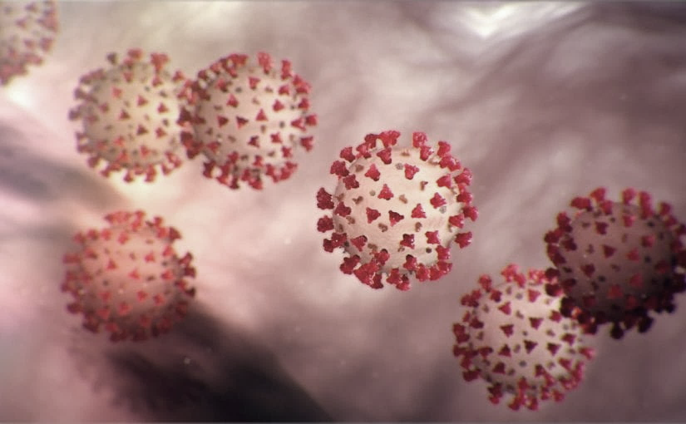
Covid-19 Webinex Update on Testing for COVID-19
Maureen Tierney, MD, MSc.
Healthcare Associated Infections Medical Director
Tom Safranek, MD, State Epidemiologist
Matthew Donahue, MD, EIS Officer, NE DHHS

Slide 2
CDC Updated Info for HCFs 3-17
Healthcare facilities and clinicians should prioritize urgent and emergency visits and procedures now and for the coming several weeks. The following actions can preserve staff, personal protective equipment, and patient care supplies; ensure staff and patient safety; and expand available hospital capacity during the COVID-19 pandemic:
Delay all elective ambulatory provider visits
Reschedule elective and non-urgent admissions
Delay inpatient and outpatient elective surgical and procedural cases
Postpone routine dental and eyecare visits

Slide 3
Updates for the Public and Returning Travelers
Updated public health recommendations for travelers-website in process of being updated
  A. All returning travelers have an increased risk of exposure to COVID-19
  B. All returning travelers should limit public interactions, practice strict social-distancing, and self-monitor for symptoms
  C. IF a returning traveler develops fever or respiratory illness, they need to IMMEDIATELY self-isolate and report to a provider or local health department

Slide 4
Updates
D. Returning travelers need to track the publicly reported COVID-19 disease burden in the areas to which they have travelled through both the local/state public health departments and public media websites.
Areas with widespread sustained transmission (e.g. CDC Level 3 countries plus U.S. locales such as WA state, Westchester County and NYC, NY, and CA esp. Santa Clara County,) are at increased risk and of special concern.
Such travelers should self-quarantine for 14 days and immediately report any symptoms consistent with COVID-19 infection to their health care provider. Individuals unable to observe the 14-day self-quarantine should consult with their local health department

Slide 5
Updates
E. Health care workers with a travel history from an area with widespread sustained transmission [Level 3 Countries, NYC, California (esp. Santa Clara Co.), Washington state, Florida, or other high-risk exposure should self quarantine if possible and self monitor.
However, if because of HCP shortage or a needed expertise they should consult with a trained medical professional (e.g. infection preventionist or physician) at their facility and
Establish a protocol such as active monitoring with PPE while at work that mitigates the risk of patient and co-worker exposure.

Slide 6
Commercial Lab Testing
Commercial labs listed below had announced the availability of commercial tests through their portals. Published turnaround time is 3-4 days.
Any patient (+) for COVID-19 virus should be immediately reported to their local/state public health office.
All such (+) tests are provisional pending confirmation at NPHL. Request the commercial lab send the specimen to NPHL for all positive test
ARUP-No longer accepting new tests
Mayo –only providing for Mayo clinic patients
Quest -1000 tests nationally per day
LabCorp?

Slide 7
Testing
Availability of Testing-
NPHL is performing the CDC-approved test.
  20 specimens per run may be able to expand to about 100/day.
  Approval via LHD through the state DPH is necessary
UNMC - separate test through Regional Pathology Laboratory (RPL),
At capacity

Slide 8
Testing Priorities
Inpatients with a clinical presentation consistent with COVID-19, after ruling out alternative diagnoses (negative RPP), should be considered for testing. Highest testing priority
Outpatients that are members of vulnerable or high-risk populations with a clinical presentation consistent with COVID-19, after ruling out alternative diagnoses (negative flu and RPP), should be considered for testing.
Vulnerable or high-risk populations include
o Healthcare workers
o Public safety (EMS, law enforcement, firefighters)
o Nursing home, group home, daycare attendees or employees
Most outpatients with a clinical presentation consistent with COVID-19 WITH A CLINICALLY CONSISTENT PRESENTATION should be considered a probable case of COVID-19 and self-isolate without expecting testing. Testing to rule out an alternative diagnosis is up to the PCP.

Slide 9
CDC: Criteria to Guide Evaluation and Lab Testing for COVID-19
Additional Criteria to Guide Evaluation and Laboratory Testing for COVID-19.
Priorities for testing may include:
1. Hospitalized patients who have signs and symptoms compatible with COVID-19 in order to inform decisions related to infection control.
2. Other symptomatic individuals such as, older adults (age ≥ 65 years) and individuals with chronic medical conditions and/or an immunocompromised state that may put them at higher risk for poor outcomes (e.g., diabetes, heart disease, receiving immunosuppressive medications, chronic lung disease, chronic kidney disease).
This is what states with lots of transmission are doing. Also preserves PPE.

Slide 10
Call In Lines; Facility Screening
1. NM-Info hotline and referral -400-922-0000; Evaluated over the phone
referred one of their outpatient clinics, Can do their own test
2. CHI-CHIhealth.com 8am to 8pm; after hours virtual care (for CB, IMM, Lakeside St. Es, St. Francis and Good Sam )
Virtual Screening referred to MD or ANP; free.
Methodist 402-815-7425 24/7
  Doing testing on main campus
4. Bryan -24/7 hotline-402-481-0500; also website from their Bryan Health homepage
ezVisit-if for coronavirus questions will be provided free of charge
5. Great Plains Health-no hotline-ask people to call their PCP.

Slide 11
Tips for Testing
Patients with COVID-19 have fever, cough, sore throat and difficulty breathing.
COVID-19 infection rarely seems to cause a runny nose, sneezing, (these symptoms have been observed in only about 5% of patients). Sneezing, and stuffy nose are most often signs of a cold.
Note that influenza, strep throat, and other respiratory pathogens (such as the 15 tested for on the respiratory pathogen panel) are circulating and need to be considered.

Slide 12
Test Results from Commercial Labs
What is the process for testing and receiving results?
If you used a commercial lab for testing:
  After your order is sent to the laboratory, results will be sent directly to you. Please do not call the local health department until you receive the results.
  If you receive NEGATIVE results, let the patient know.
  If you receive POSTITIVE results: Notify the LHD immediately of the results.
Advise the patient of the results and to stay home and isolate themselves from others. The LHD will contact them to identify who they have been in contact with recently. Cooperating LHDt is extremely important and will help protect their loved ones and their community from further spread.
Their local health department will provide them will information on how to protect themselves and others, as well as when they are able to stop self-isolating.

Slide 13
Test Results from NPHL
If you worked with the local health department:
  After your order is sent to the NPHL laboratory, results will be sent directly to you and the local health department. You will be notified as soon as results are ready, please refrain from calling the lab.
  If you receive NEGATIVE results, let the patient know.
  If you receive POSTITIVE results:
Advise the patient of the results and to stay home and isolate themselves from others.
The local health department will be in contact with the patient to identify who they have been in contact with recently. Cooperating and working with the health department is extremely important and will help protect their loved ones and others, their community from further spread.
Their local health department will provide them will information on how to protect themselves and others, as well as when they are able to stop self-isolating.

Slide 14
Reporting to LHD
Reporting to LHD should primarily be by providers not patients. The LHD staff screening for who to test need the providers to have done some clinical screening/evaluating first (which may all be by phone)
Any general questions by the public can be answered by the general COVID 19 hotlines at various LHDs
Douglas Co Help Line is the following.
Listing of the local health departments and contacts:
http://dhhs.ne.gov/CHPM%20Documents/contacts.pdf

Slide 15
Updates from Interim Guidance for IP in HC
For care other than aerosol generating procedures a face mask can replace an N-95 if an N-95 is not available
If gowns become scarce gowns should be reserved for
Aerosol generating procedures
Care where splashes and sprays anticipated
High contact care activities
In extreme scarcity-
Moving between patients with same confirmed diagnosis and eye protection and mask
not soiled by spray etc
remove only gloves and gowns and perform HH
replace gowns and gloves for next patient

Slide 16
Limited Capacity of N-95s
It is imperative that providers know and practice the strategies for preserving the supply of N95 respirators as outlined by the CDC: https://www.cdc.gov/coronavirus/2019-ncov/hcp/respiratorsstrategy/index.html
During times of limited access to respirators or facemasks, facilities could consider having HCP remove only gloves and gowns (if used) and perform hand hygiene between patients with the same diagnosis (e.g., confirmed COVID-19) while continuing to wear the same eye protection and respirator or facemask (i.e., extended use). Risk of transmission from eye protection and facemasks during extended use is expected to be very low. HCP must take care not to touch their eye protection and respirator or facemask .
Eye protection and the respirator or facemask should be removed, and hand hygiene performed if they become damaged or soiled and when leaving the unit.

Slide 17
Re-use of N-95s
Discard N95 respirators following use during aerosol generating procedures.
Discard N95 respirators contaminated with blood, resp. or nasal secretions, or other bodily fluids
Discard N95 respirators following close contact with any patient co-infected with an infectious disease requiring contact precautions.
Use a cleanable face shield (preferred) or a surgical mask over an N95 respirator and/or other steps (e.g., masking patients, use of engineering controls), when feasible
Hang used respirators in a designated storage area or keep them in a clean, breathable container such as a paper bag between uses. To minimize potential cross-contamination, store respirators so that they do not touch each other and the person using the respirator is clearly identified.
Clean hands with soap and water or an alcohol-based hand sanitizer before and after touching or adjusting the respirator (r to maintain fit). Avoid touching the inside of the respirator.
Use a pair of clean (non-sterile) gloves when donning a used N95 respirator and performing a user seal check. Discard gloves after the N95 respirator is donned and any adjustments are made to ensure the respirator is sitting comfortably on your face with a good seal.

Slide 18
Extended Use of N-95s
Extended use refers to the practice of wearing the same N95 respirator for repeated close contact encounters with several different patients, without removing the respirator between patient encounters.² Extended use is well suited to situations wherein multiple patients with the same infectious disease diagnosis, whose care requires use of a respirator, are cohorted (e.g., housed on the same hospital unit).
Discard N95 respirators following use during aerosol generating procedures.
Discard N95 respirators contaminated with blood, respiratory or nasal secretions, or other bodily fluids from patients.
Discard N95 respirators following close contact with, or exit from, the care area of any patient co-infected with an infectious disease requiring contact precautions.
Consider use of a cleanable face shield (preferred³) over an N95 respirator and/or other steps (e.g., masking patients, use of engineering controls) to reduce surface contamination.
Perform hand hygiene with soap and water or an alcohol-based hand sanitizer before and after touching or adjusting the respirator (if necessary for comfort or to maintain fit)

Slide 19
Crisis Capacity When N-95s are running low
HCP planned proximity to the case patient during encounter | Facemask or respirator determination
 | Patient masked for entire encounter (i.e., with source control) | Unmasked patient or mask needs to be removed for any period of time during the patient encounter
HCP will remain at greater than 6 feet from symptomatic patient | HCP remaining at this distance from the patient should not need to enter the patient care area; if entry required: no facemask or respirator | HCP remaining at this distance from the patient should not need to enter the patient care area; if entry required: no facemask or respirator
HCP will be within 3 to 6 feet of symptomatic patient | HCP remaining at this distance from the patient should not need to enter the patient care area; if entry required: facemask | HCP remaining at this distance from the patient should not need to enter the patient care area; if entry required: facemask
HCP will be within 3 feet of symptomatic patient, including providing direct patient care | Facemask | N95 respirator/ elastomeric /PAPR, based on availability
HCP will be present in the room during aerosol generating procedures performed on symptomatic persons | N95 respirator/ elastomeric /PAPR, based on availability | N95 respirator/ elastomeric /PAPR, based on availability

Slide 20
Strategies for Optimizing the Supply of N95 Respirators:
Contingency Capacity Strategies
NIOSH approves other filtering facepiece respirators that are at least as protective as the N95. These include N99, N100, P95, P99, P100, R95, R99, and R100.
Recommended Guidance for Extended Use and Limited Reuse of N95 Filtering Facepiece Respirators in Healthcare Settings
Extended use is favored over reuse because it is expected to involve less touching of the respirator and therefore less risk of contact transmission.

Slide 21
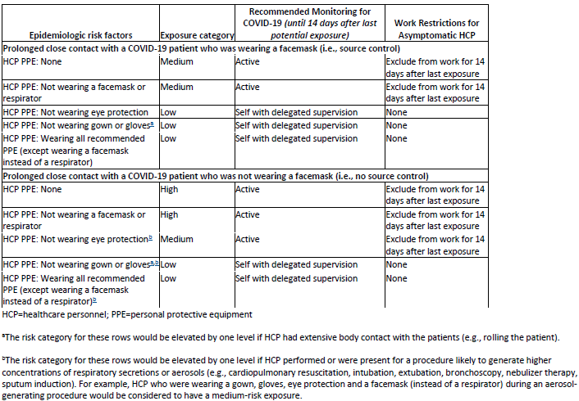
Interim U.S. Guidance for Risk Assessment and Public Health Management of Healthcare Personnel with Potential Exposure in a Healthcare Setting to Patients with COVID-19

Slide 22
Monitoring and Work Restrictions
HCP in the high- or medium-risk category should undergo active monitoring, including restriction from work in any healthcare setting until 14 days after their last exposure.
HCP in the low-risk category should perform self-monitoring with delegated supervision until 14 days after the last potential exposure.
HCP in the no identifiable risk category do not require monitoring or restriction from work.

Slide 23
Following slides are repeats
Repeat slides on
Acquiring a specimen
Some LTC guidance questions

Slide 24
DHHS HAN 3-11-2020
Specimen Collection Advice for Clinics and EDs Evaluating Patients with Febrile Respiratory Illness
Patients presenting to HCFs for evaluation of any febrile respiratory illness should be fitted with a surgical facemask upon arrival and should be segregated from other patients (e.g., immediately moved to an exam room). This is to prevent transmission of respiratory pathogens including flu and COVID-19.
If the clinical presentation and the epidemiologic risk factors create a HIGH index of suspicion of COVID-19 (this is a clinical judgement-further guidance above) personnel who collect NP (nasopharyngeal) swabs should don full personal protective equipment (PPE) prior to specimen collection. •
N95 respirator, eye protection, disposable gloves, and a gown. •
If N95 respirators or equivalent PPE are not available, the patient should be referred to a location where the person undertaking specimen collection has all CDC-recommended PPE.
A negative pressure room is not essential for testing.

Slide 25
DHHS HAN 3-11-2020
If it is determined that the risk of COVID-19 is low
Facilities lacking a supply of N95 respirators should substitute a surgical mask on persons collecting the specimen.
Eye protection is also essential. If available, a face shield would be preferable to goggles.
At the time of specimen collection, the patient’s surgical facemask should be lowered sufficiently to expose the nares, and a proper swabbing should commence per the instructional video cited below.
The patient’s surgical facemask should be properly repositioned immediately upon completion of specimen collection.

Slide 26
DHHS HAN 3-11-2020
Specimen Collection
It remains CRITICALLY IMPORTANT that staff responsible for collecting nasopharyngeal (NP) swabs be thoroughly trained and strictly compliant with specimen collection protocols. Failure to collect a proper specimen could result in a FALSE NEGATIVE test which could have major consequences for controlling COVID-19. A training video can be found here: https://www.youtube.com/watch?v=hXohAo1d6tk
Use only synthetic fiber swabs with plastic shafts. Do not use calcium alginate swabs or swabs with wooden shafts, as they may contain substances that inactivate some viruses and inhibit PCR testing. Place swabs immediately into sterile tubes containing 2-3 ml of viral transport media. Refrigerate specimen at 2-8°C and ship overnight to CDC on ice pack.
Nasopharyngeal swab: Insert a swab into the nostril parallel to the palate. Leave the swab in place for a few seconds to absorb secretions.

Slide 27

Resources (Testing)
Written instructions from NPHL and CDC on handling samples:
http://www.nphl.org/documents/NPHL%20Alert%20COVID-19%20Collection%20and%20Handling%20in%20NE%20v2020%2002%2012.pdf
https://www.cdc.gov/coronavirus/2019-nCoV/lab/guidelines-clinical-specimens.html
Video for collecting a NP swab:
https://www.youtube.com/watch?v=hXohAo1d6tk
I think this is the best video- also shows proper PPE donning and doffing
https://www.youtube.com/watch?v=c20CfI-Cr8M

Slide 28
Testing- Provider Guidance for LTC
For long-term care facilities and other facilities suspecting a patient with COVID-19, please follow current respiratory illness processes in place to identify and track respiratory illnesses in long-term care facilities and nursing facilities, specifically. If there is a respiratory infection in a facility, DHHS wants to ensure that we are considering a variety of possible respiratory viruses to ensure the safety and overall well-being of the patients. ▪ First assess if the patient will require hospitalization based on their clinical stability. If they need to be transported to the hospital and you suspect COVID-a9 please inform the receiving hospital and the ambulance crew. ▪ The facility will need to contact their local health department immediately. ▪ Separate the patient from other patients as soon as possible. ▪ The patient(s) must be tested for influenza first. ▪ If the results are negative, then complete a respiratory viral panel. ▪ If these results are negative, the sample should be sent for COVID-19 testing. ▪ Please note that there may be exceptions to this protocol depending on exposure to known or presumed COVID-19 case or other circumstances that would demonstrate exposure to this virus. The local health department will work with the facility to understand more about the case and exposures.

Slide 29

Resources
CDC is updating guidance frequently and should be considered the best authority for most situations
  https://www.cdc.gov/coronavirus/2019-ncov/index.html (main)

Slide 30
Presentation prepared by: Dr. Maureen Tierney and Dr. Tom Safranek
HAI/AR Epidemiologist
Ishrat.kamal-ahmed@Nebraska.gov
402-471-2937

