Slide 1
Clinical documentation Improvement (CDI) Chelsey Hartwell RN, BSN

Slide 2
Objectives
Understanding CDI
Importance of CDI in Healthcare
Key Components
Common Documentation Errors
Benefits
Challenges
Case Studies

Slide 3
Understanding clinical documentation improvement
Improves patient care
Reimbursement
Compliance and Quality Metrics
Patient Safety
Notes:
What is it?! Improving healthcare records to ensure better outcomes
Ensures providers have necessary information to provide care to our patients
Helps ensure accurate coding which leads to proper reimbursement for the services we provide. This helps reduce denials and need for peer to peers. Better coding and encompassing all billable services-MORE MONEY!
Increases compliance-makes sure we are meeting the regs and requirements, helps supply information for quality initiatives and helps with proper benchmarking (readmissions, mortality etc)
Patient safety/satisfaction-goal is more efficient and effective care which leads to not only safer but happier patients

Slide 4
Importance of CDI in Healthcare
Accurate and complete documentation
Improved Patient Safety
Compliance with regulatory requirements
Maximizing revenue and reducing claim denials
Notes:
If we didn’t chart it, we didn’t do it!
Makes sure that we are seeing how sick/not sick our patients are-encompassing everything that could be going on with their hospitalization
We have to-government gets really sassy when we do things without compliance

Slide 5
Key Components
Training and Education
Collaboration between coders and clinicians
Clinical Validation
Continuous Monitoring and Auditing
Notes:
Proper training for those doing the querying and proper training for the clinicians themselves on regulatory requirements and documentation practice-don’t know what they don’t know
Review of records and identifying those opportunities for improvement in real time
Providing Feedback on deficiencies and OFI’s
Have a structure in place querying
Monitor compliance-if issues, ensure there is a process to address and follow up
Create a shared mental model and team approach for continuous improvement
COMMUNICATE COMMUNICATE COMMUNICATE!! Help the physicians understand why they need to improve a chart

Slide 6
Common errors
Insufficient detail
Lack of specificity
Inconsistent terminology
Failure to capture Severity of Illness
Inaccurate Coding

Slide 7
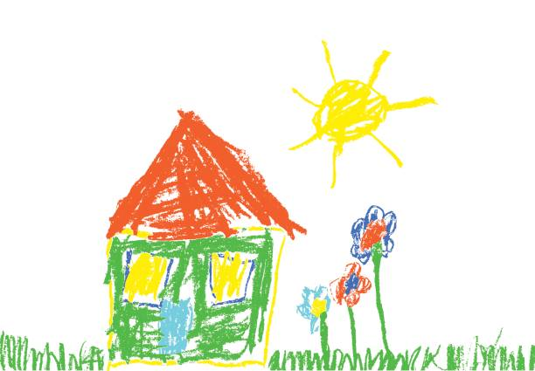
Expectations of Clinical documentation improvement
Notes:
We ask our patients to draw a picture of a house-this is the pretty picture they get

Slide 8
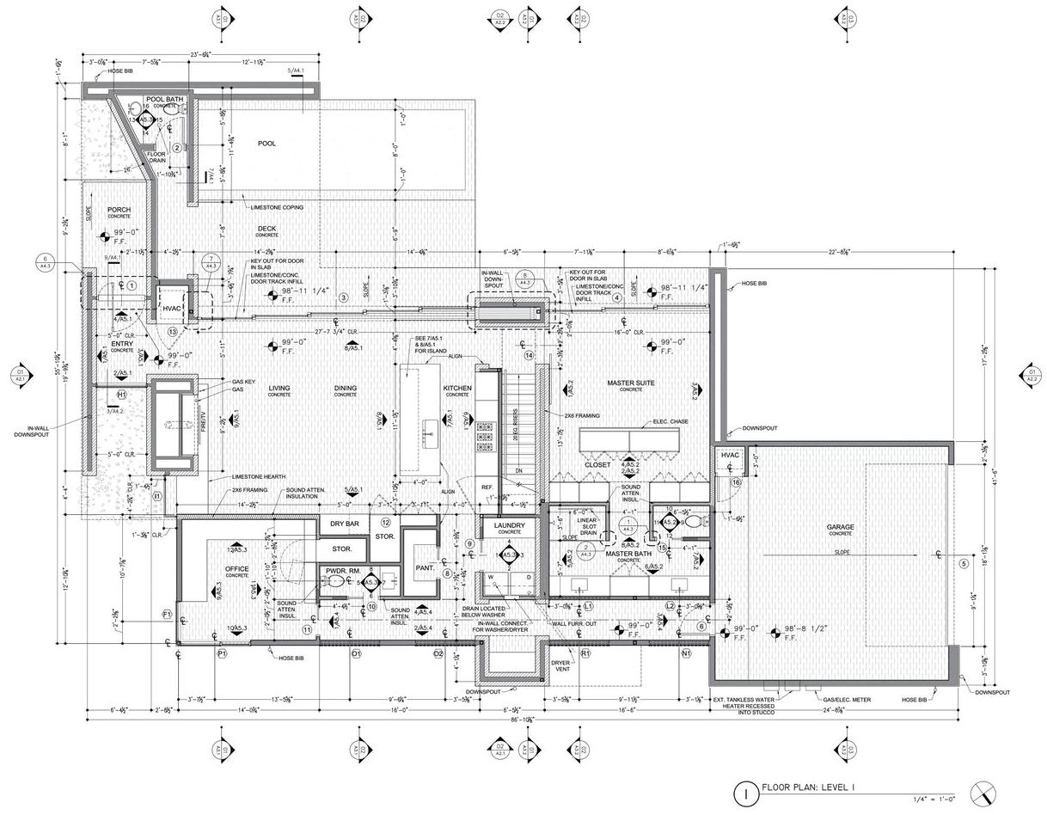
Realities of Clinical documentation improvement
Notes:
When they take care of the patients-this is what they think we are actually requiring
Inefficient EHR’s-this goes back to time constraints as well; nothing is more frustrating when you have time and the EMR is complicated or there are workarounds in order to get from point A to point B

Slide 9
Benefits of CDI Programs
Enhanced patient outcomes
Better Communications between healthcare providers
Increased accuracy of reimbursement
Reduce risk of audits and penalties
Improved quality data
Notes:
Speaks for itself: Paints a picture of how sick (or not sick) your patient is
Increases revenue when we get reimbursed for what we do
Reduces claim denials and need for peer to peers

Slide 10
Challenges of CDI Programs
Physician resistance
Time constraints
Technology
Notes:
Most docs want to take care of the patients; how many times do we hear this? Frequently the perception is this is the administrative duties of the hospital not the providers themselves. It’s lack of understanding; does take away some of the autonomy of providers

Slide 11
Challenges
Notes:
Grandma: What we think we are getting
Hot Mess: What we are actually getting
How do we ensure that we are actually painting the picture of how sick grandma really is?

Slide 12
Strategies for Effective Cdi
Physician Engagement
Use of Software
Regular Chart Reviews and Feedback
Compliance with coding guidelines
Documentation Improvement Plans
Notes:
Those who do CDI typically have both clinical and medical coding backgrounds

Slide 13
Case studies
Notes:
Some of our cases
Speak to our organization-challenges we faced and what we did to improve

Slide 14
CDI Improvement charts
Notes:
INSERT 3m chart here

Slide 15
Conclusion
CDI is crucial for ensuring accurate, complete and complaint healthcare documentation.
Requires physician engagement
Requires engagement, open dialogue between team

Slide 16
Thank you!
CHELSEY HARTWELL RN, BSN
Director of Clinical Quality Community Hospital McCook, NE
chartwell@chmccook.org

