Slide 1
MBQIP Resources

Slide 2
MBQIP
Medicare Beneficiary Quality Improvement Project (MBQIP)

Slide 3
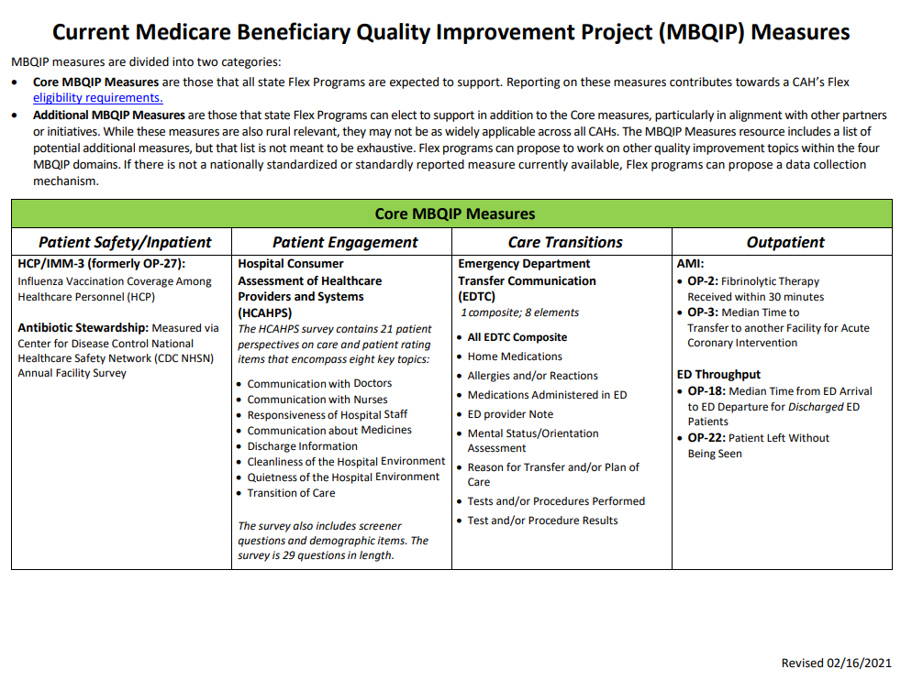
MBQIP Measures

Slide 4
Additional MBQIP Measures
For Nebraska
Falls
Swingbeds

Slide 5
Quarterly Compliance Team Reports
HCAHPS
EDTC
Inpatient/Outpatient
Sent via email to quality contact

Slide 6
MBQIP Resources
https://www.ruralcenter.org/tasc/mbqip
MBQIP Measures Chart
MBQIP Fact Sheets
MBQIP Reporting Guide
MBQIP Monthly
How-to YouTube Videos

Slide 7
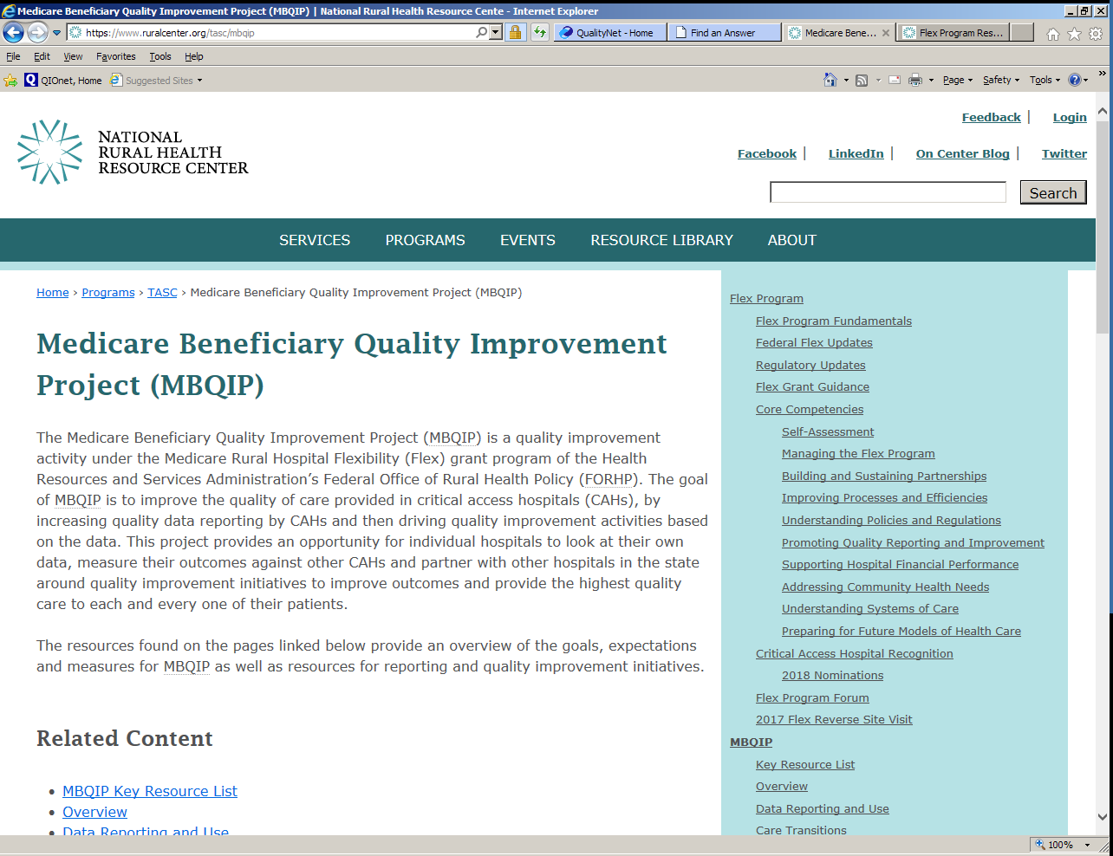
Resources for MBQIP

Slide 8
www.ruralhealthinfo.org
(RHIhub)
Funding Opportunities
Topics & States
Topic Guides
Tools for Success
Online Library
Statistics & Data

Slide 9
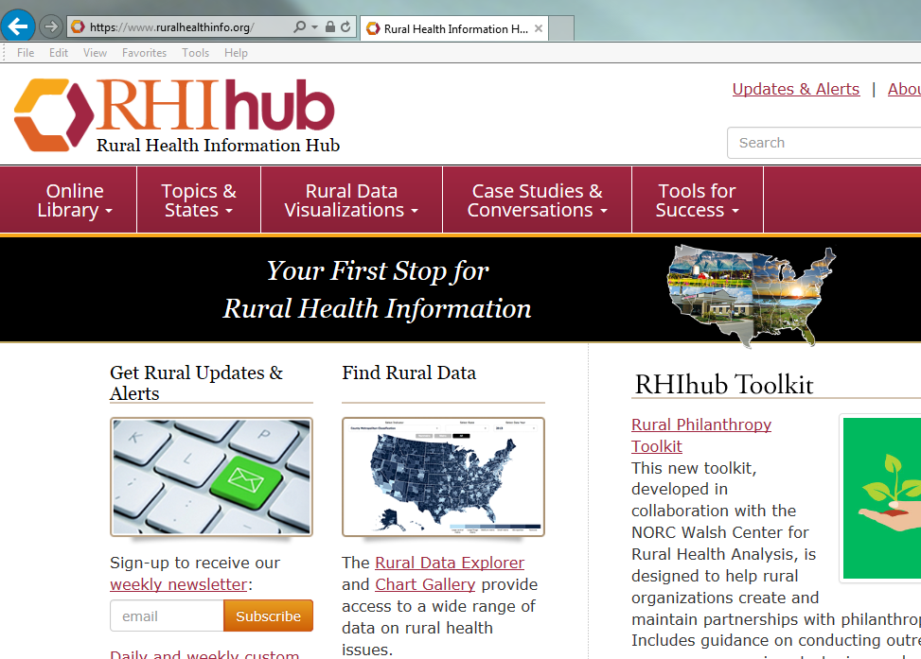

Slide 10
Who to contact:
MBQIP CART: Tasc@ruralcenter.org
Falls: Victoria Kennel
EDTC: Nancy Jo Hansen
NHSN: Resources, CDC
Antibiotic Stewardship: Maureen Tierney
Structural Measures: Resources, QualityNet HealthDesk
HCAHPS: Vender

Slide 11
Contact Information
Victoria Kennel
victoria.kennel@unmc.edu
402/559-8830
Margaret Woeppel
Nebraska Hospital Association
mwoeppel@nebraskahospitals.org
402/742-8152
Maureen Tierney
Maureen.Tierney@Nebraska.gov
402/471-6549
Nancy Jo Hansen
Office of Rural Health
Nancyjo.hansen@nebraska.gov
402/471-4616

