Slide 1
Quality Residency
Capstone Project
nebraskahospitals.org
Alisa Crown and Kristin Bailey, Gothenburg Health 2023

Slide 2
Mission:
We exist to be healthcare leaders with unparalleled passion, helping people to live their best lives because we care and we can.
Vision:
Gothenburg health leverages our Innovative Culture to optimize Health Communities
Core Values:
ICARE: Integrity—Compassion—Accountability—Respect—Excellence
Our Organization:
15 Bed Critical Access Hospital located in Gothenburg, Nebraska

Slide 3
Selecting Changes
What changes will be made to work towards improvement goals?
Team evaluated many different systems for quality and simplicity
Chose a system and team was educated on administration of the programs
Education was rolled out to entire staff on occurrences and leaders for QI initiatives
Training was documented and had 100% participation
Orientation manual developed

Slide 4
Introduction to our Project and the Team
We chose to do a project on revamping the quality program, looking at better ways to track occurrence reporting and quality metrics throughout the organization.
Our team consisted of Kristin Bailey, Chief Quality Officer; Alisa Crown, Director of Population Health and Infection Prevention; Sherry Hughes, Data Analyst; Liz Grisell, Project Manager; and Stacy Flesnar, Informatics. We developed this team based on the roles in Quality throughout the organization, the CQO responsible for overall quality, Population Health and Infection Prevention leading clinic quality, the data analyst reviewing and entering all data, Informatics to assist with implementation and education and then added project manager once she was hired.
Notes:
Prior to this year there had been a lot of turn over in the quality team, metrics were tracked on excel spreadsheets and occurrences were on paper making it difficult ability to communicate with all involved parties due to the manual process. Papers were passed from one leader to another often sitting on someone’s desk for an extended period of time.

Slide 5
Measuring Success
The Quality Team chose to purchase and implement SQSS to house all metrics and occurrences. By entering all data into one system, the quality department tracks compliance of data entry in one place and all involved departments can see incidents at the same time.
We measured our success by looking at:
Looking at time to close occurrences
Monthly data entry compliance
Estimated time saved by quality team for transfer of data

Slide 6
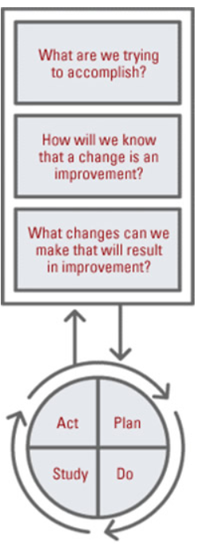
Plan ~ Do ~ Study ~ Act
Plan
I plan to implement a quality system
Work to produces better reports, easier to understand and use
Steps to execute the system include purchasing a system, implementation of system, education to staff and ongoing support
Do
We will track and review metrics for the fiscal year 2024
Compliance, time to report and time to close occurrences
Study
We are able to spend more time on analyzing data and less on tracking down information.
Continuing to monitor through June 2024
Act
We are able to react to data quickly and implement
rapid cycle improvements needed.
SQSS is sustainable and plan to implement more

Slide 7
AIM Statement
The aim of this project is to increase department compliance of quality metric tracking to 100% and decrease occurrence closing time to less than 21 days by the end of fiscal year 2024.

Slide 8
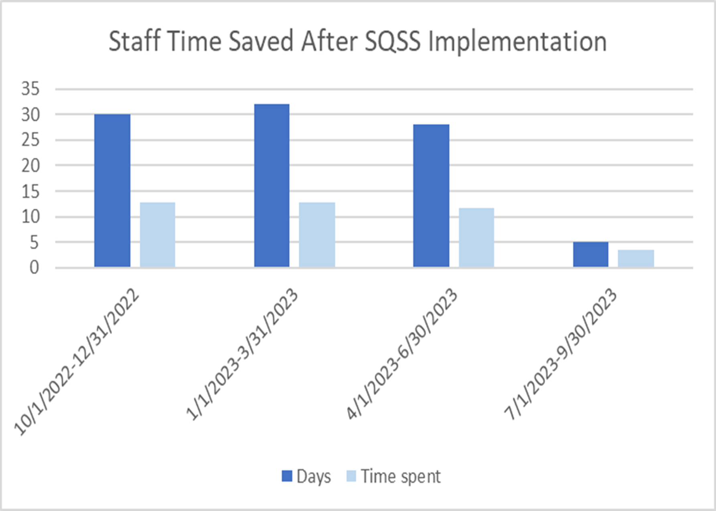
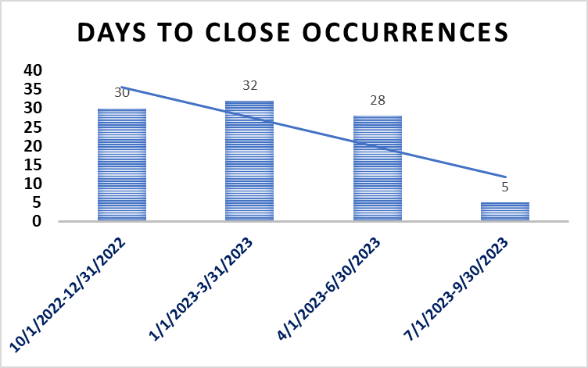
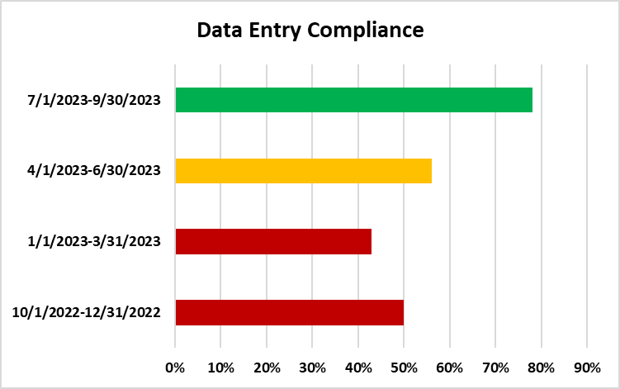
Data and Trends
SQSS implementation started July 2023

Slide 9
Return on Investment (ROI)
Explore the financial implications of the project:
Will costs/expenses be incurred to make noted changes?
No additional staff required
Initial implementation estimated 32 hours x2 people for total of $2560
No additional equipment needed
$6800 a year for subscription
What savings/revenue will be noted?
Decreased harms; able to identify issues sooner and fix issues that arise so they are not repeated.
Decreased staff hours-9.4 hours of nursing time for 2 staff x 12 months= $9024.
ROI is favorable at an extremely small net gain of $336.
Total Savings/Revenue – Total Costs/Expenses = Total ROI
Positive ROI = Dollars Earned ~~ Negative ROI = Dollars Lost

Slide 10
Spreading / Sustaining / Maintaining / Replicating
SQSS is a system with many other options such as tracking tasks within the organization for compliance, performance metrics and completing provider score cards. As these modules are implemented we will begin to see an increase in ROI and save many staff hours transitioning from paper/manual process to computer entry.
Next Steps:
All Quality Metrics from Dashboard
Physician Profiles/Score Card
Tasks

Slide 11
THANK YOU/QUESTIONS
Alisa Crown Acrown@gothenburghealth.org
Kristin Bailey
Kbailey@gothenburghealth.org
nebraskahospitals.org

