Slide 1
Nebraska Behavioral Health Landscape 2.0
Strategic Planning: Accomplishments and Moving Forward
Nebraska Hospital Association
October 20, 2022
Notes:
Add the title of your presentation, your division, name, etc.

Slide 2
Today’s Objectives
To gain an understanding of the DBH strategic plan for 2022-2024 and how key initiatives support the 5 transformational pillars of the plan.
To identify opportunities for NHA partnership in the ongoing evolution of Nebraska’s Behavioral Health System strategic transformation.

Slide 3
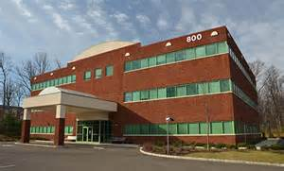
Invite and Design the Future (Thinking differently about how and where we serve)

Slide 4
Sharing a Healthcare Vision
Every Nebraskan deserves an opportunity to reach their full potential.
Nebraskans are healthier.
There is no health without behavioral health.
Access to services is simplified.
Our workforce is diverse and healthy.
Nebraska - a national leader in service and outcomes.

Slide 5
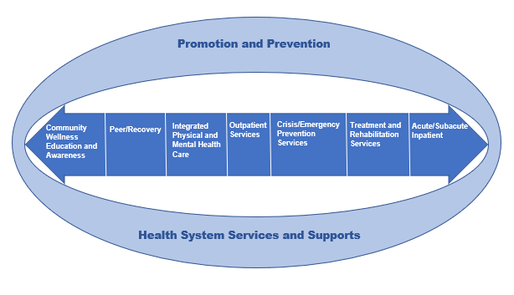
Service and Support Continuum

Slide 6
Nebraska Strategic Plan 2022-2024
Pillar 1: Enhance Behavioral Health Influence
Goal: BH influences systems and impacts people in positive ways.
3 objectives
Pillar 2: Implement an Integration Strategy
Goal: BH is integrated across public and private systems.
2 objectives
Pillar 3: Promote Stakeholder Inclusion
Goal: Stakeholders are included and contribute to planning and development of BH system.
2 objectives
Pillar 4: Drive Innovation and Improve Outcomes
Goal: The BH system advances outcomes through innovation.
3 objectives
Pillar 5: Demonstrate and Drive Value
Goal: The public BH system demonstrates and drives value
1 objective
Notes:
For Pillar 2 – Integration
1) 44% agreed and 30% disagreed that primary health care providers recognize the need for care coordination w/BH care providers. (may not be true for hospitals but impacts aftercare).
2) 50% of respondents disagreed that BH providers are integrated into primary care settings.
3) 37% agreed and 36% disagreed that BH prevention, such as screening for substance use and MH are used in primary care settings.
4) 29% agreed and 32% disagreed that BH services are integrated into hospital ER rooms.

Slide 7
NE Strategic Plan 2022-2024: What’s Inside?
(Sampled Selection)
Pillar 1: Enhance BH Influence
Develop and implement a cross agency / cross system multilingual anti-stigma campaign.
Develop and implement a recovery-friendly workplace initiative
Pillar 2: Implement an Integration Strategy
Develop plan to reduce high ER utilization.
Determine best practices for co-occurring capability and establish guidance and incentives for using behavioral health screening/evaluation tools.
https://dhhs.ne.gov/Pages/Behavioral-Health.aspx

Slide 8
Nebraska Strategic Plan 2022-2024
Analysis of familiar faces across the system by services, costs, community tenure
Identify opportunities to serve individuals with BH challenges closer to home
Explore use of a tiered system across hospitals, assessment / 23:59 in critical access hospitals, new crisis system services
Improve screening, triage, connection to resources
Agreement on outcome measures across systems
Open Bed Capacity Tool(s), connection to resources

Slide 9
Strategic Plan YR 1: Accomplishments
988 Call Center Implementation July 2022
Strategic Pillar(s): Influence, Integration, Inclusion, Innovation
Completed Planning Grant and Implementation Plan
Stakeholder advisory workgroups - developed recommendations
data, marketing, referral repository, technology, training and education
Developed tool kit for marketing
PSAs, social media images and more
Mobile Crisis Response service, inclusion of peer staffing
Web Site:
https://dhhs.ne.gov/Pages/988.aspx

Slide 10
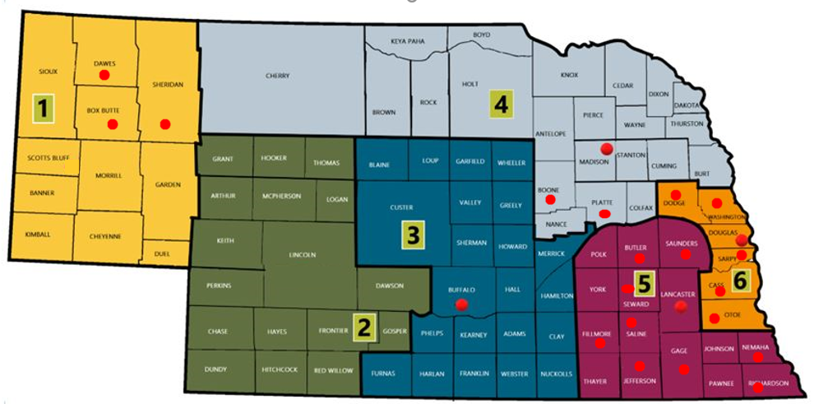
Strategic Plan YR 1: Accomplishments
Outpatient Competency Restoration (OCR)
Strategic Pillar(s): Inclusion, Innovation, Integration, Value
OCR effective July 2021 – DHHS direct contract
Focused Justice/Behavioral Health Reorganization
Addresses LRC waitlist efficiencies
Outpatient Competency Restoration: Providers by Region/County served
Region # | Provider | County
1 | A Touch of Hope | Box Butte, Dawes, Sheridan
3 | Insight Counseling & Recovery | Buffalo
4 | Good Life Counseling and Support* | Boone, Madison, Platte
5 | Blue Valley Behavioral Health* | Butler, Filmore, Gage, Jefferson, Lancaster, Nemaha, Otoe, Richardson, Seward,
5 | Capstone Behavioral Health | Saunders
5 | Paradigm, Inc* | Fillmore, Gage, Lancaster, Seward
5 | Pine Lake Behavioral Health | Lancaster
6 | Capstone Behavioral Health | Cass, Dodge, Douglas, Sarpy, Washington
6 | Blue Valley Behavioral Health* | Sarpy

Slide 11
Strategic Plan YR 1: Accomplishments
Workforce Data Analysis and Pandemic Relief
Strategic Pillar(s): Value
 | Urban | Rural | Statewide
 | Change FY19 v Fy22 | Change FY19 v Fy22 | Change FY19 V FY22
Total Licensed FTE positions | 6.79% | 11.93% | 9.13%
# of employed Licensed Treatment FTEs | -13.12% | -6.32% | -10.11%
# of vacant Licensed Treatment FTEs | 219.11% | 114.81% | 166.03%
Total Non-Licensed FTE positions | -1.73% | 4.49% | 0.80%
# of employed non-Licensed Treatment FTEs | -11.58% | -11.13% | -11.40%
# of vacant non-Licensed Treatment FTEs | 63.95% | 50.18% | 57.93%
Workforce = Access
Percentage change FY19 to FY22 in
workforce

Slide 12
Strategic Plan YR 1: Accomplishments
Alternative Service Delivery with Expansion of Telehealth
Strategic Pillar(s): Innovation
Assessed and analyzed alternative service delivery for trends.
Tracked service route of delivery (phone, telehealth, traditional, mix)
1-6/2021
9.1% service delivery by phone only, 23.1% telehealth only and 62.6% traditional only
1-6/2022
2.7% service delivery by phone only, 12.9% telehealth only and 81.2% traditional only
Services with highest delivery by one route: Telehealth only – MH Outpatient Psychotherapy and Medication Management; Phone only – Opioid Treatment Program (2021) and Recovery Support – MH (2022) and Traditional only – Children’s Wrap-Around
2021 Annual Consumer Survey
74% of adults, 69% of youth reported as receiving telehealth services and likely or very likely to recommend the service to others.
Identifying Evidence-Base Practices best delivered via telehealth.
2022 survey underway re: EBPs with fidelity delivered via telehealth

Slide 13
Strategic Plan YR 1: Accomplishments
DHHS Cross Division Infrastructure & Service Continuum
Strategic Pillar(s): Influence, Integration, Inclusion
Cross-Agency leadership team convened – Behavioral Health Collaborative
Framework / matrix of Continuum of Care established with and cross-walked with DHHS Divisions
Framework/matrix: services/supports, ages, populations, needs/gaps, crisis services, Evidenced-based practices and outcomes
Identified shared / new services for potential funding, waiver application
Complex Care Collaborative

Slide 14
Strategic Plan YR 1: Accomplishments
Safe and Affordable Housing Investment
Strategic Pillar(s): Influence
Increased funding to rehabilitate or acquire additional housing units for very low-income individuals with serious mental illness
FY20 $800,000
FY22 $1M
FY23 $1M
Partnering NIFA and award-winning CRANE projects (Collaborative Resources Allocation for Nebraska)
Strategic allocation process between NIFA, DED and other resource providers to accomplish targeted, difficult projects.
FY21: 876 unique persons served with Supported Housing funding

Slide 15
Strategic Plan YR 1: Accomplishments
Healthcare Integration with Nebraska Medical Association
Strategic Pillar(s): Integration
Drafted RFI for Integrated Care Needs Assessment - NMA
Conducted Needs Assessment survey of a broad # of recipients to determine integration
Project Focus: understand landscape and variance in settings and degrees of integration, identify opportunities to build on expressed interest
Target 1-3 pilot projects statewide with emphasis on rural integration
Expand utilization of Project ECHO - integration, coding, integrated care metrics, etc.
Working with NMA and partners to meet providers where they are at on the integration continuum.
Notes:
Survey results??

Slide 16
Strategic Plan YR 1: Accomplishments
Open Beds Pilot (Bed Registry)
Strategic Pillar(s): Influence
Partnership between DHHS/DBH, Region 6 and OpenBeds, an Appriss Health Company
Identifies, unifies and tracks behavioral health resources to facilitate rapid access
Timely access to vital services for individuals in crisis
Vision - multiple levels of care including same day/open day access and system payers
Reviewing opportunities and alignment with other tracking systems

Slide 17
Strategic Plan YR 2: Where We’re Going
System Flow Strategies and Cross System Outcomes
Strategic Pillar(s): Influence, Integration
Map statewide system capacity to meet the needs of individuals under Mental Health Board commitment
Collect community-based hospital bed capacity for youth and adult
Develop viable solutions with system partners
Explore alternative treatment to improve capacity and system flow, i.e. 23:59 service expansion

Slide 18
Strategic Plan YR 2: Where We’re Going
Opioid Settlement Advisory Committee
Strategic Pillar(s) Inclusion, Integration
Opioid Settlement Remediation Advisory Committee balanced between state and local members to provide input and recommendations regarding remediation spending from the Nebraska Opioid Recovery Fund. https://dhhs.ne.gov/Behavioral%20Health%20Documents/Overview--Opioid%20Litigation%20Settlements.pdf
Approved uses for settlement funds, including, but not limited to are:
Treatment of OUD and any co-occurring SUD / MH conditions
Full continuum of care of recovery services
Research
Prevention education
Law enforcement and first responder training and related law enforcement expenditures
Restitution for unpaid treatment costs to providers or patients.
Capital costs for opioid use disorder treatment facilities.

Slide 19
Strategic Plan YR 2: Where We’re Going
Olmstead and ADA Project
Strategic Pillar(s) Inclusion, Innovation
Olmstead v. L.C., a ruling that requires states to eliminate unnecessary segregation of persons with disabilities and to ensure that persons with disabilities receive services in the most integrated setting appropriate to their needs.
Identifying points in which Nebraskans interact with the DHHS
Direct services as well as referrals for assessments or screenings for services
Services reflect preferences and choice
Impact on behavioral health populations and services
Individuals with SMI and SED
Acute inpatient hospitalization
Assisted living
Skilled nursing facilities
Institutions

Slide 20
Strategic Plan YR 2: Where We’re Going
Behavioral Health System Data Infrastructure
Strategic Pillar(s) Value
Crosswalk behavioral health system partner metrics, dashboards and data sources.
SOPs for key cross system data sharing and reporting
Identify BH outcome indicators each system collects including health disparities and consumer experience.
Mirrors objective for value-based contracting
Determine nation benchmarks as means of comparison

Slide 21
Strategic Plan YR 2: Where We’re Going
Value-Based Contracting Strategic Pillar(s): Value
Inventory of value based outcomes across each system
Determine national benchmarks for comparison
Cross system data governance, inter- / intra-agency data sharing and reporting
Alternative payment models for contracting and pilot(s)

Slide 22
Strategic Plan YR 2: Where We’re Going
Governor’s Challenge for Veterans’ Suicide Prevention
Strategic Pillar(s): Influence
Statewide suicide prevention plan and messaging campaign consistent with national best practices.
Partnering with NDVA on a first-of-its-kind task force
Combining NDVA outreach with DBH resources
Seamless coordination for access and connections for SMVF
Draft work plan for coordinating statewide suicide prevention initiative, including postvention.

Slide 23
Strategic Plan YR 2: Where We’re Going
Forensic Justice Behavioral Health System
Strategic Pillar(s): Innovation
Created a centralized forensic & justice behavioral health services structure in May of 2022
Macro-level oversight of varied forensic services across the continuum of services
Best practices in forensic evaluations
Training / education
Expand community-based justice behavioral health initiatives
Inpatient: competency restoration, pre-trial evaluations, treatment for individuals found NRRI, risk assessment/consultation
Outpatient: court-ordered evaluations, outpatient competency restoration, jail-based in-reach/consultation

Slide 24
Strategic Plan YR 2: Where We’re Going
988 - Crisis System Service and Support Development
Strategic Pillar(s): Influence, Integration, Inclusion
Identified crisis response standards (988) including CMS/MLTC mobile crisis response service practices
Budget plans identify shared/new services
Needs/Gaps identified, data-driven
Develop plan to decrease ER and jail utilization
Map pathways to ER and develop sequential intercept mapping plan
Develop, implement, and measure impact of services and supports including community tenure

Slide 25
Strategic Plan YR 2: Where We’re Going
Youth System of Care
Strategic Pillar(s) Influence, Inclusion
A public/private partnership designing future of Nebraska’s established BH Youth System of Care.
Aligned with cross system initiatives, DHHS Divisions, Children and Family Services Strategic Transformation and BH Strategic Plan
Building a robust continuum of prevention, early intervention, treatment and recovery services and supports.

Slide 26
Opportunities for Partnership
Local Needs/Gaps – Data Driven Solutions
Opportunities for Community, Regional, State, Private/Public Partnerships
Reshaping and transforming the system through collaboration and financial blueprint
Suggestions for Ongoing Collaboration?

Slide 27
Sheri Dawson, RN
Director, Division of Behavioral Health
NE Department of Health and Human Services
Sheri.dawson@nebraska.gov
(402) 471-8553
Notes:
Include your name and contact information (email and phone number) on this slide.
Also, please encourage your audience to follow DHHS on social media and mention the DHHS website.

