Slide 1
A GUIDE TO HIRING FOREIGN NATIONAL HEALTHCARE WORKERS
Presented by:
Daniel W. Oldenburg
Immigration Attorney

Slide 2
Immigration and Healthcare
Immigration Healthcare

Slide 3
Immigration Law 101 Who’s Who?
Citizens
Immigrants (LPRs)
Nonimmigrants
Undocumented Persons
DACA/TPS

Slide 4
The Changing Face of American Medicine

Slide 5
The Changing Face of American Medicine
Data from Federation of State Medical Boards, AMA and the Educational Commission of Foreign Medical Graduates (ECFMG) and the Association of American Medical Colleges shows:
25% of licensed U.S. doctors are IMGs. That share has grown by half a percentage point since 2010.
The number of IMGs in practice has grown by nearly 18% since 2010. That figure is bigger than the 15% rise in U.S. medical graduates over that same time period.
The largest number of licensed IMGs have graduated from schools in India (23%)—per the FSMB census—followed by the Caribbean (18%), Pakistan (6%), the Philippines (6%) and Mexico (5%).
More than 45,000 IMGs practice internal medicine making it the most populated specialty among the segment.
By share of the workforce, IMGs have the largest presence in geriatric medicine, where they make up more than half of the active physician population.

Slide 6
COVID Has Highlighted an Already Existing Demand
A greater demand for physicians over the past several decades.
A predicted shortage of 125,000 physicians by 2025.
43,000 less primary care physicians by 2030.
American Academy of Family Physicians confirms that in, 2017 among all graduates of American MD schools, less than 9% went into family medicine residencies.
Dill MJ, Slasberg ES; Center for Workforce Studies. The Complexities of Physician Supply and Demand: Projections Through 2025. Washington, DC; Association of American Medical Colleges; 2008. http://www.innovationlabs.com/pa_future/1/background_docs/AAMC%20Complexities%20of%20physician%20demand,%202008.pdf. Accessed March 9, 2015.
1 in 4 physicians practicing in the U.S. is trained at a foreign medical school.
About ECFMG: overview. Educational Commission for Foreign Medical Graduates website. http://www.ecfmg.org/about/index.html. Accessed February 8, 2015.

Slide 7
Background on the Process for IMGs
IMGs must take USMLE in order to obtain state licensure.
To take the USMLE, IMGs must register with Educational Commission on Foreign Medical Graduates (ECFMG).
ECFMG is an independent non-profit credentialing body.
Once registered with ECFMG, IMGs have up to 7 years to take and pass the USMLEs. IMGs receive ECFMG certification once ECFMG certifies their credentials and they have passed Steps 1 & 2 of the USMLE.
In order to apply to a Residency/Fellowship Program, IMGs must be certified by ECMFG.
ECFMG serves as the sponsor of J-1 Physicians so they can apply to GME programs and receive training in J-1 Status.

Slide 8
ECFMG Certificate

Slide 9
Background on the J-1 VISA (Clinical)
Foreign medical graduates who complete graduate medical education in the United States in J-1 status are obliged to return to their home countries for two years unless they can obtain a waiver.
Section 212(e) of the Immigration and Nationality Act:
No person admitted under section 101(a)(15)(J) [J-1 Visa Status] can change to another status or apply to adjust their status to permanent residency (green card) until they have either returned to their home nation for a period of not less than 2 years or have been granted a waiver of this 2 year foreign residency requirement.

Slide 10
Conrad 30 Program
Foreign medical graduates who complete graduate medical education in the United States in J-1 status are obliged to return to their home countries for two years unless they can obtain a waiver.
The Conrad State 30 Program allows state departments of health to recommend up to 30 so-called J-1 waivers per year, and thus attract doctors to areas with shortages of medical care or medically underserved populations. Under the program, the doctors must serve for at least three years.
Must be a designated MUA or HPSA.
They receive H-1B status and remain in that status while fulfilling the 3 year service waiver.

Slide 11
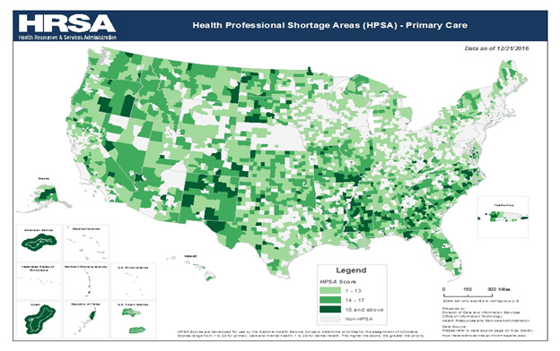
NE RuRAL Health MUA /HPSA U.S. Dept. of Health and Human Services
http://dhhs.ne.gov/publichealth/RuralHealth/Pages/ShortageAreas.aspx
https://datawarehouse.hrsa.gov/tools/analyzers/geo/ShortageArea.aspx

Slide 12
Other Visa Options H-1B /O-1
More and more GME programs are only accepting IMG residents and fellows in J-1 Status. Some programs will sponsor IMGs on H-1Bs.
After the IMG receives residency/fellowship training, in H-1B status, employers MAY BE able to also sponsor the IMG for employment in H-1B status provided they have completed all of the training and hold the necessary license.
H-1B regulations permit the issuance of the visa for a total of 6 years initially.
No waiver is needed because the IMG was never in J-1 Status and not subject to 212(e).
O-1 Extraordinary Ability or Achievement. O-1 as in lieu of H-1B when J-1 waiver is required (subject to 212(e).
H-1B
J-1
O-1

Slide 13
Visa Options For Other Healthcare Positions?
Nurses-
Two Potential Options-
H-1B in limited circumstances
I-140 Schedule A Immigrant Visa (Permanent Residency) (EB-3 Nurses and PTs)

Slide 14
H-1B for Other Healthcare Positions?
Nurses and Physical Therapists
To qualify as a specialty occupation, the regulations require that the petitioner demonstrate that the position meets at least one of the following criteria:
• A baccalaureate or higher degree or its equivalent is normally the minimum requirement for entry into the particular position;
• The degree requirement is common to the industry in parallel positions among similar organizations or, in the alternative, an employer may show that its particular position is so complex or unique that it can be performed only by an individual with a degree;
• The employer normally requires a degree or its equivalent for the position; or
• The nature of the duties [is] so specialized and complex that the knowledge required to perform the duties is usually associated with the attainment of a baccalaureate or higher degree.

Slide 15
H-1Bs for Nurses
USCIS Policy Memorandum February 18, 2015 on H-1Bs for Nurses.
Are nursing positions “specialty occupations” for H-1B purposes?
Most RN positions do not normally require a U.S. Bachelor’s Degree or higher degree in nursing as the minimum for entry and thus do not qualify as specialty occupations.
Magnet Status - American Nurses Credentialing Center (ANCC) nursing workforce within an institution has attained a number of high standards relating to quality and standards of nursing practice.
Advance Practice RNs (certified APRNs) generally will be specialty occupations due to the advance level of education and training required for certification.

Slide 16
Permanent Residency Pathway for Nurses and PTs
Schedule A - Designated Occupational Shortage
Job Offer, Notice Posting, Ability to Pay Wage, etc.
CGFNS certificate or nurse license from state where the nurse will be working or proof of passing the NCLEX licensing exam.
Nursing diploma or degree;
Visa Screen (Credentialing Service)
Adjustment of Status or
Immigrant Visa Consular Processing

Slide 17
The Road Ahead
Immigration
Healthcare

Slide 18
Questions?
Daniel W. Oldenburg
doldenburg@clinewilliams.com
402-474-6900

