Slide 1
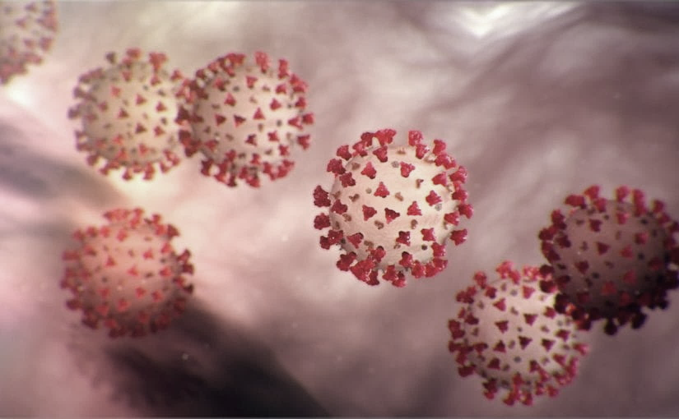
Covid-19 Webex Update 10-14-2020
​​
Tom Safranek, MD, State Epidemiologist
Louis Safranek, MD, PhD
Board certified specialist, Infectious Disease

Slide 2
Testing
Rapid detection of SARS-CoV-2 antibodies in oral fluids
We evaluated an antibody detection approach utilizing the OraSure Technologies' Oral Antibody Collection Device (OACD) and their proprietary SARS-CoV-2 total antibody detection enzyme-linked immunosorbent assay (ELISA).
We found that the OraSure test for total antibody detection in oral fluid had comparable sensitivity and specificity to serum-based ELISAs while presenting a more affordable and accessible system with the potential for self-collection
doi: https://doi.org/10.1101/2020.10.12.20210609

Slide 3
Immunity
Recent endemic coronavirus infection is associated with less severe COVID-19
Four different endemic coronaviruses (eCoVs) are etiologic agents for the seasonal “common cold,” and these eCoVs share extensive sequence homology with human severe acute respiratory syndrome coronavirus-2 (SARS-CoV-2).
Patients with a previously detected eCoV (past 5 years) had less severe coronavirus disease2019 (COVID-19) illness. They appeared to acquire infection at a similar rate.
Our observations suggest that pre-existing immune responses against endemic human coronaviruses can mitigate disease manifestations from SARS-CoV-2 infection.
https://doi.org/10.1172/JCI143380.

Slide 4
Immunity
Less severe course of COVID-19 is associated with elevated levels of antibodies against seasonal human coronaviruses OC43 and HKU1
Patients with critical disease had significantly lower levels of HCoV OC43- (p=0.016) and HCoV HKU1-specific (p=0.023) antibodies at the first encounter compared to other COVID-19 patients. Our results indicate that previous infections with seasonal coronaviruses might protect against a severe course of disease.
doi: https://doi.org/10.1101/2020.10.12.20211599

Slide 5
Immunity
Healthcare workers with mild / asymptomatic SARS-CoV-2 infection show T cell responses and neutralising antibodies after the first wave
Neutralising antibodies (nAb) were present in 90% of infected HCW sampled after the first wave; titres, likely to correlate with functional protection, were present in 66% at 16-18 weeks.
T cell responses tended to be lower in asymptomatic infected HCW than those reporting case-definition symptoms of COVID-19, while nAb titres were maintained irrespective of symptoms. T cell and antibody responses were discordant.
HCW lacking nAb also showed undetectable T cells to Spike protein but had T cells of other specificities.
Our findings suggest that the majority of HCW with mild or asymptomatic SARS-CoV-2 infection carry nAb complemented by multi-specific T cell responses for at least 4 months after mild or asymptomatic SARS-CoV-2 infection.
doi: https://doi.org/10.1101/2020.10.13.20211763

Slide 6
Immunity
Reinfection with SARS-CoV-2 and Failure of Humoral Immunity: a case report.
We sequenced viruses from two distinct episodes of symptomatic COVID-19 separated by 144 days in a single patient, to conclusively describe reinfection with a new strain harboring the spike variant D614G. With antibody and B cell analytics, we show correlates of adaptive immunity, including a differential response to D614G.
These findings suggest that poorly developed or waned antibodies against the D614 virus formed after primary infection in March were not protective against reinfection with the D614G spike variant acquired in July.
doi: https://doi.org/10.1101/2020.09.22.20192443

Slide 7
Immunity
Clinical and immunoserological status 12 weeks after infection with COVID-19: prospective observational study
The mean age of the 108 patients was 55.5 years.
75.9% presented some type of symptoms, with dyspnea being the most common.
All the patients had antibodies against SARS-CoV-2. Being a health-care worker was associated with symptom persistence, with age ≥65 years being a protective factor.
The persistence of symptoms in patents with COVID is usual 12 weeks after the acute episode, especially in patients <65 years and health-care workers. All our patients had developed antibodies by 12 weeks.
Concerning imaging tests, 89 (82.4%) patients had a control chest radiograph at 12 weeks after 121 the acute episode. In 56 (62.9%) this was normal, in 24 (26.9%) the evolution of the images 122 was favourable and in 9 (10.1%) the radiological alterations seen during the acute phase had 123 persisted or worsened.
https://www.medrxiv.org/content/10.1101/2020.10.06.20206060v1

Slide 8
Epidemiology
School closures and SARS-CoV-2. Evidence from Sweden's partial school closure
At the onset of the pandemic, Swedish upper secondary schools moved to online instruction while lower secondary school remained open.
We find that among parents, exposure to open rather than closed schools resulted in a small increase in PCR-confirmed.
Among lower secondary teachers the infection rate doubled relative to upper secondary teachers. This spilled over to the partners of lower secondary teachers who had a higher infection rate than their upper secondary.
When analyzing COVID-19 diagnoses from healthcare visits and the incidence of severe health outcomes, results are similar for teachers but somewhat weaker for parents and teachers' partners.
The results for parents indicate that keeping lower secondary schools open had minor consequences for the transmission of SARS-CoV-2 in society.
The results for teachers suggest that measures to protect teachers could be considered.
doi: https://doi.org/10.1101/2020.10.13.20211359

Slide 9
Treatment
Comparison of efficacy of Dexamethasone and Methylprednisolone in improving P/F ratio among COVID-19 patients
We compared the efficacy of methylprednisolone and dexamethasone in reducing inflammation and improving the partial pressure of arterial oxygen and fraction of inspired oxygen (PaO2/FiO2 or P/F) ratio in COVID-19 patients
We selected 60 files for this retrospective quasi-experimental study using a convenient sampling technique and divided them into two groups of 30 patients each who had received either dexamethasone or methylprednisolone.
Group 1 patients were given dexamethasone 8 mg twice daily, and Group 2 patients were given methylprednisolone 40 mg twice daily for eight days during their stay in our high dependency unit and our Intensive Care Unit.
Dexamethasone is more effective in improving the P/F ratio in COVID-19 patients compared to methylprednisolone. Physicians should consider the use of dexamethasone use in appropriate patients with COVID-19.
https://doi.org/10.1101/2020.10.06.20171579.

Slide 10
Treatment
COVID-19 Treatment Guidelines
https://www.covid19treatmentguidelines.nih.gov/whats-new/

