Slide 1
Behavioral Health partnerships NHA Annual Quality convention November, 2023
Judy Bors, MAM, BSN, RN Nursing Director
Michelle Deprez-Kreifels, MSN, RN, Quality Director

Slide 2
Behavioral health in rural communities with primary care and community partnerships
Objectives
Gain knowledge on effective strategies for implementing and sustaining mental health screenings in a primary care clinic
Identify the benefits and challenges associated with integrating mental health screenings into primary care practice
Network with community programs and other regional or state opportunities to gain insight, experience, and lessons learned

Slide 3
Demographics of service area
Highlights on Seward County Population:
17,000 Seward County
7,600 Seward, NE
1,200 students enrolled at Concordia University

Slide 4
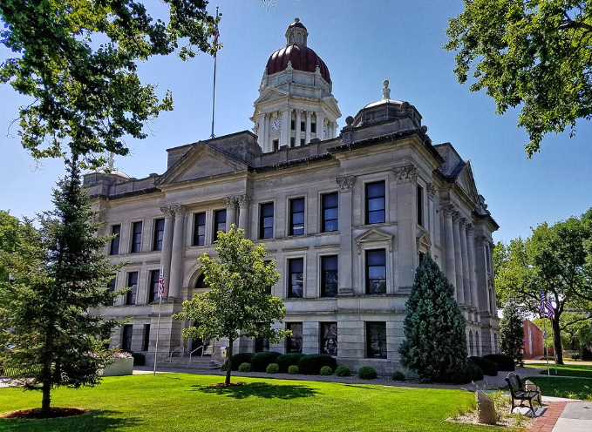
Demographics of service area
15% of the population are 65 or older
60% of the population are commuting out of the community for work
Median age 36 years

Slide 5
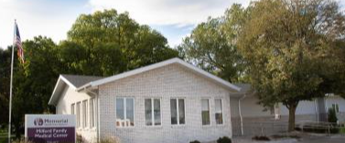
MHCS
CAH licensed for 24 beds
Assisted Living licensed for 12 beds
3 Rural Health Clinics (Seward, Utica, Milford)
9 physicians
5 physician assistants
275 employees

Slide 6
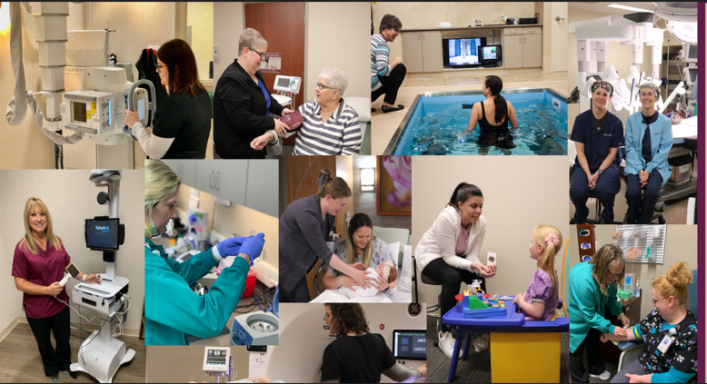
MHCS
Specialty Clinic-18 specialists
Surgical Services- DaVinci Robot
350 ER visits per month

Slide 7
How It got started
2019-Community Health Needs Assessment completed by CAH and Four Corners Health Department
Mental Health

Slide 8
PHQ in the emergency Room & Hospital
Social services started a performance improvement project monitoring mental health screening
Objective was to screen 100% of patients 10 years and older using the PHQ 2, 3, & 9
Screening built in to EMR in admission assessment ER/Hospital
Education and training completed with nursing staff on how to ask the questions
Notes:
Depression is a common mental illness that is both mentally and physically draining. Sometimes the signs and symptoms of depression may be obvious. However, sometimes it can be quite difficult to pick up on, especially in ourselves.
PHQ9 stands for Patient Health Questionnaire. It is a brief, self-administered questionnaire. The PHQ was derived from an assessment tool utilized by medical professionals in the clinic setting called the Prime-MD, which addresses multiple mental health diagnoses.
The number 2, 3, or 9, in the title is a reference to the number of questions to assess each criteria of depression. Question 9 on the PHQ9 screens for the presence and duration of suicide ideation. Knowledge is power and the PHQ9 helps those using it to start the process of healing from depression.
My Story:
When our facility implemented using this tool in the ER & Floor: Screening built in the EMR for ER Visits and Admissions to the floor – 100% for all ER patients seen and Admitted Hospital Patients.

Slide 9
PHQ in the Emergency & Hospital
In review, social services was seeing an increase in higher PHQ scores and in frequency of patients that met criteria for consult.

Slide 10
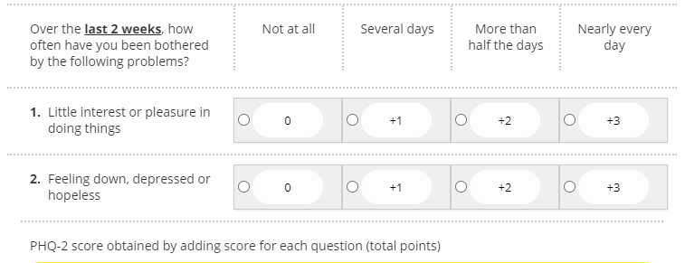
PHQ 2 in the emergency Room & Hospital
Started with the PHQ-2 in the ER/Hospital January, 2020
Notes:
NOTE: PHQ 2 and 9 Started in the ER and Floor January, 2020. If the first questions total score was high then it triggered to ask the other 7 questions.

Slide 11
PHQ 9 in the emergency Room & Hospital – January, 2020
Notes:
Elevated results would trigger a Columbia Suicide Severity rating scale for further evaluation.

Slide 12
Collaboration with public health
Summer of 2021 – MHCS met with Four Corners staff

Slide 13
Collaboration with public health
In October, 2021 - grant for nurse navigator to call and follow-up with patients with a score >14
ED Discharge instructions include a message that Tresa RN from Four Corners Health Department will be calling to follow-up on mental health concerns from this #
Notes:
Four Corners received HRSA grant dollars through the CATCH group which is a collaboration of Health Departments in SE Nebraska.

Slide 14
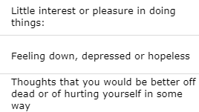
PHQ 3 in the emergency room
November, 2022 - started using the PHQ 3 instead

Slide 15
Collaboration with public health
If a patient scores high, name/DOB/MR and score would print to social services printer
Social services would then fax to Four Corners and send printed notification to quality to log and monitor
2022-figured out process for this to be automatic notification via secure e-mail from EMR to quality and Four Corners Health Department

Slide 16
Collaboration with public health
RN from Four Corners Health Dept contacts individual
Will make two attempts
Visits with them about mental health concerns and gives them resources to contact
Sends letter
Notes:
The goal is sustainability with our current efforts in completing the screening and providing follow-up calls and resources. Four Corners Health Department is receiving some funds through the NE Total Care – Medicaid $ to help with this program and the Social Determinants of Health (SDOH).

Slide 17
Historical data

Slide 18
Challenges identified by four corners
Sometimes phone numbers are incorrect
Not everyone will answer their phone
Not everyone has voicemail set-up as an option
Not everyone will return voicemails

Slide 19
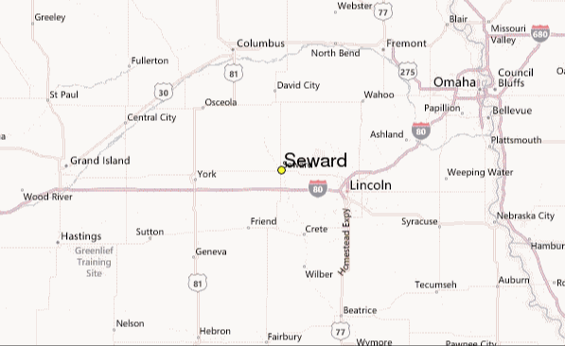
More Challenges identified by four corners
Some patients are traveling or visiting
List of options and resources don’t apply

Slide 20
Four Corners Data
146 referrals since project started
Contact made with less than half
However some were immediately transferred to Bryan, Mary Lanning, Children’s etc. for mental health needs

Slide 21
Tracking for Success
ER scores and results gets reported at ER Committee meetings
Track % of provider documents that don’t address mental or behavioral health
All results shared and discussed at quarterly collaboration meetings with Four Corners and MHCS

Slide 22
Community partnerships
Fall of 2022 partnered with ESU 5 and schools in Seward County in Wellness 4All program
Provide Licensed Mental Health Provider who rotates through the schools

Slide 23
Clinic implementation
Started routinely asking the PHQ 9 at Annual Wellness visits (April, 2023)
10-14 | Moderate | 23
15-19 | Moderate Severe | 19
20-27 | Severe | 19

Slide 24
Barriers to implementation
Time-duration of clinic
Staff comfort with asking the questions

Slide 25
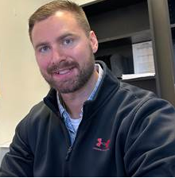
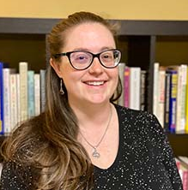
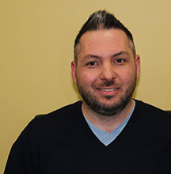
Continuing to grow mental health-Specialty Clinic
August, 2023-MHCS started to offer Genesis Psychiatric group services once a monthly telehealth services.
Andrew Corbin, PMHNP-BC McKenzie Jones, APRN-NP Jason Schmid, LIMHP
Adult Med. Mgmt. (ages 16 yrs./older) Pediatric Med. Mgmt. (<16 yrs.)

Slide 26
Continue the progress
Continue implementation in the clinic
Awareness of mental health concerns and needs in the communities that we serve
Evaluate response to providers in specialty clinic

Slide 27
Thank you for attending

