Slide 1
Quality Residency
Capstone Project
-nebraskahospitals.org-
Annie Pilsl RN, BSN
November 3rd, 2023
Bryan Grand Island Regional Medical Center

Slide 2
Introduction to the Organization
Grand Island Regional Medical Center is a state-of-the-art facility that opened amid a pandemic in 2020
It is a 67-bed acute care hospital in the rural area of Grand Island, NE
It is accredited by the Center for Improvement in Healthcare Quality (CIHQ)
We base our practices and patient care after 7 core values:
  Care Like Crazy
  Enjoy the Journey
  Know the Way, Show the Way
  Live it ,Own It
  Motivate, Appreciate
  One Team, One Purpose
  Spread a Smile, Go the Extra Mile

Slide 3

We are improving our Sepsis Bundle Compliance Rate
What is the Sepsis Bundle?
Why should a hospital want to improve their compliance rate?
Who can be involved with the improvement project?
How can we improve our compliance rate?
Where do most of the failures occur within the system?
When will the project be considered a success?

Slide 4
What is the Sepsis Bundle?
The CMS (Centers for Medicare and Medicaid Services) introduced a quality measure in October 2015 known as SEP-1. It requires the administration of a bundle that carefully prescribes precisely how patients with severe sepsis and septic shock must be treated in the early phases. If one of the measures is not completed in the timetable set by the CMS, then it is considered a failure with 0% compliance.
It is an all or nothing measure. Public reporting began in 2018.
Severe Sepsis Bundle - Within 3 hours of sepsis identification the patient needs:
Blood Cultures
Broad Spectrum Antibiotics
Initial Lactate Level
If Lactate is elevated, draw a repeat level within 6 hours
If Septic Shock – add:
30ml/kg of IV fluids within 3 hours
Vasopressors within 5 hours for persistent hypotension
Repeat volume assessment within 6 hours
Notes:
Must be done before antibiotic administration
Given after blood cultures have been obtained3
Elevated lactic acid is > 2.0 mEq/L
1. Fluid Bolus based on ideal body weight

Slide 5
Why should a hospital want to improve their compliance rate?
Sepsis is the body’s response to an infection which can lead to tissue damage, organ failure and death.
The average 30-day septic shock mortality is 34.7%
Studies have shown compliance with the SEP-1 bundle lowers the risk of sepsis mortality and morbidity, reduces the length of hospital stays, and decreases readmission rates.
CMS will include the SEP-1 measure in the pay-for-performance Hospital Value Based Purchasing Program (HVBP) in fiscal year 2026. The lowest performing hospitals will receive a 2% penalty to all Medicare payments for the following fiscal year. The performance period begins January 1, 2024.

Slide 6

Who is involved with the improvement project?
Doctors
Physician Assistants
Nurses
Laboratory staff
Pharmacy staff
Starting November 1st, 2023
Sepsis Team:
Hospitalist
Pharmacist
Emergency Department PA
Nurse Educator
Nurse House Supervisor
Laboratory Manager
ICU nurse
Clinical Improvement Consultant

Slide 7
Aim Statement
Our compliance rate from March 2022 – March 2023 was 48%.
(found from chart abstracted data)
The current National average is 60%
Aim Statement – To improve our CMS SEP-1 compliance rate greater than or equal to 60% by March 2024 for all inpatients who meet the inclusion criteria set forth by CMS. This is all admitted sepsis patients who are 18 years of age or older with a hospital stay less than or equal to 120 days, who were not transferred from another hospital.

Slide 8
How GIRMC can improve their compliance rates
I had discussions with various staff regarding the current compliance rate and areas where the failures are occurring.
In November we have a required computer lesson for laboratory and pharmacy staff, emergency department nurses and all floor nurses.
There was a discussion to change the ED order set to include a Reflex Lactic acid draw, but as a system there are many reason why this could not be done.
A Multidisciplinary Sepsis team has been created, the first team meeting is in November 2023 and will meet quarterly.
Notes:
(top left) I spoke to our Emergency Department Lead Doctor, Lead Hospitalist, the ICU nurse manager, our Nurse Educator and lab manager. The good news is that EACH and EVERY person I spoke to has a desire to improve our compliance rate. ☺
(bottom left) Our ED lead Dr did agree to manually order a repeat lactate level if initial level is > 2.0 mEq/L and educate his staff to do the same
(top right) This training will teach the importance of timing regarding blood culture draws and the administration of broad-spectrum antibiotics. It will also remind staff to look for repeat lactate levels within 6 hours if the initial level is over that number of 2.0.

Slide 9
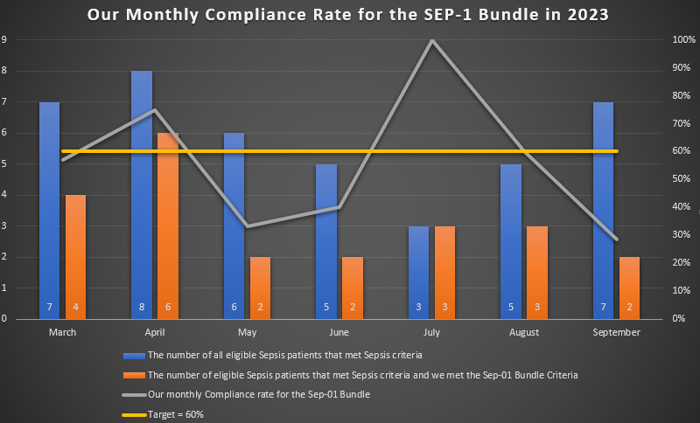

Slide 10
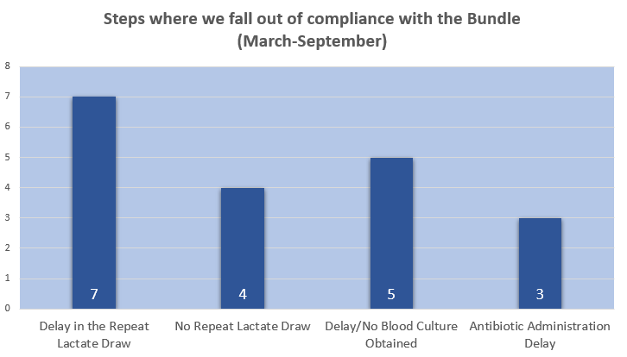

Slide 11
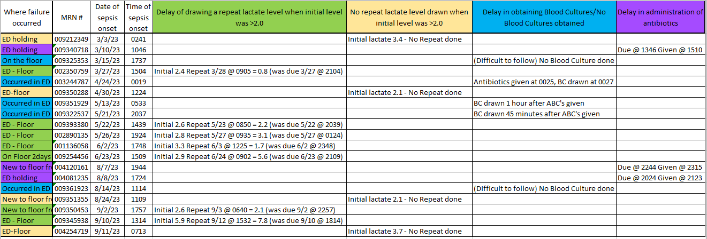
Where do most of the failures occur?

Slide 12
When will the project be considered a success?
When our Compliance Rate is and continues to be greater than or equal to 60%
Barriers
We have a low volume of severe sepsis/septic shock patients which make the rates move dramatically when one component is missed on just one patient.
We have low staff awareness on each component of the rigid rules to the Sepsis Bundle
80% of sepsis cases treated in hospitals are detected in the emergency department, and as sepsis patients are transferred to the floor for treatment the busy team may lose a step in the SEP-1 measure due to the multiple steps and specific timelines.
Few early ideas:
Create a hospital wide policy
Worksheets
Improve communication
Notes:
Must be overly diligent with patient care and timing of each aspect within the bundle.
Computer training/education to all involved staff members will be in November 2023
Sepsis Team formed to collaborate as a multidisciplinary team to find solutions to improve compliance rates

Slide 13

Conclusion
The Sepsis Bundle Compliance measure requires a high degree of manual medical record abstraction. It is a complex measure with many parts to it. It requires specific timing and implementation with communication needed hospital wide throughout most of the departments. We have a low volume of Severe Sepsis/Septic Shock patients that meet the inclusion criteria which makes it even more difficult to stay at or above our goal of 60% compliance. But with education to appropriate staff, this will not only increase the awareness of the CMS SEP-1 measure, but it will improve the compliance rate as a result. The creation of our new multidisciplinary sepsis team will find solutions to implement hospital wide and be able to share our new practices within the Bryan system to increase the entire system’s compliance rates.

