Slide 1
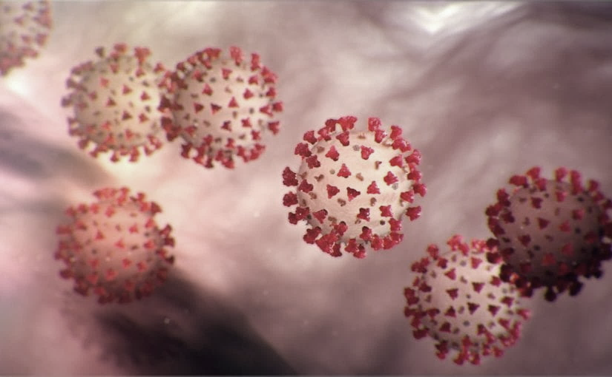
Covid-19 Webex Update
9-16-2020
​​
Tom Safranek, MD, State Epidemiologist
Louis Safranek, MD, PhD
Board certified specialist, Infectious Disease

Slide 2
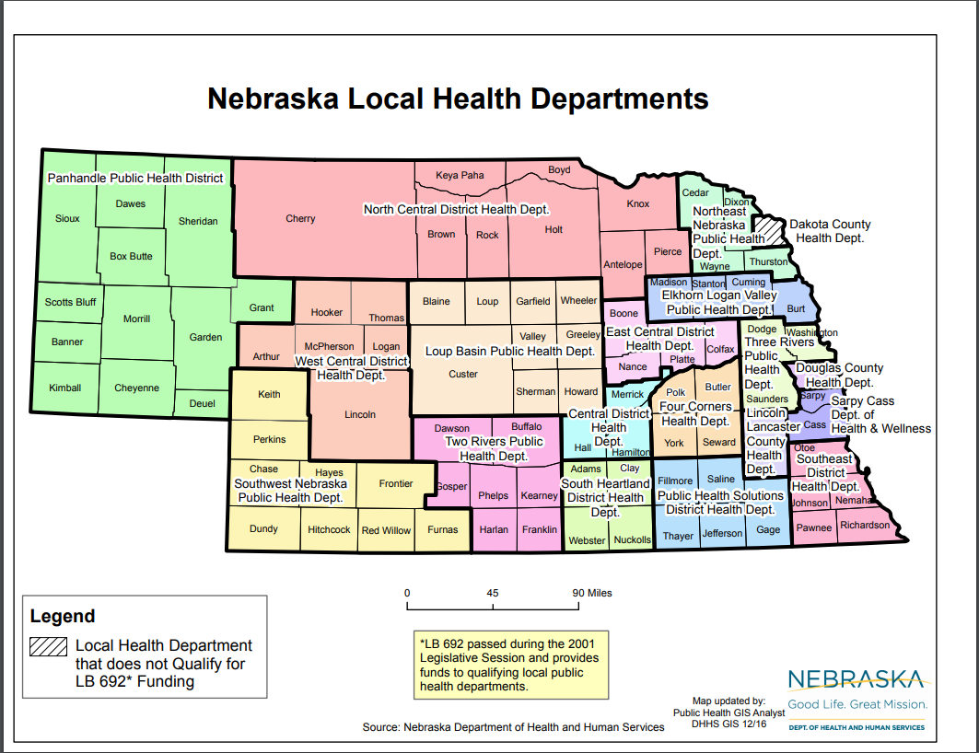

Slide 26
Slow progress
“The only wisdom we can hope to acquire Is the wisdom of humility: humility is endless.” ― T.S. Eliot, Four Quartets, East Coker

Slide 27
Masks
Slight reduction in SARS-CoV-2 exposure viral load due to masking results in a significant reduction in transmission with widespread implementation
Our model predicts that moderately efficacious masks that reduce transmission risk by 50% will lower exposure viral load 10-fold among people who do get infected, potentially limiting infection severity.
Overall, these results highlight the fact that masking is likely to have more of an impact on mean R0 than any form of licensed antiviral therapy that emerges during the course of the pandemic.
https://www.medrxiv.org/content/10.1101/2020.09.13.20193508v1.full.pdf

Slide 28
Masks
Masks Do More Than Protect Others During COVID-19: Reducing the Inoculum of SARS-CoV-2 to Protect the Wearer
Although universal public masking can certainly protect others, the “inoculum” theory argues for a major protective effect for the individual and will allow for the preservation of life, along with other COVID-19 control measures, as society re-opens.
https://link.springer.com/article/10.1007/s11606-020-06067-8

Slide 29
Experimental findings on masks
“Surgical mask partition reduces the risk of non-contact transmission in a golden Syrian hamster model for coronavirus disease 2019 (COVID-19)
  COVID-19 infected hamsters were placed in cages adjoining uninfected hamsters with no direct contact. When a surgical mask was placed between the cages, spread of infection was diminished and delayed and severity of infection reduced.
  https://www.ncbi.nlm.nih.gov/pmc/articles/PMC7314229/pdf/ciaa644.pdf
Notes:
Implication that exposure to lower viral intensity may result in less severe disease.

Slide 30
Testing
Self-collected Saline Gargle Samples as an Alternative to Healthcare Worker Collected Nasopharyngeal Swabs for COVID-19 Diagnosis in Outpatients
5 cc swish/gargle saline x each 5 seconds, total three 5 cc samples
Gargle was most sensitive compared to sputum or nasal pharyngeal swab
https://www.medrxiv.org/content/10.1101/2020.09.13.20188334v1.full.pdf

Slide 31
Effect of mutation on viral spread
The original virus has undergone mutation, and one particular mutation has become very wide spread.
This mutation changes the amino acid at position 614 on the spike protein, from D (aspartic acid) to G (glycine) — so, D-614-G.
This strain may be more contagious and is now the dominant strain in circulation.
https://medium.com/microbial-instincts/what-the-d614g-mutation-means-for-covid-19-spread-fatality-treatment-and-vaccine-7dda1c066f0d

Slide 32
Mysteries
Patients with severe Covid infections produce large amounts of antibodies.

Slide 33
Hydroxychloroquine
The Effect of Early Hydroxychloroquine-based Therapy in COVID-19 Patients in Ambulatory Care Settings: A Nationwide Prospective Cohort Study (Saudi Arabia)
All patients received zinc sulphate 60 mg once daily for five days. Those who received HCQ were prescribed a regimen of 400 mg orally twice a day for the first day, followed by 200 mg twice daily for an additional four days according to the MOH management guideline.
In mild to moderate COVID-19 patients was associated with lower odds of hospitalization and ICU admission and/or death
https://www.medrxiv.org/content/10.1101/2020.09.09.20184143v1.full.pdf

Slide 34
? Vitamin D
Vitamin D and Covid-19 Susceptibility and Severity: a Mendelian Randomization Study
The findings do not support a protective role of increased 25OHD levels on Covid-19 93 outcomes and may suggest harm.
Authors suggest that at present, individuals should not use vitamin D 94 supplements to protect against Covid-19 outcomes
https://www.medrxiv.org/content/10.1101/2020.09.08.20190975v2.full.pdf

