Slide 1
Behavioral Health Education Center of Nebraska (BHECN – unmc.edu/bhecn)

Slide 2
Answer these questions (Scale: 1= low to 5= high)
I am deliberate and purposeful when I work to overcome obstacles.
I believe I am in control of my life (behavior / destiny).
I attribute most of my mistakes/shortcomings to my inadequacies.
I attribute most of my mistakes/shortcomings to my circumstances.
I perceive most difficult situations/problems as a _______________.
My approach to difficult situations/problems are most affected by _________________________.

Slide 3
Behavioral Health Education Center of Nebraska (BHECN – unmc.edu/bhecn)
Dr. Krista Fritson, Director of BHECN (Kearney/UNK)
Licensed Clinical Psychologist
UNK Psychology Professor
Dr. Marley Doyle, Director of BHECN
Psychiatrist
UNMC

Slide 4
What is BHECN?
Created by Nebraska Legislature in 2009 to deal with the shortage of mental health professionals in rural/underserved areas of the state
Collaboration with colleges/universities and other academic institutions (UNMC, UNK, Chadron State, FCCLA, etc.), state legislature, and community resources

Slide 5
Mission
“BHECN is dedicated to improving access to behavioral health care across the state of Nebraska by developing a skilled and passionate workforce.”

Slide 6
Quick Facts about Behavioral Health Professionals in Nebraska
Nearly 1 in 5 Nebraskans have a mental illness
88 of 93 counties in Nebraska are designated as HRSA Mental Health Professions Shortage Areas
29 Counties have no behavioral health provider of any kind

Slide 7
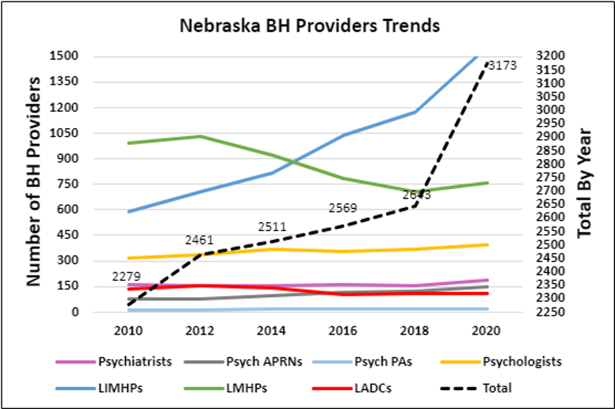
Preliminary Nebraska Provider Trends: 2010-2020
Nebraska’s behavioral workforce has seen positive growth, but the workforce is aging (half over age 50). More diverse providers are in demand, especially those who are bilingual. The need for behavioral health providers will always exist in Nebraska.

Slide 8
Monitoring Growth Behavioral Health Workers in Nebraska
From 2010 to 2020, the supply of behavioral health providers has increased by 32 percent among psychiatric prescribers and 39 percent among psychologists and mental health therapists
BHECN has strengthened partnerships with the 18 academic institutions providing graduate and doctoral behavioral health education in the state to collaborate on training and workforce retention
BHECN provided professional training for more than 4,914 individuals during fiscal years 2020-2021, a 49% increase over 2018-2019. The coronavirus pandemic swiftly shut down our plans for in-person conferences and training at the start of 2020. BHECN was able to adapt quickly and offer training virtually

Slide 9
Engage & Recruit

Slide 10
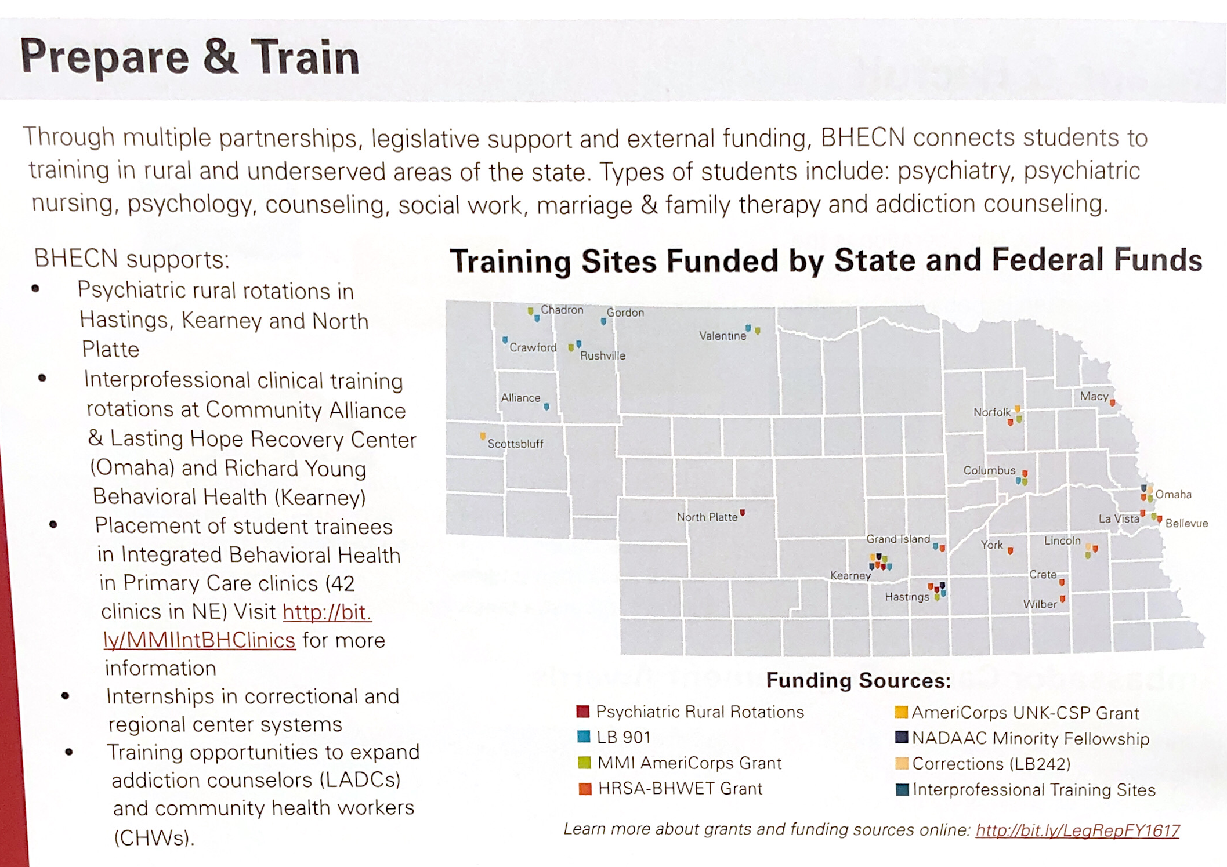

Slide 11
Behavioral Health Career Options

Slide 13
Retaining Behavioral Health Students
Goal - Retain 50% of behavioral health graduates by 2020
How? - Partnering with the 18 academic institutions providing graduate and doctoral behavioral health education in Nebraska to track the number of students graduating and staying in Nebraska

Slide 14
Nebraska Behavioral Health Regions

Slide 16
LEARNED HELPLESSNESS (Quit Trying)
Learned helplessness is the behavior exhibited by a subject after enduring repeated aversive stimuli beyond their control. Wikipedia

Slide 17
RESILIENCE
INTENTIONALITY
LOCUS OF CONTROL
ATTRIBUTION
PERCEPTION
APPROACH (or not)

Slide 18
Behavioral Health Education Center of Nebraska (BHECN – unmc.edu/bhecn)
Resilience
The capacity to recover quickly from difficulties;
toughness.

Slide 19
Behavioral Health Education Center of Nebraska (BHECN – unmc.edu/bhecn)
Intentionality
The fact of being deliberate or purposeful.

Slide 20
Behavioral Health Education Center of Nebraska (BHECN – unmc.edu/bhecn)
Locus of Control
A person’s perception of their personal control over their behavior; over their destiny.

Slide 21
Behavioral Health Education Center of Nebraska (BHECN – unmc.edu/bhecn)
Attribution
(Credit & Blame)
Dispositional
Situational

Slide 22
Behavioral Health Education Center of Nebraska (BHECN- unmc.edu/bhecn)
Perception
Threat
Challenge
Opportunity

Slide 23
Behavioral Health Education Center of Nebraska (BHECN – unmc.edu/bhecn)
Approach
Intentionality = LoC + A + P

Slide 24
Behavioral Health Education Center of Nebraska (BHECN – unmc.edu/bhecn)
INTENTIONALITY
=
Resilience
(The capacity to recover quickly from difficulties; toughness.)

Slide 25
Behavioral Health Education Center of Nebraska (BHECN- unmc.edu/bhecn)
CRISIS Phone / Text Lines:
Crisis/Suicide Line: 800-273-8255
Crisis/Suicide Text Line: 741-741 (Start texting to begin conversation.)
Need Someone to Talk to? (NON-EMERGENCY):
Warm Line: 877-823-8992
Self-Safety App:
MyCompanion Journal App: https://www.nsspc.org/mycompanion-app/
MyLINK App (Nebraska Resources – Mental Wellness & Life Needs): http://unknews.unk.edu/rovides-eas
COMING SOON
“988” -- Nation-wide Mental Health Emergency Calls (proposed July 2022
BHECN App: Connecting Resources, Professionals, & Future professionals

Slide 26
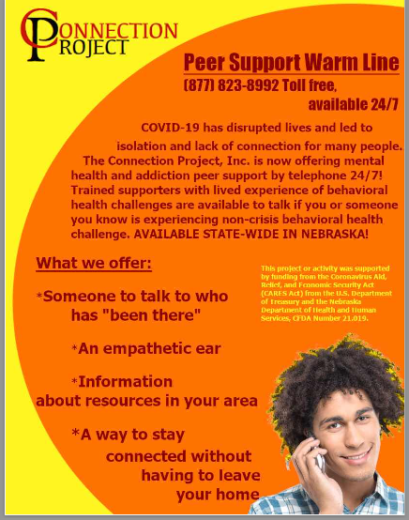
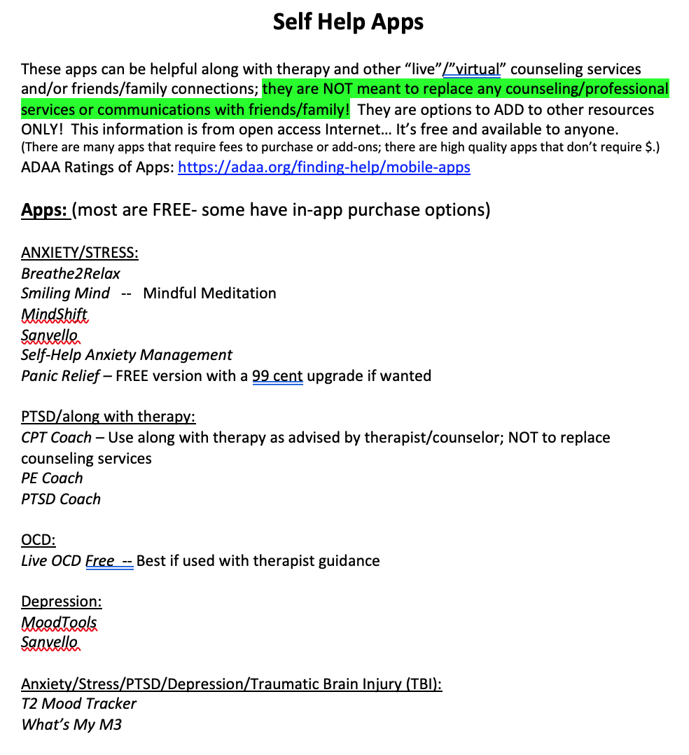
Behavioral Health Education Center of Nebraska (BHECN – unmc.edu/bhecn)
Progressive Relaxation / Mindfulness Activity
https://www.youtube.com/watch?v=utGa6rqzs3g
Activity options:
Pre-video:
What do you think progressive relaxation is?
Have you ever engaged in it?
What is mindfulness?
Have you done it?
How might these activities be helpful?
Post-video:
What was your experience like?
Pros/cons?
When might this be helpful in your life?
Would you share this video with anyone to improve their life/options for stress?

Slide 27
Behavioral Health Education Center of Nebraska (BHECN – unmc.edu/bhecn)

Slide 28
Behavioral Health Education Center of Nebraska (BHECN – unmc.edu/bhecn)

