Slide 1
Nebraska Hospital Association
Residency program
Terry Stafford PhD, EJD, RN, CPHQ, CHCQM, PCC
July 9, 2021

Slide 2
Objectives
Synthesize and apply quality/safety improvement methods and tools in a clinical setting.
01
Promote sustained improvement of an identified goal through effective application of quality improvement tools and methods.
02
Integrate improvement science, complexity science, quality and safety tools and methodologies to develop systematic designs to sustain improvement in population healthcare delivery and outcomes.
03

Slide 3

To Err is Human
To Err Is Human: Building a Safer Health System is a landmark report issued in November 1999 by the U.S. Institute of Medicine that may have resulted in increased awareness of U.S. medical errors. The push for patient safety that followed its release continues.
Notes:
This IOM report provided a scathing report of the medical errors that occur in our Health System. 22 year later we continue to work on safety, however, have made gains from the electronic medical record, National patient safety goals, safety reporting, and transparency to mandatory reporting. All this yet errors occur in medication, surgical areas, lab, and communication.

Slide 4

Second in the Series
Made an urgent call for fundamental change to close the quality gap. This book recommends a sweeping redesign of the American health care system and provides overarching principles for specific direction for policymakers, health care leaders, clinicians, regulators, purchasers, and others. In this comprehensive volume the committee offers:
A set of performance expectations for the 21st century health care system.
A set of rules to guide patient-clinician relationships.
A suggested organizing framework to better align the incentives inherent in payment and accountability with improvements in quality.
Key steps to promote evidence-based practice and strengthen clinical information systems.
Notes:
The second in the series Crossing the Quality Chasm took efforts and provided strategies to close the gap between care delivered and quality care. The four steps, performance expectations, rules to promote patient centered care through patient – clinician relationships, payments based on quality and using evidence-based practice.

Slide 5


Transformation
Notes:
So, transformation has occurred

Slide 6
Transforming Healthcare
Despite serious and widespread efforts to improve the quality of health care, many patients still suffer preventable harm every day. Hospitals find improvement difficult to sustain, and they suffer “project fatigue” because so many problems need attention. No hospitals or health systems have achieved consistent excellence throughout their institutions. High-reliability science is the study of organizations in industries like commercial aviation and nuclear power that operate under hazardous conditions while maintaining safety levels that are far better than those of health care. Adapting and applying the lessons of this science to health care offer the promise of enabling hospitals to reach levels of quality and safety that are comparable to those of the best high-reliability organizations.
High-Reliability Health Care: Getting There from Here MARK R. CHASSIN and JEROD M. LOEB
The Joint Commission 2013

Slide 7
The Why
Inpatient Quality Reporting Program. CMS proposed several changes to the Inpatient Quality Reporting Program, which reduces payment to hospitals that fail to meet program requirements. CMS is seeking to add five new measures, including COVID-19 vaccination rates among healthcare personnel, a metric targeting maternal morbidity and two medication-related adverse event electronic clinical quality measures. CMS also wants to remove the exclusive breast milk feeding measure, among other changes.
https://www.beckershospitalreview.com/finance/cms-proposed-inpatient-payment-rule-for-2022-8-things-to-know.html?origin=RCME&utm_source=RCME&utm_medium=email&utm_content=newsletter&oly_enc_id=2226C7659690D7
Notes:
So why should healthcare transform? Well for one reason, the Centers for Medicare and Medicaid Services (CMS) has tied hospital reimbursement to quality outcome scores. This article came from a May Becker’s Hospital Review and this clearly supports the reporting of quality metrics.

Slide 8
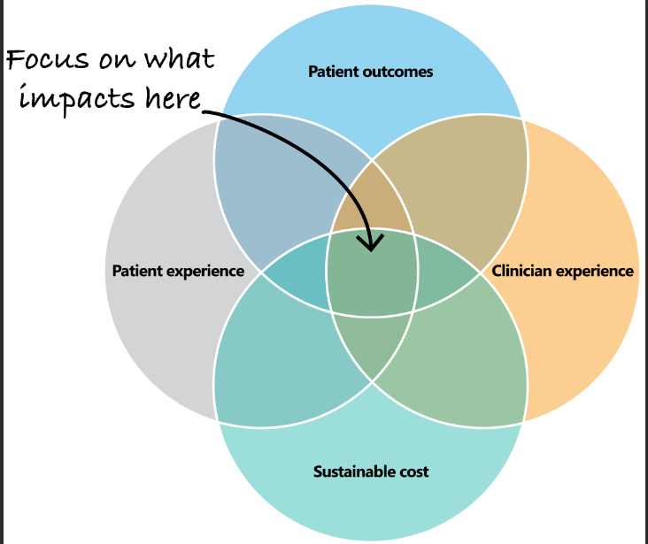
The Why – the Quadruple Aim
Improve patient outcomes
Improve patient experience
Lower health care costs
Higher healthcare workforce satisfaction
Triple aim created by the Institute of Healthcare Improvement (IHI) 2007
We haven’t finished with the triple aim – the triple aim is patient centered. We can’t lose focus and we must measure what matters. (IHI)
Notes:
Another Why: In 2007 Donald Berwick, a physician and a former administrator of CMS and former President of IHI developed the “Triple Aim” for healthcare. The Triple aim challenged health care to improve patient experience – satisfaction measurements came into play, improve patient outcomes – quality became paramount measuring clinical outcomes, infection rates, mortality, and reducing cost of services. Then in 2017, a fourth aim was added – enhancing the workforce and improving the work life of clinicians – also there is an element of equity – addressing bias's and assuring equality. So these are the Whys, the catalyst for transformation

Slide 9
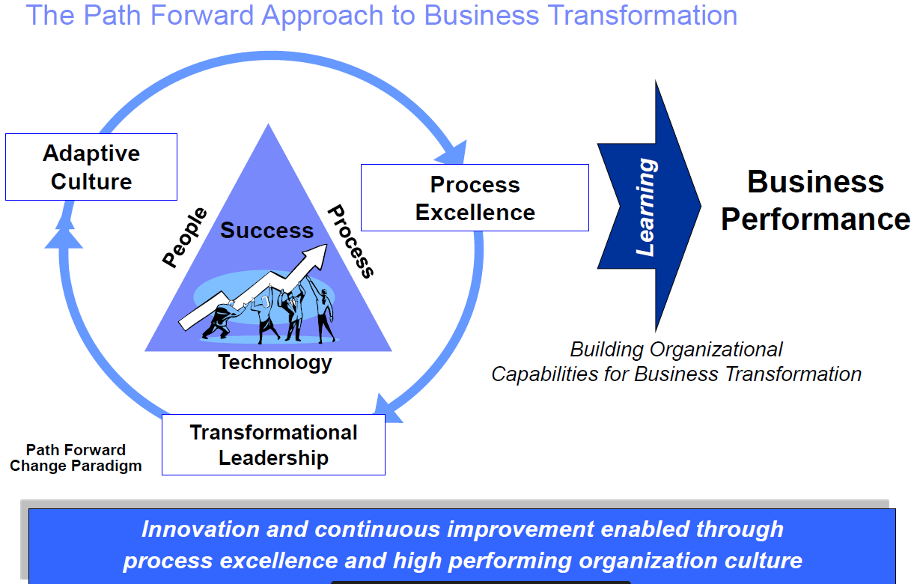
Purpose - Business Relevance: Refers to the characteristics of a particular change – aka, the burning platform and the vision; Balanced scorecard decision making, COMPELLING REASONS FOR CHANGE
Adaptive Culture is a way of operating where change is expected Adapting to change is smooth, routine and seamless. Change, growth, and innovation are a "given" part of the business environment.
Process - Innovation, change for the better, strategies
People can quickly and effectively make good decisions, and a team (group, organization, etc.) can coordinate efficiently, and ultimately
reach the targeted goal together
Transformational leadership is an approach in which a leader inspires and motivates team members to create positive changes within an organization.
https://www.iise.org
Notes:
I like this slide because this slide addresses the transformation process. Healthcare is a business. Transformation begins with an adaptive culture – recognizing change occurs and adapting to change. Change becomes part of the culture. Organizations should also consider the purpose of change. Change leads to process change and becomes a learning experience for all. Processes should demonstrate change for the better, strategies that make work efficient and simple. Technology comes into play with process improvement. Transformational leadership is when leaders inspire teams, staff to create positive change. In high reliable organizations –everyone expects the unexpected and proactively seeks improvement.

Slide 10
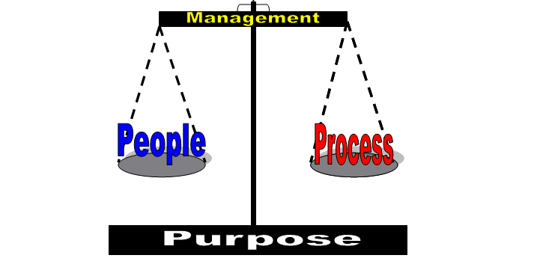
It’s a balancing act!
Notes:
So it’s a balancing act. The people (leaders and culture) , the process improvement strategies for the purpose of accepting change and making things better need to align.

Slide 11
Tools and Methods
Notes:
Now I would like to discuss tools and methods used in quality and process improvement that are proven, best practice and widely used. These tools and methods (of which there are many) create a toolbox for quality professionals to have at their disposal for process improvement.

Slide 12
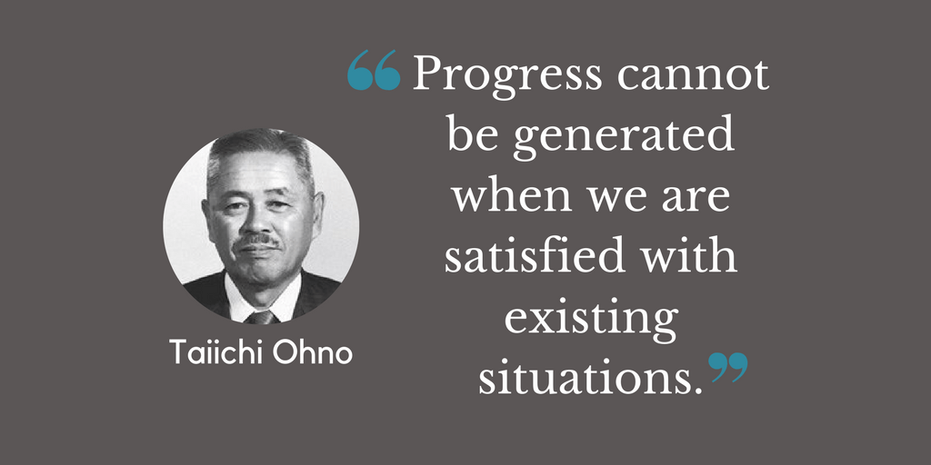
The Developer
Ohno Taiichi was a Japanese Industrial engineer and businessman. He is considered the father of the Toyota Production System, which inspired Lean Manufacturing in the U.S. He devised the seven wastes as part of this system.

Slide 13
What is LEAN Thinking?
At its core, Lean is a business methodology that promotes the flow of value to the customer through two guiding tenets: continuous improvement and respect for people.
Roots in Manufacturing
Lean methodology originated with the Toyota Production System, or TPS, which revolutionized the manufacture of physical goods in the 1950s, ‘60s, and beyond. Lean maintains its hold in manufacturing, but has also found new applications in knowledge work, helping businesses in all industries eliminate waste, improve processes, and boost innovation.
Lean thinking is a transformational framework that aims to provide a new way to think about how to organize human activities to deliver more benefits to society and value to individuals while eliminating waste.
Notes:
Healthcare has adapted LEAN thinking in its transformational journey. Healthcare realized that there is waste, inefficiency, untimely access to care, inequity, motion, unsafe practices occurring and has embraced LEAN thinking to improve in areas such as patient flow, communication, transitions of care (level of care, organization to organization, admission to home). Some of the tools apply to LEAN methodology and Six Sigma (DMAIC) that we will review next. Any questions so far?

Slide 14
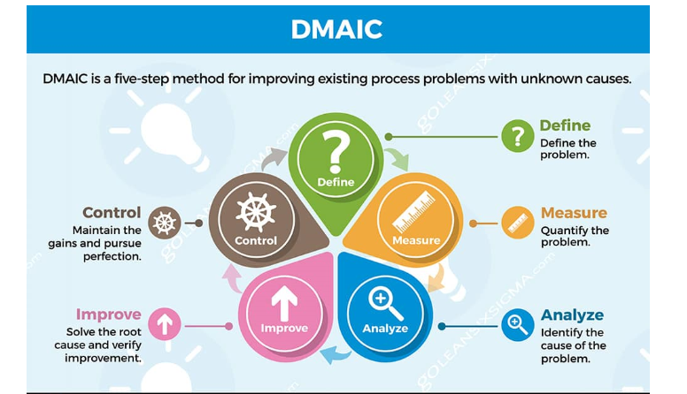
Six Sigma
Six Sigma is a process improvement methodology that is a disciplined, data-driven approach for eliminating defects and waste from a process. To achieve Six Sigma, a process must not produce more than 3.4 defects per million opportunities. A defect is anything that falls outside of a customer’s specification.
Six Sigma uses a method called DIMAC which stands for Define, Measure, Analyze, Improve, and Control. Each stage of this process is designed to help you identify, measure and improve existing processes.
Notes:
With LEAN comes Six Sigma – a very data driven process. Helpful though because data should drive improvement, projects, resources. The Joint Commission Center for Transforming Healthcare uses LEAN and Six Sigma Robust Process Improvement (RPI) Methods. Six Sigma projects are driven by reliable measurements, and they provide an ideal source of data on the impact of solutions that emanate from them. So, let’s review the DMAIC 5 step method. As we do this, I will provide examples of REAL projects that have been undertaken and show you how the method works.

Slide 15
Define – What do Customer’s Value?
What is the problem?
Why is it important?
Who is the customer?
What is critical to quality?
What is the goal?
Who are the stakeholders?
Who are team members?
Do you anticipate resistance?
What does the current state look like?
What are you going to improve, by how much and by when (timeline)?
Tools
Project Charter
15 Words – what is most important?
5 Whys (5 W’s)
Voice of the customer
SMART Goals (specific, measurable, achievable, relevant, timebound)
ARMI Analysis: Approval, R = Resource, M = Member, I = Interested Party
Stakeholder Analysis
Barriers to Success Analysis
Process mapping – define what you are changing
Value Stream Mapping
WWW
2011 The Joint Commission www.centerfor transforminghealthcare.org.
Notes:
The DEFINE phase is very important – in this phase the quality professional need to ask some questions – listed
This slide also describes TOOLS that are used in this phase, and we will discuss these as well. (talk about the tools)
A process map differs from a value stream map. The process map shows the current process and what you want to change.
A Value Stream Map – material information flow map. Not only analyzes the current state but designs a future state from beginning until the process reaches the customer. Shows all critical steps in the process and quantifies time and volume at each stage. Shows the flow of materials and information as the process progresses.

Slide 16

Columbo Approach
Detective Columbo always scratched his head and asked a lot of questions. A good mapping facilitator does the same. Good facilitators often suspect where the critical issues lie and direct questions accordingly.
Notes:
I call the DEFINE phase as the Columbo approach.

Slide 17

Project Examples
Reducing Falls
Patient Flow (ED, Clinic, Surgery, Procedures)
Patient Experience
Readmissions
Reducing infections
Reducing length of stay
Admission and discharge process
Care transitions
Reduce billing cycle time
Reduce purchasing costs and par levels
Achieving National Patient Safety Goals
What are the projects in your facility?
Notes:
Here are some projects commonly worked on in organizations. These often-become collaboratives, state or regional projects to share best practices across organizations. Is your hospital working on these or working on other projects?

Slide 18
Project Summary
Importance of this Opportunity to You: Having a child undergo surgery is a stressful event for a family. Providing as positive an experience as possible for the family surrounding the time of the procedure is important to me. Providing the family improved methods of education regarding the procedure and the postoperative recovery will arm families with information. Giving small amounts of information over time will improve retention.
AIM Statement: By December 31, 2019, the Division of Pediatric Otolaryngology at Nemours will provide text message-based messages postoperatively to families whose children have undergone two commonly performed surgeries, adenotonsillectomy and tympanostomy tube insertion. Families will understand and retain a greater amount of information regarding their child’s post-operative course. Frequency of postoperative calls and visits to the emergency department regarding information provided in the handout will decrease by 20% and family satisfaction will improve.
Rationale for Choosing this Project: As a busy pediatric otolaryngology practice, thousands of the surgeries are performed in our division each year. Improving retention of information will help improve the care that parents are able to provide their children at home. In addition, I hypothesize that 1. Improved understanding will translate into a more efficient outpatient practice, by decreasing the volume of postoperative parent calls fielded by the otolaryngology staff and so allowing more time to be dedicated to direct patient care. 2. The number of visits to the ED within 30 days of the procedure will decrease, which has benefits to both families and the health care system. 3. Families’ satisfaction regarding their child’s surgical experience will increase.
Notes:
Here is a Project summary from a MD – a Pediatric Otolaryngologist, She and I worked on this project and during the define phase asked the purpose, importance and defined the direction of the project. Here is a project that will improve family experience and satisfaction in the practice and hospital. Nemours is a Children’s Health System that operates in New Jersey, Delaware, Pennsylvania and Florida. The system provides primary care, urgent care , specialty care, Hospital ED services, and conducts research trials. Services span 97 location.

Slide 19
Project Summary
Project Title: Combating alarm fatigue by reducing the number of pulse oximeter alarms in the ICU.
AIM Statement: AIM to combat alarm fatigue in the nursing staff, this project will decrease the number of a frequent alarm, the pulse oximeter alarms, that sound daily in a medical ICU by 35% from baseline by October 1, 2019
Importance of this Opportunity to You:
  Alarm management is a national patient safety goal
  Too many alarms sounding causes alarm fatigue.
  Alarm fatigue is a risk to patient safety
  Alarm fatigue is a contributes to staff burnout
Rationale for Choosing this Project:
  Recent SCORE survey revealed a high level of burnout in the medical ICU.
  I am the support person for the national patient safety goal of alarm management.
  The alarm management committee needs an actionable goal for FY 2020
  A patient safety issue for patients and families.
Notes:
This project is a project from an ICU nurse addressing one of the National Patient Safety Goals. Alarm fatigue in the ICU is very real, nurses become desensitized to alarms, thus causing a huge patient safety issue for nurses and patients. Here the nurse defined the problem – so far as to the type of alarm with a data driven AIM statement and smart goal.

Slide 20
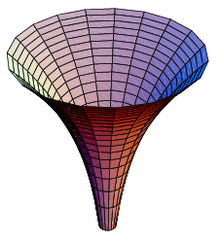
Summary - Define
Drill down - keep questioning until you have the problem, issue or project clearly defined, measurable and relevant and workable.
Don’t boil the ocean
Team consensus for understanding
Use tools to define the problem
Notes:
In summary in the define phase assure you have drilled down enough to have a project of value to the customer, remember the Columbo approach. Do not boil the ocean, if the project is big, hospital wide

Slide 21
Measure – Identify all steps in the process
What steps have the biggest impact on the customer?
What could go wrong within the key steps?
What are probable causes?
What are you going to measure?
How reliable and accurate are your data?
How can a new process meet the customer’s demand?
Tools
Cause and Effect Diagram
RCA
Data Collection Plan
Spaghetti Diagram
Value Stream Map
Failure Mode Effects Analysis (FMEA)
2011 The Joint Commission www.centerfor transforminghealthcare.org.
Notes:
In this step the key is to determine what process to measure. You may think to measure the entire process when in fact one step in the process causes the problem or results in the outlier. Therefor the tools provided here are necessary to breakdown the process. The next few slides will demonstrate how to identify significant measure points.

Slide 22
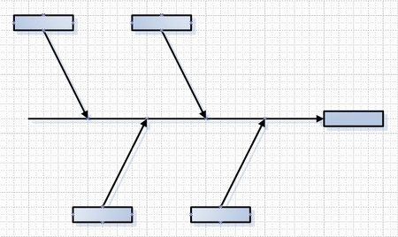
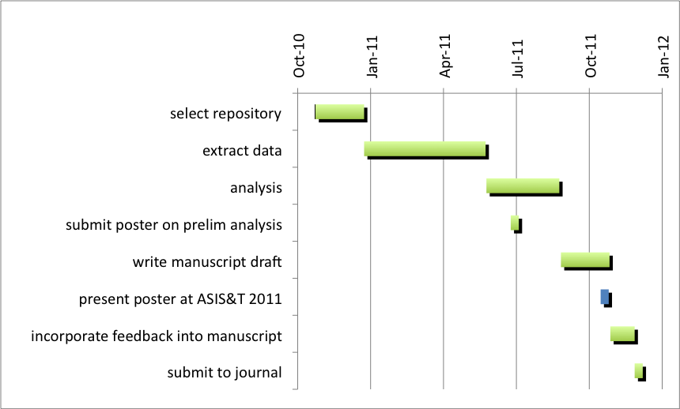
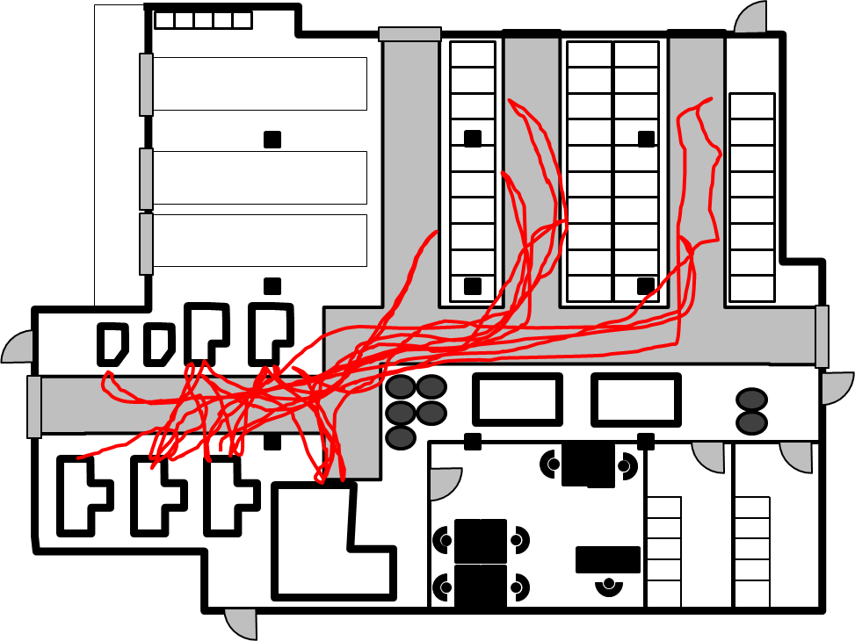
Tools
Examples
Notes:
Spaghetti diagram
Cause / Effect Diagram (Ishikawa – fishbone diagram)
Data Collection Plan (timeline, amount, type, analysis)

Slide 23

Value Stream Mapping
“Whenever there is a product (or service) for a customer
There is a value stream. The challenge lies in seeing it!.... John Shook
A Value Stream Map (VSM) is a graphic map of all steps
that occur from the specific request for a product (or service) to the actual delivery. A VSM provides a simple means to see the request.

Slide 24
VSM Attributes
A high level view
Recognizes activities as value added or nonvalue added
Demonstrates workflow as of NOW
Plots steps in request as the occur right to left
Plots steps in the process left to right
Identifies areas of delay, wastes and inconsistences
Forms the basis for future state development
Maps the flow of patient, information and materials

Slide 25
Value Added
Product or service transformed into a state required by the customer
If asked the customer is willing to pay for the product or service

Slide 26
Non-Value Added
Needed | True Non-Value Added
Activities causing no value or created value but cannot be eliminated | Activities consume resources but create no value in the eyes of the customer
Required/Regulatory, customer mandate | Pure Waste
Necessary due to non-robustness of the process

Slide 27
The VSM Perspective
Walk the Gemba to get information to create a VSM – Observe people doing the job.
A VSM shows how the work flows NOW, current state VSM show the “how” through direct observation.
The current state VSM highlights all types of waste (waiting, transporting, motion, excess processing, defects, overproduction)
The goal is to eliminate the waste in the future state VSM add design and make the process standard work
Customer point of view and high level
Shows where the process doesn’t flow because of waste and delays.
Notes:
Gemba – the crime scene, where the work is done

Slide 28
Uses of a VSM
Understand process steps
Visualize location of problems
Launch problem solving efforts
Educate staff on the process
Describe the process to others (leaders)
Springboard for future state processes

Slide 29
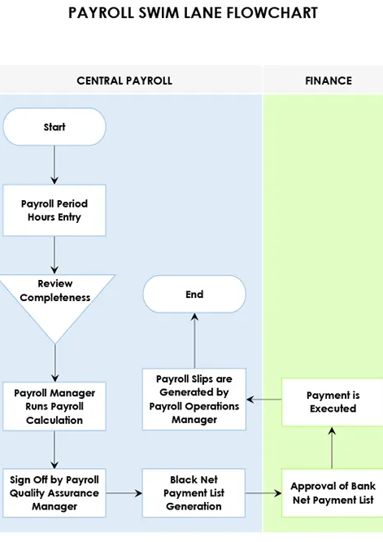
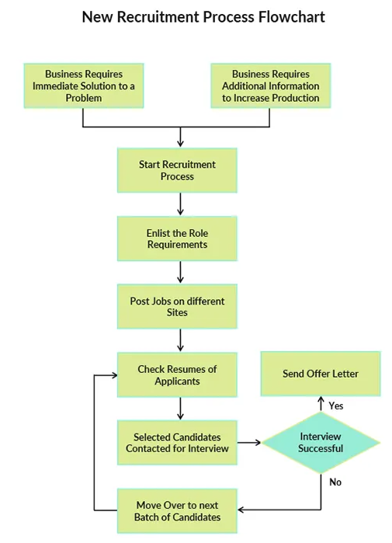
Typical Flow Charts
(shows step by step)
Notes:
Many of us use typical flow charts to demonstrate how something works or flow. This slide show a swim lane flow chart that has the duties or functions (process steps) list beneath the department or person responsible for that step. The other flow chart is a typical flow chart.

Slide 30

Typical Flow (Process) Chart ordering Ice Cream – This is NOT a VSM
The Ice Cream Cone Assembly Process
Get Customer order
Hand Customer Ice Cream Cone
Find Flavor
Find and rinse scoop
Get empty cone
Scoop Ice Cream into Cone
Viewed from how the work is done
Notes:
To demonstrate the difference between a typical process step flow chart I used a process of familiar to all of us……ordering an ice cream cone

Slide 31


Value Stream Map
This Photo by Unknown Author is licensed under CC BY-SA
This Photo by Unknown Author is licensed under CC BY-SA
This Photo by Unknown Author is licensed under CC BY-SA
Ice Cream Cone Purchase VSM
Customer enters ice cream store and chooses flavor
waiting
Gives order to server
Assembles ice cream cone and delivers
Pays for cone
Exits and eats cone
waiting
waiting
Viewed from what the customer expects, and different from a
conventional flow chart because the VSM indicates waste.
= delay
Notes:
A value stream map looks at the same process through expectation of the customer and identifies areas of measurements. One can see where in the process work could begin to reduce delay time and improve efficiency.

Slide 32
What flows through a Value Stream
In Manufacturing: Materials
In Services: External needs of the customer and information
In Healthcare: Patients and family members, also materials (objects) and information (handoffs)

Slide 33
Questions that Create a VSM
Is what we think happens really happening?
How long does each step take
Do we have all the details of the process?
Do we know what triggers the start and when the process finishes (cycle time)?
What resources are necessary in each step?
What opportunities for improvement exist?

Slide 34
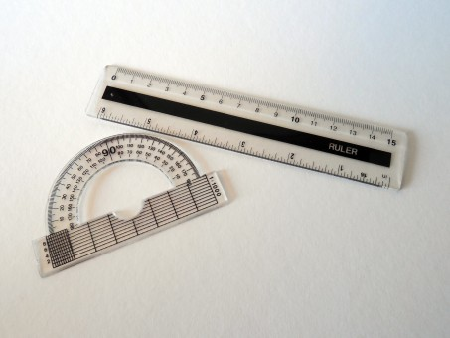
Summary - Measure
Know your process – observe
Flow the process to identify value added and nonvalue added steps (from the customer’s perspective
Identify the areas of waste, delay and measure.
Identify and prioritize the steps in the process that require improvement
Notes:
In summary in the define phase assure you have drilled down enough to have a project of value to the customer, remember the Columbo approach. Do not boil the ocean, if the project is big, hospital wide

Slide 35
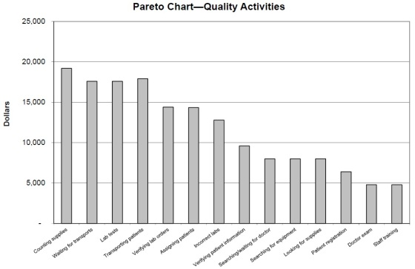
Analyze – Validate the root cause, waste and defects
What does your data show (statistical or practical significance)?
How are you going to communicate your results to stakeholders
Tools
Pareto charts
Histograms
Dashboard
Communication Plan
Notes:
After you have collected measurements, one then analyzes the data and graphically displays the data in order to communicate change and improvement areas to others

Slide 36
Analyze
Goal is to get as much information and measurements on the current process as possible
Identify and spot problem areas
Identify defects
Use statistical tools, correlations, comparisons, etc. to report the data

Slide 37
Summary - Analyze
Use these data to make a business case for change, set realistic and achievable goals and drive improvements.

Slide 38
Improve – stabilize the process, reduce or eliminate waste, variation and defects
What are possible solutions targeted to improve the validated root causes?
What is the best solution?
How are you going to test the solution?
Where should you focus change management efforts?
Tools
Brainstorming
Facilitated meetings
Mistake proofing
Plan Do Study Act (PDSA) cycles

Slide 39
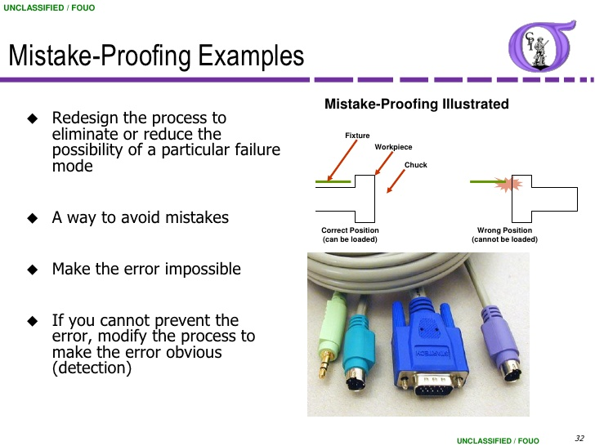
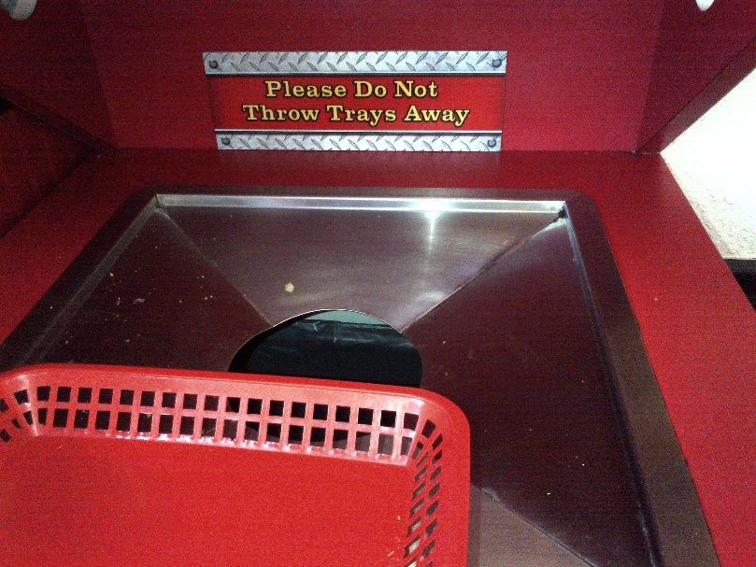
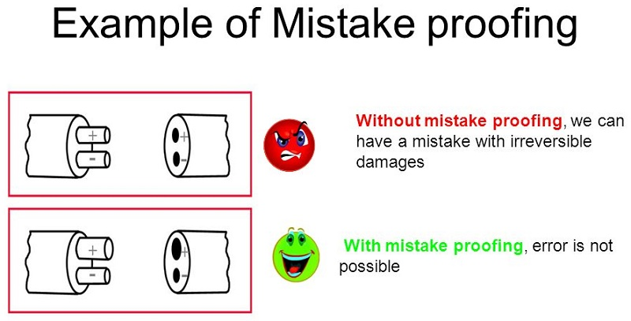

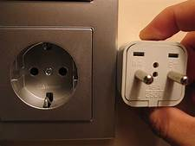
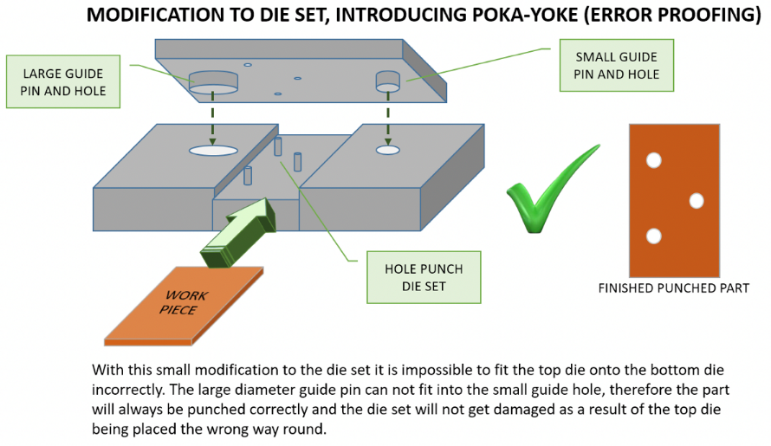
Visual Controls for Mistake Proofing
Notes:
In terms of patient safety making a process “mistake proof” eliminates chances for error. This slide demonstrates examples of mistake proofing.

Slide 40
Other Types of Mistake Proofing Strategies
Barcoding
Arm Bands
Sensors
Checklists
Templates
Electronic order entry systems
Medication scanners
Notes:
When we work around these strategies is when mistakes happen.

Slide 41
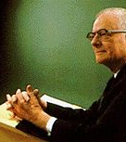
Plan–Do–Study–Act (PDSA) “Tests of Change”
A systematic approach to learning about a process that leads to continuous quality improvement.
Dr. Edwards Deming popularized the PDSA approach in 1950”s
Plan – Define the project and risk factors and what will happen (intervention)
Do - collect data and carry out the planned strategy
Study – analyze outcomes; what part of the strategy worked or failed to meet the desire goal
Act – Identify and adopt new strategies, tweak the current strategies, repeat the

Slide 42
PDCA – Follow up after surgery
PLAN
Decrease the number of postoperative calls to the office
Check
baseline and post-intervention data will be collected regarding the number of phone calls to office and the number of visits to the ED that could have been avoided if a family had a better understanding of the expected/normal postoperative symptoms
ACT
The system has not yet been implemented; it is anticipated that an internal pilot/test phase will start over the next month.
Decrease the number of postoperative visits to the emergency department
Texts will contain small amounts of information in each message and will be distributed over several days, at times when symptoms are most likely to be occurring
Improve understanding and retention of information related to the child’s surgery and expected postoperative course
DO
Improve family satisfaction regarding the perioperative/postoperative experience
How? By providing a new method for the distribution of educational information to families, via text message
If an improvement is not seen in the two primary outcome measures, then the types of calls and/or visits to the ED will be examined, to see if there is a better way or better time to convey the related information to families
The last text message will also have a link to a patient survey, regarding the utility of the text messages, thus measuring satisfaction with the new system of delivery
A run chart will then be constructed for each of these measures

Slide 43
PDCA –Alarm Fatigue
PLAN
Goal for this project: Decrease the number of pulse oximeter alarms that sound daily in a medical ICU by 35% by October 1, 2019
DO
Check
Success will be measured by collecting data on number of alarms that sound
ACT
Currently only baseline data is available. When new data is collected, I will be to fill out this section.
Decrease the default parameter for pulse oximeter from 90% to 88%
Educate nurses on the importance of individualizing parameters for each patient.
Pulse check burnout survey for staff
Notes:
After you have your plan you will execute the plan or set the plan in motion. During the implementation phase you will want to watch what happens. In this DO section you could also document what you observed. How did the staff react to the change? Did implementation go as planned? Did you make any modifications to the plan. These are questions as you advance further with the project and recommendation to address these issues in your final poster .
Check means after implementation what did you learn and did you meet your measurement goal?
In this section you make conclusions about the entire PDCA cycle. What went well, what would you have done differently, and are you ready to spread the process across to other units. When you have your final data then you can address these questions as well.

Slide 44
When completing a PDSA consider …….
1) What are you trying to accomplish?
2) How will you know when the change is an improvement?
3) What changes will result in the improvement?
www.ihi.org.
Notes:
In summary when conducting a PDSA, remember what you want to accomplish? What will be a small outcome to tell you the intervention is working as intended?
How will you notice improvement? Metrics?
What change will result in the improvement?

Slide 45
Summary - Improve
Select strategies based on best practice, safety, simple, not burdensome to the department, staff, organization.
Test the strategy, tweak, measure and reimplement
Use multiple PDSA cycles in PI activities
Make sure improvement strategies are controllable, sustainable and spreadable
Notes:
You will more than likely conduct many PDSA cycles to achieve what you want. Do not be afraid to test and retest all making the process better.
The ideal is a process that sustains the testing and may spread or work in other areas of the organization. For example, if a process works on the inpatient side, the same process with minor adaptation can work in a clinic setting

Slide 46
Control – Standardize and Sustain Improvement
How will you know your improvements are sustained?
What if anything could go wrong with the improvements
How are you going to make these improvements routine?
How will you celebrate success
Can the improvements be applied to other areas (spread)
How will you hand off the project and communicate to stakeholders?
Tools
Data charts
Visual Management System
Rewards and Recognition
Control Plan
WWW

Slide 47
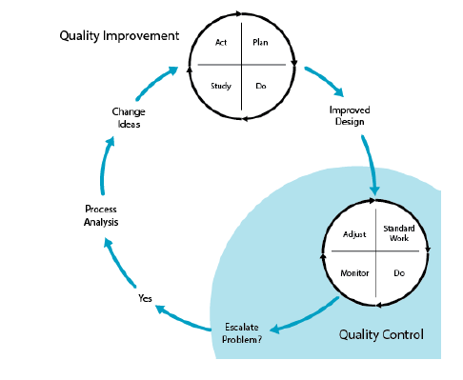
Quality Control Model
Scoville R, Little K, Rakover J, Luther K, Mate K. Sustaining Improvement. IHI White Paper. Cambridge, Massachusetts: Institute for Healthcare Improvement; 2016. (Available at ihi.org)
Notes:
This model shows the difference between quality improvement and quality control. With improvement you have a problem (escalated), noticed that what we were doing is not working. To rectify the problem, more than likely a process change must occur, so a team forms to analyze the process, gather data, create improvement metrics, generate ideas for change. Once a change is selected, the PDSA cycle occurs with an outcome of an improved design. In the control phase, the intervention becomes standard work, everyone knows the process is done as intended, monitoring occurs to assure stand work and the process in in control and handed off to a process leader.

Slide 48
Project Improvement Plan Results Summary
 | GOAL | RESULT | IMPROVE or SUSTAIN? | ACTION PLAN
AIM
AIM Statement: By December 31, 2019, the Division of Pediatric Otolaryngology at Nemours will provide text message-based messages postoperatively to families whose children have undergone two commonly performed surgeries, adenotonsillectomy and tympanostomy tube insertion. Families will understand and retain a greater amount of information regarding their child’s post-operative course as evidenced by fewer ED visits and fewer calls to the office with post op questions. | Postoperative calls and visits to the emergency department regarding information provided in the text messages will decrease by 20%. | TBD | Improve | Implement the text messaging system Educate providers, office staff and families as to the purpose, content and timing of the messages Data metrics will focus on reduced calls to the office and decreased ED results for normal post op sequelae.

Slide 49
Project Improvement Plan Results Summary
 | GOAL | RESULT | IMPROVE or SUSTAIN? | ACTION PLAN
METRICS
Number of calls per month/number of bilateral myringotomy with tube insertions per month | 20% decrease | Initial data collection began____(date) | Preliminary data suggests continued improvements through PDSA cycles | Continue with education to staff and providers Develop a tool to collect family satisfaction comments about the text messages. Do families like receiving the messages? Do families read the text messages? Do they find the information helpful to understand the post op plan? What information could be added to the messages? What information could be eliminated from the messages?
Number of calls per month/number of adenotonsillectomies per month | 20% decrease | Initial data collection began____(date)
Number of ED visits per month/number of bilateral myringotomy with tube insertions per month | 20% decrease | Initial data collection began____(date)
Number of ED visits per month/number of adenotonsillectomies per month | 20% decrease | Initial data collection began____(date)

Slide 50
Project Improvement Plan Results Summary
 | GOAL | RESULT | IMPROVE or SUSTAIN? | IMPROVE or SUSTAIN? | ACTION PLAN
AIM
AIM to decrease alarm fatigue in a medical intensive care unit through actions that decrease the total number of pulse oximeter alarms that sound daily. | Decrease number of pulse oximeter alarms by 35% from baseline by October 1, 2019 | Still collecting data but so far there are less pulse oximeter alarms. but I don’t have all the data yet. |  | Sustain | Continue to monitor number of alarms that sound daily.
METRICS
Number of alarms sounding that are low pulse oximeter alarms before intervention | Baseline Data | 50-60% of all alarms are low pulse oximeter alarms |  | Improve | Decrease the default parameter to 88% for low pulse oximeter Educate nurses on individualizing parameters for each patient each day. | Decrease the default parameter to 88% for low pulse oximeter Educate nurses on individualizing parameters for each patient each day.
Number of nurses educated on the new parameter and individualization of alarm parameters. | 95% | 100% were educated as part of mandatory competencies. |  | Sustain | no further action required | no further action required Continue to perform bedside competencies as needed
Number of alarms sounding that are low pulse oximeter alarms post intervention | Decrease | Still collecting data |  | sustain/improve depending on results | Audit nursing documentation of parameters Random real-time discussion with nurses about their patient and parameters | Audit nursing documentation of parameters Random real-time discussion with nurses about their patient and parameters Continue to monitor noise levels to assure sustainable results

Slide 51
Project Improvement Plan Results Summary
Future spread projects | GOAL | RESULT | IMPROVE or SUSTAIN? | ACTION PLAN
METRICS
In the medical intensive care unit create a process to decrease CO2 alarms. This study showed this was also a high-rate alarm. | Decrease CO2 alarms that sound daily by 35% by January 1, 2020 | TBD | TBD | Bring sales rep back in to evaluate cause of alarms and determine intervention Analyze appropriateness of patients being monitored Analyze need for continuous monitoring vs intermittent monitoring to decrease alarms
Evaluate alarms in surgical trauma, neuro and cardiac ICU units for greatest alarms that sound daily | Decrease these alarms that sound by 35% by January 1, 2020 | TBD | TBD | If it is pulse oximeter decrease default to 88% Work with leadership and staff to create a unit specific process to decrease most frequent alarms.
Continue analyzing alarms on other units to decrease highest volume alarms on each unit. | Decrease these alarms by 20% by March 1, 2020 | TBD | TBD | Work with leadership and staff on each unit to customize a process to decrease these alarms on each unit.

Slide 52

Summary - Control Phase/Sustainability
Sustainability occurs when processes or improved outcomes last within an organization after implementation has occurred. An improvement that has become part of the organizational culture and has been maintained regardless of workforce turnover is an example of a sustained improvement.
Sustainability is also related to successful culture change within an organization. Maintaining the ideas, beliefs, principles, or values underlying an initiative and having the new ways of working become the norm show that the change has positively influenced the culture.
CELEBRATE
Notes:
Control and sustainability are very important. This slide explains that the improvement lasts within the organization, regardless of workforce turnover and becomes part of the “CULTURE” of the organization. Everyone has responsibility to carry out the process. The new way one works becomes the norm. This phase is the ideal and what quality strives to achieve.
This is my husband’s horse Dan kicking up his heals!

Slide 53
Objectives
Synthesize and apply quality/safety improvement methods and tools in a clinical setting.
01
Promote sustained improvement of an identified goal through effective application of quality improvement tools and methods.
02
Integrate improvement science, complexity science, quality and safety tools and methodologies to develop systematic designs to sustain improvement in population healthcare delivery and outcomes.
03
Notes:
Well let's review our objectives. I think we accomplished how to apply quality tools and methods in a healthcare setting, learned what it takes to sustain improvement, and through definition, of our project integrated population health – drill down into a particular population , and complexity science, which is what quality professionals use in leading and solving complex, unpredictable problems in highly complex organizations and evolving health care systems.

Slide 54
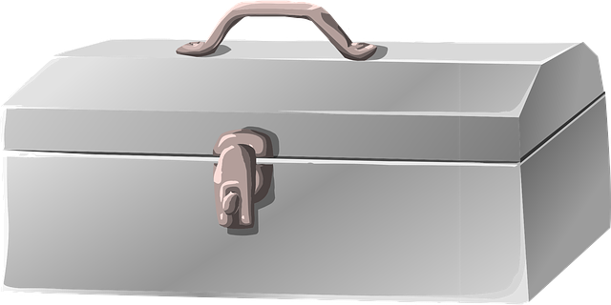
Lean Tool Learned
Value Stream Maps
Current State Maps
Future State Maps
Leadership
Coaching
Cultural Transformation
Change Management
WWW
Control Plan
Communication Plan
Stakeholder Analysis
Data charts
FMEA
ARMI Analysis
Rewards and Recognition
Visual Management Systems
Cause and Effect Diagrams
SMART Goals
Barriers to success
Voice of the Customer
Project Charter
Waste walks
Gemba walks
Spaghetti Diagrams
Standard Work
Mistake Proofing
Six Sigma
PDSA
Notes:
These are the tools we either referred to or discussed - this is a start to a full quality tool box.

Slide 55

David Lawrence,
Chairman Emeritus
Kaiser Permanente
“Every great organization in the world does two things everyday: makes a product, and makes the product better”
Notes:
And finally, Kaiser Permanente is one of the largest nonprofit healthcare plans in the United States, with over 12 million members.
operates 39 hospitals and more than 700 medical offices, with over 300,000 personnel, including more than 80,000 physicians and nurses.
The President of this organization says….. This is quality improvement

Slide 56
Resources
Institute for Healthcare Improvement (IHI) www.ihi.org
Crossing the Quality Chasm: A New Health System for the 21st Century Institute of Medicine (US) Committee on Quality of Health Care in America Washington (DC): National Academies Press (US); 2001.PMID: 25057539 Bookshelf ID: NBK222274 DOI: 10.17226/10027
https://www.nap.edu/resource/9728/To-Err-is-Human-1999--report-brief.pdf
Scoville R, Little K, Rakover J, Luther K, Mate K. Sustaining Improvement. IHI White Paper. Cambridge, Massachusetts: Institute for Healthcare Improvement; 2016. (Available at ihi.org)
Agency for Healthcare Research and Quality www.ahrq.gov.
The Joint Commission www.jointcommission.org.
Becker Hospital Review CMS' proposed inpatient payment rule for 2022: 8 things to know
Alia Paavola - Wednesday, April 28th, 2021
Quality improvement and patient safety: Reality and responsibility from Codman to today Martin A. Koyle a,b , Leah C.C. Koyle c , G. Ross Baker Journal of Pediatric Urology 2018 14, 16-19
www.kaiserpermanente.org.
Gridller, Steven J., Glezos, Christopher D. MD, Link, Timothy M., Sharan, Alok, MD, The Science of Quality Improvement. Journal of Bone and Joint Surgery; JSBS Reviews Vol 4(8) 2 August 2016.
https://www.lean.org.
Notes:
I will take questions, comments, feedback at this point.

