Slide 1
Best Practices in Sepsis & The Nebraska Sepsis Toolkit
A Panel Discussion

Slide 2
Panelists:
Dr. Amy Vertin, ED Medical Director & Physician Leader
  Bryan Health
Anne Timmerman, Director of Quality & Safety
  Franciscan Healthcare
Andrew McCarty, Stroke & Sepsis Program Coordinator
  Mary Lanning Healthcare
Jenni Meiergerd, Infection Control, Employee Health, Safety Coordinator
  Franciscan Healthcare
Kevin Sponsel, Infectious Disease / Antimicrobial Stewardship Clinical Pharmacist Specialist
  Bryan Health
Denise Moeschen, Clinical Quality Specialist
  Bryan Health

Slide 3
Learning Objectives:
Define sepsis and recognize signs / symptoms of sepsis.
Compare sepsis screening tools.
Discuss and review sepsis bundles and Evidence-Based sepsis care.
Relate best practices to sepsis care in rural healthcare.
Describe best practices for patients transferred to a tertiary care center.

Slide 4
Question #1
What are the newest / approved sepsis definitions?

Slide 5
Sepsis Definitions:
Sepsis
Severe Sepsis
Septic Shock

Slide 6
Question #2
Describe the best sepsis screening tools / processes and how do those tools fit into daily patient care?

Slide 7
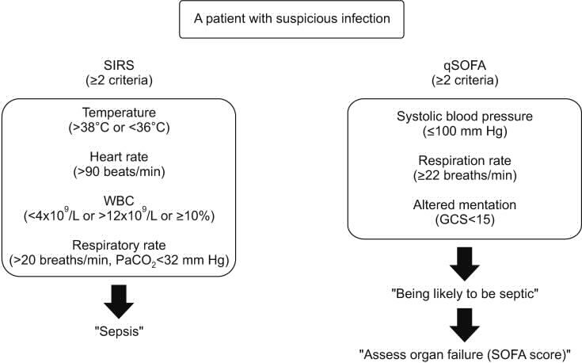
SIRS Criteria

Slide 8

qSOFA

Slide 9
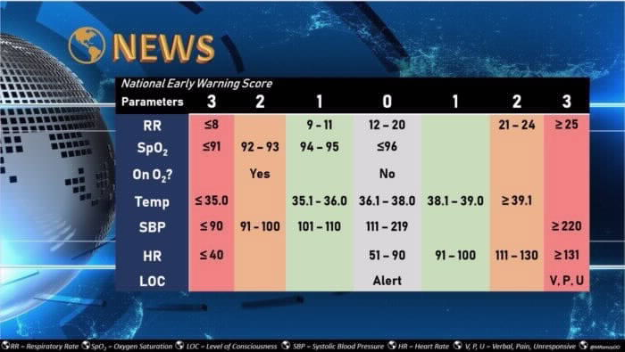
NEWS

Slide 10
Other Screening Considerations:

Slide 11
Question #3
What are the most current CMS Bundle Requirements and how have those changed over the past 12-months?

Slide 12
Sepsis Bundles
Time Zero: time zero is recognition time: for the ED that is triage completion time; see tips
3 Hour Bundle: everything in this bundle must be completed prior to 3 hours after time zero
  Lactate drawn *repeat in 4 hours if > 2.0
  Blood Cultures drawn *2 sets - can be drawn concurrently with 2 separate venipunctures
  Antibiotic delivery *goal all antibiotics initiated within 1 hour of order time
  Fluid Resuscitation Bolus *For SBP < 90; MAP < 70; Lactate > 4.0
6 Hour Bundle: everything in this bundle must be completed prior to 6 hours after time zero
  Addition of vasopressors *Norepinephrine preferred
  Repeat lactate *If initial >2
  Central line insertion
  Monitor CVP
  Monitor ScV02

Slide 13
Sepsis Tips
“Time Zero” is defined as the time of earliest chart annotation consistent with all elements of severe sepsis, or septic shock ascertained through chart reviews. If unknown, may use: Triage Completion time for ED; time of arrival for direct admits with sepsis; sepsis BPA time; BRRT time; Time orders are first received.
3 hour bundle
  2 sets of Blood cultures should be drawn PRIOR to antibiotic delivery
  All antibiotics must hit the body within 1 hour of order time AND within 3 hours from time zero
  Fluid resuscitation is defined as 30 ml/kg crystalloid (Normosol/Plasma-Lyte,NS) bolus initiate ASAP
    For SBP < 90; MAP < 70; Lactate > 4.0
    A bolus is defined as 1 liter over 30 minutes (ICU/ED) or 60 min (other acute care areas) some situations may require faster administration. If so, consider transfer to ICU.
6 hour bundle
  If hypotension persists, start a vasopressor. Norepinephrine is the preferred vasopressor.
    Requires adequate fluid resuscitation to be successful
    Norepinephrine gtt starts at 0.02 mcg/kg/min for sepsis. Titrate by 0.01 or 0.02 mcg/kg/min q 5 min to goal MAP > 65
    If initial lactate > 2, a repeat needs to be drawn. The repeat lactate needs to be completed within 6 hours from time zero
Centrally inserted central line preferred for a patient in shock
A repeat assessment of volume status and tissue perfusion is required for patients with septic shock. Measure and ScVO2 (lab drawn from distal port) – these can be obtained from a PICC as well

Slide 14
Question #4
What does a sepsis alert look like in use on your units?

Slide 15
Code Sepsis – Sepsis Alert
Developing a process for Code Sepsis or Sepsis Alert:
Create triggers for alert to be called (i.e. two SIRS + infection + organ dysfunction [elevated lactate (> 2 mmol/L) or hypotension (SBP < 90 mmHg or MAP < 65 mmHg)]
Code Sepsis or Sepsis Alerts should include:
  Mobilizing resources to the patient’s bedside, as available in the facility. Could include:
    laboratory technologists
    pharmacists
    house managers / charge nurse
    respiratory therapists
    If your facility already utilizes a rapid response team, this could be part of that role.
  Roles of each person responding should be well-defined
  Directly following the alert, (before end of shift), gather the team to review/assess the case to identify exceptional care recognition or opportunities for improvement (debrief).
Primary Care Team suspects or has a confimed sepsis diagnsis
Any team member can initiate "Code Sepsis"
Sepsis Team goes to bedside
Team members receive patient information from primary team and assist in treatment bundle.

Slide 16
Question #5
What are the most important keys to caring for a septic or suspected sepsis patient? Specifically in a rural cares setting when resources are more limited?

Slide 17
Initial Sepsis Treatment:
Antibiotics (broad spectrum; OR directed at the source infection, if identifiable)
IV Fluids
  30 mL/kg bolus over an hour if marked hypotension (<90 SBP)
  1 liter bolus over an hour if normotensive
Monitor closely (q 15 minute vitals?) These patients can decline quickly!
Also consider:
  Do you need to protect the airway?
  Do you need pressors?

Slide 18
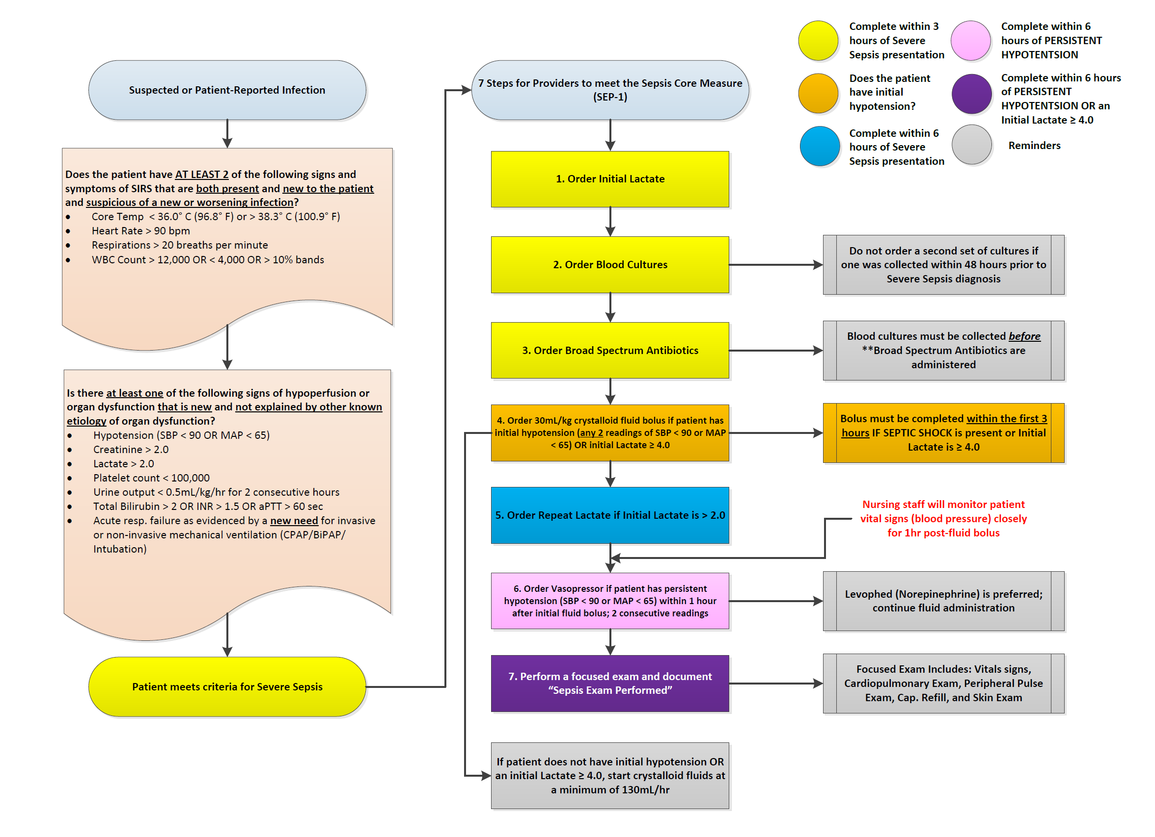
Sepsis Algorithm:

Slide 19
Question #6
When a rural care team is preparing for the transfer of a sepsis patient, what er the keys to crating the best opportunity for a good outcome?

Slide 20
Transfer Considerations:
Decision to transfer a patient after provider assessment.
Physician/Midlevel in makes initial call, gets physician at receiving facility to accept the patient.
Provider to determine if any treatments will need to be continued en route as this will affect the level of transport needed. In the case of sepsis, fluids and antibiotics and perhaps oxygen and vasopressors!
If ambulance transfer is needed, have provider determine if it is to be by BLS, Basic Life Support (no paramedic or medications) or ALS, Advanced Life Support (paramedic present and meds may be administered).
Physician/Midlevel completes and signs “Transfer Record” and the “Physician’s Certification of Medical Necessity for Ambulance Transportation” if patient is being transferred by ambulance.
Copies of old records, progress note, transfer sheets, lab, EKG, CD of radiology studies obtained.
Receive call from receiving facility to the Emergency Dept. confirming bed acceptance, usually from the house supervisor or bed desk at the receiving facility. If no call is received in a reasonable amount of time (usually 10-15 minutes), may call the receiving facility and inquire about the delay.
The ED nurse can then call for ambulance.
ED Nursing completes the rest of the “Transfer Record” with the specific name of person from the receiving facility confirming acceptance and the time.
Nursing report is called to the nurse at the receiving facility who will be caring for the patient after transfer (this call occurs either before or immediately after patient leaves our facility).

Slide 21
Question #7
What role does AB stewardship play in sepsis care? How should AB selection process be handled both in rural settings and after transfer to a tertiary care setting?

Slide 22
Antibiotics:
Super Infection
Toxicities
Allergies
Antibiotic Resistance
Age
Comorbid Conditions
ADEs
Virulence Factors
Host Factors
Pathogen Factors
MIC
Organ Function
Prosthetics
Optimal Antibiotic
PK Profile
Bacterial Burden
Antibiotic Factors
Infection Site
PD
Target
Deep vs Superficial
Route
Dose
Interval
Tissue pH
Drug Penetration

Slide 23
Antibiotics:
Rello et al. Am J Respir Crit Care Med 1997;156:196–200. Lee JS, et al. JAMA. 2016 Feb 9;315(6):593-602.
Kollef et al. Chest 1998;113:412–420. Ibrahim et al. Chest 2000;118:146–155.
Luna et al. Chest 1997;111:676–685. Alvarez-Lerma et al. Intensive Care Med 1996; 22:387-94
Dupont H, et al. Intensive Care Med. 2001;27:355-362.

Slide 24
Question #8
Discuss your sepsis team structure and keys to a successful and productive sepsis program / team.

Slide 25
Sepsis Team:
​​​​​​​​​​
Team Member | Potential Role
Executive Leader | Encourages a culture of support and understanding
Quality Leader | Drives data collection and review to improve the quality of care
Nursing Leader | Understands the needs of caretakers to ensure that communication and education of nursing staff is effective.
Physician Champion | Drive medical decision making, educates all providers
Non-Physician Provider | Nurse practitioners and Physician Assistants are key players in healthcare and often plan a large role in rural communities
Frontline Nursing Staff | Help understand the formalization of the program into daily work
Laboratory | Brings specialized laboratory information
Pharmacy | Helps understand antibiotic options and medication protocols
Infection Preventionist | Brings expertise in the underlying infectious process
Care Management / Care Transitions | Ensure a plan is in place for patients following a sepsis diagnosis – decrease readmission potential or long-term deficit
Information Technology | Assists in using your EHR effectively

Slide 26
Question #9
Discuss some quality improvement metrics / topics / projects related to sepsis and how that can improve care of the sepsis patient.

Slide 29
MLH SEPSIS COMPLIANCE DATA FOR 2019

Slide 30
MLH SEPSIS COMPLIANCE DATA FOR 2020
Of Note: We began treating our first COVID patients at the end of March; processes in the ED and ICU had to be modified at that time. As you can see, compliance was impacted during Q2 when COVID admissions were at their highest.

Slide 32
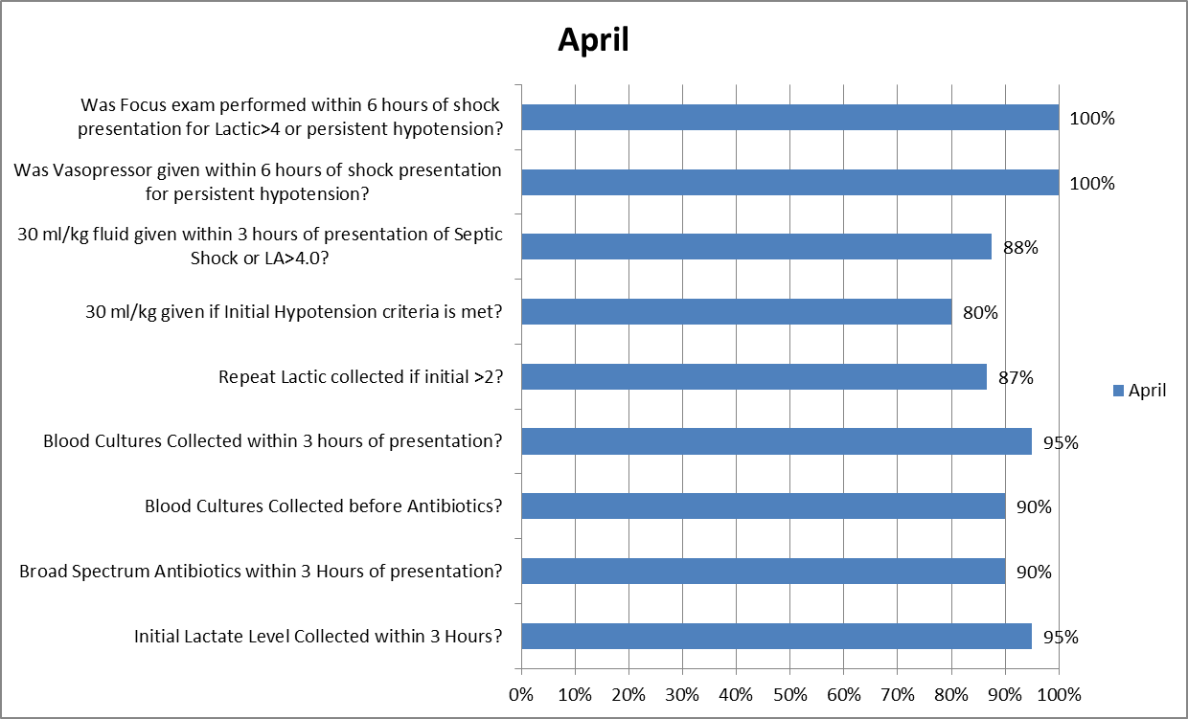
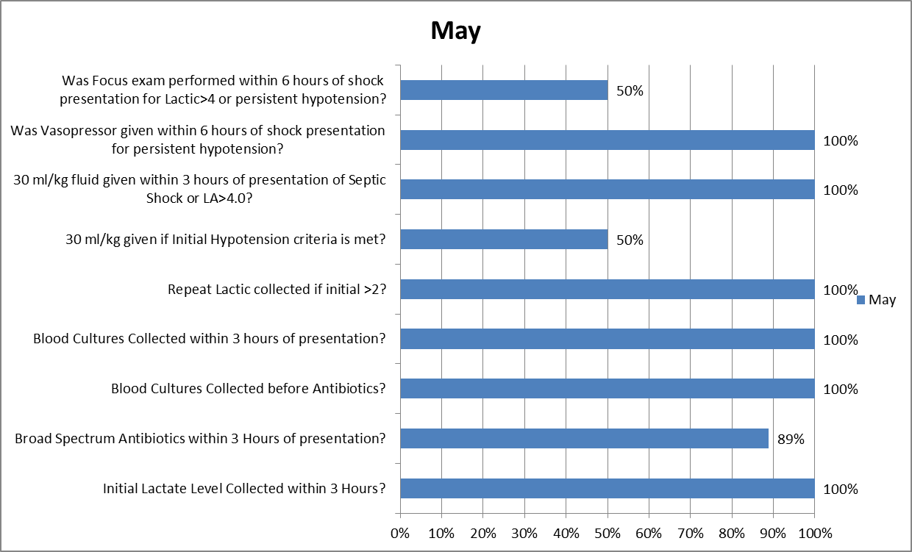

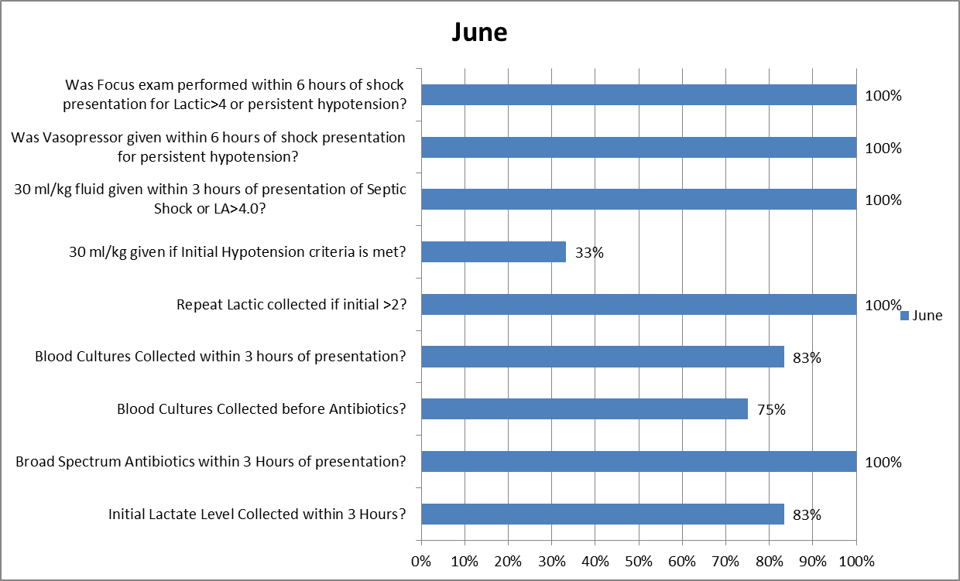
MLH Sepsis Process Standards
Fluid bolus administration compliance decreased during Q2 of 2020; first COVID patients were being treated in March
Incomplete (or absent) fluid bolus administration has been the primary reason for SEP-1 fallouts since 2018
Year-to-Date fluid bolus compliance for all patients meeting Severe Sepsis/Septic Shock criteria is at 66%
The only acceptable reason for exclusion from the SEP-1 measure, regarding fluids, is “Patient refusal”

Slide 33
A daily dashboard is emailed every morning before our organizational safety huddle; this is presented by our manager of the Quality and Patient Safety Department

Slide 34
Nebraska Sepsis Toolkit Available

Slide 35
Dana Steiner BSN, MBA
dsteiner@nebraskahospitals.org
308.627.3086

