Slide 1
Implementation of Oncology Nurse Navigator Program In a Rural Primary Care Setting April Gaines, RN, MSN & Becky Kaelin, RN, BSN, ONC

Slide 2
Nursing Background
2
Worked on medical/oncology unit for 7 years
Worked in hospital outpatient infusion center for 2 years
Worked in Private oncology office for 6 years
Crete Area Medical Center Clinic
Trained in all roles of clinic, main role was provider nurse
Crete Area Medical Center:
Oncology Care Management nurse

Slide 3
Problem
Cancer patients in rural settings are more prone to poor health outcomes due to multiple social determinants of health
Primary Care Providers do not have the resources and time that is necessary to commit to the specialized care their patients with a cancer diagnosis have, to ensure all needs are met and care coordination complete

Slide 4
Background
Context
Rural hospital clinic
Serving Saline County – population ~ 14,000
4 Physicians, 5 clinic APPs
Cancer Survivorship Team
Need based upon Community Needs Assessment
Provider Needs
Time and Resources for Cancer Patients

Slide 5
Background
Community needs assessment identified need for additional cancer care and resources
Cancer survivorship team (consisting of leaders, providers & front line team members) @ CAMC was developed
Identified the greatest need was for improved coordination of care for cancer patients
Notes:
Providers identified that large amounts of time and resources are needed to help coordinate the care for oncology patients

Slide 6
Aims:
To improve the coordination of care for oncology patients

Slide 7
Timeline & Plan
November 2020-
Create new job role & job description modeled after the Pfizer Oncology Patient Navigation in Cancer Care 2.0
December 2020-
Hired Oncology Care Management RN
January 2021-
Orientation to internal process & external key resources
Oncology Care Management Services offered

Slide 8
Team
Becky Kaelin, BSN, RN, OCN – Oncology Care Management RN
April Gaines, RN, MSN-CNO
Steph Hollman- Clinic Operations Director
Stephanie Boldt- President/CEO

Slide 9
Practice Question
After implementing a cancer navigator role in a rural hospital clinic setting, do medical providers perceive improved coordination of care for their patients?

Slide 10
Available Knowledge
Improved provider satisfaction and increased communication among the health care team when navigators are part of cancer patient’s treatment team (Valaitis et al., 2017)
Providing emotional support & eliminating barriers to care is part of cancer navigator role (Palomino et. al., 2017)
In primary care settings, biggest barriers to providing ongoing care to cancer patients is the lack of coordination of care with the patient’s oncology provider (Chin & Rabinovich , 2017)
Meta-analysis on 14 qualitative studies who used patient navigation as an intervention in cancer care in low income areas, and all 14 studies showed some degree of positive effect for the cancer patients (Dalton, et. al., 2019)

Slide 11
Results

Slide 12
Methods
Intervention
Nurse Navigator Program
Job Title – Oncology Care Manager
Started 12/2020
Process of implementation started 10/2020
Study of Intervention
Survey conducted 90 days post implementation
All 9 Clinic Providers
6 surveys completed

Slide 13
Data Analysis
Measures/Data Analysis
Likert scale survey
4 questions total with 2 questions using 5 point Likert scale
I feel that the services the Cancer Care manager provides has improved coordination of care for my patients.
Strongly Agree (5) – Strongly Disagree (1)
Results – MEAN- 4.83, Standard Dev = 0.41
I feel like my patients have benefited from the Oncology Nurse Navigator program.
Strongly Agree (5) – Strongly Disagree (1)
RESULTS – MEAN = 4.83, Standard Dev = 0.41

Slide 14
Discussion
Summary
All Clinic Providers Agreed or Strongly Agreed that the Oncology Nurse Navigator program had positive affects on their patients
Surveys of patients in other studies have shown the positive affects that Nurse Navigators have on Oncology patients. This studies shows that providers are in agreement with their patients.
Limitations
Small number of providers
6 of 9 clinic providers completed the survey

Slide 15
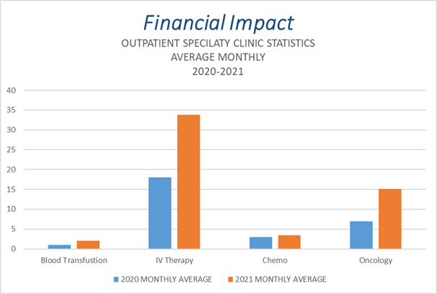

Slide 16
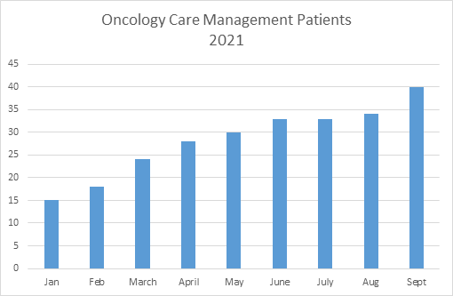
Active oncology care management patients

Slide 17
Conclusions
Improved Provider satisfaction with program
Increase in Outpatient Specialty clinic visits related to Oncology
Response to community needs assessment
Increased coordination of care between oncology & primary care providers

Slide 18
References
Bryan Health Crete Area Medical Center. (2018). Bryan Health Crete Area Medical Center Community Health Needs Assessment Report (Saline County, NE) [Report]. Bryan Health.
Chin, K., & Rabinovich, M. (2017). Cancer survivorship in primary care: Barriers and recommendations for improving care and outcome. Journal of Oncology Navigation & Survivorship, 8, 70–77. JONS-online.com
Dalton, M., Holzman, E., Erwin, E., Michelen, S., Rositch, A., Kumar, S., Vanderpuye, V., Yeates, K., Liebermann, E., & Ginsburg, O. (2019). Patient navigation services for cancer care in low and middle-income countries: A scoping review. PLOS One, 1–14. https://doi.org/10.1371/journal.pone.0223537
Dearholt, S. (2012). Johns Hopkins Nursing Evidence-Based Practice: Model and Guidelines (2 ed.). Retrieved from https://iau-neyshabur.ac.ir/Dorsapax/userfiles/file/Amozesh/EDO/Amozesh/977_Johns_Hopkins_Nursing_Evidence.pdf
Gentry, S., Bellomo, C., Glidden, E., Goetz, P., Johnston, D., Shockney, L., Strusowski, T. (2018). Patient Navigation in Cancer Care 2.0: Guiding patients to quality outcomes. Pfizer Oncology.
Helzlsouer, K., Appling, S., Gallicchio, L., Henninger, D., MacDonald, R., Manocheh, S., & Varanasi, A. (2016). A pilot study of a virtual navigation program to improve treatment adherence among low-income breast cancer patients. Journal of Oncology Navigation & Survivorship, 7, 20–29. JONS-online.com
Hendershot, A. (2019). Cancer survivorship in rural county. Journal of Oncology Navigation & Survivorship, 10, 524–529. JONS-online.com
Johnson, P., & Bongiorno, A. W. (2018). Efficacy of the breast cancer navigator role in reducing distress in newly diagnosed breast cancer patients: A pilot study. Journal of Oncology Navigation & Survivorship, 9, 182–190. JONS-online.com
Ko, E., Zuniga, M., Preacher, D., Palomino, H., & Watson, M. (2018). Efficacy of cancer care communication between clinicians and Latino patients in a rural US-Mexico boarder region: to better communication. Journal of Cancer Education, 33, 116–127. https://doi.org/10.1007/s13187-016-1100-8
Likert scale questions with examples. (2020). QuestionPro. Retrieved October 10, 2020, from https://www.questionpro.com/article/likert-scale-survey-questions.html
McBrian, K., Ivers, N., Barnieh, L., Bailey, J., Lorenzetti, D., Nicholas, D., Tonelli, M., Hemmelgarn, B., Lewanczuk, R., Edwards, A., Braun, T., & Manns, B. (2018, February 20). Patient navigators for people with chronic disease: A systematic review. PLOS One, 1–33. https://doi.org/10.1371/journal.pone.0191980
Palomino, H., Peacher, D., Ku, E., Woodruff, S., & Watson, M. (2017). Barriers and challenges of cancer patients and their experience with patient navigators in ht rural US/Mexico border region. Journal of Cancer Education, 32, 112–118. https://doi.org/10.1007/s13187-015-0906-0
Tonorezos, E., & Conigliaro, J. (2017). Integration of cancer survivorship care and primary care practice. Journal of American Medical Association, 177, 1732–1734. jamainternernalmedicine.com
Valaitis, R., Carter, N., Lam, A., Nicholl, J., Feather, J., & Cleghorn, L. (2017). Implementation and maintenance of patient navigation programs linking primary care with community-based health and social services: A scoping literature review. BioMedical Central Health Services Research, 17(116), 1-14. http://dx.doi.org/10.1186/s12913-017-2046-1

Slide 19
Crete Area Medical Center Oncology Care Management Program
Becky Kaelin, BSN, RN, OCN

Slide 20
Oncology Care Management Role
20
Patient involvement:
Coordinate cares, appointments
Follow patient through out treatment
Follow-up calls on patients post hospitalization
Provide survivorship care plan to patients at end of treatment
Notes:
Patient involvement:
- Meet & educate patients shortly after initial dx
- Coordinate cares, appointments before patient even meets oncology
- Follow patient through out tx and facilitate communication between patient, oncology, pcp
- f/u calls on post hospitalization
- provide survivorship care plan to patients at end of tx

Slide 21
Importance of Primary Care Provider Involvement in a Rural Community
Continuity of care for patient
Safer care and better outcomes for patient
Primary Prevention of Cancers, increase screenings
You Don’t Know, What you Don’t know
Notes:
Continuity of care for patient
Enables PCP to contact oncology for questions/concerns
Safer care and better outcomes for patient
Example:
- Neutropenic fevers- reduce sepsis by activating septic protocol/neutropenic protocol because provider is able to quickly access what/when patient has had last treatment
Control blood sugars and hypertension related BEFORE they become out of control

Slide 22
Oncology Care Management Role
Organizational involvement:
Identify & address barriers of quality issues
Serve as a resource and provide assistance to the entire facility and care team involved with oncology patient
Update chart
Notes:
Identify and address barriers such as.
- Serve as a resource and provide assistance to entire facility:
- educate staff to be more comfortable access port/blood administration
Increase referrals to local ancillary programs such as :
- identify how radiology services are utilized for staging and restaging scans
- developed standing order for referrals to PT/OT
Update charts:
- “sticky notes to access current tx, most common s/e and specific dx

Slide 23
How to Keep Primary care providers involved:
Communication
Encourage patients to continue seeing PCP through out cancer treatments
Treatment completion & hand off
Notes:
Send office notes, scans, and labs after EACH time they see oncology
- MD, APP, Nurse for chemo. Visits
Encourage patients to continue seeing PCP through out treatment for health screenings and communication during patient education
Completion of therapy-
Once treatments are complete, inform what the plan is going forward, how often will patient be seen by oncologist, how often will restaging scans be performed

Slide 24
New ACO Guidelines
Cancer Care Management
New Cancer Diagnosis of Lung, Colon, & Breast
Care Plans
Diagnoses
Providers
Ancillary Services
Medications
Member Contact
Barriers to care and solutions to barriers
CAMC belongs to Bryan Health Connect ACO

Slide 25
Discussion/Questions?

