Slide 2
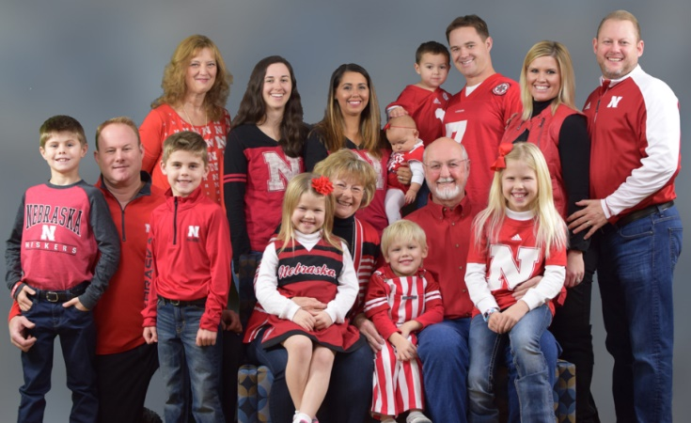
The Kim Foundation
Founded in honor of Larry Courtnage’s Daughter, Kim
We strive to:
Connect people to resources
Provide grants to local non-profits
Increase awareness about mental health and suicide prevention
Break down stigma often associated with seeking mental health care
Larry and Kathy Courtnage
Family

Slide 3
The Kim Foundation Website Resources
About Mental Illness
COVID-19 Resources
Emergency Response Resources
Local and National Resources
Regional Map of Nebraska
Support Groups in Nebraska

Slide 4
The Kim Foundation Website Resources
Support Groups in Nebraska

