Slide 1
QI Residency Program
Module A – Orientation & How Quality Fits in the Big Picture
afternoon session

Slide 2
The Quality Plan
Defines responsibility, scope, methodology and organization of the quality program
Work plan for the organizations quality improvement activities
Formal ongoing process for improvement efforts
The Quality Continuum – QA,QI,PI
Defines responsibility, scope, methodology and organization of the quality program
Work plan for the organizations quality improvement activities
Formal ongoing process for improvement efforts
The Quality – QA,QI ,PI
Notes:
1. Overarching work plan for the organizations clinical, safety and service improvement activities.
2. Serves at the roadmap for quality improvement within the organization. A systematic approach to identifying and pursue opportunities to improve services and resolve identified problems.
3. Generally developed by executive and clinical leadership and approved by the governing board.
4. QI plan vs QI project : QI plan may address diabetes measures but the QI project targets improvement efforts to improve on specific identified measures.

Slide 3

The Quality Plan
Purpose/ Introduction
Authority
Scope
QI committee
Responsibilities
  Leadership
  Medical staff
  Manager/Department staff
  Network Hospital
Notes:
Refer to NHA document as reference and example. HRSA document.
Purpose: Define what you want to accomplish in the future. Usually relates back to organizations mission and vision
Authority: Governing board has ultimate responsibility for quality. COP’s and NE state law. Reference board education North Dakota Hosp Assoc. https://ruralhealth.und.edu/projects/flex/mbqip/pdf/boards_role.pdf
Scope: Everyone is responsible for quality and what does your quality plan include? Peer review, Preventable harm, Surgical Case review , Risk management …
Responsibilities: who is responsible for what, can list out. Board, medical staff, managers, staff etc…

Slide 4
The Quality Plan
Confidentiality
Quality improvement processes and methodology
Communication
Annual review of document
Notes:
Confidentiality: want this stated and also included on any quality documents to ensure they are protected work documents for improvement purposes. Ne 71-7912
Improvement methodology: How is improvement work conducted in the organization what method is taught and utilized?
Communication: How will or is quality communicated in the organization top to bottom and bottom to top?
Annual review of QI plan: signed off by Board chair and CEO

Slide 5
The Quality Continuum
QI tomorrow
PI
future
QA
today
and organization of the quality program
Work plan for the organizations quality improvement activities
Formal ongoing process for improvement efforts
The Quality – QA,QI ,PI
Regulatory compliance
PDSA cycles, LEAN
High reliability processes
© d. d. bainbridge and associates
Notes:
QA – today, keeping doors open to take care of patients today
QI – tomorrow, improving processes to take care of patients tomorrow
PI – future, having highly reliable systems to be the in the future for your patients
Need to understand this continuum to help establish priorities for quality and communication of quality to key stakeholders.

Slide 6
The Quality Continuum
Responsibility for Quality
  Strategic – outcome measures
    CEO , board, medical staff
  Operational – outcome measures and key processes
    CEO, medical staff, senior leadership
  Tactical – structure & process measures
    Managers and frontline team members
© d. d. bainbridge and associates
Notes:
Need to connect the right information to the right people base upon their responsibility.
We will talk about structure , process and outcome measures later.

Slide 7
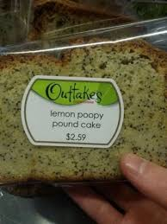
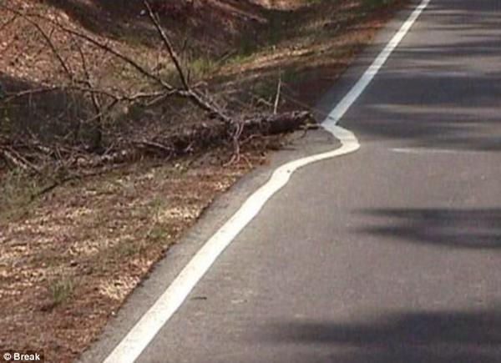

Establishing Priorities for Quality
QA – regulatory compliance
Notes:
If you can’t get it right you can’t keep the door open for today. Identify QA in your organization activities_______________________
Temp logs, crash cart checks, generator testing, lab quality controls, PM’s , chart audits, Think about the measures related to this improvement work.
You have to have a foundation to grow upon.

Slide 8
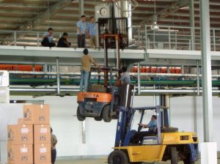
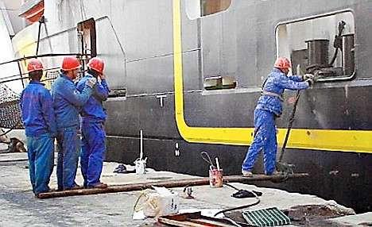

Establishing Priorities for Quality
QI – Processes and Systems
Notes:
Using improvement methods to change process and systems for the better.
ID QI activities projects in your organization______________________________
Opioid practices, care transitions, medication administration, falls program
Think about the measures related to these types of improvement work.

Slide 9
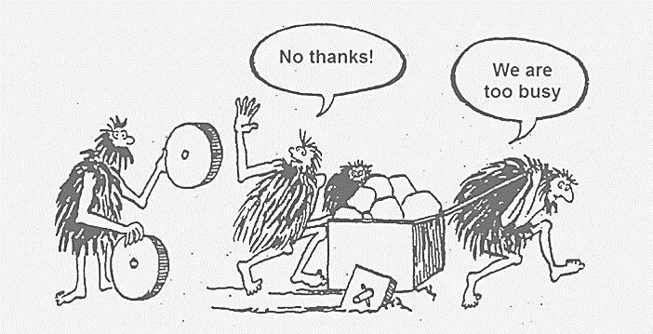
Establishing Priorities for Quality
PI – Highly reliable systems & processes
Notes:
Systems in place that identify and correct errors before they occur. Organizations that can work in complex ways while avoiding disasters/ errors.
Surgery timeout process. Central line insertion checklist. Think about the measures related to this improvement work.
Other preventative systems __________________ aviation checklists,

Slide 10
Establishing Priorities for Quality
Strategic Plan/Vision/Mission
  Sets direction for improvement activities
  Align priorities with initiatives to maximize resources
  Engages leadership in quality as Vision/ Mission are applied to strategic plan
Notes:
What are the strategic initiatives in your organization? Do they align with your quality work or focuses?
Creates shared goals – medication safety - nursing, pharmacy, quality, med staff, IT.
Keeps structure and accountability . Helps the organization move forward.

Slide 11
Establishing Priorities for Quality
ID priority list of processes or services for improvement
Evaluate Institute of Medicine quality domains
Areas to evaluate
  Culture – Engagement and Safety Culture
  Credentialing /Privileging
  Peer Review
  Continuous Survey Readiness ( CSR)
  Chart audits
Notes:
You may also ID gaps in services, care etc… that need to be addressed. Set up your quality dashboard to reflect your organizations scope and complexity.
Want to focus on data driven quality that works to improve patient outcomes. ( HAC, Falls, Readmissions, ADE’s , errors, Medications, clinical EBP – stroke, AMI, sepsis)
IOM quality aims
Safe
Effective
Patient-centered
Timely
Efficient
Equitable

Slide 12
Establishing Priorities for Quality
  Mandatory/ Voluntary reporting measures
  Patient experience measures
  Infection Prevention
  Safety and Risk
  Clinical quality
  Patient complaints/ comments
  Staff feedback
  Other...
Notes:
High –risk, problem prone areas
Make the “list” review with leadership set priorities based upon strategy/vision/mission.

Slide 13
Goal Setting
Goals
  Specific – what is specific goal?
  Measureable – how will you track progress on goal?
  Achievable – do you have resources to accomplish goal?
  Relevant – is the goal meaningful?
  Time- bound – when will you accomplish goal by?
Notes:
Review different goal setting models
1 SMART
2. Aim statement

Slide 14
Goal Setting
Examples of Goals
  Generator testing will be competed weekly 100% of the time.
  To improve patient satisfaction scores for the question "Where you told when you could expect your results” to the 80th percentile by Q4 2021.

Slide 15
Action Planning
Creates desired movement to attain the goal
  What, when, how, where and by whom
Use improvement methodology – LEAN, PDSA, PACE etc…

Slide 16


Slide 17
Methodology for Improvement
Process Improvement Methodology
  Process improvement is the proactive task of identifying, analyzing and improving upon existing processes within an organization for optimization and to meet new quotas or standards of quality. It often involves a systematic approach which follows a specific methodology...

Slide 18
Methodology for Improvement
Why use a methodology?
  Creates desired movement to attain the goal
  Defines the what, when, how, where, and by whom
  Provides focus and scope
  Attempts to improve or change will not last if you have no plan and follow up
Notes:
Brief overview of methodologies
What ever methodology chosen make sure you train on it , and then teach others. Be consistent in its use.

Slide 19
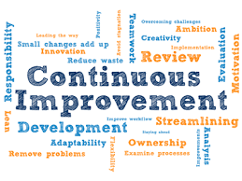
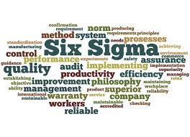



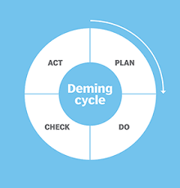
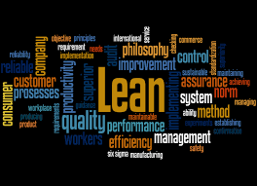
Methodologies

Slide 20
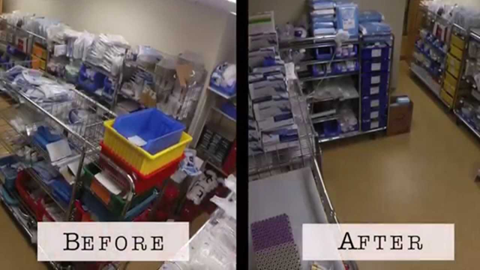
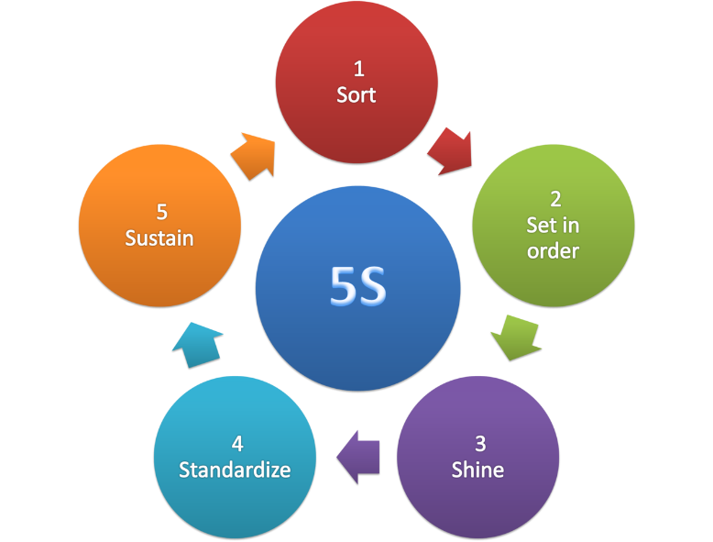
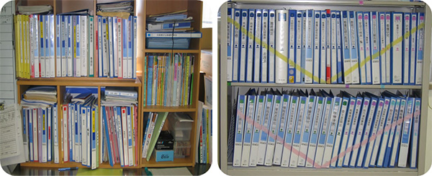
LEAN
Eliminating waste and adding value for the customer
  Value stream map
  5S
  A3
Notes:
.

Slide 21
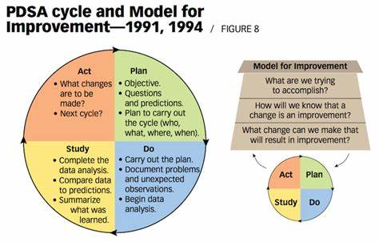
Plan-Do-Study-Act
Continual process improvement
Notes:
IHI Model for improvement this becomes a repeated process to continually improve. IHI model for improvement
IHI model for improvement ; is your aim clear, what are you measuring to show a change is an improvement then using a methodology to make change and improve.

Slide 22
Plan-Do-Study-Act
https://www.youtube.com/watch?v=szLduqP7u-k

Slide 23
Just In Time or Kaizen
Small incremental improvements lead to significant results
  Flowcharts
  5S
  5 Whys
  Recognize success or improvement
Notes:
Inventory policy, only order what you need at the exact time it is needed. I.e. visual management inventory cards. Extra inventory is viewed as waste or an inefficiency, People close to the work own the process. . Background comes from the Japanese auto industry

Slide 24
The Quality Continuum
QI tomorrow
PI
future
QA
today
and organization of the quality program
Work plan for the organizations quality improvement activities
Formal ongoing process for improvement efforts
The Quality – QA,QI ,PI
Regulatory compliance
PDSA cycles, LEAN
High reliability processes
© d. d. bainbridge and associates
Notes:
QA – today, keeping doors open to take care of patients today
QI – tomorrow, improving processes to take care of patients tomorrow
PI – future, having highly reliable systems to be the in the future for your patients
Need to understand this continuum to help establish priorities for quality and communication of quality to key stakeholders and decide measures/ metrics for quality.

Slide 25
Measurement
Measure the important things
What gets measured gets focused on and improves
We measure to align behaviors to drive results
Notes:
With these improvement methods need to remember there is an overarching theme of improving and how will you know if you are improving , working towards a goal which is a measurement so what do you measure?
What gets measured gets focused on and improves
We measure to align behaviors to drive results. For example, patient experience or clinical quality. Nurse communication results and bed side report or timeliness of EKG or CT for patients and improved patient outcomes , so needs to be the right information to impact and cause standard work to occur.
Telling or sharing a patient story is often the best motivator.
Need clear goals , consistent measurement, expected action ( behaviors) to see results. Results motivate.

Slide 26
The “measures”
Defined – numerator/ denominator
Timeliness
Consistency
“measure-vention”
Benchmarks
Notes:
Example: readmission rates:
EKG / CT times/ TNKAse times
Falls
Do you report to leadership regularly?? Weekly on real time measures? Which ones?

Slide 27
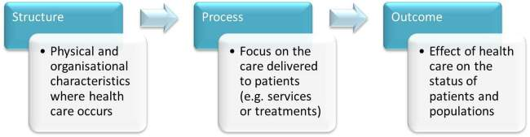
Donabedian’s Model
Notes:
Examples: Outcome – clean toilet structure – toilet brush process – cleaning schedule
Outcome – decrease fall rate structure – red socks, yellow star process – falls assessment
1. Who is interested in what metrics/ information in the organization? Think back to the who is responsible for what aspects for the quality continuum.

Slide 28
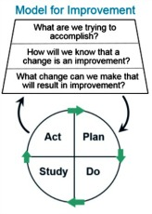
Evaluating Improvement Efforts
Are you in compliance with regulations?
Did you attain set goals?
Are your systems/ processes highly reliable?
Patient/ Staff/ Provider feedback
Notes:
IHI Model for Improvement
What do you want to accomplish
How will we know a change is an improvement?
What change can we make that will result in improvement?
Run your tests of change or your improvement methodology to cause improvement. See what happens , measure, evaluated. Repeat.

Slide 29
Reporting Improvement Efforts
Reporting platforms in organization
  Quality meeting
  Employee forums
  Department postings
  Medical staff & Governing board
  Others…
What information goes to whom?
Notes:
Right information to the right people: remember the responsibilities of strategic, operational, tactical and donabedian model.
A Key role of the quality professional is to organize and coordinate activities and provide useful information to the governing board and medical staff that is easily understood. This also encourages questions and involvement in quality by the board / medical staff.
Often using the strategic alignment of what is important for quality projects to guide your quality report is a good idea for reporting so you don’t get soooo much data that the audience loses interest.

Slide 30


Communication of Quality
Committees and Councils
Quality sub-committee with a board member
Transparency
Be honest
Celebrate successes
Notes:
Often people do not like what the data is. “ it is what it is” Some like to bury their heads. Often the quality professional is the one alone showing the data. Persistance and perseverance is needed.
Celebrate success!!!! Even small milestones.

Slide 31

Questions
Notes:
B

Slide 32
Module A - activities
Organizations strategic plan and goal alignment
Organizations quality plan assessment & review
Notes:
Brief overview of methodologies

Slide 33
QI Residency Program
Module B - Accreditation & Surveys
morning session

Slide 34
Q & A Day 1 (Module A)
What was the one thing you found most interesting from yesterdays session?
What is one thing you will take back to apply in your work?
Other questions?
Notes:
So yesterday we talked about the fundamentals of quality, what it is, the quality continuum, the quality plan, Goal setting, action planning methodologies and measurement and using your organizations vision and mission to align quality work..
Today we will discuss Accreditation and Surveys.

Slide 35
The History of Quality Assessment
1910 - Flexner report recognizes the appalling state of U.S. medical schools – standards for medical education
1917 - American College of Surgeons establish Hospital Standardization Program and began surveying hospitals- medical staff standards
1952 - Joint commission formed, continued surveying – added physical plant, equipment
Notes:
Flexner - set standards for medical school education, based upon science
ACS- medical staff standards

Slide 36
The History of Quality Assessment
1965 - Medicare mandates principles of hospital operations , staff credentialing, round the clock nursing, and utilization review
1980’s to current- transitions from quality assurance to performance improvement
2010 – Affordable Care Act, quality is a matter of improving the experience of care, the health of populations and reducing costs
Notes:
Quality is and has been continuously changing, in response to both voluntary and governmental sense. Today we need to be ensuring our quality programs are able to be flexible, adept at changing and meeting needs of patients, communities and the organization
With these changes accrediting agencies have formed to ensure adherence to regulations and safe quality care for patients

Slide 37

Accreditation
A process of review that allows healthcare organizations to demonstrate their ability to meet regulatory requirements and standards recognized by accreditation organizations.

Slide 38
Accrediting Bodies for Healthcare
The Joint Commission
DNV
NCQA
Others
Notes:
Joint Commission is the largest healthcare accrediting body.
Examples of TJC standards:
Pain management
2. NPSG and RCA’s for improvement
Diagnostic Imaging Compliance checklist

Slide 39

State Survey
Nebraska DHHS survey
  CMS State Operations Manual Appendix A or W
  Chapter 9 Title 175
  Life Safety Codes
  Other…
Notes:
Establishes compliance with regulatory requirements for safety, patient care, medical staff, staffing, quality etc… Most CAH’s participate in the DHHS survey. Larger hospitals participate in TJC survey process.

Slide 40
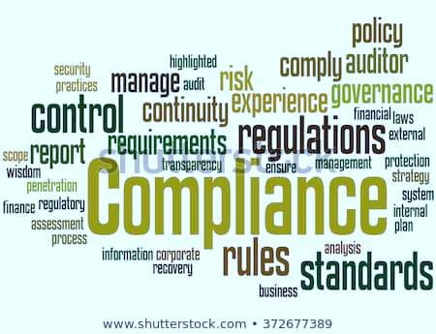
Regulations Review

Slide 41
Conditions of Participation (COP’s)
Organization is evaluated against to establish their level of performance in relation to regulatory requirements
CMS SOM appendix A – hospitals
  A tags
CMS SOM appendix W – CAH’s
  C tags
CMS SOM appendix G- RHC’s
  J tags

Slide 42
COP’s Emergency Services
What tag is emergency services listed under?
  Appendix A
  Appendix W
How many standards are there under the emergency services tag?
  Appendix A
  Appendix W
Notes:
Let’s practice:
Appendix A – A 1100 Standards – (2) a. (Organization & Direction), b. ( Personnel)
Appendix W C 880 Standards = (5) a. (Availability), b.(Equipment, Supplies & Medication), c.(Blood &Blood Products), d.(Personnel), e. (Coordination with Emergency Response)

Slide 43
NE Title 175 Chapter 9
Nebraska state law governing hospitals
Compare COP’s and state law utilize the stricter of the two to guide practices and policy
Compare Emergency Services requirements with CMS SOM COP’s

Slide 44
Life Safety Code & Environmental Care
Appendix I - K tags
Plant operations responsibility
Refer to checklists as a resource
https://www.cms.gov/Medicare/CMS-Forms/CMS-Forms/Downloads/CMS2786R.pdf
Notes:
Be aware of these tags, however plant operations/ maintenance should be responsible for compliance with these tags.

Slide 45
Questions

Slide 46
Continuous Survey Readiness (CSR)
Ideal model
Ongoing process, not a ramp up for survey
Leadership commitment
Involves staff at all levels
Variety of approaches
Notes:
Why is CSR important: Goal is to break crisis management or just in time culture
Create high reliability
Provide continuous safe, quality patient care and regulatory compliance
Leadership commits to a culture of readiness, understanding of the cost of non – compliance and needed resources to be ready
All staff involved, manager accountability for readiness, are frontline trained are policies in place, etc… Needs to be a team
Can use different approaches
Goal is to break crisis management or just in time culture

Slide 47
Continuous Survey Readiness
Understanding of standards, survey requirements
Training for person leading the readiness process
Training for leadership, management and frontline in policies and practices that support standards and survey requirements

Slide 48
Continuous Survey Readiness
Various approaches and learning methods
  Face to face interactions
  Department rounds with environmental assessment and staff questions
  Self assessment tools/ gap analysis
    Annual
    Ongoing
  Resources for updated regulations
  Other
Notes:
How do you become survey ready? Some activities
Conduct MR audits for high risk areas i.e. verbal orders, signatures, medication administration
Check education material and pt. resources to ensure they are available in common languages
Check signage to ensure required signs are posted.
Monitor environment to ensure it is clean and in good repair
Check HR files for required documents
Check policies to ensure all are current

Slide 49
CSR example
Leadership prioritizes resources for readiness
Concern identified in COP’s with emergency services
Quality professional leads CSR process/plan
  Self assessment completed
  Process Improvement
  Training plan developed
    Story boards
    Social Media posts
    Self study modules
    Re – check self assessment
Notes:
CSR team is dependent upon organization. Usually includes at least administration, quality, department leader,

Slide 50
Let’s practice
  Emergency Services self assessment
    What types of questions would you ask staff?
    What environmental inspections would you look at?
    What inventory would you assess?
    What policies would you review?
Notes:
Do self assessment of your organizations emergency services compared to COP’s
Pick one of the standards and evaluated what questions you would ask of staff to determine compliance with regulations. What policies would you want to review or make sure were in place? Equipment would you check for. Training that would be needed?

Slide 51
The Quality Professional
  Responsible to develop and manage survey procedures
  Develop multidisciplinary group to anticipate survey and assist with readiness
  Develop survey checklist and readiness activities
Notes:
Check list to do items when surveyors present
Readiness activities i.e.
Assign roles such as EMR navigators, Escorts , Notifications, Who is getting requested documents?
Set up room for surveyors
Review previous surveys to ensure compliance with corrective plans
Sweep areas for outdates items, policies, order sets etc…
Monitor environment for cleanliness, good repair.
Check paper resources are they in date.
Etc…

Slide 52
Activity
Draft survey setup checklist
Continuous survey readiness activities
Notes:
What actions will you do to be ready for survey.
Targeted reviews in departments for compliance with regulations, chart audits, environmental scans

Slide 53
Questions

