Slide 1



medicinal / recreational marijuana
JASON R. YUNGTUM
HENRY L. WIEDRICH

Slide 2


Jason R. yungtum
Henry L. Wiedrich
jyungtum@clinewilliams.com
(402) 384-7552
hwiedrich@clinewilliams.com
(402) 384-7550

Slide 3
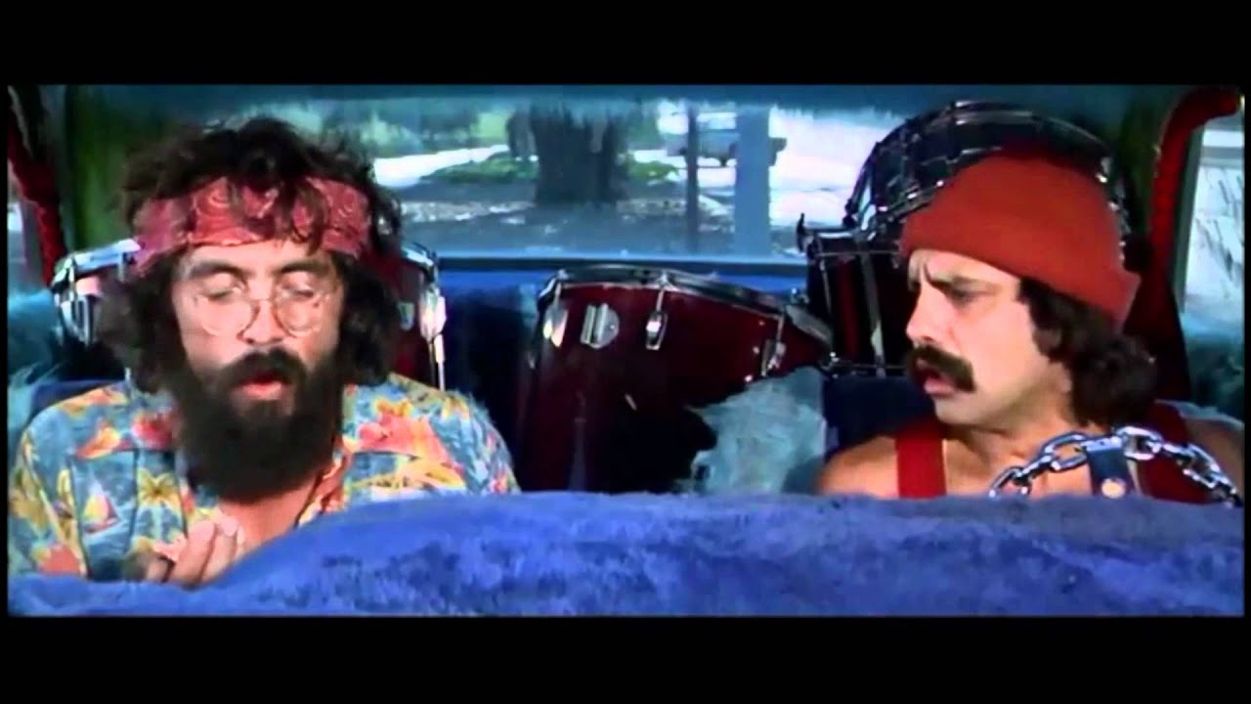
What are we even talking about man?
(The vernacular)

Slide 4
What are we even talking about man?
(The vernacular)
Cannabis: Cannabis is a family of plants with two primary classifications — Indica and Sativa. While marijuana can be considered a member of either the Indica or Sativa families, Hemp is a member of the Cannabis Sativa family.
Marijuana: Marijuana has broad leaves, dense buds, and a short bushy appearance. Contains high levels of THC. Also contains CBD. Generally grown for medicinal or recreational purposes.
Hemp: Hemp features skinny leaves that are concentrated towards the top of the plant and grows taller and skinnier than Marijuana, with few branches beneath its upper portion. Contains CBD, and has low levels of THC. Generally grown for industrial applications. Under United States law, to be deemed hemp, the cannabis plant must have a THC concentration of less than 0.3%.

Slide 5
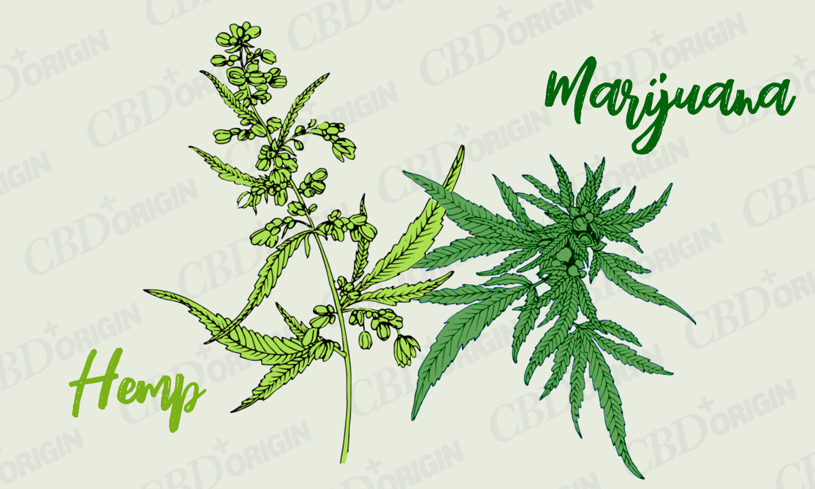
What are we even talking about man?
(The vernacular)

Slide 6
What are we even talking about man?
(The vernacular)
Tetrahydrocannabinol (THC): THC is the chemical within cannabis that induces psychoactive effects. It binds to the cannabinoid 1 receptors found in the body. Marijuana is abundant in THC (about 20%).
Cannabidol (CBD): No psychoactive properties, even though CBD oil may contain THC (generally trace amounts if derived from hemp). CBD is believed to block interactions with cannabinoid receptors.

Slide 7
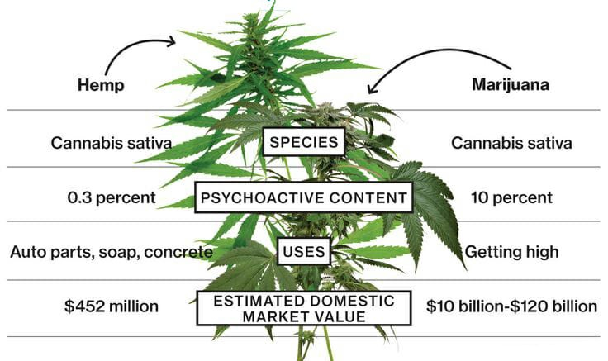
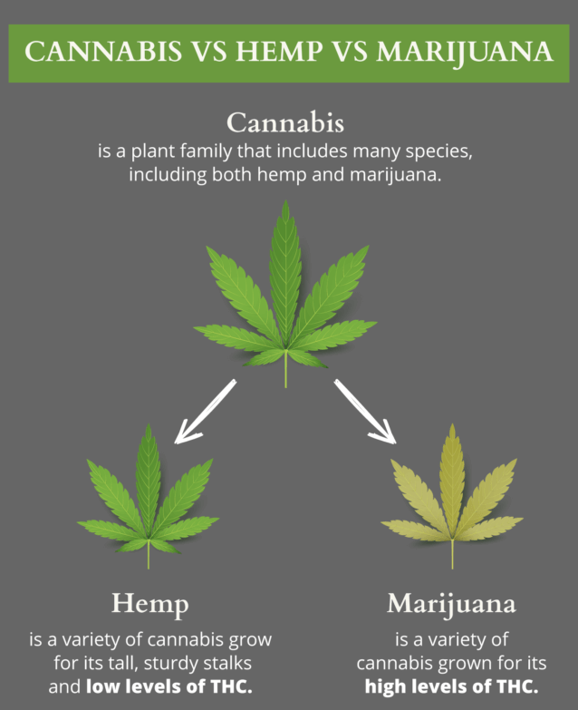
What are we even talking about man?
(The vernacular)

Slide 8
Current state of the law: federal
Federal law does not differentiate between medical or recreational uses of marijuana
Marijuana is classified as a Schedule I drug. See 21 U.S.C. 812

Slide 9
Current state of the law: federal
A Schedule I drug is defined as a drug or substance that has a high potential for abuse, it has no currently accepted medical use in treatment in the United States, and there is a lack of accepted safety for use of the drug under medical supervision. Id.
Thus, even though a majority of states have approved the medicinal use of marijuana, marijuana remains defined as a Schedule I drug under federal law

Slide 10
Federal definition of marijuana
(A) Subject to subparagraph (B), the term “marihuana” means all parts of the plant Cannabis sativa L., whether growing or not; the seeds thereof; the resin extracted from any part of such plant; and every compound, manufacture, salt, derivative, mixture, or preparation of such plant, its seeds or resin.
(B) The term “marihuana” does not include—
(i) hemp, as defined in section 1639o of title 7; or
(ii) the mature stalks of such plant, fiber produced from such stalks, oil or cake made from the seeds of such plant, any other compound, manufacture, salt, derivative, mixture, or preparation of such mature stalks (except the resin extracted therefrom), fiber, oil, or cake, or the sterilized seed of such plant which is incapable of germination.

Slide 11
Current state of the law: federal
In August 2013, the United States Department of Justice issued a guidance memorandum (the Cole Memo) stating that prosecuting state-legal marijuana cases was not a department priority. The memorandum provided 8 guidelines for prosecutors to consider:
  Preventing of distribution of marijuana to minors;
  Preventing revenue from the sale of marijuana from going to criminal enterprises, gangs or cartels;
  Preventing the diversion of marijuana from states where it is legal under state law in some form to other states;
  Preventing state-authorized marijuana activity from being used as a cover or a pretext to traffic other illegal drugs or other illegal activity;
  Preventing violence or the use of firearms in cultivation and distribution of marijuana;
  Preventing drugged driving and the exacerbation of other adverse public health consequences associated with marijuana use;
  Preventing the growing of marijuana on public lands and the attendant public safety and environment dangers posed by marijuana production on public lands;
  Preventing marijuana possession or use on federal property.
Because most state cannabis programs require the same, the memo made it less likely for a cannabis business legal in a state to be prosecuted under federal law, which allowed the industry to grow (no pun intended). This did not eliminate all federal prosecution.

Slide 12
Current state of the law: federal
The Cole Memo did not have the effect of law, and was instead merely a department memorandum that could be changed at any time. Marijuana remained illegal; the Department of Justice instead decided to selectively enforce the law.
On January 4, 2018, Attorney General Jeff Sessions rescinded the Cole Memo. The rescission did not mean that all federal marijuana crimes would be prosecuted, but that the decision to prosecute would follow the same principles that governed all other offenses, as set forth in the U.S. Attorney’s Manual.

Slide 13
Current state of the law: federal
There was fear that this rescission would create a torrent of federal prosecutions of state-legal marijuana offenses, but this has not occurred over the last 17 months.
Since the rescission, there has been no industry crack down and more states legalized cannabis in some form.

Slide 14
Current state of the law: federal LAW
Under the Americans with Disabilities Act, federal law does not require that employers accommodate the use of marijuana for medicinal purposes. The ADA does not protect the use of marijuana.
Because marijuana remains illegal under federal law, money that can be traced back to state marijuana operations could be considered money laundering and expose a bank to significant legal, operational and regulatory risk. Often, banks won’t do any business with the cannabis industry, or if they do, they must comply with onerous regulations and file suspicious activity reports.

Slide 15
Current state of the law: federal LAW
Hemp: For years, federal law did not differentiate between hemp and other cannabis plants, all of which were made illegal in 1937 and were later incorporated into the federal Controlled Substances Act.
2018 Farm Bill: Legalized hemp and its derivatives, and the sales thereof. Defined as: “[T]he plant Cannabis sativa L. and any part of that plant, including the seeds thereof and all derivatives, extracts, cannabinoids, isomers, acids, salts, and salts of isomers, whether growing or not, with a delta-9 tetrahydrocannabinol concentration of not more than 0.3 percent on a dry weight basis.” Additional restrictions included compliance with shared state-federal regulations and the hemp must be grown by a properly licensed grower.

Slide 16
Current state of the law: federal LAW
THUS:
  CBD oil derived from hemp is not illegal under federal law
  CBD oil derived from marijuana remains illegal under federal law

Slide 17
Position of food and drug administration
https://www.fda.gov/news-events/press-announcements/statement-fda-commissioner-scott-gottlieb-md-signing-agriculture-improvement-act-and-agencys
“In particular, we continue to be concerned at the number of drug claims being made about products not approved by the FDA that claim to contain CBD or other cannabis-derived compounds. Among other things, the FDA requires a cannabis product (hemp-derived or otherwise) that is marketed with a claim of therapeutic benefit, or with any other disease claim, to be approved by the FDA for its intended use before it may be introduced into interstate commerce.”

Slide 18
Position of food and drug administration
“Additionally, it’s unlawful under the FD&C Act to introduce food containing added CBD or THC into interstate commerce, or to market CBD or THC products as, or in, dietary supplements, regardless of whether the substances are hemp-derived. This is because both CBD and THC are active ingredients in FDA-approved drugs and were the subject of substantial clinical investigations before they were marketed as foods or dietary supplements. Under the FD&C Act, it’s illegal to introduce drug ingredients like these into the food supply, or to market them as dietary supplements. This is a requirement that we apply across the board to food products that contain substances that are active ingredients in any drug.”
FDA will hold a public hearing on CBD on May 31, 2019.

Slide 19
federal LAW & PENDING LEGISLATION
In January 2019, H.R. 420 was filed by Rep. Earl Blumenauer (D-OR), which would regulate marijuana like alcohol.
In February 2019, S-420, introduced recently by Sen. Rony Wyden (D-OR), would de-schedule marijuana by removing it from the Controlled Substances Act, establish a federal excise on legal sales, and create permitting for the industry.
Bills like these have been filed annually for some time now.
38 State attorney-generals recently asked the federal government to pass cannabis banking legislation.

Slide 20
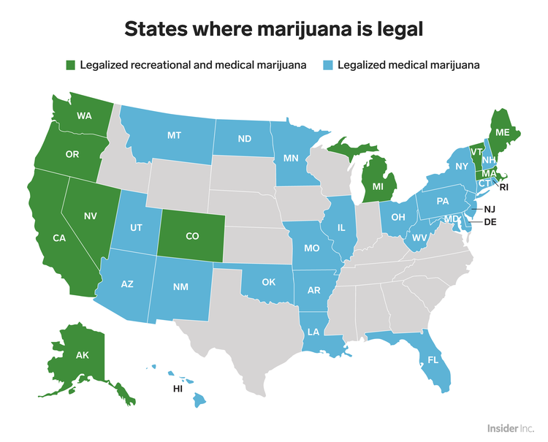
Current state of the law: other states
Source: https://www.businessinsider.com/legal-marijuana-states-2018-1
10 states and Washington D.C. have legalized recreational marijuana for adults over 21. Vermont was the first state to do this through its legislature. All other states (and D.C.) did so through ballot initiatives.
33 states have legalized medical marijuana.
Other states where medical marijuana has not been approved have legalized the use of CBD (with varying restrictions), including Alabama, Georgia, Indiana, Iowa, Kentucky, Mississippi, North Carolina, South Dakota, Tennessee, Texas, Virginia, Wisconsin, and Wyoming.
Canada legalized marijuana (at least federally) in October 2018. Now it is province dependent.

Slide 21
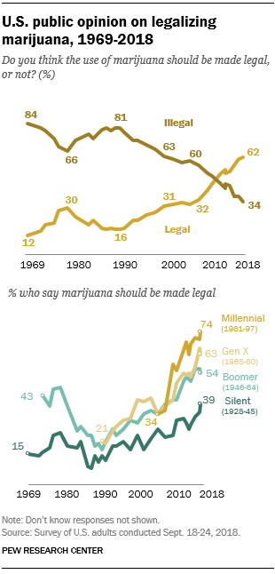
Current state of the law:
Trends
An October 2018 Pew Research Center poll found that 62% of Americans believe marijuana should be legalized. In 2000, only 31% of adults supported legalization. https://www.pewresearch.org/fact-tank/2018/10/08/americans-support-marijuana-legalization/

Slide 22
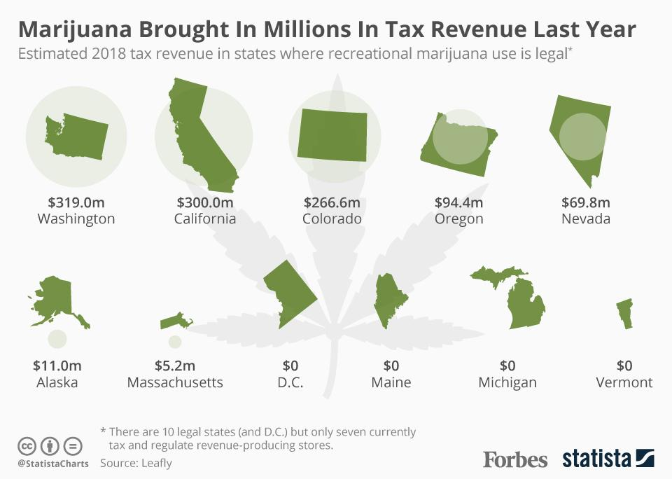
Financial impact on states where legal
Source: https://www.forbes.com/sites/niallmccarthy/2019/03/26/which-states-made-the-most-tax-revenue-from-marijuana-in-2018-infographic/#7997fe967085
Colorado’s budget for 2018-2019 (July 1-June 30) was $28.9 billion. Assuming an annualized tax stream of $270M on marijuana sales, marijuana tax revenue accounts for 0.9% of Colorado’s budget.

Slide 23
Current state of the law: NEBRASKA
Marijuana is listed as a Schedule I controlled substance under Nebraska law, as is any substance containing THC, which would include hemp (except as grown in connection with state-sponsored research).
There is no distinction between recreational and medicinal use. Possession and use is illegal.
Neb. Rev. Stat. 28-405 provides in part:
The following are the schedules of controlled substances referred to in the Uniform Controlled Substances Act, unless specifically contained on the list of exempted products of the Drug Enforcement Administration of the United States Department of Justice as the list existed on November 9, 2017: …
(c) Any material, compound, mixture, or preparation which contains any quantity of the following hallucinogenic substances, their salts, isomers, and salts of isomers, unless specifically excepted, whenever the existence of such salts, isomers, and salts of isomers is possible within the specific chemical designation, and, for purposes of this subdivision only, isomer shall include the optical, position, and geometric isomers: …
(7) Marijuana; …
(12) Tetrahydrocannabinols, including, but not limited to, synthetic equivalents of the substances contained in the plant or in the resinous extractives of cannabis, sp. or synthetic substances, derivatives, and their isomers with similar chemical structure and pharmacological activity…

Slide 24
Current state of the law: NEBRASKA
Neb. Rev. Stat. 28-401 (13)
“Marijuana means all parts of the plant of the genus cannabis, whether growing or not, the seeds thereof, and every compound, manufacture, salt, derivative, mixture, or preparation of such plant or its seeds, but does not include the mature stalks of such plant, hashish, tetrahydrocannabinols extracted or isolated from the plant, fiber produced from such stalks, oil or cake made from the seeds of such plant, any other compound, manufacture, salt, derivative, mixture, or preparation of such mature stalks, the sterilized seed of such plant which is incapable of germination, or cannabidiol contained in a drug product approved by the federal Food and Drug Administration or obtained pursuant to sections 28-463 to 28-468. When the weight of marijuana is referred to in the Uniform Controlled Substances Act, it means its weight at or about the time it is seized or otherwise comes into the possession of law enforcement authorities, whether cured or uncured at that time. When industrial hemp as defined in section 2-5701 is in the possession of a person as authorized under section 2-5701, it is not considered marijuana for purposes of the Uniform Controlled Substances Act;”

Slide 25
Current state of the law:
CBD RESEARCH IN NEBRASKA
Neb. Rev. Stat. 28-463 defines CBD as: “Cannabidiol means processed cannabis plant extract, oil, or resin that contains more than ten percent cannabidiol by weight, but not more than three-tenths of one percent tetrahydrocannabinols by weight, and delivered in the form of a liquid or solid dosage form”
Neb. Rev. Stat. 28-463 to 28-468 were passed “to permit medical professionals to conduct limited-scope, evidence-based studies exploring the safety and efficacy of treating intractable seizures and treatment resistant seizures using cannabidiol.”
CBD production and possession is limited to research purposes by the University of Nebraska and Nebraska Medicine.
CBD “may only be obtained by patients with intractable seizures and treatment resistant seizures and on the order of a physician who is licensed to practice medicine and surgery in Nebraska and designated as a medical provider under section 28-465 and administered to a patient by or under the direction or supervision of such medical provider participating in the Medical Cannabidiol Pilot Study”

Slide 26
Current state of the law: CBD
The Nebraska Attorney General issued a memorandum to law enforcement officials on November 16, 2018 regarding CBD (similar statement on September 1, 2017). In the Memo, the Attorney General stated:
CBD is part of the definition of marijuana, and is thus a Schedule I drug, with just two exceptions: (1) where the CBD was obtained pursuant to Neb. Rev. Stat. 28-463 to 28-468, or (2) where the CBD is contained in a drug product approved by the FDA.
Currently the only CBD product approved by the FDA is Epidiolex, which is an oral solution used to treat two severe forms of epilepsy.
“Therefore, with the exception of Epidiolex oral solution, cannabidiol or any product containing cannabidiol, obtained by any means other than the authorized UNMC study, remains illegal to possess, manufacture, distribute, dispense, or possess with the intent to manufacture, distribute, or dispense. Such conduct is subject to prosecution for illegally possessing or trafficking a Schedule I controlled substance. ”

Slide 27
NEBRASKA LAW & PENDING LEGISLATION:
NEBRASKA HEMP ACT
After the 2018 federal Farm Bill was passed and signed by President Trump, the Nebraska Hemp Act (LB 657) was proposed in the Nebraska Unicameral. https://nebraskalegislature.gov/FloorDocs/106/PDF/Final/LB657.pdf
The bill would exclude industrial hemp from the definition of a controlled substance, along with its derivatives and products, including CBD products, with a THC concentration of not more than 0.3 percent. “Notwithstanding any other provision of law, hemp shall not be considered a controlled substance under the Uniform Controlled Substances Act.”

Slide 28
NEBRASKA LAW & PENDING LEGISLATION:
NEBRASKA HEMP ACT
Product testing would be required. Any person wanting to grow industrial hemp would be required to register with the state.
The Nebraska Hemp Act received first round approval by 37-4, and was placed for final reading on May 7. The bill is likely to pass the Legislature and Governor Ricketts is likely to sign it into law.

Slide 29
NEBRASKA LAW & PENDING LEGISLATION:
LB 110
Several attempts have been made to pass a bill legalizing the use of marijuana for medicinal purposes.
Most recent attempt is LB110. Introduced by Lincoln Senator Anna Wishart. Just this month the bill stalled in the Unicameral, when supporters could not get 33 votes to end a filibuster against the bill. https://www.omaha.com/livewellnebraska/health/nebraska-medicinal-cannabis-bill-stalls-in-legislature-backers-look-to/article_8a1166fb-9b29-52a4-a428-5c6ad4e709b7.html
LB 110 would permit use and limited possession of cannabis by patients with qualifying medical conditions who are enrolled in the registry program, and sets up a regulatory framework for producing, processing, and dispensing cannabis.
A petition effort is underway to get the issue on the ballot in 2020. The ballot measure could be far less restrictive than the proposed bills.

Slide 30
PROPOSED CONSTITUTIONAL AMENDMENT
The people of Nebraska, if recommended by a physician or nurse practitioner, have the right to use, possess, access, and safely and discreetly produce an adequate supply of cannabis, cannabis preparations, products and materials, and cannabis-related equipment to alleviate diagnosed serious medical conditions without facing arrest, prosecution, or civil or criminal penalties. A minor with a serious medical condition only has the right to use cannabis if recommended by a physician or nurse practitioner and with the consent of a custodial parent or legal guardian.
These rights include accessing cannabis, cannabis preparations, products and materials, and cannabis-related equipment from state-legal private entities in Nebraska, subject only to reasonable laws, rules, and regulations that promote the health and safety of patients, ensure continued access by patients to the type and quantity of cannabis they need, and prevent diversion without imposing an undue burden on patients or providers or compromising patients’ confidentiality. A person who has been recommended medical cannabis may be assisted by a caregiver in exercising these rights.
This section shall not be construed to allow the smoking of cannabis in public or possession of cannabis in detention facilities, nor shall it allow driving while impaired by cannabis or otherwise engaging in conduct that would be negligent to undertake while impaired by cannabis. This section does not require an employer to allow an employee to work while impaired by cannabis, nor does it require any insurance provider to cover medical cannabis.

Slide 31
NEBRASKA LAW & PENDING LEGISLATION:
LB 659
LB 659: Would remove CBD from the definition of marijuana and remove CBD from the list of controlled substances.
The bill defines CBD as: “Cannabidiol means processed cannabis plant extract, oil, or resin that contains more than ten percent cannabidiol by weight, but not more than three-tenths of one percent tetrahydrocannabinols by weight, and delivered in the form of a liquid or solid dosage form, regardless of whether or not the cannabidiol is contained in a drug product approved by the federal Food and Drug Administration or obtained pursuant to sections 28-463 to 28-468.”
Last entry was a hearing on February 20, 2019.

Slide 32
Public opinion in Nebraska
February 2017 (most recent poll):
77% of polled voters indicated they would vote in favor of legalizing marijuana for medicinal purposes. https://journalstar.com/legislature/survey-shows-majority-of-nebraskans-would-favor-medical-marijuana-prescribing/article_c01078b4-ef21-576a-a38d-35ea0600a52a.html

Slide 33
GOVERNOR RICKETTS’ STANCE
https://governor.Nebraska.gov/press/marijuana-dangerous-drug
Entitled: “Marijuana is a Dangerous Drug”
Relies heavily on the position that the FDA should make determinations on whether treatment is safe and effective, and that the process should not be circumvented.
“In the absence of an FDA review, expert medical research shows that marijuana is dangerous.”

Slide 34
GOVERNOR RICKETTS’ STANCE
https://governor.Nebraska.gov/press/marijuana-dangerous-drug
“As the debate over medical marijuana takes center stage in the Unicameral, we must be cautious before we follow the lead of other states. Legalizing marijuana legislatively not only gives marijuana a pass on the important FDA review process, but it also puts the well-being of Nebraskans at risk. If you feel strongly about this issue, please take a moment to contact your state senator. You can find all the information you need to reach them at www.NebraskaLegislature.gov.”

Slide 35
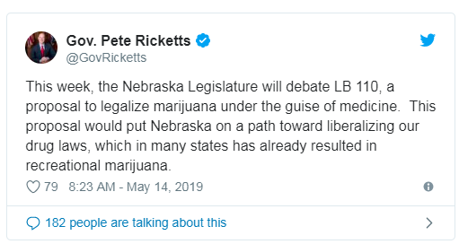
GOVERNOR RICKETTS’ STANCE
Current term ends 2023. Governor Ricketts would be likely to veto legislation passed while governor.

Slide 36
What types of discussions can medical providers in Nebraska have with patients re: marijuana, cbd?
Nebraska medical providers confront multiple risks if/when they engage in inappropriate discussions with their patients regarding the potential use of medical cannabis, including:
  Criminal charges (e.g., aiding and abetting a crime)
  Revocation of DEA registration
  NE-DHHS licensure sanction/revocation
  Medical malpractice claims
  Being placed on the OIG List of Excluded Individuals and Entities, etc.
Consequently, when a patient broaches the topic of medical cannabis, medical providers need to be very careful to ensure they provide information only related to the possible health risks and benefits of medical cannabis, not whether the provider recommends its use or how/where it may be legally obtained.
Where such conversation occurs, best practice would be to have the patient sign a written acknowledgment outlining what was and was not discussed.

Slide 37
Additional questions
raised by legalization
1. Whether employers must accommodate an employee who uses medicinal marijuana?
Currently this is not required under the ADA or Nebraska law. If it becomes legal under federal law, the ADA and FMLA issues will have to be revisited.
In states where marijuana is legal, the early cases found that employers were not required to accommodate marijuana use. However, a few courts have held otherwise. The Massachusetts Supreme Court has held that “an exception to the employer's drug policy to permit offsite marijuana use may be a reasonable accommodation where the employee's physician determines that marijuana is the most effective treatment for the employee's disability and that any alternative medication permitted by the employer's drug policy would be less effective” Barbuto v. Advantage Sales and Marketing, LLC, 477 Mass. 456 (2017).
To avoid a court fight on the issue, some states have written such protections into the statute legalizing marijuana. For example, Arizona, Arkansas, Connecticut, Delaware, Illinois, Maine, Minnesota, New York, Pennsylvania and West Virginia provide employment protections for medical marijuana patients.

Slide 38
Additional questions
raised by legalization
2. If employers can prohibit the use or possession of marijuana in the workplace, even if the state has legalized marijuana use in certain circumstances?
Likely yes, although it could depend upon the state legalization language. Just like alcohol is legal, but it may be banned from the premises, the same is likely true for marijuana. Although if taken for medicinal purposes, there could be a grey area and argument made that an accommodation is required under state law.

Slide 39
Additional questions
raised by legalization
3. If legalized, how will that effect employee drug tests?
This will depend upon the legalization language and what protections are provided to marijuana users while away from work. Absent protections, employers could still choose to test for marijuana, although the employer might find that its potential workforce is smaller than before.

Slide 40
Additional questions
raised by legalization
4. If legalized, can employees come to work under the influence of marijuana?
No. Legalization does not mean that employees must be allowed to be high at work.

Slide 41
Additional questions raised by legalization
5. Might the costs of medicinal marijuana be deemed a reasonable and necessary medical expense and be reimbursable under worker’s compensation?
Potentially yes. A New Mexico appellate court has held that an employer and its workers’ compensation carrier must reimburse the employee for medical marijuana costs (Vialpando v. Ben’s Auto. Servs., No. 32,920, 2014 WL 2420112 (N.M. Ct. App. May 19, 2014)).

Slide 42

QUESTIONS?
JASON R. YUNGTUM
jyungtum@clinewilliams.com
HENRY L. WIEDRICH
hwiedrich@clinewilliams.com

