Slide 1
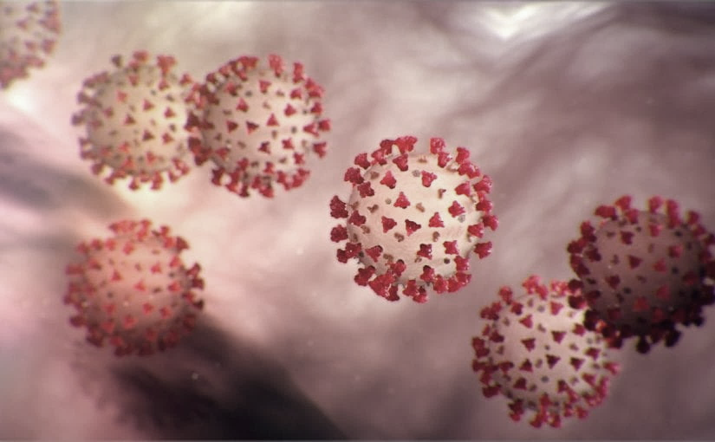
Covid-19 Webex Update 6-24-20
Tom Safranek, MD, State Epidemiologist
Louis Safranek, MD, PhD,
Board certified specialist, Infectious Disease

Slide 2
No Webinar July 1, 2020

Slide 3
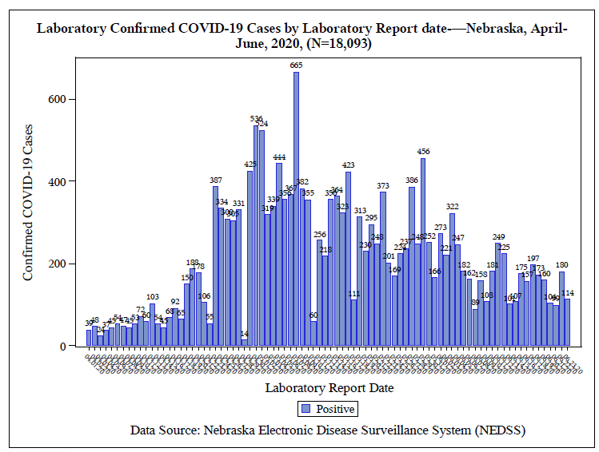

Slide 4
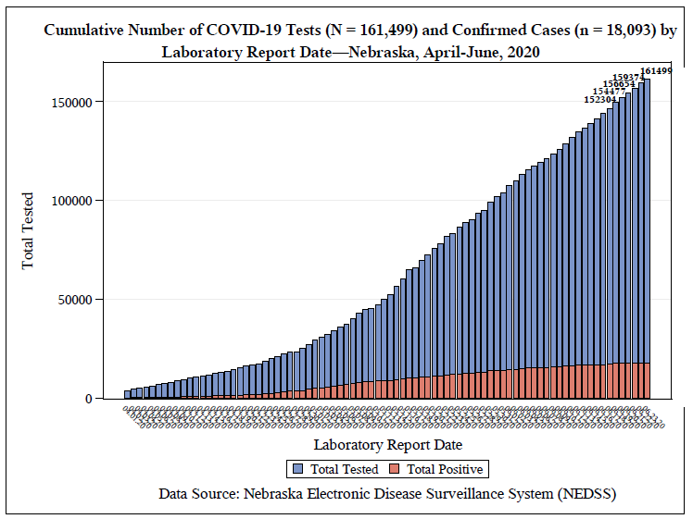

Slide 5
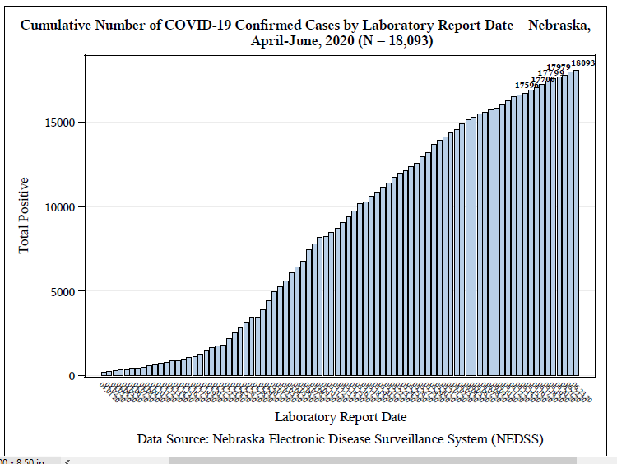

Slide 6
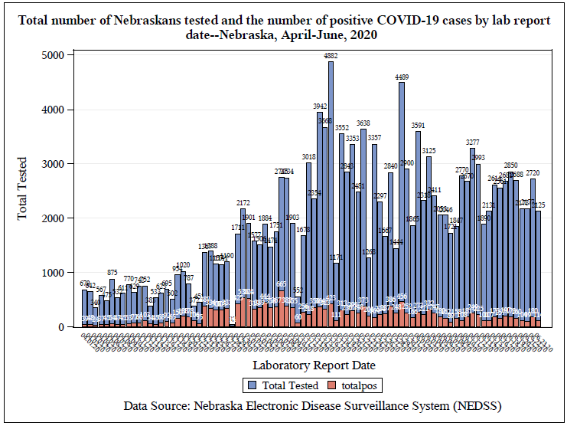

Slide 7
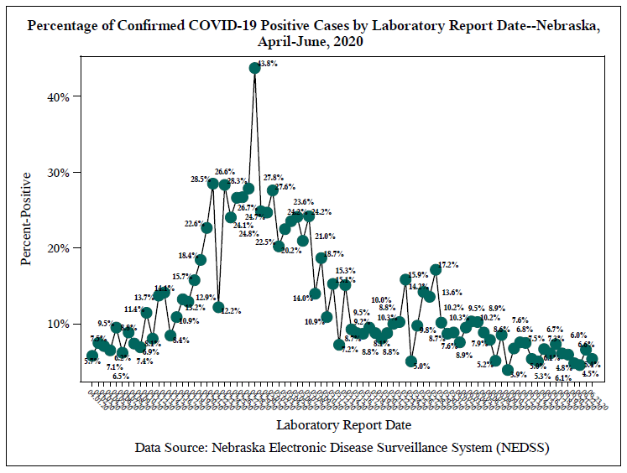

Slide 8
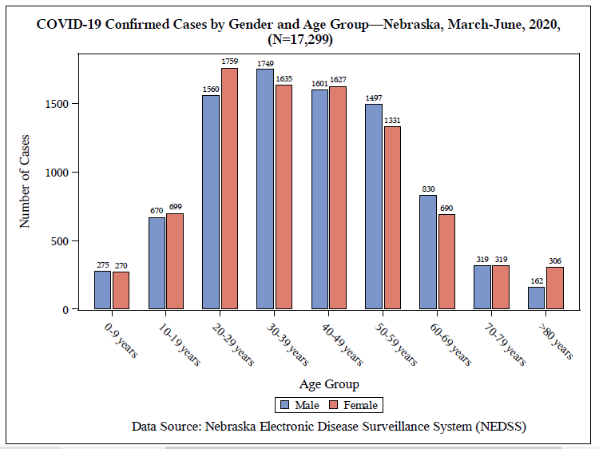

Slide 9
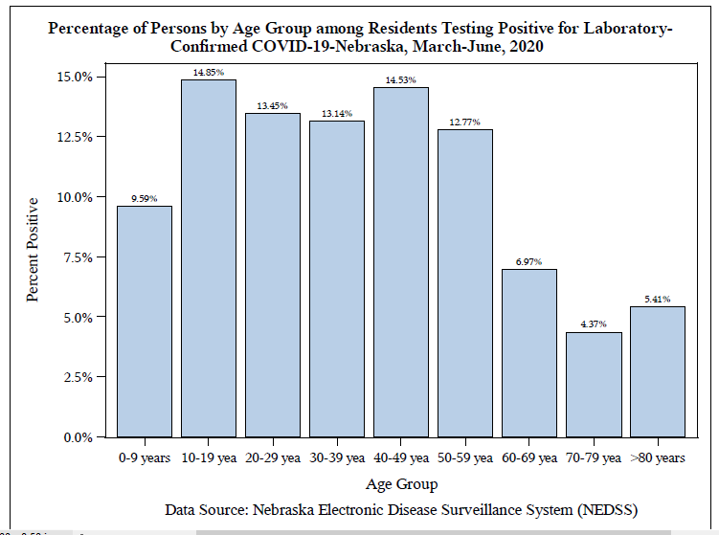

Slide 10
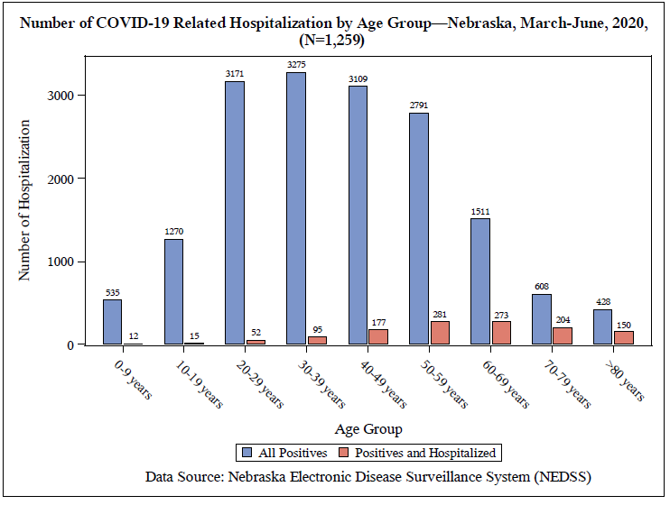

Slide 11
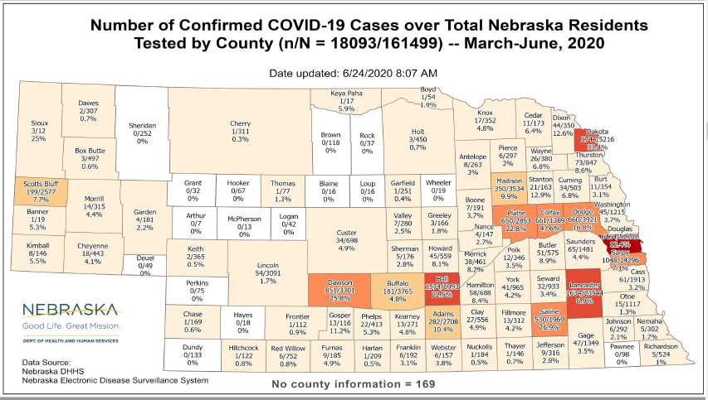

Slide 12
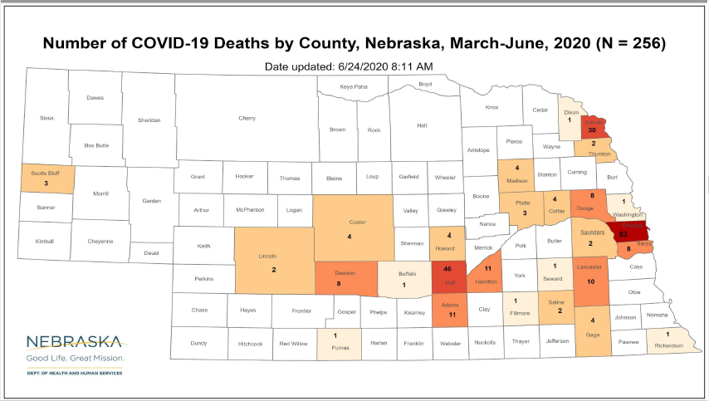

Slide 13
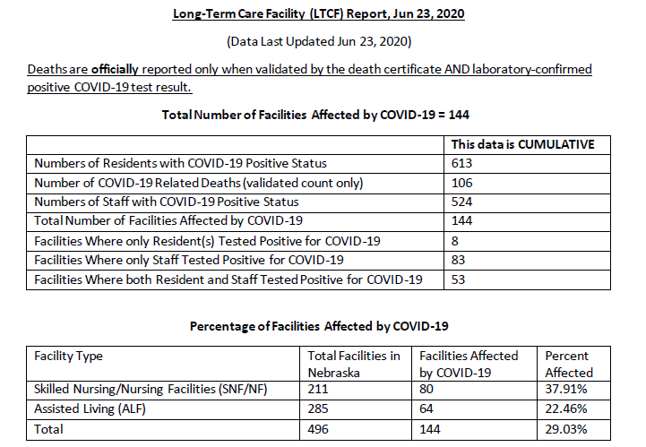
Long Term Care Facility Data

Slide 14
Yes to Masks
Airborne Transmission Route of COVID-19: Why 2 Meters/6 Feet of Inter-Personal Distance Could Not Be Enough
The available information on the SARS-COV-2 spreading supports the hypothesis of airborne diffusion of infected droplets from person to person at a distance greater than two meters (6 feet). The inter-personal distance of 2 m can be reasonably considered as an effective protection only if everybody wears face masks in daily life activities.
Int. J. Environ. Res. Public Health 2020, 17, 2932; doi:10.3390/ijerph17082932

Slide 15
Masks
Masks and closed-loop ventilators prevent environmental contamination by COVID-19 patients in negative-pressure environments
Patient 2, a 68-year-old male, and Patient 3, a 60-year-old female, both presented simple SARS-CoV-2 bronchopneumonia. Both patients were admitted to a negative-pressure isolation room in an ordinary ward with 12 air exchanges per hour (patients 2 and 3). Both wore masks. Virus was detected in the masks but on no environmental surfaces, extensively tested.
https://www.sciencedirect.com/science/article/pii/S1684118220301158

Slide 16
Saliva Testing
Temporal profiles of viral load in posterior oropharyngeal saliva samples and serum antibody responses during infection by SARS-CoV-2: an observational cohort study
Posterior oropharyngeal saliva samples are a non-invasive specimen more acceptable to patients and health-care workers.
Salivary viral load was highest during the first week after symptom onset and subsequently declined with time
PMID: 32213337

Slide 17
Asymptomatic COVID infections
The median duration of viral shedding in the asymptomatic group was 19 days
The asymptomatic group had a significantly longer duration of viral shedding than the symptomatic group (19 days vs 14 days)
Antibody titers and cytokine levels were lower in the asymptomatic patients.
40% of asymptomatic patients became seronegative by 8 weeks after diagnosis.

Slide 18
Asymptomatic COVID patients
These data suggest that asymptomatic individuals had a very different immune response to SARS-CoV-2 infection.
Serologic studies done beyond 8 weeks may underestimate the number of patients infected.
Uncertain implications for immunity, vaccinations, and risks of re-exposure.
Clinical and immunological assessment of asymptomatic SARS-CoV-2 infections
https://www.nature.com/articles/s41591-020-0965-6.pdf

Slide 19
Dexamethasone
Corticosteroid in use since the early 1960’s.
30x active as cortisone, about 5x as active as prednisone or methylprednisolone.
Used in other infections, e.g., meningitis due to tuberculosis.
Dexamethasone for the Treatment of Tuberculous Meningitis in Adolescents and Adults N Engl J Med 2004; 351:1741-1751 DOI: 10.1056/NEJMoa040573 0.4 mg/kg/day for 1 week, then taper slowly

Slide 20
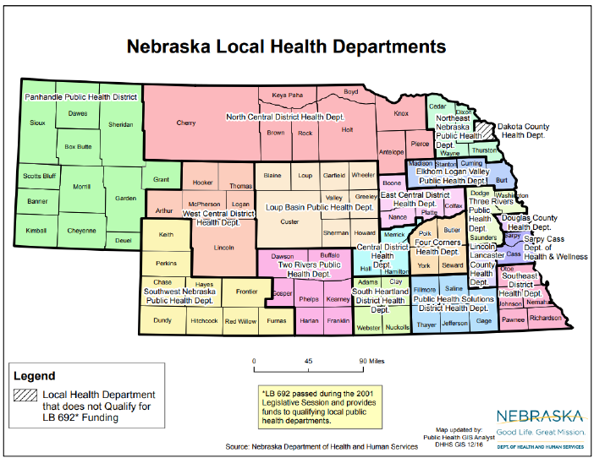

Slide 21
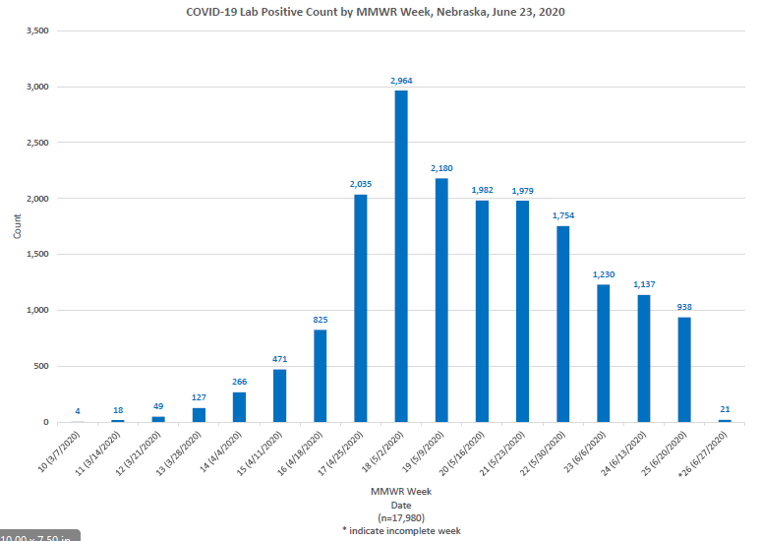

Slide 22
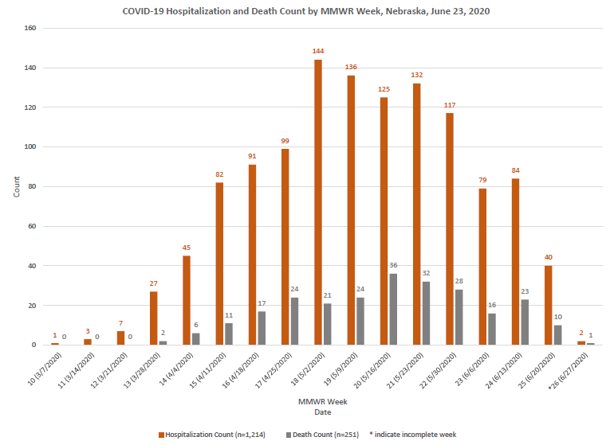

Slide 23
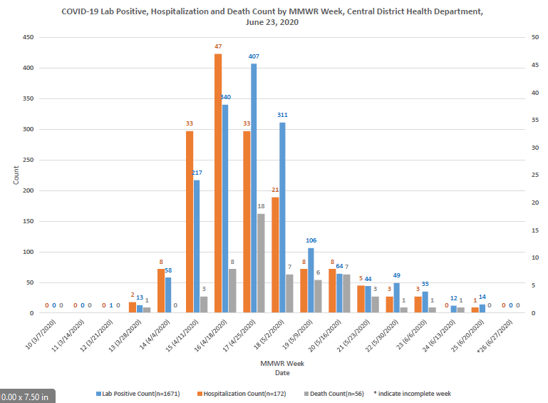

Slide 24
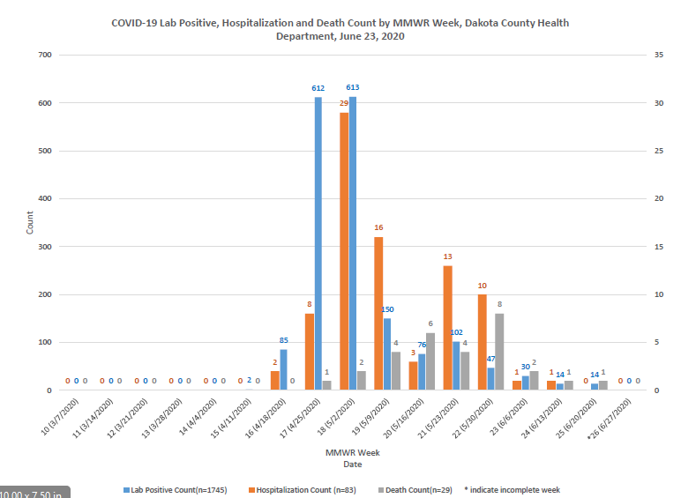

Slide 25
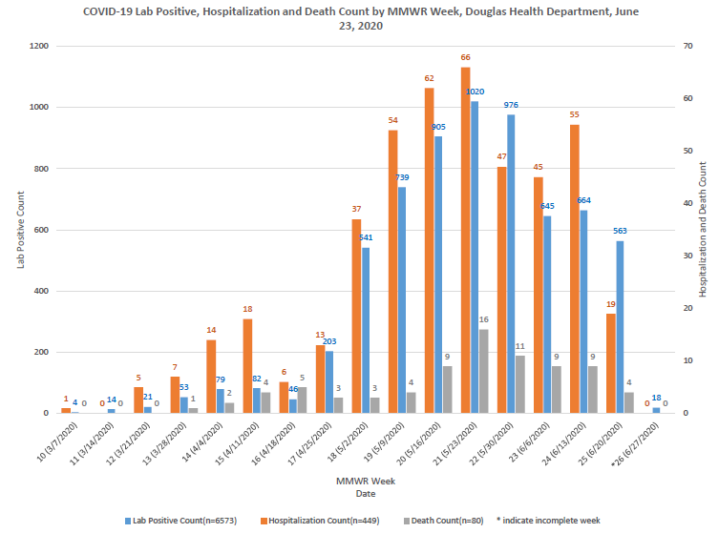

Slide 26
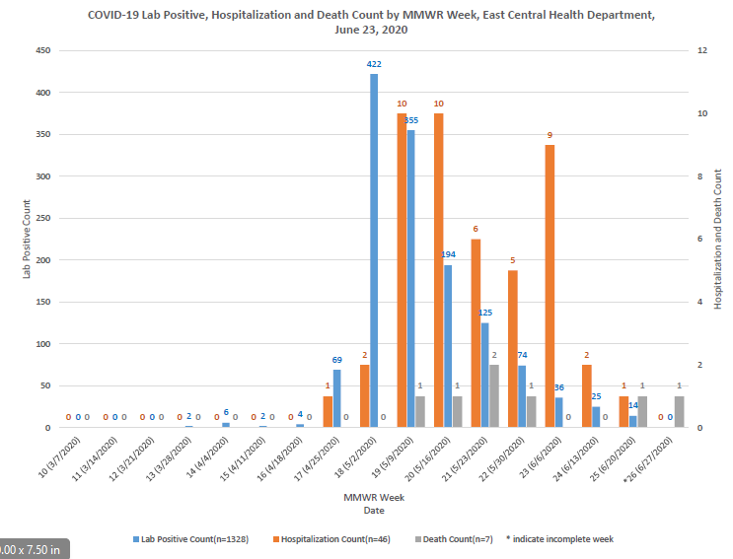

Slide 27
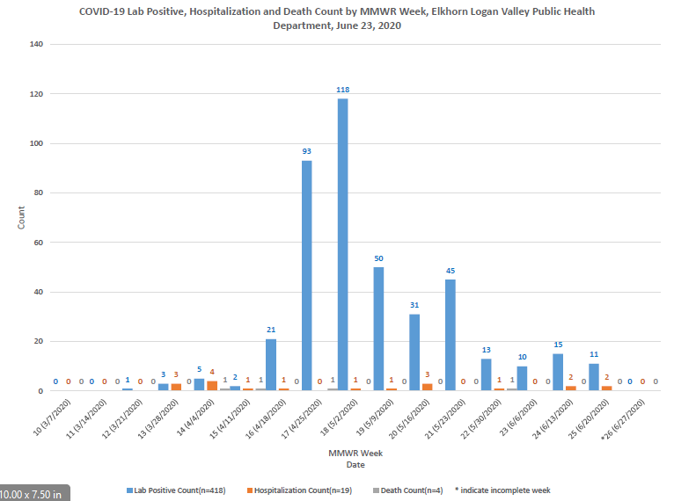

Slide 28
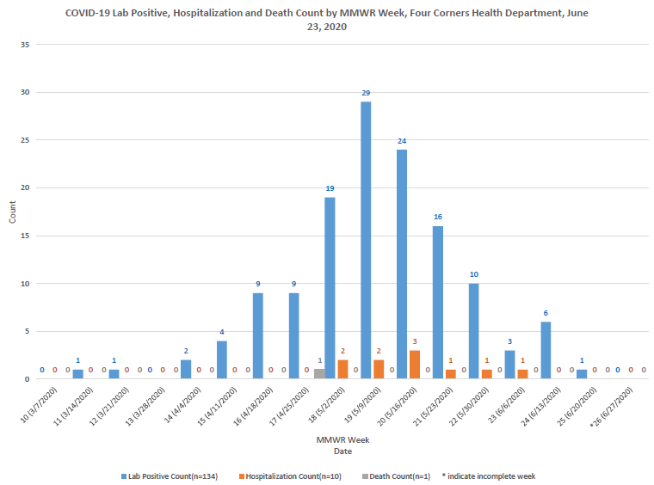

Slide 29
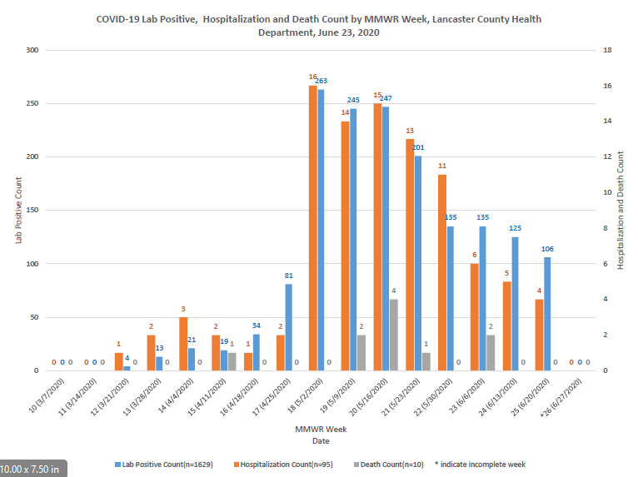

Slide 30
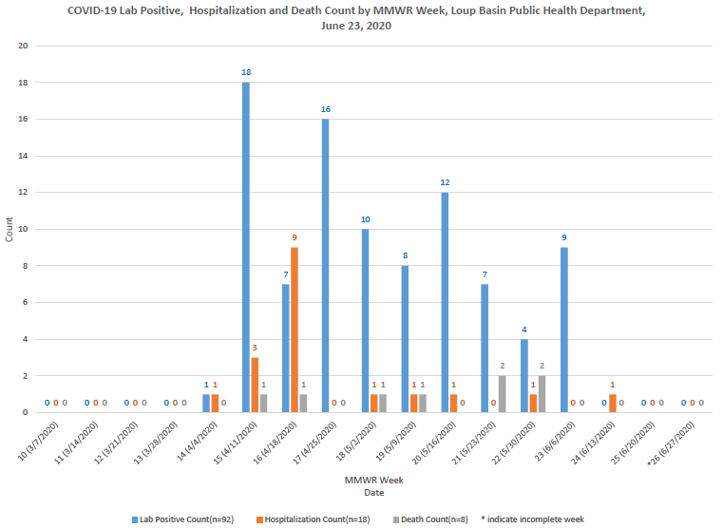

Slide 31
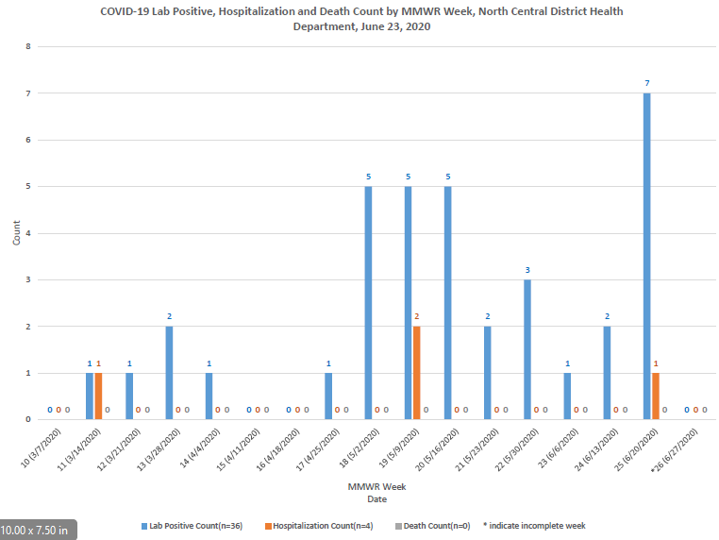

Slide 32
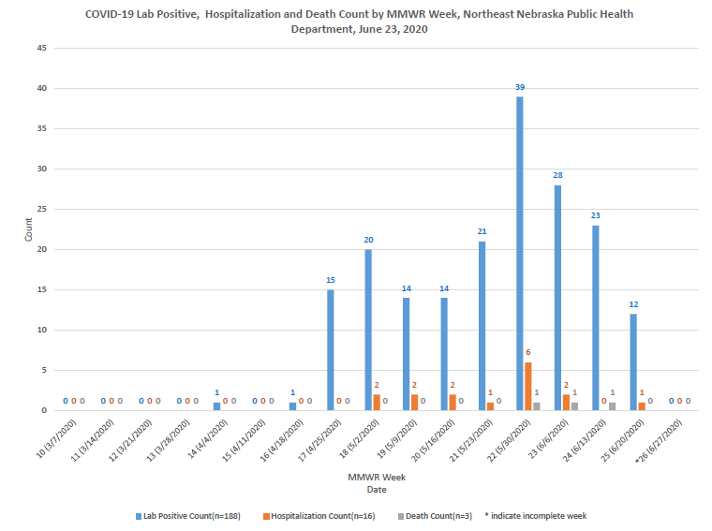

Slide 33
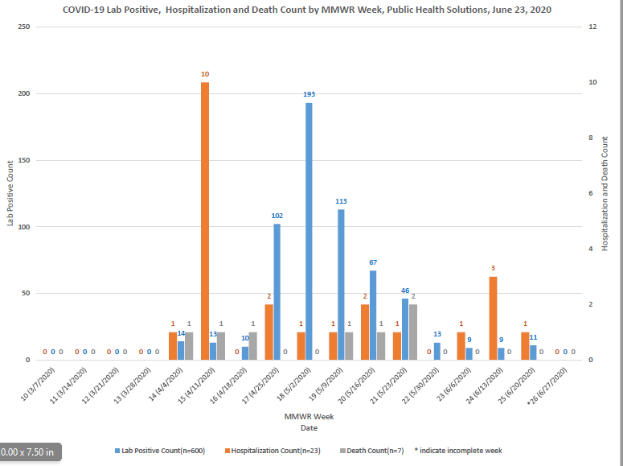

Slide 34
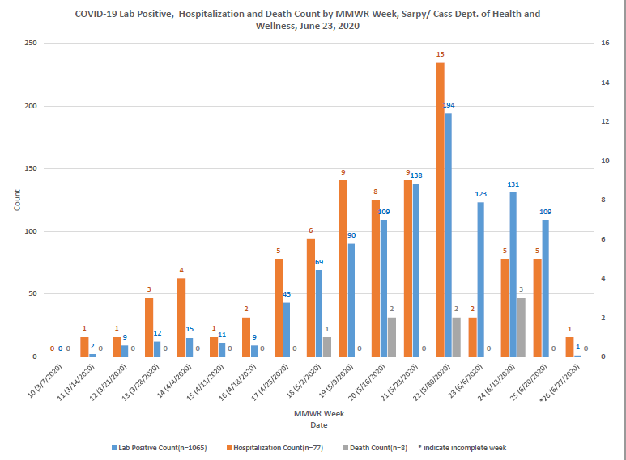

Slide 35
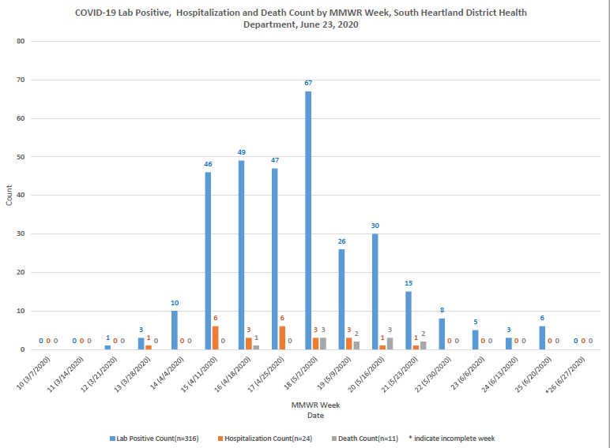

Slide 36
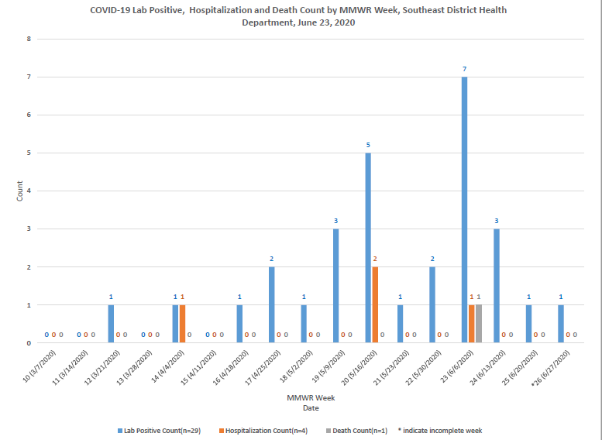

Slide 37
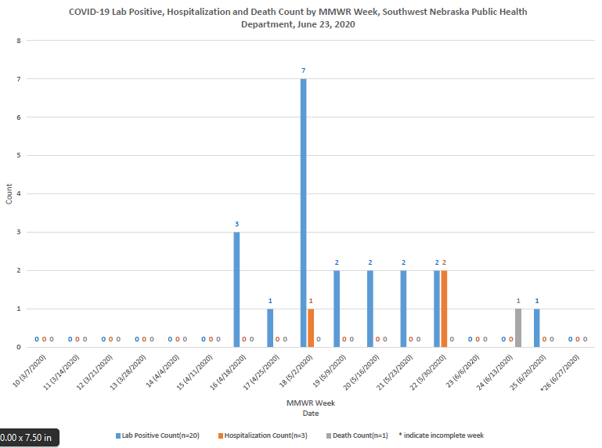

Slide 38
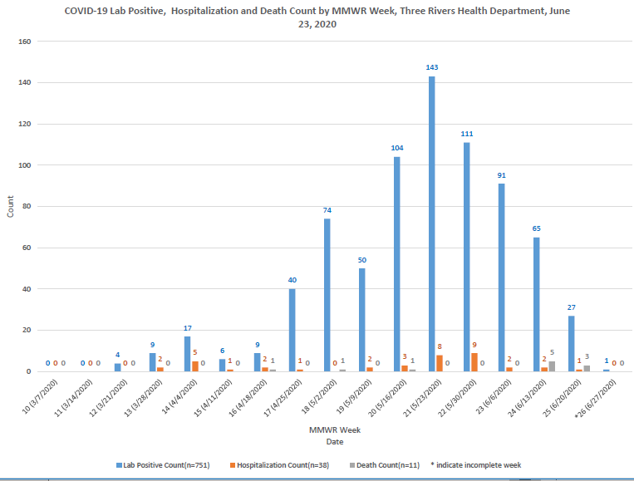

Slide 39
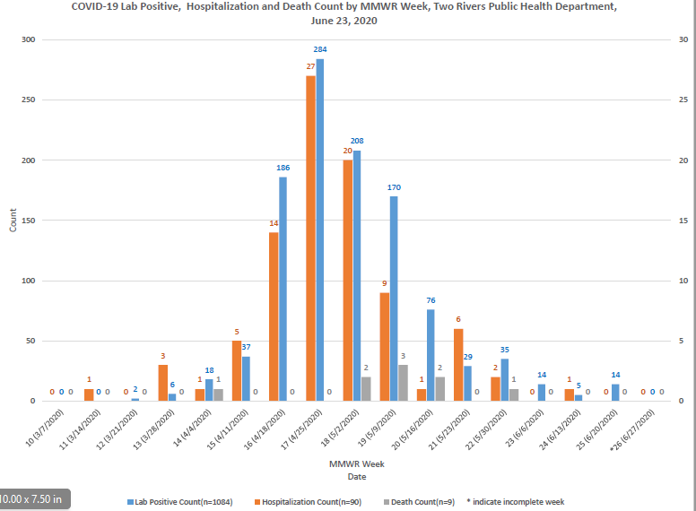

Slide 40
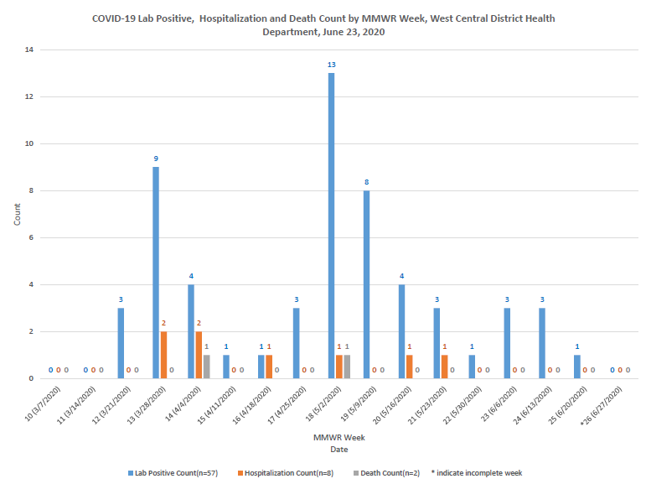

Slide 41
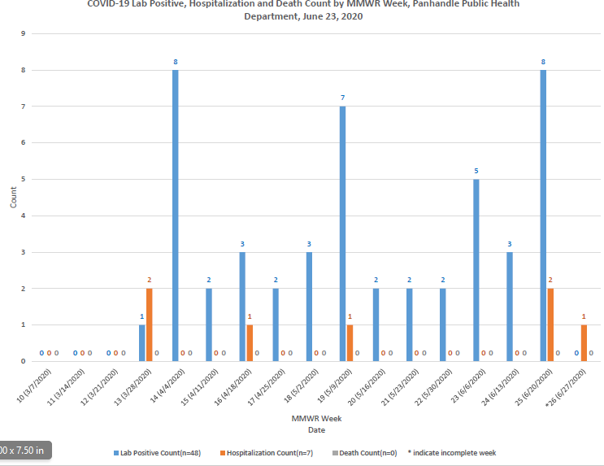

Slide 42
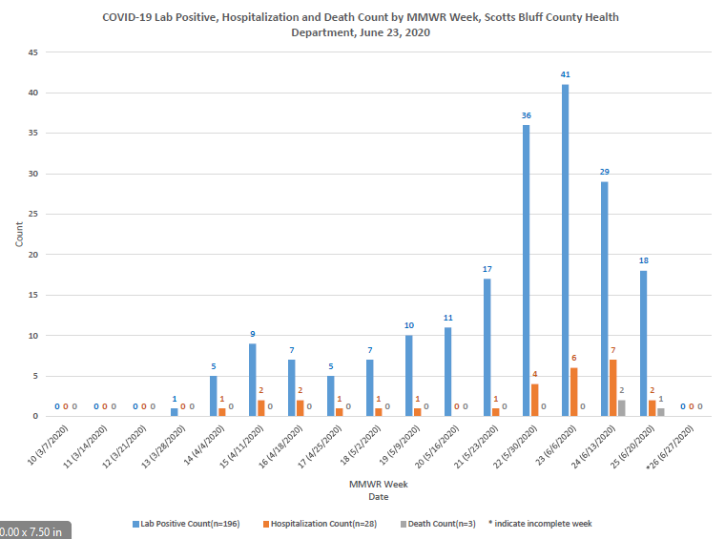

Slide 43
