Slide 1
Quality Residency – Module C
What is HQIC?
May 5, 2022

Slide 2
Your NHA HQIC Team
Margaret Woeppel MSN, RN CPHQ | Vice President, Quality & Data
  mwoeppel@nebraskahospitals.org
Dana Steiner BSN, MBA | HQIC Quality & Performance Improvement Director
  dsteiner@nebraskahospitals.org
Amber Kavan RN, BSN |HQIC Quality & Performance Improvement Advisor
  akavan@nebraskahospitals.org
David DeVries | Director of Health Data
  ddevries@nebraskahospitals.org
HQIC Advisory Council

Slide 3
HQIC – Your team
Annie Jeffrey Memorial County Health Center
Antelope Memorial Hospital
Avera Creighton Hospital
Avera St. Anthony's Hospital
Beatrice Community Hospital & Hlth Ctr
Boone County Health Center
Box Butte General Hospital
Brodstone Memorial Hospital
Brown County Hospital
Butler County Health Care Center
Callaway District Hospital
Chadron Community Hospital
Chase County Community Hospital
Cherry County Hospital
CHI Health Plainview
CHI Health Schuyler
CHI Health St Mary's
Columbus Community Hospital
Community Hospital
Community Hospital Association-Fairfax
Community Medical Center
Cozad Community Health System
Crete Area Medical Center
Dundy County Hospital
Faith Regional Health Services
Fillmore County Hospital
Franklin County Memorial Hospital
Genoa Community Hospital
Gordon Memorial Hospital District
Gothenburg Health
Grand Island Regional Medical Center
Great Plains Health
Harlan County Health System
Henderson Health Care
Howard County Medical Center
Jefferson Community Health & Life
Jennie Melham Memorial Medical Center
Johnson County Hospital
Kearney County Health Services
Kearney Regional Medical Ctr
Kimball Health Services
Lexington Regional Health Center
Mary Lanning Healthcare
Memorial Community Hospital & Health System
Memorial Health Care Systems
Memorial Hospital
Merrick Medical Center
Methodist Fremont Health
Morrill County Community Hospital
Nebraska Spine Hospital
Nemaha County Hospital
Niobrara Valley Hospital
Osmond General Hospital
Pawnee County Memorial Hospital
Pender Community Hospital
Perkins County Health Services
Phelps Memorial Health Center
Providence Medical Center
Regional West Garden County
Rock County Hospital
Saunders Medical Center
Sidney Regional Medical Center
St Francis Memorial Hosp (Franciscan Healthcare)
Syracuse Area Health
Thayer County Health Services
Tri Valley Health System (Cambridge Memorial Hospital)
Twelve Clans Unity Hospital
Valley County Health System
Warren Memorial Hospital (Friend Community Healthcare System)
Webster County Community Hospital
West Holt Memorial Hospital
York General Hospital
72 STRONG

Slide 4
HQIC – Your Team – Telligen
Meg Nugent, MHA, RN
  HQIC Program Director
  mnugent@telligen.com
Sue Stefan, DNP, MS, MBA, RN, CPHQ
  Executive Director
Rachel Megquier, BSN, RN
  Quality Improvement Facilitator
  rmeguier@telligen.com
Dr. Christine LaRocca, MD
  Medical Director
Ann Loges, BSN, RN
  Sr. Quality Improvement Facilitator
  aloges@telligen.com
Joanna Haize-Clawson
  Sr. Quality Improvement Facilitator
  Jhaize-clawson@telligen.com
Notes:
Margaret
Why Partnered with Telligen
Local scope vs regional Telligen resources

Slide 5
Other Telligen Partners:
Alaska State Hospital & Nursing Home Association
Idaho Hospital Association
Oklahoma Hospital Association
Wyoming Hospital Association
Mountain-Pacific Quality Health

Slide 6
HQIC Overview:
Target population for the HQIC grant:
Rural Hospitals
Critical Access Hospitals
Hospitals serving:
  Populations with poor access to alternative hospital settings
  Vulnerable populations: elderly, medically underserved, chronically ill, low-income and/or homeless
  HQIC Increase Patient Safety
Opioid Stewardship
Adverse Drug Events
Central Line-associated Blood Stream Infections
Catheter-associated Urinary Tract Infections
C-diff, MRSA and Antibiotic Stewardship
Sepsis and Septic Shock
Pressure Ulcers
Readmissions

Slide 7
HQIC Goals
3 Main Goals
Improve Behavioral Health Outcomes and Decrease Opioid Misuse
Increase Patient Safety
Improve Quality of Care Transitions
Supportive Goals
Support Hospitals in response to public health emergencies
Facilitate authentic person and family engagement
Address Disparities
Engage Hospital Leadership
Promote Antibiotic Stewardship
Facilitate authentic person and family engagement
Implementation of a planning checklist for patients known to have a planned admission
Implementation of a discharge planning checklist
Conducting shift change huddles and bedside reporting with patients and families
Designation of an accountable leader in the hospital who is responsible for person and family engagement
Hospitals to have an active Person & Family Engagement Committee where patients are represented and report to the Board

Slide 8
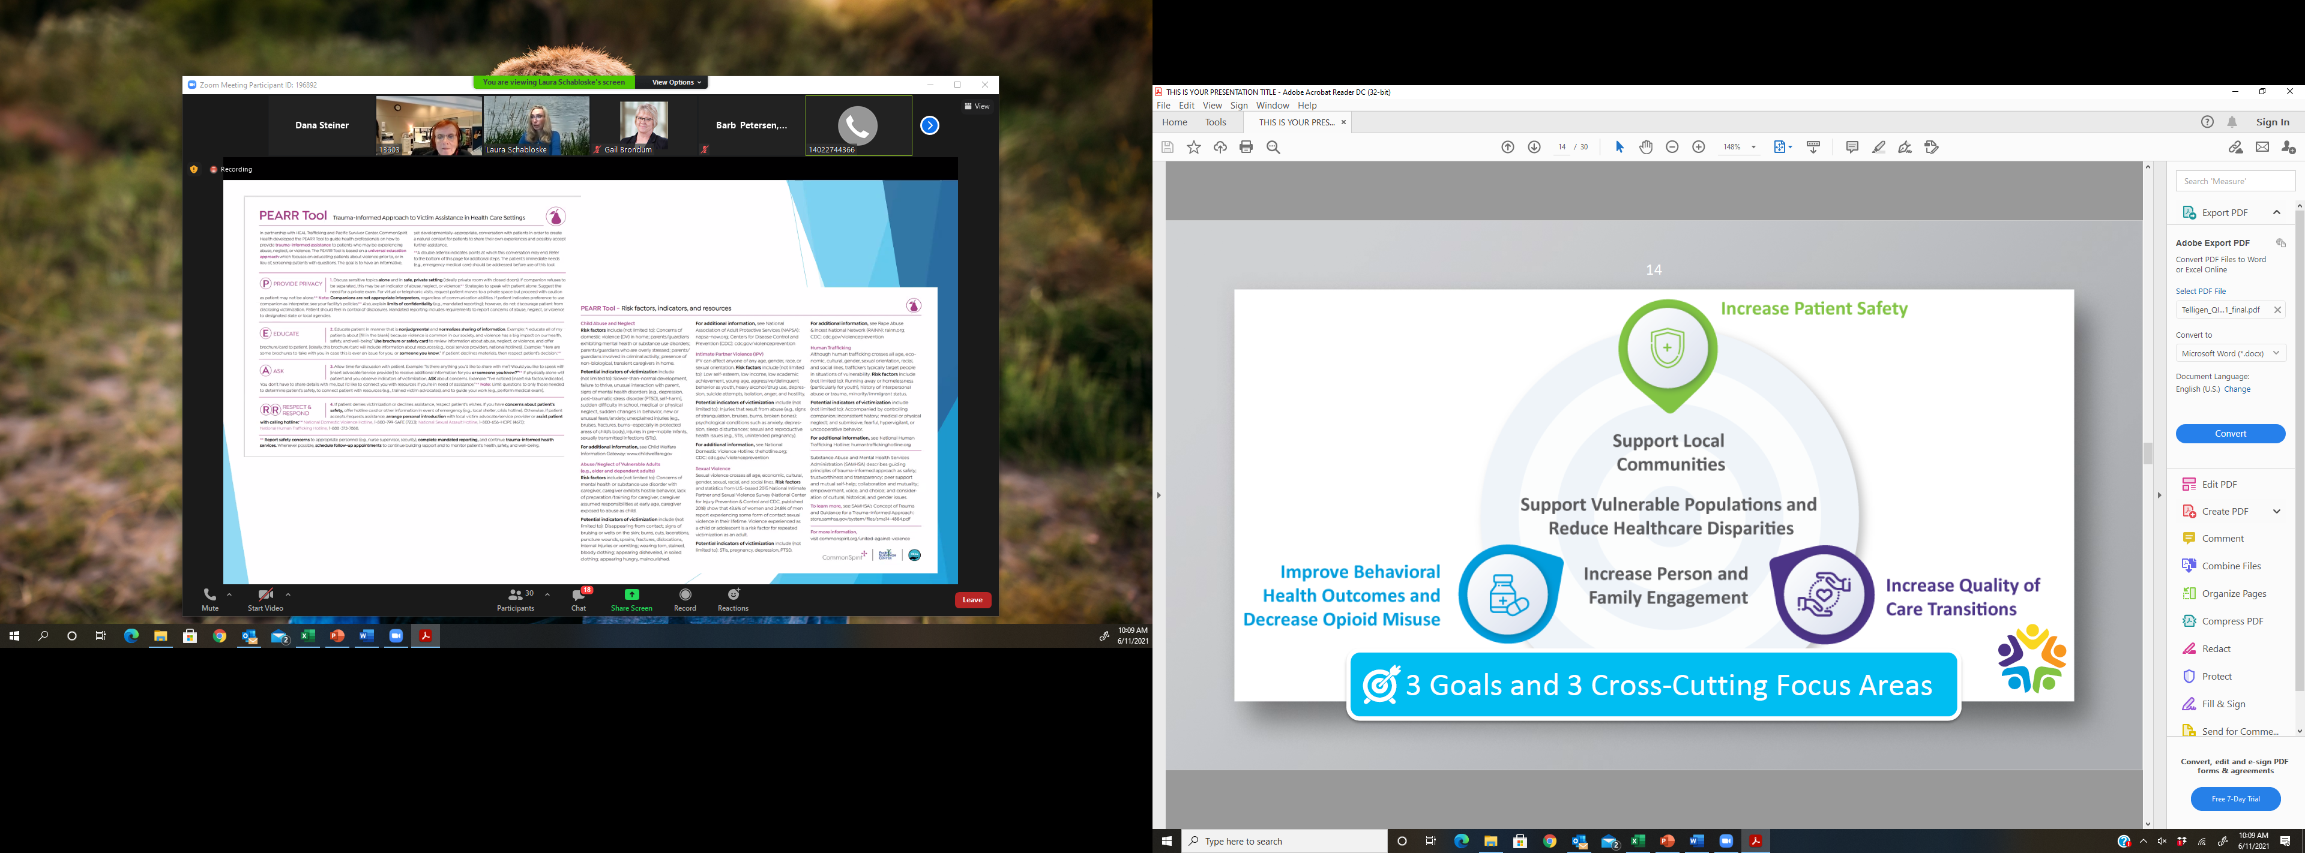

Slide 10
HQIC Measures
Improve Behavioral Health Outcomes & Decrease Opioid Misuse
Decrease opioid related adverse events, including deaths, by 7% with a focus on Medicare beneficiaries using opioids.
Decrease opioid related adverse events by 7%, including deaths with a focus on the Medicare population
Decrease opioid prescribing (for prescriptions ≥ 90 MME daily across recruited, acute care hospitals by 12%.
Improve Quality Of Care Transitions
Reduce hospital readmissions by 5% in recruited hospitals.
Reduce readmissions by 5% for the recruited population.

Slide 11
HQIC Measures
Improve Patient Safety
Reduce all-cause harm in hospitals by 2024, including: reduce by 9% or more all-cause harm in recruited hospitals to include reducing Adverse Drug Events (ADEs).
Reduce all-cause harm in hospitals by 9% or more by 2024.
Reduce readmissions by 5% for the recruited population by 2024.
Reduce ADEs in hospitals by 13%.
Reduce Clostridioides difficile (C. difficile, formerly known as Clostridium difficile) in hospitals.

Slide 12
Data Collection Methods:
Hybrid Data Collection for HQIC:
  Medicare Fee-for-Service Claims
  Infection Prevention Measures:
    NHSN
    Self-reported
  Self-Reported Nebraska Measures
Use CDS Data Repository

Slide 13
Measure List from CDS:
Medicare FFS Claims | Infection Prevention | Self-Reported
Opioid Prescribing Practices (Claims): Tell_Core_OP1 | Central Line Utilization Ratio - All Units (NHSN): Tell_Core_CLAB3 / / (Self Reported): Tell_SR_CLAB3 | Opioid Related ADEs (self-reported): Tell_SR_NEOP
Opioid Related ADEs (Claims): Tell_Core_ADE1c | CLABSI Rate all units (NHSN): Tell_Core_CLAB2 / / (Self Reported): Tell_SR_CLAB2 | Glycemic Management ADEs (self-reported): Tell_SR_NEGL
Glycemic Related ADEs (Claims): Tell_Core_ADE1b | Catheter Utilization Ratio all units (NHSN): Tell_Core_CAU3 / (Self Reported): Tell_SR_CAU3 | All Cause Readmission Rate : Tell_SR_NERead
Anticoagulation Related ADEs (Claims): Tell_Core_ADE1a | CAUTI Rate all units (NHSN): Tell_Core_CAU2 / (Self Reported): Tell_SR_CAU2 | Falls Rate: Tell_SR_NEFALL
ADE Rate (Claims): Tell_Core_ADE1 | CDI Rate (NHSN): Tell_Core_CDI2 / (Self Reported): Tell_SR_CDI2
Postoperative Sepsis Rate (Claims): Tell_Core_Sep1 | MRSA Rate (NHSN): Tell_Core_MRSA2 / (Self Reported): Tell_SR_MRSA2
Pressure Ulcer Rate, Stage 3+ (Claims): Tell_Core_PRU1 | SSI Rate Colon Surgeries (NHSN): Tell_Core_COLO2 / (Self Reported): Tell_SR_COLO2
Hospital-acquired Pressure Ulcer Prevalence, Stage 2+ (Claims): Tell_Core_PRU2 | SSI Rate Total Knee Replacements (NHSN): Tell_Core_HPRO2 / (Self Reported): Tell_SR_KPRO2
All Cause Readmission Rate (Claims): Tell_Core_Read1 | SSI Rate Total Hip Replacements (NHSN): Tell_Core_KPRO2(Self Reported): Tell_SR_HPRO2
Falls - CMS HAC (Claims): Tell_Core_Fall1
PE/DVT Rate (Claims): Tell_Core_DVT1

Slide 14
Key Elements and Links HQIC
Telligen Portal: Communication and Information Hub
  QIN-QIO Portal (telligenqinqio.com)
Comprehensive Data System (CDS): Data Repository
  AHA Comprehensive Data System (ahacds.org)
Nebraska Hospital Association Website:
  NHA Home page (nebraskahospitals.org)
  Currently being updated
CDC – NHSN
  https://www.cdc.gov/nhsn/index.html
Institute for Healthcare Improvement
  http://www.ihi.org

Slide 15
HQIC – Performance Improvement 101
Key Elements:
IHI Model for Improvement
PDSA Cycles – Rapid Cycle Improvement
Six Meetings for Success
HQIC Consult Visit:
Project specific education / audits / infrastructure creation
Notes:
Add links

Slide 16
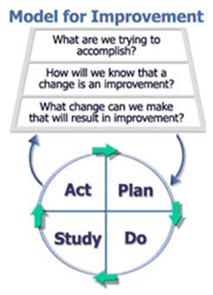
HQIC – Performance Improvement
IHI Model for Improvement
Notes:
Dana
Show video
Model For Improvement Clip 1 – YouTube

Slide 17
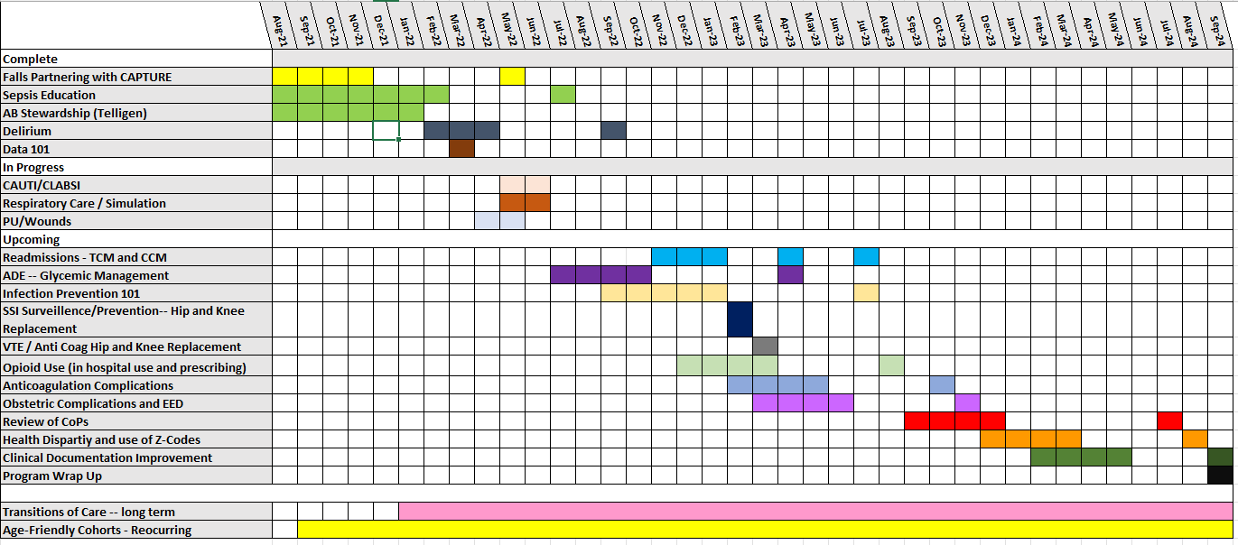
HQIC – Performance Improvement
Notes:
Dana
Who selected
What is a cohort
What will be covered
How long
When begin
Template for meetings

Slide 18
Sepsis Cohort Lessons Learned
Key sepsis themes with the most opportunity for growth:
  Creation of a multidisciplinary sepsis team that meet regularly and drives sepsis programming.
    Pre- gap assessment: 40%
    Post-gap analysis: 45%
  EHR Sepsis Alert
    Pre-gap assessment: 30% had a sepsis alert in the EHR
    Post-gap assessment: > 50% had a sepsis alert in EHR
  Staff education: annual competency for staff
    Pre-gap assessment: 30%
    Post-gap assessment: 30%
  Patient, family and community education and involvement in sepsis work
    Pre-Gap assessment: 20%
    Post-gap assessment: 50%

Slide 19
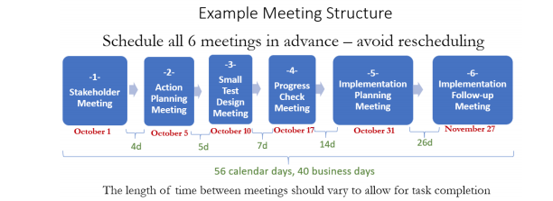
Six Meetings for Success:
  Nebraska Hospital Association : Quality and Safety : Process Improvement Tools : Tools (nebraskahospitals.org)

Slide 20
NHA Data Dimensions
New NHA data system
Log in available to designated member of your organization
Ability to run organizational specific reports
REAL data is current focus

Slide 21
HQIC
NEXT STEPS
Notes:
Dana

Slide 22
Questions or Comments
Thank you for your time!

