Slide 1
Perinatal Care in Nebraska – Training Resources and Quality Programming – Methodist Women's Hospital Outreach Program
Ashley Denker, MSN, RNC-MNN, IBLC – Clinical Nurse Educator – Mother Baby & GYN Focus & Mary Seger Barker, MSN, RNC-OB, C-EFM, CIMI – Clinical Nurse Educator – Labor & Delivery Focus

Slide 2
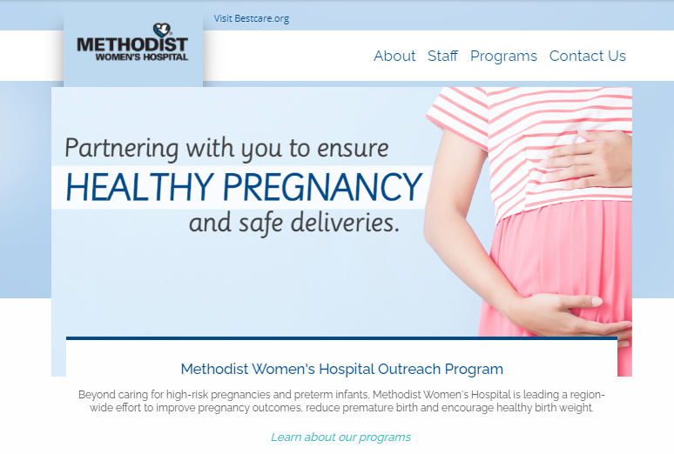
Methodist Women’s Hospital Outreach
http://www.mwhoutreach.com/

Slide 3
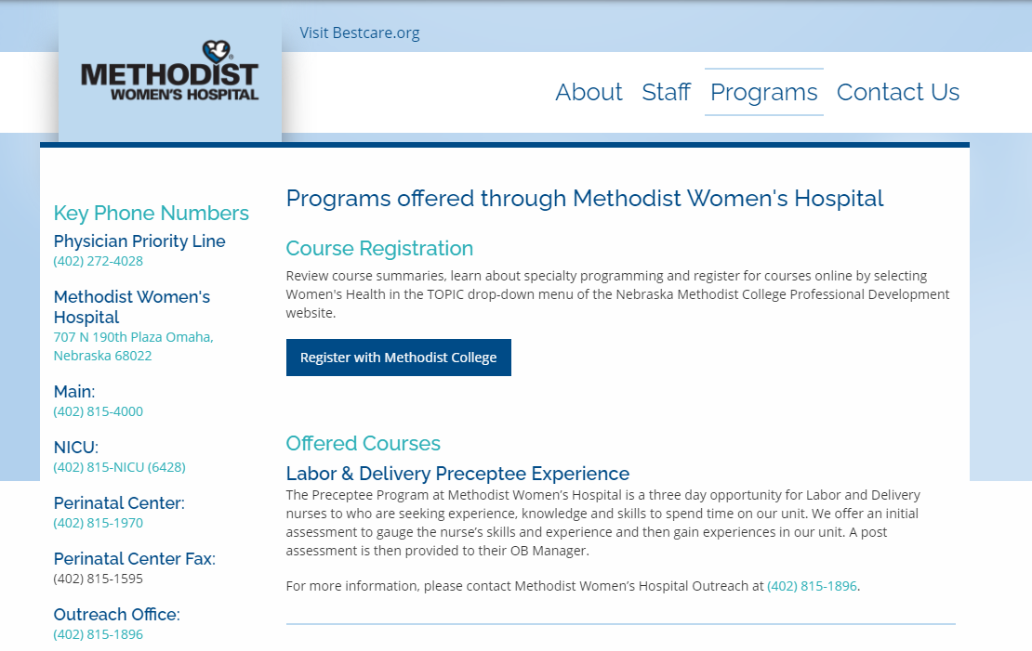
www.mwhoutreach.com/

Slide 4
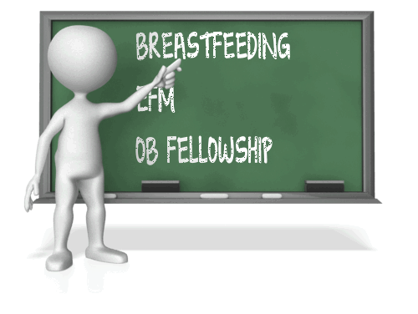
Resources Our Department Offers
Didactic Programs related to Labor and Delivery, Mother Baby and NICU Practice

Slide 5
A Sampling of the Programs We Offer
EFM Certification Review
EFM for the Novice Nurse
Stabilization of the Newborn
OB Fellowship
Newborn Fellowship
Maternal and NICU Fellowships
Advanced NICU Fellowship
Key Components of Breastfeeding
Cervical Ripening and Pitocin
Labor Support
Advanced Concepts of Breastfeeding
CEUs are awarded to participants who attend the programs offered
$ Cost for educational programs is discounted for any Outreach Facility and is mandated by the Methodist College Professional Development Department

Slide 6

For A Complete Listing Please Visit:
https://www.methodistcollege.edu/professional-development
You will be directed to the following page

Slide 7
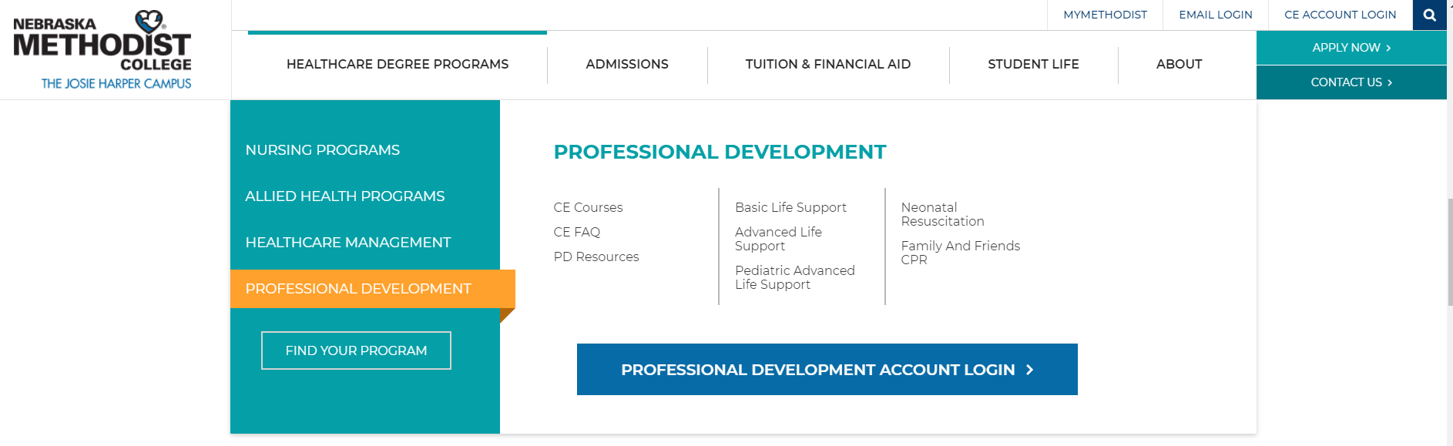
https://www.methodistcollege.edu/professional-development
Select CE Courses
To register multiple employees for programs, please contact Tara.MillerDonohue@methodistcollege.edu

Slide 8
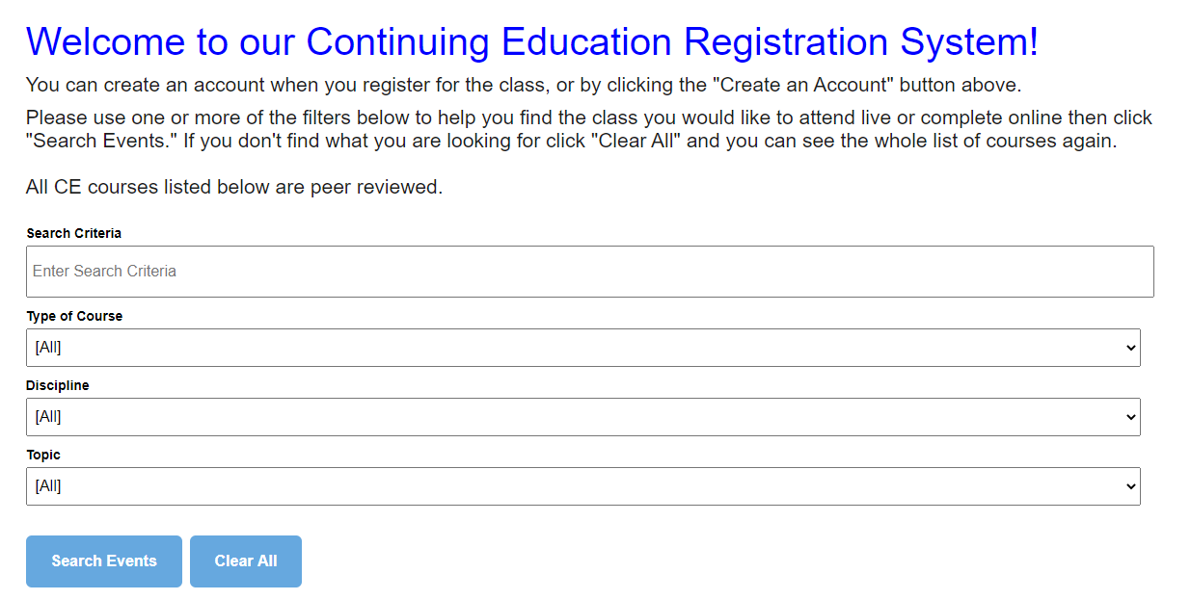
Enter in a “Key Word” such as “Fellowship, Cervical Ripening etc. in the
Search Criteria and select Search Events for a Calendar Listing
*Please note 2021 programs have not been added to the registration page

Slide 9

Education Hosted by Outreach Facilities

Slide 10
Outreach “Trips”
Specific education based upon Outreach “Needs Assessment”
  We do not offer programs which are available at our facility – For example – EFM for the Novice Nurse – Outreach facilities are encouraged to register participants at this time via WebEx
  Examples of programs we offer at Outreach Facilities – Post Partum Hemorrhage lecture and drills, Hypertensive Disorders lecture and drills, Breastfeeding, Diabetes (maternal and newborn focus) Sepsis lecture etc.
    CEUs are available if approved by the Methodist College Professional Development Department
    Currently, there is not a cost to the facility host
    Perinatologist accompany presenters when physician attendance is guaranteed
      Currently, Outreach Trips have been suspended due to COVID19 regulations

Slide 11

To Request Specific Programs Please Submit Request To The Following email Address:
mwhoutreach@nmhs.org

Slide 12

QUESTIONS……

