Slide 1
Improving your 340B Net Revenue
By Chase Dudzinski, CPA, CAH CFO

Slide 2
The Problem:
The problem defined:
Drug manufacturers have made it increasingly difficult to navigate the 340b program and successfully maximize the 340b benefit. The knowledge needed and complexity of the program create barriers to covered entity participation and optimization.
Why we can’t overcome the difficulty:
We as rural healthcare leaders have the odds stacked against us. We have the same challenges and difficulties as large hospital systems only we have less resources and personnel. Many of you are Critical Access Hospitals and by definition we are paid lower than our cost. 101% less 2% sequestration = 99% reimbursement.
How are we to survive?
Annual (Single Covered Entity)
Illustrative Opportunity Size*
Opportunity
Description of Opportunity
340B Basic Set Up
Providers don’t have their 3rd Party TPA’s set up correctly
$250k to $1M*
Specialist Recapture
Not flipping scripts to capture additional net revenue
$120k to $500k*
Engage patients to move to contracted pharmacy
Direct outreach to patients via the text channel to display preferred pharmacy
$1M to $2M*

Slide 3
The 340B Basics:
Designating your sole contract pharmacy
Placing contracts that match volume – You have all of the data on your where your patients fill prescriptions. Are you using it?
3rd Party TPA set up issues (have you had a review?)
- Providers not added correctly
- Retail cross walks not completed
- TPA caused issues – not monitoring and 340b eligible drugs are not deemed eligible
- Drug spend on 340b account with no 340b reimbursement
- Do providers know which drugs are 340b eligible?
Does your team understand how 340b works?
How is your cash card program administered? Is it needs based or open to everyone?

Slide 4
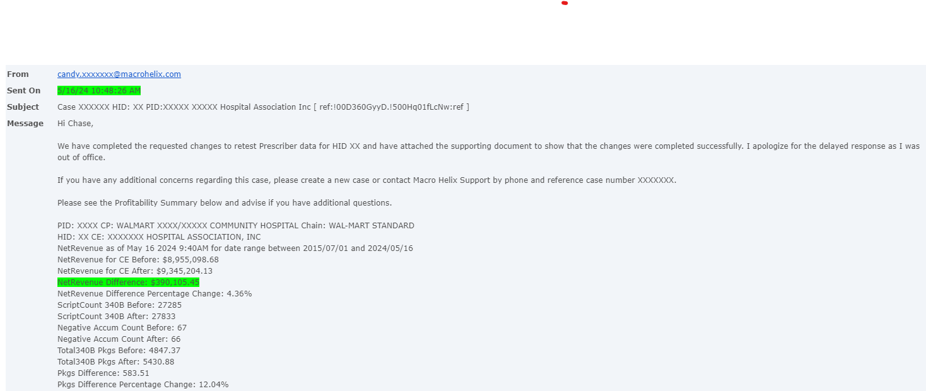
The 340B Basics: Real Example
This hospital had thought everything was working appropriately. Their TPA was set up incorrectly. We did an analysis and they will receive a check for $390k
Digital Conversation

Slide 5
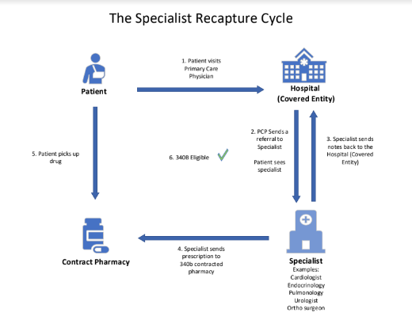
Specialist Recapture:
Hospitals are seeing additional 10-40k per month from specialist recapture services
Digital Conversation

Slide 6
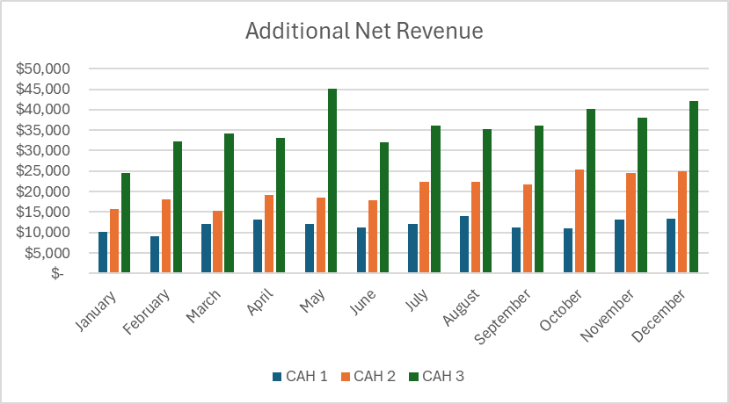
Specialist Recapture: Case Study
Combined Savings for 3 CAHs of $818,344 over a 12 month period
CAH 3 had additional $35,771 of average 340b revenue

Slide 7
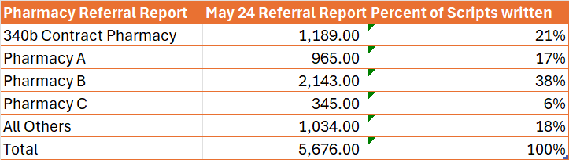
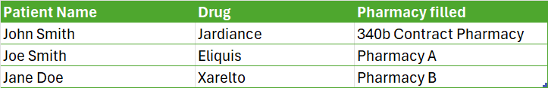
Direct Patients to your 340b Contracted Pharmacy :
We own all of the pharmacy prescription data within our EMR

Slide 8
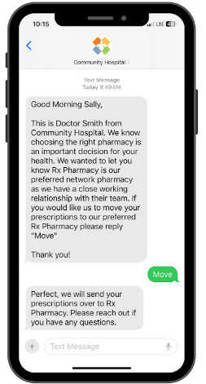
Direct Patients to your 340b Contracted Pharmacy :
Proactive Patient Outreach
Provider Scripting

Slide 9
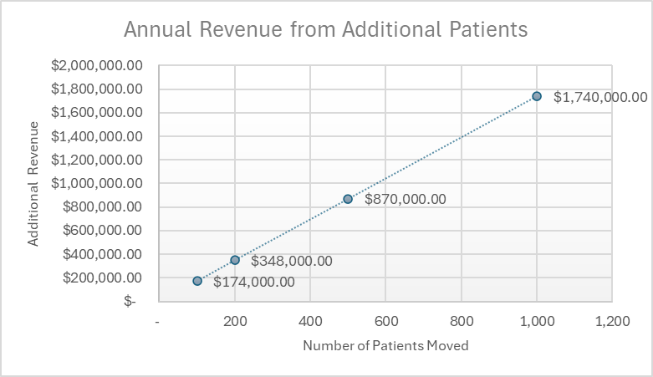
Direct Patients to your 340b Contracted Pharmacy Illustrated Example
Assume each patient has a 30 day supply. 12 prescriptions per year per patient
Average 340b Revenue per script is $145 based on sample of 3 CAHs.

