Slide 1
Nebraska Hospital Association
Ben Hammersley, October 19 2022

Slide 2
How to think about the future

Slide 3
The Obligatory Slide

Slide 4
Linear Stories and The Heroic Myth

Slide 5
The Covid Andon

Slide 6
Unveiling of New Capabilities .v. Exposure of Old Problems

Slide 7
The Co-Arising of Change

Slide 8
Medical risks
Access to healthcare
Access to healthcare without bankruptcy
Access to nutrition
Access to education
Access to harm reduction
Access to safe sexual health
Access to preventatives
All in the context of interconnectedness and contagion

Slide 9
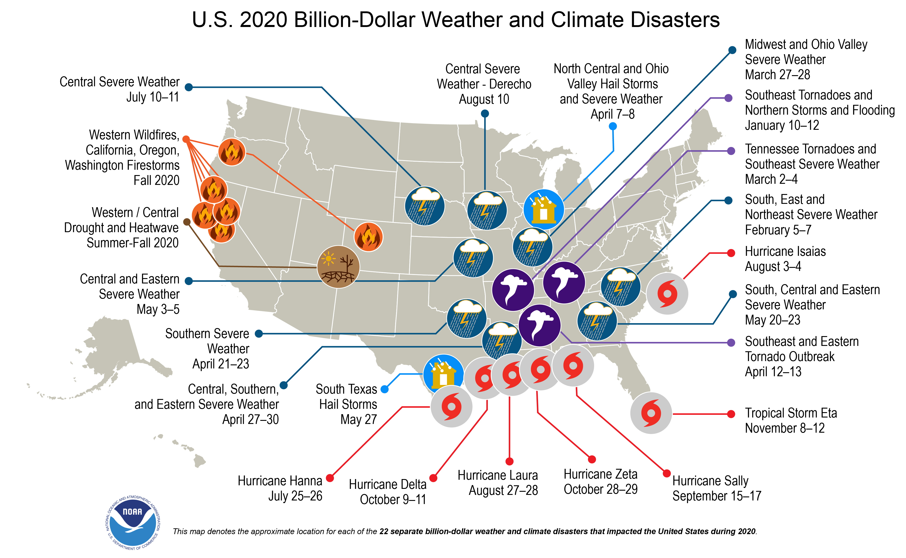
Climate Risk

Slide 10
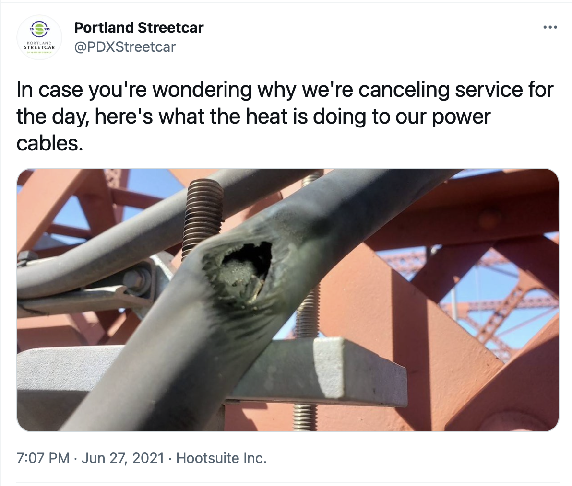
Infrastructure Overwhelm

Slide 11
Cognitive Risk

Slide 12
Political Consequence Risk

Slide 13
The Kodak Mistake In All Things

Slide 14
The impossibility but necessity of prediction

Slide 15
Predicting Through Deciding: World Building

Slide 16
Rules for World Building
Everything will be true somewhere
Energy to move forward can also be used to stay still
Things exist in the world they grew up in
Any believable prediction will be wrong
Any correct prediction will sound insane
But magical thinking never works

Slide 17
Capacity Building And Adaptive Futurism

Slide 18
Constant Legacy-Free Reinvention

