Slide 1
Revenue Cycle Residency
Putting it in action
Notes:
I started this residency program about 1 month after starting a new role within a new facility. I had quite a bit of professional billing knowledge, very little institutional billing knowledge and some payment posting knowledge. I have worked on the self pay collections side of the business and the billing side of the business. The revenue cycle director role was new to Brodstone and as a new face coming into the organization they didn’t make it easy. I definitely had to prove myself and I think this program has helped me build a network to reach out to for support when needed and has provided information and materials to help me to grow my confidence level within my role. Here are a few of the fun things that took place over the last year!

Slide 2

WHAT’S HAPPENING?!
CERNER – AUGUST 2023
NEW CLEARING HOUSE/CLAIM SCRUBBER (SSI)
  MONTHLY MEETINGS/1-ON- 1 ‘S
  RCAT – REVENUE CYCLE ACTION TEAM

Slide 3
CERNER
CHALLENGES
ADVANTAGES
  CHARGE AUTOMATION
  CLAIM AUTOMATION
  SUPPORT PROCESS
  CHANGE
  AUTOMATION
  TRANSPARENCY
  ACCOUNTABILITY
  CUSTOMIZATION
Notes:
What a roller coaster ride this was and continues to be! Cerner brought MANY challenges, but it also brought many advantages. I didn’t have much experience in our old EMR, but I do know that it was a lot of manual processes. We were posting every single payment manually except for Medicare. I honestly was shocked! Coming from a facility that had very little manual processes to one that had very little automated processes was a culture shock.
Charge Automation – we went from paper charge sheets that were manually entered to clinically driven charge capture process has been an on-going challenge, but also a huge advantage. We are still working on writing claim rules for certain charges and charge transformation rules to ensure charges are dropping accurately and appropriately. Having the capability of creating rules so we aren’t having to manually touch claims is such an advantage as it allows us more time to focus on other duties, but while we are still in the early stages and writing rules it does present it’s challenges
Claim Automation – This has been a struggle with our experienced billers who instinctively want to touch every claim to review it and make any necessary changes. We have had struggles with them manually ‘fixing’ things and not communicating that so that we can create automation so we aren’t having to touch every claim.
Support Process – SR system has not been promising with Cerner. A lot of times there is a language barrier with Oracle India and that creates misunderstandings of what changes/functionality we are requesting. We struggle getting timely movement on our support tickets
Change – Change is hard! We have several experienced staff members who haven’t embraced the change. I think there is a level of fear with automation and job security. I also think t here is a lot of ‘We have always done it this way’ mentality that we are trying to change.
Advantages
Transparency – Cerner has created more transparency on where some of our issues are. Transparency is great for problem solving and creating process improvements! We have already discovered some areas for improvement and are working on training/workflows for improvement.
Accountability – with the transparency comes the accountability. Because of the transparency within Cerner we can see who is doing what and we are able to hold them accountable and provide further education on the right way to do things. I am a firm believer that people don’t make mistakes on purpose and they most likely don’t even realize they are doing something wrong and this provides us with the opportunity to provide them with education and help them excel in their position
Customization – Cerner has a lot of areas that allow us to create custom rules and this helps prevent manual intervention

Slide 4
SSI
CHALLENGES
ADVANTAGES
WORKING EDITS
SEARCHING EOB’S
CLAIM ASSIGNMENT
REPORTING
CUSTOMIZATION
Notes:
Challenges – The challenges we have faced with SSI are mostly due to lack of training and just learning how to navigate the system. We have had a challenge of being able to route our claims to the appropriate billers due to the way we have our work split up. So there has been a bit of a challenge in making sure filters are set appropriately to ensure you’re seeing ALL of the claims that need attention.
Like Cerner we can create custom edits within SSI and have the ability to turn on/off edits and this is just another way for us to prevent any unnecessary manual intervention.
One of the biggest advantages that SSI has in my opinion is their ability to run reports. We have been able to identify some areas in need of improvement based off of our SSI reports. Being able to have the data to take back to other departments and show them that there is room for improvement is huge in process improvement initiatives!

Slide 5
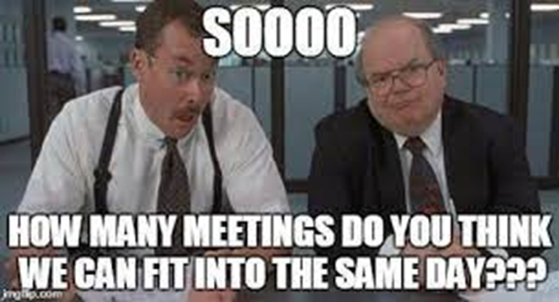
Notes:
Everyone loves meetings …. Right??
I am sure we have all felt like this at some point!

Slide 6
MEETINGS …
- MONTHLY STAFF MEETINGS
- 1-ON-1’S
- RCAT – REVENUE CYCLE ACTION TEAM
  STANDING AGENDA ITEMS
    KPI REVIEW
    DENIALS
    COMPLIANCE ISSUES
    CHARGE ISSUES
    PAYER CONTRACTS
    UPCOMING EDUCATION OPPORTUNITIES
Notes:
Aside from software implementation we have implemented a few regularly scheduled meetings. As long as meetings are meaningful and productive they aren’t always a bad thing.
Monthly Staff Meetings – We have a QI goal of % of denials to total revenue. Each month we take time to review our denials and we pick one of our trending denials and dig into it over the following month. We then report back with our findings. Not only does this help with our QI plan, but it has also allowed us to improve processes/develop work flows and provide education where needed.
Monthly 1-on-1’s – I make it a point to meet with my staff one on one once a month. This is a very casual meeting where we can discuss any barriers/issues they might be facing and discuss positives and quickly catch up with one another. I think it is important for building a relationship with my staff and creates a level of trust between us. One big thing that I incorporate into our 1-on-1’s is to recognize other team members. I do require them to give me 1 person within the facility to recognize and what they want to recognize them for. I take that information and send that co-worker an email or post card letting them know that they have been recognized, who they have been recognized by and why they are being recognized. I think this has really helped with team building/mutual respect within my own department, but have also gotten a lot of positive feedback from outside departments
RCAT
We have staff from RHC, HIM, Auth Team, Case Management, Billing & Executive team attend. This is a place where we meet to have open communication regarding topics that impact multiples areas across the revenue cycle. We review our KPI’s and discuss opportunities for improvement. This is generally where I take the denial information from our Business Office Meetings to review what we believe is a process issue and allow other departments to take that back and come up with a plan for improvement. This group holds each other accountable to make any necessary changes to processes/workflows.

Slide 7
WHAT THE FUTURE HOLDS
FUTURE INITIATIVE – PATIENT REGISTRATION ON-BOARDING PROCESS
Financial Assistance – Screening Process/Understanding of Assistance
Public Benefits Screening Process
Cost Estimates
Copay/Balance Collection
Pre-Registration Process
Prior Auth Process
Scanning/Labeling of Insurance Cards
MSPQ
Basic Insurance Understanding
Claim Form Information
Career Ladder
KPI’s
Notes:
We currently have a work group established that meets every 2-3 weeks and assign each other topics to develop training material. Once we have all of our material created we will work on putting it all together to create a program for on-boarding. Our goal is to create standardized processes across the facility to help provide some consistency and education to our registration staff.
Right now ALL calls for payments and/or FA are transferred to our Financial Counselor. The goal is to have educated staff that is comfortable in having those conversations with patients and physically doing the work rather than passing the patient around to multiple people. Screen patients for FA/Public Benefits and IF they might qualify then we can offer them the FA App or transfer them to Case Management to help qualify for coverages.
Estimates/Payment Collection – Would like to start having a formal process for providing patients estimates for scheduled high $ procedures and allow them to make down payments/pre pay
Implement a career ladder - obtain a certification through AAHAM or HRMA and move up on pay scale. Encourage people to be field experts
Education on MSPQ, Claim Form, Registration Processes, Where to locate/enter auth information within Cerner

Slide 8
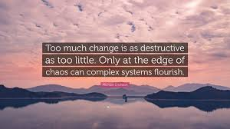
QUESTIONS/COMMENTS

