Slide 1
Nebraska Nursing Workforce Data: Let’s Talk About Solutions
Ann Oertwich, PhD, RN
June 3, 2022
Notes:
Background nursing shortages develop when forces temporarily alter the demand or supply of nurses.
Such shortages almost always resolve and do not become permanent.
For example, consider a hospital where four of seven labor and delivery nurses begin maternity leave at nearly the same time, leaving the hospital facing an acute shortage of nurses with the knowledge and skill needed for this patient care setting. This type of supply side disruption can occur just as easily in other hospital and non-inpatient settings.
Or consider a demand-driven background shortage that develops when a new hospital opens in the community and offers wages above the prevailing rate and sign-on bonuses to lure nurses from an established hospital(s). Some nurses will leave their current position for the new hospital, which could create a temporary shortage for the established hospital(s).
Eventually, the shortage resolves as new nurses move to the community, local nursing programs graduate additional registered nurses (RNs), or temporary and traveling nurses make up for the shortfall, etc. For different supply and demand reasons, background nursing shortages are always occurring some where. They can disrupt operations, but they eventually resolve and do not spread to other communities. Shortages can also be long lasting or static – such as in a rural area

Slide 2
We are LIVING the shortage

Slide 3
Nebraska Nurses by the Number
Registered Nurses 32,902
Licensed Practical Nurses 5,582
Total 38,487
Advanced Practice Registered Nurses (APRN)
APRN-NP APRN-CRNA APRN CNS APRN-CNM | 3594 724 77 64

Slide 4
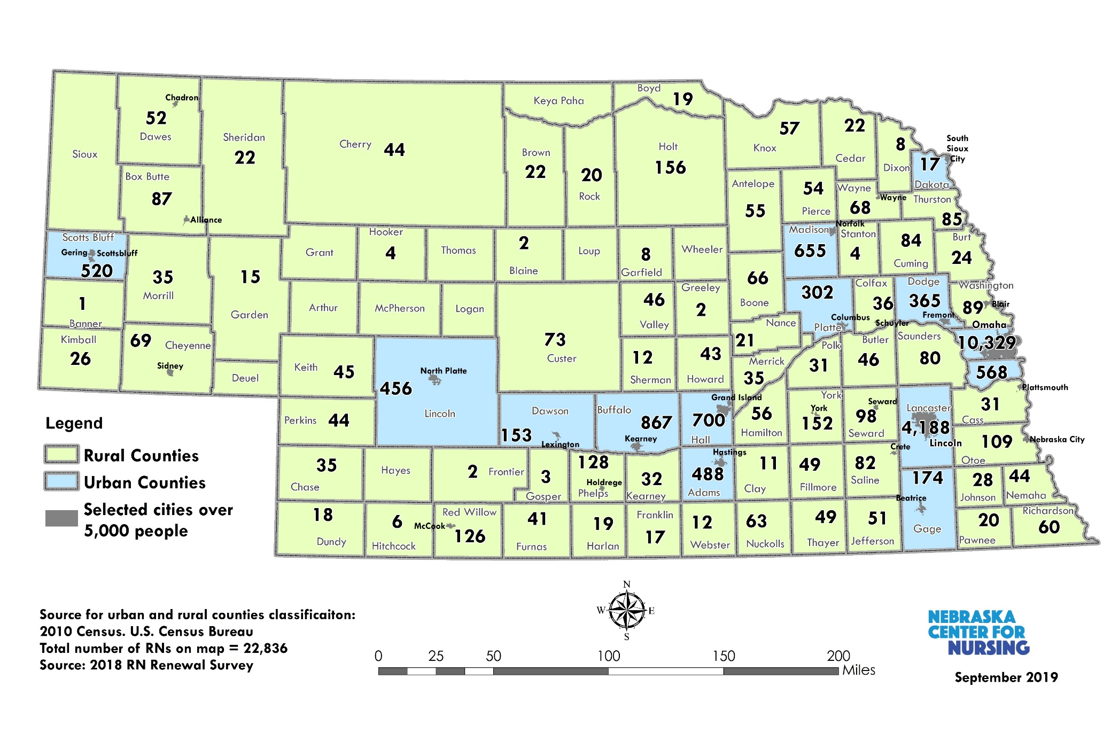
Geographic Distribution of RNs by County
Urbanized areas 63%.
Urban clusters: 29%
Rural: 8%
11 counties with no RNs:
Arthur
Deuel
Grant
Hayes
Keya Paha
Logan
Loup
McPherson
Sioux
Thomas
Wheeler
Notes:
Nearly two-thirds of all RNs working in Nebraska are concentrated in Douglas and Lancaster counties (63.6%). Nearly three out of ten RNs (29%) working in rural areas travel more than 20 miles (one-way) to their workplaces. In comparison, nearly two out of ten RNs (18%) travel the same distance in urban areas.

Slide 5
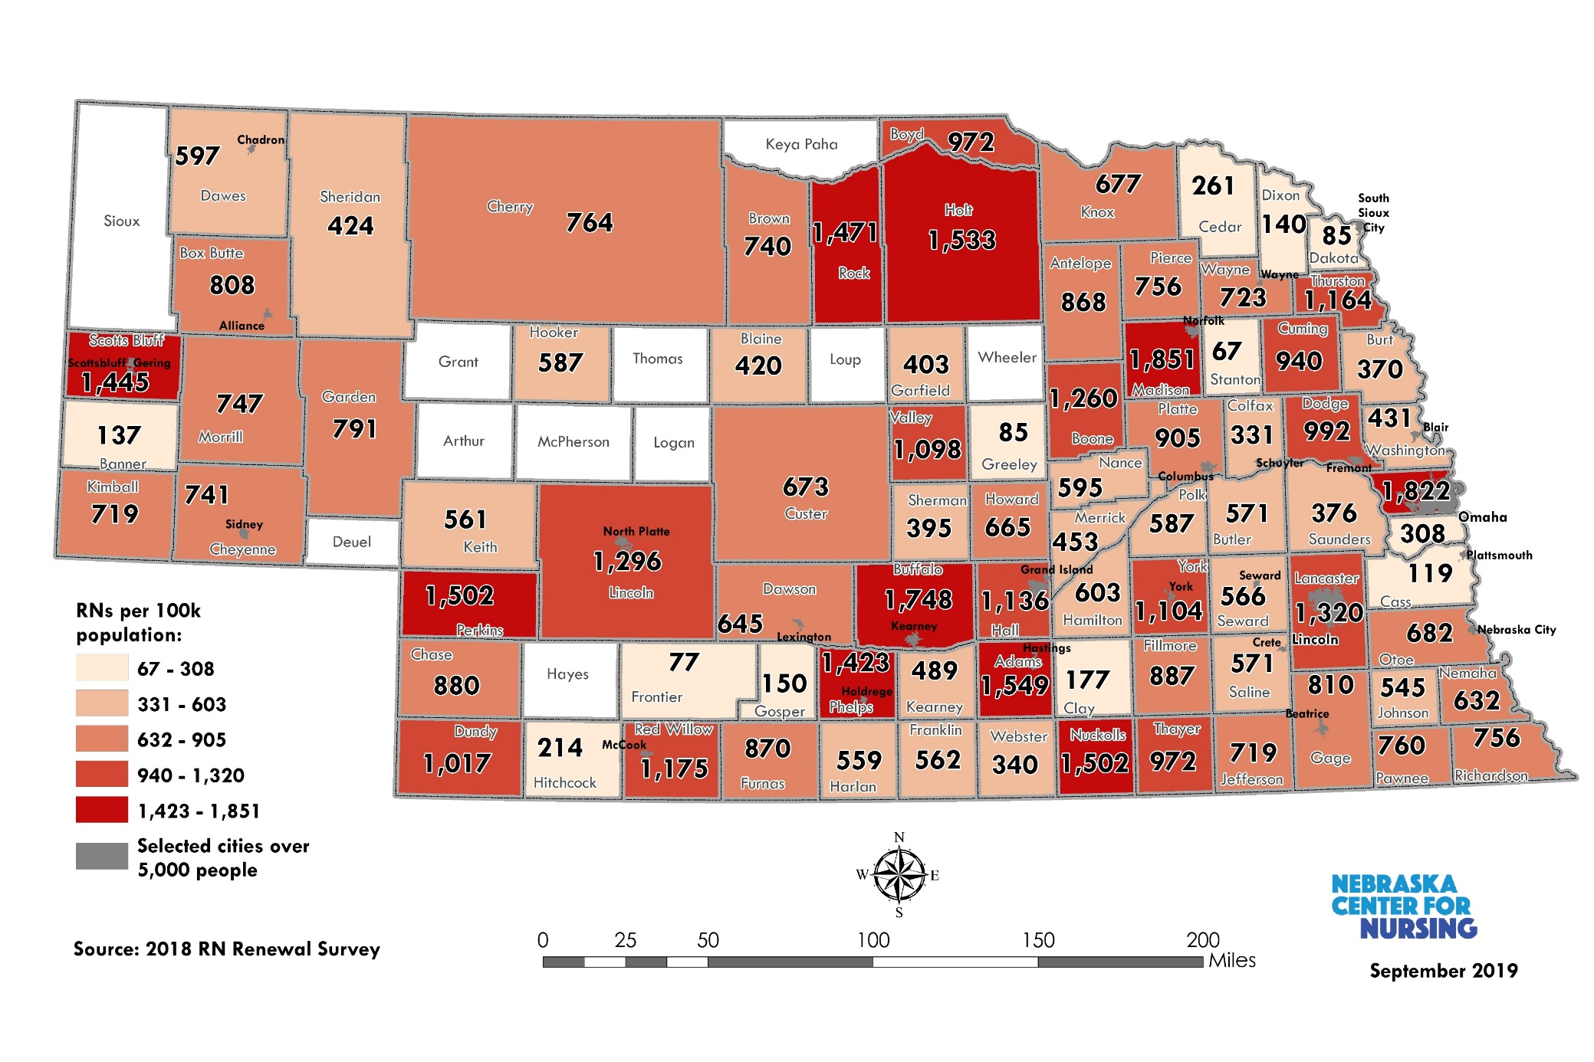
Nebraska RNs Per 100,000 Population
Counties with the highest RN per 100,000 population in Nebraska are:
Madison (1,851), Douglas (1,822), Buffalo (1,748), Adams (1,549), and Holt (1,533).
Counties with the lowest RN per 100,000 population are:
Stanton (67), Frontier (77), Dakota (85), Greeley (85), and Cass (119)
Notes:
*Includes urban clusters and urbanized areas in Nebraska. Sources: 1) 2018 RN Renewal Survey. 2) American Community Survey (2013-2017 5-year estimates, Table S0101)

Slide 6
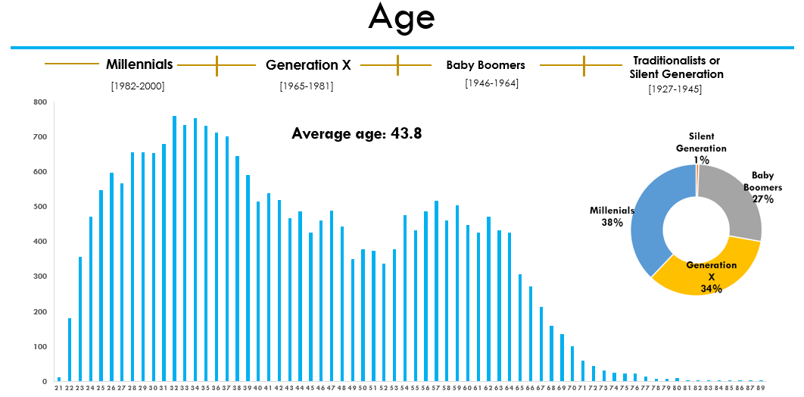
Demographics
Distribution of Nebraska Registered Nurses by Age
National average age: 51 (NCSBN, 2017)
Nearly four out of ten RNs (38%) are millennials (36 years old and younger)
RNs working in rural areas are on average 3.2 years older than RNs working in urban areas.
On average, RNs are nearly three years younger than ten years ago (43.8 vs. 46.6 years old, respectively).
Source: 2018 RN Renewal Survey (n = 23,668)
Notes:
*Includes urban clusters and urbanized areas in Nebraska. Sources: 1) 2018 RN Renewal Survey. 2) American Community Survey (2013-2017 5-year estimates, Table S0101)
National level: 19.2% of RNs are minorities (NCSBN, 2017)
Nebraska: 7.1% of RNs are minorities
Nebraska RN minorities increased 2% when compared to the nursing workforce in 2008

Slide 7
Projected Nursing Shortages
Notes:
First discussion is sources of data – our model is based on the 2018 RN renewal survey and 2019 LPN renewal survey; population all counties by economic region by gender and geographic area (urban v non-urban)
Actuarial utilization data the older one gets – the more nursing care you need … other models use HRSA – which is flawed – its based on zero shortages – supply & demand is the same; in the orginal HRSA 2017 report predicted nursing workforce to the year 2030 – used the balanced model assumption - plus its statewide – not regional

Slide 8
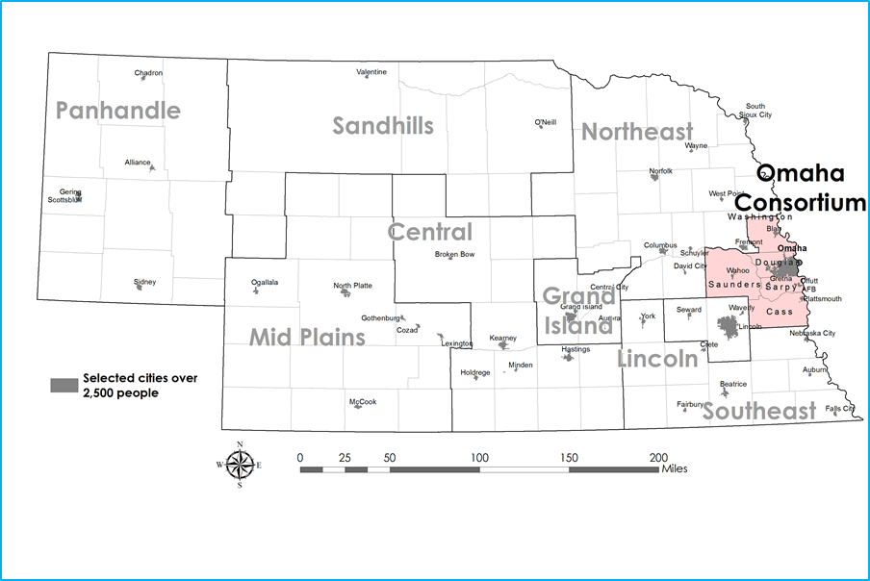
Omaha: Projected Nursing Shortages
OMAHA | Nursing Shortage
 | 2021 | 2025
RNs | -1,269 | -1,572
APRNs | -255 | -316
LPNs | -613 | -783
Total | -2,137 | -2,671

Slide 9
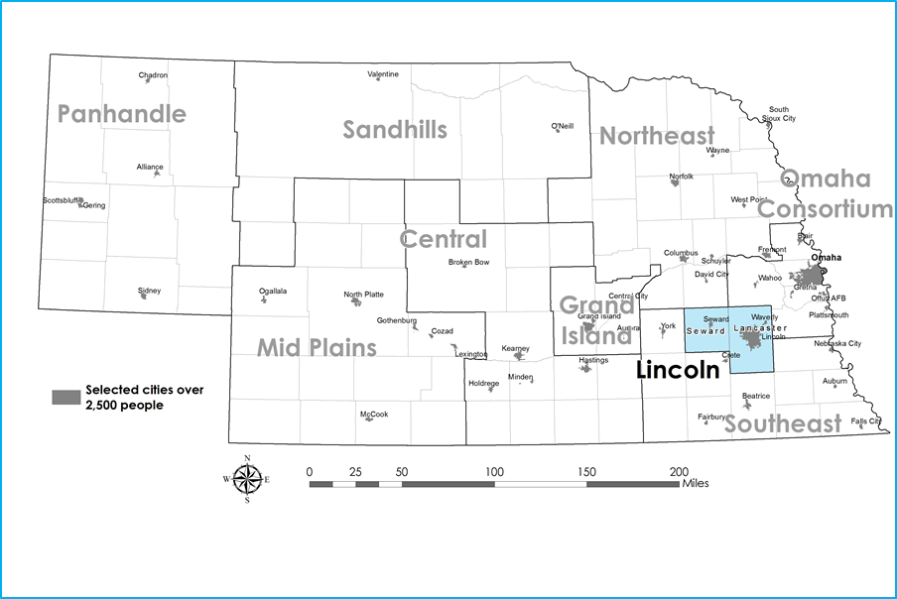
Lincoln: Projected Nursing Shortages
LINCOLN | Nursing Shortage
 | 2021 | 2025
RNs | -513 | -745
APRNs | -109 | -150
LPNs | -178 | -244
Total | -800 | -1,139

Slide 10
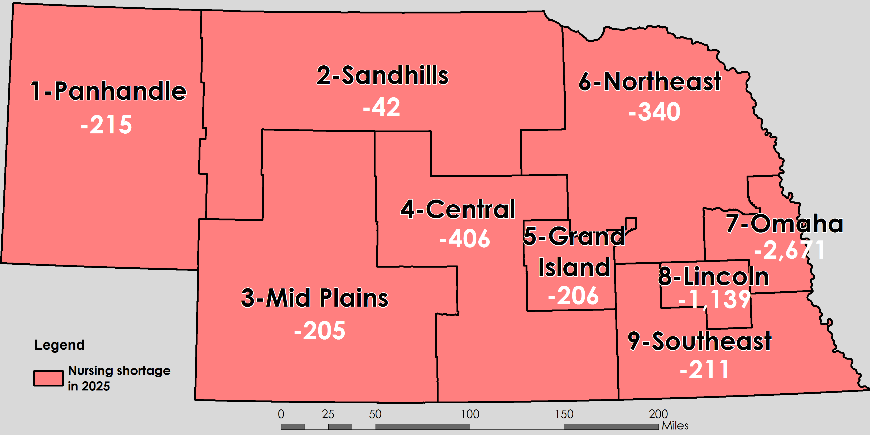
Projected Nursing Shortages (all type of nurses) by Region in 2025

Slide 11
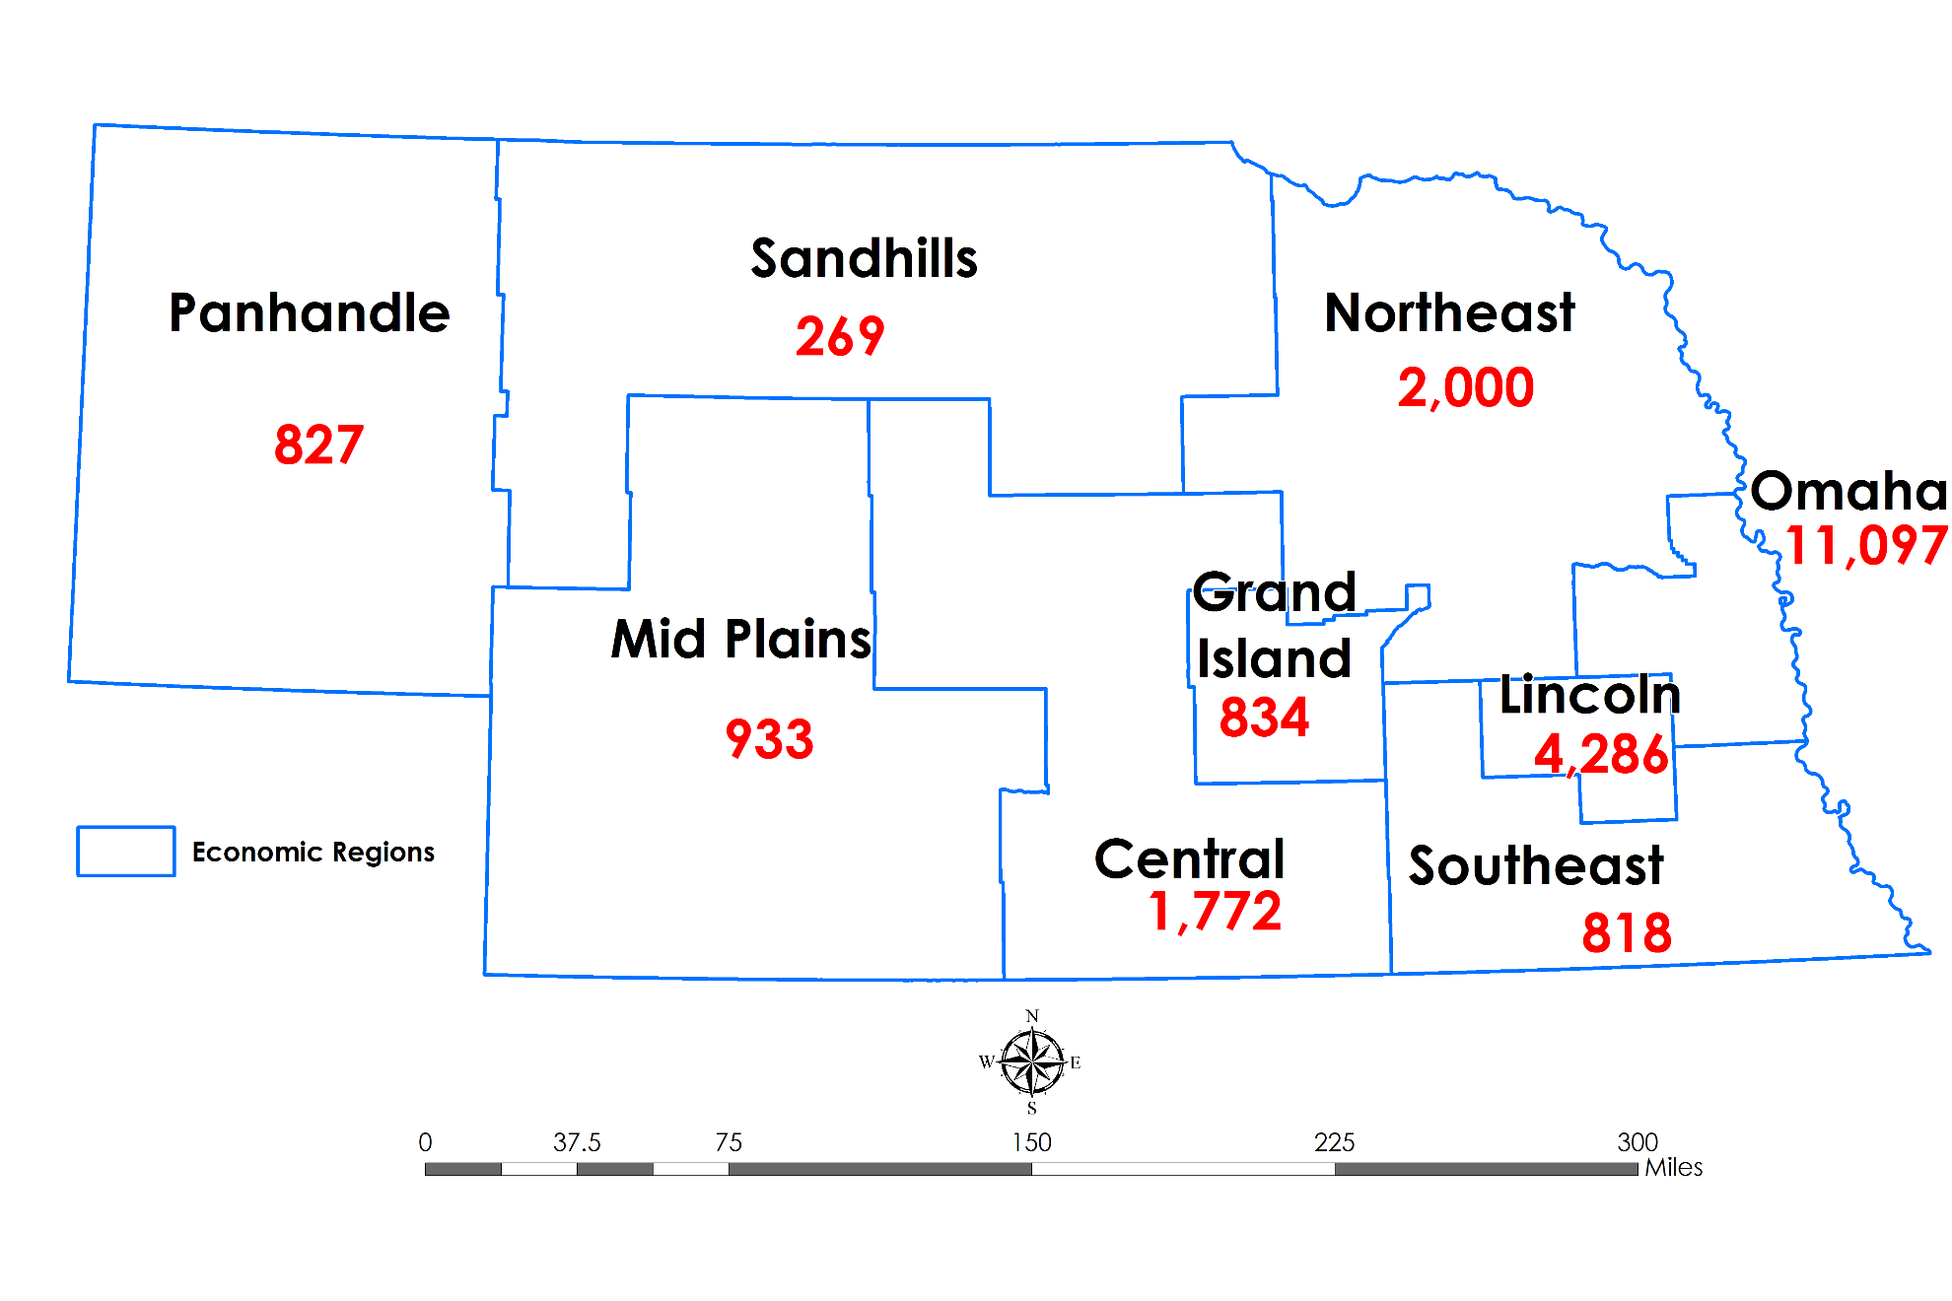
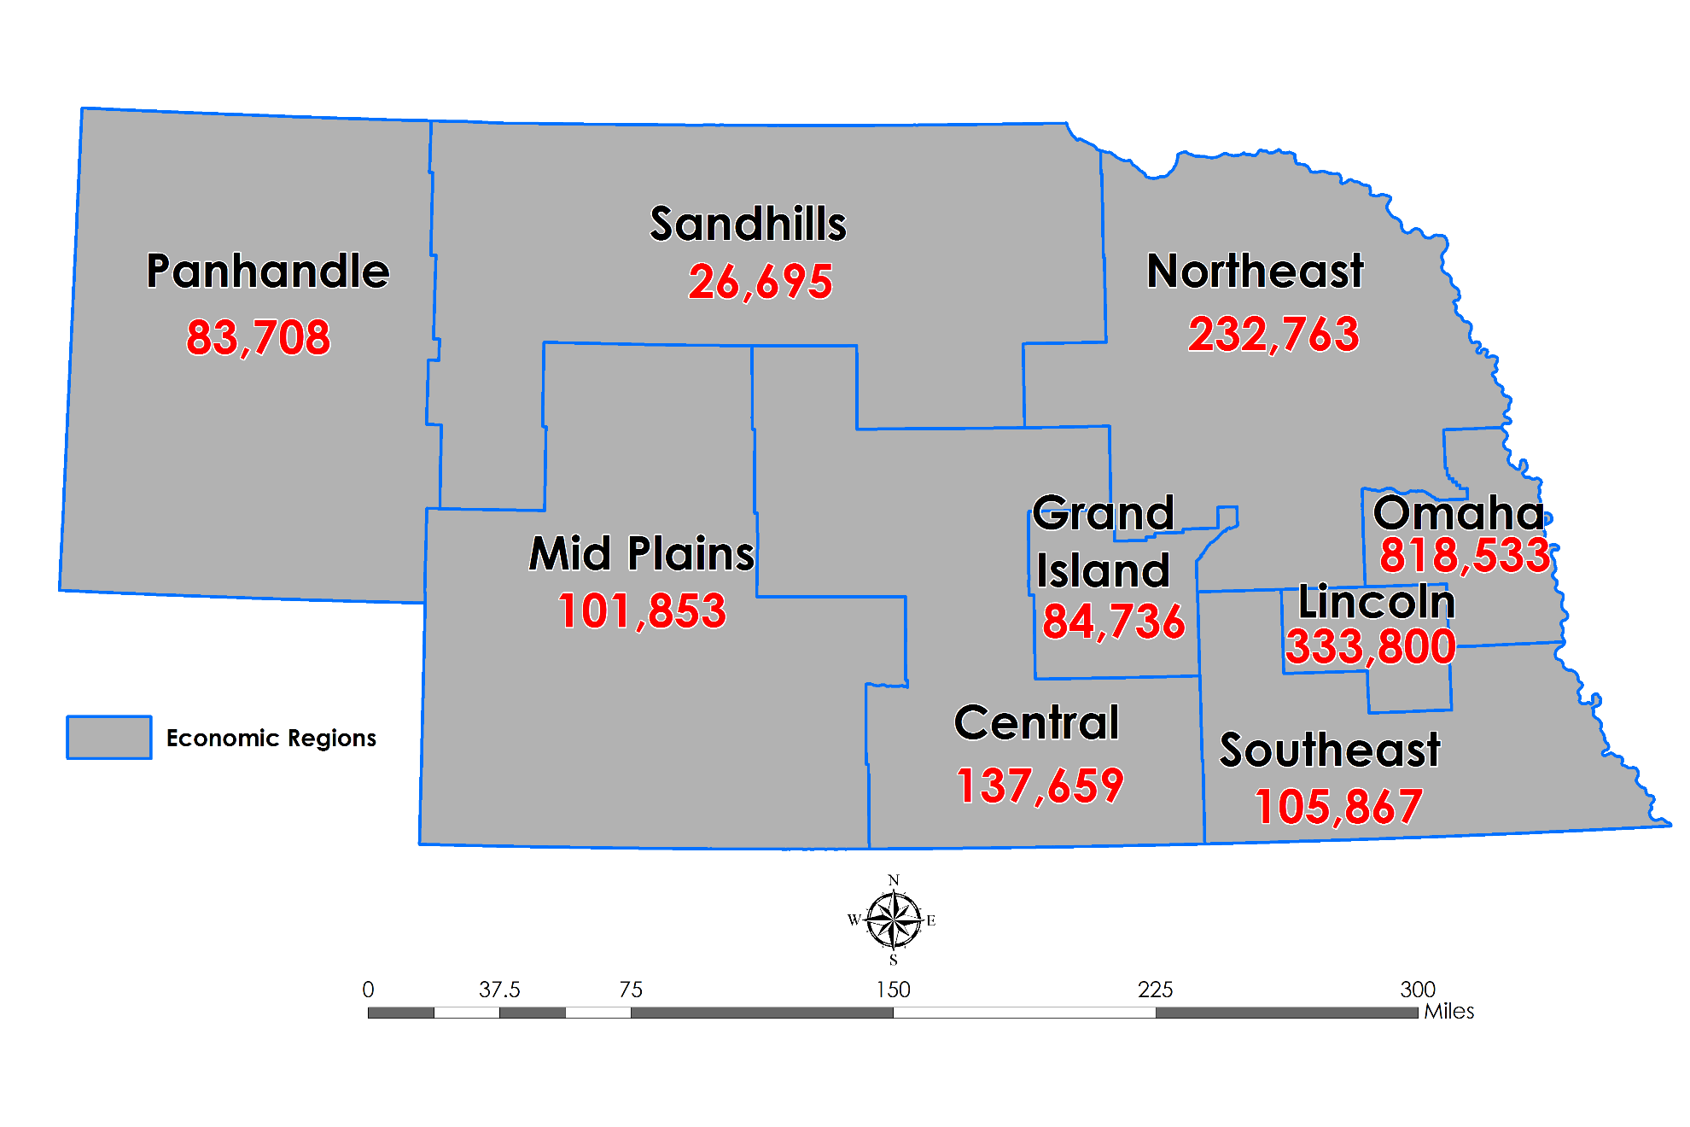
Supply of RNs vs. Total Population by Economic Region
Number of RNs by Economic Region
Population by Economic Region
Source: 2018 RN Renewal Survey. Nebraska Center for Nursing.
Source: U.S. Census Bureau (2018 population by county). Nebraska Department of Labor, Economic Regions.

Slide 12
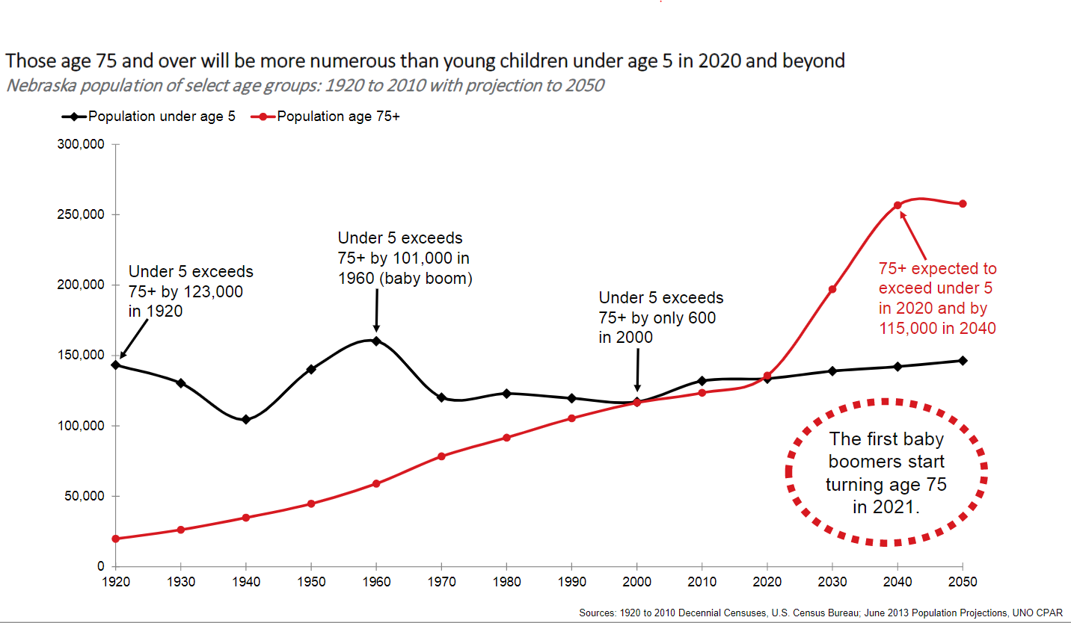
Nebraska Shifting Demographics
Nebraska population of select age groups (under 5 and over 75): 1990 to 2010 with projection to 2050
The UNO Center for Public Affairs Research (CPAR) reports that in 2020 for the first time ever in the history of our state, the proportion of the population >75 years of age exceeds that <5 years of age. By 2040, the number of Nebraskans >75 years of age is projected to exceed those <5 years of age by 115,000.
The relationship of increasing age to chronic disease has been well-established. Eighty (80) percent of older adults have at least one chronic disease—77% have two.
Four chronic diseases—heart disease, cancer, stroke and diabetes—cause almost two-thirds of all deaths. According to the National Council on Aging, chronic disease accounts for 75% of all health care spending.

Slide 13
RN Supply – the Educational Pipeline
Overall, between 2003 and 2020, RN NCLEX testers increased 79%
Between 2010 and 2020, RN NCLEX testers increased 15%

Slide 14
Nationwide RN VACANCY Rates (2018-2022)
Source: 2022 NSI National Health Care Retention & RN Staffing Reports. Nursing Solutions, Inc.

Slide 15
How do we attract and retain nurses and other healthcare workers?

Slide 16
What do Nurses Seek? Need?
Advisory Board, 2021
Notes:
Advisory Board pre-COVID research pointed to Maslow. We are overlooking things at the bottom of the hierarchy – sleep, food, water, shelter – nurses basic human needs must be met before one can fulfill their higher level needs. Most leaders focus their efforts at the top of the hierarchy – attempting to inspire nurses to work creatively and to their full potential.

Slide 17
Something to think about …
Ensure that nurses are safe and feel safe at work
Transparency – about how you are staffing the mission
Make emotional support an opt-out, not an opt-in
Carve out time for personal connection
Nurses are creative problem solvers!
We must work together to make our ideas and goals become a reality in the workplace
(Advisory Board, 2021)
Notes:
Focus on things that undermine a team’s resilience

Slide 18
Summary: Current State of Nursing
Supply has always been an issue … since 2000 when the Center for Nursing was created to address shortage issues
Demand continues to increase in ways that provide attractive roles for nurses
Work from home, flexible schedule, preferred hours, etc.
Culture has not changed, and may have worsened during COVID-19
“If you don’t like it here, we can replace you”
Impact of prolonged stress on bedside nurses during COVID-19 (PTSD)
Education is working hard to maintain and keep up, but can not replace nurses at the rate the supply is being exhausted
Notes:
Add data 17% of all nurses in 2018 renewal survey reported bullying and incivility in the workplace.

Slide 19
Immediate Challenge
Control the message --- to display a positive image of nursing
OR risk repeating the 1990s drop in interest in nursing, enrollment, graduations … led to the last big shortage
Shared responsibility
Nurses, leaders, educators, professional associations, media, social media and unions

Slide 20
Imperative Challenge
Reset Relationships
Hospitals and nurses
Relationships with students
Relationships with patients and communities
Economic relationship – Embrace value-based payment

Slide 21
Reset Relationships with Hospitals & Nurses
Host gatherings of nurses or town halls for discussions – listening – seeking to understand – apologizing if necessary
Focus on the positives – what we did right – what were our strengths – what did we learn about ourselves and our culture that were helpful – how did nurses grow as clinicians (skills, confidence, competence) and as leaders, identify what we want to take forward and build more of in the future
Identify the negatives – what we didn’t get right, what were things we learned about ourselves and our culture that were not helpful, what can we learn from these disappointments – and what should we now leave in the past
Assess nurse’ readiness to change and willingness to change
What are the priorities?

Slide 22
Reset Relationships with Students
Reach out to faculty to gather information (verify) and insights, identify student leaders and issues from clinical faculty perspective
Meet with students, convey their importance, ask what was positive – what did we do right – what strengths did they (students) learn about themselves -how did they grow as clinicians (skills, confidence, competence) and as leaders - identify what students think is worth building on and taking into the future
Let them know how important they are – re-invite them to be part of your future
What do they need most from us to support their future?

Slide 23
Bullying/Incivility Experienced by Faculty and Non-Faculty in the Workplace*
Faculty were 1.7 times more likely to experience bullying/incivility when compared to non-faculty nurses (based on 2021 RN Renewal Survey data).
In 2018, Faculty were 1.5 times more likely to experience incivility/bullying when compared to non-faculty.
Source: 2018 and 2021 RN Renewal Surveys
*Bullying/incivility questions were first included in the 2018 RN Renewal Survey

Slide 24
Reset relationships with patients & community
Consider community outreach – television, radio, a mini-documentary summarizing experiences during the pandemic
Communicate what nurses (including students) accomplished – how many people they cared for, how many people were saved and are now among the living
Communicate where nurses (and students) struggled and what we, as an organization, learned and intend to do differently to strengthen our collective future
Examine what we are doing to ensure that nurse-patient interactions continue to be designed and implemented to keep patients safe and protected, assure quality of care, and … finally … reset our economic relationship

Slide 25
How do we embrace value-based payment?
Value = 2 things
outcomes produced and the cost to produce those outcomes
Value-based payment reimburses hospitals more for achieving better outcomes at lower costs
Nurses know how to do this!!
Improve patient care
Contribute to the economic stability of the organization
Empower nurses and shift the focus of nurses as costly to ‘revenue generators’

Slide 26
Early Outcomes Data on Care Quality & Patient Safety
Feb 14 report in Becker’s Hospital Review – The New England Journal of Medicine … increases for infections over seven months of 2020:
Central line-associated bloodstream infections: 60% increase
MRSA: 44% increase
Catheter-associated UTIs: 43% increase
3 top patient safety concerns per Leapfrog CEO (Becker’s, Jan 25)
Hospitals bringing in underqualified physicians due to staffing shortages
Significant rise in bacterial, fungal infections
Practicing proper hand-hygiene monitoring
Notes:
Below are three new findings:
1. Central-line associated bloodstream infections in U.S. hospitals increased 28 percent in the second quarter of 2020, compared to the second quarter of 2019, according to CDC data. In the five years preceding the pandemic, central-line associated bloodstream infections had decreased by 31 percent.
2. A study of 148 HCA Healthcare-affiliated hospitals through 2020 found central line-associated bloodstream infections, catheter-associated urinary tract infections, and methicillin-resistant staphylococcus aureus bacteremia all increased as the COVID-19 burden increased.
3. Rates of hospital-onset bloodstream infections and multidrug resistant organisms, vancomycin-resistant enterococcus and Gram-negative organisms were each significantly associated with COVID-19 surges, the study found.

Slide 27
Early Outcomes Data on Care Quality & Patient Safety
COVID-19 and Nurse-Sensitive Indicators: Using Performance Improvement Teams to Address Quality Indicators During a Pandemic [Sifter, et al., (2020) Journal of Nursing Care Quality, 36(1), pp 1-6.]
2020 process improvement team-work at Rush
New COVID-19 CLABSI Tip Sheet and a Prone Positioning Kit for HAPI Prevention
Nurse driven data and decisions that decreased nurse-sensitive health care-associated infections and set new standards of care for COVID patients
Chronic Hospital Nurse Understaffing Meets COVID-19: an observational study [Lasater et al., (2021) BMJ Quality & Safety, 30:639-647.]
Survey data of nurses & patients in 254 hospitals in NY and IL between December 2019 and February 2020; documents associations of nurse staffing with care quality
Notes:
Linda Aiken was 2nd author – this was a study already in existence (just prior to COVID) looking at nurse staffing to inform nurse staffing legislation (mandatory ratios) in NY and IL – the data collection documented associations of nurse staffing with care quality, patient experiences and nurse burnout. Bottom line – hospital nurses were burned out and working understaffed PRIOR to the first wave of COVID

Slide 28
Current Initiatives

Slide 29
Nebraska Collaborative Investment in Nurses
Resiliency, Retention & Well-being
UNMC-CON, Nebraska Center for Nursing, Board of Nursing, and UNMC College of Public Health
HRSA U.S. Department of HHS under U3NHP45394-01-00 $2,245,694
Target populations in rural and medically underserved areas across NE
Practicing nurses
Nursing students
Psych APRNs
Middle Managers

Slide 30
American Rescue Plan Act (ARPA) Funds
LB 1014 appropriations for ARPA Federal Funds
Nursing Incentive Act; 5 mil for scholarships for nurses (LPN, ADN, and accelerated BSN) DHHS Public Health administering
5 mil for Rural Health Incentive Program for health providers (upper division – BSN, MSN, DNP only)
7 nurses funded this round
Premium pay for frontline workers (50 mil) NDOL administering
Notes:
There was an expansion of the State Loan Repayment Program to include bachelor’s degree RNs

Slide 31
Parting Thoughts …
Refocus the lens on the basic needs of nurses
Support the existing workforce
Mental health support
Simple reward/recognition for nurses who stay
Nurses need a sense of control and input
Staffing, scheduling, career ladders, reward tenure for bedside nurses
Develop best practices around the Nurse Sensitive Indicators (NSI)
Track and calculate the ROI for RN driven care models
Engage interdisciplinary teams (including students) in problem solving and best practices based on evidence
Notes:
Choose an employer that matters – that you can stay with … gone are the days of brand loyalty

