Slide 1
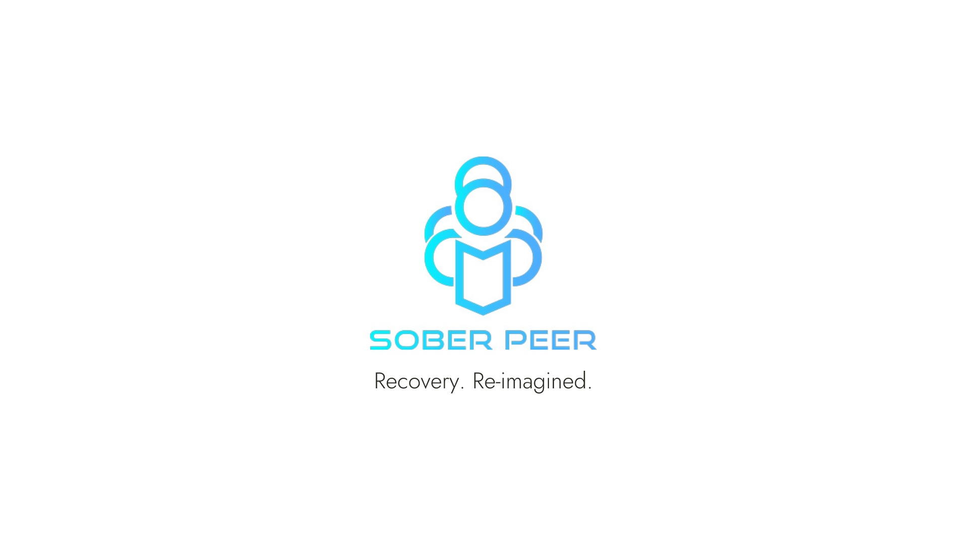
2021 Behavioral Health Summit
Nebraska Hospital Association

Slide 2
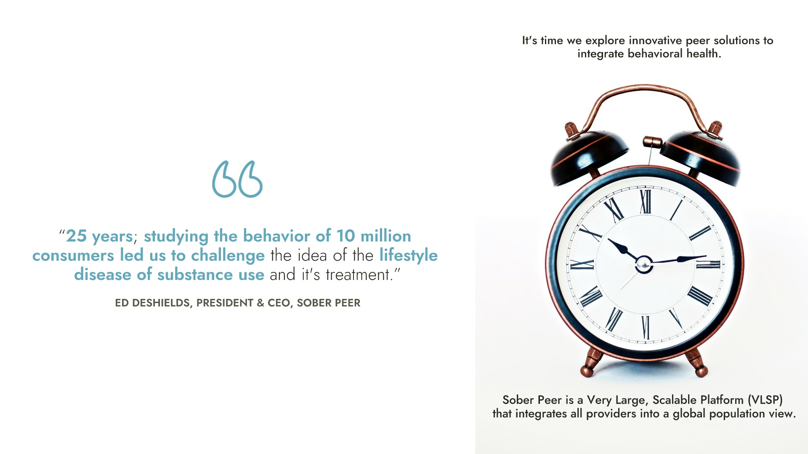

Slide 3
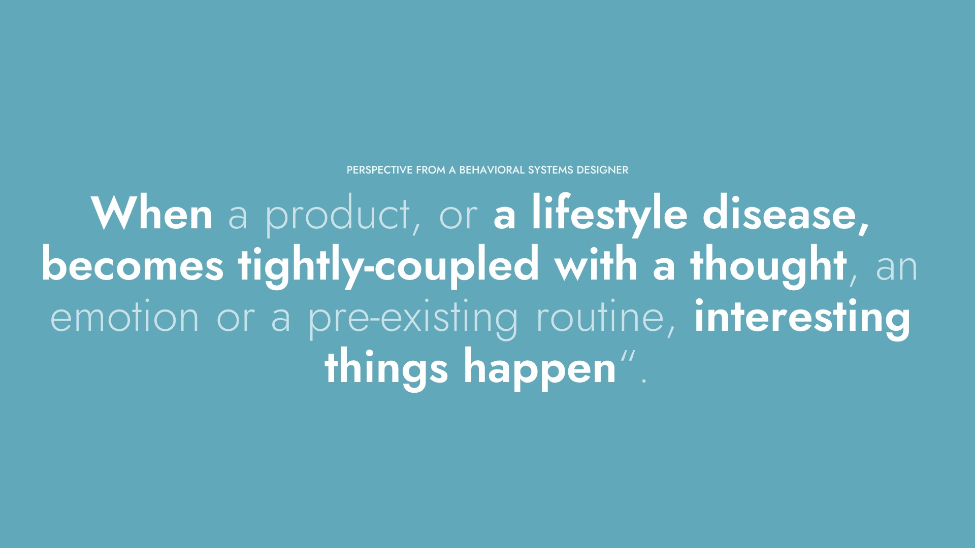

Slide 4
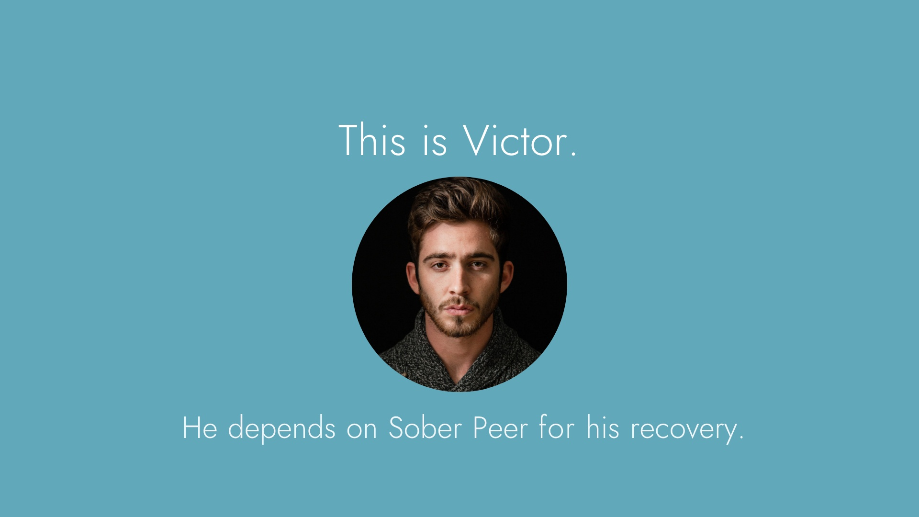

Slide 5
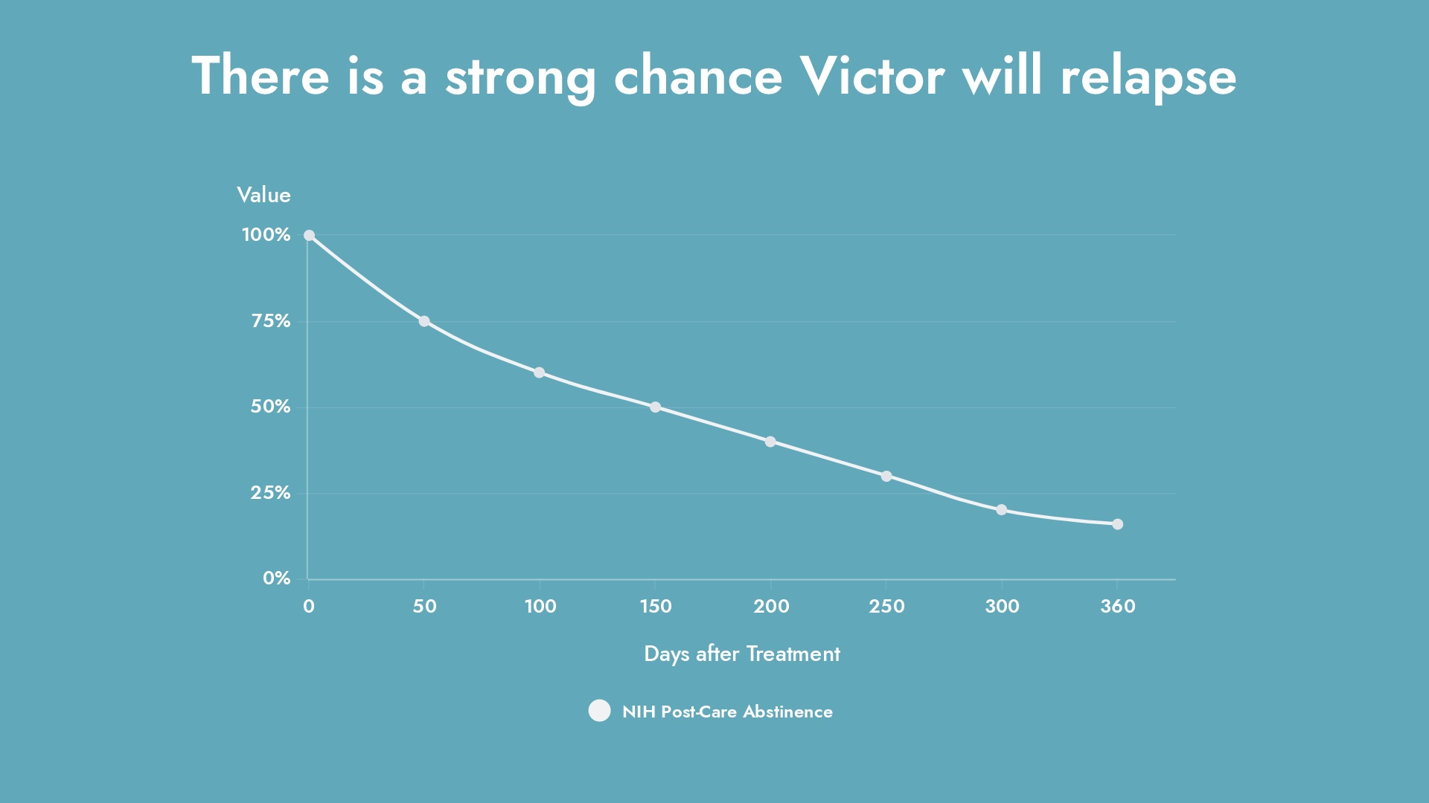

Slide 6
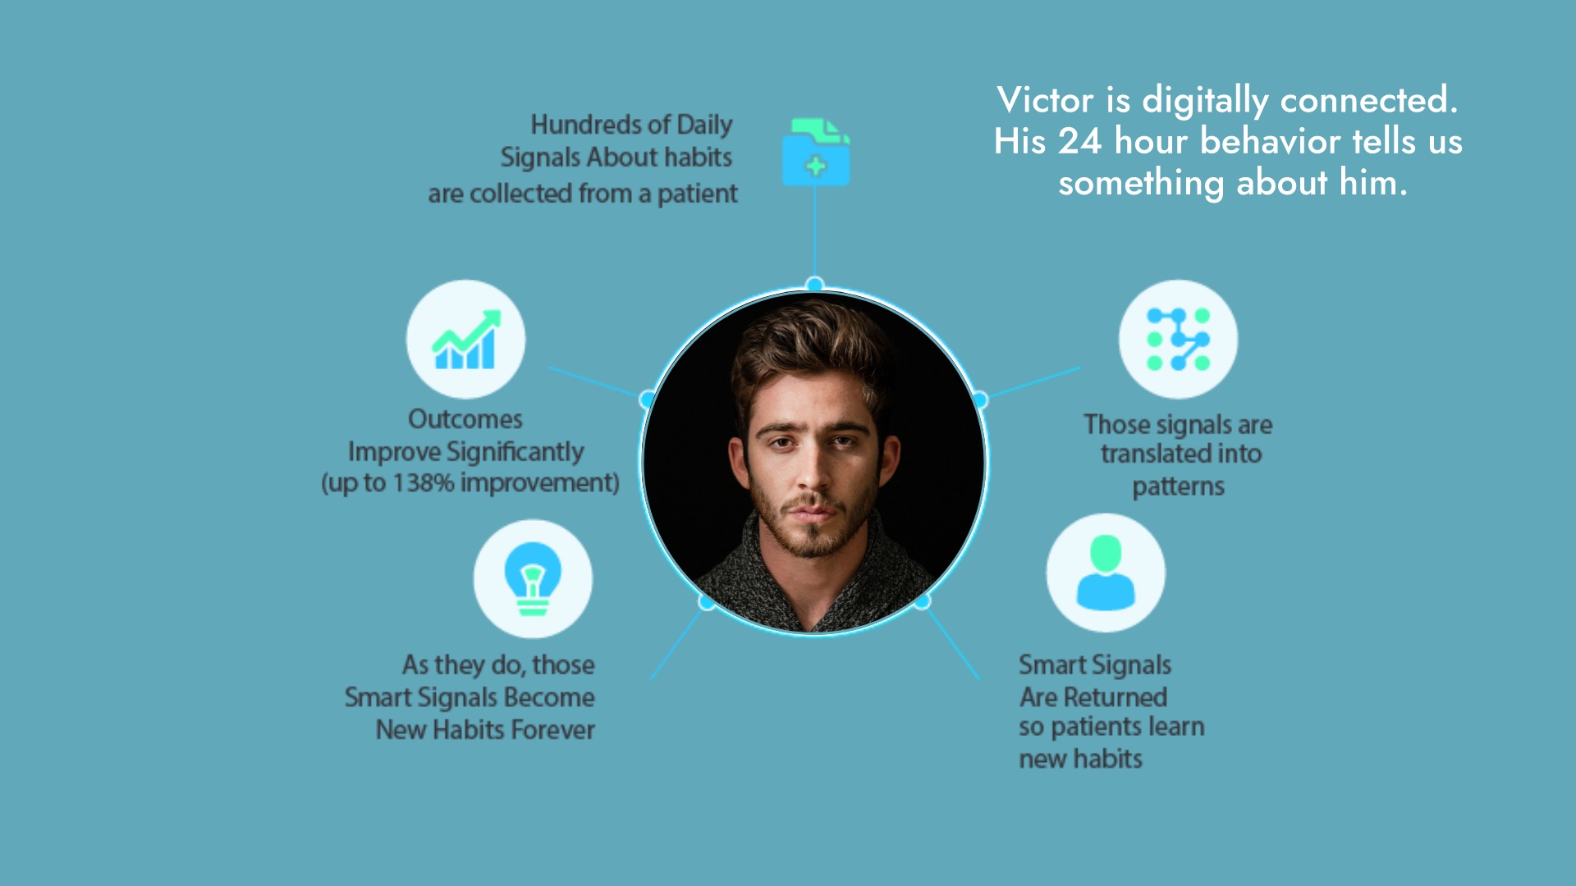

Slide 7
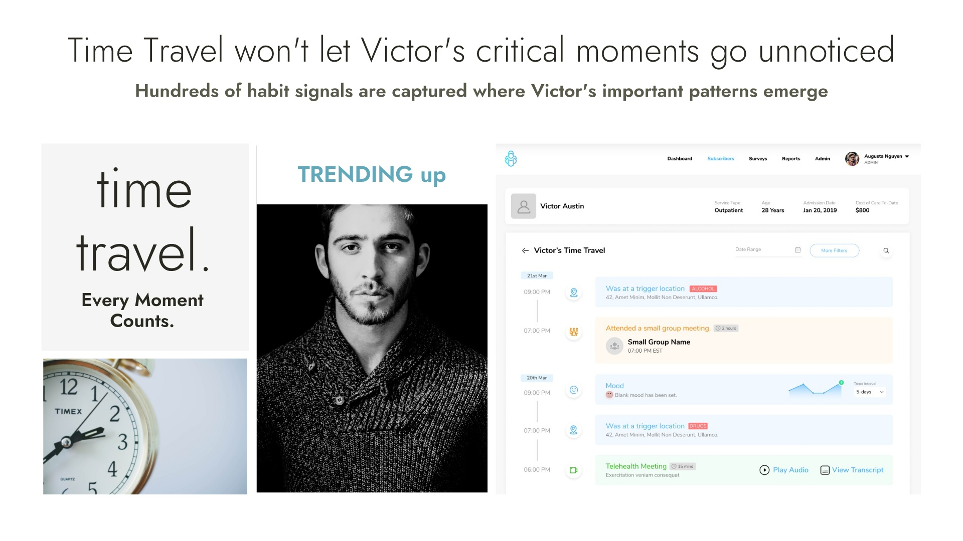
Notes:
New behaviors have a short half-life because our minds tend to revert to our old way of thinking.
-- and doing the habits most recently acquired are also the ones that go away soonest. It's what we call FIFO. or First In / First Out.
It is not uncommon for a client to experience 100,000 external and internal triggers identified by Sober Peer's Person/Place technology.
Those triggers are often subconscious "Habit-Drivers" that can be positive, or negative.
Time Travel won't let these critical moments be ignored and will respond with external trigger processes to start a psychological processes of habit retraining.

Slide 8
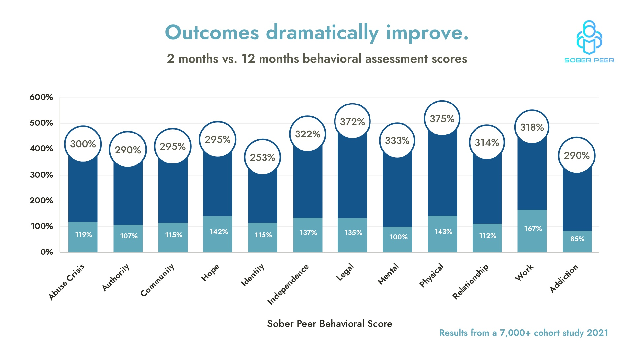
1.1 million patient observations

Slide 9
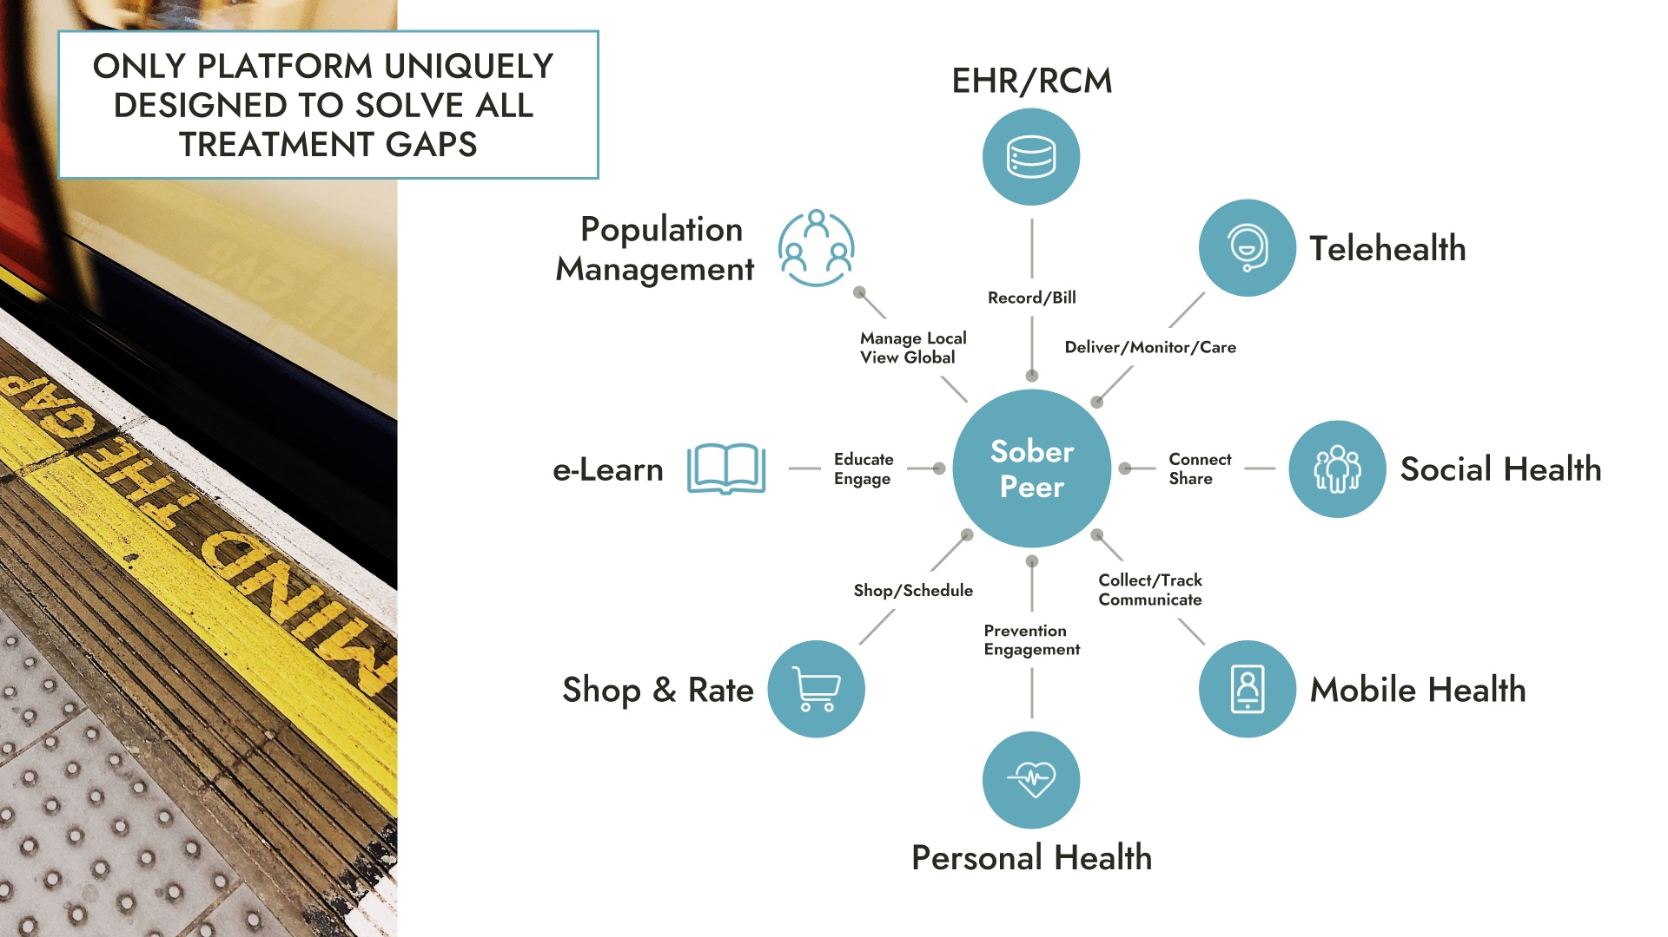

Slide 10
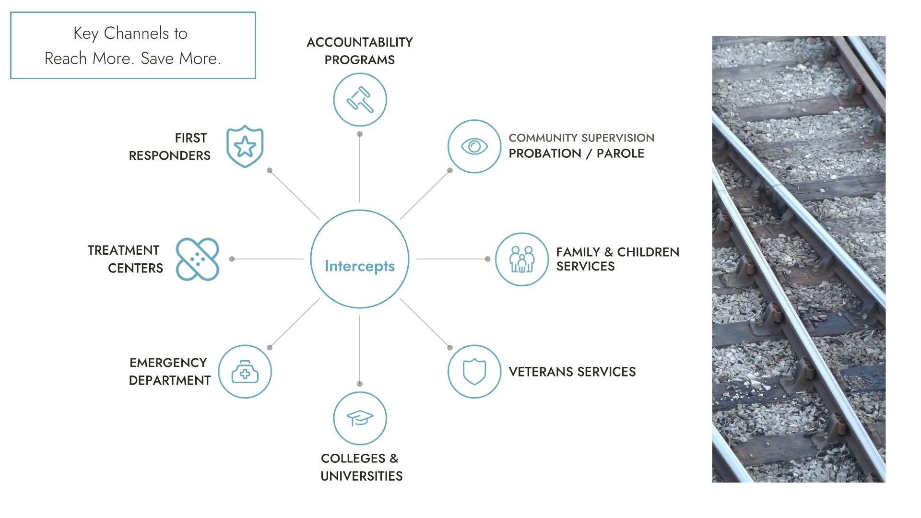

Slide 11
