Slide 1


Behavioral Healthcare in 2021 & Beyond: Riding the Leading
Edge of the Wave
Robert Althoff, MD, PhD
Associate Professor of Psychiatry, Psychology, & Pediatrics
Vice Chair for Clinical Affairs, Department of Psychiatry
Director, Child Emotion Regulation Laboratory
Larner College of Medicine at the University of Vermont

Slide 2
Disclosures
Source | Consultant | Advisory Board | Stock or Equity >$10,000 | Speakers’ Bureau | Honorarium | Research Support
NIMH NIGMS |  |  |  |  |  | X X
NWO AFSP KTGF |  |  |  |  |  | X
Oakstone Publishing; MGH Psych Academy |  |  |  |  | X
WISER Systems, LLC |  |  |  |  |  | X

Slide 3
Objectives
At the end of this 50-minute hour participants will be able to
  Identify 3 trends that existed for behavioral health prior to 2020
  Describe 3 ways in which the pandemic affected those trends
  Discuss the ways that future trends can affect their organization and their employees

Slide 4


2021 and Beyond

Slide 5
What Are We Doing Here?
Notes:
The lifetime prevalence of psychiatric illness in adults is about 18%, more so in certain age groups and races.

Slide 6
Take Home #1
Behavioral patterns, social circumstances, and environmental exposures account for ~60% of the outcomes in health care

Slide 7
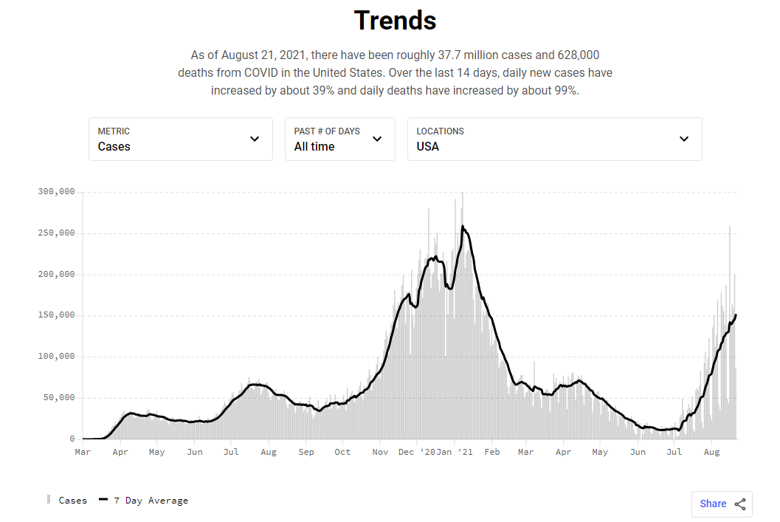


The Wave
covidactnow.org

Slide 8
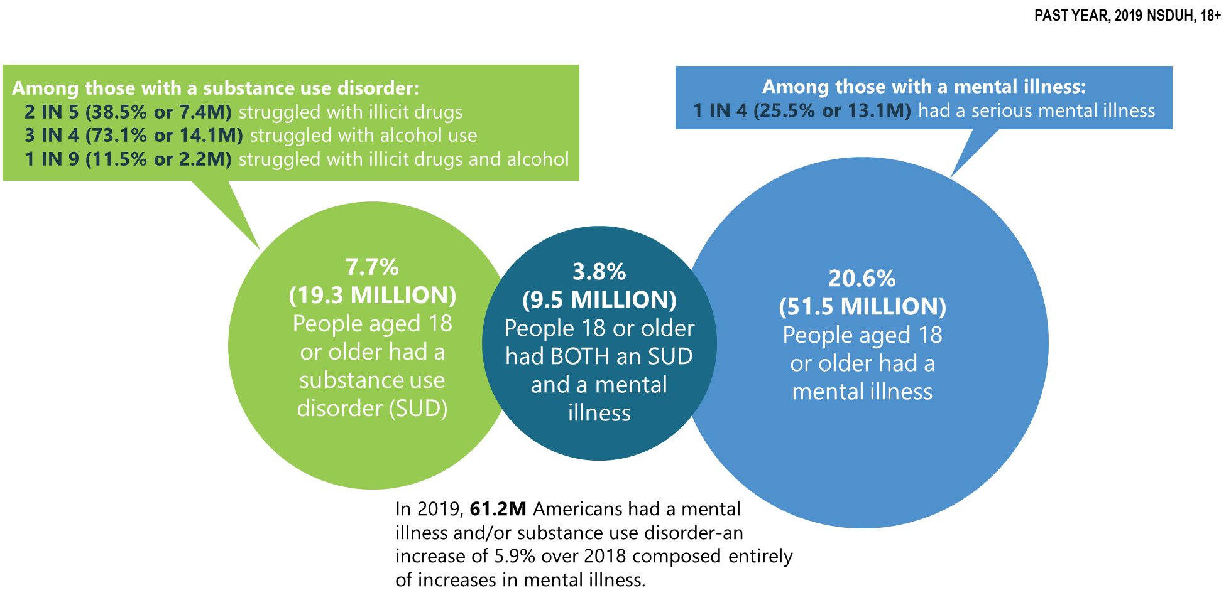
Before the pandemic…
SAMHSA (2020): NSDUH 2019

Slide 9
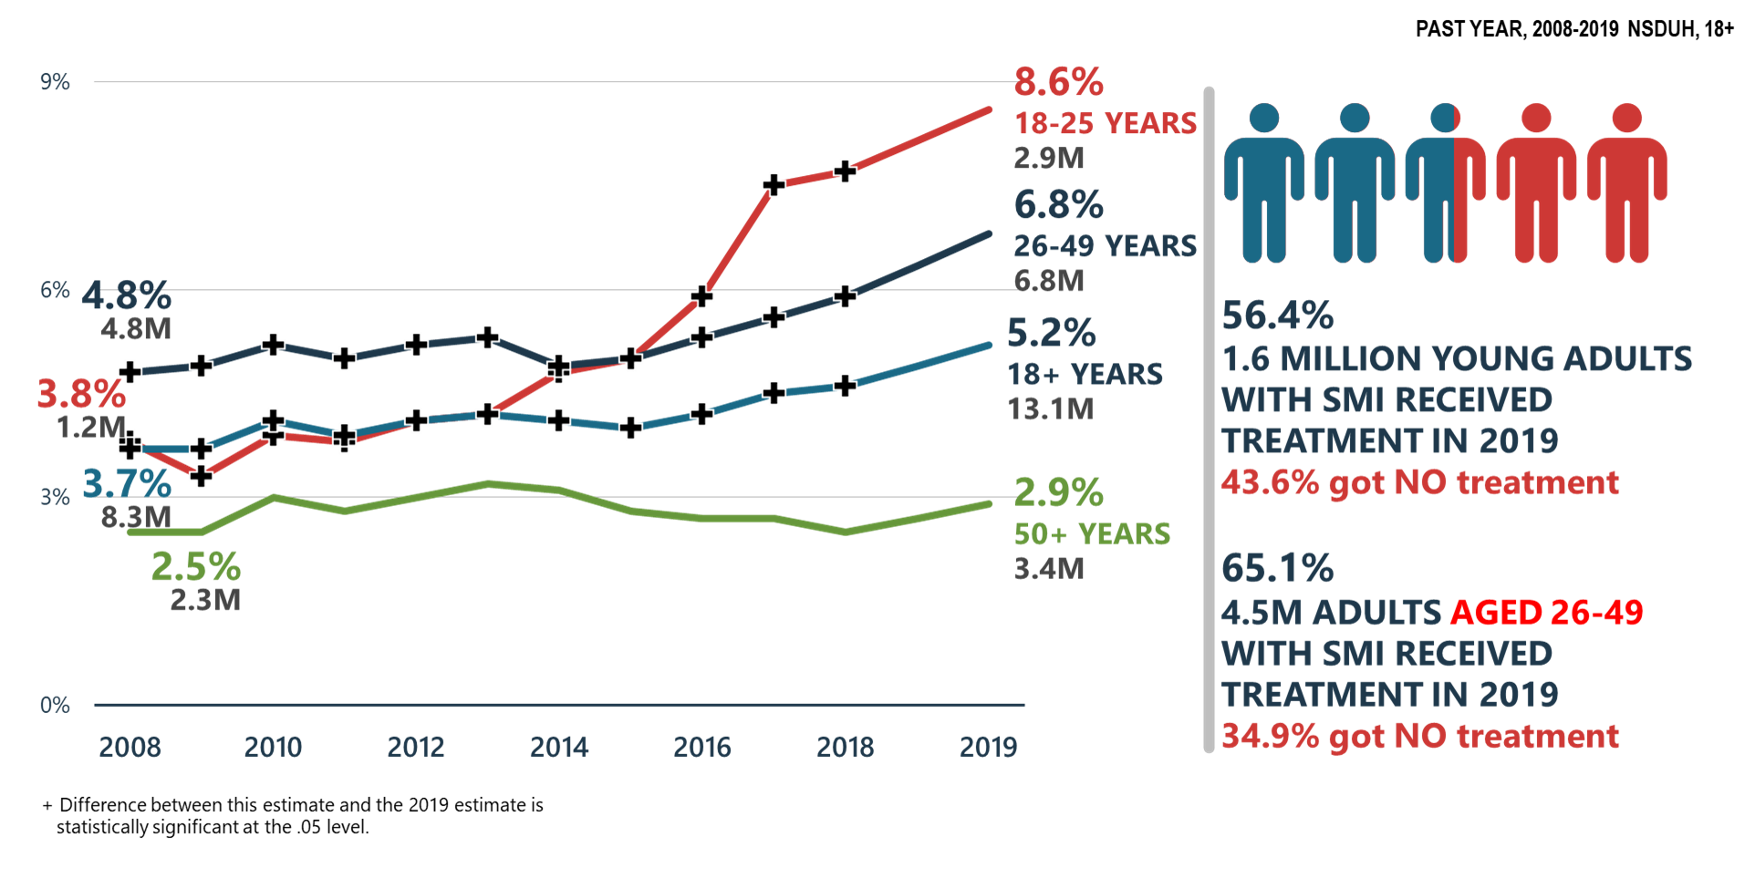
Before the pandemic…
Serious Mental Illness
SAMHSA (2020): NSDUH 2019

Slide 10
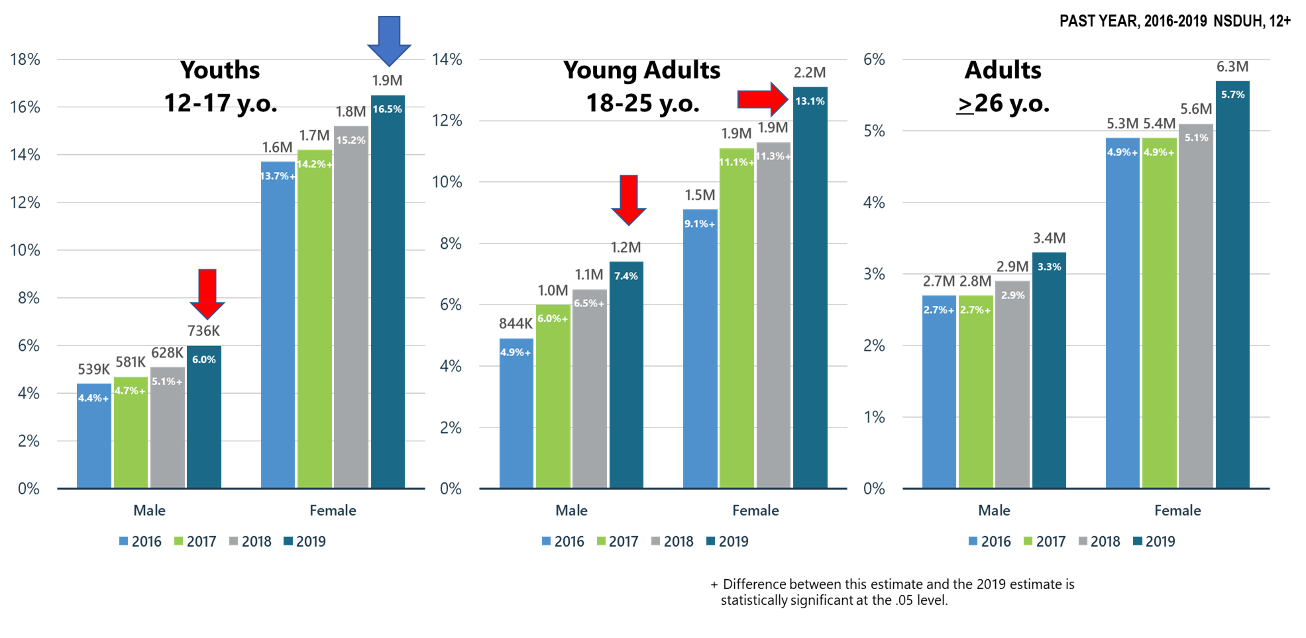
Before the pandemic…
Major Depressive Episode with Severe Impairment
SAMHSA (2020): NSDUH 2019

Slide 11
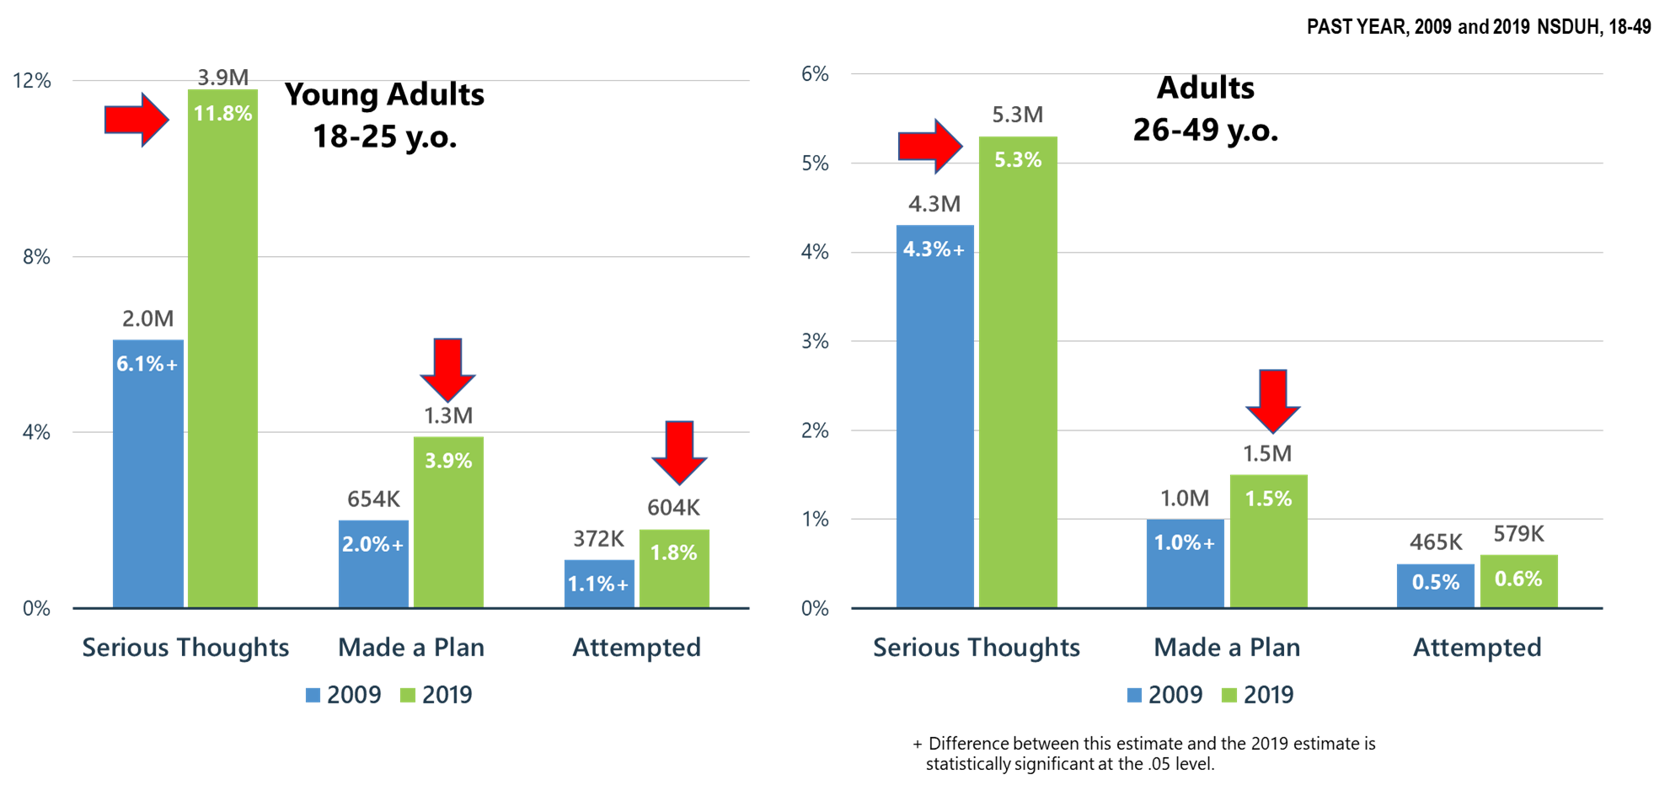
Before the pandemic…
Suicidal Ideation and Attempt
SAMHSA (2020): NSDUH 2019

Slide 12
Take Home #2
For the last decade, rates of severe mental illness, depression, anxiety, and suicidality have been increasing in the U.S. population

Slide 13
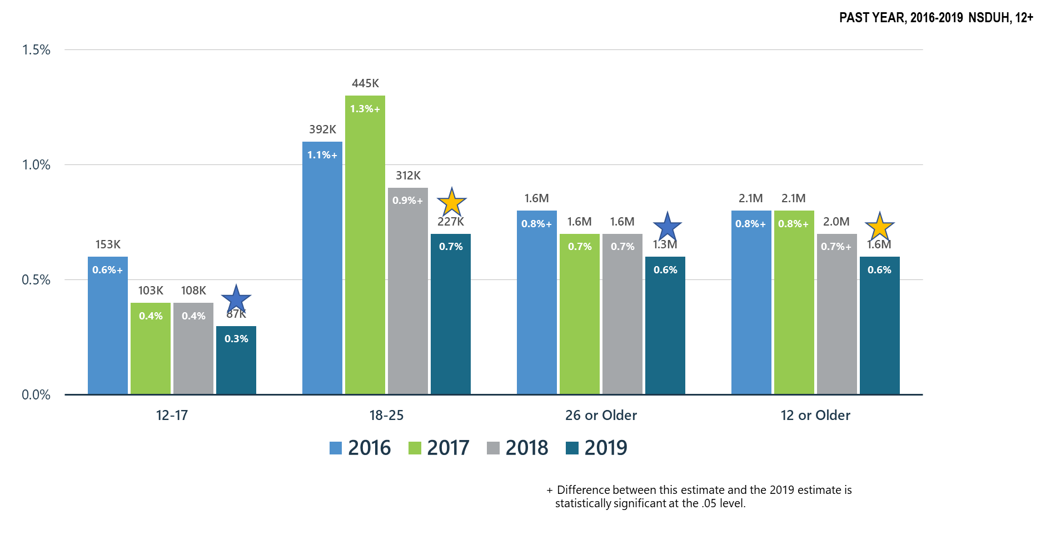
Before the pandemic…
Opioid Use Disorder
SAMHSA (2020): NSDUH 2019

Slide 14
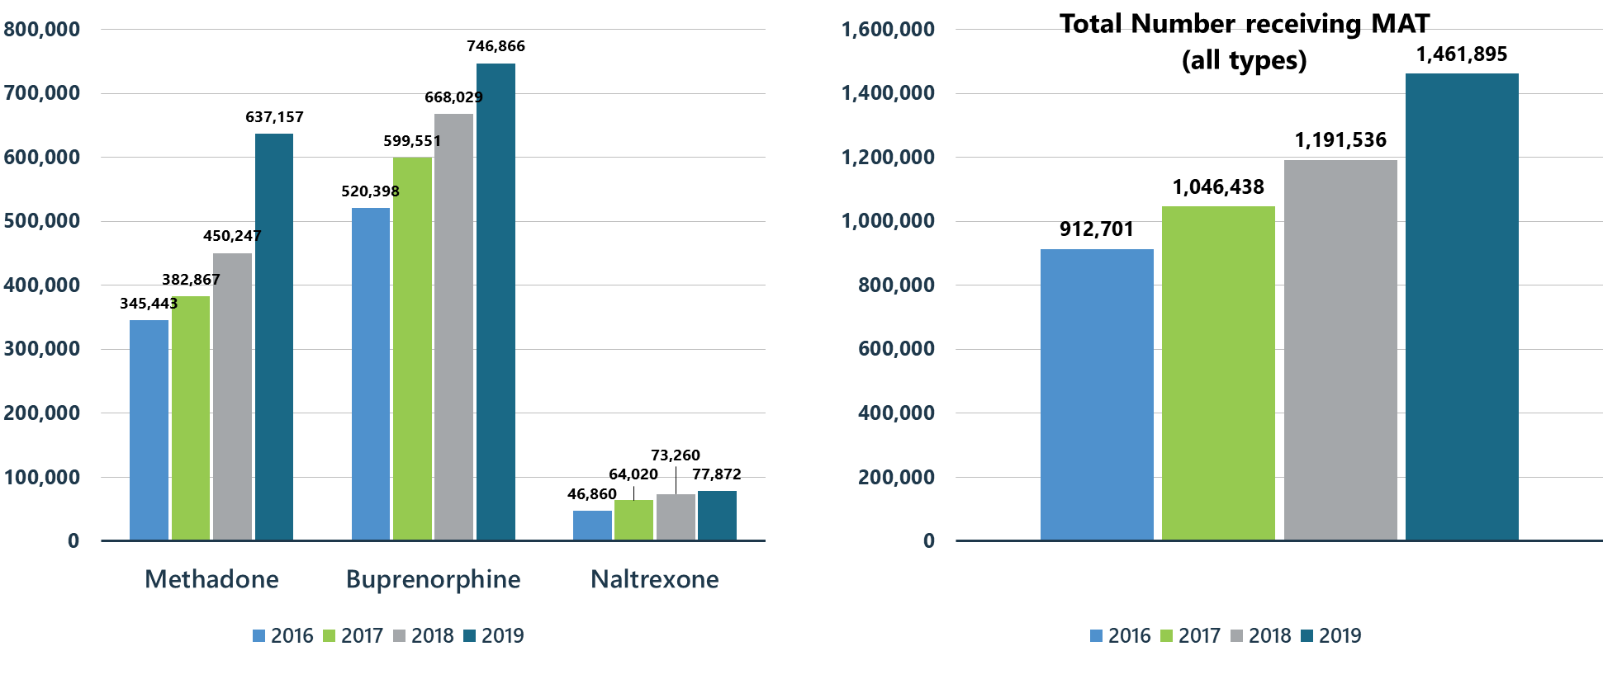
Before the pandemic…
Opioid Use Disorder
SAMHSA (2020): NSDUH 2019

Slide 15
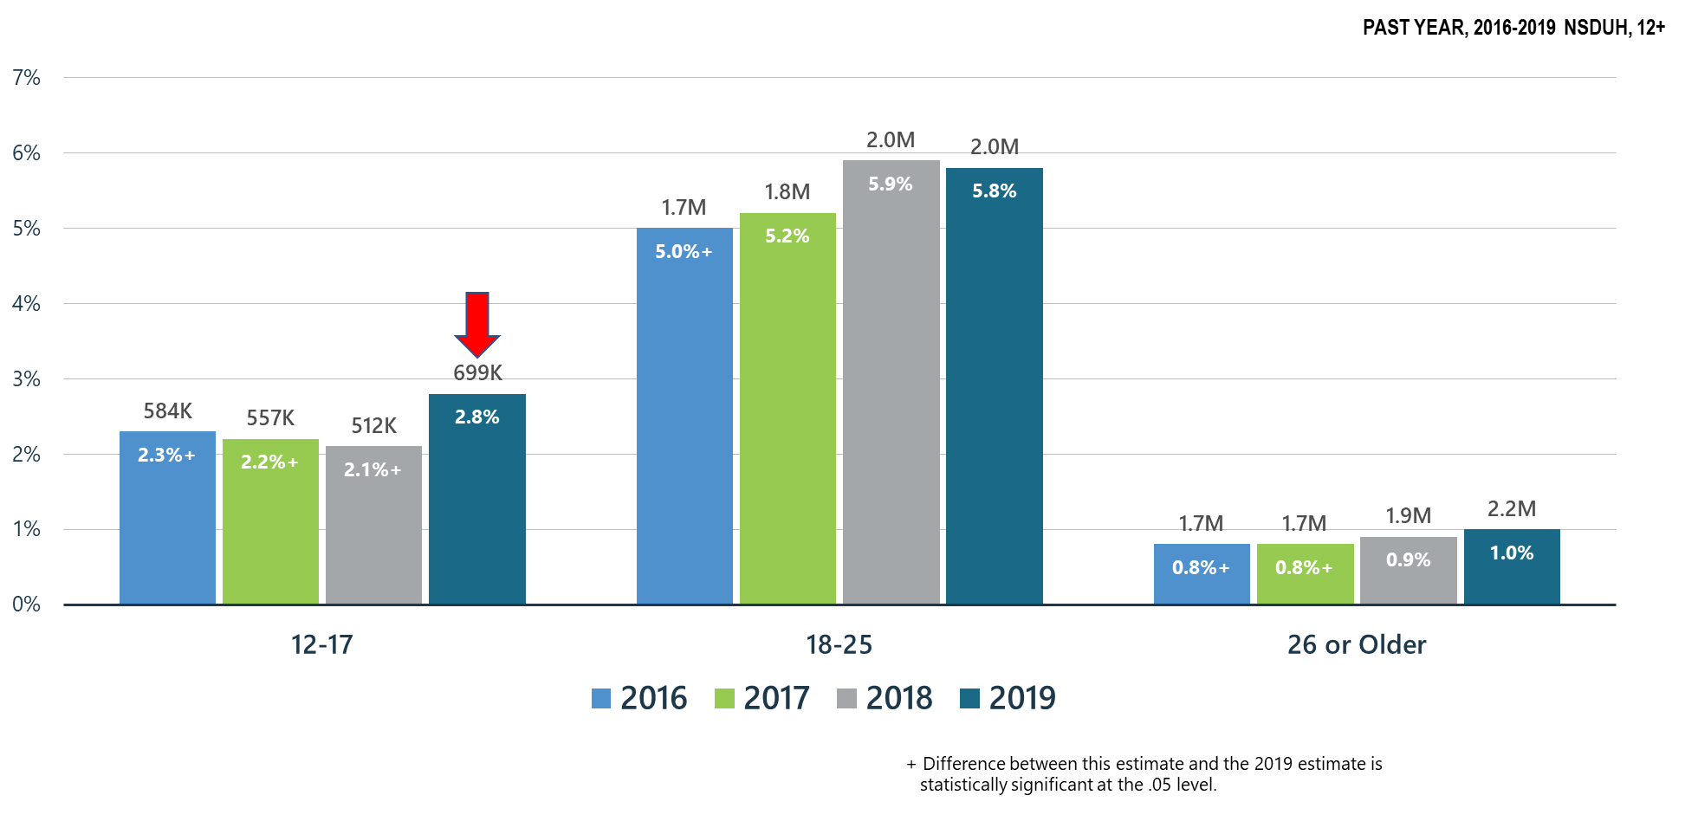
Before the pandemic…
Cannabis Use Disorder
SAMHSA (2020): NSDUH 2019

Slide 16
Take Home #3
We made headway over the past 5 years in the management of opioid use disorders in part through increased programming including MAT. But cannabis use has been increasing among youth

Slide 17
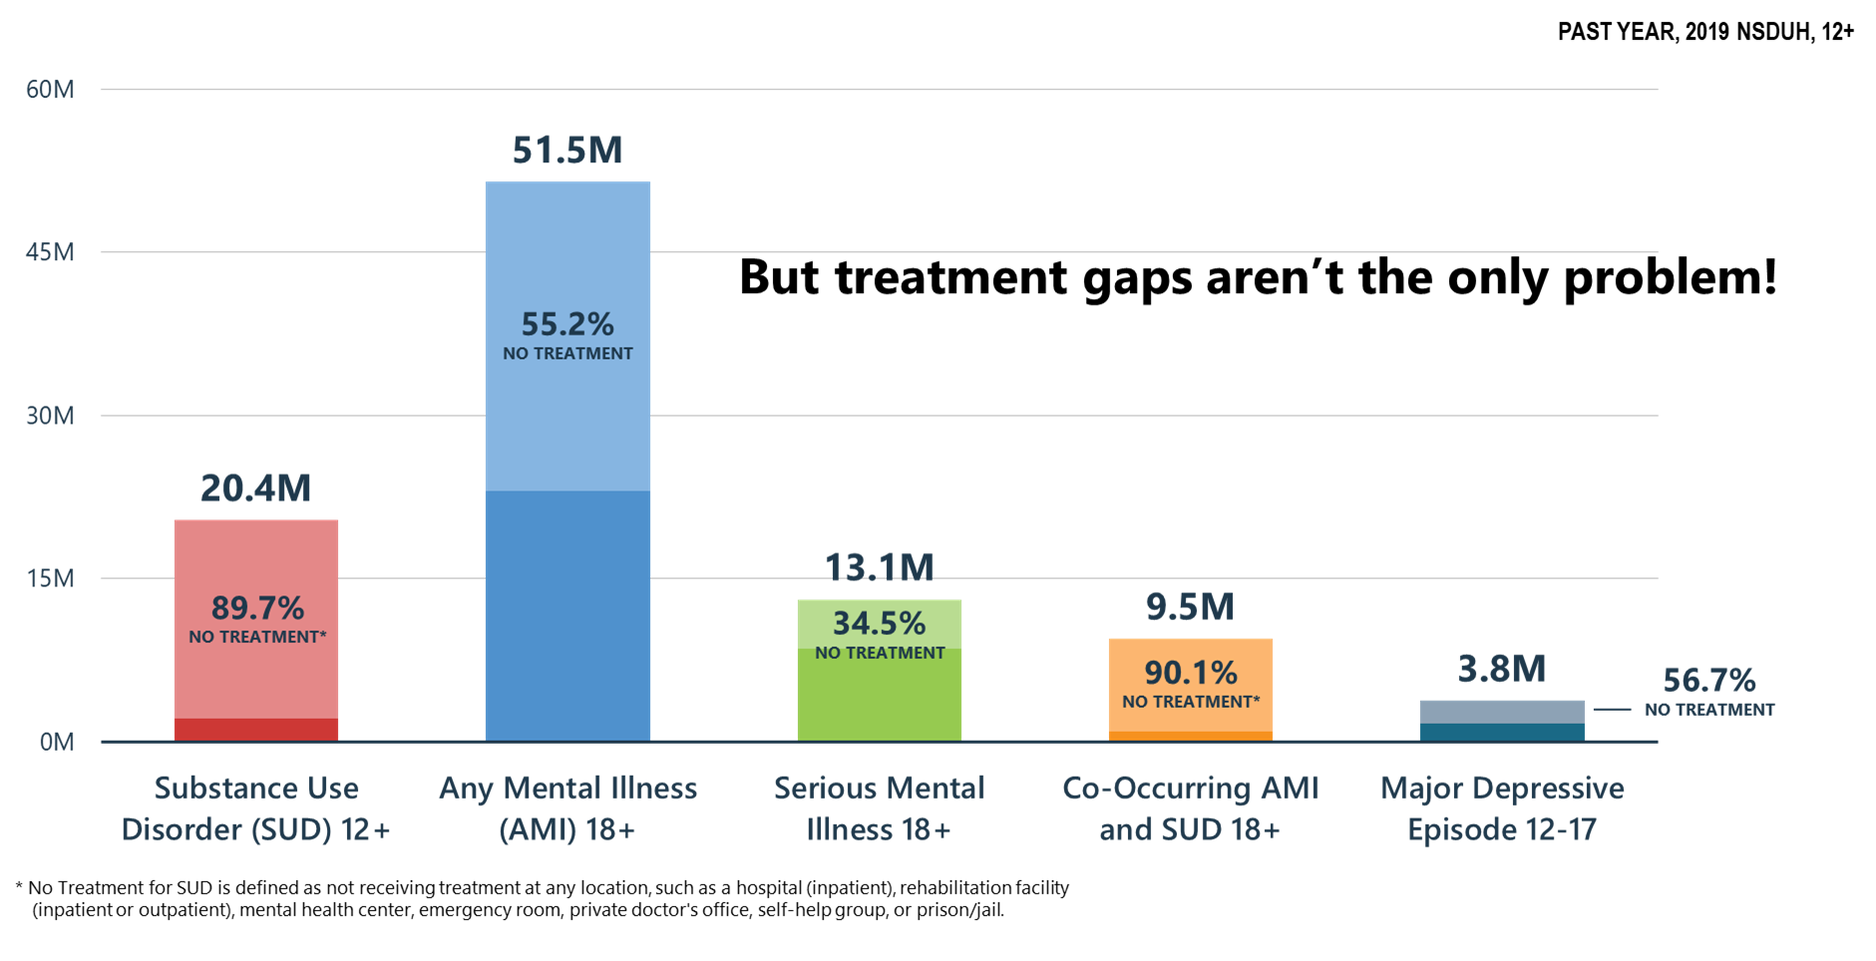
Before the pandemic…
Treatment Gaps
SAMHSA (2020): NSDUH 2019

Slide 18
Take Home #4
Before the pandemic, most people who needed treatment were not getting it

Slide 19
The Geriatric Wave
Prior to COVID, when the average lifespan of the U.S. population began to decline, the aging of the population has been a significant driver of healthcare
By 2030, the segment of the U.S. population age 65 and older will increase substantially, and the projected 74 million older Americans will make up over 20 percent of the total population (up from 16 percent in 2019)
Alzheimer’s Association (2019). Alzheimer's disease facts and figures.

Slide 20
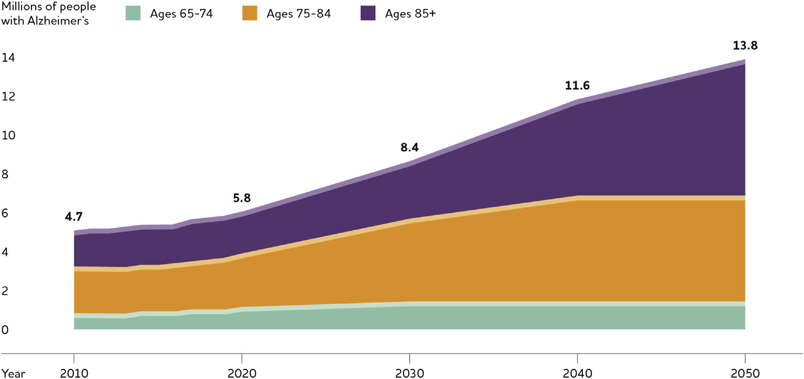
The Geriatric Wave
Alzheimer’s Association (2019). Alzheimer's disease facts and figures.

Slide 21
Take Home #5
With the aging of the U.S. population, and despite a declining incidence of dementia in the U.S., there will be rapid and substantial increases in dementia prevalence

Slide 22
The Genetic/Big Data Wave
30% of health-related outcomes related to genetics
Are there specific genes that place one at risk?
Results from either:
  Candidate gene studies: studies that examine specific genes thought to be associated
  Genome-Wide Association Studies (GWAS): studies that look at markers across the entire genome

Slide 23
Example: Nicotine
Single-nucleotide polymorphisms (SNPs) most likely to be involved have been associated with:
  CHRNA5, CHRNA3, CHRNB4 – all subunits of nicotine receptor
  However, these may also be associated with risk for alcohol, cocaine, and opiate use/misuse.
  Effect sizes are small (Odds Ratios ~1.2 - 1.4)

Slide 24
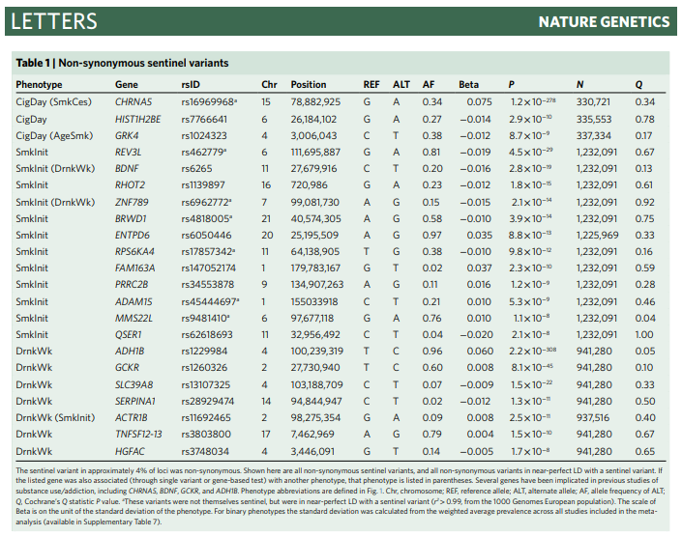
Example: Alcohol and Smoking

Slide 25
Example: Cannabis
To date:
  FOXP2 – a gene regulator associated with cannabis use and speech/language delay
  Chromosome 8 locus – near CHRNA2 and EPHX2
  Certainly nothing that could be considered a biomarker
  May be different for cannabis use vs. cannabis use disorder

Slide 26
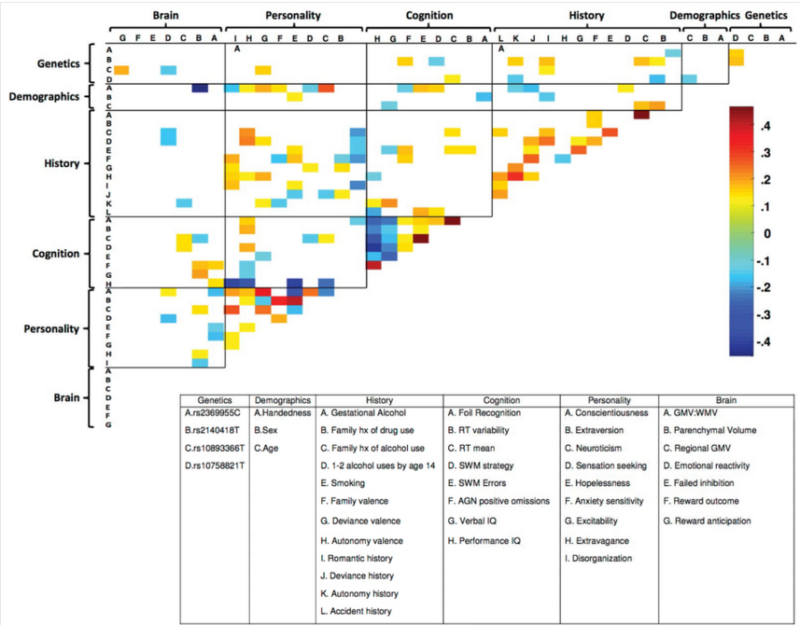
What Does Predict Later Substance Use?
Examined prediction of binge drinking 14→16
Genetics played a small role compared to personality, history, and cognition
Data from Whelan et al (2014)

Slide 27
Take Home #6
With the advent of rapid whole-genome scans and big-data methods, there will be an increase in the use of predictive algorithms to help guide treatment

Slide 28
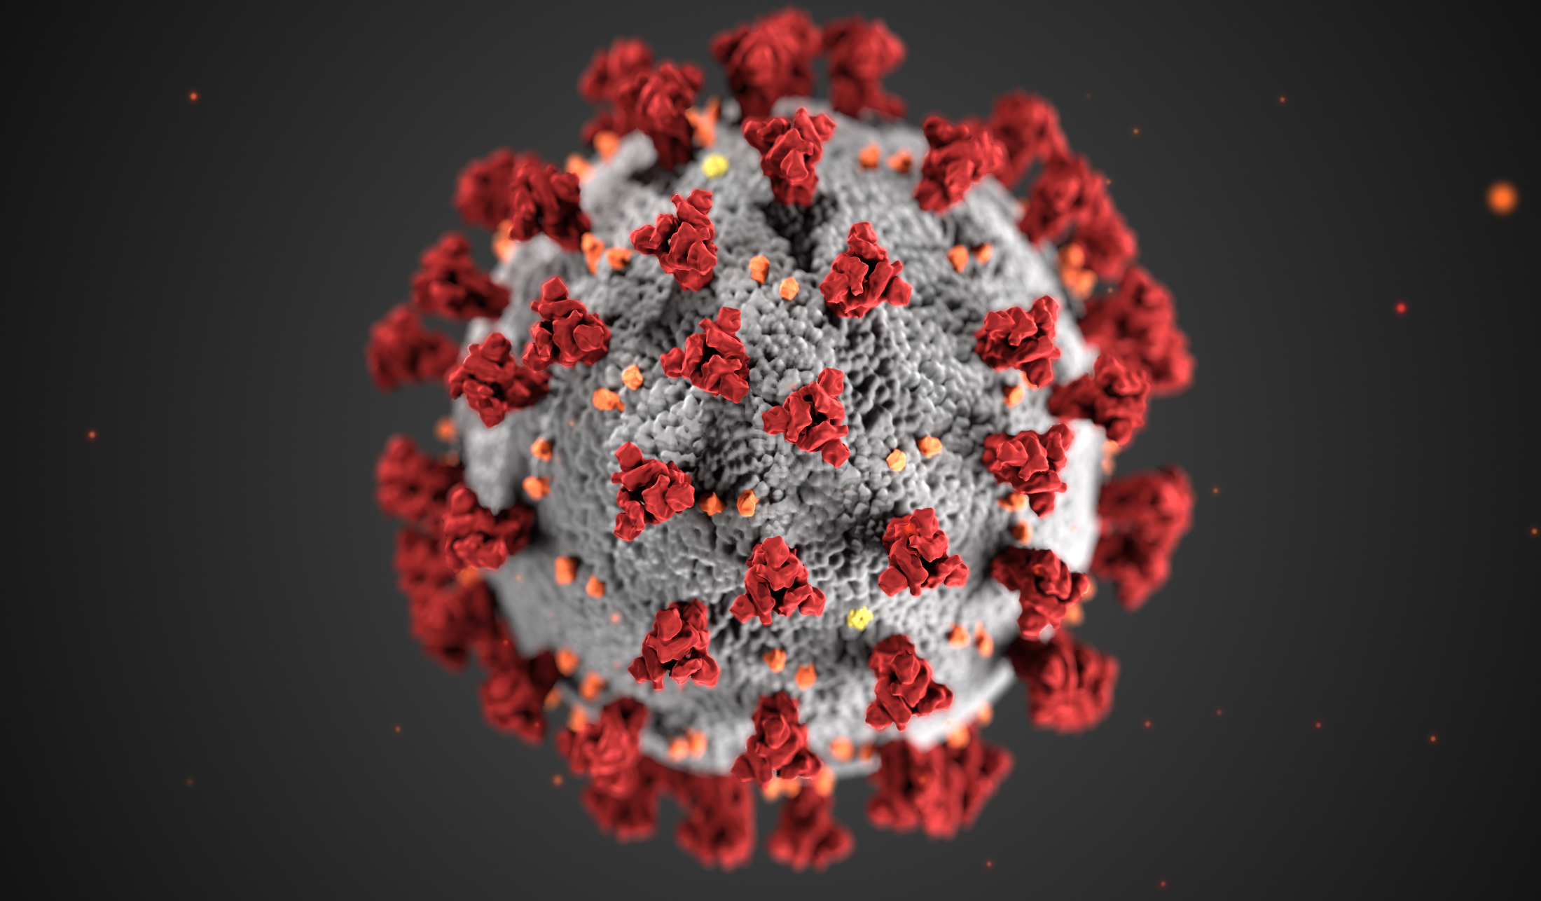
And then…

Slide 29
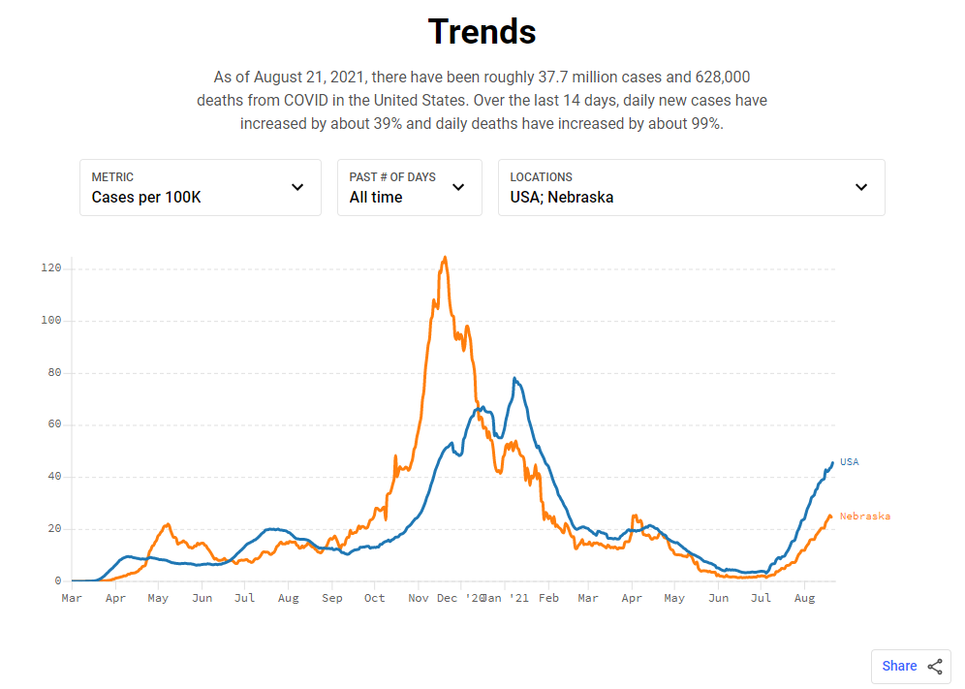
The Wave
covidactnow.org

Slide 30
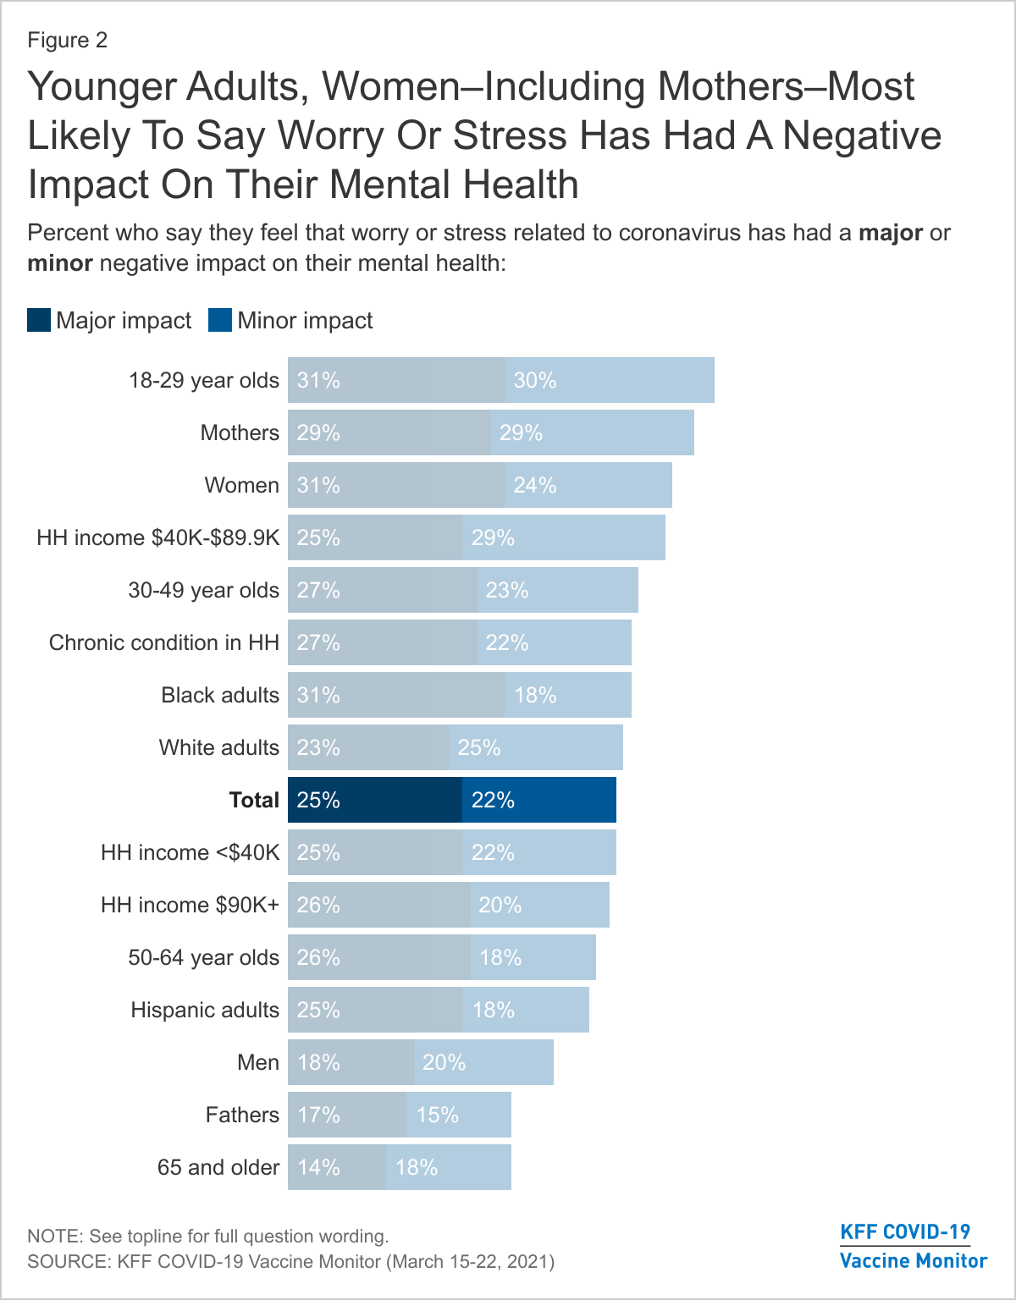
Stress

Slide 31

Stress

Slide 32


Slide 33
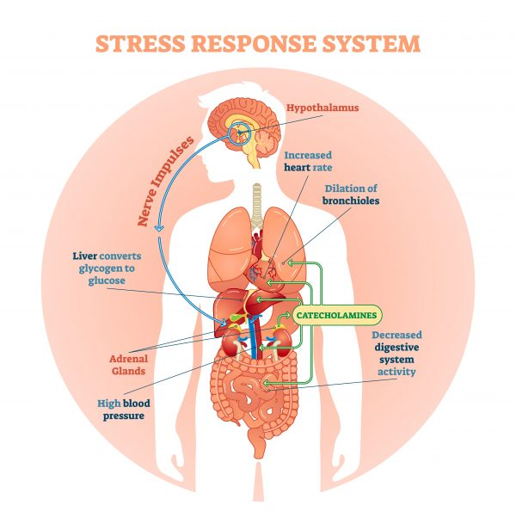

Slide 34



It’s not the leopard chasing us anymore...

Slide 35

Effects of Cortisol in the Body
Increase blood sugar
Suppress the immune system
Increase metabolism of fuels
Decrease bone formation
Worsens healing

Slide 36
Clinical Effects of Excess Cortisol
Depression
Hypertension
Fatigue
Sleep deprivation
Migraine headache
Acid Reflux
Hostility and anger
Arthritis
Decreased immune response – more illness
Decreased metabolism – obesity and overweight

Slide 37
Take Home #7
With the pandemic, we have seen several years of chronic, unremitting stress which previous data suggests is not good for later medical outcomes

Slide 38


A Dichotomy
I remember how we would bang pots and pans for doctors and nurses at 7:00 every night…
And I remember how we slowly stopped doing that until there was just one lonely guy doing
it for 2 weeks. We went from “I love New York!” to “I hate that one guy”
– SNL 5-22-21

Slide 39
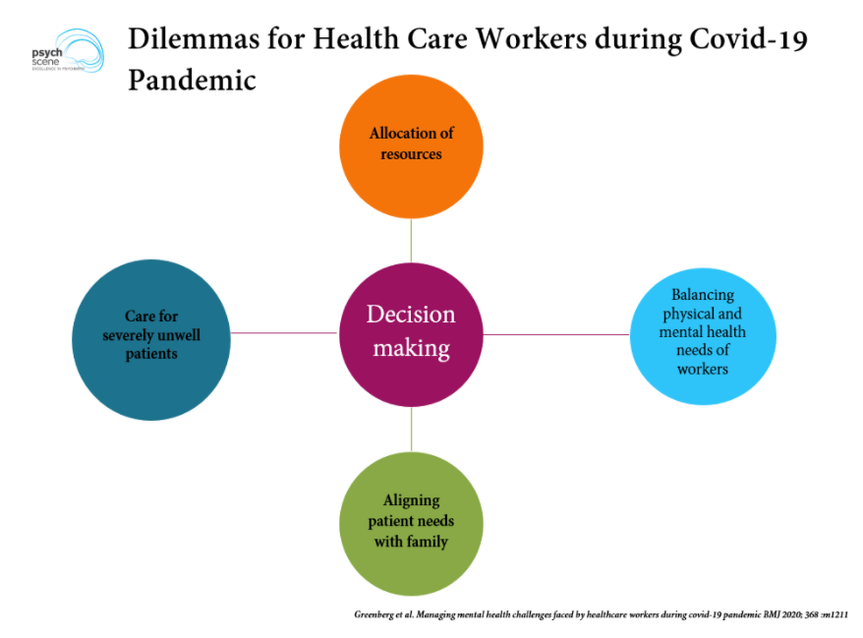

Slide 40
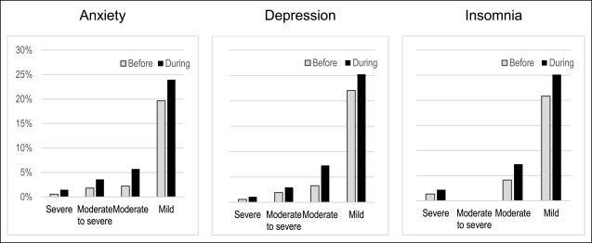
HCW Stress During COVID
Miller et al, 2020

Slide 41
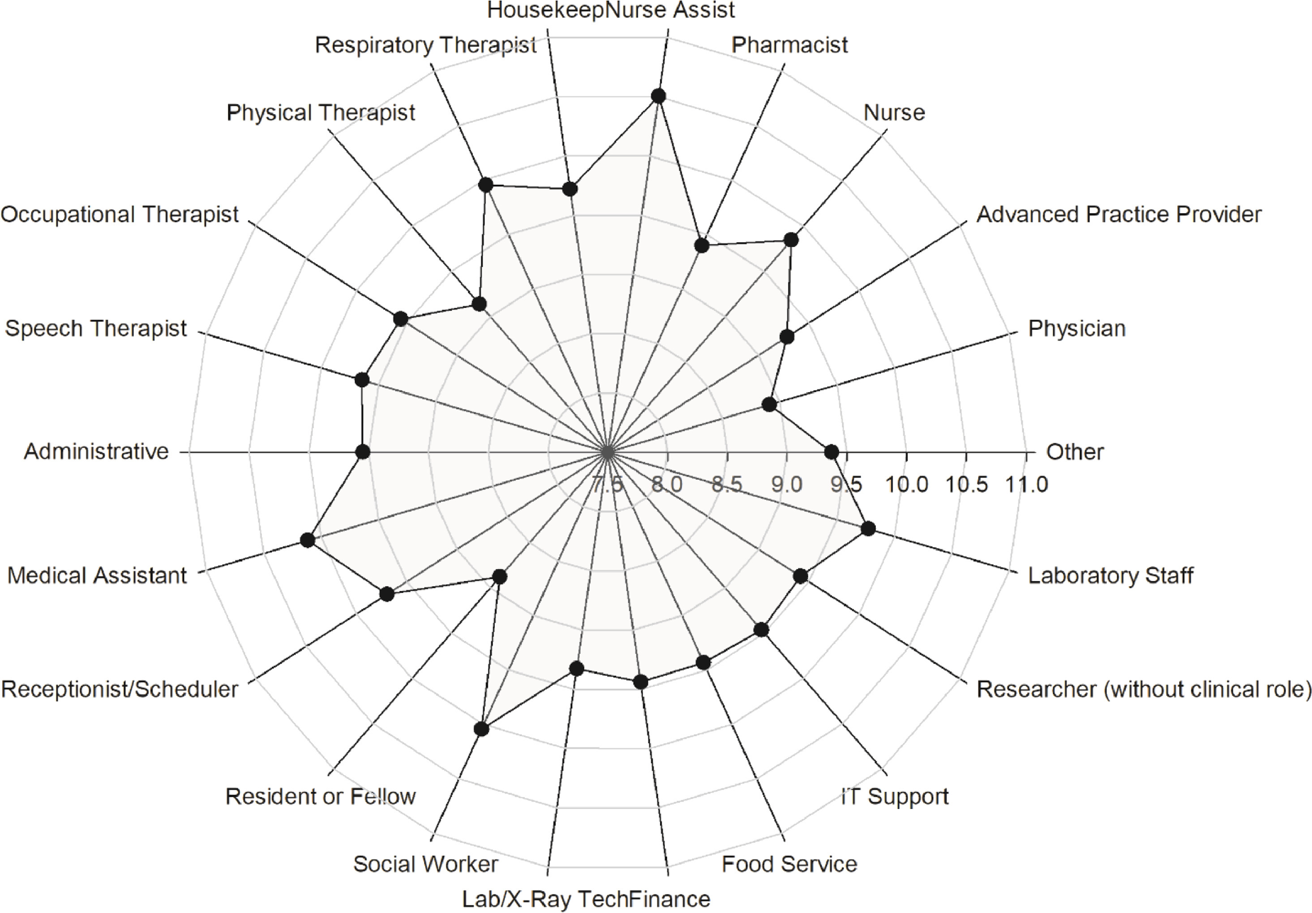
HCW Stress During COVID
Prasad et al. (2021). Lancet.

Slide 42
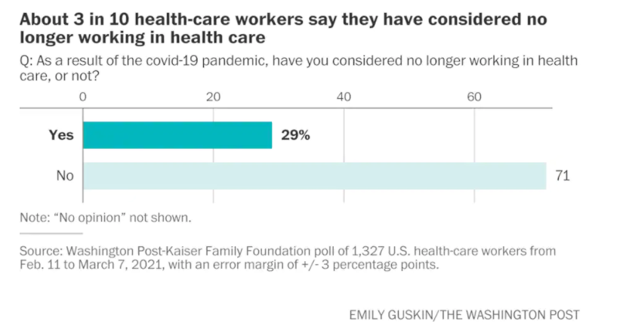
The Wave Goodbye

Slide 43
Take Home #8
Healthcare workers are under exceptional stress, resulting in increased need for their own wellness and increased work on the part of healthcare organizations to reduce burnout and mobility

Slide 44
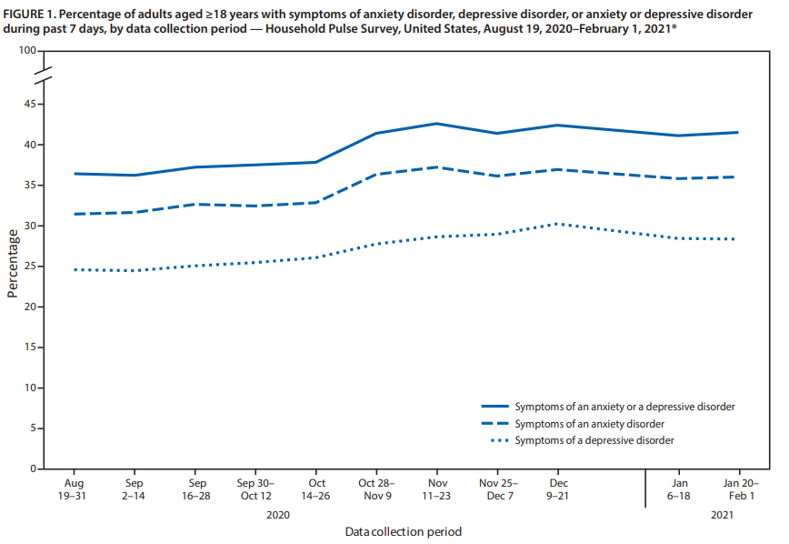
Post-COVID Depression and Anxiety
CDC MMWR, April 2, 2021

Slide 45
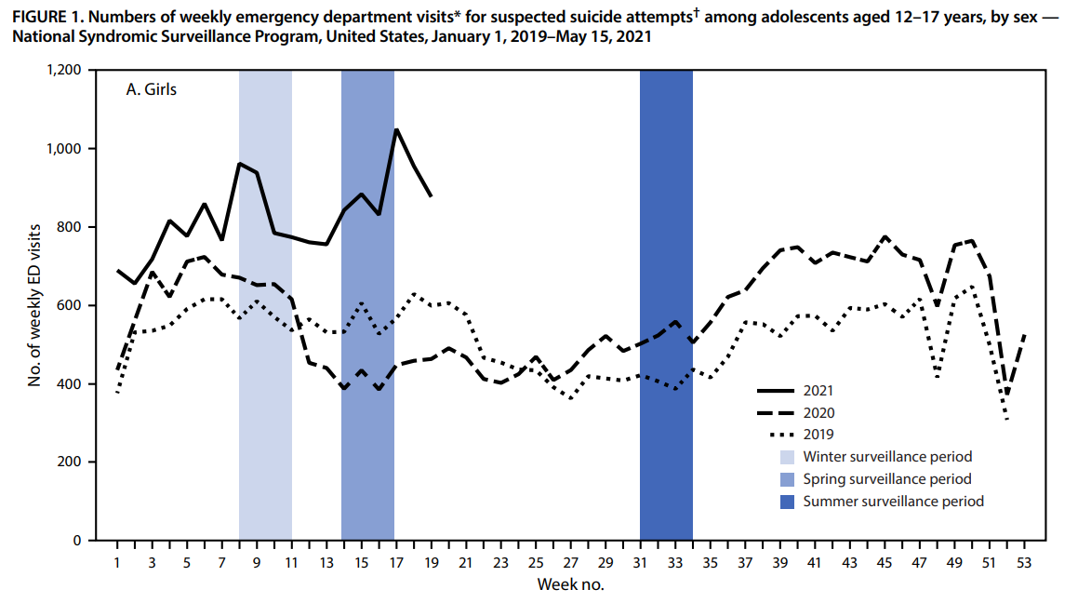
Pandemic Suicidality
CDC MMWR, June 18, 2021

Slide 46
Take Home #9
The pandemic has led to increased behavioral health needs in the area of depression, anxiety, and suicidality

Slide 47
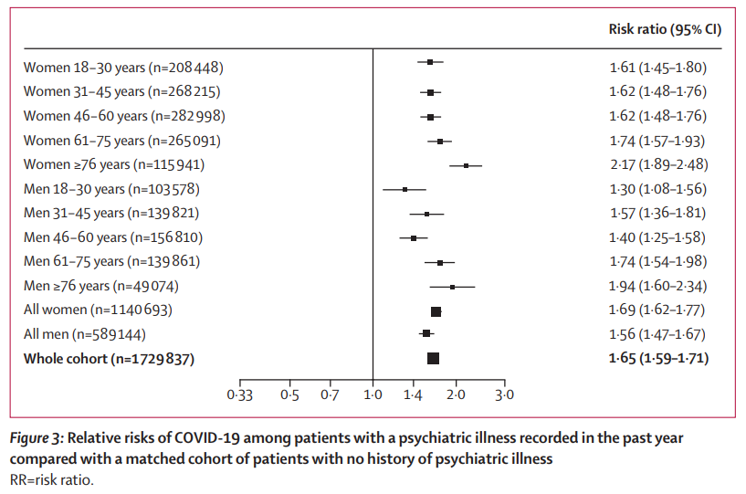
Post-COVID Psychiatric Illness
Taquet et al (2021) Lancet Psychiatry

Slide 48
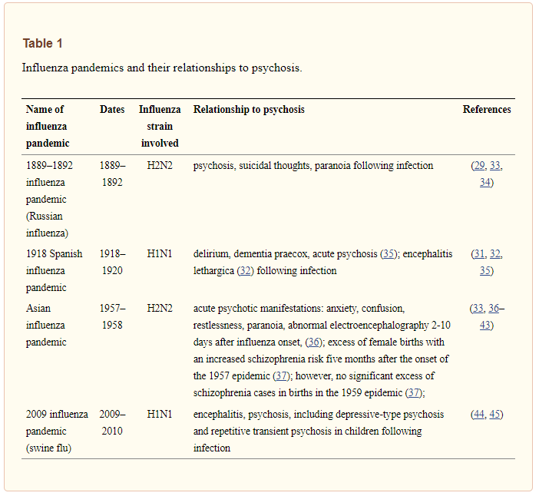
Post-COVID Psychiatric Illness
Kepinska et al (2020) Frontiers in Psychiatry

Slide 49
Take Home #10
COVID-19 has infected more than 37.7 Million Americans and 211 Million worldwide. It appears that infection may be related to later psychiatric manifestations and, if other inflammatory viral infections are a guide, may lead to increased rates of SMI.

Slide 50
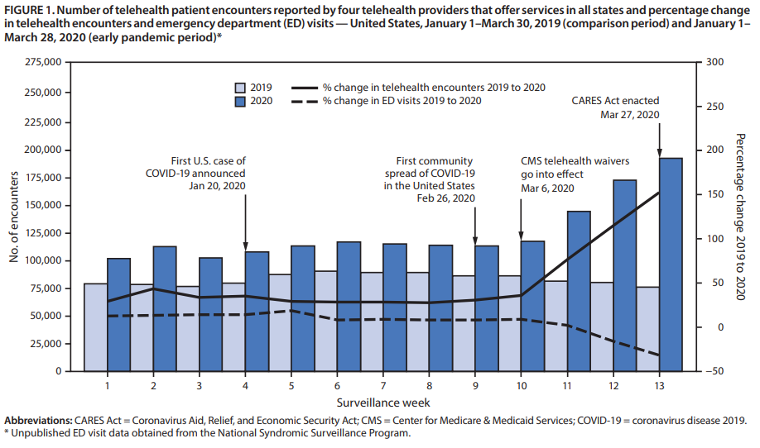
Pandemic Telehealth
CDC MMWR, October 30, 2020

Slide 51
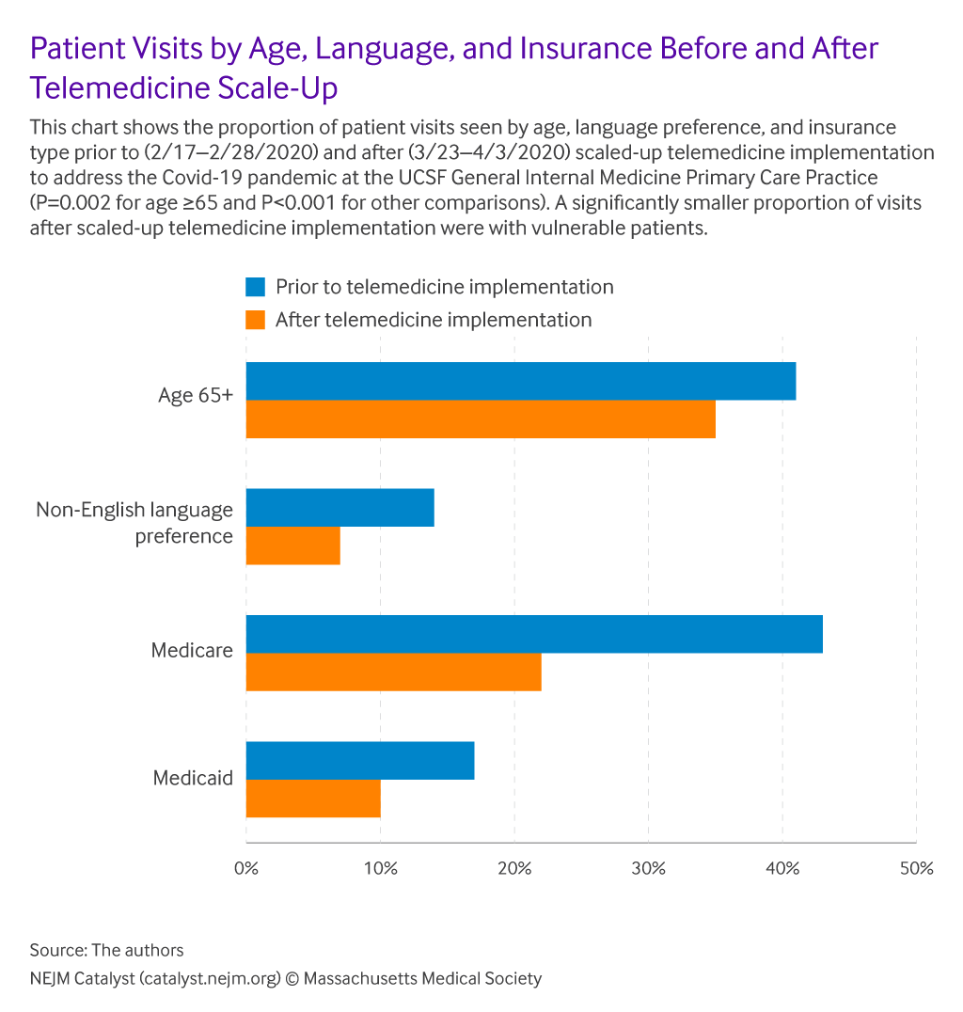
Pandemic Telehealth

Slide 52
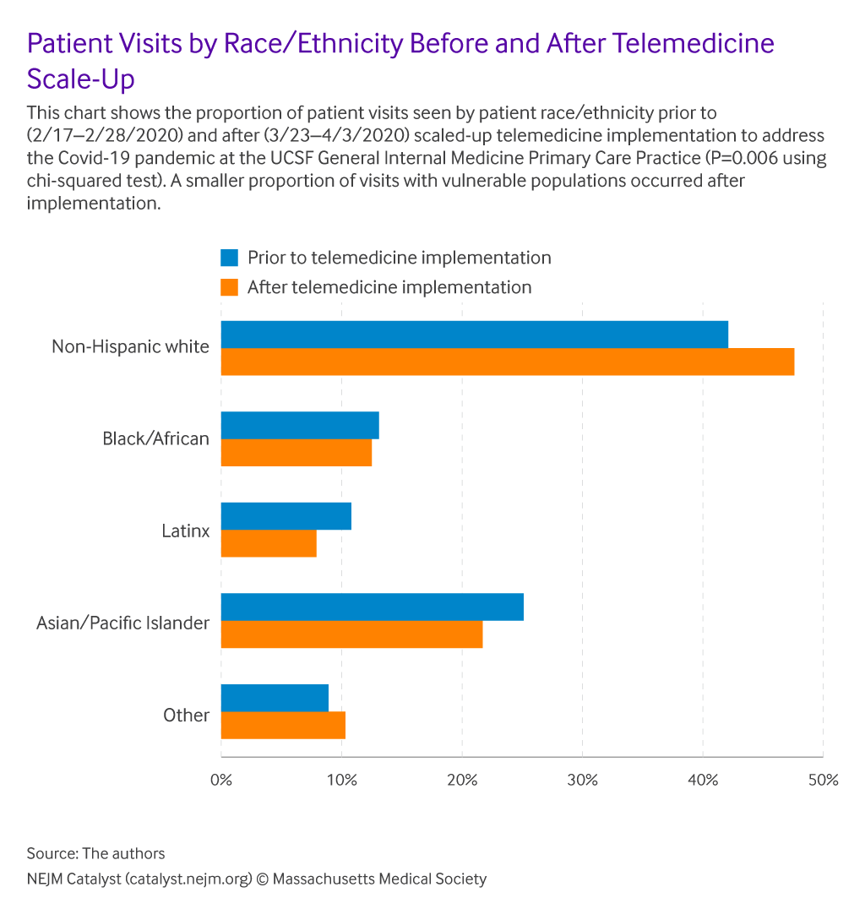
Pandemic Telehealth

Slide 53
Take Home #11
Telehealth expanded markedly during the pandemic and looks to be here to stay, yet it may increase already existing disparities

Slide 54
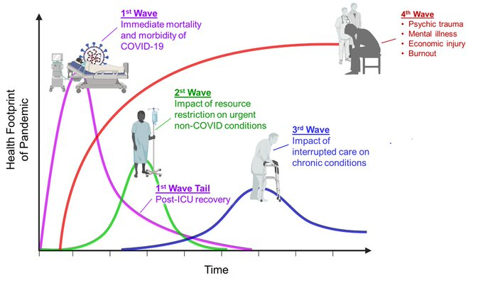
Phases of the Pandemic
Victor Tseng @VectorSting

Slide 55
Take Home #12
Each time there is a new surge in cases, if this limits the care of chronic illness or reduces access to urgent procedures, this increases morbidity and mortality in the population

Slide 56
Implications of these Trends
Increased demand for services
  Youth mental health
  Suicidal ideation
  Dementia care
Need for increased access
Decreased and more mobile workforce
  Increased need to address connection to organization
Increased demand for telehealth/digital health
  Demand for employee mental health
  Increase in demand for critical behavioral health support
  Increase in use of expert systems/big data/genetic technologies
  Increased need for cybersecurity systems

Slide 57

Thank you!
Email me at: ralthoff@med.uvm.edu
Follow me on Facebook:
www.facebook.com/childpsychvt
Follow me on Twitter:
@childpsychvt
Visit my website: http://www.childemotionregulationlab.org
Image Credit: U.S. Department of Energy
Human Genome Program

