Slide 1
Emergency Preparedness
Maxcey Smith B.S.N., R.N., CPHQ
Director of Quality/Safety-Risk Coordinator
Nemaha County Hospital

Slide 2
DISCLAIMER
This presentation may contain references or links to statues, regulations, or other policy materials. The information provided is only intended to be a general summary. It is not intended to take the place of either the written law or regulations. Please review the specific statues, regulations and other interpretive materials for a full and accurate statement of their contents.

Slide 3
Agenda
Understanding the CMS Regulations and Interpretive Guidelines
Assessment and Implementation
Steps of Emergency Management
Resources

Slide 4
CMS Emergency preparedness rule
Medicare and Medicaid Programs; Emergency Preparedness Requirements for Medicare and Medicaid Participating Providers and Suppliers
Published September 16, 2016
Applies to all 17 provider and supplier types
Implementation date November 15, 2017
Compliance required for participation in Medicare

Slide 5
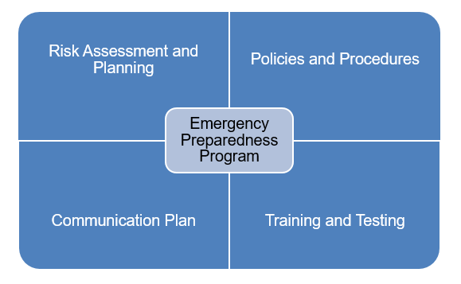
Four Core elements

Slide 6
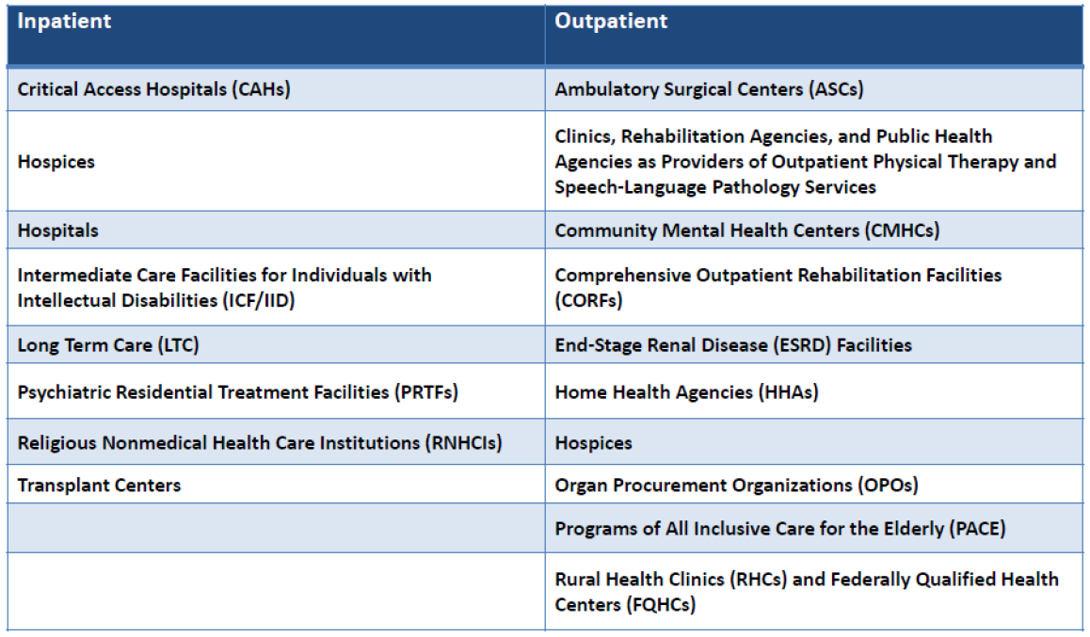
Who is affected?

Slide 7
Appendix W
485.625 COP: Emergency Preparedness
https://www.cms.gov/regulations-and-guidance/guidance/manuals/downloads/som107ap_w_cah.pdf
Last Revised 02/21/2020

Slide 8
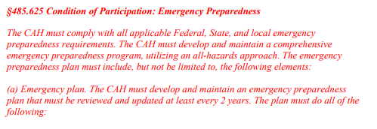

Slide 9
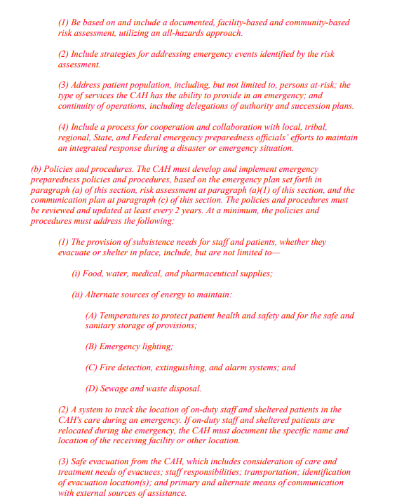

Slide 10
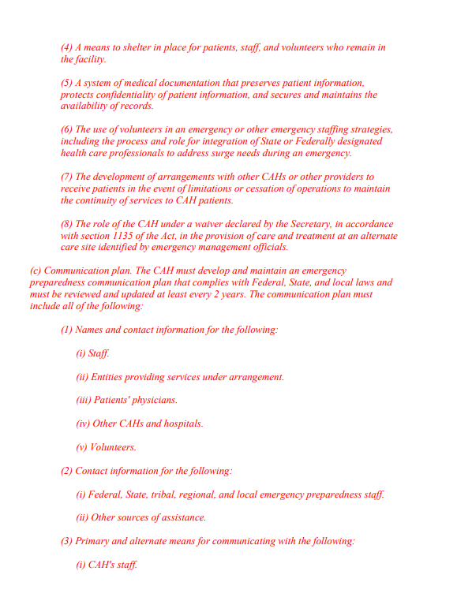

Slide 11

Emergency Plan
Purpose-provides effective response to external and internal disasters and emergencies. Reviewed annually and as needed.
Statement of need-disasters and emergencies can impact the operation of a hospital.
Objectives-Provide alternative sources of essential utilities, alternative communication systems, facilities for isolation/ decontamination, evaluation of effectiveness of plan, ensure staff knowledge and define alternative roles/responsibilities of personnel.

Slide 12
Approach Overview-Based on annual risk assessment and incorporates and all hazards approach. Goal is to save lives, limit casualties, limit damage and restore normalcy as soon as possible.
Information Gathering and Reporting-Response to disaster drills/events and identifying strengths/deficiencies. Actions to correct deficiencies. Actions to improve performance during emergency response.
Orientation and Training Programs-Facilitate training opportunities for dept. heads and staff in plans, procedures, assignments and responsibilities.
Statement of Authority and Approval- Will manage all incidents and pre-planned events in accordance with Incident Command System organizational structures as defined by NIMS (National Incident Management System)

Slide 13
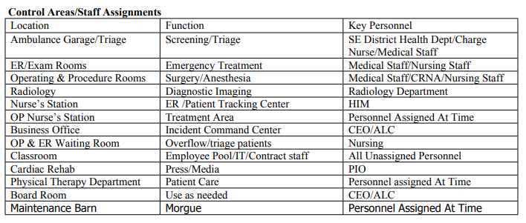
Additional Partners-Law Enforcement, Local Emergency Management, Local Health Department.
Control Area/Staff Assignments
Chain of Command
Local Facilities

Slide 14
Community Plan
Ambulance
Transfer Protocol
Transfer Plan
External Communication
Location, Size
MD Coverage
Staffing
Radiology
Laboratory and Blood Bank
Surgery and Anesthesia
Respiratory Therapy
Central Supply

Slide 15
Emergency Plan Policies and Procedures
Cardiac Arrest
Evacuation Procedure
Security Lockdown Plan
Abduction Plan
Fire
Active Shooter Plan
Bomb Threat Plan
Utility Management Plan
Medical Equipment Management Plan
Tornado
Emergency Winter Weather Plan
Evacuation of the city
Radiation Contamination Plan
Decontamination Plan
Hazard Communication Plan
Closed Pod Mass Prophylaxis Plan
Bioterrorism Readiness Plan
Water Management Plan
Communication Plan

Slide 16
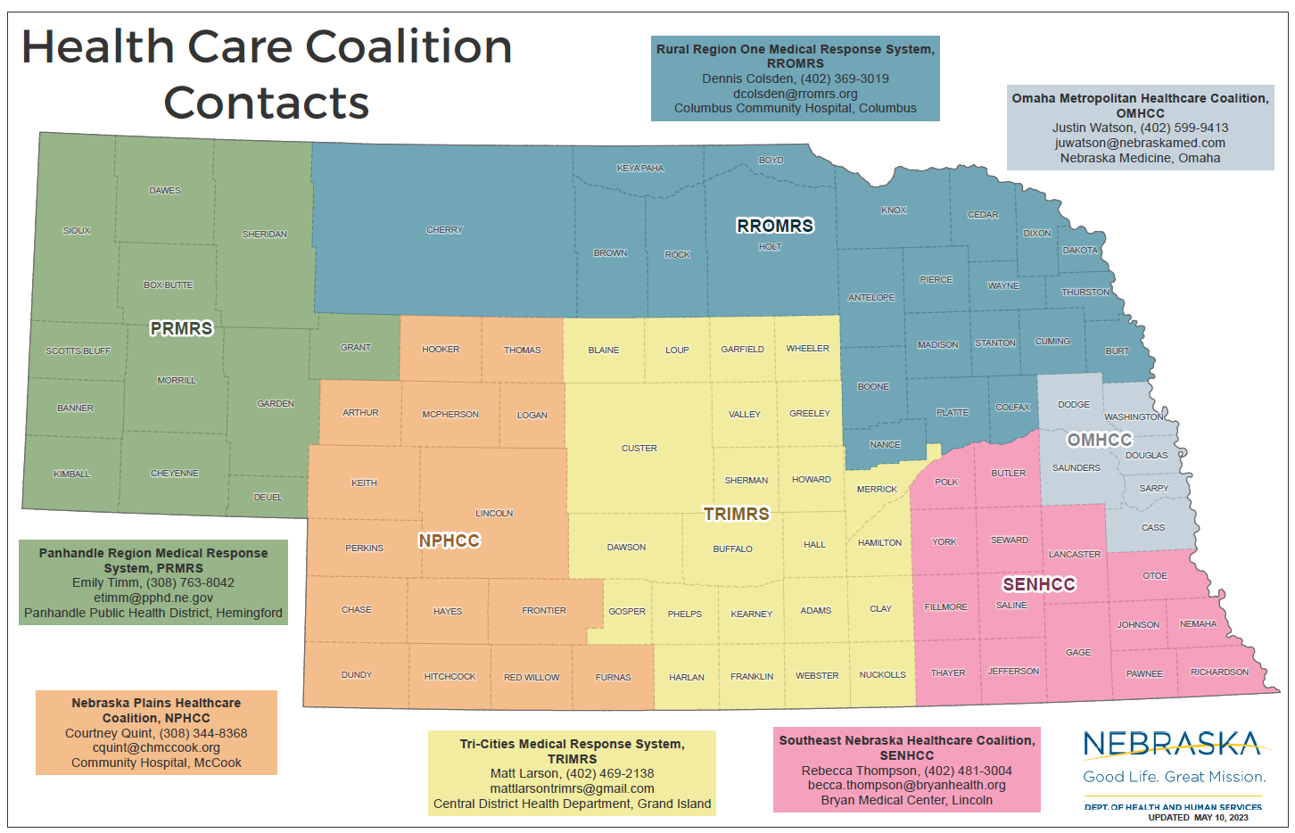
HCCs in Nebraska

Slide 17


Hospital Incident Command System (HICS)

Slide 18
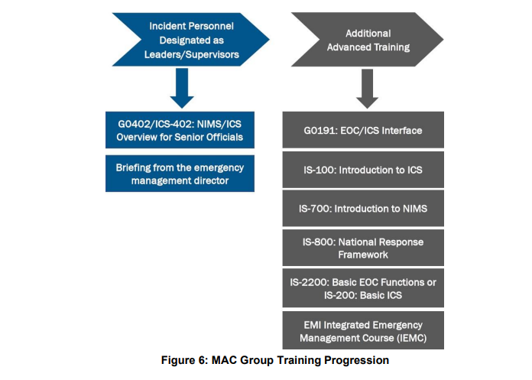

National Incident Management System (NIMS)

Slide 19
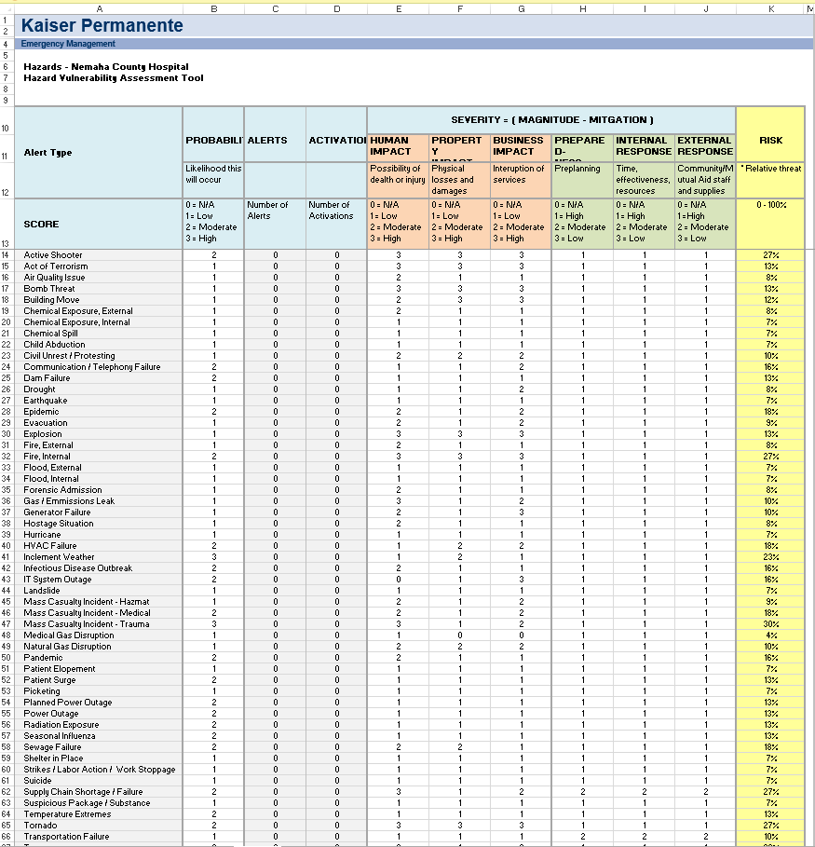
Hazard Vulnerability Assessment

Slide 20
96 Hour Resource inventory
Loss of Medical Supply
Loss of Nutrition and Food
Loss of Laundry Service
Sewer System Failure
Loss of Medication Supply
Loss of Hazardous Waste Pickup
Chiller System Failure
Loss Of Power

Slide 21
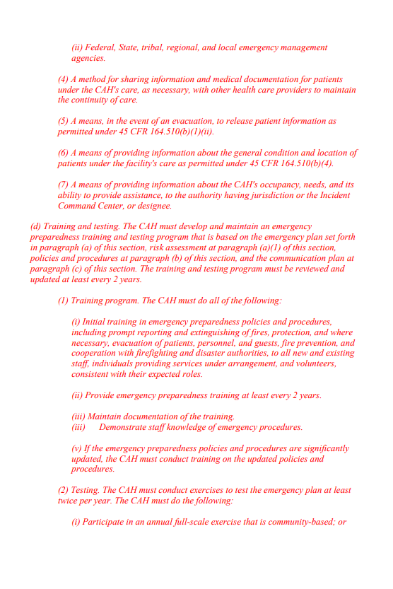

Slide 22
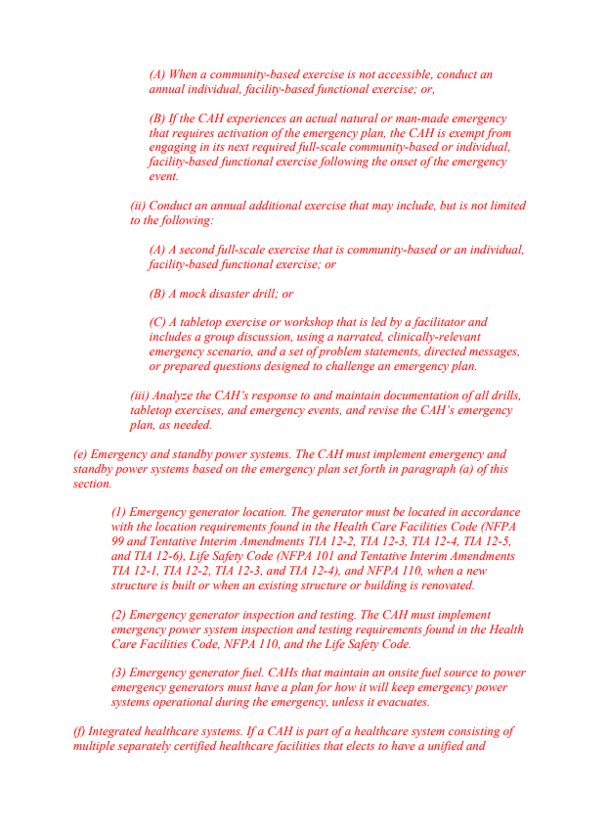

Slide 23

Emergency Preparedness Exercises
Fire Drills
Nuclear Disaster Drills
Chlorine Chemical Spill/Leak at local pool
Mass Casualty Drill
Pandemic Tabletop
Active Shooter Tabletop
Safety/Risk Monthly Meeting

Slide 24
Why do we prepare?
Tornadoes
Floods
Wildfires
School Shootings
Mass Casualty trauma’s
Pandemics

Slide 25
Emergency and standby power systems
Generator location
Generator Inspection and Testing
Generator Fuel

Slide 26
Questions?

Slide 27
Resources
CMS
HICS
NIMS
Hazard Vulnerability Assessment Tool
Health care Coalitions
Federal and Accrediting organizations

