Slide 1

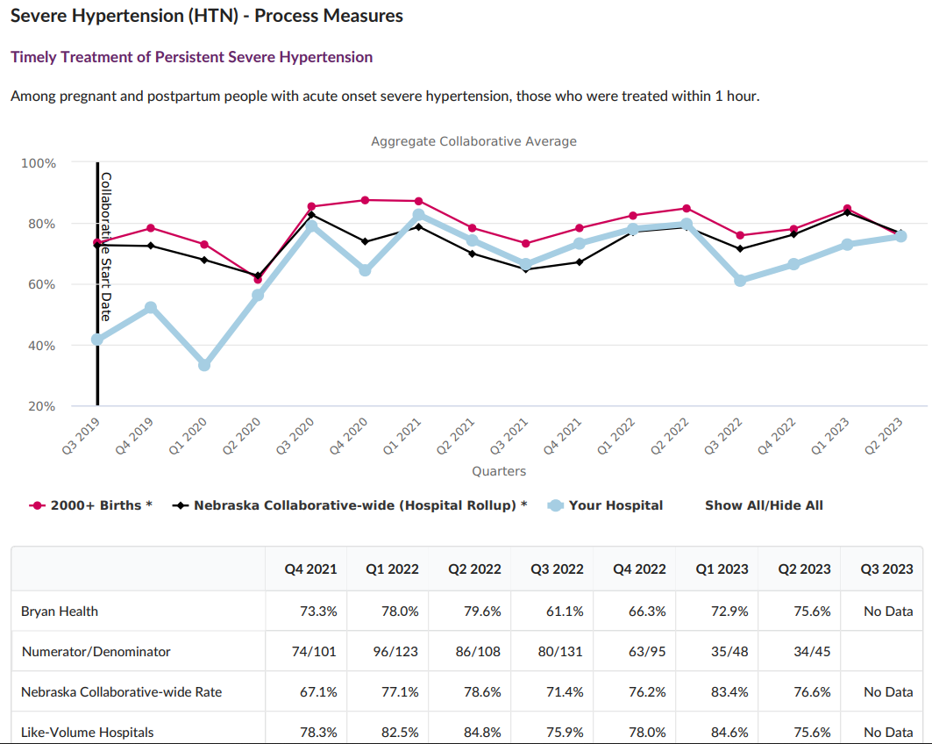

INCREASING COMPLIANCE OF TIMELY RECOGNITION AND TREATMENT OF SEVERE MATERNAL HYPERTENSION IN PREGNANCY AND POSTPARTUM
Bryan Medical Center, Labor and Delivery & Postpartum, Lincoln, NE
Background
Plan
Results
15 bed Labor and Delivery Unit, 33 bed Postpartum Unit
Systolic Blood Pressure > 160 or Diastolic Blood Pressure > 110 with confirmation 15 minutes from initially elevated systolic or diastolic treated within 60 minutes of first elevated SBP or DBP
Gap identified in nursing recognition of crisis blood pressures as well as standardized provider treatment regimen
Identification of patients meeting criteria through pregnancy encounter or diagnoses and unit on at the time of elevated BP
Severe Hypertension Treatment Panel created for ease of use with nifedipine and labetalol algorithms imbedded
A Best Practice Advisory (BPA) alert created for patients with systolic blood pressure >160 or diastolic blood pressure >110 for nursing to retake BP in 15 minutes
Severe Hypertension Single Dose Standing Order Set created for nursing to give the first dose of the nifedipine protocol and then notify the provider of a severe hypertensive crisis event
A BPA alert created to prompt treatment when the second/confirmation BP is elevated to trigger the nurse to order the Single Dose Standing Order Set
Incorporated into required quarterly simulation for all OB nursing staff (providers encouraged to attend)
Imbedded education into:
  Daily nursing huddles
  Perinatal Quality Newsletter
  OB Division discussions
  Posters in the doctors lounge
Strong front line staff engagement
Providers and nurses recognize importance of project to decrease maternal morbidity and mortality
36% overall increase in recognition and treatment of severe maternal hypertension within 60 minutes
69.5%
Next Steps
Continuously monitoring variances in blood pressure management on a quarterly basis
Work with ED to escalate care of maternal patients to maternal providers and L&D unit
Aims
Measure
To increase compliance of severe maternal hypertension treatment within 60 minutes of initially elevated SBP > 160 or DBP > 110 from 40% to 80%.
  Total number of maternal patients pregnant through 6 weeks postpartum who had a systolic blood pressure >160 or diastolic blood pressure >110 during their inpatient stay (Denominator)
  Filtered by total number of patients treated with PO nifedipine, IV labetalol, or IV hydralazine within 60 minutes of the initial elevated systolic blood pressure >160 or diastolic blood pressure >110 (Numerator)
  Disaggregated by race, ethnicity, and payer
Team Members
Samantha Kenning, MSN, RN, C-EFM, C-ONQS
Marisa Schaffer, MSN, RNC-MNN, C-EFM
Sean Kenney, MD

