Slide 1
VA Community Care Scheduling External Provider Scheduling
Notes:
Talking Points:
Hello, my name is [name], and I am [title, position] with [organization] representing the Department of Veterans Affairs. I want to talk to you about a new External Provider Scheduling platform that VA is implementing, and why you and your medical scheduling team should consider partnering with us if you haven’t already, to take advantage of this amazing, collaborative service for Veteran scheduling.

Slide 2
Agenda
Overview
Existing Scheduling Challenges
EPS as a Solution
Benefits to the Community Care Provider
Questions
Next Steps
Point of Contact
Notes:
Talking Points:
Here is a brief overview of what we will be discussing today.
Overview
Existing Scheduling Challenges
EPS as a Solution
Benefits to the Community Care Provider
Questions
Next Steps
Point of Contact

Slide 3
Overview
Department of Veterans Affairs (VA) strives to continuously improve processes for community partners, staff, and Veterans.
VA is working to make real-time digital scheduling with community providers possible using a new External Provider Scheduling (EPS) system.
EPS:
Is a digital healthcare platform connecting federal and commercial health systems
Contains modern features and capabilities that streamline care navigation activities
Is connected to over 100 commercial electronic health record and scheduling systems
Has partnerships with other healthcare industry leaders including Zocdoc and Kyruus
Notes:
Talking Points:
Department of Veterans Affairs (VA) is always striving toward continuous improvement and seeking new ways to improve processes for its staff and partners and quality care for Veterans. VA formed a partnership with WellHive and Booz Allen Hamilton to provide access to digital scheduling capabilities with community providers. The new platform will provide community providers with a convenient way to receive Veteran referrals and address current challenges with scheduling.
WellHive is a healthcare platform designed to connect federal and commercial health systems. It is the first and only platform that directly connects federal and commercial healthcare systems. The platform provides software for veterans' health management, which offers scheduling, monitoring, status claim, enrollment, and eligibility. It enables leading health systems, hospitals, and medical groups nationwide to deliver care through secure, modern technology
medical groups nationwide to deliver care through secure, modern technology.

Slide 4
Existing Scheduling Challenges
Inefficient Coordination - Current scheduling requires multiple phone calls between VA medical scheduling assistant (MSA), community care provider staff and the Veteran.
MSAs average four community care appointments daily.
Long Wait Times - 15+ business days.
Lack of Tracking - VA lacks insight into the scheduling process.
Notes:
Talking Points:
VA has worked with community providers over the years to ensure Veterans receive the best possible care. Currently medical support assistants and community provider schedulers spend a substantial amount of time working to address existing scheduling gaps and challenges such as:
Inefficient coordination - Currently, scheduling community care for Veterans requires multiple phone calls between medical scheduling assistant (MSA), community care providers and the Veteran to confirm appointment availability. On average, MSAs are only able to schedule four community care appointments per day.
Long wait times for Veterans - The current time to successfully schedule an appointment is between 7-14 business days.
Lack of tracking tools - After the appointment is scheduled, VA often does not have additional insight into the scheduling process.

Slide 5
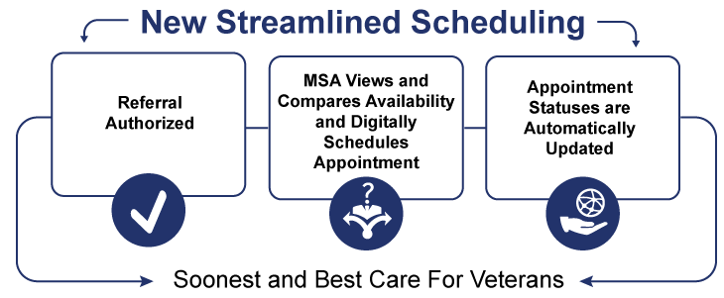
EPS as a Solution
Compare real-time appointment availability across connected providers and organizations
VHA MSAs can book Veteran appointments directly into community provider grids
VHA staff maintain visibility and insight into Veteran appointment outcome
Connected & automated
Notes:
Talking Points:
As mentioned previously, the scheduling process consisted of long hold times, long wait times, referral packets often set aside and not prioritized, and no visibility into the process for VA. The new process is streamlined and more efficient for VA and community providers and should drastically cut the amount of time required to schedule a patient.

Slide 6
Benefits to Community Care Provider
Why is VA doing this?:
Improve referral and scheduling process
Replace time-consuming faxes and phone calls
Increased ability to deliver more timely care for Veterans
EPS resolves challenges in the scheduling process:
Community care provider staff will no longer need to confirm appointments with Veterans
Real-time integrated scheduling
Work out of the system you’re already using – current system and workflows
Ability to control scheduling into your grid
Notes:
Talking Points:
Why is VA doing this? The partnership goals of the platform are:
Improve referral and scheduling process
Replace time-consuming faxes and phone calls
Increased ability to deliver more timely care for Veterans
EPS streamlines the scheduling process and will help address many of the challenges you and your team faced with the previous process:
Your staff will no longer need to confirm appointments with Veterans – this will ultimately save staff time and create more availability
Real-time integrated scheduling – You’ll be able to view appointments the VA schedules; patient demographics will be delivered at the time of booking; and you will be able to configure your dashboard to display appointment and visit times applicable to VA
Ability to control scheduling into your grid – MSAs will only be able to schedule an initial consult with a provider

Slide 7
Next Steps
Decision on participation
Define primary point of contact to work on next steps
Call to discuss onboarding process and what to expect
Complete Intake Form

Slide 8
Questions and Answers
Notes:
Talking Points:
I now would like to open the floor to see if anyone has any questions or wants additional clarification on what we have discussed so far.

