Slide 1
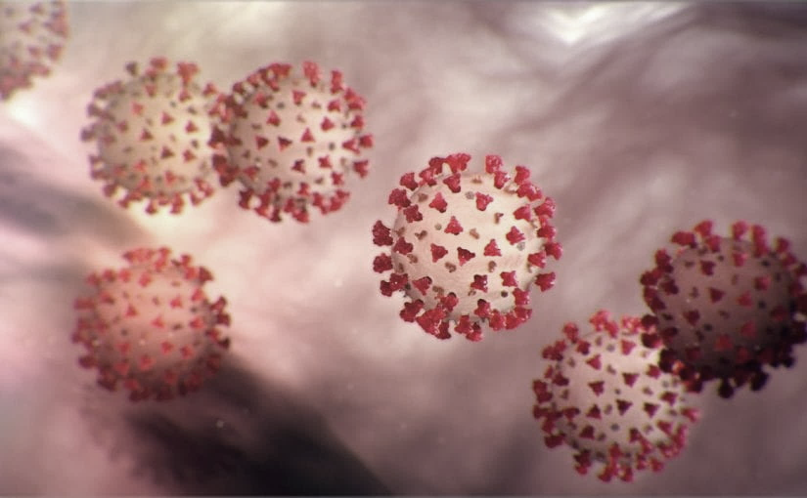
Covid-19 Webinex Update on ACH for COVID-19 3-20-20
Maureen Tierney, MD, MSc.
Healthcare Associated InfectionsMedical Director
Tom Safranek, MD, State Epidemiologist
Matthew Donahue, MD, EIS Officer, NE DHHS

Slide 2
CDC Updated Info for HCFs 3-17
Healthcare facilities and clinicians should prioritize urgent and emergency visits and procedures now and for the coming several weeks. The following actions can preserve staff, personal protective equipment, and patient care supplies; ensure staff and patient safety; and expand available hospital capacity during the COVID-19 pandemic:
Delay all elective ambulatory provider visits
Reschedule elective and non-urgent admissions
Delay inpatient and outpatient elective surgical and procedural cases
Postpone routine dental and eyecare visits

Slide 3
Minimizing Spread
The best way to minimize COVID-19 virus introduction/spread in Nebraska is to:
minimize out- of-state travel;
maximize the amount of self-quarantine, social distancing, and non-pharmaceutical interventions among travelers returning to Nebraska.
At this time we have clear but limited evidence of local transmission of COVID-19 (i.e., persons with no travel history and no identifiable exposure to a likely source of COVID-19

Slide 4
Cases in Nebraska
The vast majority of Nebraska COVID-19 cases can be traced to a traveler that introduced COVID-19 virus to the state. Many have arrived from regions of the world and other states which at the time of their return appeared to be low-risk or non-risk areas. The epidemiology of COVID-19 infection is rapidly evolving. While the exposure risk is certainly variable depending on where a traveler has visited, there is heightened concern for COVID-19 infection risk for all travelers entering Nebraska.
Nebraska Total Cases-32
Tested negative 240
3 cases of Community transmission
Rest are traveled related or contacts of travel related cases
UK, Italy, Singapore, WA, CA, FL, CO, NY

Slide 5
Updates for the Public and Returning Travelers
Updated public health recommendations for travelers-website in process of being updated
  A. All returning travelers have an increased risk of exposure to COVID-19
  B. All returning travelers should ideally self quarantine limit public interactions, practice strict social-distancing, and self-monitor for symptoms
  C. IF a returning traveler develops fever or respiratory illness, they need to IMMEDIATELY self-isolate and report to a provider or local health department

Slide 6
Updates
D. Returning travelers from areas with widespread sustained transmission (e.g. CDC Level 3 countries plus U.S. locales such as WA state, Westchester County and NYC, NY, and CA esp. Santa Clara County,) are at increased risk and of special concern.
Such travelers must self-quarantine for 14 days and immediately report any symptoms consistent with COVID-19 infection to their health care provider. Individuals unable to observe the 14-day self-quarantine should consult with their local health department

Slide 7
Updates
E. Health care workers with a travel history from outside the US, an area with widespread sustained transmission [Level 3 Countries, NYC, California (esp. Santa Clara Co.), Washington state, Florida, Colorado) or elsewhere other high-risk exposure should self quarantine if possible and self monitor
However, if because of HCP shortage or a needed expertise they should consult with a trained medical professional (e.g. infection preventionist or physician) at their facility and
Establish a protocol such as active monitoring with PPE while at work that mitigates the risk of patient and co-worker exposure.

Slide 8
Commercial Lab Testing
Commercial labs listed below had announced the availability of commercial tests through their portals. Published turnaround time is 3-4 days.
Any patient (+) for COVID-19 virus should be immediately reported to their local/state public health office.
All such (+) tests are provisional pending confirmation at NPHL. Request the commercial lab send the specimen to NPHL for all positive test
ARUP-No longer accepting new tests
Mayo –only providing for Mayo clinic patients
Quest -1000 tests nationally per day
LabCorp?

Slide 9
Testing
Availability of Testing-
NPHL is performing the CDC-approved test.
  20 specimens per run may be able to expand to about 100/day.
  Approval via LHD through the state DPH is necessary
  If performed 100 /day would run out within the week
UNMC - separate test through Regional Pathology Laboratory (RPL),
At capacity

Slide 10
UPDATED TESTING RECOMMENDATIONS
Evidence suggests >80% of COVID-19 infections are mild (fever is variable with COVID-19 infection and may be absent), might not warrant a healthcare visit or lab test, and do not require hospitalization. Telephone triage and appropriate self-isolation can suffice in most cases.
Capacity and supplies for COVID-19 laboratory testing cannot meet current demand. A simple clinical diagnosis of COVID-19 infection warrants self-isolation, and should be the norm, even in the absence of a positive COVID-19 lab result. This could change if testing capacity expands.
Rapid influenza tests and multiplex PCR respiratory pathogen panel (RPP) tests are still available at in-state laboratories, and if positive, should usually preclude the need for COVID-19 testing (co-infections appear to be uncommon).

Slide 11
Clinical Diagnosis
Given the consequences of widespread transmission, public health authorities nationally are broadening the range of clinical syndromes warranting self-isolation:
• Temperature ≥100.4°F
• Cough
• Shortness of breath
• Sore throat
To limit potential transmission, if any of these symptoms are present, alone or in combination (in the absence of a known alternative diagnosis): patients should self-isolate.

Slide 12
STREAMLINED COVID-19 TEST ORDERING AT NPHL FOR SELECTED PATIENTS
We are streamlining the ordering of the COVID-19 PCR test at the Nebraska Public Health Lab to enable direct on-line ordering without telephone pre-approval by public health. Given restricted testing capacity, we REQUIRE that patients tested at NPHL meet the priority requirements published in yesterday’s HAN:
Inpatients: for suspected COVID-19, rule out flu and RPP, then order COVID-19
Outpatients: vulnerable or high-risk populations with a clinical diagnosis of COVID-19, after ruling out alternative diagnoses (negative flu/RPP), will be considered for testing
  Healthcare workers
  Public safety (EMS, law enforcement, firefighters)
  Nursing home, group home, daycare attendees or employees

Slide 13
Specimens failing to meet these requirements will be rejected unless a state/local public health authority has given telephone pre-authorization.
On-line ordering of the COVID-19 test is strongly recommended using the NuLirt online ordering system at NPHL
Use your existing NPHL account or if lacking a pre-existing account, create a new account through this link:
https://test-nulirt.nebraskamed.com/register [gcc02.safelinks.protection.outlook.com]

Slide 14
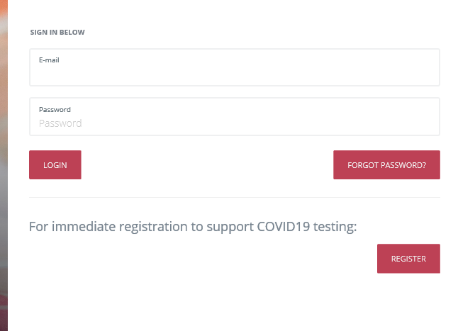
https://nulirt.nebraskamed.com/login
FOR HELP -- https://nulirt.nebraskamed.com/help

Slide 15
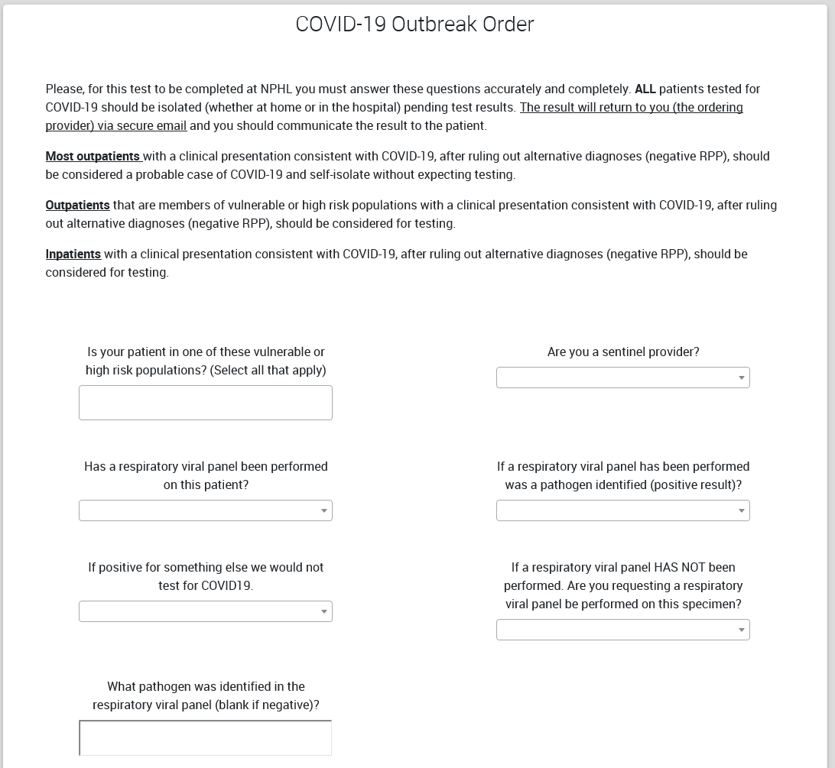

Slide 16
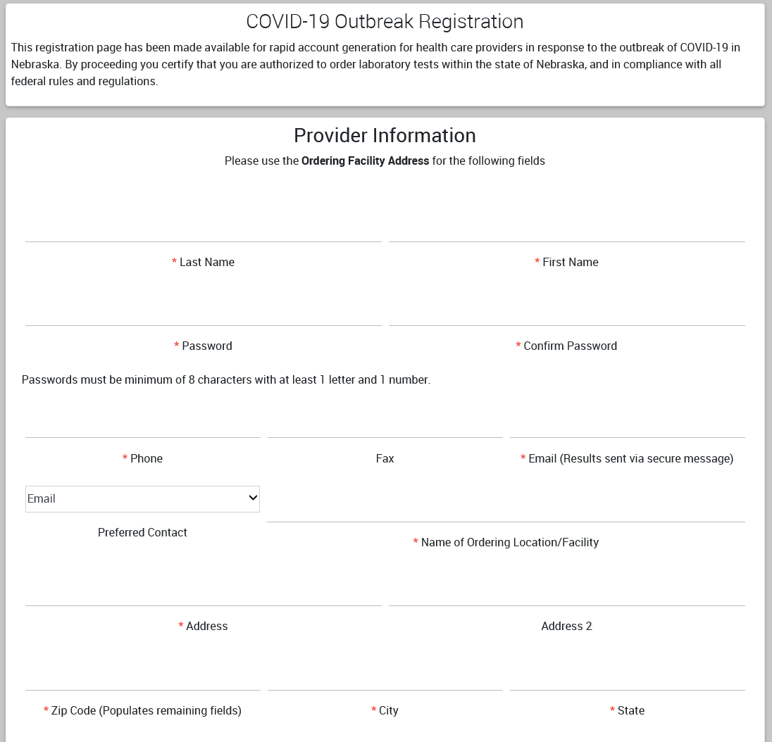
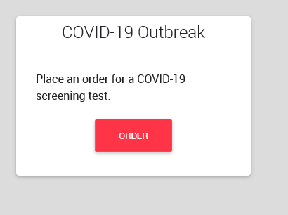
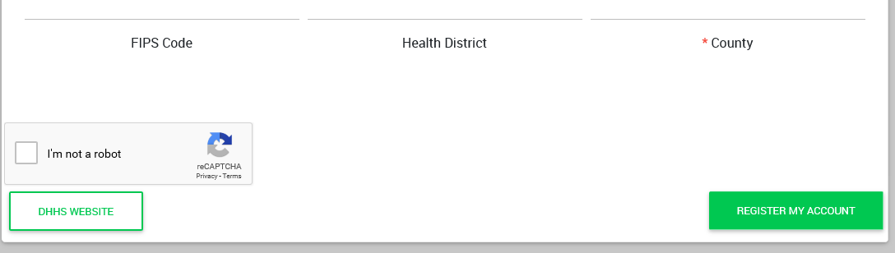
FOR NEW USERS
FOR CURRENT USERS

Slide 17
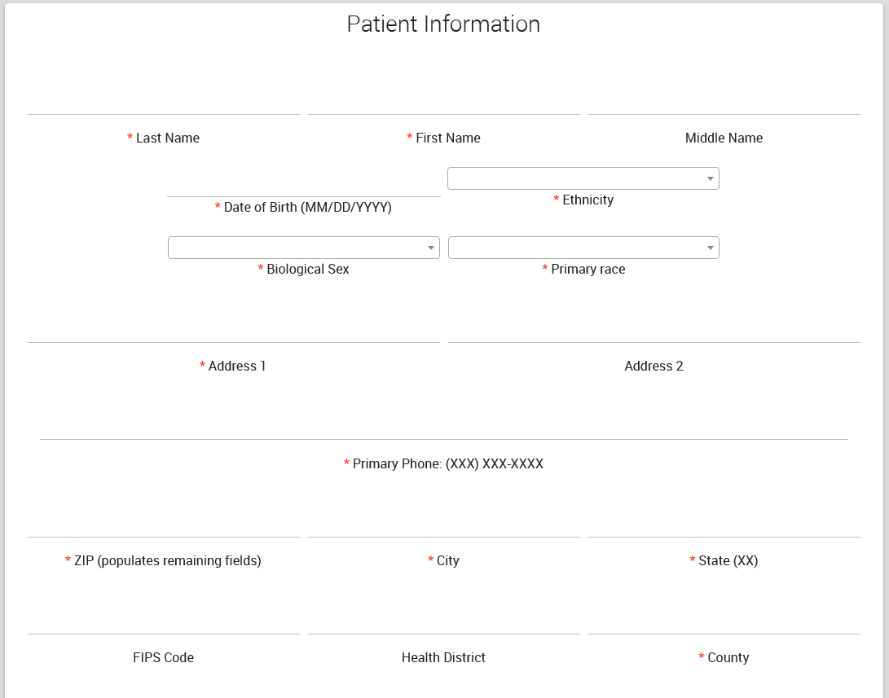

Slide 18
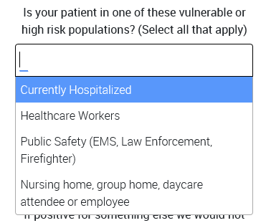
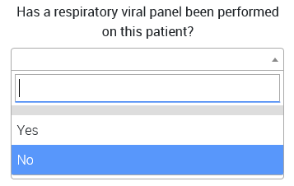
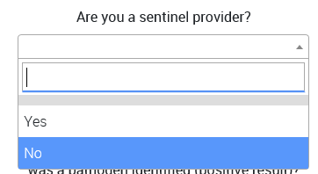
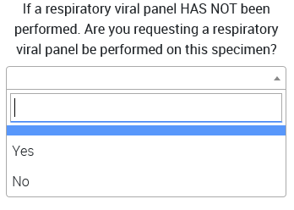
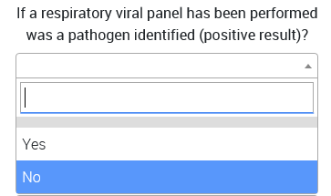

Slide 19
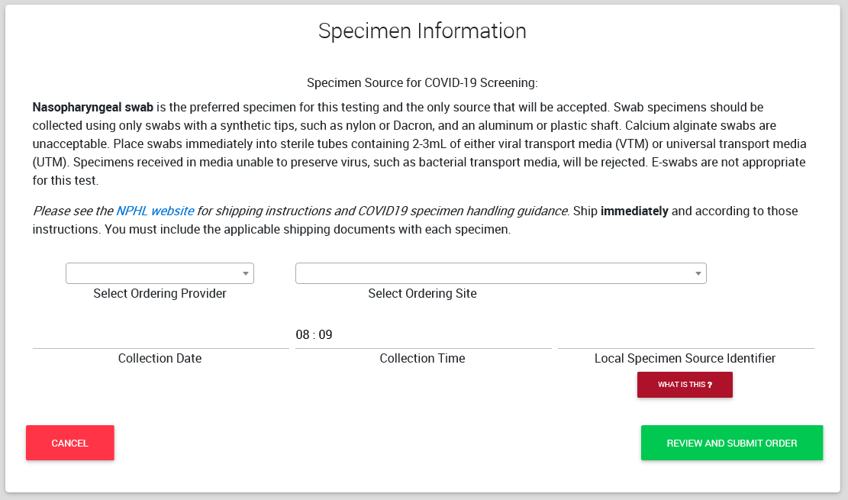

Slide 21

Collection and Handling Laboratory Specimens from Nebraska Patients with Suspected COVID-19 Infection AT http://nphl.org

Slide 22
Call In Lines; Facility Screening
1. NM-Info hotline and referral -400-922-0000; Evaluated over the phone
referred one of their outpatient clinics, Can do their own test
2. CHI-CHIhealth.com 8am to 8pm; after hours virtual care (for CB, IMM, Lakeside St. Es, St. Francis and Good Sam )
Virtual Screening referred to MD or ANP; free.
Methodist 402-815-7425 24/7
  Doing testing on main campus
4. Bryan -24/7 hotline-402-481-0500; also website from their Bryan Health homepage
ezVisit-if for coronavirus questions will be provided free of charge
5. Great Plains Health-no hotline-ask people to call their PCP.

Slide 23
Reporting to LHD
Reporting to LHD should primarily be by providers not patients. The LHD staff screening for who to test need the providers to have done some clinical screening/evaluating first (which may all be by phone)
Any general questions by the public can be answered by the general COVID 19 hotlines at various LHDs
Douglas Co Help Line is the following.
Listing of the local health departments and contacts:
http://dhhs.ne.gov/CHPM%20Documents/contacts.pdf

Slide 24
Updates from Interim Guidance for IP in HC
For care other than aerosol generating procedures a face mask can replace an N-95 if an N-95 is not available
If gowns become scarce gowns should be reserved for
Aerosol generating procedures
Care where splashes and sprays anticipated
High contact care activities
In extreme scarcity-
Moving between patients with same confirmed diagnosis and eye protection and mask
not soiled by spray etc
remove only gloves and gowns and perform HH
replace gowns and gloves for next patient

Slide 25
Limited Capacity of N-95s
It is imperative that providers know and practice the strategies for preserving the supply of N95 respirators as outlined by the CDC: https://www.cdc.gov/coronavirus/2019-ncov/hcp/respiratorsstrategy/index.html
During times of limited access to respirators or facemasks, facilities could consider having HCP remove only gloves and gowns (if used) and perform hand hygiene between patients with the same diagnosis (e.g., confirmed COVID-19) while continuing to wear the same eye protection and respirator or facemask (i.e., extended use). Risk of transmission from eye protection and facemasks during extended use is expected to be very low. HCP must take care not to touch their eye protection and respirator or facemask .
Eye protection and the respirator or facemask should be removed, and hand hygiene performed if they become damaged or soiled and when leaving the unit.

Slide 26
Strategies for Optimizing the Supply of N95 Respirators:
Contingency Capacity Strategies
NIOSH approves other filtering facepiece respirators that are at least as protective as the N95. These include N99, N100, P95, P99, P100, R95, R99, and R100.
Recommended Guidance for Extended Use and Limited Reuse of N95 Filtering Facepiece Respirators in Healthcare Settings
Extended use is favored over reuse because it is expected to involve less touching of the respirator and therefore less risk of contact transmission.

Slide 27
Extended Use of N-95s
Extended use refers to the practice of wearing the same N95 respirator for repeated close contact encounters with several different patients, without removing the respirator between patient encounters.² Extended use is well suited to situations wherein multiple patients with the same infectious disease diagnosis, whose care requires use of a respirator, are cohorted (e.g., housed on the same hospital unit).
Discard N95 respirators following use during aerosol generating procedures.
Discard N95 respirators contaminated with blood, respiratory or nasal secretions, or other bodily fluids from patients.
Discard N95 respirators following close contact with, or exit from, the care area of any patient co-infected with an infectious disease requiring contact precautions.
Consider use of a cleanable face shield (preferred³) over an N95 respirator and/or other steps (e.g., masking patients, use of engineering controls) to reduce surface contamination.
Perform hand hygiene with soap and water or an alcohol-based hand sanitizer before and after touching or adjusting the respirator (if necessary for comfort or to maintain fit)

Slide 28
Re-use of N-95s
Discard N95 respirators following use during aerosol generating procedures.
Discard N95 respirators contaminated with blood, resp. or nasal secretions, or other bodily fluids
Discard N95 respirators following close contact with any patient co-infected with an infectious disease requiring contact precautions.
Use a cleanable face shield (preferred) or a surgical mask over an N95 respirator and/or other steps (e.g., masking patients, use of engineering controls), when feasible
Hang used respirators in a designated storage area or keep them in a clean, breathable container such as a paper bag between uses. To minimize potential cross-contamination, store respirators so that they do not touch each other and the person using the respirator is clearly identified.
Clean hands with soap and water or an alcohol-based hand sanitizer before and after touching or adjusting the respirator (r to maintain fit). Avoid touching the inside of the respirator.
Use a pair of clean (non-sterile) gloves when donning a used N95 respirator and performing a user seal check. Discard gloves after the N95 respirator is donned and any adjustments are made to ensure the respirator is sitting comfortably on your face with a good seal.

Slide 29
Crisis Capacity When N-95s are running low
HCP planned proximity to the case patient during encounter | Facemask or respirator determination
 | Patient masked for entire encounter (i.e., with source control) | Unmasked patient or mask needs to be removed for any period of time during the patient encounter
HCP will remain at greater than 6 feet from symptomatic patient | HCP remaining at this distance from the patient should not need to enter the patient care area; if entry required: no facemask or respirator | HCP remaining at this distance from the patient should not need to enter the patient care area; if entry required: no facemask or respirator
HCP will be within 3 to 6 feet of symptomatic patient | HCP remaining at this distance from the patient should not need to enter the patient care area; if entry required: facemask | HCP remaining at this distance from the patient should not need to enter the patient care area; if entry required: facemask
HCP will be within 3 feet of symptomatic patient, including providing direct patient care | Facemask | N95 respirator/ elastomeric /PAPR, based on availability
HCP will be present in the room during aerosol generating procedures performed on symptomatic persons | N95 respirator/ elastomeric /PAPR, based on availability | N95 respirator/ elastomeric /PAPR, based on availability

Slide 30
Nebraska Medicine has posted how they are extending PPE use on the Nebraska Medicine COVID page- open access.
https://www.nebraskamed.com/sites/default/files/documents/covid-19/COVID-Extended-Use-Reuse-of-PPE-and-N95.pdf?date=03182020

Slide 31
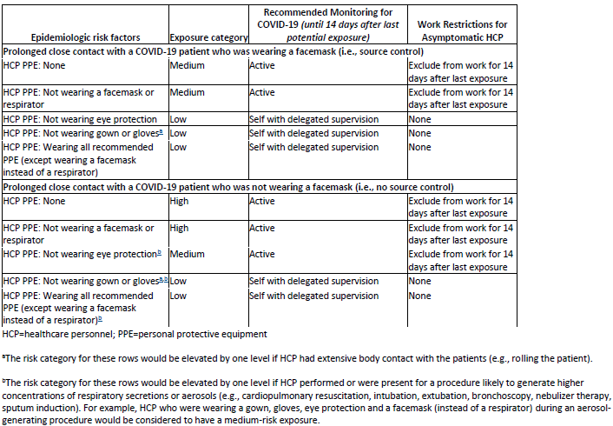
Interim U.S. Guidance for Risk Assessment and Public Health Management of Healthcare Personnel with Potential Exposure in a Healthcare Setting to Patients with COVID-19

Slide 32
Monitoring and Work Restrictions
HCP in the high- or medium-risk category should undergo active monitoring, including restriction from work in any healthcare setting until 14 days after their last exposure.
HCP in the low-risk category should perform self-monitoring with delegated supervision until 14 days after the last potential exposure.
HCP in the no identifiable risk category do not require monitoring or restriction from work.

Slide 33
Following slides are repeats
Repeat slides on Acquiring a specimen

Slide 34
DHHS HAN 3-11-2020
Specimen Collection Advice for Clinics and EDs Evaluating Patients with Febrile Respiratory Illness
Patients presenting to HCFs for evaluation of any febrile respiratory illness should be fitted with a surgical facemask upon arrival and should be segregated from other patients (e.g., immediately moved to an exam room). This is to prevent transmission of respiratory pathogens including flu and COVID-19.
If the clinical presentation and the epidemiologic risk factors create a HIGH index of suspicion of COVID-19 (this is a clinical judgement-further guidance above) personnel who collect NP (nasopharyngeal) swabs should don full personal protective equipment (PPE) prior to specimen collection. •
N95 respirator, eye protection, disposable gloves, and a gown. •
If N95 respirators or equivalent PPE are not available, the patient should be referred to a location where the person undertaking specimen collection has all CDC-recommended PPE.
A negative pressure room is not essential for testing.

Slide 35
DHHS HAN 3-11-2020
If it is determined that the risk of COVID-19 is low
Facilities lacking a supply of N95 respirators should substitute a surgical mask on persons collecting the specimen.
Eye protection is also essential. If available, a face shield would be preferable to goggles.
At the time of specimen collection, the patient’s surgical facemask should be lowered sufficiently to expose the nares, and a proper swabbing should commence per the instructional video cited below.
The patient’s surgical facemask should be properly repositioned immediately upon completion of specimen collection.

Slide 36
DHHS HAN 3-11-2020
Specimen Collection
It remains CRITICALLY IMPORTANT that staff responsible for collecting nasopharyngeal (NP) swabs be thoroughly trained and strictly compliant with specimen collection protocols. Failure to collect a proper specimen could result in a FALSE NEGATIVE test which could have major consequences for controlling COVID-19. A training video can be found here: https://www.youtube.com/watch?v=hXohAo1d6tk
Use only synthetic fiber swabs with plastic shafts. Do not use calcium alginate swabs or swabs with wooden shafts, as they may contain substances that inactivate some viruses and inhibit PCR testing. Place swabs immediately into sterile tubes containing 2-3 ml of viral transport media. Refrigerate specimen at 2-8°C and ship overnight to CDC on ice pack.
Nasopharyngeal swab: Insert a swab into the nostril parallel to the palate. Leave the swab in place for a few seconds to absorb secretions.

Slide 37

Resources (Testing)
Written instructions from NPHL and CDC on handling samples:
http://www.nphl.org/documents/NPHL%20Alert%20COVID-19%20Collection%20and%20Handling%20in%20NE%20v2020%2002%2012.pdf
https://www.cdc.gov/coronavirus/2019-nCoV/lab/guidelines-clinical-specimens.html
Video for collecting a NP swab:
https://www.youtube.com/watch?v=hXohAo1d6tk
I think this is the best video- also shows proper PPE donning and doffing
https://www.youtube.com/watch?v=c20CfI-Cr8M

Slide 38

Resources
CDC is updating guidance frequently and should be considered the best authority for most situations
  https://www.cdc.gov/coronavirus/2019-ncov/index.html (main)

Slide 39
Presentation prepared by: Dr. Maureen Tierney and Dr. Tom Safranek
HAI/AR Epidemiologist
Ishrat.kamal-ahmed@Nebraska.gov
402-471-2937

