Slide 1
QI Residency Program
Module J-Quality role in Medical Staff

Slide 2
What IS the role of the Quality Professional related to Medical Staff?
Our job is to engage the Medical Staff as meaningful partners in the development and implementation of our hospital patient safety/quality strategies.
To equip the Governing Board with information to provide appropriate oversight of Medical Staff practices and outcomes.
Notes:
The Governing Board is responsible for approving all reappointments to the Medical Staff. Our job is to give them the information they need to make good decisions.

Slide 3
The Provider Performance Pyramid
Manage Poor Performance
Set and Communicate Expectations
Appoint Excellent Providers
Measure Performance Against Expectations
Provide Periodic Feedback
Take Corrective Action
Adapted from HCPro: Peer Review and Quality Committee Essentials Handbook 2012

Slide 4
The Provider Performance Pyramid
Manage Poor Performance
Set and Communicate Expectations
Appoint Excellent Providers
Measure Performance Against Expectations
Provide Periodic Feedback
Take Corrective Action
You are here!
Adapted from HCPro: Peer Review and Quality Committee Essentials Handbook 2012

Slide 5
What is Data Used to Assess Provider Practices and Outcomes?
Internal Peer Review
Physician scorecards
Credentialing
Antibiotic Stewardship
Medical Record Review
Cancer Registries/Tissue Review
Blood Utilization
Notes:
How do we assess the quality and appropriateness of physician’s diagnosis and treatment? Collecting and monitoring data on various measures, compare to peers and benchmarks.
Internal peer review:

Slide 6
Data sharing
Share appropriate data through committees
Keep Minutes
Flow Through Med Staff and to Board
Notes:
Share data in a manner that is clear/concise. They have to know what data is out there. May be trial and error of what works.
Include in minutes; this is important to be able to show compliance with regulations regarding Med Staff and Governing Board oversight of quality.
Aggregate reporting acceptable.

Slide 7
Specialized Case Review
Tissue Review
Surgical Case Review
Work to ensure committees are staffed with those who have specific knowledge and training
Justification / Compliance with standards and protocols
Evaluate structure and composition of this review – Active Staff with assistance via subcommittees

Slide 8
Cancer Registries
The Nebraska Cancer Registry was created by the Nebraska Unicameral in 1986 and began collecting data in 1987. The purpose of the registry is to gather data that describe how many Nebraska residents are diagnosed with cancer, what types of cancer they have, how far the disease has spread at the time of diagnosis, what types of treatment they receive, and how long they survive after diagnosis.
Monthly reporting to Nebraska Cancer Registry
Typically, a HIM function; EMR queues
Based on provider dictation or orders, ie blood transfusions, radiology, lab
Manually type up log and fax the log and patient records

Slide 9

Antibiotic Stewardship
Notes:
Why is this a focus?

Slide 10
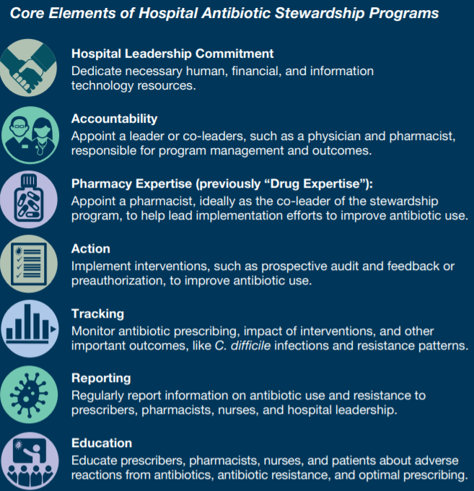
Antibiotic Stewardship

Slide 11
Antibiotic Stewardship
Determine design that is best for you:
Hospitals:
https://www.cdc.gov/antibiotic-use/core-elements/small-critical.html
Small and Critical Access Hospitals:
https://www.cdc.gov/antibiotic-use/healthcare/pdfs/core-elements-small-critical.pdf
Outpatient:
https://www.cdc.gov/antibiotic-use/core-elements/outpatient/implementation.html
- Nursing Home:
https://www.cdc.gov/antibiotic-use/core-elements/nursing-homes.html

Slide 12
Chart Reviews
Internal vs External
  Policy in place
Random selection of charts
Focused selection of charts
Notes:
Co-morbitities/extended length of stay, etc. Include in policy types does not have to be all inclusive.
Chart reviews can be random- for ongoing evaluation of provider practices- or focused- based on identified concern. For example, if a provider has higher than average number of readmissions a focused review of all readmission charts might be indicated. Another example of a focused review is doing a chart abstraction for core measures or antibiotic usage.

Slide 13
Provider Scorecards
Data kept on providers to ensure quality improvement/measurement
Choose measures
Data collected and shared at time of re-appointment
Notes:
Measures can be chosen by areas of concern, standard of care, core measures, etc. Guide for med-staff and board decisions. Should align with patient safety/quality strategies. Be sure to check your Med Staff bylaws to see if there are any specific benchmarks to be met for reappointment and include these on your scorecard.
Included in re-credentialing process. Can take into account internal peer review

Slide 14
Data in practice: Med Staff assessments and outcomes
PROVIDER NAME:
YEAR: | JAN | FEB | MAR | APR | MAY | JUN | JUL | AUG | SEP | OCT | NOV | DEC | TOTAL
VOLUME INDICATORS
Acute care admits (01)
Acute care average LOS
Swing bed admits (06)
Hospice ICF Admits (10)
ICF admits (09)
OB patients (04)
Number of deliveries (05)
STOP admits (27)
Total ER visits
Admit from ER
Total transfers
- by ambulance
- by helicopter
- by family vehicle
ER Avg LOS (in minutes)
Left AMA
Number of deaths, any level
Number of codes in ER
Number of codes in hospital
Total surgical patients
-Inpatient
-Outpatient
# of nosocomial infections
CONTINUOUS QUALITY IMPROVEMENT
# of occurrences
# of charts sent to med staff review
# of charts to external peer review
# of charts with peer rev. concern
PROCEDURES
Upper endoscopy
Colonoscopy
Sigmoidoscopy
Circumcision
C-section
Tubal ligation
PATIENT SATISFACTION SURVEY
# of positive comments
# of negative comments
MEDICAL RECORDS
# of overdue records: 15-30 days
# of overdue records: >30 days
UTILIZATION REVIEW
# of denial letters isssued
MEETING ATTENDANCE
# of Medical Staff meetings attended

Slide 15
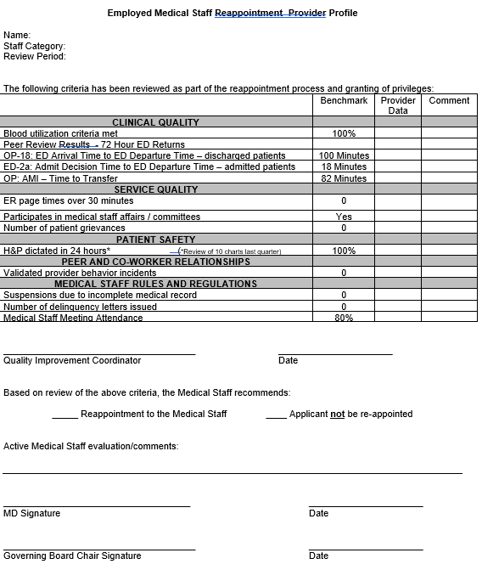
Provider Reappointment

Slide 16
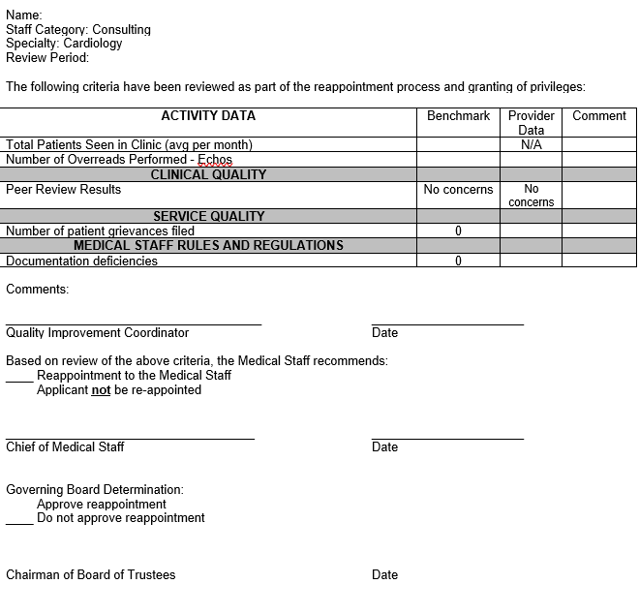
Provider Reappointment

Slide 17
Presenting Data to Providers
Be confident in your data
Be able to explain “why” the data is being collected
Be discreet in sharing specific provider data; suggest it be de-identified or shared only with that provider

Slide 18
Utilization Review
What is the 2 Midnight Rule?
- Applies to Medicare patients
- The stay must be expected to span at least 2 midnights
- All others must be initially placed in Observation and moved to Inpatient status if they stay 2 midnights or more
Notes:
The 2 midnight rule was not impacted by any of the waivers related to COVID Public Health Emergency. A great practice for providers is to document in their admission notes WHY they expect the patient to stay at least 2 midnights. There are software programs to help guide providers through decision making, can be very helpful IF they use them.

Slide 19
Utilization Review
Certification requirements: reasonably expected to be discharged or transferred within 96 hours
Inpatient/Observation
  2 midnight rule
Condition Code 44
Work with provider to make decisions on appropriate admission status
Notes:
Who make IP/OBs decisions in their hospital? Work with provider to ensure patient is in appropriate level of care. What is Condition Code 44? When the provider initially admits to inpatient but the hospital later determines the patient did not meet acute criteria, the hospital may change the status to outpatient.

Slide 20
Inpatient vs Observation
Observation: Outpatient services such as lab test or x-rays used to determine if Inpatient stay is indicated.
Inpatient: Patient is generally expected to require 2 or more midnights for treatment
Notes:
Observation vs. Inpatient impacts how the hospital bills for services.
MOON letter: Hospitals are required to issue to patients who are getting observation services vs. inpatient and why, and also how this may affect how much they have to pay and the care they can get when leaving the hospital.

Slide 21
Code 44
Patient admitted Inpatient and UR determines level of care did not meet criteria.
Hospital can change status to outpatient (observation) by adding Code 44 for claim for payment

Slide 22
Working with Providers
Know the guidelines
Be respectful
Communicate directly with the provider if possible
Notes:
Praise in public, coach in private! Always a good rule of thumb.

Slide 23
Small Group Work
Share Policy and procedures for chart review
Current status of Antibiotic Stewardship program

Slide 24
Questions?
Shari Michl, RN CPHQ
Director of Quality
Filmore County Hospital (Geneva)
Christina Pollard
  Chief Quality Officer
  Valley County Health System (Ord)

