Slide 1
Mental Health and Suicide Prevention in Nebraska
David Miers, PhD, LIPC
Director, Behavioral Health Services Bryan Medical Center
Board Member, Nebraska State Suicide Prevention Coalition

Slide 3
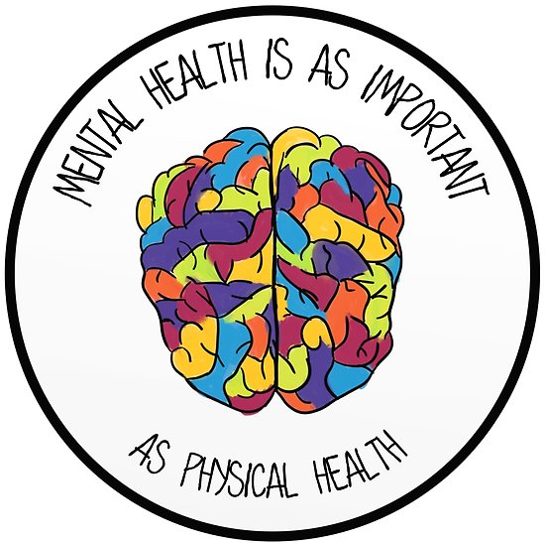

Slide 4
Prevalence of Mental Illness
About 1 in 4 – 25% of Adult Population in USA suffers from some mental illness
1 in 7 U.S. kids and teens has a mental health condition, and half go untreated (JAMA Pediatr. Published online February 11, 2019. doi:10.1001/jamapediatrics.2018.5399)
Depression is one of most common mental illnesses
Only 1/3 of those with depression seeking help

Slide 5
Healthy Community/Citizens

Slide 6
Integrated Medicine
Notes:
Balance
Physical can lead to mental
Mental can lead to physical
Need to take care of both
Providers working together
Holmes Lake, Crete Area Medical Center, Family Medicine of Lincoln

Slide 7
Treatment is Important
Primary care settings, like a doctor's office, provide about half of all mental health care for common psychiatric disorders
Adults with serious mental illnesses and substance use disorders also have higher rates of chronic physical illnesses and die earlier than the general population
People with common physical health conditions also have higher rates of mental health issues.
Untreated or undertreated mental illnesses have serious consequences.
People with severe mental illness often die 13-30 years earlier than the general population from medical conditions that could have been treated by primary care.

Slide 8
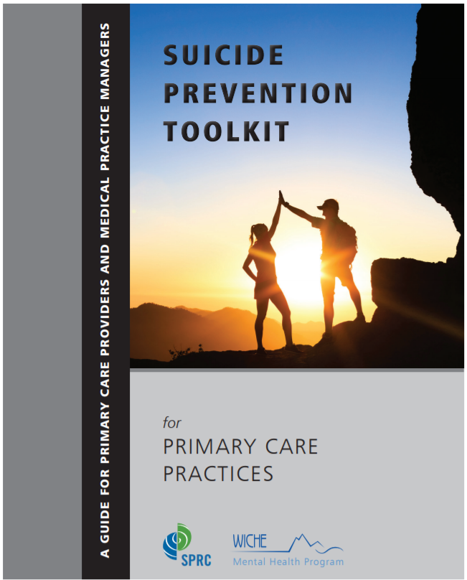
http://www.sprc.org/sites/default/files/Final%20National%20Suicide%20Prevention%20Toolkit%202.15.18%20FINAL.pdf

Slide 9
Mental Illness
There are more than 200 classified forms of mental illness.
Some are more common disorders such as clinical depression, other mood disorders such as bipolar disorder, dementia, schizophrenia and other psychotic disorders, eating disorders, and anxiety disorders.
We won’t go into symptoms in this presentation but they may include changes in mood, social withdrawal, dramatic changes in eating or sleeping habits, sadness or irritability, fear, worry, or anxiety to name a few.

Slide 10
WELL KNOWN PERSONS WITH DEPRESSION
Abraham Lincoln
Edgar Allen Poe
Robert Schumann
Theodore Roosevelt
Mike Wallace
Mark Twain
Ludwig von Beethoven
Vincent van Gogh
Drew Carey
Virginia Woolf
Dick Cavett
Taken from material of the National Alliance for the Mentally Ill
Notes:
Depression is a common illness that affects people regardless of their circumstances or position in life. This slide has names of well known people who had depression. The names were taken from the National Alliance for the Mentally Ill website.

Slide 11
Depression
Major depression is one of the most common mental illnesses, affecting 6.7% (more than 16 million) of American adults each year.
Depression can occur to anyone, at any age, and to people of any race or ethic group. Depression is never a “normal” part of life, no matter what your age, gender, or health situation.
2/3 don’t seek treatment for their depression.
Some don’t think it is serious, some think they can treat themselves, others see it as a weakness rather than illness.
The majority of the 1/3 with depression who do seek treatment have full remission of the disorder with effective treatment.
Depression causes people to lose pleasure from daily life, can complicate other medical conditions, and can even be serious enough to lead to suicide.

Slide 12
Depression
Not all persons with depression are suicidal, but depression is the most common diagnosis in completed suicide.
Symptoms can include:
Feeling sad during most of the day, every day
Losing interest in usual activities
Losing weight (when not dieting) or gaining weight
Sleeping too much or too little or waking too early
Feeling tired and weak all of the time
Notes:
Key Point: Depression is a risk factor that merits special attention as a high percentage of people who suicide, also have signs of clinical depression.
Depression is a down mood in conjunction with other symptoms. Review the following definition of suicide from the National Institute of Mental Health (NIMH) below:
When a "down" mood, along with other symptoms [listed on the slide], lasts for more than a couple of weeks, the condition may be clinical depression.
Clinical depression is a serious health problem that affects the total person. In addition to feelings, it can change behavior, physical health and appearance, academic performance, social activity and the ability to handle everyday decisions and pressures.
Review the symptoms of depression listed on this and the next slide.

Slide 13
Depression (cont.)
Feeling worthless, guilty or hopeless
Feeling irritable and restless all the time
Having difficulty in concentrating, making decisions or remembering things
Having repeated thoughts of death and suicide
Adapted from World Health Organization 2000
Notes:
(End this slide by saying that not every symptom is present in everyone.)
You may have clinical depression if you experience a “down” or “sad” mood that you can’t seem to lose, along with several of the symptoms listed.
Reemphasize that not everyone who is depressed is suicidal, but that depression is a serious illness that causes great psychological pain. It is a serious risk factor that can be treated.

Slide 14
Importance of Screening Programs
Example-Suicidal Behaviors Questionnaire-Revised-SBQ-R
Adopted by Lincoln Public Schools –Elementary through High School
Pilot first year – 4 Schools (Approximately 2016)
Rolled out following year all schools
Counselors, social workers, psychologists, psychotherapists, and nurses used SBQ-R
Protocol when to refer to Medical Center
Benefits-All providers communicating off of same screening and speaking same language
4 Items-Lifetime suicidal ideation and suicide attempts
Frequency of suicidal ideation
Threat of suicide behavior
Likelihood of suicidal behavior

Slide 16
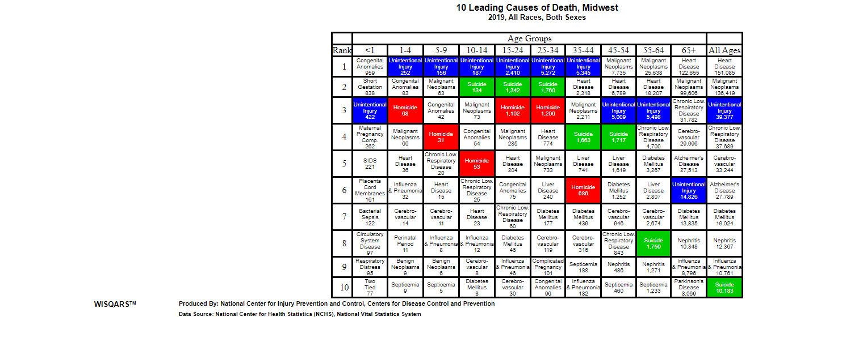

Slide 17
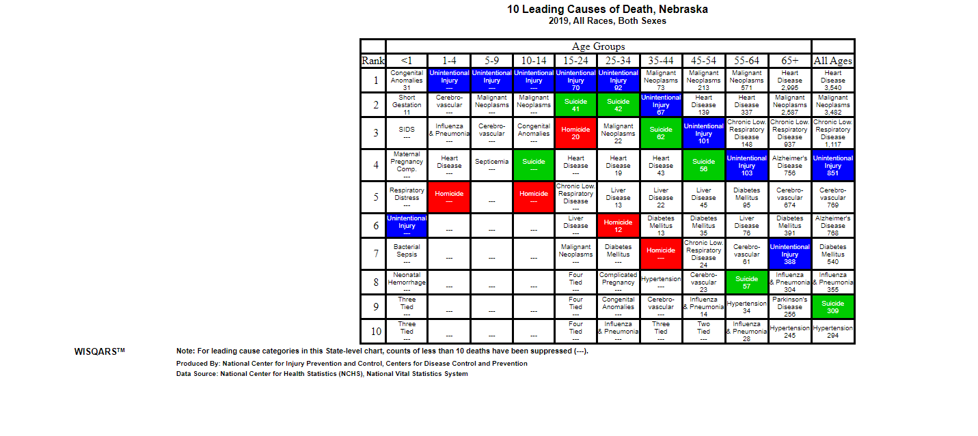

Slide 18
Suicide Prevention
Suicide is preventable
There is hope and there is help
It is okay to talk about suicide

Slide 19
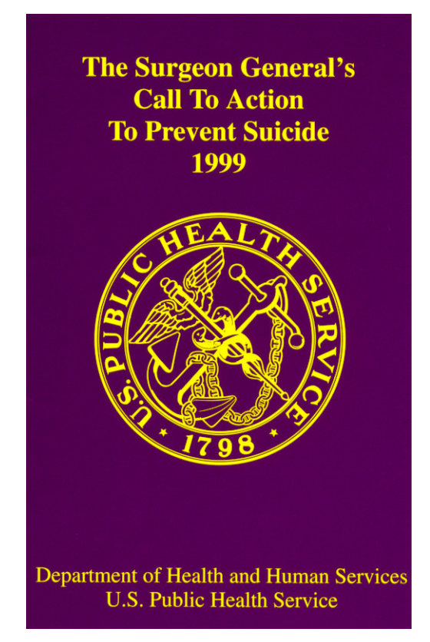
Surgeon General’s Call to Action to Prevent Suicide 1999
Surgeon General David Satcher, MD-July 1999 Meeting-NE representation
August 1999 Regional Office in KC Held Multi-State Meeting
Nebraska State Suicide Prevention Coalition was formed

Slide 20
Our Mission
The mission of the Nebraska State Suicide Prevention Coalition (NSSPC) is to increase awareness, decrease stigma, and implement programs throughout Nebraska aimed at suicide prevention. The NSSPC is a voluntary group made up of committed and passionate people representing public and private agencies, suicide survivors and Nebraskans interested in suicide prevention. NSSPC is recognized by the Department of Health and Human Services as the primary group responsible for coordinating Nebraska’s suicide prevention efforts. NSSPC relies on the generosity of private foundations, grants, and in-kind donations to continue the work of preventing suicide in Nebraska.

Slide 21
Our Efforts
The NSSPC Mini-Grant Program
Annually, we enhance and support suicide prevention efforts throughout the state through our Nebraska State Suicide Prevention Coalition Mini-Grant Program. This program annually awards multiple individual $500-$3,000 grants to local suicide prevention coalitions, Local Outreach to Suicide Survivors (LOSS) Teams, schools, communities, and non-profit entities to support local suicide prevention and postvention efforts.

Slide 22
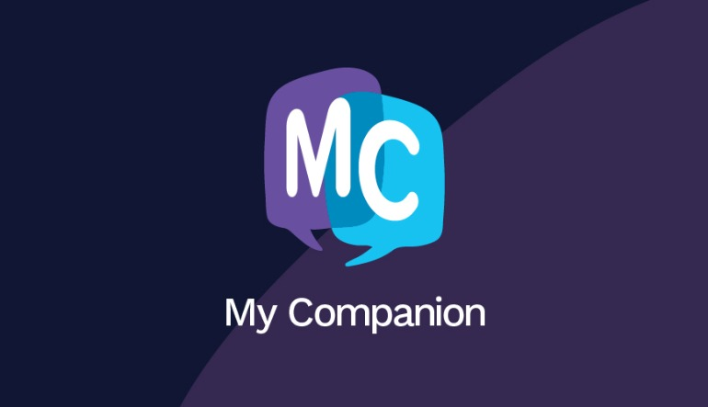
Coming Fall 2021

Slide 23
The My Companion Phone Application
The Nebraska State Suicide Prevention Coalition is releasing an app called My Companion in Summer 2021.
“The application allows youth to communicate their feelings in a journal-like format and to create a support system and crisis system including warning signs of suicide and access to emergency resources,” Dr. Dave Miers, founder of the Nebraska State Suicide Prevention Coalition, said. Work on My Companion began in July 2018, and it was created in collaboration with Don’t Panic Labs and Boys Town National Hotline. It was modeled after a similar app released in Utah under the name SafeUT.

Slide 24
Strengthening & Supporting Prevention Efforts in Nebraska
At NSSPC, we strive to increase awareness, decrease stigma, and implement programs throughout Nebraska aimed at suicide prevention and postvention.
Learn More or Get Involved by visiting us at www.nsspc.org

Slide 25
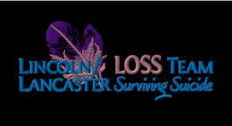
Local Outreach to Suicide Survivors (LOSS)
-Started in Lincoln, NE as Pilot July 1999
-Public Private Partnerships-Local Grant
Video produced to help educate about purpose of LOSS
https://youtu.be/t8cuM0arUME

Slide 26
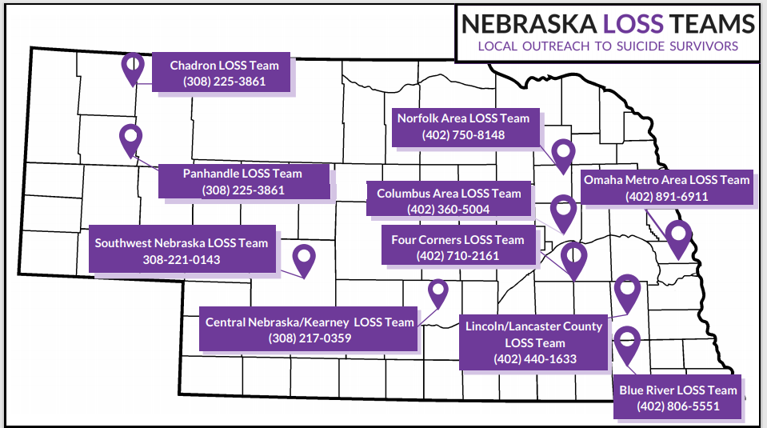

Slide 28
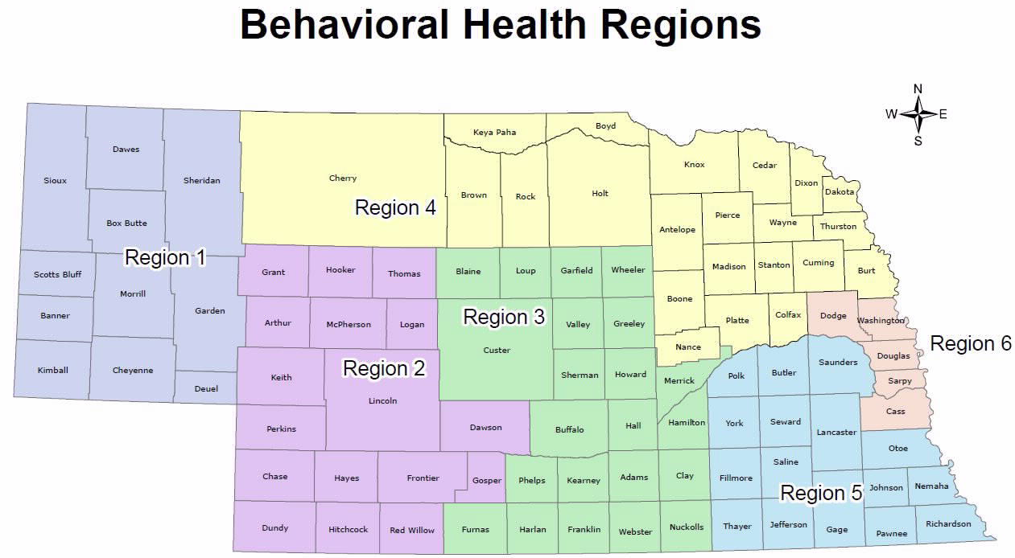
Suicide Prevention for Staff
QPR and Mental Health First Aid are offered by each region throughout their area of the state

Slide 29
QPR for Staff
Implemented QPR for all managers and supervisors
Offered QPR for all staff (nurses, techs, EVS, Facilities, etc.)
Updated our Suicide Prevention Procedure for staff

Slide 30
http://region1bhs.net/
www.region4bhs.org/
www.regionsix.com
www.r2hs.com/
www.region3.net
www.region5systems.net

Slide 31
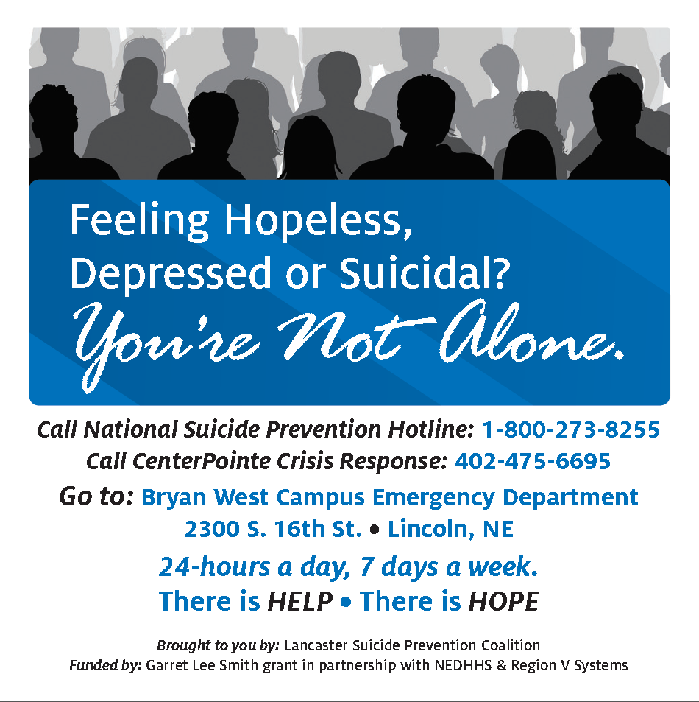
Lincoln Lancaster Youth Suicide Prevention Coalition-HOPELNK.ORG
Signage developed at Bryan Medical Center for our garages and shared and adopted city-wide. Mayor approved in all city owned garages. Since then UNL and others have also utilized or expressed interest. Several stories of signage saving lives.

Slide 33
Thank you! Any Questions?
Contact Information:
Dave Miers, PhD, LIPC
Director, Behavioral Health Services, Bryan Medical Center
Dave.Miers@Bryanhealth.org
402-481-5165

