Slide 1
What is a QIN-QIO?
What is a BFCC-QIO?
Ardis A. Reed, MPH, RD, LD, CDCES
TMF Health Quality Institute
NHA QI Residency Program 2023

Slide 2

Your Speaker
TMF Quality Innovation Network Quality-Improvement Organization (QIN-QIO) Chronic Disease Subject Matter Expert
Part of the writing group that revised the current Competencies for Diabetes Educators and the 2017 National Standards for Diabetes Self-Management Education and Support (DSMES)
Appointed to the Texas Diabetes Council by Governor Greg Abbott
Ardis A. Reed, MPH, RD, LD, CDCES
Notes:
Thank you everyone. My name is Ardis Reed and I am your Quality Improvement Specialist and Chronic Disease subject matter expert from TMF Health Quality Institute. TMF headquarters are located in Austin, Texas. We have been a strong QIN-QIO for almost 50 years.
I have been with TMF for the past 12 years. I wear many hats, as we all do but my expertise is working in Chronic disease and Diabetes self-management education.

Slide 3
True or False Pre-Test
The Centers for Medicare & Medicaid Services (CMS) is the oversight agency that directs Quality Innovation Network-Quality Improvement Organization (QIN-QIO) activities and budget.
QIN-QIOs lead CMS quality improvement efforts for a network of states and territories.
There is one type of CMS QIO.
Notes:
So let’s begin with a small pre-test to get our brains going
True
True
False

Slide 4
Learning Objectives
Define Quality Innovation Network-Quality Improvement Organization (QIN-QIO) and Beneficiary and Family Centered Care (BFCC)-QIO.
Explain the difference between a QIN-QIO and BFCC-QIO.
List three QIN-QIO projects going on in your state.
Discuss how the QIN-QIO can assist in your role as a quality improvement leader.
Notes:
So here are our learning objectives for today.

Slide 5
Principles of Quality Improvement
Apply changes in the actual clinical environment as that leads to better adaption of the process change.
Measures should be patient-centered and person-neutral without bias.
Measure the system not the people.
Use a proven quality framework for the improvement process.
Learn from the variants of data; is it intended or unintended?
A Guide to Applying Quality Improvement to Healthcare: Five Principles. Lloyd Provost. https://www.healthcatalyst.com/insights/quality-improvement-healthcare-5-guiding-principles
Notes:
You probably have covered these principles of Quality Improvement earlier but these are the principles that the QIN QIO work from on a daily basis. As healthcare continues to evolve, our role is to help healthcare systems and individual providers adapt to the change to quality to provide quality outcomes for Medicare beneficiaries.
We look at the system not person but at the same time want the system to be patient centered- that seems to be a conflicted statement- but what that means is that we want the system to work to improve the quality of health for the person being treated ( patient centered) and that the our technical assistance is working at a systemic level and not with an individual within the system.
QIN-QIO use evidence based processes for improvement that are data driven so that process and outcome measures can be calculated or evaluated.
And that evaluation is looked at with our partners as a learning event: was that outcome intended or unintended. And what did we learn.

Slide 6
History of the Medicare QIO Program
In 1965, Medicare, under oversight of the Health Care Financial Administration, was established to provide hospital care, nursing home care, home nursing service and outpatient treatment for people over 65.
In 1972, Medicare Professional Standards Review Organizations began to oversee quality of care at the local level and, in 1982, became Peer Review Organizations (PROs) with new authority to protect Medicare beneficiaries from underuse of necessary health services.
https://qioprogram.org/qionews/articles/history-qio-program
Notes:
Here is a little back history Medicare and the QIO program. It started in 1965 and was under HCFA. For us dinosaurs HCFA was the surveying groups for the hospitals before the joint commission.☺ then in 1972 the QIO changed its mission to protect Medicare beneficiaries under Peer Review.

Slide 7
History of Peer Review Organizations
A significant program milestone came in 1996 when PROs could systematically collect data, measure progress and identify areas for improvement.
This allowed PROs to shift focus from auditing of charts and following up on complaints to more targeted efforts.
PROs began to focus on specific diseases, and improve the management of common chronic conditions, such as diabetes and cardiovascular disease.
https://qioprogram.org/qionews/articles/history-qio-program
Notes:
Peer Reviews made a significant impact in improving patient care through chart audits, data collection, outcome and progress measurement and eventually transitioned into looking at specific diseases and the management of those diseases

Slide 8
History of How PROs become QIOs
In 2002, PROs were renamed Quality Improvement Organizations (QIOs) to reflect the multidisciplinary approach of all team members — physicians, nurses, and administration — working together to improve the quality of care.
QIOs became the boots on the ground in communities, helping patients, families and providers carry out local activities that rolled up into national progress.
https://qioprogram.org/qionews/articles/history-qio-program
Notes:
The Peer Review Organizations changed their name and approach to QIO in 2002 with a change in focus to quality improvement and became more hands on working in the community WITH the health systems at the local level but on notational initiative.

Slide 9
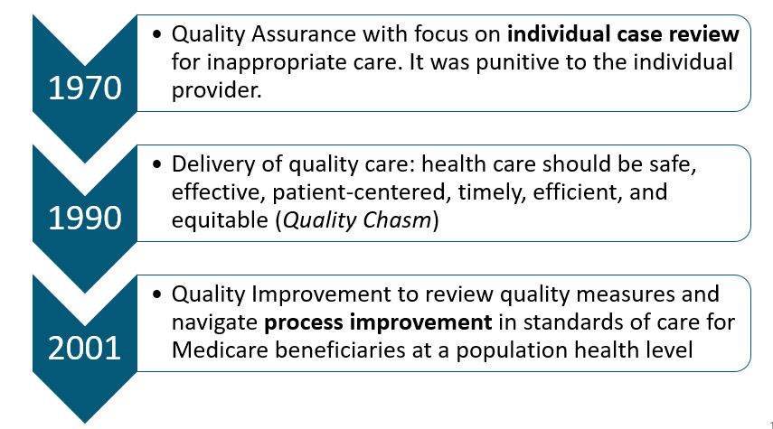
The Transition in Focus
Notes:
Here is a little timeline showing the transition of focus from the individual case to process improvement.

Slide 10
Quality Assurance vs Quality Improvement
Quality Assurance reviews the minimum level of quality service and the process identifies and can potentially punish individuals or licensed health entities that may be providing sub-standard care.
Quality Improvement standards are evidence-based processes that are adapted and implemented to have an effective process for continually measuring and improving the care delivered by all providers through technical assistance and is not punitive.
Notes:
Before we go any farther lets look at the definition of Quality Assurance versus Quality Improvement
Quality Assurance looks at the service being provided where as
Quality Improvement are evidence based standards or processes that are adapted to improve the effective in the quality of care and is not punitive.

Slide 11
History of the Transition to QIOs
Each state and territory was assigned a Quality Organization now known as a Quality Improvement Organization (QIO).
Oversite of Medicare and the QIO Program transitioned from HCFA to the newly named, Centers for Medicare & Medicaid Services (CMS).

Slide 12
Growth of the QIO Program
The QIO Program has achieved success in a number of areas, including reducing the incidence of pressure ulcers, the use of antipsychotic medications and unnecessary hospital readmissions.
QIOs have played an important role in driving recognition of quality improvement. They also have provided technical assistance and tools, and shared best practices to achieve their overall goal of enhancing the quality of services delivered to Medicare beneficiaries.
https://qioprogram.org/qionews/articles/history-qio-program
Notes:
The QIO programs across the nation have had numerous successes in improving the quality of care and outcomes for Medicare beneficiaries. Many strong effective communication tools, best practices for providers have been developed based on work from QIO’s.

Slide 13
CMS Quality Improvement Organizations
In 2014, CMS established a new functional structure for the Quality Improvement Organization (QIO) Program.
Under the new structure, CMS separated case review from quality improvement work, with both segments of the QIO Program serving all 50 states and our territories.
Notes:
Quality Improvement Organizations parallel the age of Medicare. Originally each state had a QIO that provided case review for Medicare beneficiaries but in 2014 CMS restructured the QIO program. Under the new structure Case review is now separate from the Quality Improvement work.
So prior to 2014 if you had a complaint about your care as a medicare beneficiary you could call a 800 number and that call actually went to the cubical across from my desk in Austin . But now that call goes to a different QIO.

Slide 14
QIO Program Today
As previously highlighted, CMS established a new functional structure for the QIO program in 2014 separating case review and quality improvement work, creating QIN-QIOs and BFCC-QIOs.
To maximize efficiencies and provide consistency, the program was regionalized and each state and territory no longer has an individual QIO.
Currently there are:
  12 regional QIN-QIOs
  Two BFCC-QIOs
Notes:
The change maximized the efficiency of the QIO’s and allowed for more diversity and decreased conflicts of interest as well.
Today there are 12 regional Quality Innovation Network- Quality Improvement Organizations ( QIN-QIO) and 2 Beneficiary Family Center Care (BFCC)

Slide 15
Two Types of QIOs
Quality Innovation Network–Quality Improvement Organization (QIN-QIO) system
Beneficiary and Family Centered Care–Quality Improvement Organization (BFCC-QIO) individual
Notes:
So there are now two different types of QIO’s and that is where you have sent me a lot of emails. Which is fine because it is confusing.
So a QIN-QIO in this case TMF Health Quality Institute is the Quality Innovation Network-Quality Improvement Organization that covers Nebraska. We work on specific projects designed by CMS
However the BFCC-QIO works on monitoring the care of the individual beneficiarie

Slide 16
Role of the Quality Innovation Network – QIOs
QIN-QIOs:
work with providers, community partners, Medicare beneficiaries and caregivers on data-driven quality improvement initiatives designed to improve the quality of care for people with specific health conditions.
QIN-QIOs are able to help quickly spread best practices for better care while accommodating local conditions and cultural factors.
https://qioprogram.org/about/why-cms-has-qios
Notes:
So lets focus on the QIN-QIO- QIN-QIO look at the system.
Again we are data driven and all about quality improvement for providers, community partners and look at initiatives to promote best practices for specific health conditions. These initiatives are designed by CMS based on claims data, trends and other data reports CMS evaluates looking at where the CMS dollars are being spent and/or projected to be spent.

Slide 17
More about QIN-QIOs
Twelve regional QIN-QIOs oversee and implement CMS quality improvement initiatives throughout 50 states and three territories.
QIN-QIOs collaborate with national and local partners on major initiatives to improve patient safety and health care quality.
QIN-QIOs engage providers and stakeholders in learning and action networks and improvement collaboratives that rapidly effect large-scale change for the better.
Notes:
Many initiatives are aligned with major national initiatives like:
-Million Hearts
-Home Health Quality Improvement
Work with leading national organizations like:
-AARP
-American Cancer Society
-American Heart Association
-CDC
-And many more
Work with state and local chapters of these organizations, engaging them as community partners in learning and action networks and improvement collaboratives that rapidly effect large-scale change for the better.
Community level, QIN-QIOs work with Area Agencies on Aging to improve the experience of patients as they transfer from one care setting to another.
QIN-QIOs unite hospital associations, medical groups, health plans and numerous community-based partners to address the unique medical, social and economic factors affecting care in the area.

Slide 18
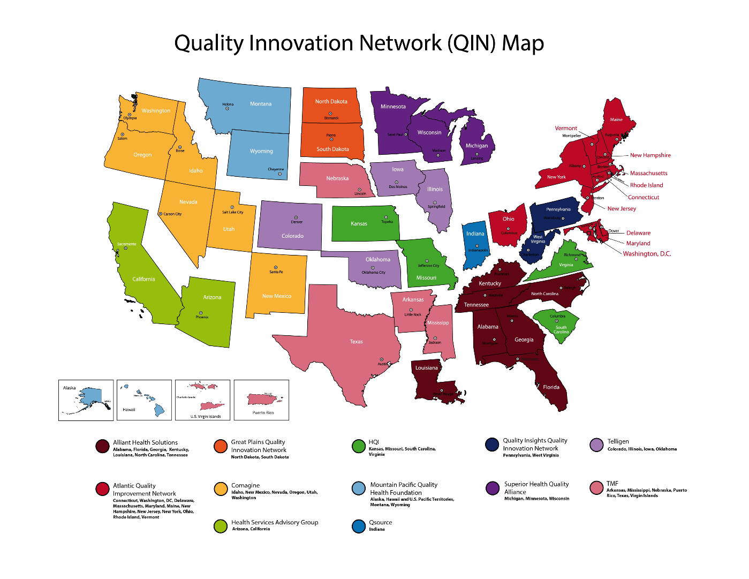
Quality Innovation Network Map
Notes:
Here are the current 12 Networks. You can see that some networks are closely neighbored and some are not next to each other. Leads of networks bid for states every 5 years but CMS in the end decides based on multiple factors which states are going to be networked together.

Slide 19
TMF QIN-QIO Service Area
3,928,911 Medicare beneficiaries impacted
48 communities
Notes:
For this current 5 year contract CMS reorganized the new networks in 2019. Here is the service area that TMF is currently covering. We are the QIN-QIO for Texas, Nebraska, Arkansas, Mississippi, Puerto Rico and US Virgin Islands. This current contract is for 5 years 2019-2024, and we will be working in 48 regional communities across our service area, where just under 4 million Medicare beneficiaries reside. TMF is covering 3 time zones, in addition to very different cultures and landscapes… but it makes work more fun and challenging.

Slide 20
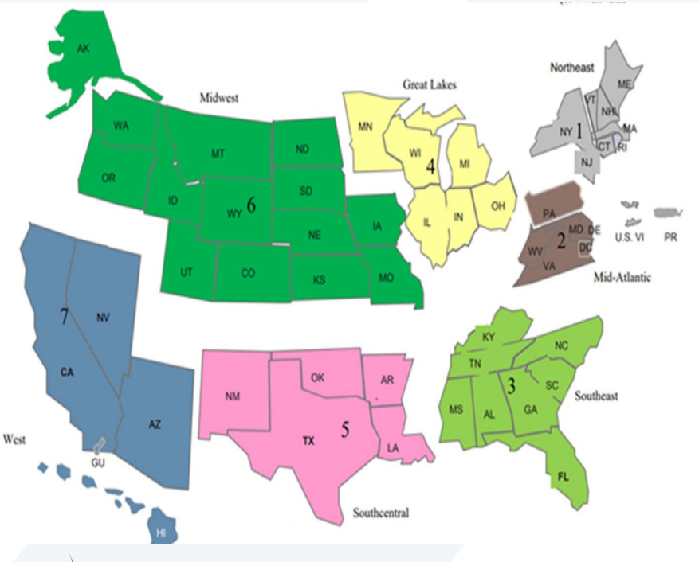
Upcoming Service Areas 2024-2029
QIO 13thScope of Work (2024-2029) CMS Quality Improvement Program (b8cdn.com)

Slide 21
Your Involvement
Participation is voluntary.
Work is data-driven so you will be asked to collect data and send it to TMF.
Data from our partners is aggregated before it is sent to CMS.
Involvement is through a contract cycle but you can withdraw at anytime.
All QIN-QIO services are free of charge.
Notes:
Your work with any QIN-QIO is voluntary. You don’t have to work with a QIN-QIO however, in some cases CMS will add a carrot that benefits a healthcare system/provider by working with a QIN-QIO. Since our work is data driven most often working with a QIN-QIO you will be asked to provide Data and yes in our current contract you will eventually be asked to provide some data to TMF as well. Currently CMS is drawing up a contract modification so TMF is holding off any requests for data until we know exactly what is being asked from us. We try very hard not to burden our partners if there is a portal you are already submitting information. More importantly, we want you to understand how to collect data and the benefit and importance of collecting data for your sustainability and validation of your department. When a QIN-QIO does share data it is aggregated so no one is thrown under the bus or exposed. And at any time any program can withdraw from a QIN-QIO project- but we hate for that to happen.
Best of all !!! Our services are FREE!!!! So I like to think of us as a free team member or extra pairs of hands.

Slide 22
Role of Beneficiary Family Centered Care-QIOs
BFCC–QIOS:
Manage all complaints and quality of care reviews to ensure consistency in the review process
Handle cases in which Medicare patients want to appeal a health care provider’s decision to discharge them from the hospital or discontinue other types of services
Use the Immediate Advocacy process to address complaints quickly
Provide health care navigation services
Notes:
Now the role of the BFCC is all about the individual patient
This QIO manages the complaints about care from a provider or a hospital. At discharge there is usually a 1-800 number included in the discharge papers if a patient has a complaint. That number goes to the BFCC. The complaints are usually about a discharge process being too quick, a procedure, poor care, or a providers care. The BFCC will address the issue thru their Immediate Advocacy process and actually contact the Patient Representative,and sometimes the Quality Improvement Department and/or help the patient or family member navigate the system.

Slide 23

Two BFCC QIOs
Livanta
Kepro
Help Line:
1-888-755-5580
Covers Nebraska
www.livantaqio.com/
Regional Zone Helpline
www.keproqio.com
Notes:
There are currently two BFCC that cover the US
Livanta and Kepro
Livanta covers Nebraska and here is the contact information and their website

Slide 24
Current QIN-QIO Work in Nebraska
TMF Health Quality Institute
Telligen and Nebraska Hospital Association
Livanta Beneficiary and Family Centered Care – BFCC-QIO
Partnership for Community Health (PCH)
Ardis Reed
Nanci Newberry
Clin5
Kerri Sireno
Abby Carney
Hospital Quality Improvement (HQIC)
Dana Steiner
To file concerns, complaints and navigate care for Medicare beneficiaries, call:
1-888-755-5580
Improved Outcomes for Medicare Beneficiaires
Notes:
So WHO is in Nebraksa.???
It used be only one QIO in a state but now there are many so I thought I would give you a guideance here
TMF is over the Community Coalition and Nursing Home Quality work
Telligen/ Nebraska Hospital Association is over the Hospital Quality Improvement Contract ( HQIC)
Livanta is the BFCC

Slide 25
Current QIO Priority Areas (2019-2024)
Improve Behavioral Health Outcomes
  Focusing on decreasing opioid misuse
Improve Patient Safety
Improve Chronic Disease Self-Management
  Cardiac and vascular health
  Diabetes
  Slowing and preventing end-stage renal disease (ESRD)
Improve Quality of Care Transitions
Improve Nursing Home Quality
Notes:
For TMF here are the priority areas that we are working on for this contract period. Of course COVID19 had put a wrench in our progress as well as the contract modification expected from CMS but we are pushing forward.

Slide 26



Regional Community Coalitions
Community Health Touch Points
Medical
Population Health
Acute
Critical access hospitals
Rural health clinics
Private provider offices
Psychiatric and rehabilitation services
Provider associations
Department of Health and Human Services
District health departments
Area Agency on Aging
The Centers for Disease Control and Prevention
Community Non-Profits
Connections
YMCA
Lions clubs
Health ministries
Food pantries
Health care providers and clinicians
Health care systems
Social determinants of health
Funding and support
Community members
Notes:
TMF will be recruiting community health touch points in each regional community to have discussions on needs, barriers, successes, and develop new collaborations to help make improvements at a regional level in the 4 QIO Priority Areas.
Participation is voluntary

Slide 27
National Targets – Community Coalitions and Opioid-related Adverse Drug Events
Engage community coalitions to increase access to behavioral health (BH) services for 6.8 million beneficiaries by 15.7%.
Decrease opioid-related adverse events by 7%, including deaths, with a focus on Medicare fee-for-service high-risk and BH-risk beneficiaries.
  Decrease opioid prescribing (for prescriptions > 90 morphine milligram equivalents (MME) daily)
    12.5% by acute and specialty hospitals
    12.5% by long-term care (LTC)
    12% by outpatient facilities
Notes:
This National Target may be modified to look only at pain management and not access to behavioral health access but the primary focus is to decrease the opioid related adverse events and decrease prescribing rates of morphine milligram equivalents. We will use the tools most familiar to you in Nebraska such as the Nebraska Hospital Association has the Opioid Toolkit and the TMF Opioid change package

Slide 28
National Target – All-cause Harm
Reduce all-cause harm in hospitals, community-based facilities and LTC settings by 2024, including:
Reduce by 9.7% all-cause harm in hospitals and reduce adverse drug events (ADEs) across all settings.
  Reduce ADEs in all community settings by 6.5%.
  Reduce ADEs in LTCs for high-risk beneficiaries by 13%.
    High risk = three or more medications including, but not limited to, anticoagulant, diabetes, opioid or antipsychotic medications
Reduce C. difficile infections in all settings.
Developmental: Reduce hospitalizations for nursing home-onset C. difficile infections.
Notes:
We will also be looking at adverse Drug events specifically events caused by anitcoagulants, glycemic management, opioid and antipsychotic medications.

Slide 29
National Target – Cardiovascular Disease
Achieve 13.8% reduction in smoking prevalence for Medicare (69,000 beneficiaries)
Achieve at least 80% performance on ABCS
  A: Improve Aspirin use
  B: Control Blood pressure
  C: Manage Cholesterol
  S: Support Smoking cessation
  Promote cardiac rehabilitation
Notes:
We will be looking at cardio vascular events but I believe this target is going to change to just looking at blood pressure management.

Slide 30
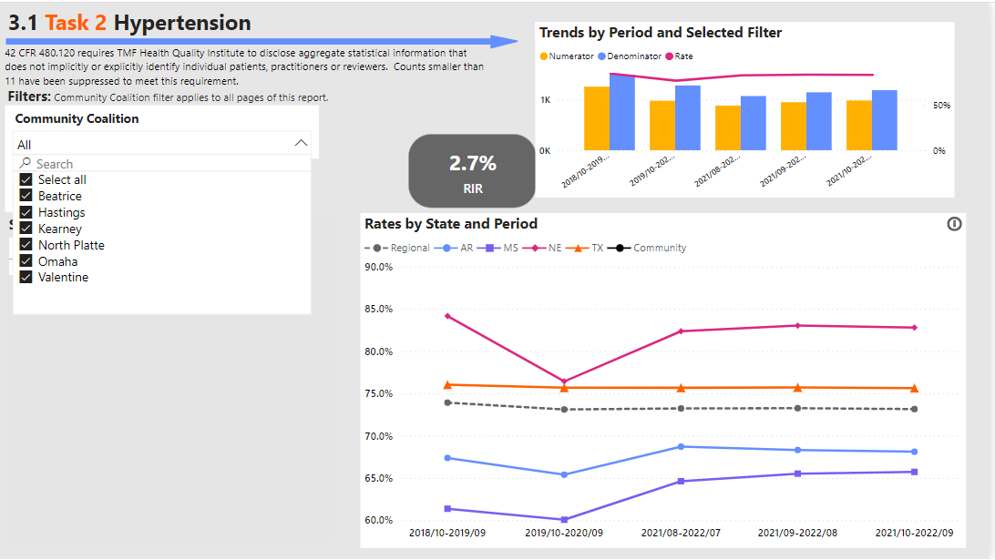
Hypertension In Nebraska
Goal is 15% RIR by November 2024
RIR=relative improvement rate
Data is from Medicare FFS claims reports

Slide 31
National Target – Diabetes
Prevent 25,171 Medicare beneficiaries from developing diabetes by 2024.
Identify patients at high-risk of developing complications related to having diabetes.
Improve diabetes management for at least 238,464 Medicare beneficiaries.
  Achieve at least 55% referral of Medicare beneficiaries, who are served by a QIN-QIO and identified as pre-diabetic, to a Centers for Disease Control and Prevention Diabetes Prevention Program (DPP).
Notes:
And improving access to diabetes education and I am not sure if this will remain pre-diabetes and or add on DSMES as well

Slide 32
National Target – Chronic Kidney Disease
Screen, diagnose and manage 238,464 Medicare beneficiaries with chronic kidney disease (CKD).
  Prevent progression to ESRD.
Identify patients at high risk for developing CKD.
Improve outcomes for patients with kidney disease.
Notes:
Screening for CKD is so important but again we are waitng to see what specific measures Medicare is asking us to reach with the modification

Slide 33
National Target – Hospital Admissions and Readmissions
Reduce hospital admissions by 4.1% nationally.
Reduce hospital readmissions by 5.4% nationally.
Reduce community-based ADEs for Medicare beneficiaries by 6.8%.
Reduce rate of ED visits and admissions of super-utilizers among the Medicare population by 12.24%.
Developmental: Monitor potentially preventable ED visits and observations stays.
Developmental: Monitor access to care that leads to hospital use.
Developmental: Reduce potentially avoidable admissions, readmissions and super-utilization in Medicare Advantage patients.
Notes:
And Medicare is always looking at hospital admission and readmissions. a

Slide 34
National Target: Improve Quality and Patient Safety in LTC Settings by 2024
Improve the mean total quality score for all nursing homes.
Reduce the percentage of nursing homes with a total quality score of less than 1,258.
  Homes with two-star or lower rating on the quality measures domain
Reduce ADEs in nursing homes.
Reduce healthcare-related infections in nursing homes.
  QIN-QIO to contribute to development of a national baseline.
Reduce ED visits and readmissions in short-stay nursing home residents by 2024.
Notes:
This measure is being conducted by a different team but I just wanted you to know this activity is also happening. And it is related to Acute and CAH as it involves transition in care

Slide 35
How can a QIN-QIO help you?
Provide free technical assistance for your project.
Teach you how to conduct a quality improvement process and support your new role in quality improvement.
Align with your quality improvement goals and objectives.
Be a second pair of constructive critical eyes for your project.
Help you look at a project with evidence-based processes.
Help you shine with your leadership.
Notes:
So why do you want to work with a QIN-QIO- or how can we help you…
Again we are a program that provides free technical assistance
We can teach you QI process as part of our TA
We look for alignment with your goals- we try not to re-invent your wheel but work with what you have to accomplish
Give your project as second pair of critical eyes
Use evidence based processes
We want you to SHINE with your leadership

Slide 36
Health Quality Improvement Associations
American Health Quality Association (AHQA)
Institute for Healthcare Improvement (IHI)
National Association for Healthcare Quality (NAHQ)
Notes:
There are three main Health quality improvement associations listed here

Slide 37
True or False Post Test
CMS is the oversight agency that directs QIN-QIO activities and budget.
QIN-QIOs lead CMS quality improvement efforts for a network of states and territories.
There is one type of CMS QIO.
Notes:
So here is your post test☺
True
True
False

Slide 38
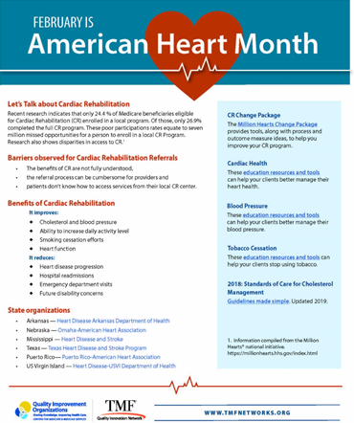
February is American Heart Month
https://tmfnetworks.org/link?u=34f608

Slide 39
Acronyms
ADE | Adverse Drug Event
BFCC | Beneficiary Family Centered Care
BH | Behavioral Health
CKD | Chronic Kidney Disease
CMS | Centers for Medicare & Medicaid Services
DPP | Diabetes Prevention Program
DSMES | Diabetes Self-management Education and Support
ED | Emergency Department
EMCRO | Experimental Medical Care Review Organization
ESRD | End-Stage Renal Disease
HCFA | Health Care Finance Administration
LTC | Long-term Care
MedPac | Medicare Payment Advisory Committee

Slide 40
Acronyms, continued
MOA | Memorandum of Agreement
MOU | Memorandum of Understanding
QIN | Quality Innovation Network
QIO | Quality Improvement Organization
PRO | Professional Review Organization
PSRO | Professional Standards Review Organization
RFP | Request for Proposal

Slide 41
References
A Guide to Applying Quality Improvement to Healthcare: Five Principles. Lloyd Provost. https://www.healthcatalyst.com/insights/quality-improvement-healthcare-5-guiding-principles
IOM. 2001. Crossing the Quality Chasm: A New Health System for the 21st Century. Washington, DC: National Academy Press.
Medicare's Quality Improvement Organization Program: Maximizing Potential 2006-History of QIO- chapter 1. National Academies Press.
https://qioprogram.org/about/why-cms-has-qios
https://qioprogram.org/qionews/articles/history-qio-program

Slide 42
Questions?
Ardis Reed, MPH, RD, LD, CDCES
Ardis.Reed@tmf.org
This material was created by TMF Health Quality Institute, the Medicare Quality Innovation Network-Quality Improvement Organization under contract with the Centers for Medicare & Medicaid Services (CMS), an agency of the U.S. Department of Health and Human Services. This content does not necessarily reflect CMS policy. 12SOW-QINQIO-CC-21-17

