Slide 1
Quality Residency
Capstone Project
nebraskahospitals.org
Crystal Newman RN
Hospital Nurse Manager
Henderson Health Care

Slide 2
Introduction to the Organization, Project, Team
Hi! My name is Crystal. I am the Nurse Manger at Henderson Health Care (HHC). We are a 13 bed Critical Access Hospital in Henderson Nebraska. We have 2 associated Rural Health Clinics, Henderson Family Care & Sutton Family Practice, as well as a Long-Term Care facility, Legacy Square, & an Assisted Living facility, Rosewood Court.
For my capstone project, I chose to focus on Transitional Care Management (TCM). TCM services address the hand-off period between the inpatient & community setting. The intention is to reduce potentially preventable (costly) readmissions & medical errors during the 30 days following a discharge.
This success of this project required coordinated efforts between our hospital nurses, clinic nurses, providers (MDs & PAs), HIM coding staff, medical billing staff, & myself, with the unwavering support & help of our CNO.

Slide 3
AIM Statement
The aim of this project is to capture all qualifying patient Henderson Hospital discharges & increase the rate at which we provide and bill for TCM services from 17.58% (2022) to 80% by the end of the calendar year 2023.

Slide 4
Measuring Success
Number of qualifying discharges
Disqualified discharges
Surgical patients
OB patients
Newborns
Patients on Medicaid
Self pay patients
Patients who do not primarily doctor with HHC (will follow up with their PCP)
Discharges within a previously billed for 30 day window
Number of successfully billed TCM visits
Discharge phone call within 2 days (not on day of discharge, before TCM appointment)
TCM appointment within 7-14 days of discharge (dependent upon medical complexity
Notes:
Of course we want to use quantitative metrics to determine if we are getting where we want to go. We will measure or success by

Slide 5
Selecting Changes
What changes will be made to work towards improvement goals?
Discharge phone calls completed by hospital nursing on all qualifying patients
Admission date, discharge date, discharge diagnoses
Discharge instruction review, review of scripts, review of medications, offer pharmacist follow up, review of ADL abilities
Follow up appointments in 7-14 days dependent upon medical complexity
TCM appointment in place of regular post hospital follow up
HIM Coding to ensure proper coding
Medical Biller to ensure TCM visit meets requirements & bills appropriately
Hospital Nurse Manager TCM process audit

Slide 6
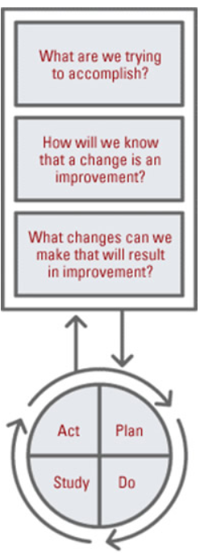
Plan ~ Do ~ Study ~ Act
Plan
I plan to: Improve TCM visit rates
I hope this produces: Increased revenue & decreased readmissions
Steps to execute: Review TCM rates from 2022, evaluate the TCM process, re-introduce staff to the process (Do), evaluate monthly, make adjustments as needed
Do
Discharge phone calls to all qualifying patients
TCM appointments
Coding
Billing
Study
Completion of discharge phones increased but still showed room for improvement
TCM appointments improved but also showed room for improvement
Coding/Billing improved but found some misses
Act
Hospital Nurse Manager and CNO to check for discharge phone calls need
Daily reminder placed in nurse cell phones to check for discharge phone calls needing completed
Nurses reminded to set follow up appointments up as TCM not just follow up
LTC educated on TCM visits
Discharge phone call documentation reviewed
Added date of hospitalization, date of discharge, & discharge diagnoses
Hospital & clinic nursing review of discharge form

Slide 7
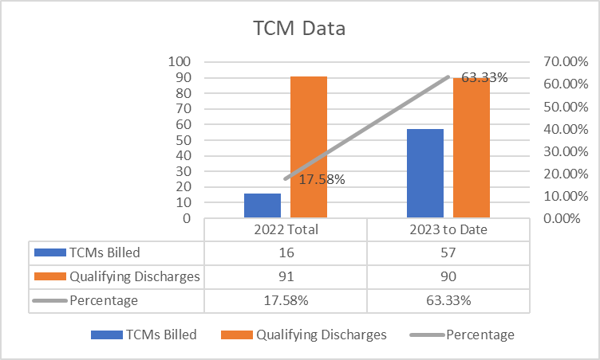
Data and Trends
In 2022, Henderson Health Care had 91 qualifying discharges. Of those discharges, just 16 met all TCM qualifying criteria resulting in successful billing, resulting in an average rate of 17.58%.
So far in 2023 (through August) we have had 90 qualifying discharges. Of which 57 met all TCM qualifying criteria resulting in successful billing, resulting in an average rate of 63.33%.

Slide 8
Return on Investment (ROI)
Explore the financial implications of the project:
Additional costs/expenses to be incurred
Additional staff - None
Additional hours - None
Equipment - None
IT expense - None
Additional revenue noted
Clinic level billing - $223.75 (average)
TCM level billing - $440 (average)
Total Revenue $216.25 – Total Costs/Expenses $0.00 =
Total Positive ROI $216.25
Notes:
Average billing cost a regular clinic appointment (level 2-5) billing = $223.75. Average billing cost for TCM appointments = $440. Resulting difference = $216.25.

Slide 9
Spreading / Sustaining / Maintaining / Replicating
Continued audits to ensure ongoing success
Results of audits communicated to all of the TCM team
Consider ways to extend TCM services by capturing qualifying discharges from outside healthcare organizations
Notes:
Initially monthly to see which qualifying discharges are missed & why. After a duration of success, transition to quarterly.

Slide 10
THANK YOU/Questions
Crystal Newman RN
Hospital Nurse Manager
Henderson Health Care
Email: cnewman@hendersonhealth.org
Office number: (402)723-4013
nebraskahospitals.org

