Slide 1
QI Residency Program
Module A-Fundamental Principles of Quality

Slide 2
What is Quality?
“The degree to which health services for individuals and populations increase the likelihood of desired health outcomes and are consistent with current professional knowledge.” –
          Institute of Medicine(IOM). (2001)
Notes:
What does it mean to you? How does your facility define it?

Slide 3
Quality
Quality in healthcare means providing the care the patient needs when the patient needs it, in an affordable, safe, effective manner. Quality healthcare also means engaging and involving the patient, so the patient takes ownership in preventive care and in the treatment of diagnosed conditions.
Notes:
Quality in the healthcare context is a collaborative effort that involves the patient, the independent physician, the patient’s family, and the community as a whole.
Quality is a way of thinking about work, how you approach work every day for yourself personally, for those you work with and ultimately and for those who depend on you for delivering quality service. It’s not about the right turn of a phrase, a slogan, or a single department.

Slide 4
Quality Principles
Customer focus.
Leadership.
People involvement.
Process approach.
Systematic approach to management.
Continual improvement
Factual Approach to Decision Making.
Mutually Beneficial Supplier Relations.
Notes:
The 8 universal principles of quality management
Principle 1: Customer focus.
Principle 2: Leadership.
Principle 3: People involvement.
Principle 4: Process approach.
Principle 5: Systematic approach to management.
Principle 6: Continual improvement.
Principle 7: Factual Approach to Decision Making.
Principle 8: Mutually Beneficial Supplier Relations.

Slide 5
Customer Focus
When you understand what your customer wants or needs, you have a better chance of figuring out how to get the right materials, people, and processes in place to meet and exceed their expectations.
Notes:
Research and understand your customers’ needs and expectations.
Align your organization’s objectives with customer needs.
Communicate with customers, measure satisfaction, and use the results to find ways to improve processes.
Manage customer relationships.
Find a balance for satisfying customers and other interested parties (such as owners, employees, suppliers, and investors).

Slide 6
Total Employee Commitment
Employees need to understand the vision and goals that have been communicated.
They must be sufficiently trained and given the proper resources to complete tasks in order to be committed to reaching goals on time.
Notes:
Clearly communicate and acknowledge the importance of each individual contribution to the completed product.
Stress that each team or individual accepts ownership and give them the responsibility and opportunity to solve problems when they arise.
Encourage employees to self-evaluate performance against personal goals and objectives, and make modifications as necessary to improve workflow.
Acknowledge successes and optimized performance to build confidence in your employees and your stakeholders.
Make responsibilities clear, provide adequate training, and make sure your resources are used as efficiently as possible.
Encourage people to continually seek opportunities to learn and move into other roles to increase their knowledge, competence, and experience.
Create an environment where employees can openly discuss problems and suggest ways to solve them.

Slide 7
Integrated System
In an integrated system, everybody in every department should have a thorough understanding of policies, standards, objectives, and processes.
Notes:
Promote a work culture focused on quality.
Use flowcharts and other visual aids to help employees understand how their functions fit in with the rest of the company.
Use as-is process analysis to see where improvements can be made.
Make training available for employees who need to learn new processes and who want to explore opportunities for advancement.

Slide 8
Process Approach
Adhering to processes is critical in quality. Processes ensure that the proper steps are taken at the right time to ensure consistency and patient safety.
Notes:
Use tools such as process flowcharts to define and delineate clear roles and responsibilities so everybody knows who does what at certain times.
Create a visual action plan so everybody can easily see the specific activities that need to be completed to achieve the desired result.
Analyze and measure current activities to see where improvements can be made or where steps in the process are creating bottlenecks.
Evaluate the impact your processes and activities may have on your customers, suppliers, and all stakeholders.

Slide 9
Strategic and Systematic Approach
“Identifying, understanding and managing interrelated processes as a system contributes to the organization’s effectiveness and efficiency in achieving its objectives.”
Notes:
Provide your people with the proper training and resources that will help them complete their individual steps in the process.
Continually improve processes and products, and upgrade equipment as necessary to reach goals.
Make continual improvement a measurable objective for all employees.
Recognize, acknowledge, and reward innovations and process improvements.

Slide 10
Continual Improvement
Your hospital should continually find ways to improve processes and adapt your products and services as customer needs shift.
Notes:
Implement policies to establish product, process, and system improvements as measurable goals for individuals, teams, and departments.
Recognize, acknowledge, and encourage innovation to improve processes and development.
Encourage employees to participate in available training sessions to learn and take on new and additional roles.

Slide 11
The ‘WHY’?
Why do we have quality?
What difference does it make?
Who is impacted?
Notes:
Provides clear understanding
Ensures consistency
Everyone on the same page
Why take quality seriously?
• It is the right thing to do and part of your mission; shortcomings can result in direct harm to patients.
• You have a legal responsibility; it is part of meeting Medicare’s Condition of Participation.
• Reputation for quality care plays a significant role in maintaining/increasing your market share.
• Future reimbursement models will be based on quality of care and patient outcomes

Slide 12
Responding to Change
Be knowledgeable of what is happening around us
Legislative updates
Informed patients
Media influence
Increased demand

Slide 13
The ‘HAVE TO’
Hospitals that participate in Medicare or Medicaid
  Must meet the Conditions of Participation (COPs)
  For all patients in the facility
Notes:
Pull up CoP’s. Share tags related to Quality and Quality assurance plans. How to ensure compliance with the regulations.
CMS has new QAPI regulations which are going into effect on March 30, 2021.

Slide 14
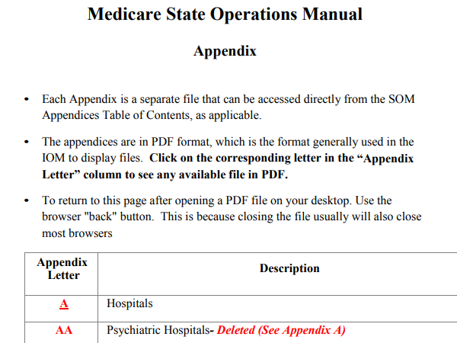
CMS Hospital COP Manual
https://www.cms.gov/files/document/som107appendicestoc.pdf.
Notes:
https://www.cms.gov/files/document/som107appendicestoc.pdf.

Slide 15
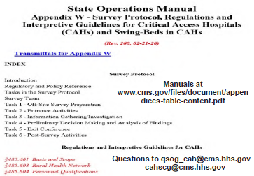
CMS COP or State Operations Manual
https://www.cms.gov/Regulations-and-Guidance/Guidance/Manuals/downloads/som107ap_w_cah.pdf
Notes:
https://www.cms.gov/Regulations-and-Guidance/Guidance/Manuals/downloads/som107ap_w_cah.pdf

Slide 16
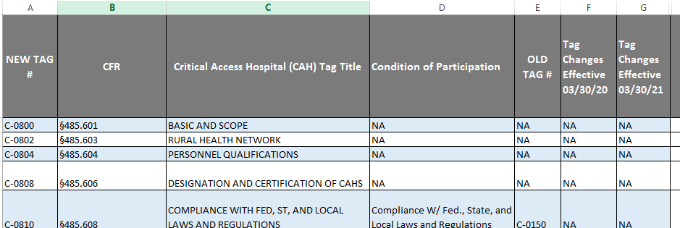
New Quality Tag Numbers
Notes:
www.cms.gov/files/document/c-tag-crosswalk.xlsx

Slide 17
C1300-1325 QAPI Program Tags
§485.641 Condition of Participation: Periodic Evaluation and Quality Assurance Review
Interpretive Guidelines §485.641
Survey Procedures §485.641

Slide 18
Defining Quality in Your Organization
-Mission statement current focus
-Vision statement preparing for the future
-Strategic Plans
-How does Quality fit?
Notes:
Defining quality in your organization.
To what degree does your organization have a healthy quality program that has an effective balance of quality assurance, quality improvement and performance improvement activities?
To what degree does your board understand its role in assuring quality of care?
How satisfied is your board with the reports it receives regarding quality?
To what degree does your organization continuously focus on improving the quality of care and services provided?
What are the goals of your organization’s quality improvement program? What metrics and benchmarks are used to measure progress towards each of these performance goals?
How does your organization measure and improve the quality of patient/resident care? Who are the key management and clinical leaders responsible for these quality and safety programs?
Are clinical quality standards supported by operational policies? How does management implement and enforce these policies? What internal controls exist to monitor and report on quality metrics? Does the board have a formal orientation and continuing education process that helps members appreciate external quality and patient safety requirements?
Are human and other resources adequate to support patient safety and clinical quality?

Slide 19
Improvement Processes
QI, PI, QA all mean the same thing:
By what means does your agency ensure you deliver quality care and service?
Notes:
So we don’t get lost in the technical part coming up-

Slide 20
Improvement Processes
Quality Assurance (QA)
  Today
Quality Improvement (QI)
  Tomorrow
Performance Improvement (PI)
  Future
Notes:
Understanding the Quality Continuum: An effective quality program has a healthy balance of activities that focus on quality assurance (QA), quality improvement (QI), and performance improvement (PI).
QA-Activities inside an organization are focused on the delivery of high quality patient care and services today. Focus is on compliance with current standards/practice as defined in policies, procedures, regulations & professional standards
QI-Improving processes to care for patients tomorrow-continuous assessment of current activity. Focuses on taking what exists today and working to make it better for tomorrow.
PI-High reliability systems and processes to continue into the future. Looks at all QI initiatives that must come together to make the org stronger and better prepared to meet demands of changing healthcare environment. Overall coordination of quality related activities that must come together to move the organization forward.
What quality assurance, improvement efforts are they doing.—are they preparing for today, tomorrow and future?

Slide 21
QA vs QI
QA-Are we meeting the standards?
QI-Answers why didn’t we meet the standard and what can we do to meet and then exceed the standard?
Notes:
Quality Assurance answers the question: Are we meeting the standard(s)?
Quality Improvement answers the questions: Why didn't meet the standard? What can we do to meet and then exceed the standard?
Quality Assurance question is: “Are we doing a task the way we agreed it is supposed to be done?”
Quality Improvement question is: “How can we improve the way we do things”

Slide 22
QA
- Reactive
- Works on problems after they occur
- Regulatory usually by State or Federal Law
- Led by management
- Periodic look-back
- Responds to a mandate or crisis or fixed schedule
- Meets a standard (Pass/Fail)

Slide 23
QA
Specific standards of quality of service and outcomes
Assures care is maintained at acceptable levels in relation to those standards
Ongoing-anticipatory and retrospective
Identify how organization is preforming
Notes:
QA is the specification of standards for quality of service and outcomes, and a process throughout the organization for assuring that care is maintained at acceptable levels in relation to those standards. QA is on-going, both anticipatory and retrospective in its efforts to identify how the organization is performing, including where and why facility performance is at risk or has failed to meet standards.

Slide 24
QI
Examines processes to improve them
Still relies on guiding principles of teamwork, systems and processes
Notes:
Simply stated, QI examines processes in order to improve them. Like the other components of QA, QI relies on the guiding principles of teamwork, systems and processes, client focus, and measurement. The focus on teamwork recognizes that team members bring valuable insights regarding the process to be improved because of their knowledge of and experience in it, and are more likely to implement improvements they helped to develop.

Slide 25
Quality Improvement
- Proactive
- Works on processes
- Seeks to improve (culture shift)
- Led by staff
- Continuous
- Proactively selects a process to improve
- Exceeds expectations

Slide 26
QI/PI
Continuous study and improvement of processes
Intent to better services
Prevent or decrease likelihood of problems
Identify areas of opportunity and testing new approaches to fix systemic problems
Notes:
PI (also called Quality Improvement - QI) is the continuous study and improvement of processes with the intent to better services or outcomes, and prevent or decrease the likelihood of problems, by identifying areas of opportunity and testing new approaches to fix underlying causes of persistent/systemic problems or barriers to improvement. PI aims to improve processes involved in health care delivery and quality of life. PI can make good quality even better.

Slide 27
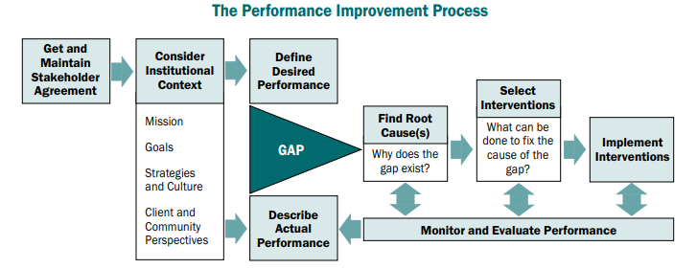
The PI Process

Slide 28
Clinical Examples of QI
Pharmacist-led Medication Therapy Management Reduces Total Cost of Care
Optimizing Sepsis Care Improves Early Recognition and Outcomes
Systematic, Data-Driven Approach Lowers Length of Stay and Improves Care Coordination

Slide 29
Example QA/QI/PI
Problem - Phone messages taken by clerical staff are not complete and not delivered to staff in a timely manner.
QA would be a process to find out "who" was not getting complete information and delivering the message in a timely manner. (Reactive)
QI would be a process in which the entire task of taking/delivering messages are looked at and a uniform method is developed for all clerical staff to use. (Proactive process to improve).

Slide 30
Quality Priorities
•ID priority list of processes or services for improvement
Areas to evaluate:
–Culture – Engagement and Safety Culture
–Credentialing /Privileging-Peer Review
–Continuous Survey Readiness (CSR)
–Chart audits
–Gap Analysis
Notes:
You may also ID gaps in services, care etc… that need to be addressed. Set up your quality dashboard to reflect your organizations scope and complexity.
Want to focus on data driven quality that works to improve patient outcomes. ( HAC, Falls, Readmissions, ADE’s , errors, Medications, clinical EBP – stroke, AMI, sepsis).
Take each section of the COPs and document how you comply-Include tag numbers in policies, Include policies, Highlight section that corresponds to the required P&P in
the CoP, Have one person in charge to keep up with changes and who knows what to do if CMS shows up survey

Slide 31
Priorities
–Mandatory/ Voluntary reporting measures
–Patient experience measures
–Infection Prevention
–Safety and Risk
–Patient complaints/ comments
–Staff feedback
–Other...
Notes:
1.High –risk, problem prone areas
2.Make the “list” review with leadership set priorities based upon strategy/vision/mission.

Slide 32
Goals for QA/QI/PI
Goals
–Specific
–Meaningful/connects to purpose
–Measureable
–Realistic/Attainable
–Set time- frame
Notes:
SMART Goals:

Slide 33
Goal Examples
–Generator testing will be competed weekly 100% of the time.
– Don’t reinvent the wheel-what are you currently monitoring
Is it measurable? Attainable?

Slide 34
Quality Responsibility
Key stakeholders
  Governing Boards
  Leadership
  Supervisors/Managers
  Frontline staff
  Quality leaders
Notes:
Governing board-legally responsible for quality of health care delivered in the organization. The board is accountable for the actions or lack of actions of every person within the organization, including the medical staff. The board is responsible for ensuring effective systems exist for evaluating and improving the delivery of high quality care.
The board is responsible for assuring the quality program is designed to:
Adequately monitor the delivery of care and services so activities that could create risk or harm are easily identifiable.
Easily identify opportunities to drive improvement into existing systems and activities.
Assure effective linkages between the different activities in an organization are designed to protect patients from harm and assure compliance with current standards of care (risk management, infection control, utilization review, credentialing and privileging, safety, and quality).
Assure that changes for improvement remain in place over time.
Once the board has a comfort level that the systems are in place and strong, it has the responsibility to monitor for success. This is achieved through regularly delivered quality reports.
Leadership-Lead by example, buy-in, feedback
Supervisors/Managers-setting expectations and follow through
Frontline Staff-implementing and follow through on measures/initiatives-impact on patients
Quality Leader—not the sole owner, directs, communicates, recognition, focus-The Quality Director is basically the coach, facilitator, and mentor. His or her job is to instill principles of quality at all levels, helping everyone in the organization — every employee, executive, service user, caregiver, and consultant— feel driven to achieve excellence.

