Slide 1
Quality Residency – Module D
Goal Setting
July 9, 2021

Slide 2
Objectives:
Understand why is goal setting important
Learn basics on how to set a goal?
  AIM Statement
  SMART goals
Target v. Target Conditions
Delineate use of stretch goals.

Slide 3
Key Steps to Goal Setting:
Benchmarking: evaluation of the current status of the practice, understand performance internally, understand how peers are performing
Risk Adjustment: know realistic targets, state necessary and available resources, acknowledge factors that will affect success, understand potential unintended consequences
Target: Set appropriate targets based on current knowledge

Slide 4
HQIC – Performance Improvement
IHI Model for Improvement
AIM Statement
  How will you know a change is an improvement?
  Timeframe, amount of expected change of population or denominator will desired outcome.
  By February 2021, 25% of nursing staff in Blue County Hospital will be trained in the “Crucial Conversations" curriculum.
  Practice: Hospital X has seen decrease in barcoding prior to administration of meds being given in the Emergency Department in Q1 2021.
Notes:
What additional information do you need?
Write an AIM Statement –
Share

Slide 5
Know what you are measuring:
Measurement
  Outcome Measure: An endpoint, measure of effect - a measure which is used to assess the effect, both positive and negative, of an intervention or treatment. i.e.: a fall
  Process Measure: specific steps in a process that lead — either positively or negatively — to a particular outcome metric. i.e.: bed alarms usage
Notes:
Process measures can be useful when the ‘n’ is small

Slide 6
HQIC – Performance Improvement
IHI Model for Improvement
Measures – SMART Objectives
  What changes can you implement to achieve the AIM?
  SMART or SMTRA
    Specific
    Measurable
    Achievable
    Relevant
    Time-bound
Practice: ED staff will be trained on barcoding process.
Original Objective | How Can we Improve? | SMART-er Objective
Staff will be trained in Quality Improvement. | Need to clarify the who and the what and the timeframe. | Blue County Hospital will offer Quality Improvement training opportunities resulting in 75% of staff completing the training by December 31, 2020.
Notes:
Make the goal a SMART goal

Slide 7
Steps for change:
PDSA
  PLAN: team, AIM, Objectives, examine current process, describe the problem
  DO: implement action plan created in step 1 – be sure to collect data and document problems, unexpected effects, general observations
  STUDY: Use AIM and Data to determine effectiveness – improvement, trends, unintended side effects
  ACT: If the plan worked → standardize / spread it – if the plan did not work start over at Plan
Notes:
Dana
Review
Give examples

Slide 8
Target v. Target Condition
Target = finite end goal; i.e.: 5 patients
  Can lead to staff not following the stated process in order to attempt to achieve the set target
Target Condition = a description of processes to reach a desired outcome
  Gives a sense of direction in process improvement
Challenge: picture of success
Notes:
Margaret

Slide 9
Target Condition:
A Target Condition is an interim goal on the way to the Challenge, described in greater detail than the Challenge. It usually takes several successive target conditions to reach a Challenge, so it is sometimes called the “Next Target Condition

Slide 10
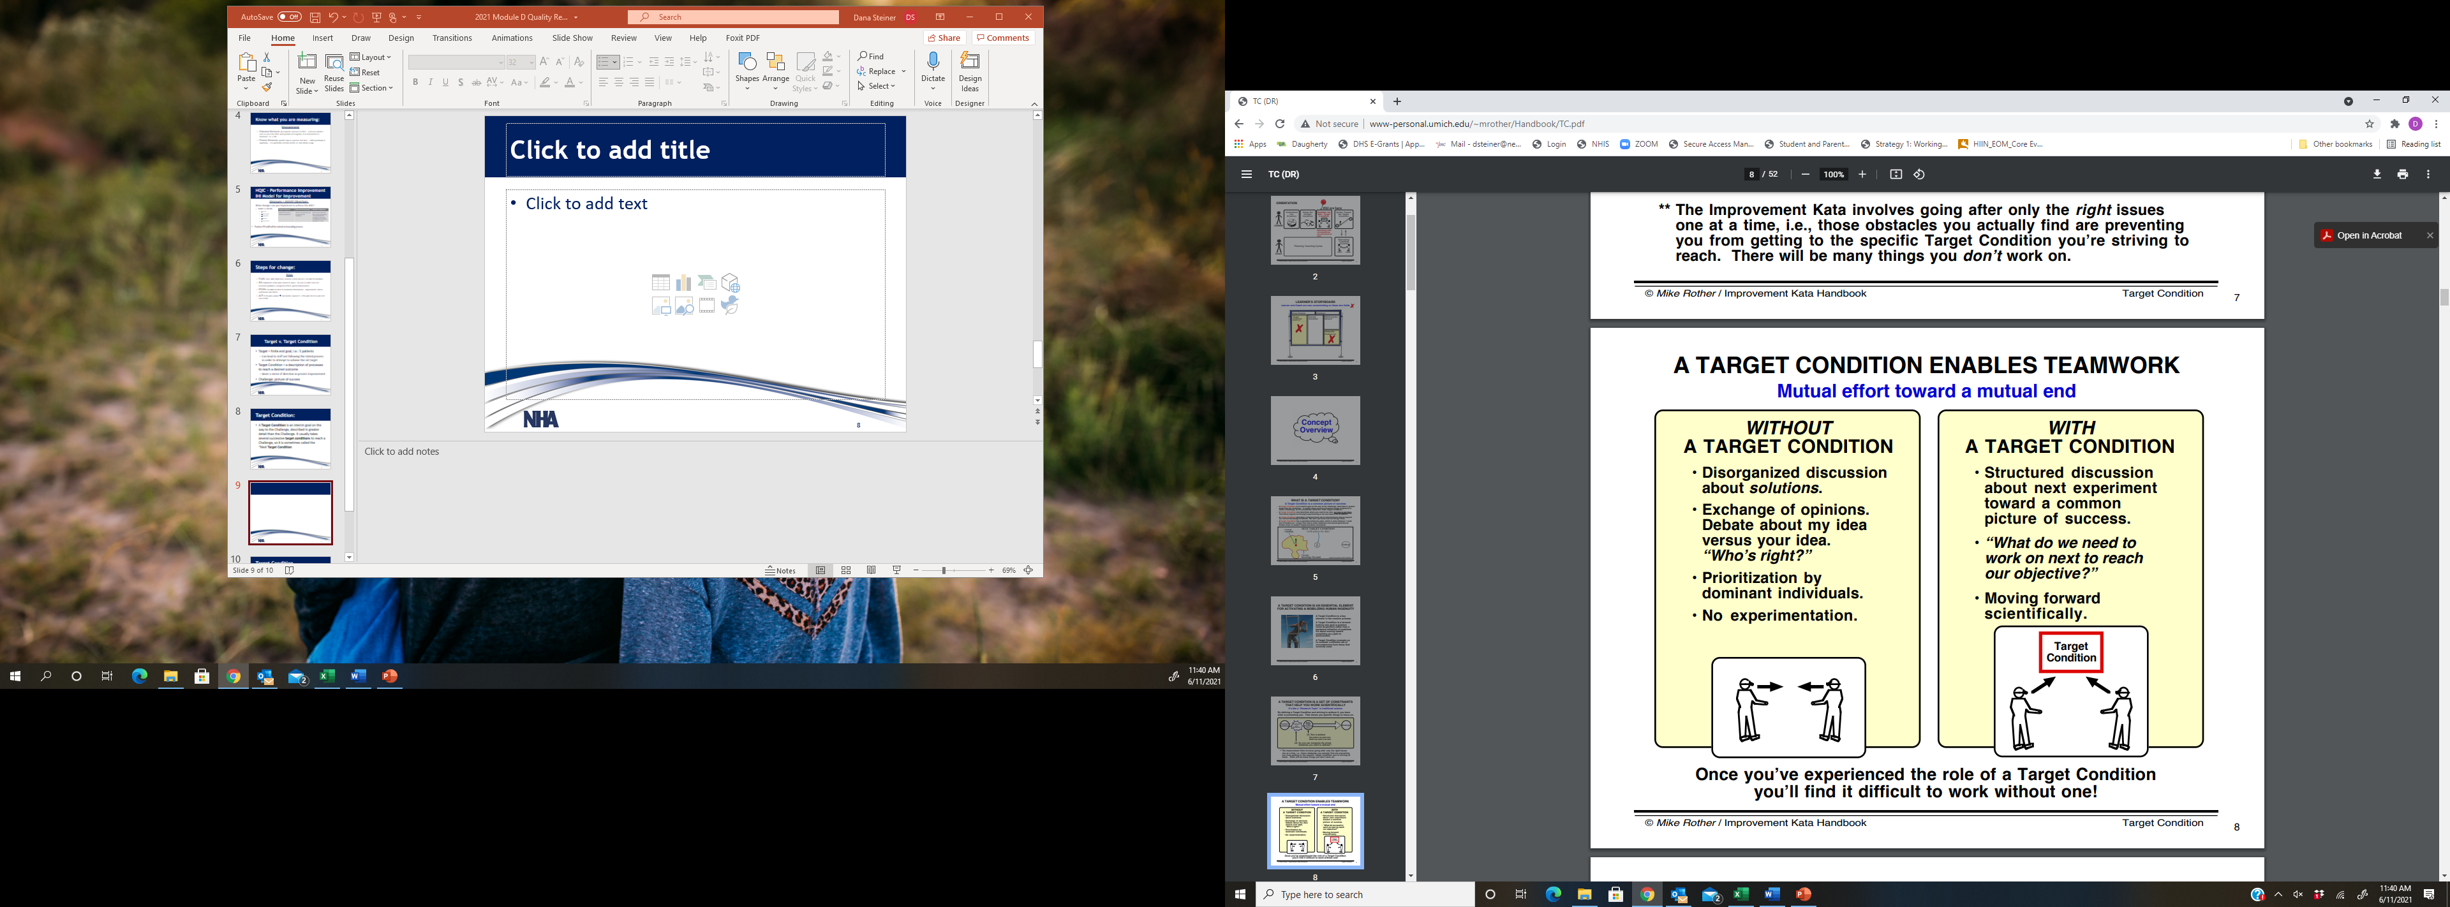

Slide 11
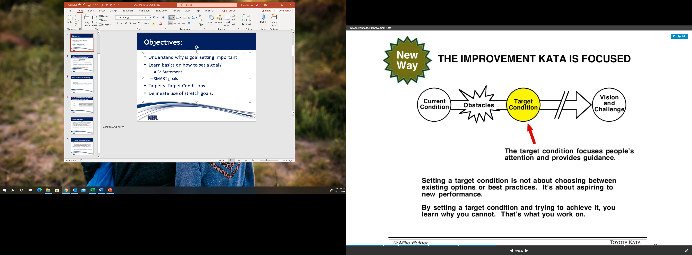
Target Condition

Slide 12
Stretch Goals:
Definition: a target that is intentionally designed to be challenging to attain.
  Used to counter the common tendency of teams to set conservative goals that are easy to meet
  Often set in conjunction with a regular target goal
  Failure to meet a stretch goal is not viewed ‘negatively’ but meeting it is exceptional.

Slide 13
Pros and Cons of a Stretch Goal?
Pros:
  Can motivate
  Move teams out of a rut
  Encourage organizations to dream bi
Cons:
  Can also demotivate
  Lead to poor / inconsistent reporting

Slide 14
Examples of a Stretch Goal:
Target: To increase provider communication HCAHPS score to above the 90th percentile.
Stretch Goal: Every patient that completes an HCAHPS Survey will rate our hospital a 10 for overall care

Slide 15
Unintended Consequences:
Unanticipated or unforeseen outcomes of a purposeful action
Can be positive or negative
Need to be aware and assess processes for unintended consequences
Negative Example:
  Strict isolation for COVID-19 patients
    Intended outcome: decreased spread
    Unintended outcome: increased falls
Positive Example:
  Hourly Rounding:
    Intended outcome: decreased falls
    Unintended outcome: increased patient and family satisfaction

Slide 16
Questions or Comments?
Dana Steiner, BSN, MBA
dsteiner@Nebraskahospitals.org

